Slide 1
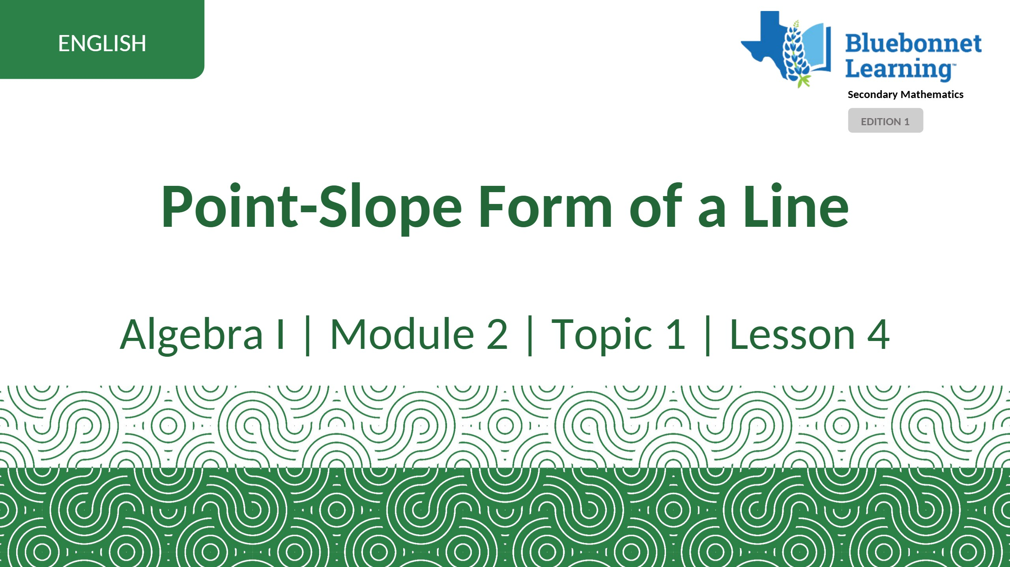

Slide 2
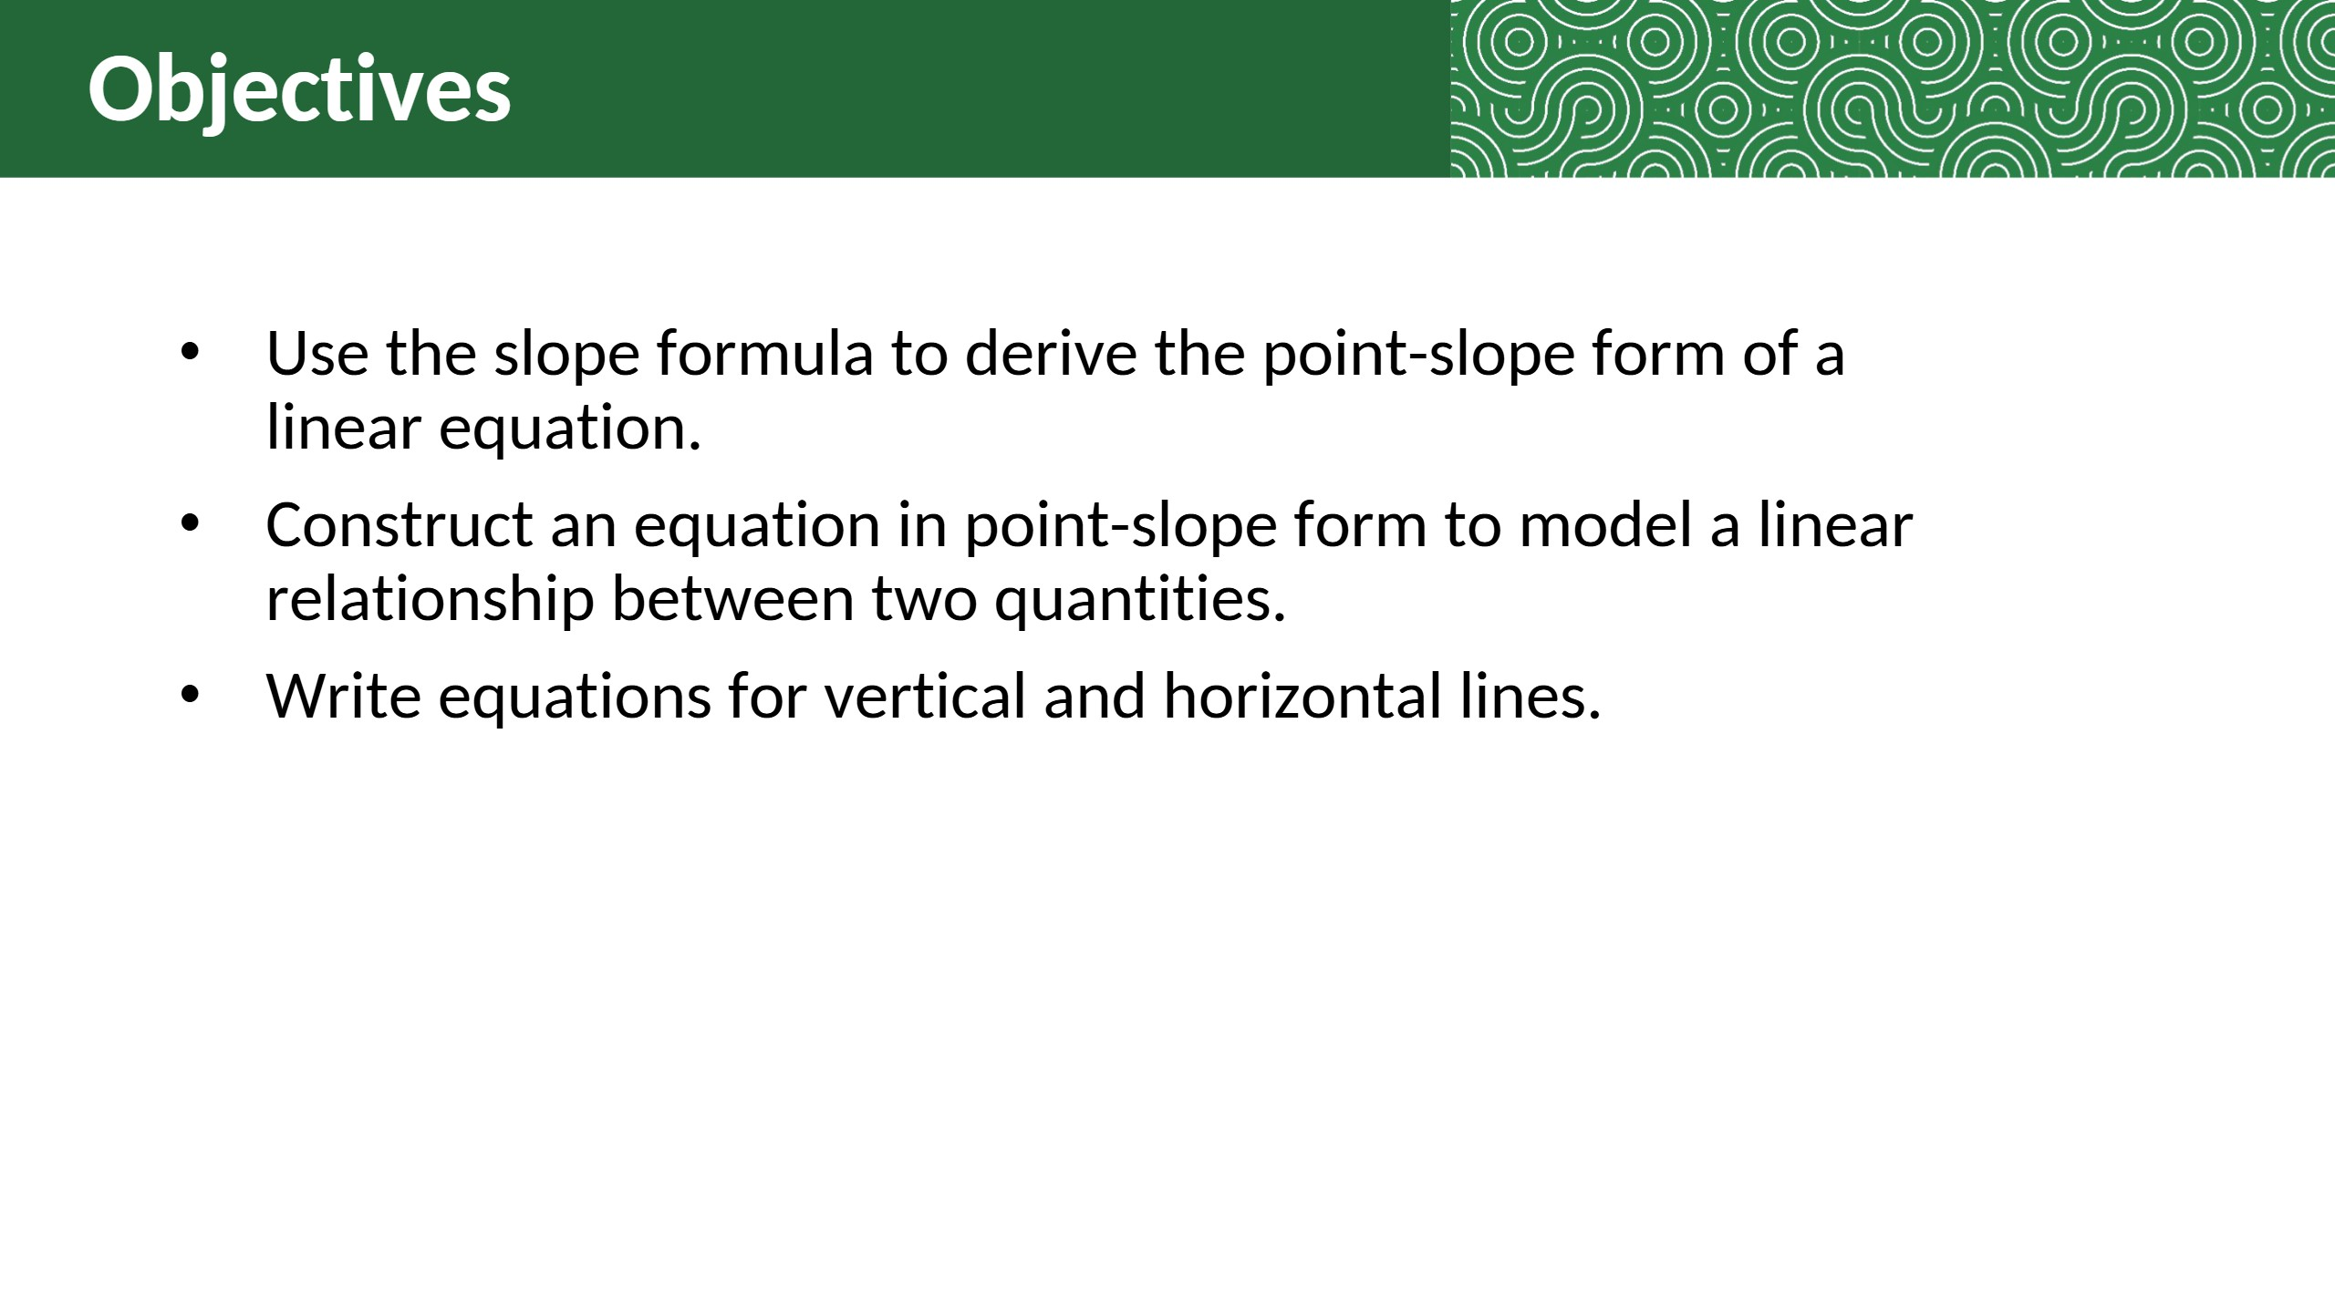

Slide 3
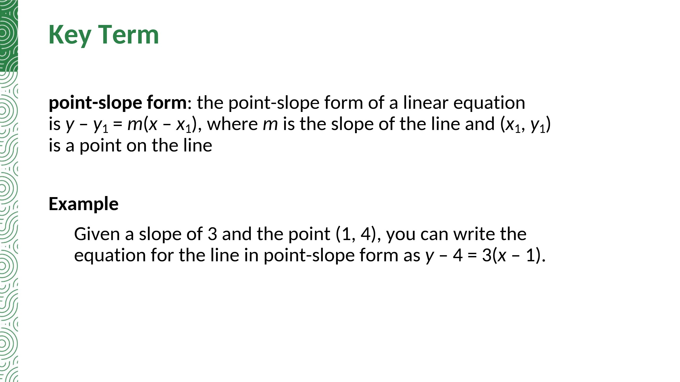

Slide 4
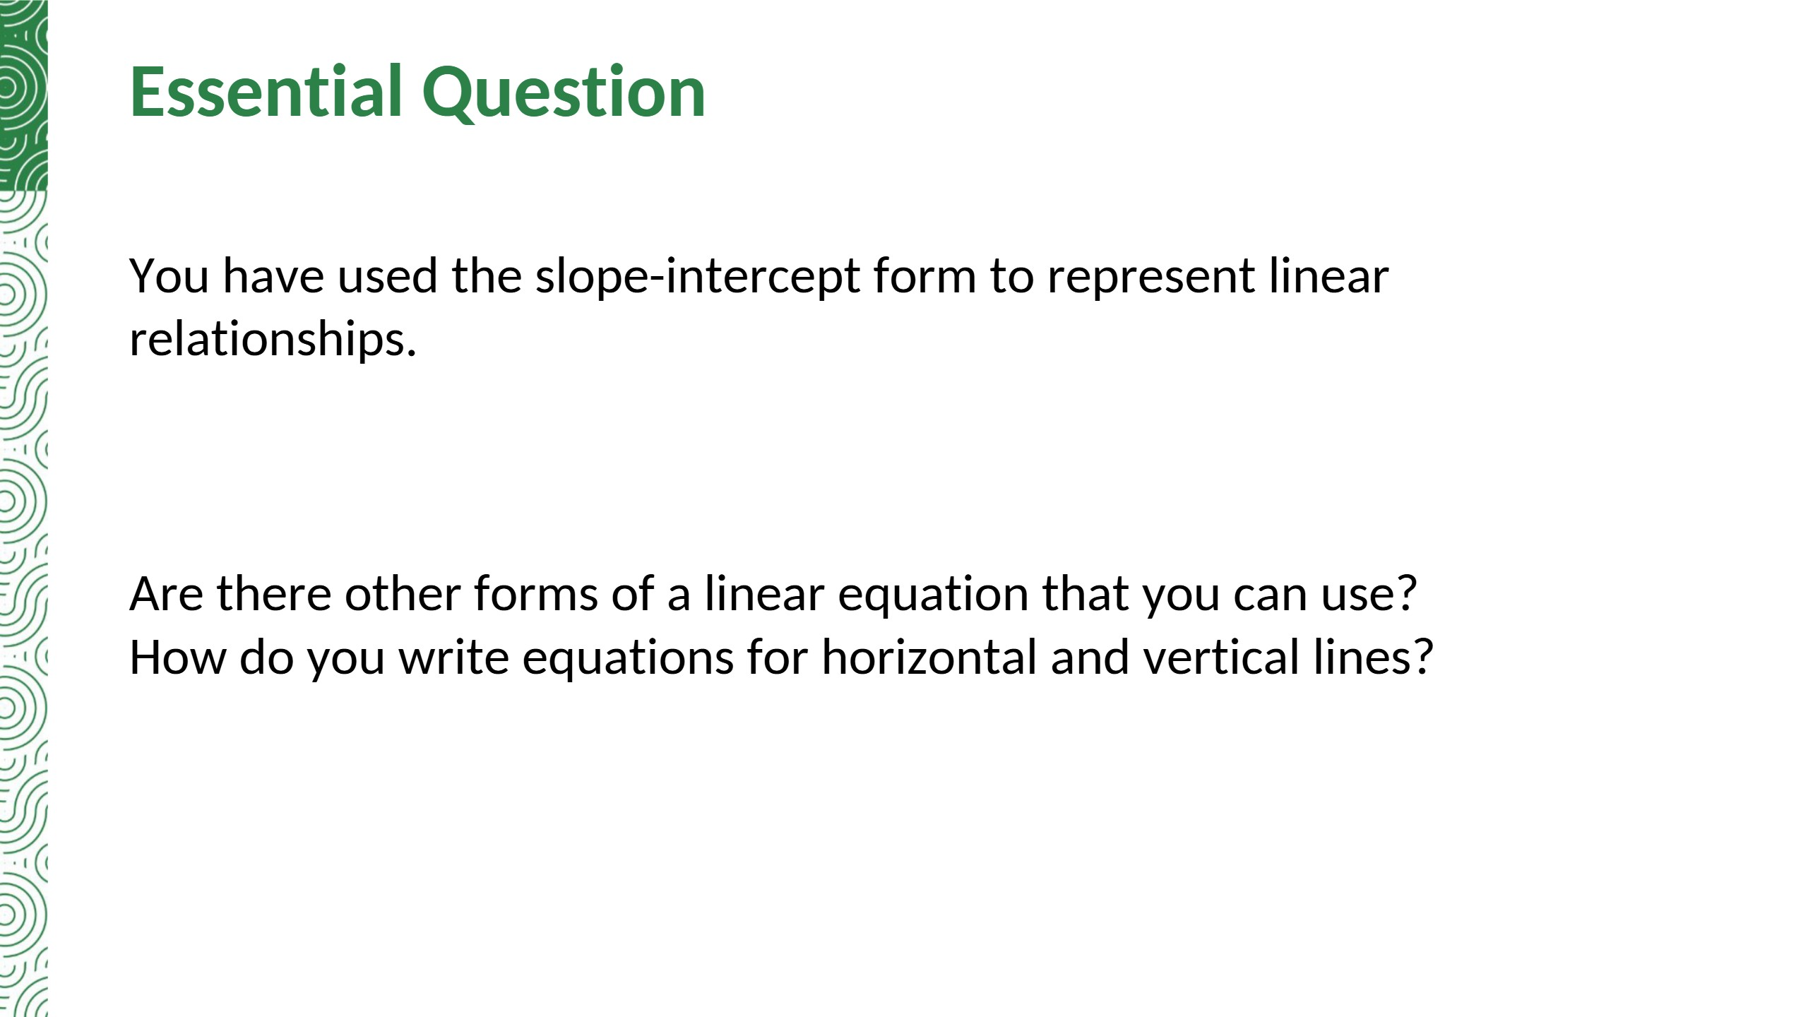
Yes. Point-slope form: y − y1 = m(x − x1), where m is the slope and (x1, y1) is a point on the line. A horizontal line is y = c (slope 0). A vertical line is x = c (slope undefined).
Notes:
TE correction: the TE sample answer names the slopes of horizontal and vertical lines but not their equations; y = c and x = c added.

Slide 5


Slide 6


Slide 7
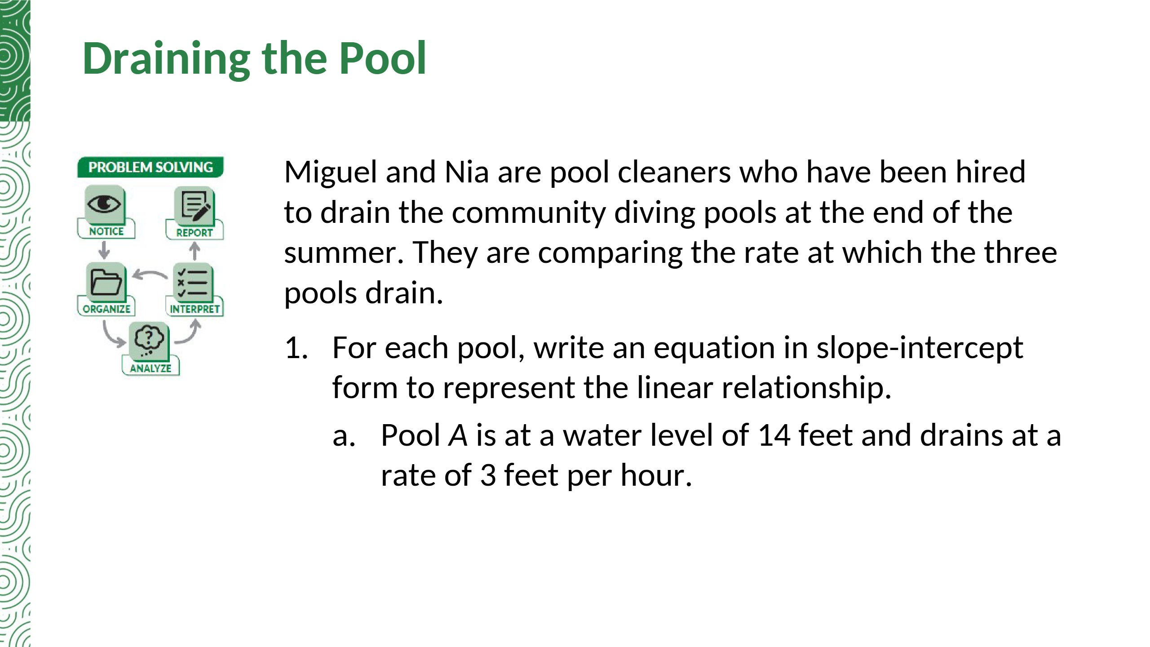
y = −3x + 14

Slide 8
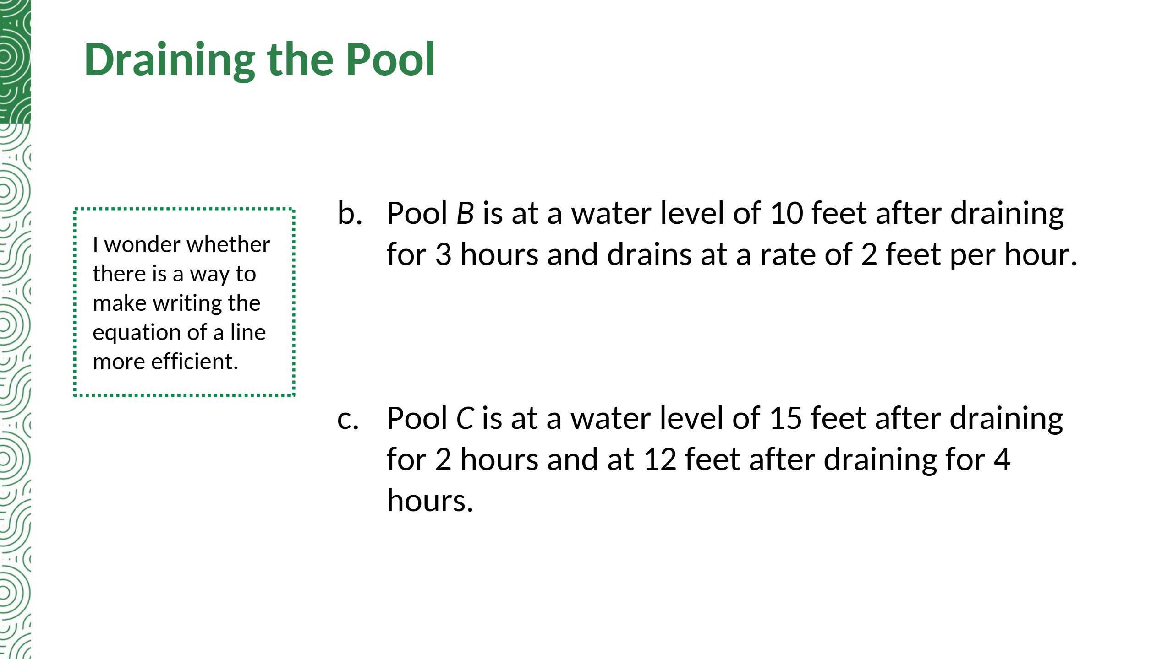
y = −2x + 16
m = (12 − 15)/(4 − 2) = −3/2
y = −(3/2)x + 18

Slide 9
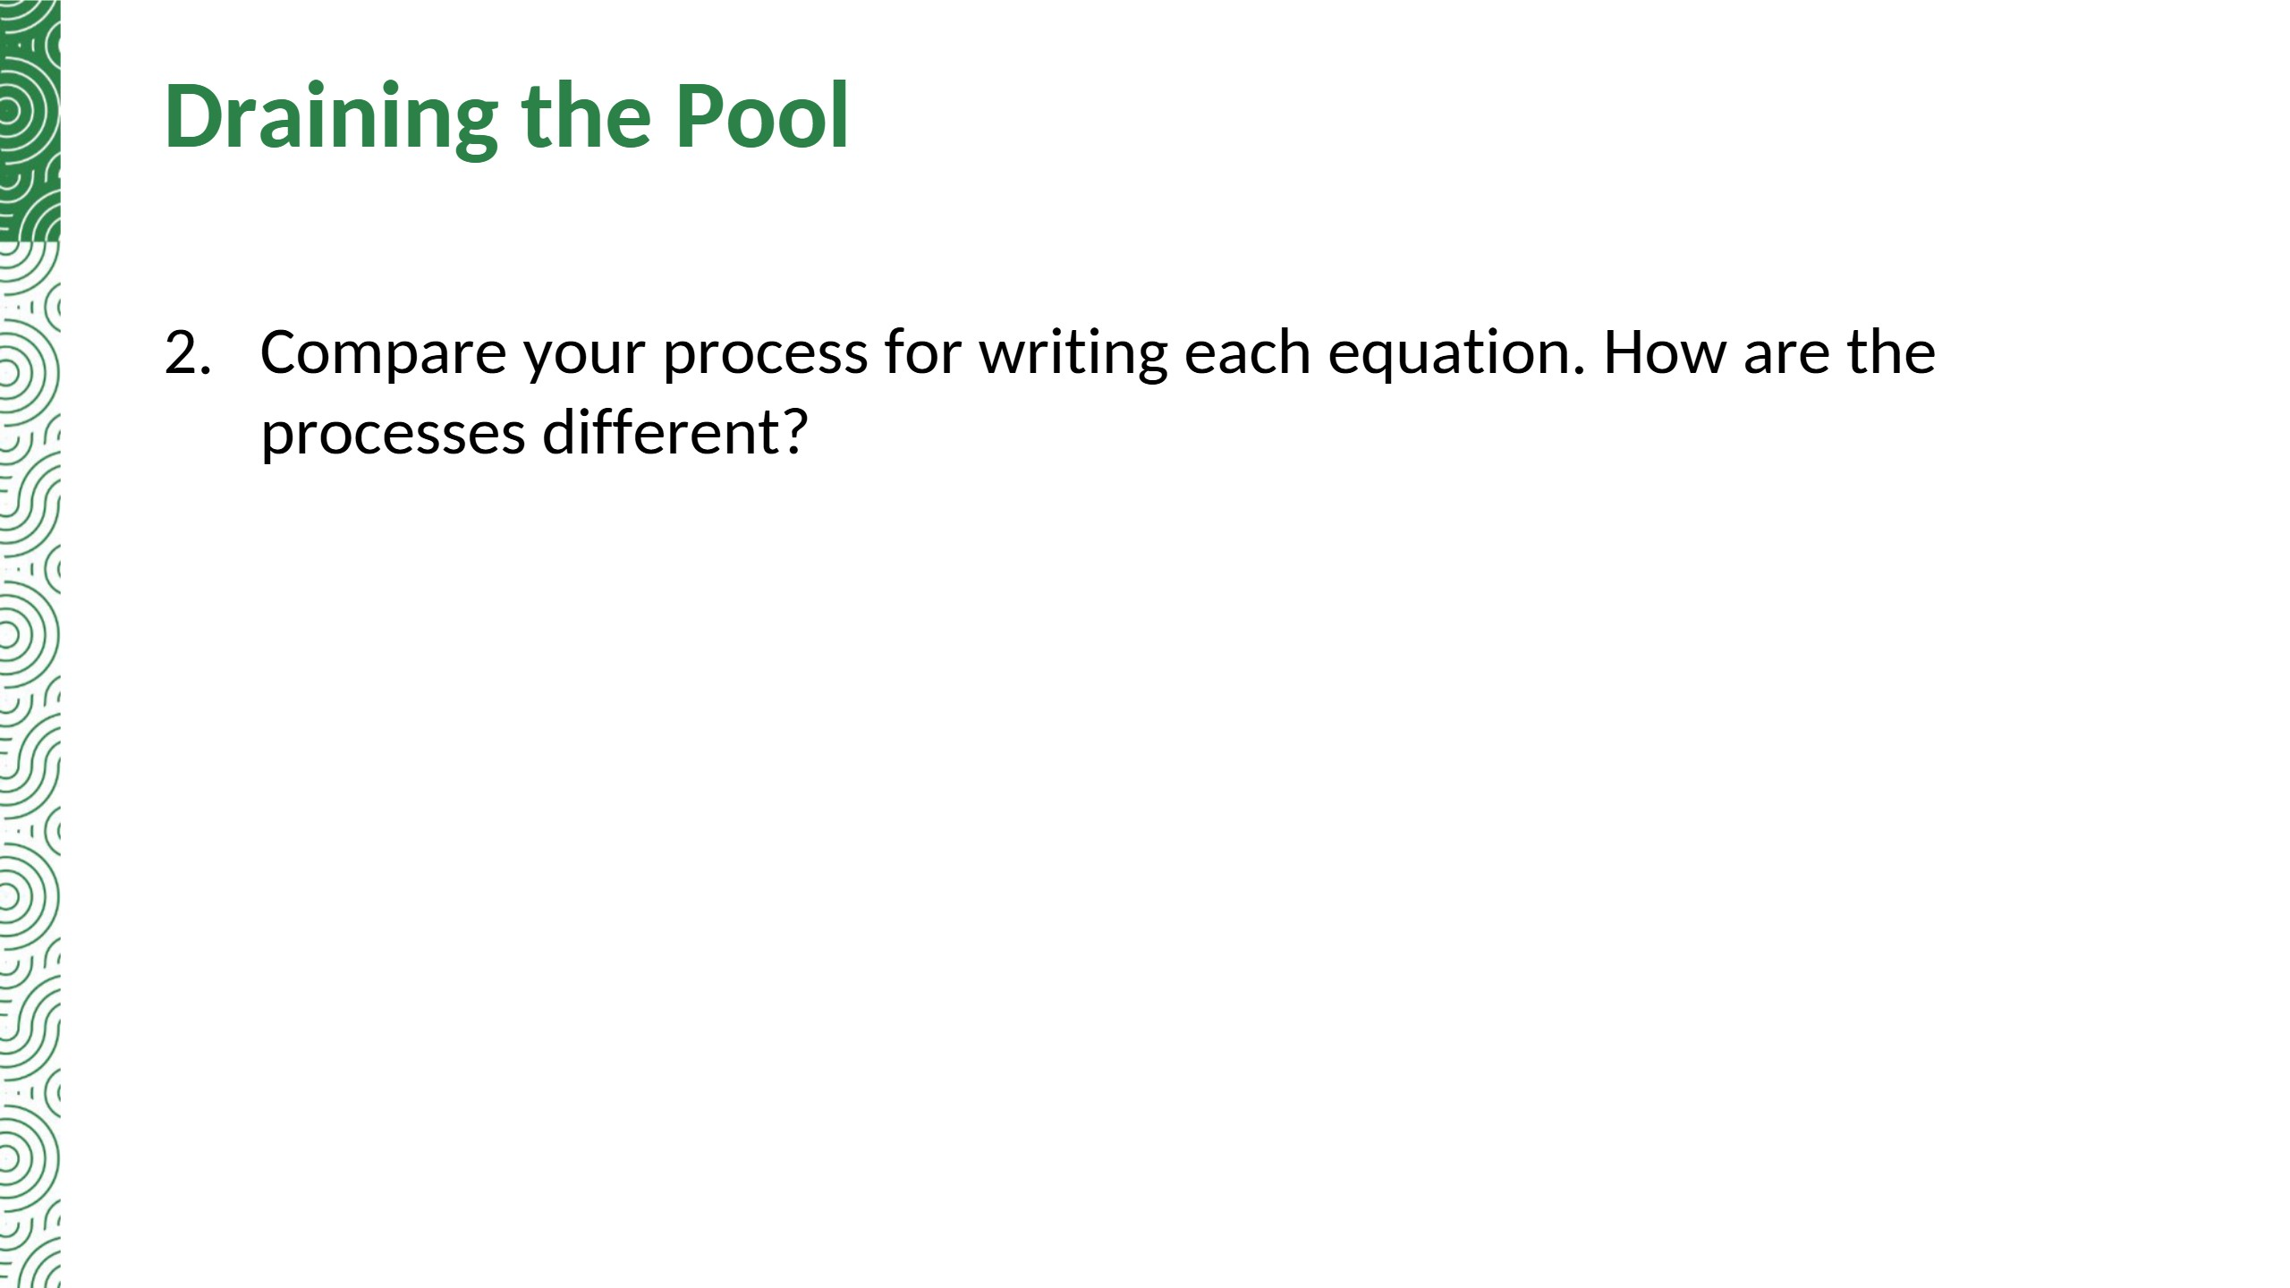
Sample answer: The slope and y-intercept were given for Pool A. The slope was given for Pool B, but I had to calculate the y-intercept. I had to calculate the slope and y-intercept for Pool C.

Slide 10

Summary: Real-world situations modeling linear relationships can be expressed as an equation in slope-intercept form, y = mx + b, where m is the slope and b is the y-intercept.

Slide 11


Slide 12


Slide 13
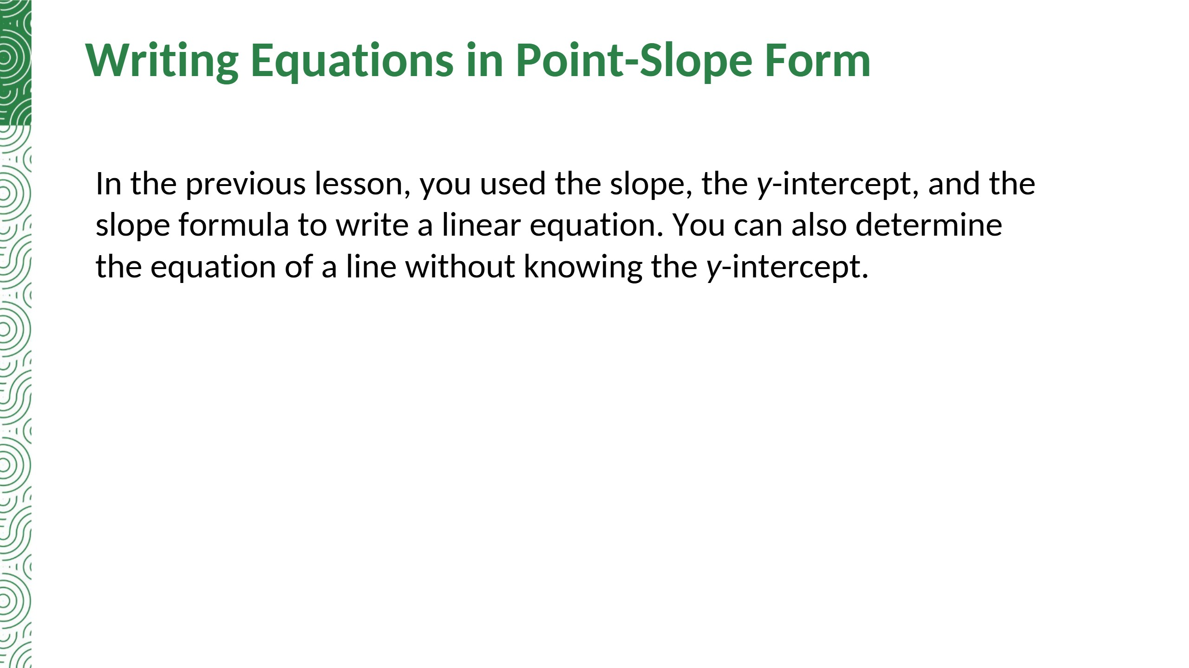

Slide 14
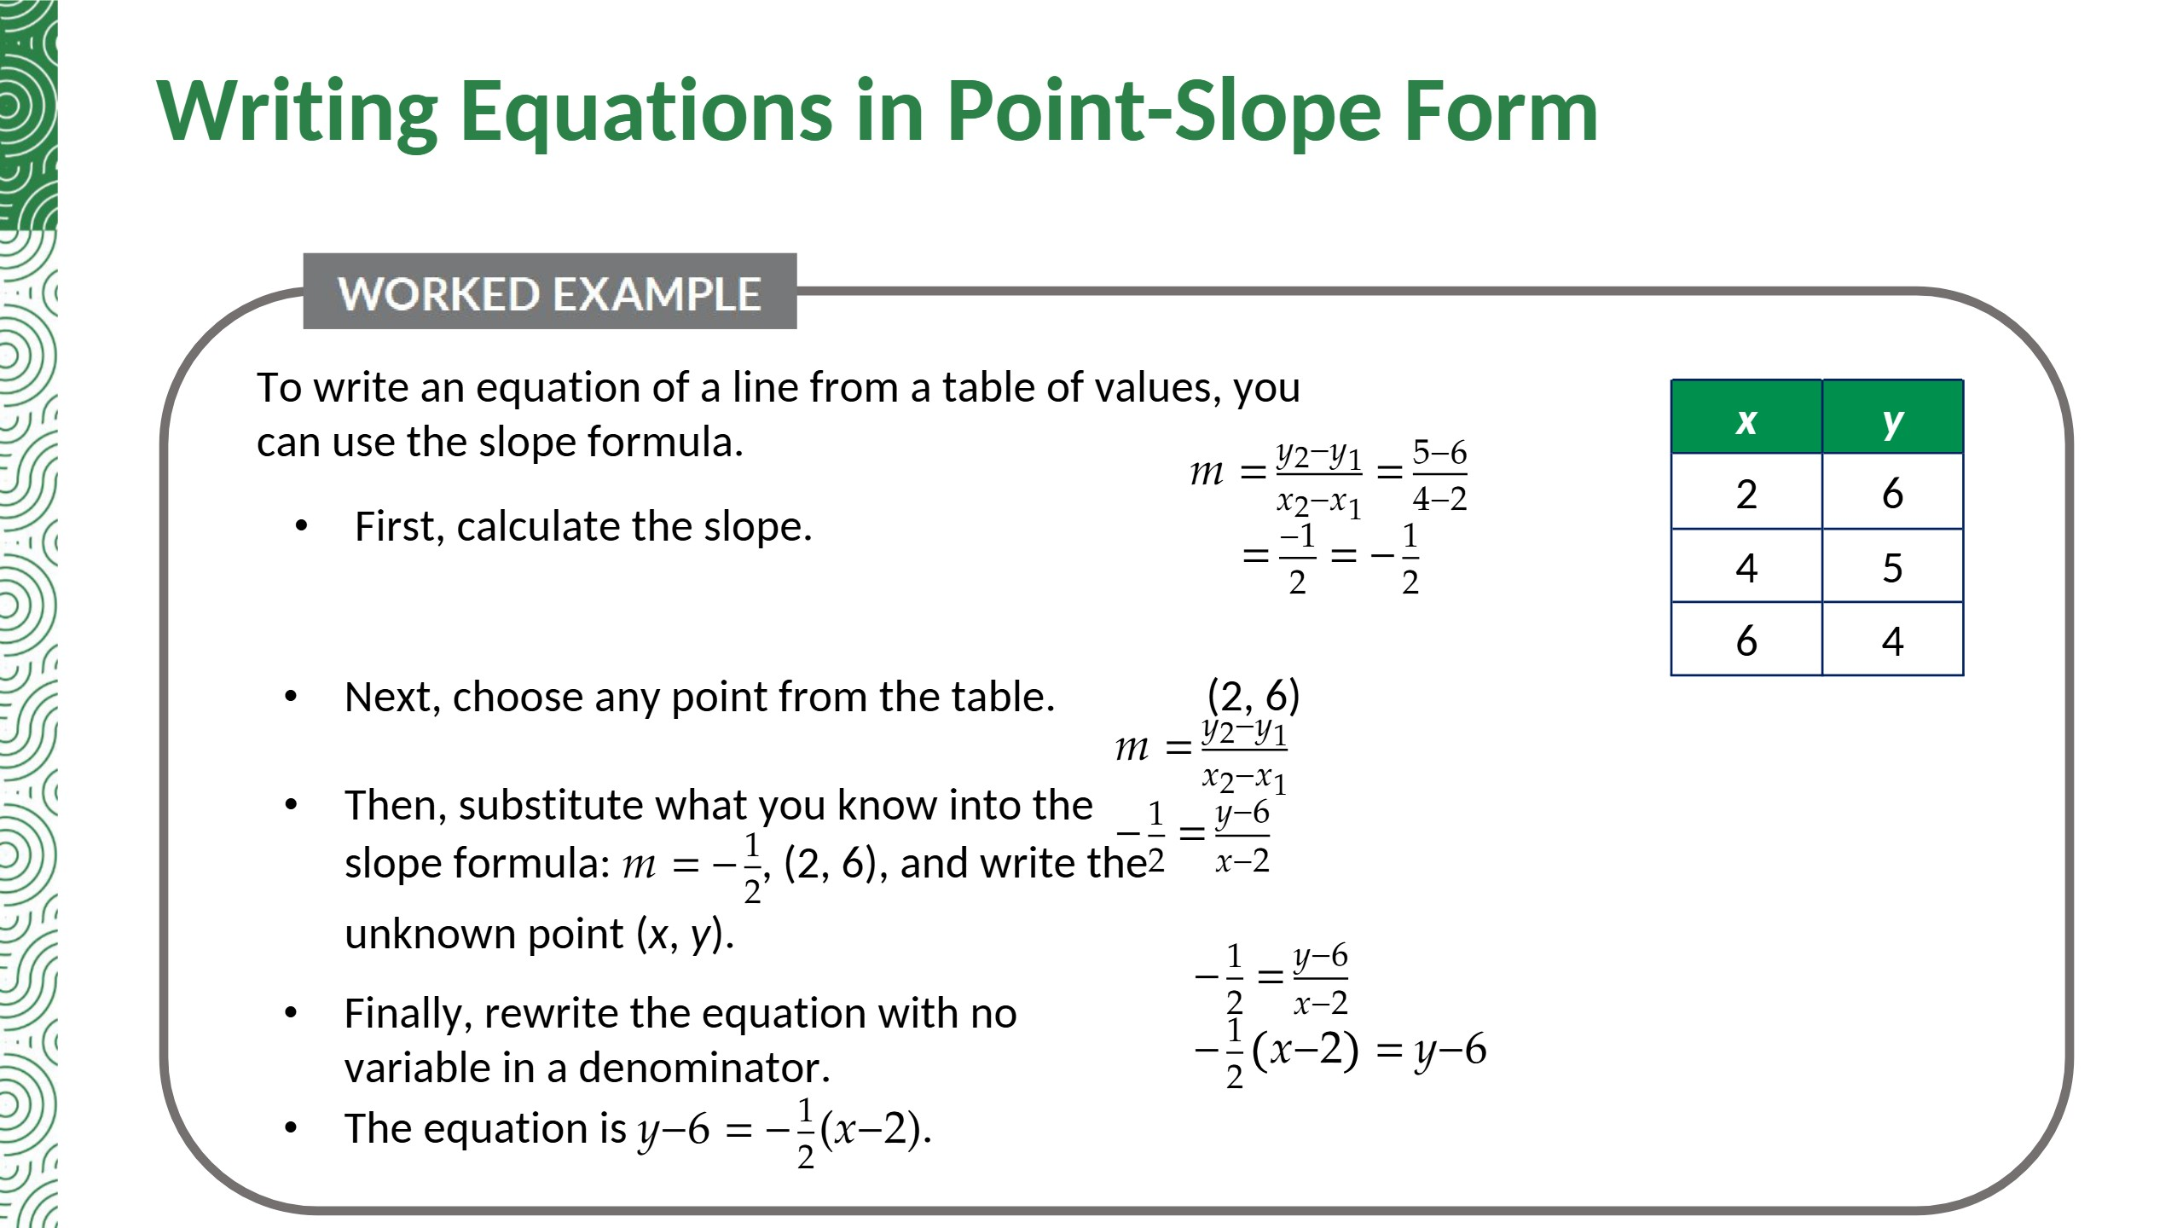

Slide 15
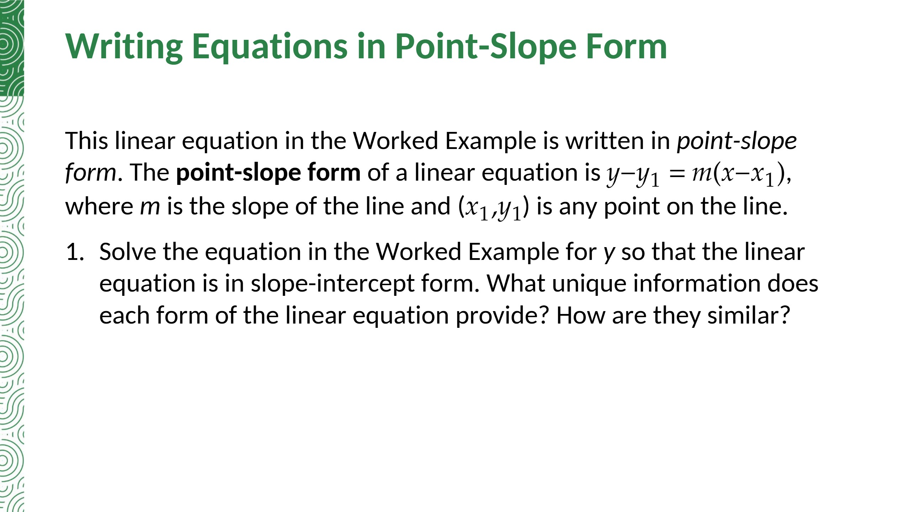
−(1/2)(x − 2) = y − 6 → −(1/2)x + 1 = y − 6 → y = −(1/2)x + 7
Both forms show the slope. Point-slope form shows a point on the line (which may not be the y-intercept); slope-intercept form shows the y-intercept.

Slide 16
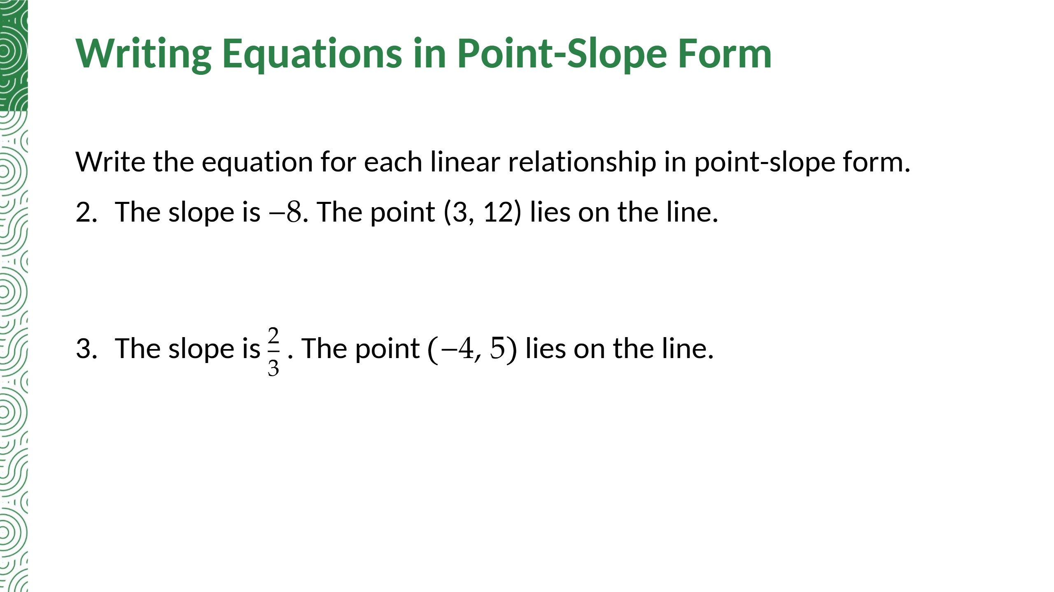
y − 12 = −8(x − 3)
y − 5 = (2/3)(x + 4)

Slide 17
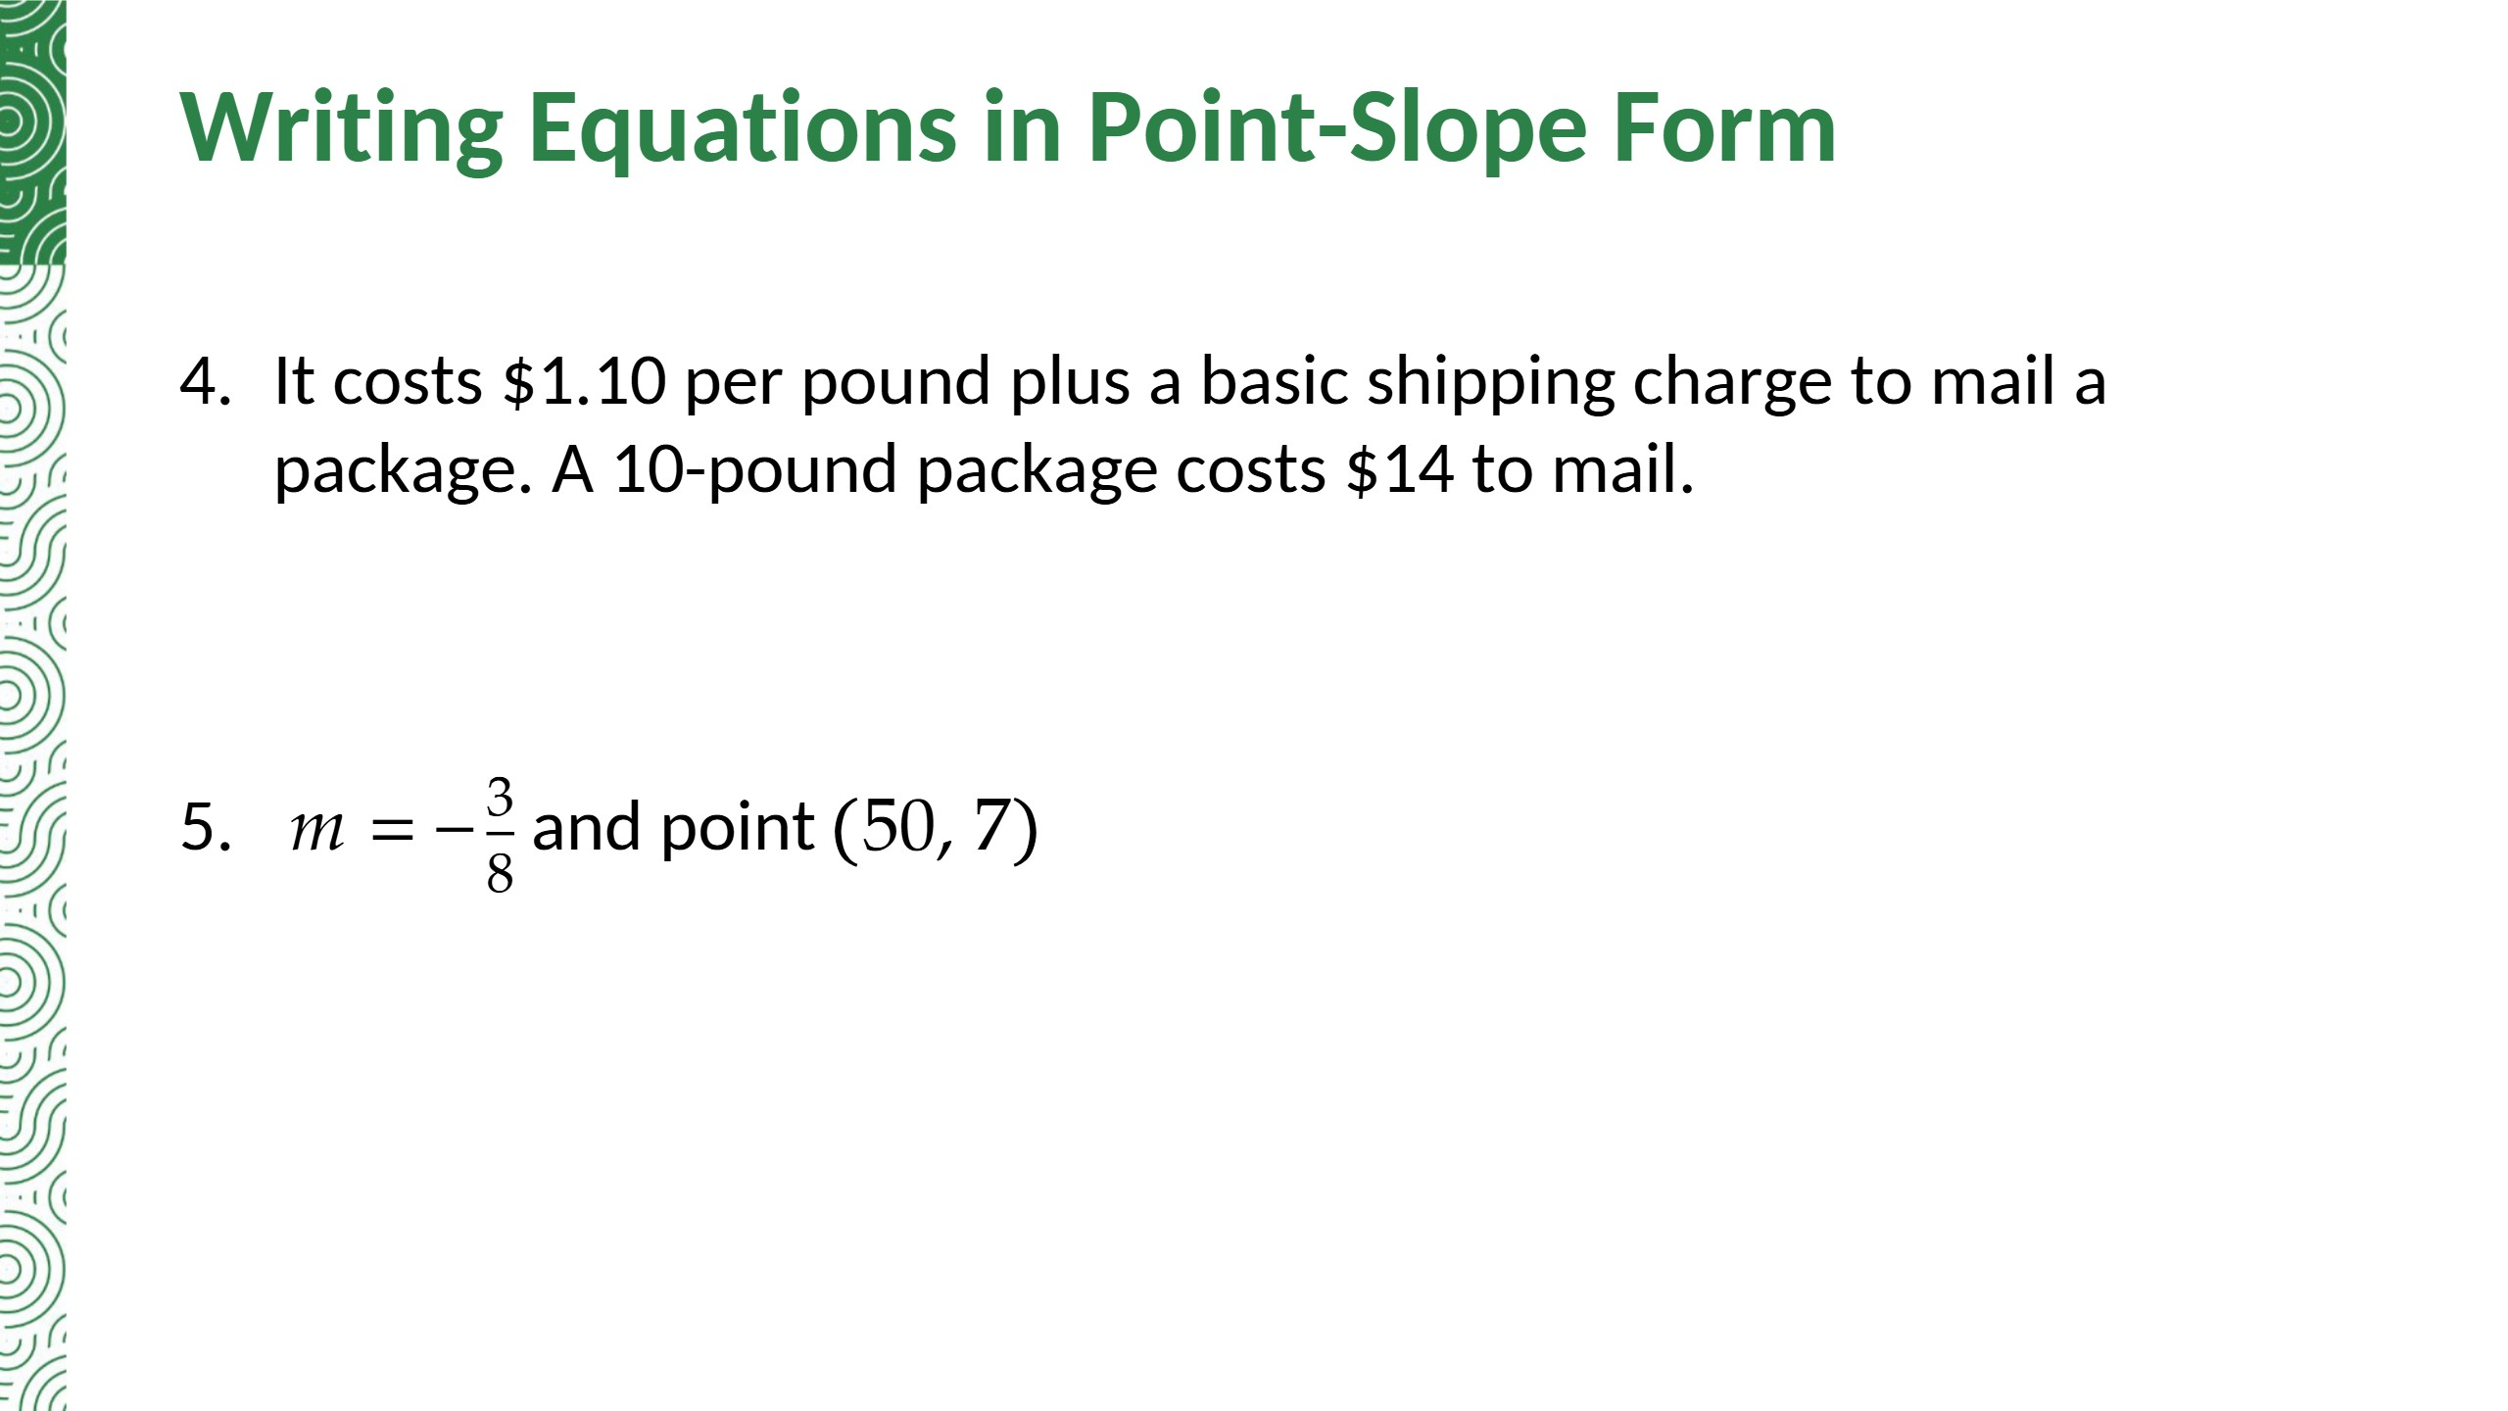
y − 14 = 1.1(x − 10)
y − 7 = −(3/8)(x − 50)

Slide 18
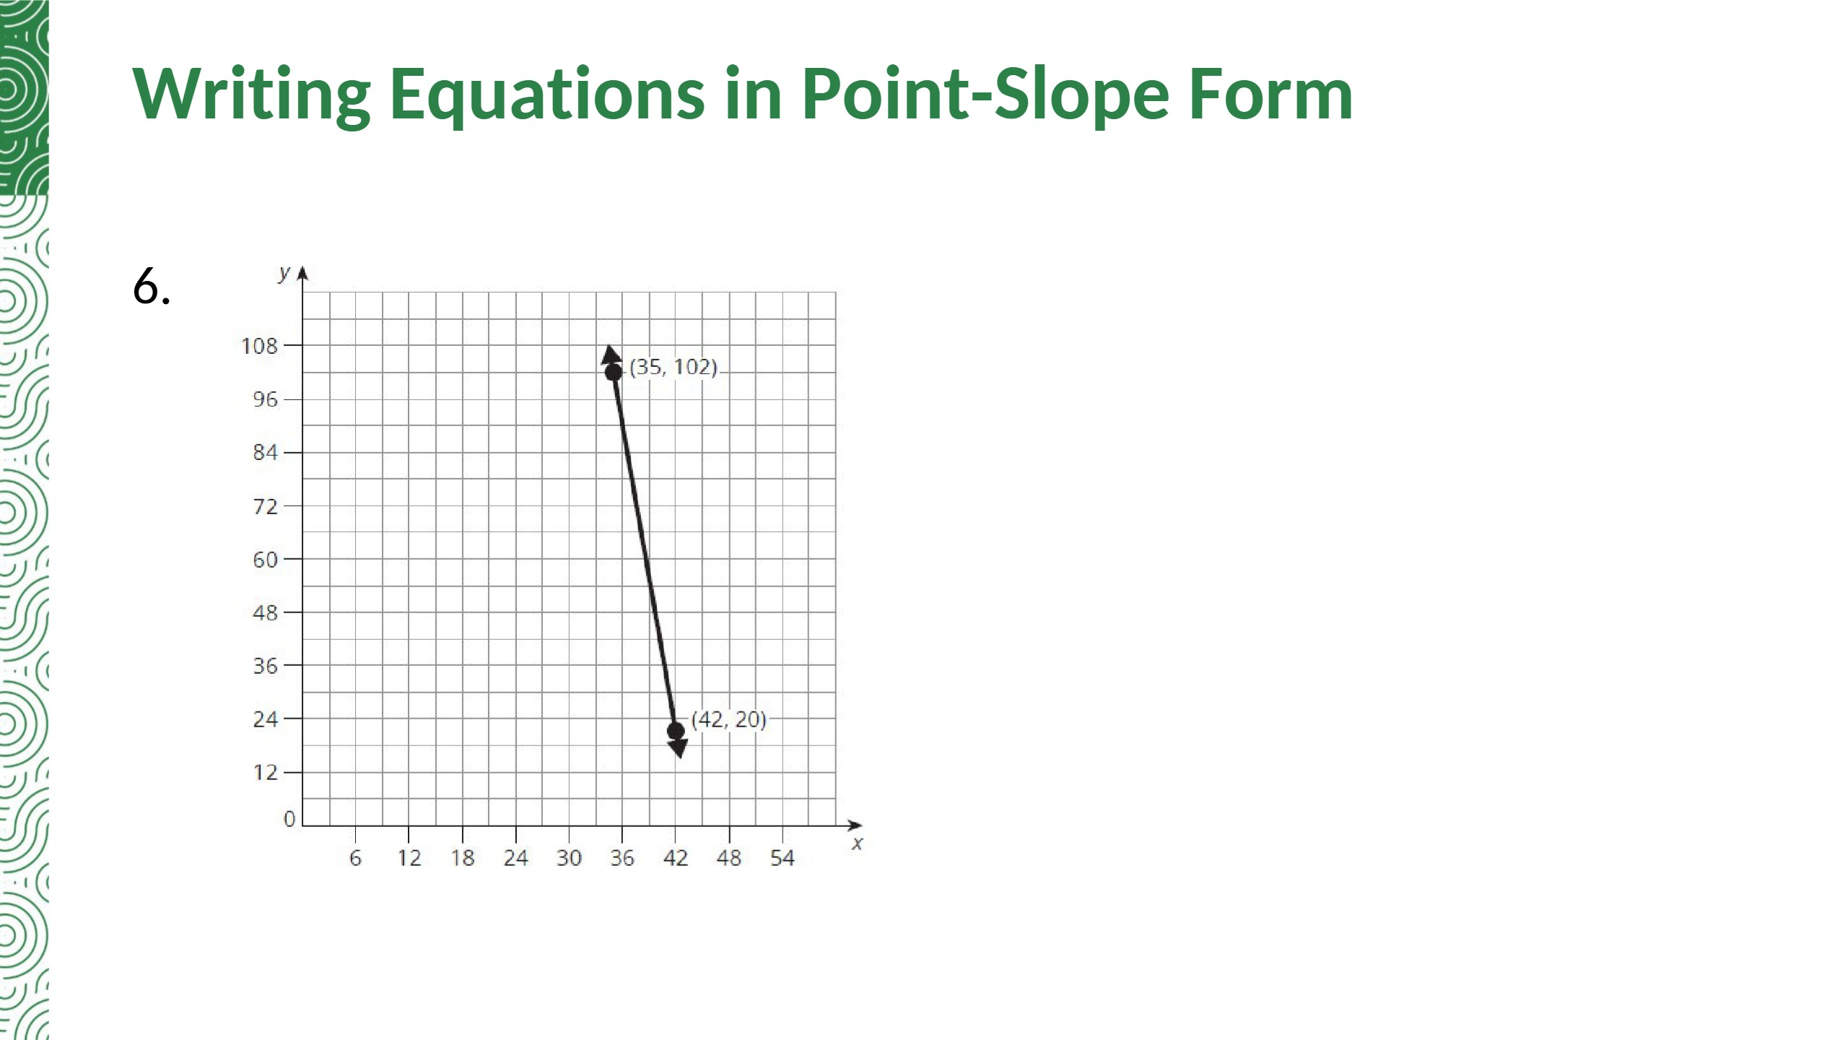
m = (20 − 102)/(42 − 35) = −82/7
y − 20 = −(82/7)(x − 42)
or y − 102 = −(82/7)(x − 35)
Notes:
Added: the same line written through the other point, (35, 102).

Slide 19
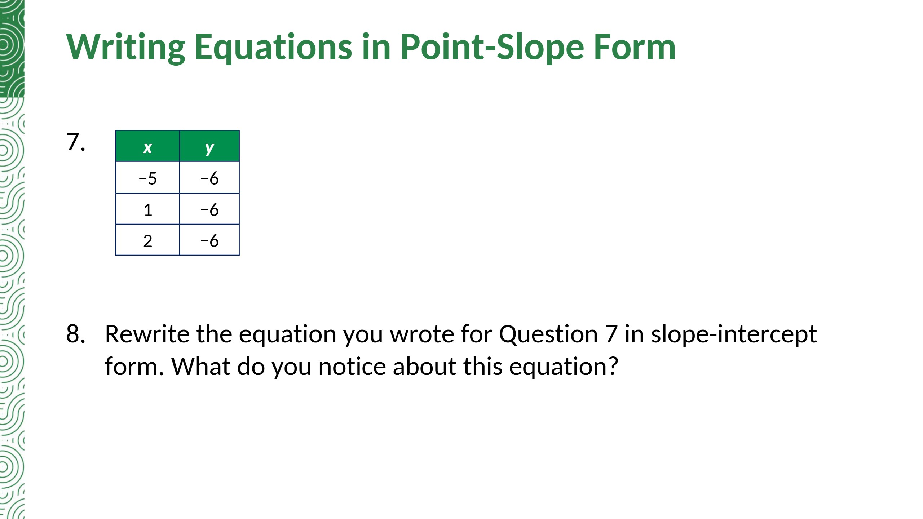
Sample answer:
y + 6 = 0(x − 1)
y + 6 = 0(x − 1) → y + 6 = 0 → y = −6
There is no x-term: y is −6 for every x. It is a constant function (a horizontal line).

Slide 20
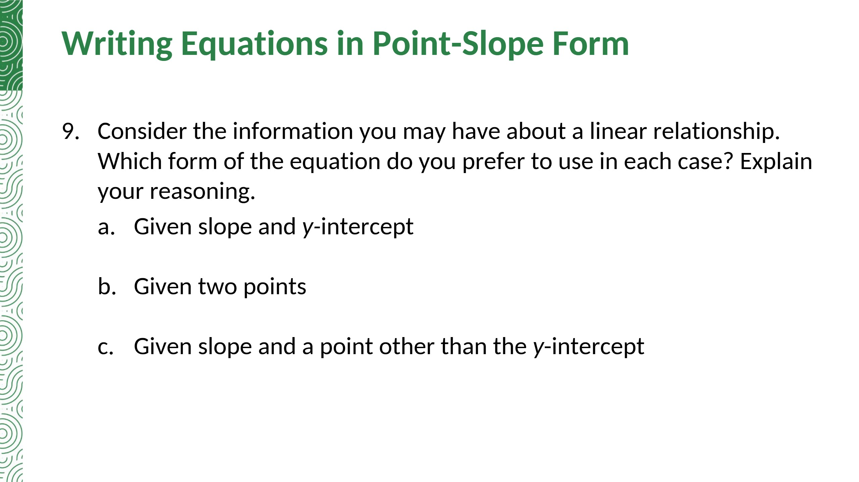
Slope-intercept form: m and b go straight into y = mx + b.
Calculate the slope first, then use point-slope form with either point.
Point-slope form: use m and the point (x1, y1) directly.

Slide 21
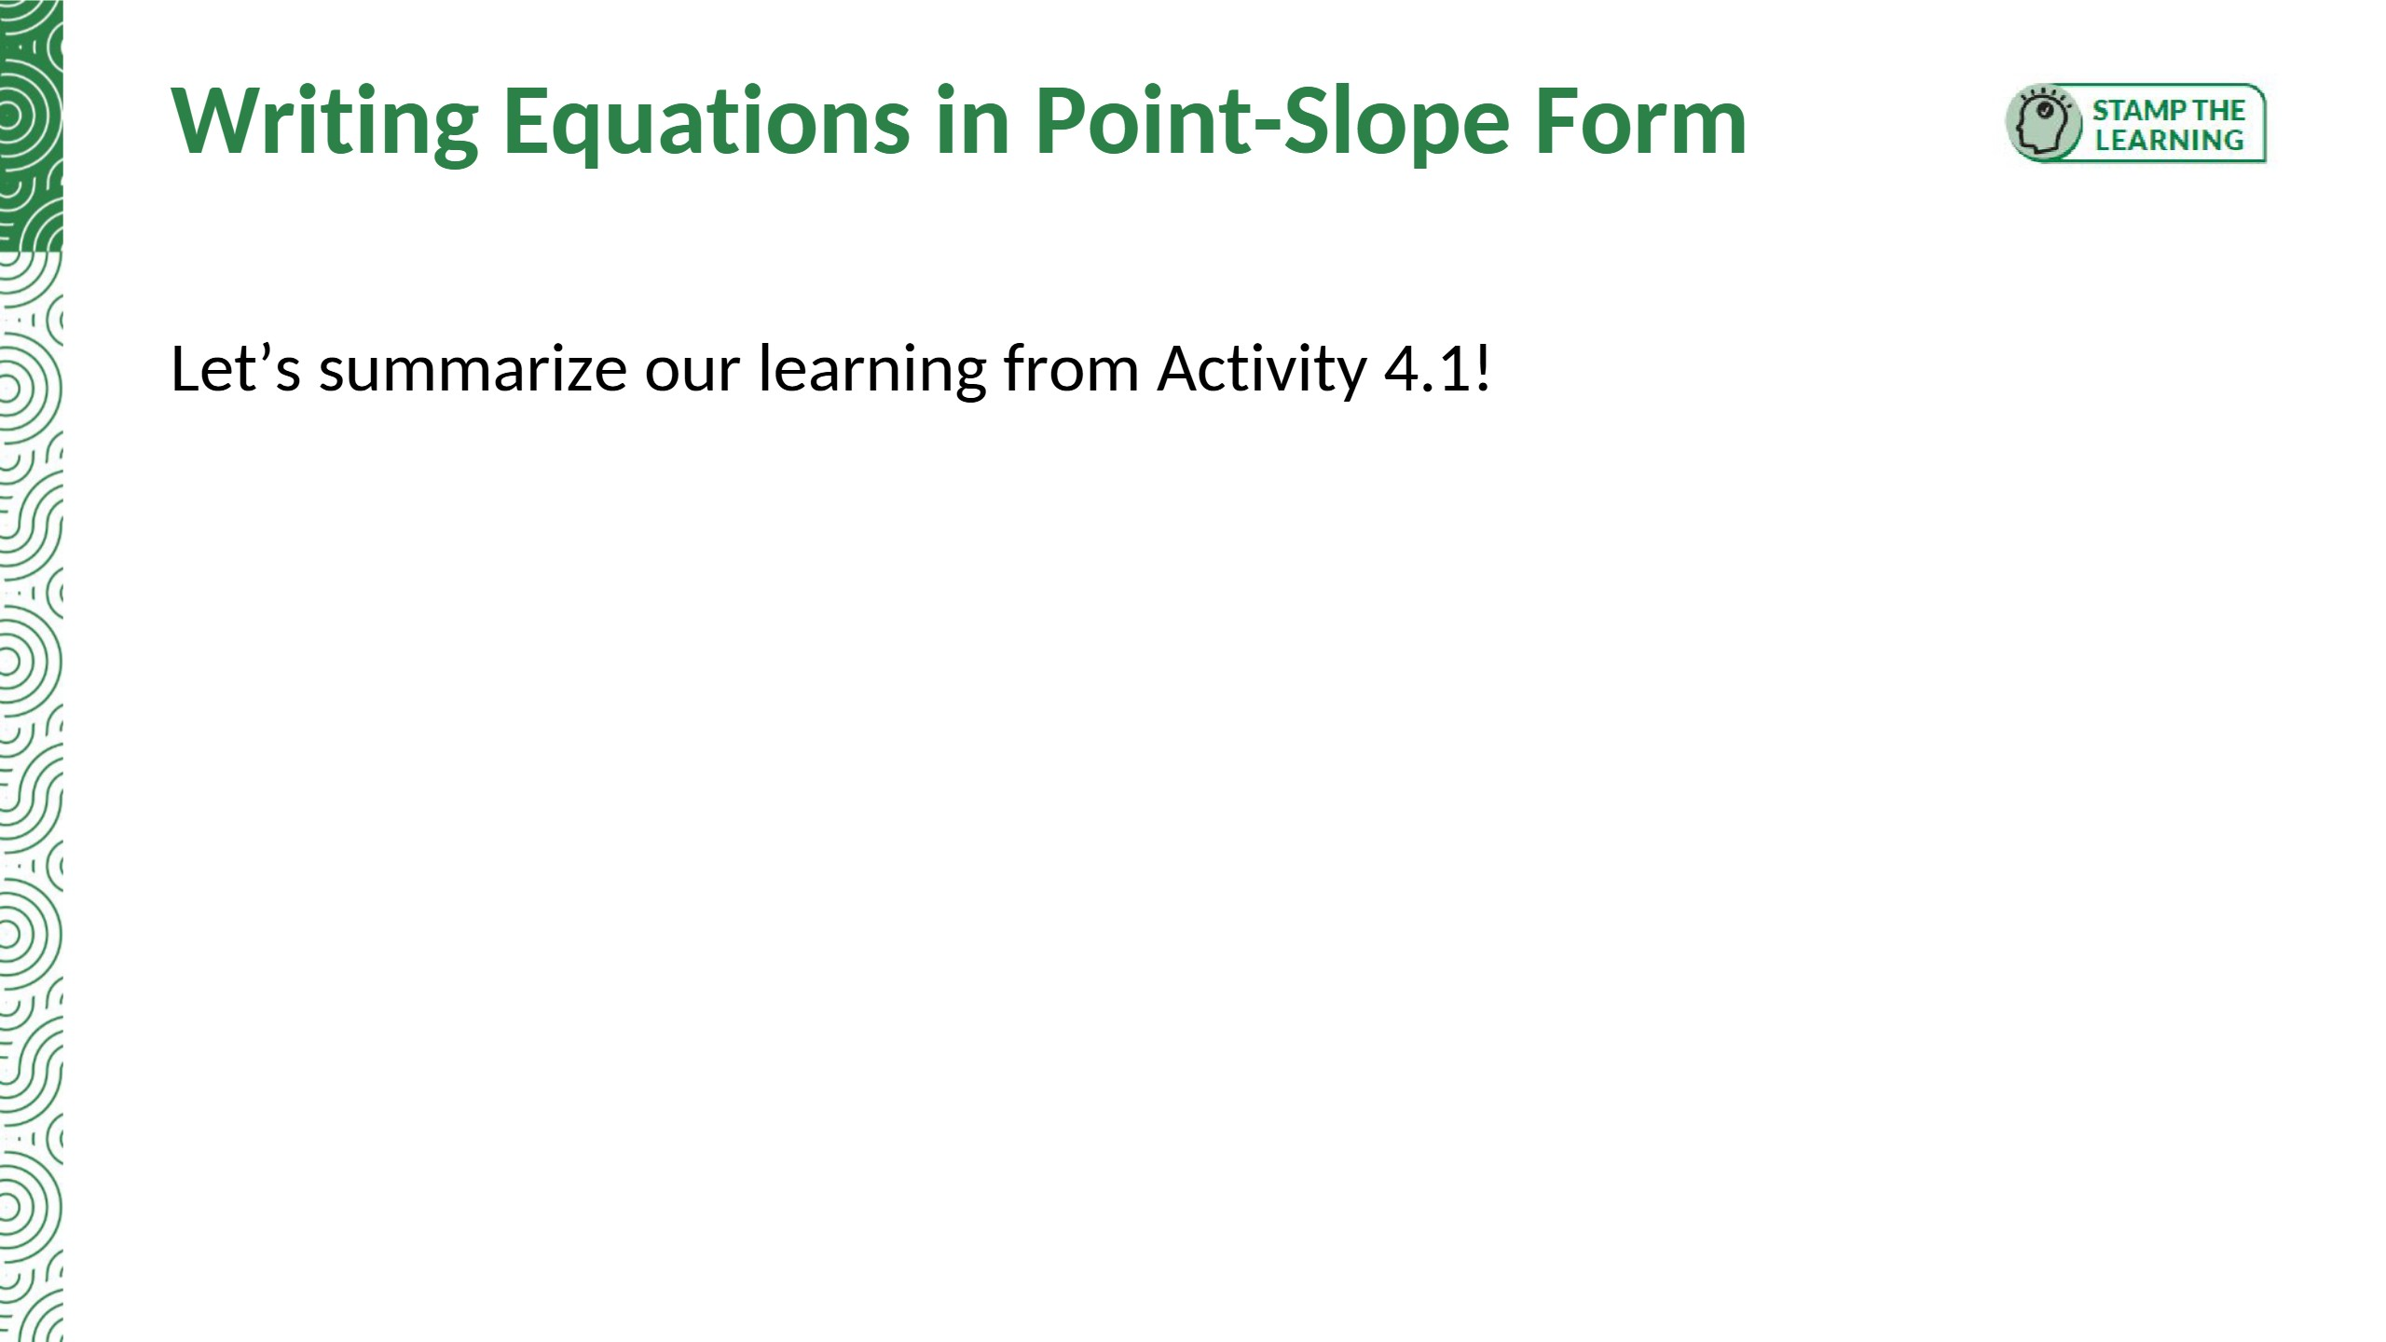
Summary: The point-slope form of a linear equation is y − y1 = m(x − x1), where m is the slope of the line and (x1, y1) is any point on the line.

Slide 22
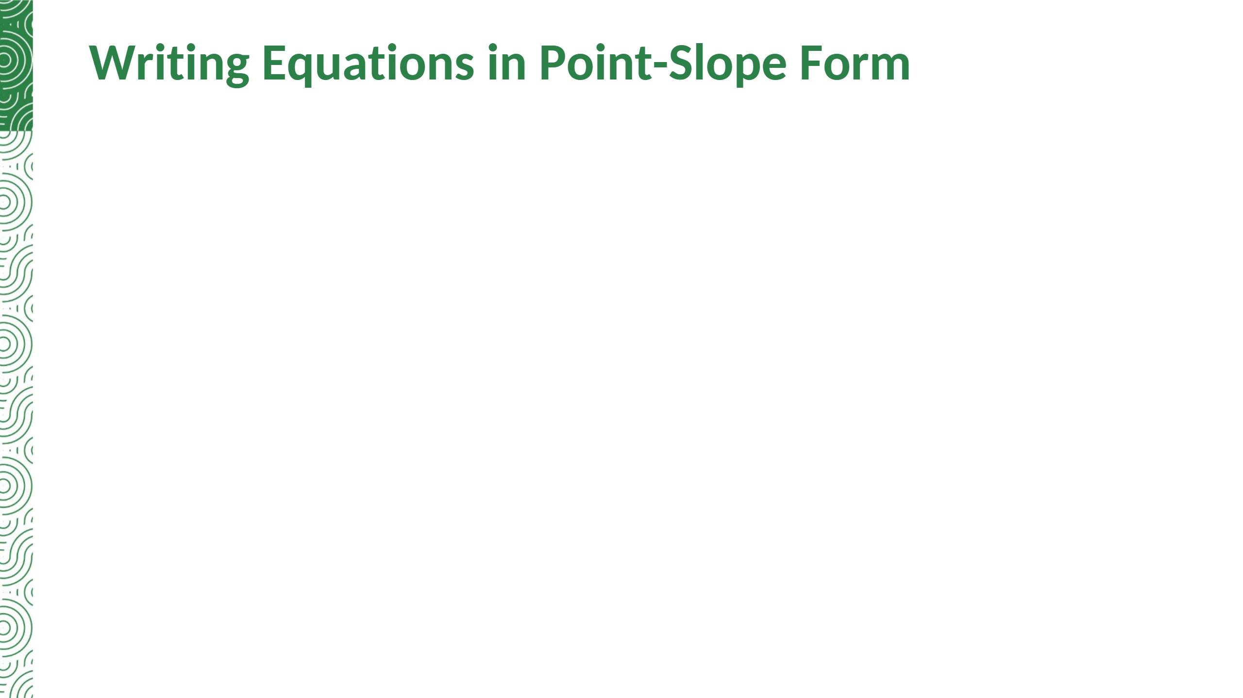

Slide 23


Slide 24
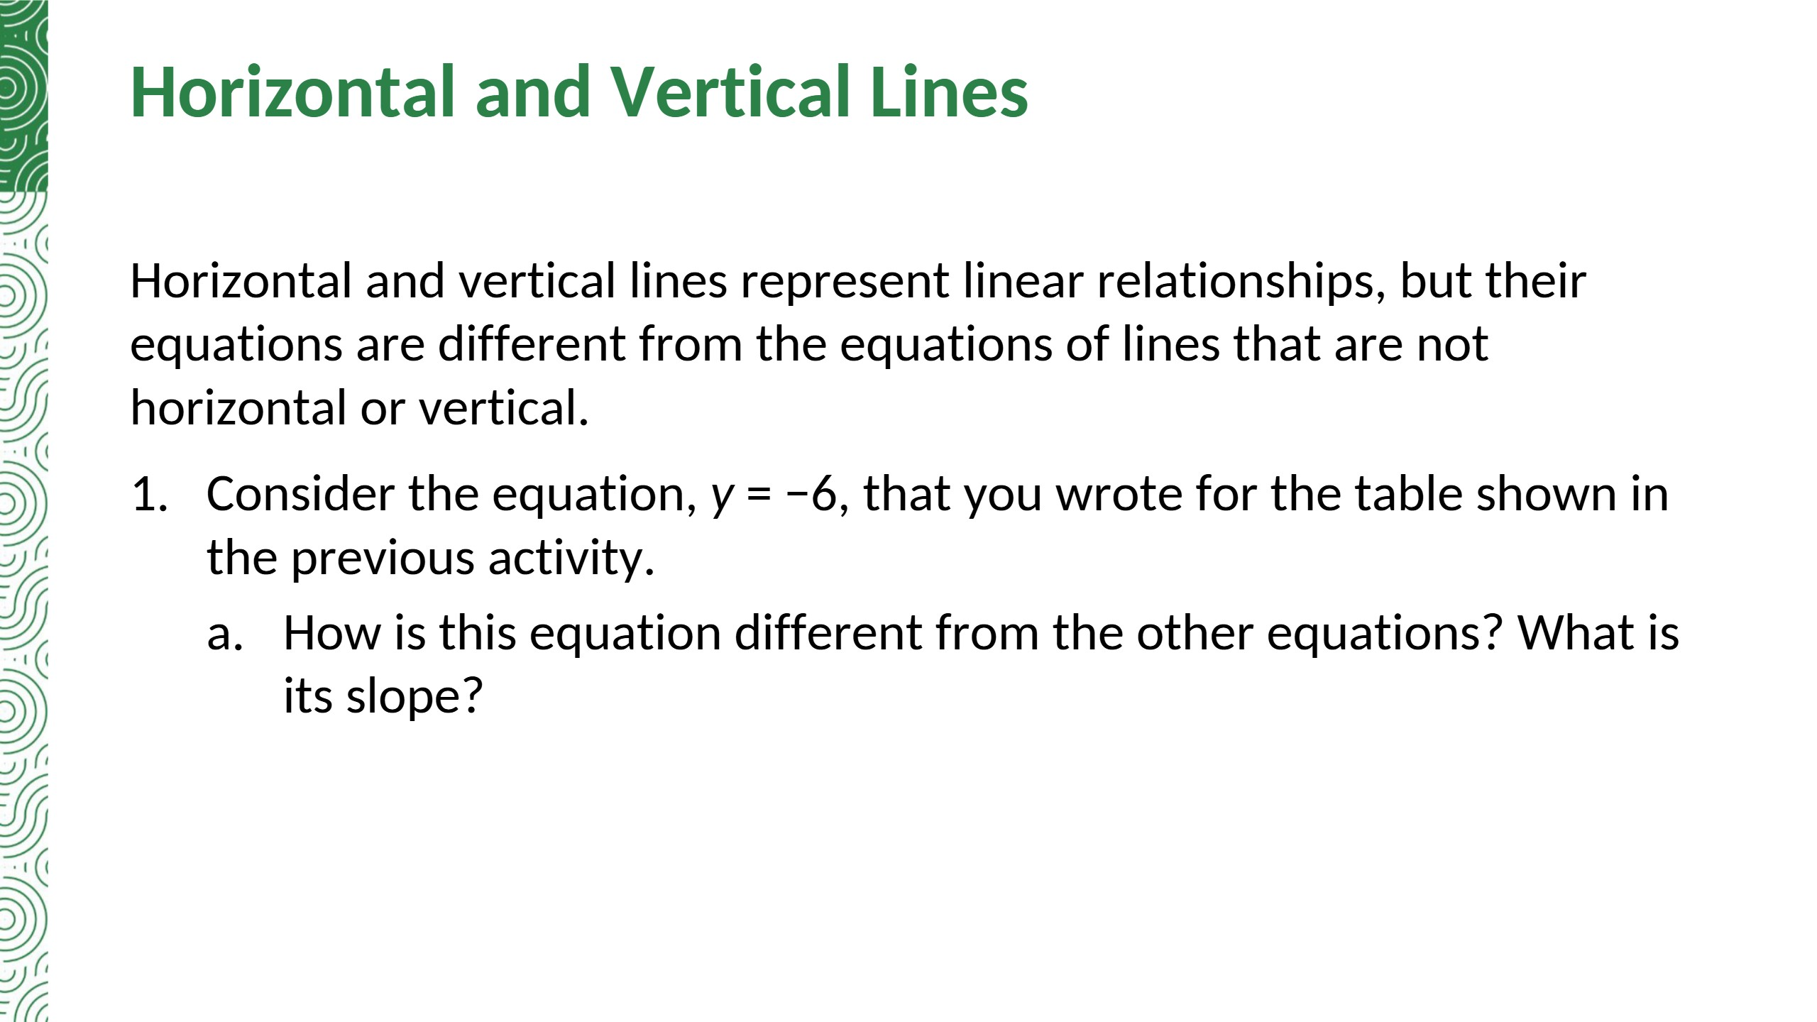
The equation has no x-term: y stays the same for every x. The slope is 0.

Slide 25
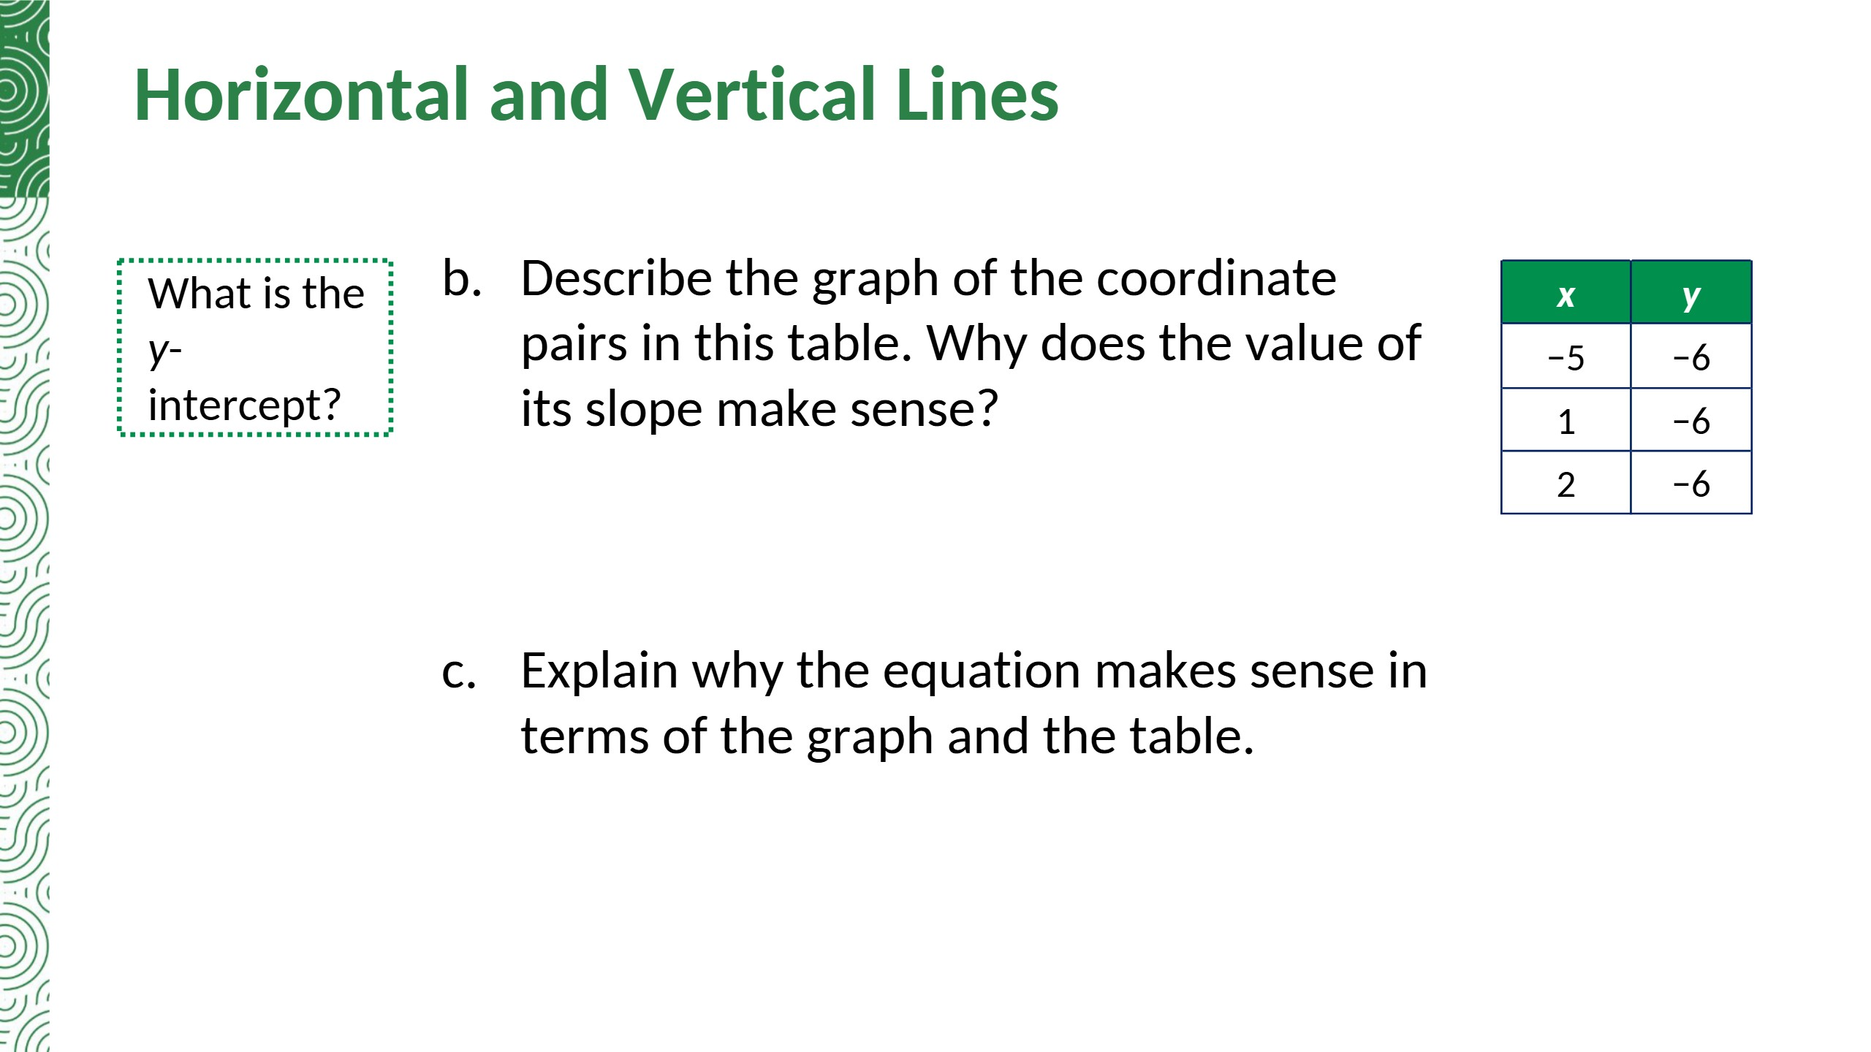
A horizontal line through (0, −6). The slope is 0 because y never changes: the rise is 0, so rise ÷ run = 0.
The equation says y is always −6. Every y-value in the table is −6, and every point on the graph has a y-value of −6.
Notes:
TE correction: part b asks why the slope makes sense; the TE answer only describes the graph. Reason added: y never changes, so the rise is 0.

Slide 26
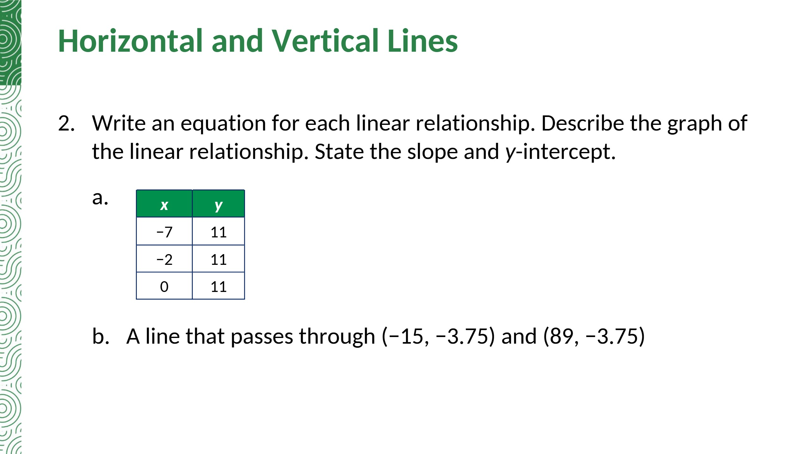
y = 11
Horizontal line; slope 0; y-intercept (0, 11)
y = −3.75
Horizontal line; slope 0; y-intercept (0, −3.75)

Slide 27
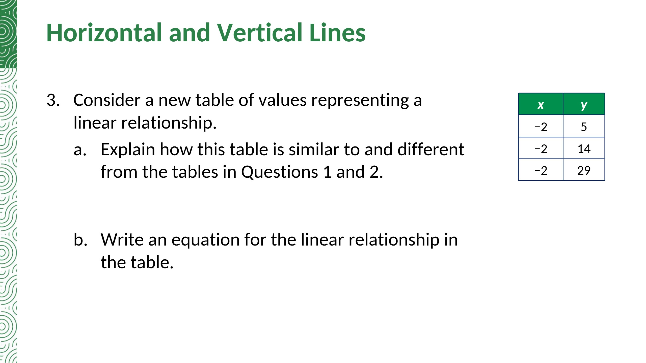
All the x-values are the same (−2) instead of all the y-values; this time the y-values change.
x = −2

Slide 28
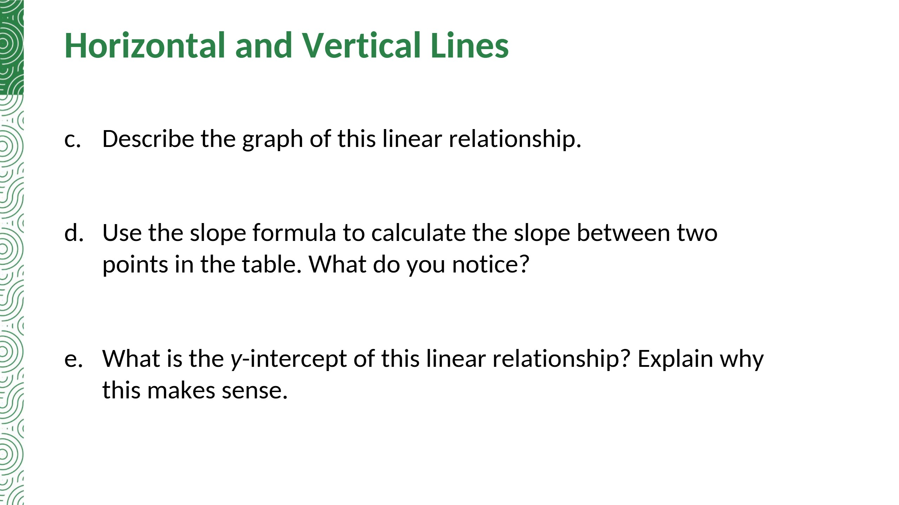
A vertical line through (−2, 0).
m = (14 − 5)/(−2 − (−2)) = 9/0. You cannot divide by 0, so the slope is undefined.
There is no y-intercept. The line x = −2 is parallel to the y-axis and never crosses it (x is never 0).
Notes:
TE correction (part e): the TE says the line 'does not slope toward the y-axis'. The accurate reason: x = −2 is parallel to the y-axis and never reaches x = 0.

Slide 29
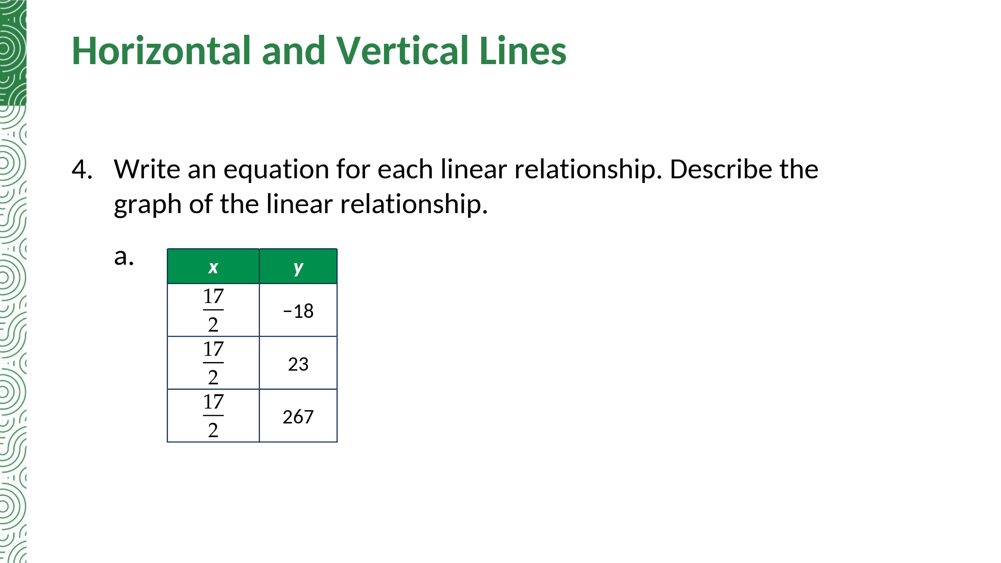
x = 17/2 (x = 8.5)
Vertical line through (17/2, 0); slope undefined

Slide 30
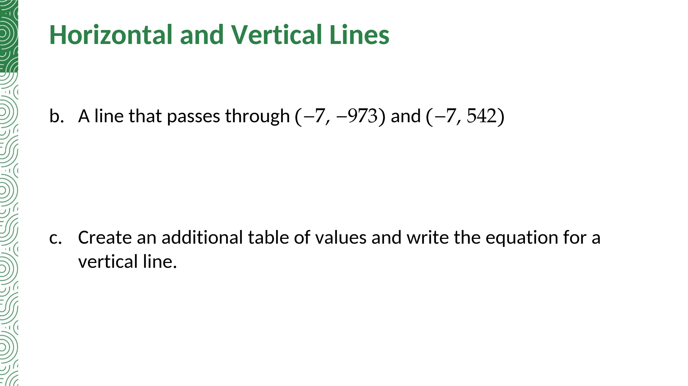
x = −7
Vertical line through (−7, 0); slope undefined
Sample: x-values 3, 3, 3 with y-values −1, 0, 5 give x = 3. Any table whose x-values are all the same number c gives the vertical line x = c.
Notes:
Added a sample table for part c (TE: answers will vary).

Slide 31
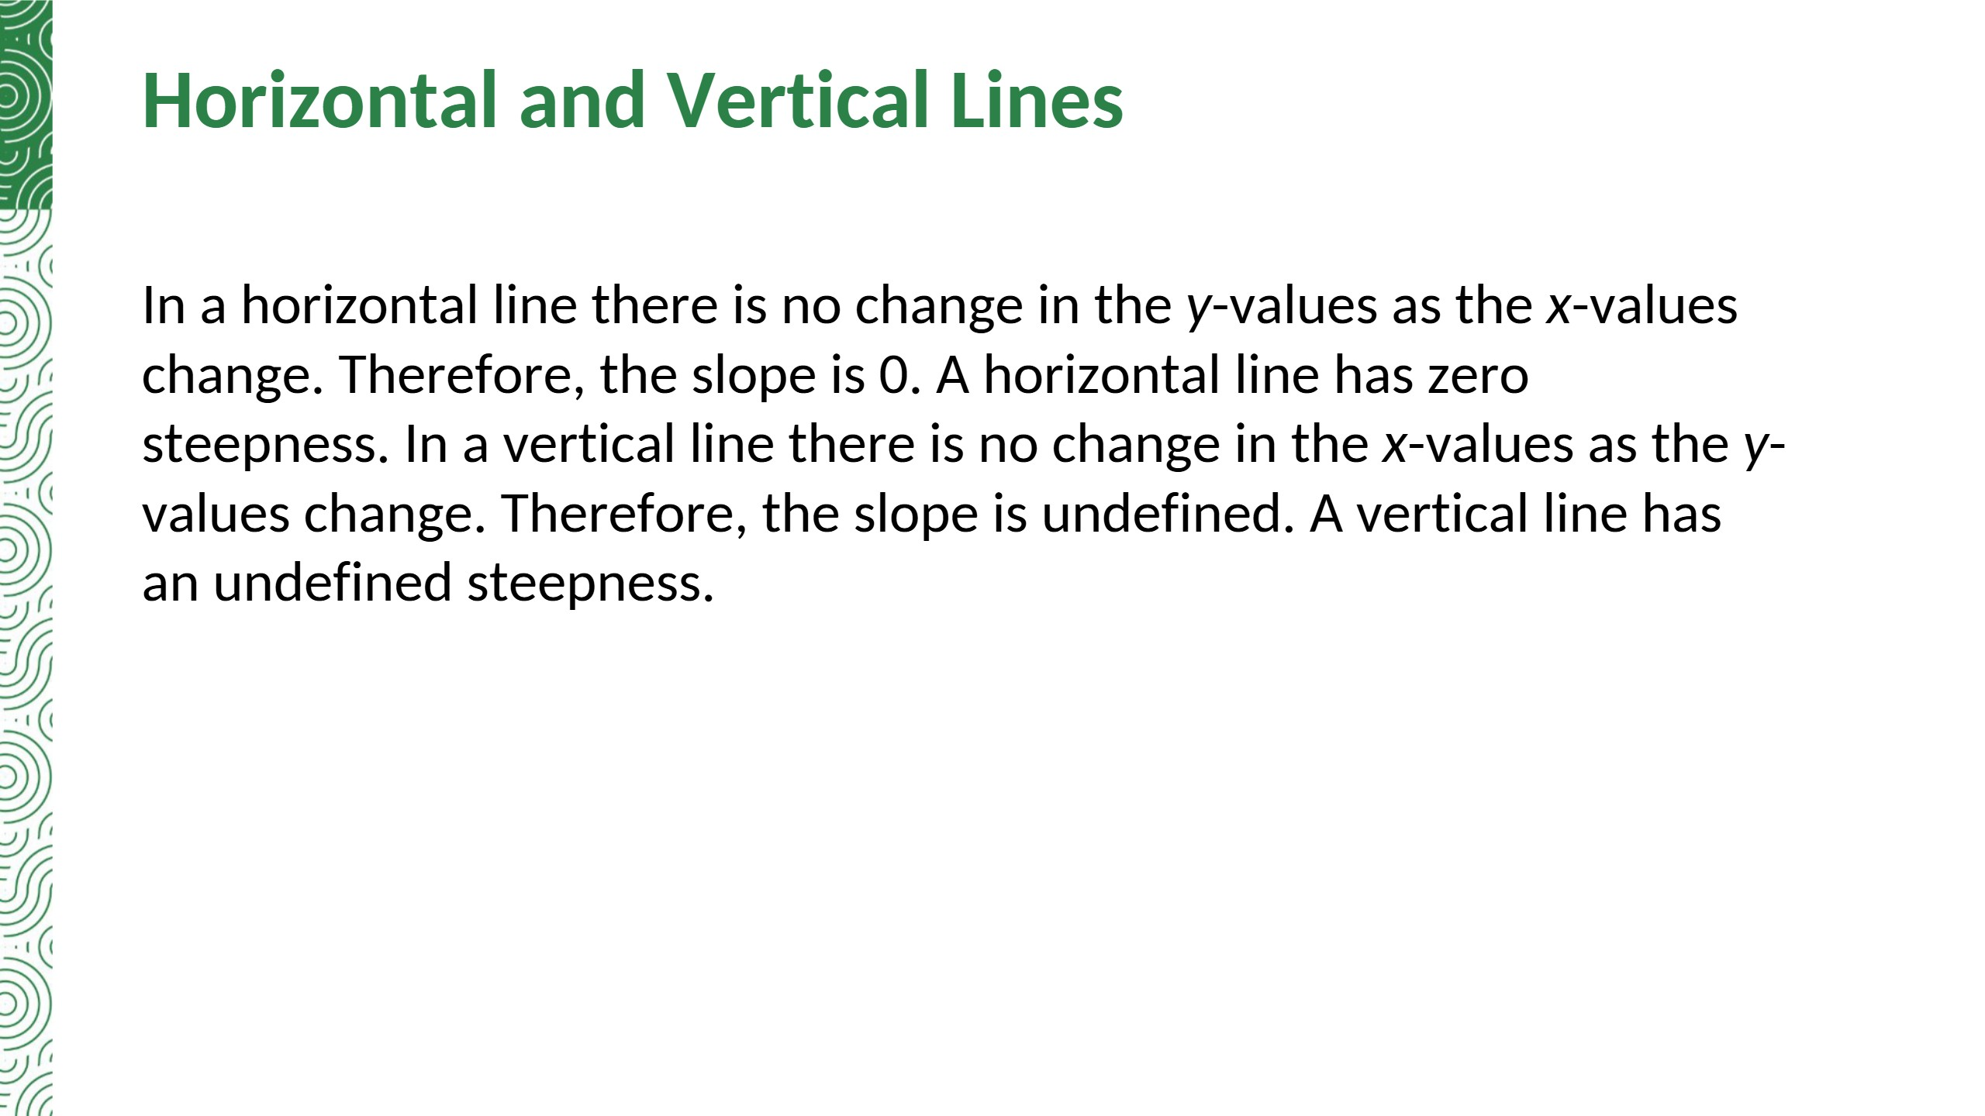

Slide 32
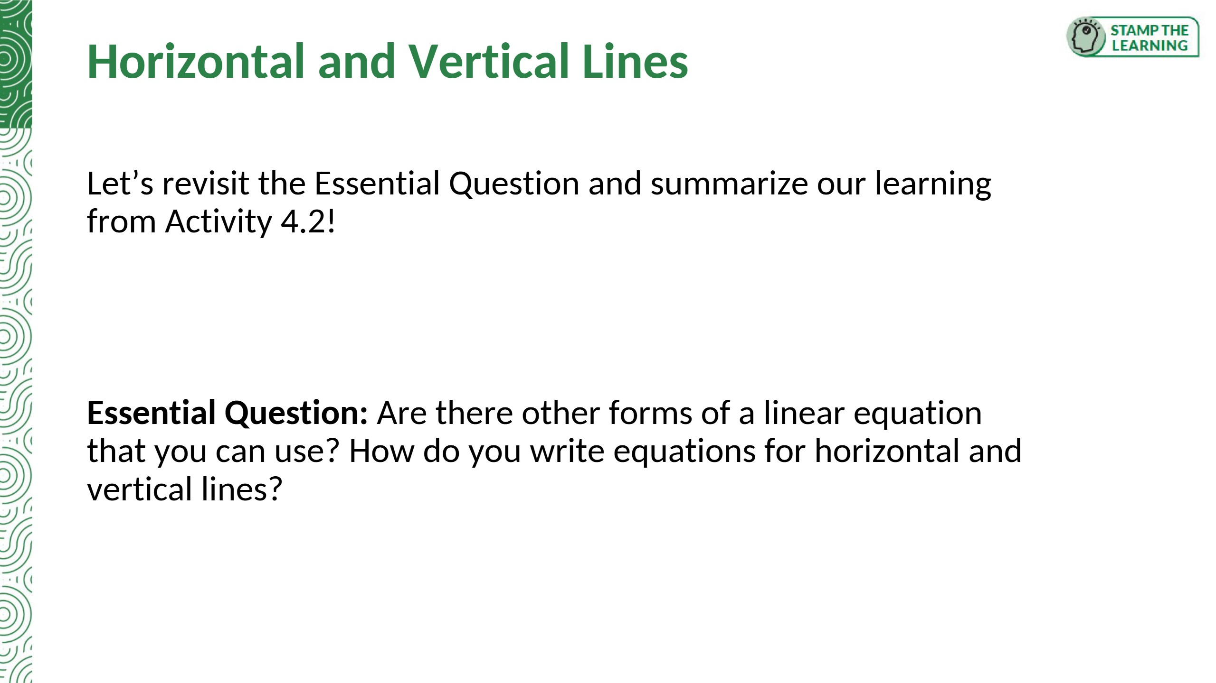
Summary: A horizontal line is y = a constant (no change in y, so the slope is 0). A vertical line is x = a constant (no change in x, so the slope is undefined).
Yes, point-slope form: y − y1 = m(x − x1). Horizontal line: y = c. Vertical line: x = c.

Slide 33
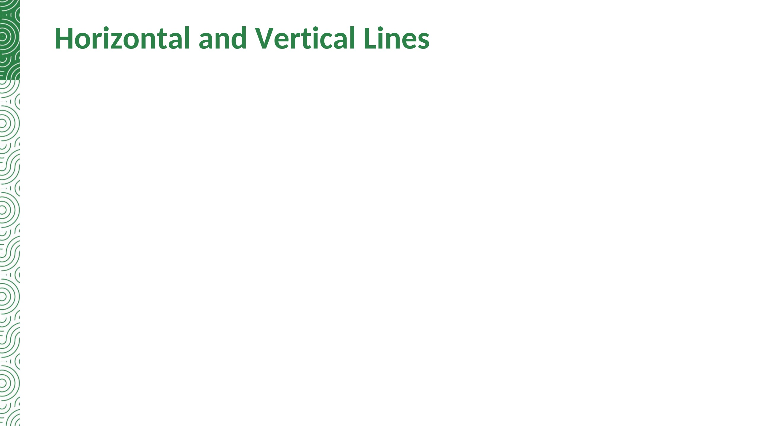

Slide 34


Slide 35
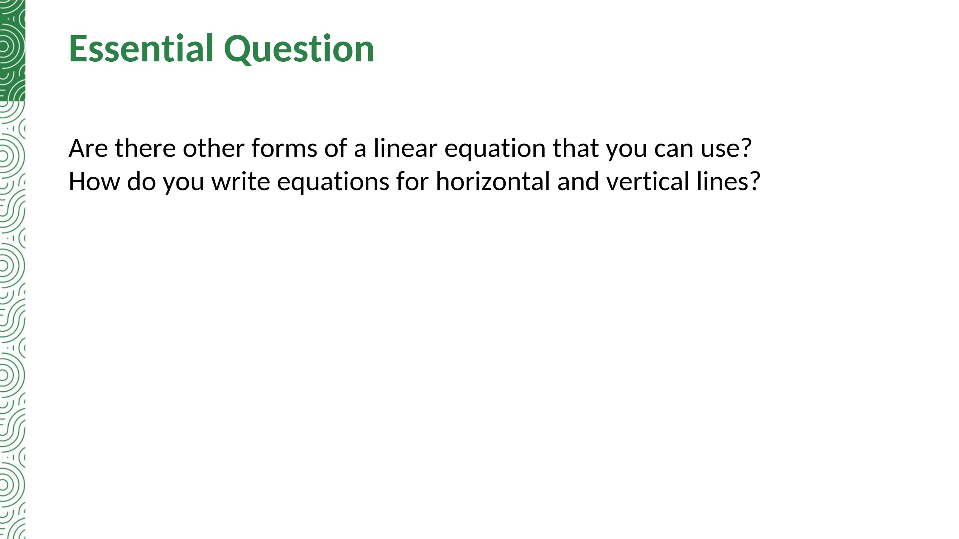

Slide 36


Slide 37
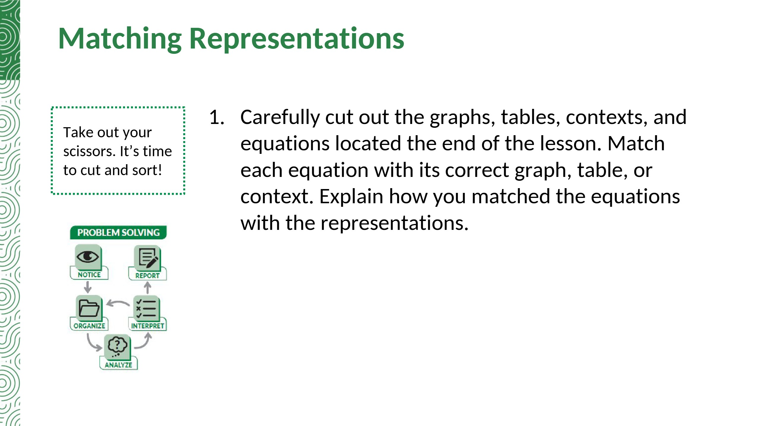
Explanations will vary.
A: y − 200 = −5(x − 24) B: y = (1/2)x + 40
C: y − x = 2 D: y = −(3/4)x + 33/2
E: y = 8x + 120 F: y = 1.2x + 9

Slide 38
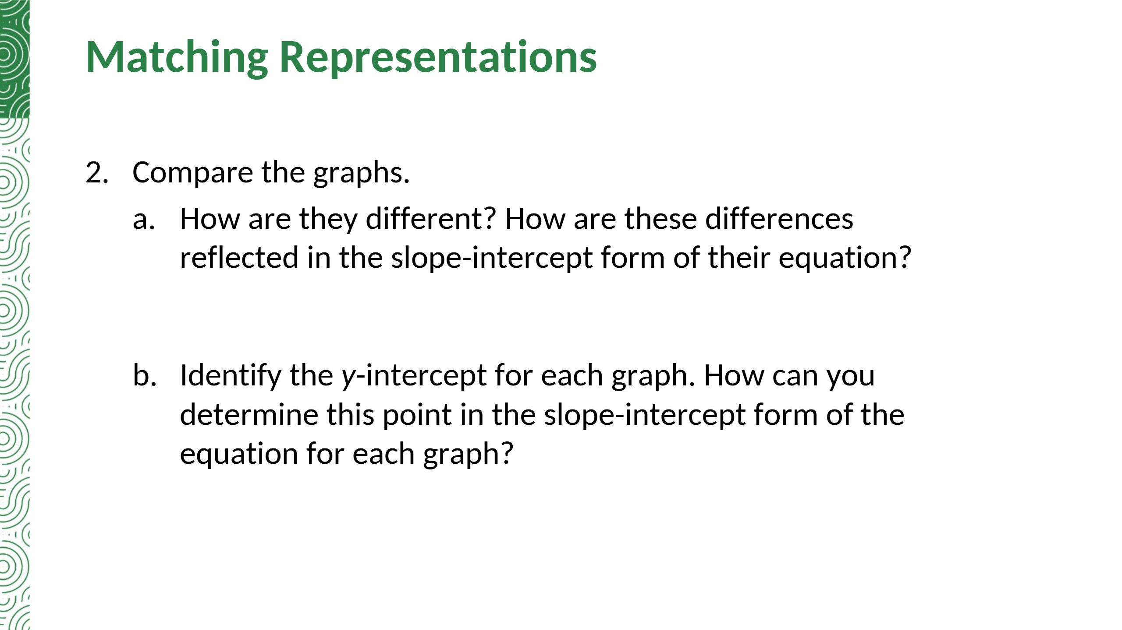
Graph A falls from left to right (negative slope, −5); Graph C rises (positive slope, 1). The sign of m in y = mx + b shows this.
Graph A: (0, 320). Graph C: (0, 2). In y = mx + b the y-intercept is (0, b), the number that is added: A is y = −5x + 320 and C is y = x + 2.
Notes:
TE correction (part b): the TE never states the y-intercepts. Added (0, 320) and (0, 2).

Slide 39
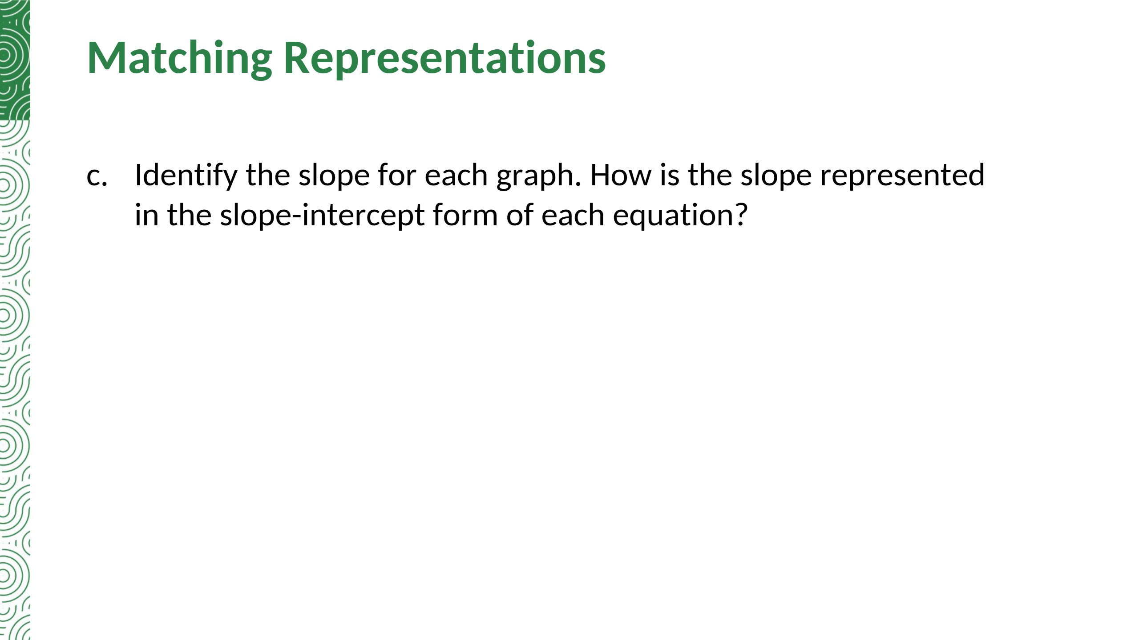
Graph A: slope −5. Graph C: slope 1.
The slope is the coefficient of x when the equation is written in slope-intercept form.

Slide 40
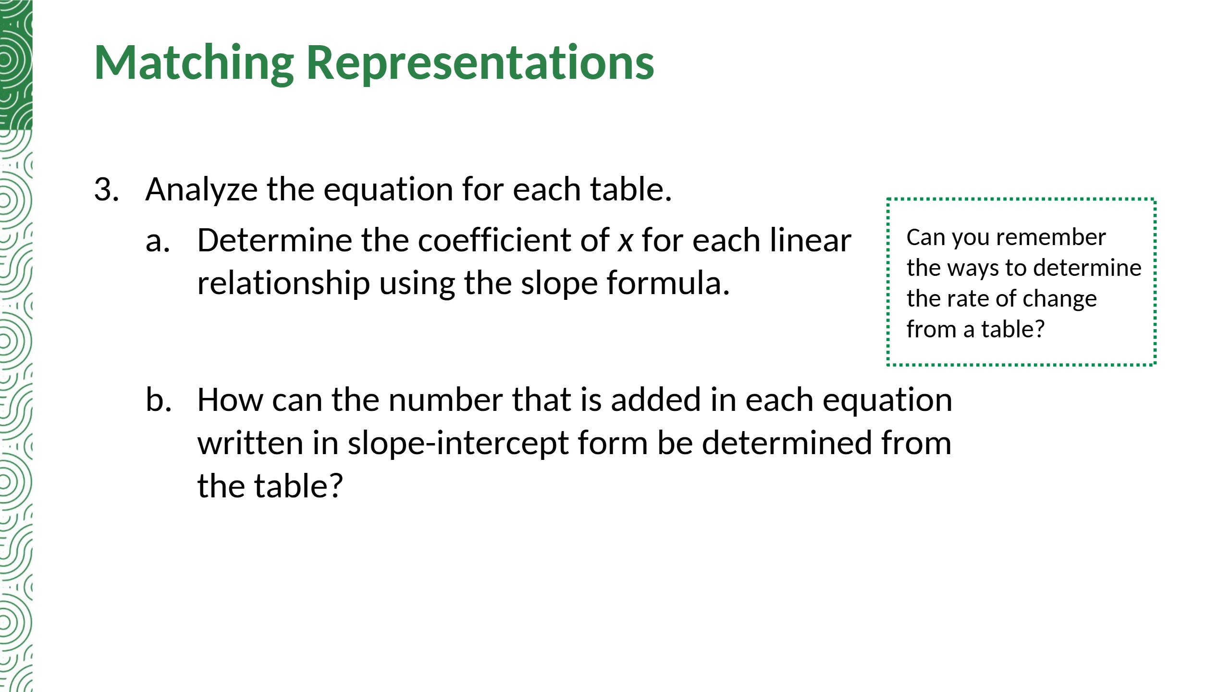
Table D: m = (9 − 15)/(10 − 2) = −6/8 = −3/4
Table E: m = (264 − 216)/(18 − 12) = 48/6 = 8
It is the y-value when x = 0. If (0, y) is not in the table, find the slope, then substitute a point to solve for b. Table D: b = 33/2. Table E: b = 120.
Notes:
Added the b-values for Tables D and E: y = −(3/4)x + 33/2 and y = 8x + 120.

Slide 41
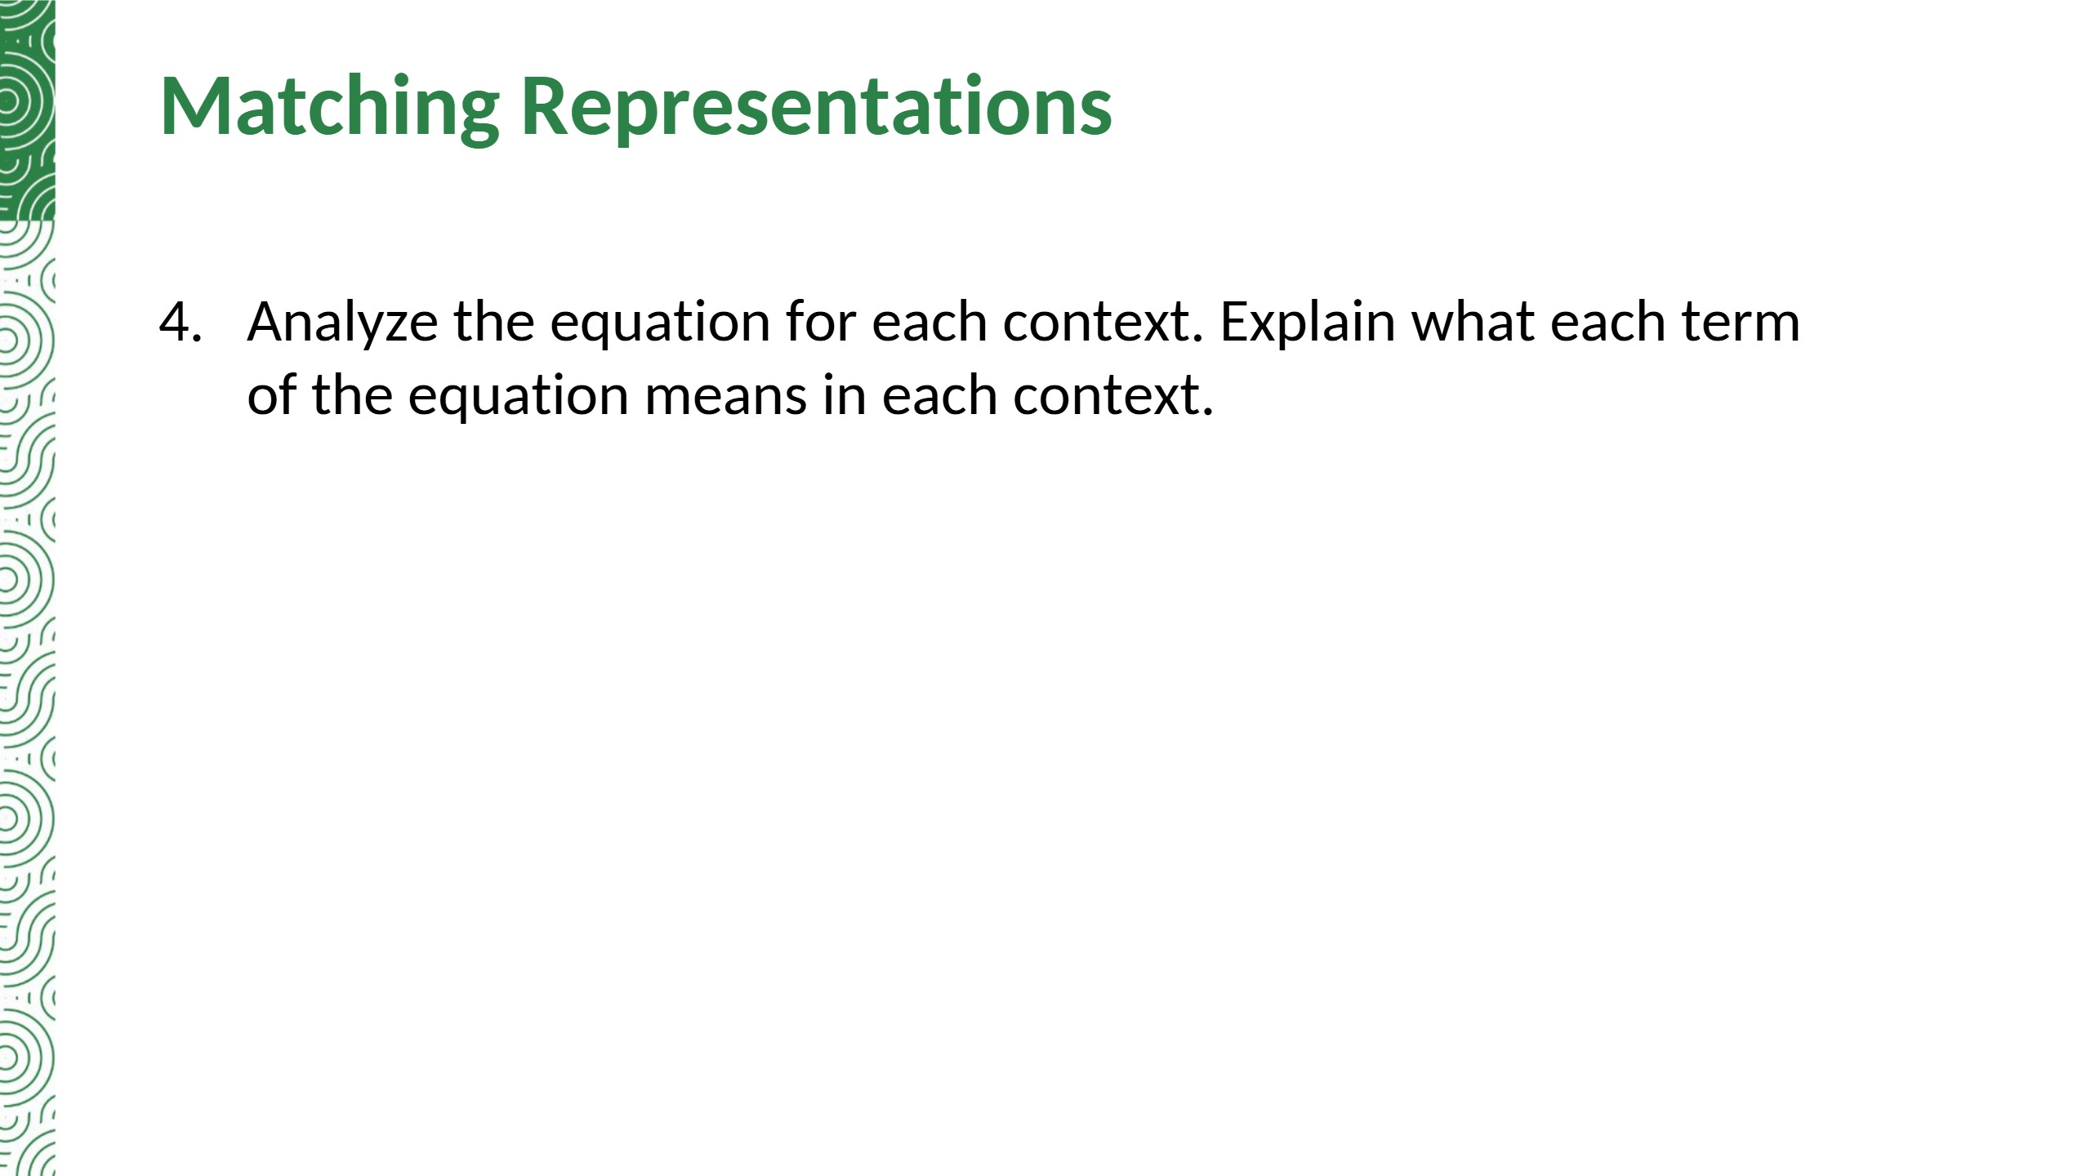
Context B: The term (1/2)x means Juliana reads one page every two minutes, or 1/2 page per minute; x is the number of minutes. The term 40 is the number of pages she had already read.
Context F: The term 1.2x means each additional topping costs $1.20; x is the number of additional toppings. The term 9 is the cost of a large pizza.
Notes:
TE correction: the TE calls the reader in Context B 'Michele'; the cutout card (b) names Juliana.

Slide 42
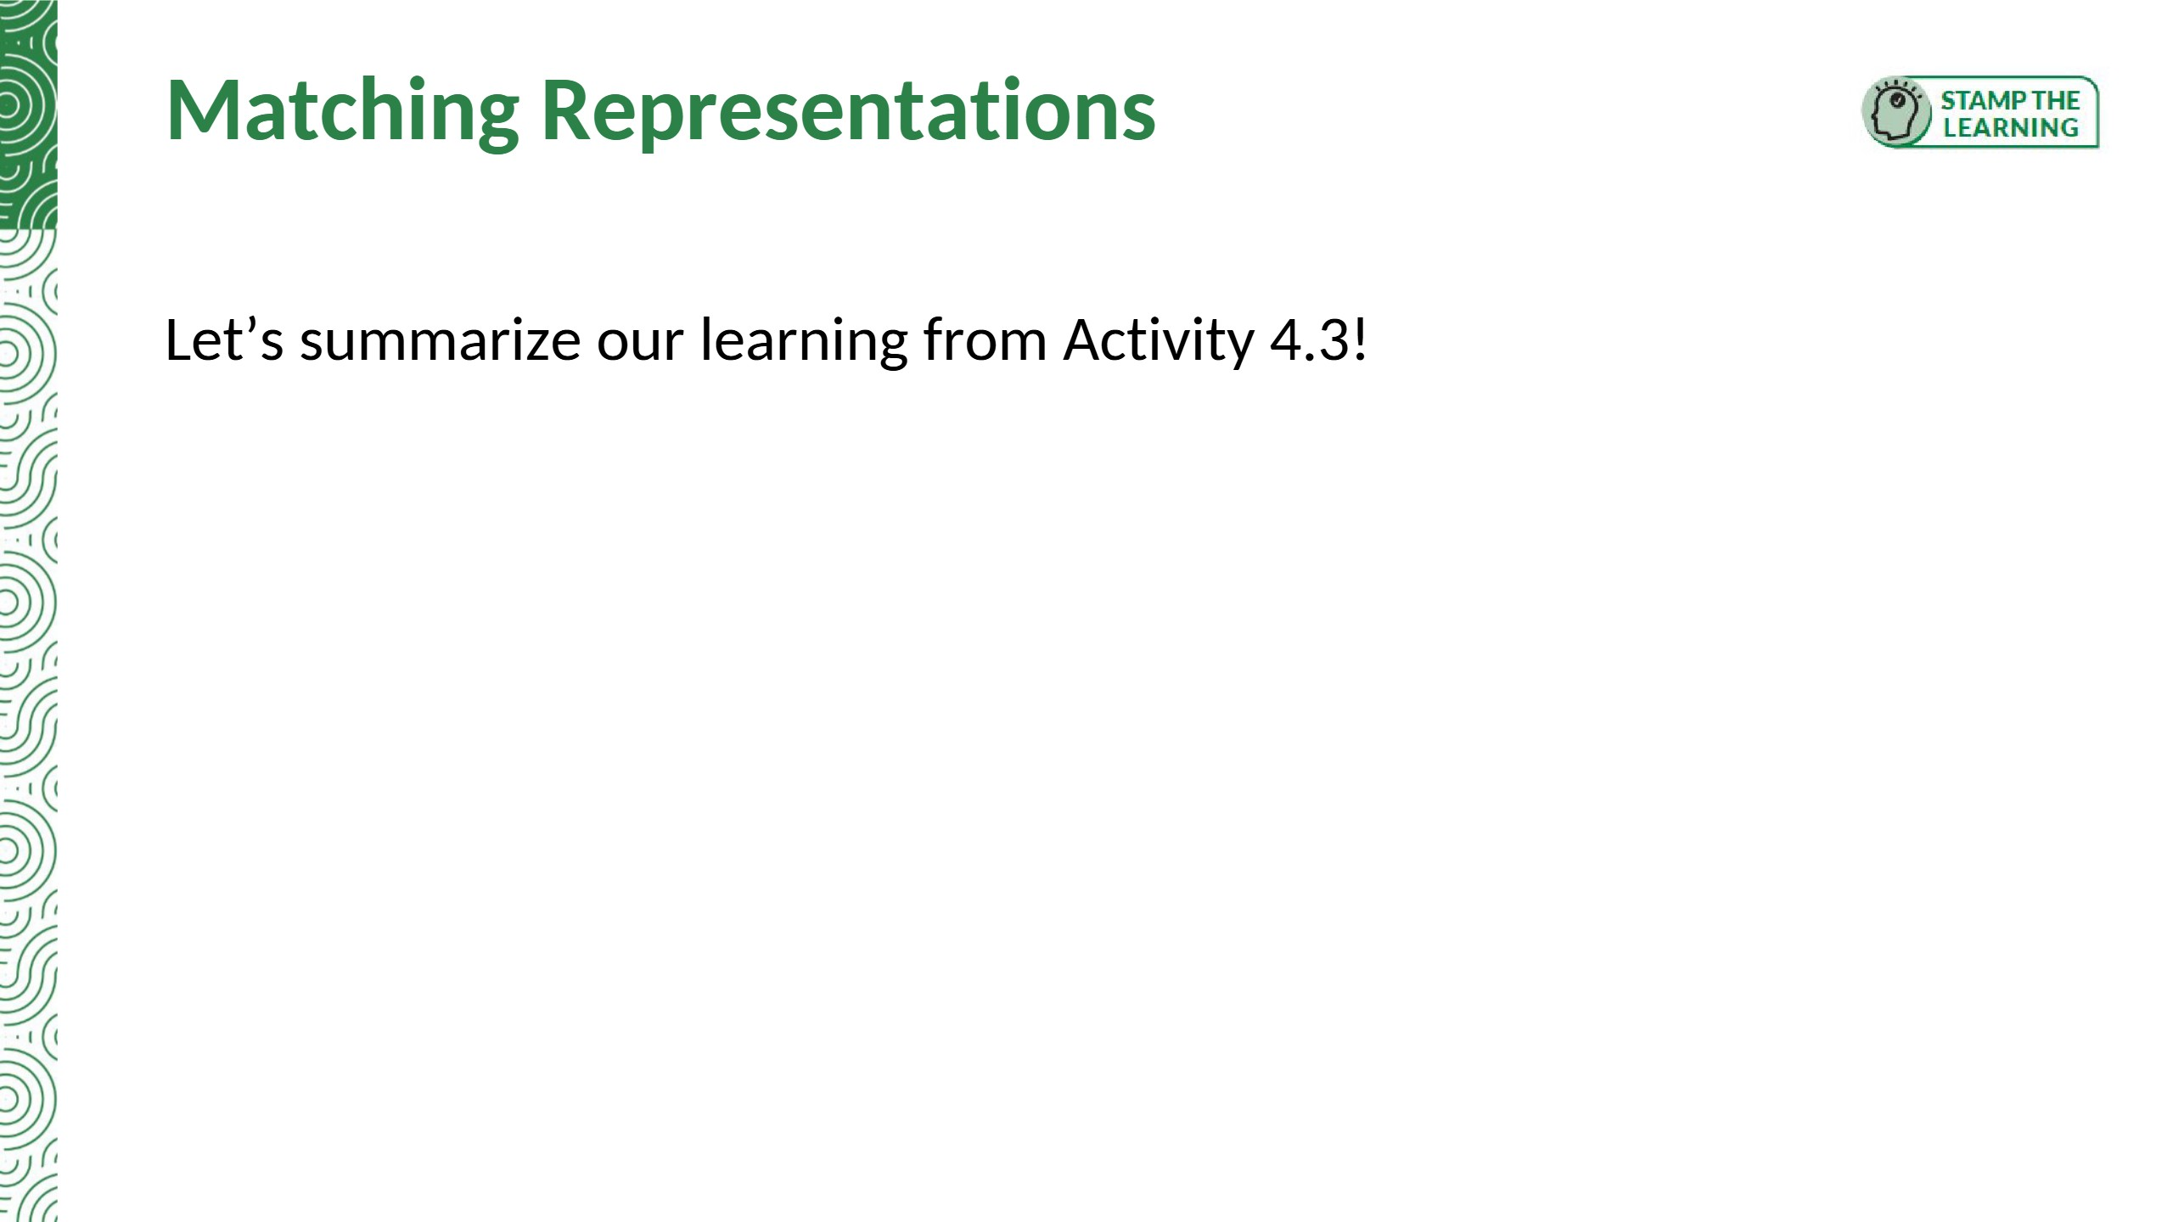
Summary: Linear relationships can be modeled using graphs, tables, contexts, and equations.

Slide 43


Slide 44


Slide 45
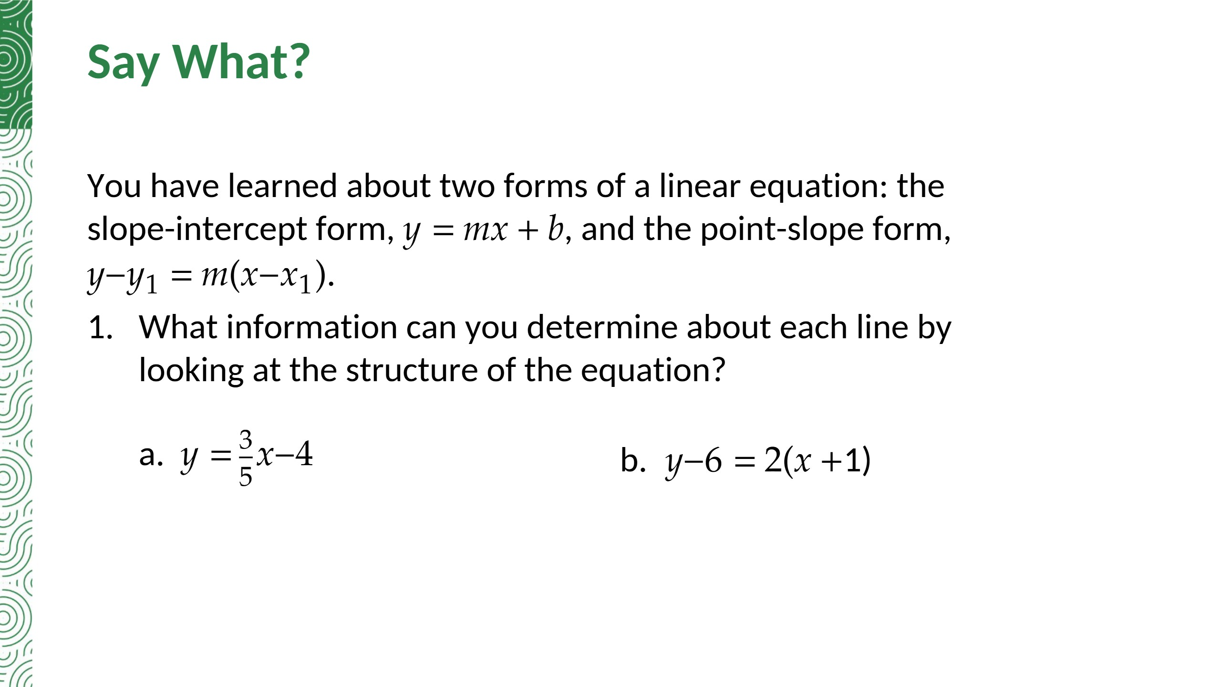
Slope 3/5; y-intercept (0, −4)
Slope 2; point (−1, 6)

Slide 46
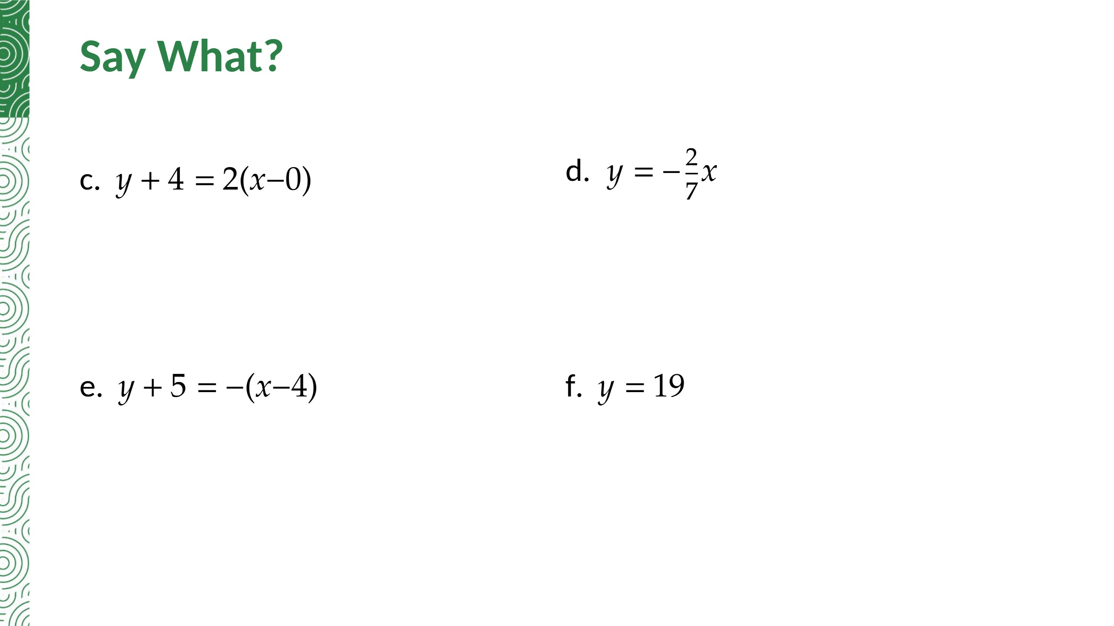
Slope 2; point (0, −4), which is also the y-intercept
Slope −2/7; y-intercept (0, 0)
Slope −1; point (4, −5)
Slope 0; y-intercept (0, 19); a horizontal line

Slide 47
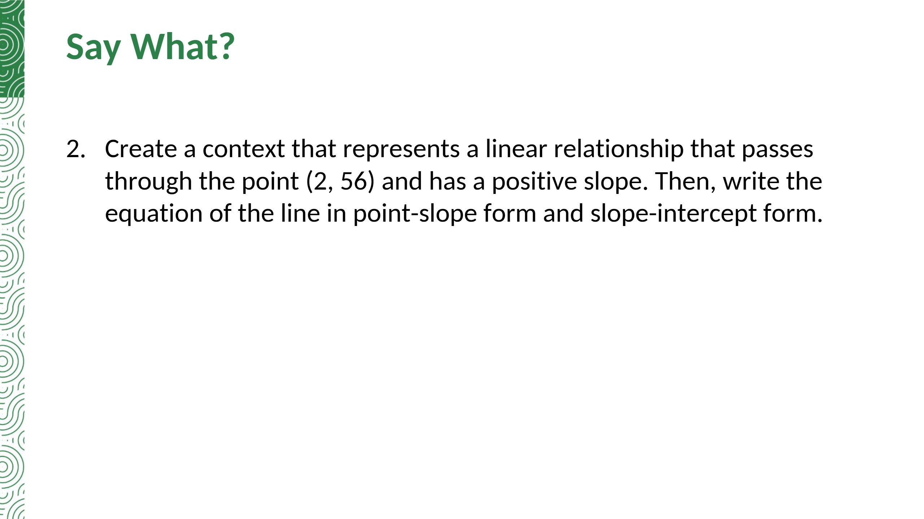
Sample answer: Omar earns 4 credits for each game he plays. After playing 2 games today, he has 56 credits.
Point-slope form: y − 56 = 4(x − 2)
Slope-intercept form: y = 4x + 48
Notes:
TE correction: the question asks for point-slope AND slope-intercept form; the TE gives only point-slope. Added y = 4x + 48.

Slide 48
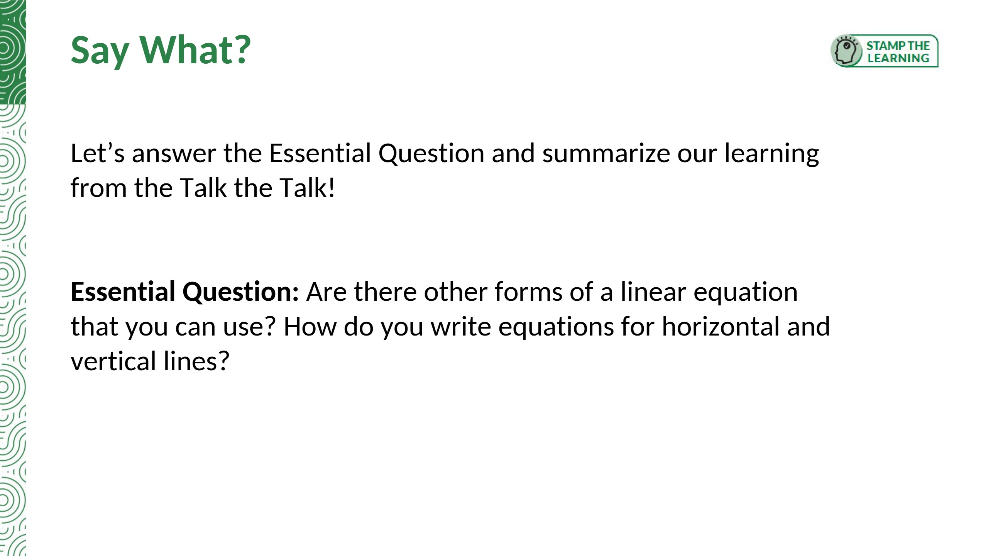
Summary: Characteristics of linear relationships can be identified when their equations are written in slope-intercept form and point-slope form.
Yes, point-slope form: y − y1 = m(x − x1). Horizontal line: y = c. Vertical line: x = c.

Slide 49


Slide 50


Slide 51
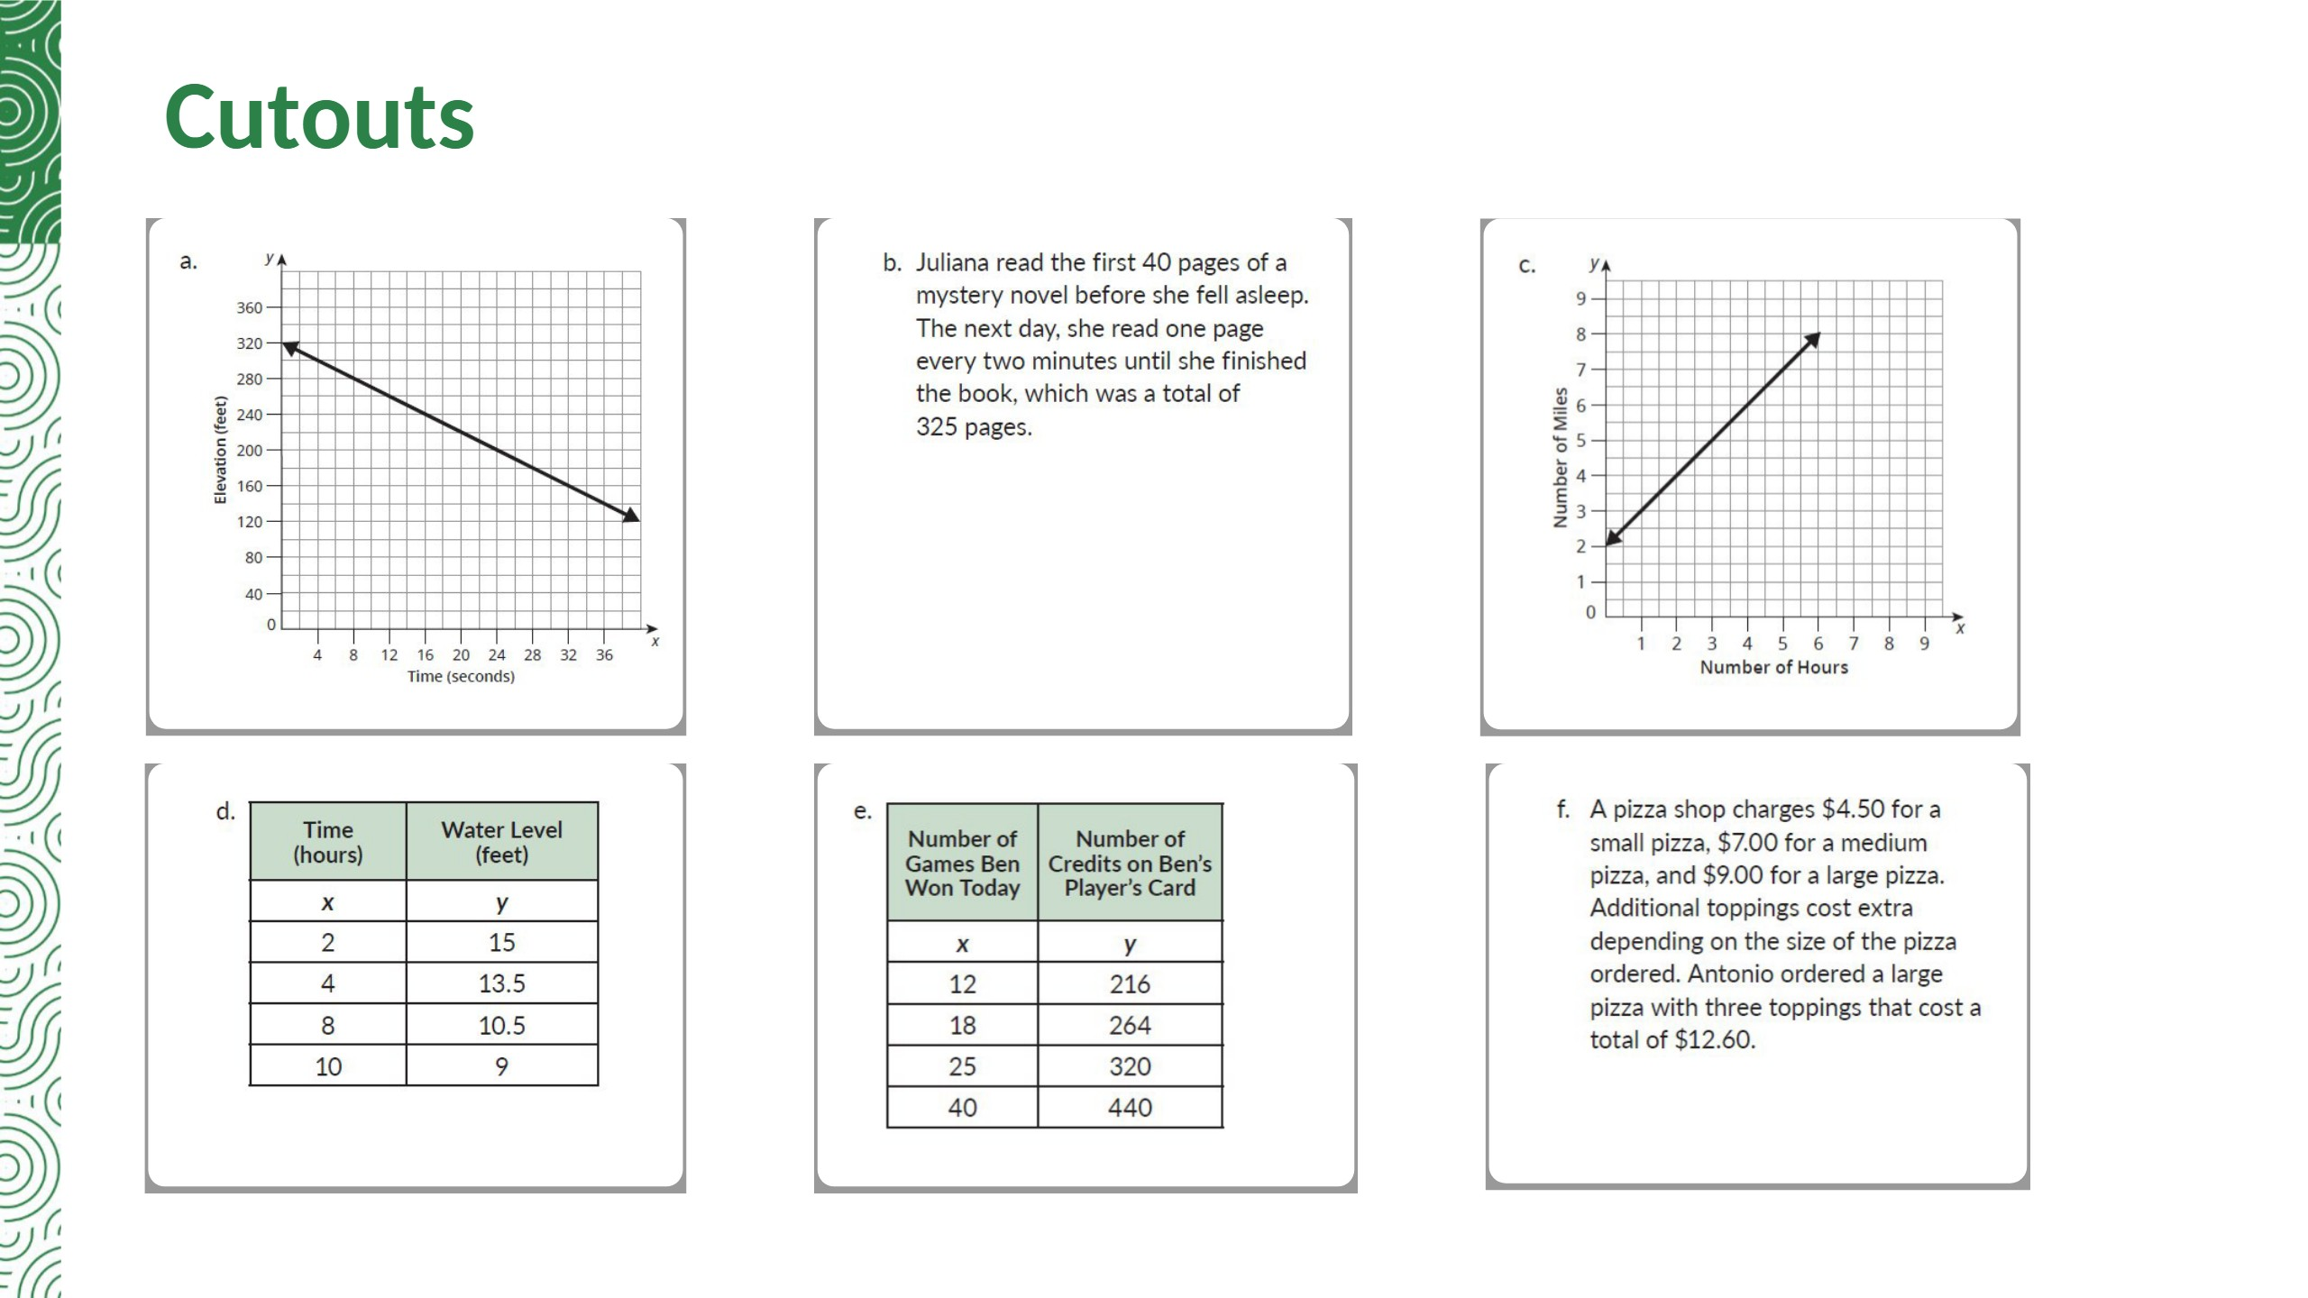
Notes:
Card matches (from slide 37): a. y − 200 = −5(x − 24); b. y = (1/2)x + 40; c. y − x = 2; d. y = −(3/4)x + 33/2; e. y = 8x + 120; f. y = 1.2x + 9.

Slide 52
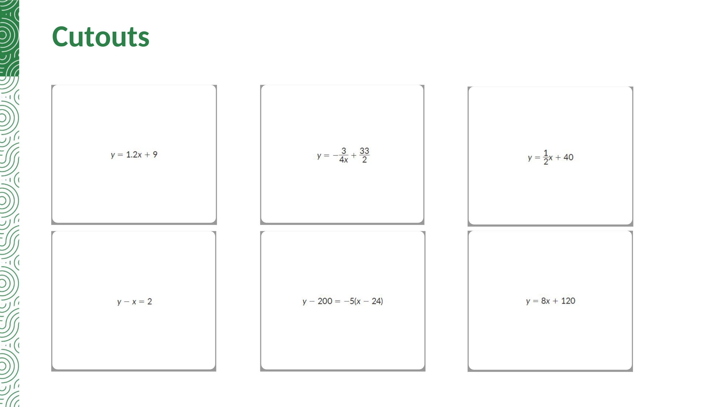

Slide 53


Slide 54
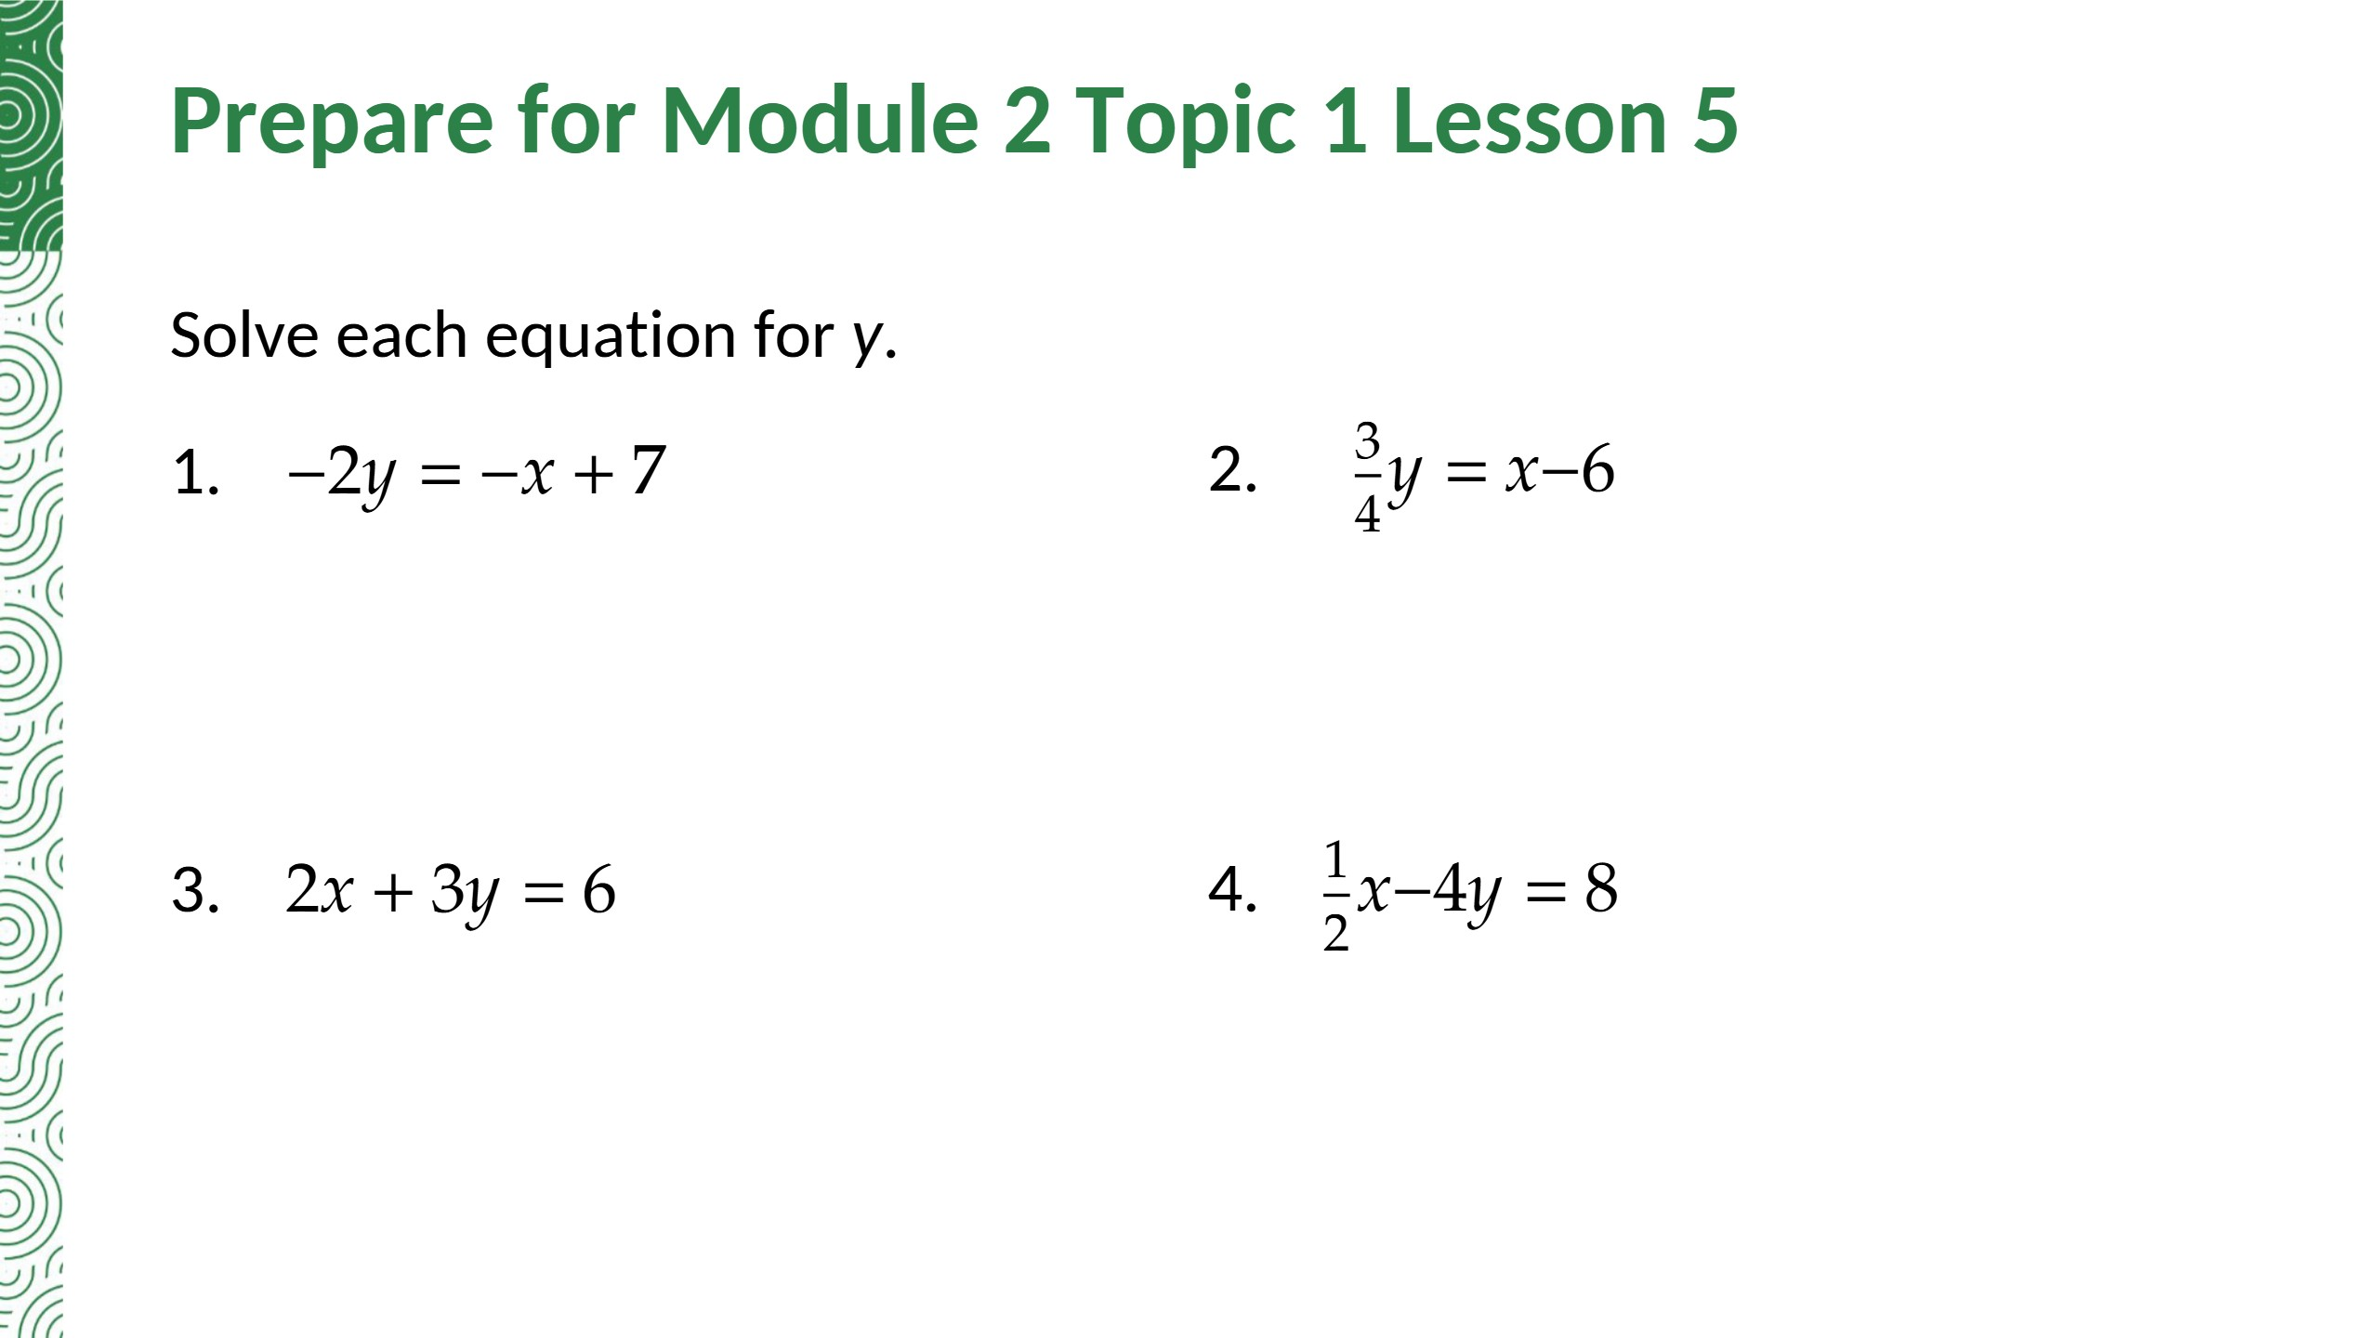
y = (1/2)x − 7/2
y = (4/3)x − 8
y = −(2/3)x + 2
y = (1/8)x − 2
Notes:
Answers from the Lesson 4 Assignment Prepare section, TE p. 216 (checked).

Slide 55
Teacher Edition corrections in this deck
• Activity 4.2 Q1b: the TE does not explain why a slope of 0 makes sense. Added: y never changes, so the rise is 0.
• Activity 4.2 Q3e: the TE says the line 'does not slope toward the y-axis'. Corrected: x = −2 is parallel to the y-axis and never crosses it.
• Activity 4.3 Q2b: the TE never identifies the y-intercepts. Added (0, 320) and (0, 2).
• Activity 4.3 Q4: the TE names the reader 'Michele'; the cutout card says Juliana. Corrected.
• Talk the Talk Q2: the TE omits the slope-intercept form. Added y = 4x + 48.
• Essential Question: added the equations y = c (horizontal) and x = c (vertical).
• Every other TE answer was re-solved and is correct, including the Lesson 4 Assignment (pp. 215-216).
Notes:
Summary of every change from the Teacher Edition answers.

Slide 56
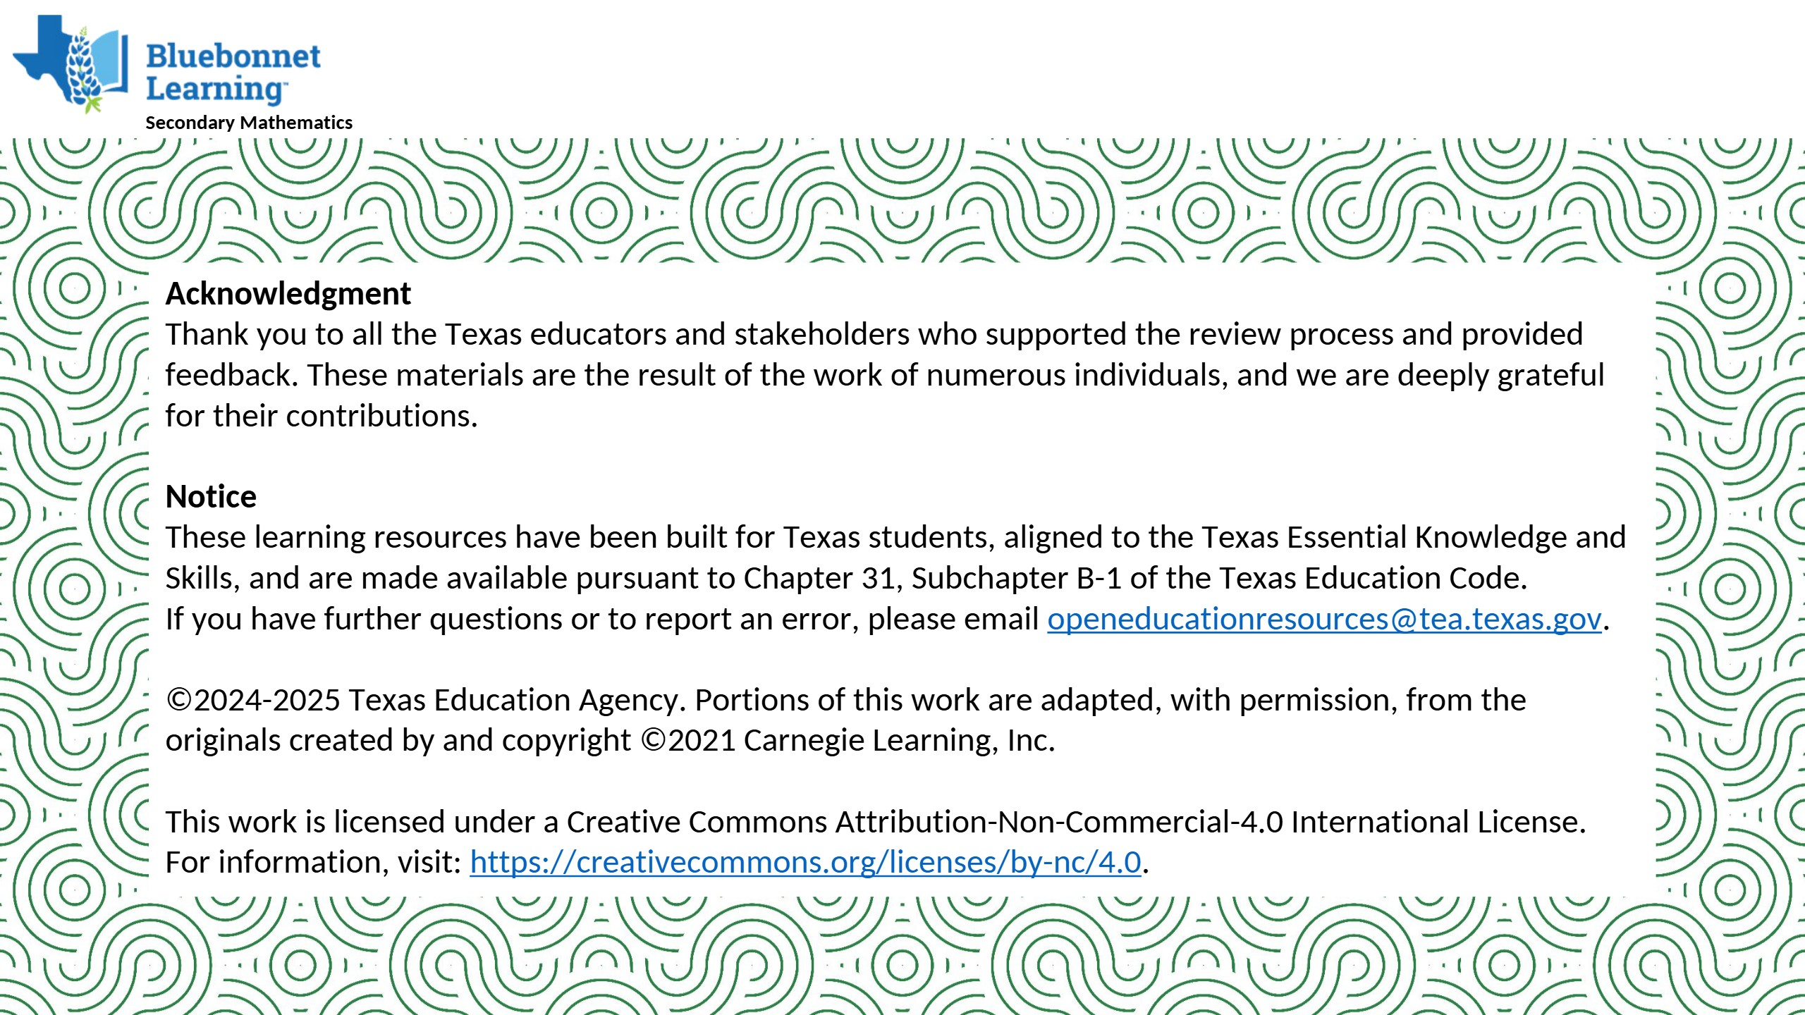

Slide 57


