Slide 1
Using Linear Equations
Algebra I | Module 2 | Topic 1 | Lesson 5
Notes:
Note: Total suggested pacing for this lesson is three 45-minute sessions.

Slide 2
Objectives
Construct linear equations to model relationships between
two quantities.
Graph lines using the slope-intercept form of a linear equation.
Graph lines using the point-slope form of a linear equation.
Graph lines using the standard form of a linear equation.
Convert equations from point-slope or standard form to
slope-intercept form.
Discuss the advantages and disadvantages of slope-intercept, point-slope, and standard form.
Notes:
TEKS:
A.1C: select tools, including real objects, manipulatives, paper and pencil, and technology as appropriate, and techniques, including mental math, estimation, and number sense as appropriate, to solve problems.
A.1F: analyze mathematical relationships to connect and communicate mathematical ideas.
A.2B: write linear equations in two variables in various forms, including $y=mx+b$, $Ax+By=C$, and$y−y_{1}=m(x−x_{1})$, given one point and the slope and given two points.
A.2C: write linear equations in two variables given a table of values, a graph, and a verbal description.
A.3A: determine the slope of a line given a table of values, a graph, two points on the line, and an equation written in various forms, including $y=mx+b$, $Ax+By=C$, and $y−y_{1}=m\left(x−x_{1}\right).$
A.3C: graph linear functions on the coordinate plane and identify key features, including x-intercept, y-intercept, zeros, and slope, in mathematical and real-world problems.
ELPS:
1.D: speak using learning strategies such as requesting assistance, employing non-verbal cues, and using synonyms and circumlocution (conveying ideas by defining or describing when exact English words are not known).
3.B: expand and internalize initial English vocabulary by learning and using high-frequency English words necessary for identifying and describing people, places, and objects, by retelling simple stories and basic information represented or supported by pictures, and by learning and using routine language needed for classroom communication.
4.F: use visual and contextual support and support from peers and teachers to read grade-appropriate content area text, enhance and confirm understanding, and develop vocabulary, grasp of language structures, and background knowledge needed to comprehend increasingly challenging language.

Slide 3
Key Terms (1 of 2)
standard form: the standard form of a linear equation is Ax + By = C, where A, B, and C are integers and A and B are not both zero
Example
  5x + 8y = 1600
Notes:
Note: Standard form is introduced on Day 2.

Slide 4
Essential Question (1 of 3)
You have graphed equations using tables of values.
Is there a more efficient method to graphing a linear relationship? Can you use the equation of a linear relationship to create a graphical representation?
Notes:
Setting the Stage:
Tap into your student’s prior learning by reading the narrative statement.
Provide a sense of direction by reading the Essential Question.

Slide 5
Day 1
1
Notes:
Note: Total suggested pacing for Day 1 is 45 minutes.

Slide 6
Getting Started
10–15
Notes:
Note: Total time of 10-15 minutes allotted for the Getting Started.

Slide 7


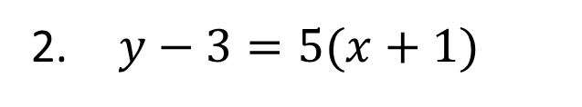
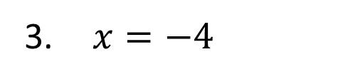
Jump In the Line (1 of 3)
Describe what you know about the graph of each relationship by analyzing each equation. Then, explain how you might graph each line given its equation.
$y=\frac{2}{3}x+7$
$x=−4$
$y−3=5(x+1)$
$−3x+8y=10$
Notes:
Questions to Support Discourse – Probing:
Identify the y-intercept as a point.
Questions to Support Discourse – Seeing Structure:
What is the form of this equation?
Explain how you determined the signs of the point that lies on this line.
Questions to Support Discourse – Probing:
What are the coordinates of several points on this line?
How could you work with this equation to determine its slope or any points that lie on it?
Questions to Support Discourse – Seeing Structure:
How would you describe the structure of this equation?

Slide 8

Jump In the Line (2 of 3)
Let’s summarize our learning from the Getting Started!
Notes:
Getting Started Summary:
Characteristics of linear relationships can be identified when their equations are written in different forms such slope-intercept form, point-slope form, and standard form.

Slide 9
Jump In the Line (3 of 3)
Notes:
Note: This slide is blank for optional use with displaying work.

Slide 10
Activity 5.1
5.1
25–30
Notes:
Note: Total time of 25-30 minutes allotted for Activity 5.1.

Slide 11
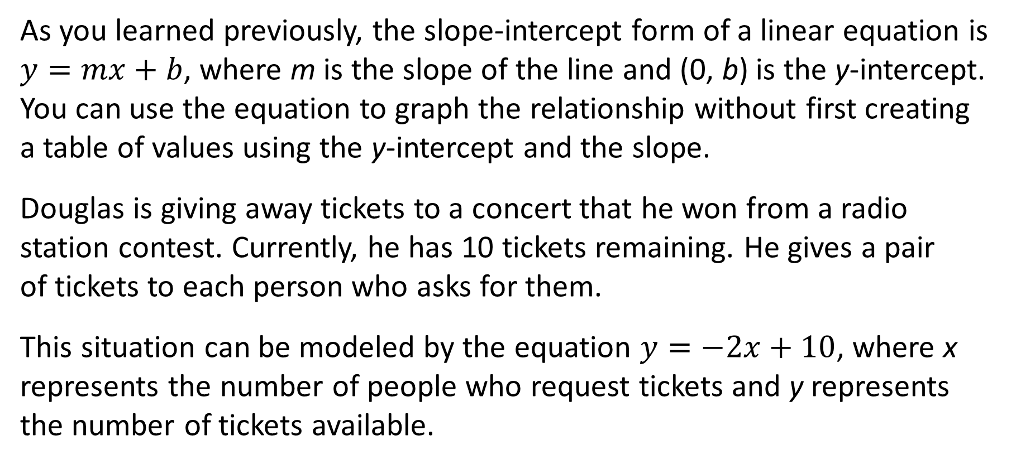
Using Slope-Intercept Form to Graph a Line (1 of 10)
As you learned previously, the slope-intercept form of a linear equation is $y=mx+b$, where m is the slope of the line and (0, b) is the y-intercept. You can use the equation to graph the relationship without first creating a table of values using the y-intercept and the slope.
Douglas is giving away tickets to a concert that he won from a radio station contest. Currently, he has 10 tickets remaining. He gives a pair
of tickets to each person who asks for them.
This situation can be modeled by the equation $y=−2x+10$, where x represents the number of people who request tickets and y represents the number of tickets available.

Slide 12
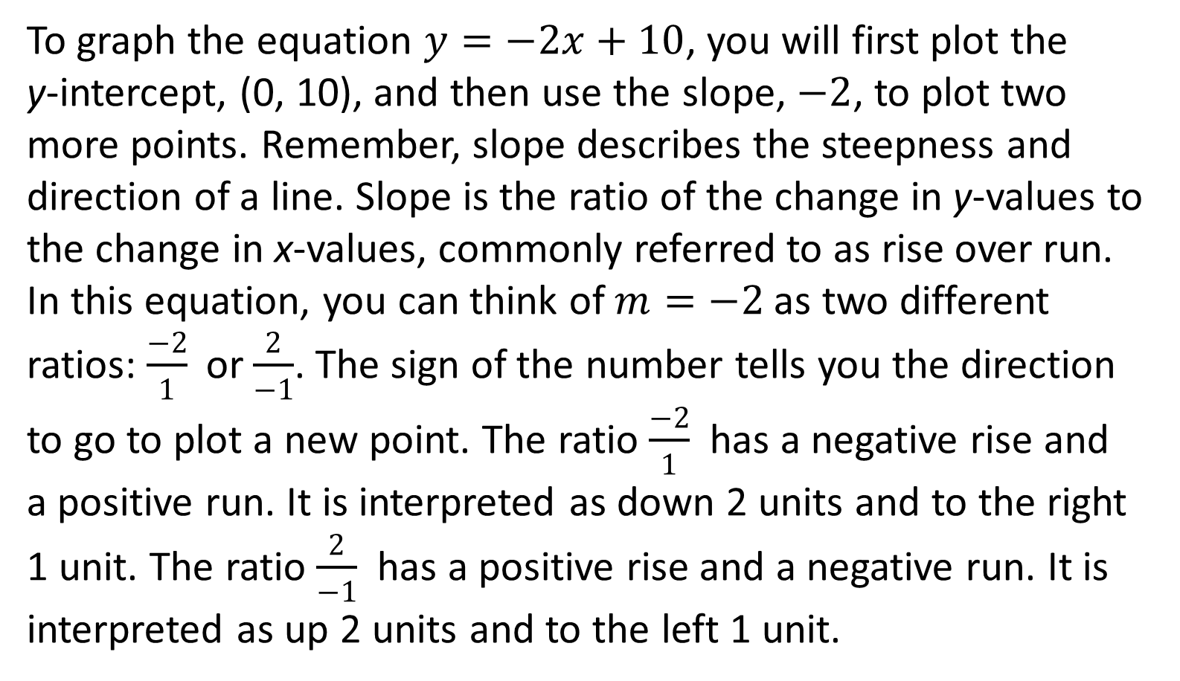
Using Slope-Intercept Form to Graph a Line (2 of 10)
To graph the equation $y=−2x+10$, you will first plot the
y-intercept, (0, 10), and then use the slope, $−2$, to plot two more points. Remember, slope describes the steepness and direction of a line. Slope is the ratio of the change in y-values to the change in x-values, commonly referred to as rise over run. In this equation, you can think of $m=−2$as two different ratios: $\frac{−2}{1}$ or $\frac{2}{−1}$. The sign of the number tells you the direction to go to plot a new point. The ratio $\frac{−2}{1}$has a negative rise and
a positive run. It is interpreted as down 2 units and to the right 1 unit. The ratio $\frac{2}{−1}$ has a positive rise and a negative run. It is interpreted as up 2 units and to the left 1 unit.
A rule of thumb when graphing
a line is to plot at least three points.

Slide 13

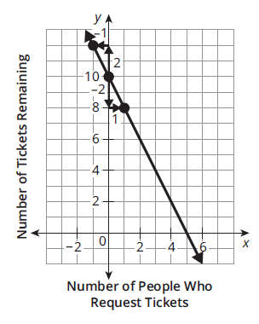
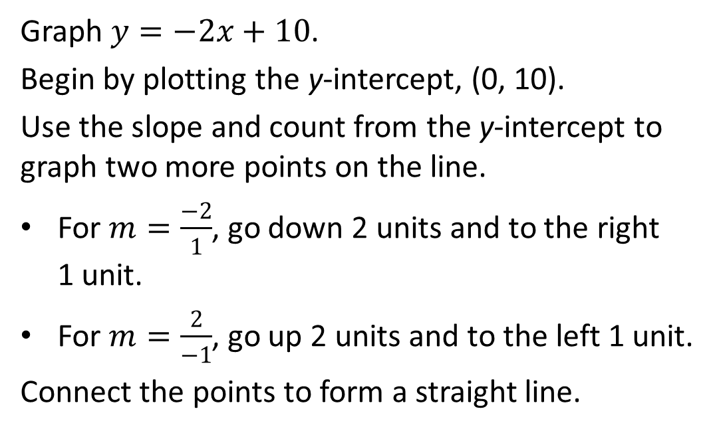
Using Slope-Intercept Form to Graph a Line (3 of 10)
Graph $y=−2x+10$.
Begin by plotting the y-intercept, (0, 10).
Use the slope and count from the y-intercept to graph two more points on the line.
For $m=\frac{−2}{1}$, go down 2 units and to the right
1 unit.
For $m=\frac{2}{−1}$, go up 2 units and to the left 1 unit.
Connect the points to form a straight line.

Slide 14
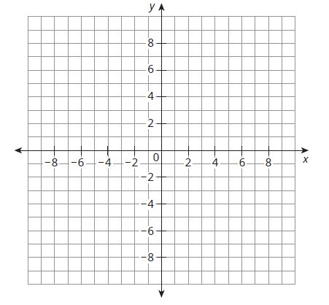
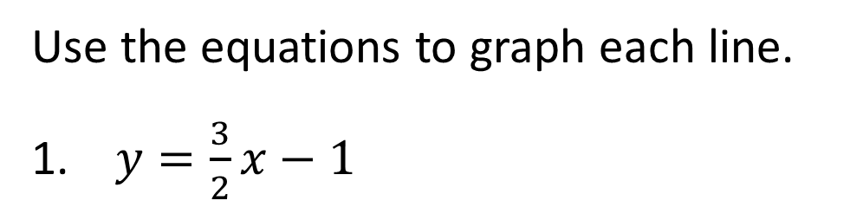
Using Slope-Intercept Form to Graph a Line (4 of 10)
Use the equations to graph each line.
$y=\frac{3}{2}x−1$
Think about the direction of the line before you start graphing.
Notes:
Questions to Support Discourse – Probing:
Which point did you plot first? Where did you locate it?
How did you apply the slope $\frac{2}{3}$ to plot an additional point?
Questions to Support Discourse – Seeing Structure:
How is graphing using the slope related to slope triangles?
In which direction do you move with a positive numerator? A negative numerator? A positive denominator? A negative denominator?
How do you know the direction of the line is correct?
Why does it help to write the number 10 as a fraction?
Why is this graph increasing?
Use the graph to show how the total savings increases by 15 for every one lawn mowed.
Why is this graph decreasing?
Use the graph to show how the amount owed decreased by 10 for every one week.

Slide 15
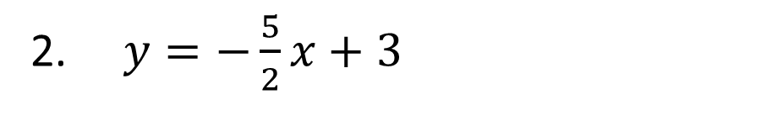
Using Slope-Intercept Form to Graph a Line (5 of 10)
$y=−\frac{5}{2}x+3$
Notes:
Questions to Support Discourse – Probing:
Which point did you plot first? Where did you locate it?
How did you apply the slope $\frac{2}{3}$ to plot an additional point?
Questions to Support Discourse – Seeing Structure:
How is graphing using the slope related to slope triangles?
In which direction do you move with a positive numerator? A negative numerator? A positive denominator? A negative denominator?
How do you know the direction of the line is correct?
Why does it help to write the number 10 as a fraction?
Why is this graph increasing?
Use the graph to show how the total savings increases by 15 for every one lawn mowed?
Why is this graph decreasing?
Use the graph to show how the amount owed decreased by 10 for every one week.

Slide 16
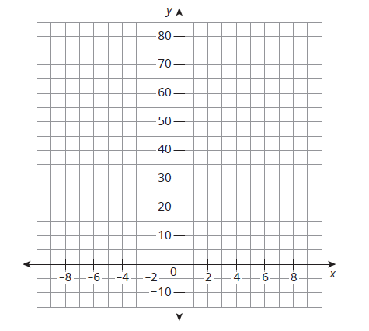
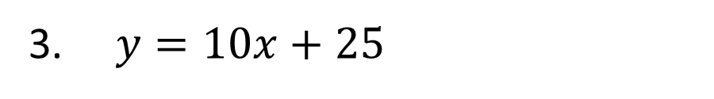
Using Slope-Intercept Form to Graph a Line (6 of 10)
$y=10x+25$
Use a straightedge to draw your lines.
Ask Yourself…
Should each graph have arrows or points on each end? When using a point, how do you know whether to use an open circle or a closed circle?
Notes:
Questions to Support Discourse – Probing:
Which point did you plot first? Where did you locate it?
How did you apply the slope $\frac{2}{3}$ to plot an additional point?
Questions to Support Discourse – Seeing Structure:
How is graphing using the slope related to slope triangles?
In which direction do you move with a positive numerator? A negative numerator? A positive denominator? A negative denominator?
How do you know the direction of the line is correct?
Why does it help to write the number 10 as a fraction?
Why is this graph increasing?
Use the graph to show how the total savings increases by 15 for every one lawn mowed?
Why is this graph decreasing?
Use the graph to show how the amount owed decreased by 10 for every one week.

Slide 17
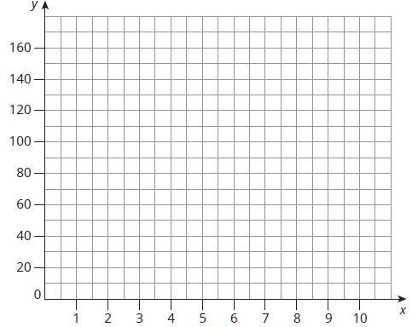
Using Slope-Intercept Form to Graph a Line (7 of 10)
Write an equation for each problem situation. Then, graph
each equation.
Avery wants to buy a virtual reality headset. He already
has $30 saved and plans to mow lawns for $15 each.
Remember to
label the axes with the appropriate variable quantities.
Notes:
Questions to Support Discourse – Probing:
Which point did you plot first? Where did you locate it?
How did you apply the slope $\frac{2}{3}$ to plot an additional point?
Questions to Support Discourse – Seeing Structure:
How is graphing using the slope related to slope triangles?
In which direction do you move with a positive numerator? A negative numerator? A positive denominator? A negative denominator?
How do you know the direction of the line is correct?
Why does it help to write the number 10 as a fraction?
Why is this graph increasing?
Use the graph to show how the total savings increases by 15 for every one lawn mowed?
Why is this graph decreasing?
Use the graph to show how the amount owed decreased by 10 for every one week.

Slide 18
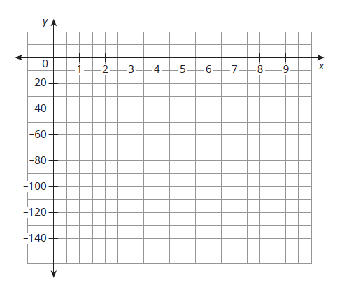
Using Slope-Intercept Form to Graph a Line (8 of 10)
A scuba diver is 130 feet below sea level. The diver ascends at a constant rate of 20 feet per minute.
Notes:
Questions to Support Discourse – Probing:
Which point did you plot first? Where did you locate it?
How did you apply the slope $\frac{2}{3}$ to plot an additional point?
Questions to Support Discourse – Seeing Structure:
How is graphing using the slope related to slope triangles?
In which direction do you move with a positive numerator? A negative numerator? A positive denominator? A negative denominator?
How do you know the direction of the line is correct?
Why does it help to write the number 10 as a fraction?
Why is this graph increasing?
Use the graph to show how the total savings increases by 15 for every one lawn mowed?
Why is this graph decreasing?
Use the graph to show how the amount owed decreased by 10 for every one week.

Slide 19
Using Slope-Intercept Form to Graph a Line (9 of 10)
Let’s revisit the Essential Question and summarize our learning from Activity 5.1!
Essential Question: Is there a more efficient method to graphing a linear relationship? Can you use the equation of a linear relationship to create a graphical representation?
Notes:
Note: To close Day 1, have students reread the Essential Question and then read the Stamp the Learning summary aloud.
Activity 5.1 Summary:
An equation written in slope-intercept form can be graphed by first plotting the y-intercept and then using the slope to locate two additional points by counting from that initial point.

Slide 20
Using Slope-Intercept Form to Graph a Line (10 of 10)
Notes:
Note: This slide is blank for optional use with displaying work.

Slide 21
Day 2
2
Notes:
Note: Total suggested pacing for Day 2 is 45 minutes.

Slide 22
Essential Question (2 of 3)
Is there a more efficient method to graphing a linear relationship? Can you use the equation of a linear relationship to create a graphical representation?
Notes:
Note: To begin Day 2, have a student read the Essential Question aloud.

Slide 23
Activity 5.2
5.2
15–20
Notes:
Note: Total time of 15-20 minutes allotted for Activity 5.2.

Slide 24
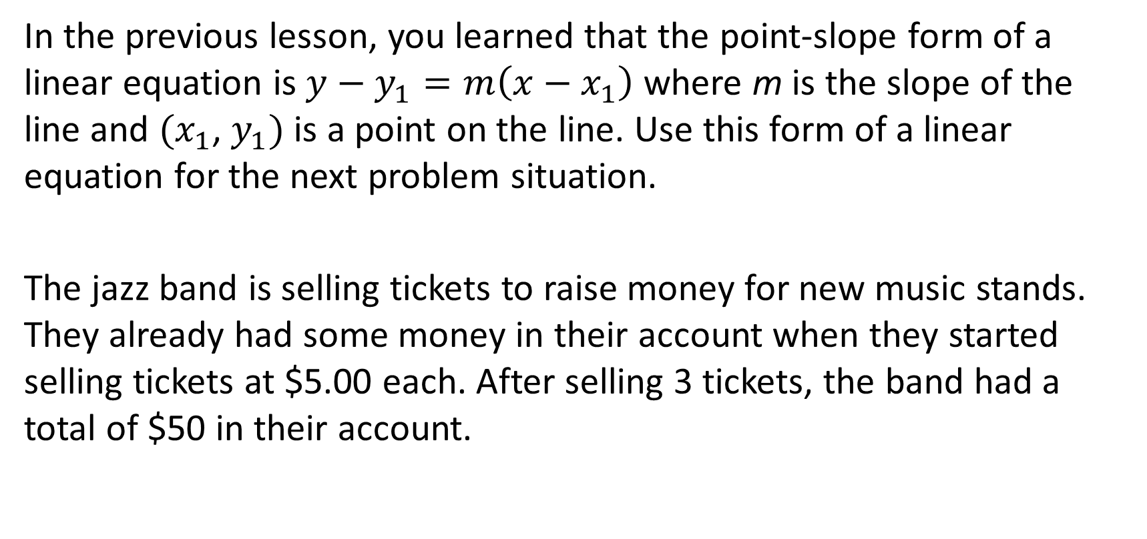
Using Point-Slope Form to Graph a Line (1 of 8)
In the previous lesson, you learned that the point-slope form of a linear equation is $y−y_{1}=m\left(x−x_{1}\right)$ where m is the slope of the line and $(x_{1}$, $y_{1})$ is a point on the line. Use this form of a linear equation for the next problem situation.
The jazz band is selling tickets to raise money for new music stands. They already had some money in their account when they started selling tickets at $5.00 each. After selling 3 tickets, the band had a total of $50 in their account.

Slide 25
Using Point-Slope Form to Graph a Line (2 of 8)
Let x = the number of tickets sold, and let y = the total amount of money in the jazz band’s account.
  Write an equation in point-slope form.
Notes:
Questions to Support Discourse – Gathering:
Why did it make sense to use the point-slope form for this situation?
Questions to Support Discourse – Probing:
What other way did you express the slope $\frac{5}{1}$ to graph points on the other side of (3, 50)?
Questions to Support Discourse – Seeing Structure:
How is this process the same and different from graphing a point in slope-intercept form?
Questions to Support Discourse – Gathering:
What is the known point?
What are the two different ways you expressed the slope?
Questions to Support Discourse – Reflecting and Justifying:
How do you know that the direction of the line is correct?
Questions to Support Discourse – Gathering:
How did you rewrite the given rate to substitute the value for the slope in your equation?
Questions to Support Discourse – Reflecting and Justifying:
Why is this graph increasing?
Use the graph to show how the number of bracelets increased by 14 for every 1 hour.

Slide 26
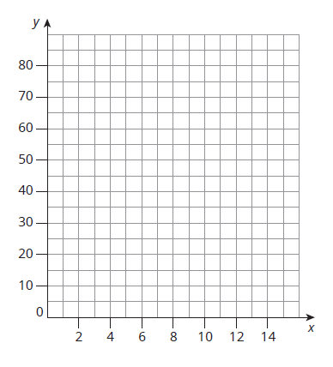
Using Point-Slope Form to Graph a Line (3 of 8)
  Use the point-slope form to graph the equation.
    Write the coordinates for the known point. Plot the point on the coordinate plane.
    Write the slope as a ratio. Then, use the slope and count from the point. To identify another point on the graph, start at the point and count either down (negative) or up (positive) for the rise. Then, count either left(negative) or right (positive) for the run.
    Continue the counting process to plot at least two more points.
    Connect the points to form a straight line.
Notes:
Questions to Support Discourse – Gathering:
Why did it make sense to use the point-slope form for this situation?
Questions to Support Discourse – Probing:
What other way did you express the slope $\frac{5}{1}$ to graph points on the other side of (3, 50)?
Questions to Support Discourse – Seeing Structure:
How is this process the same and different from graphing a point in slope-intercept form?
Questions to Support Discourse – Gathering:
What is the known point?
What are the two different ways you expressed the slope?
Questions to Support Discourse – Reflecting and Justifying:
How do you know that the direction of the line is correct?
Questions to Support Discourse – Gathering:
How did you rewrite the given rate to substitute the value for the slope in your equation?
Questions to Support Discourse – Reflecting and Justifying:
Why is this graph increasing?
Use the graph to show how the number of bracelets increased by 14 for every 1 hour.

Slide 27
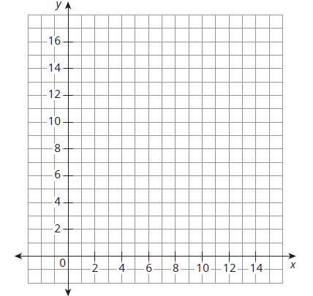
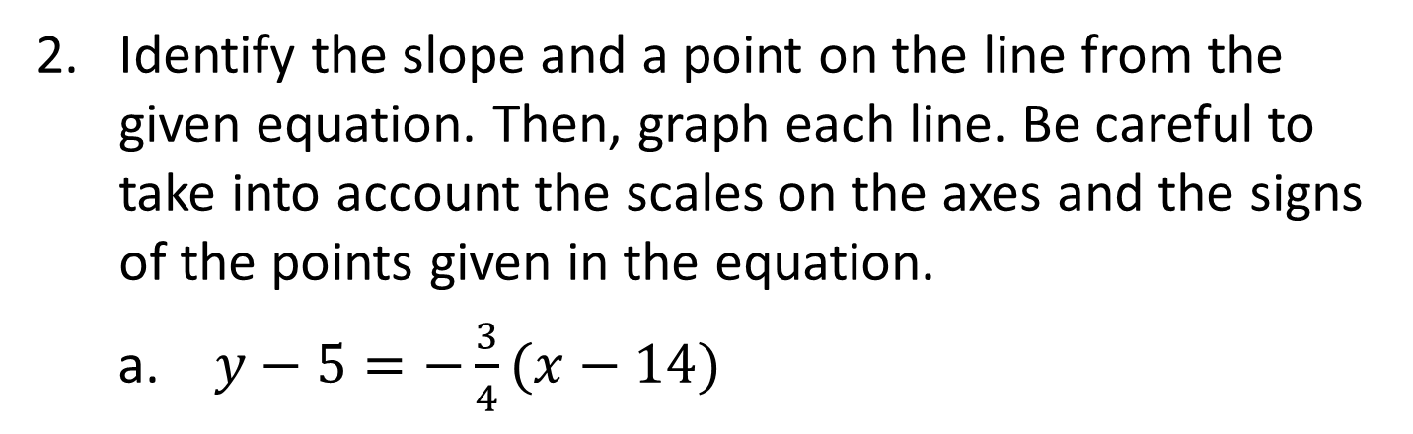
Using Point-Slope Form to Graph a Line (4 of 8)
  Identify the slope and a point on the line from the given equation. Then, graph each line. Be careful to take into account the scales on the axes and the signs of the points given in the equation.
    $y−5=−\frac{3}{4}(x−14)$
Remember, start with the given point and then use the slope to plot two more points.
Notes:
Questions to Support Discourse – Gathering:
Why did it make sense to use the point-slope form for this situation?
Questions to Support Discourse – Probing:
What other way did you express the slope $\frac{5}{1}$ to graph points on the other side of (3, 50)?
Questions to Support Discourse – Seeing Structure:
How is this process the same and different from graphing a point in slope-intercept form?
Questions to Support Discourse – Gathering:
What is the known point?
What are the two different ways you expressed the slope?
Questions to Support Discourse – Reflecting and Justifying:
How do you know that the direction of the line is correct?
Questions to Support Discourse – Gathering:
How did you rewrite the given rate to substitute the value for the slope in your equation?
Questions to Support Discourse – Reflecting and Justifying:
Why is this graph increasing?
Use the graph to show how the number of bracelets increased by 14 for every 1 hour.

Slide 28
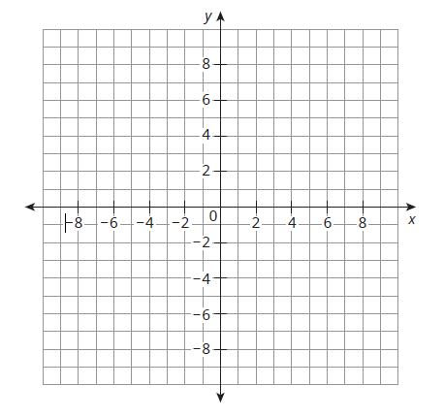
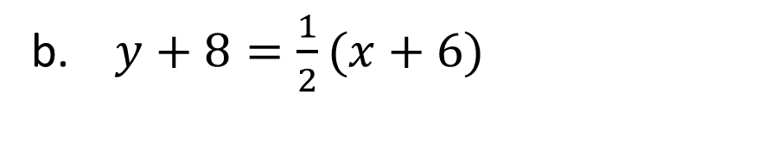
Using Point-Slope Form to Graph a Line (5 of 8)
  $y+8=\frac{1}{2}(x+6)$
Notes:
Questions to Support Discourse – Gathering:
Why did it make sense to use the point-slope form for this situation?
Questions to Support Discourse – Probing:
What other way did you express the slope $\frac{5}{1}$ to graph points on the other side of (3, 50)?
Questions to Support Discourse – Seeing Structure:
How is this process the same and different from graphing a point in slope-intercept form?
Questions to Support Discourse – Gathering:
What is the known point?
What are the two different ways you expressed the slope?
Questions to Support Discourse – Reflecting and Justifying:
How do you know that the direction of the line is correct?
Questions to Support Discourse – Gathering:
How did you rewrite the given rate to substitute the value for the slope in your equation?
Questions to Support Discourse – Reflecting and Justifying:
Why is this graph increasing?
Use the graph to show how the number of bracelets increased by 14 for every 1 hour.

Slide 29
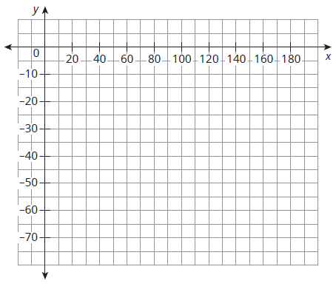
Using Point-Slope Form to Graph a Line (6 of 8)
    An underwater remote operated vehicle (ROV) is lowered from a boat at a constant rate of 0.3 meters per second. After 90 seconds, the ROV is at a depth of −25.8 meters.
    Define your variables and units. Then, write and graph an equation for the depth of the submarine over time.
Notes:
Questions to Support Discourse – Gathering:
Why did it make sense to use the point-slope form for this situation?
Questions to Support Discourse – Probing:
What other way did you express the slope $\frac{5}{1}$ to graph points on the other side of (3, 50)?
Questions to Support Discourse – Seeing Structure:
How is this process the same and different from graphing a point in slope-intercept form?
Questions to Support Discourse – Gathering:
What is the known point?
What are the two different ways you expressed the slope?
Questions to Support Discourse – Reflecting and Justifying:
How do you know that the direction of the line is correct?
Questions to Support Discourse – Gathering:
How did you rewrite the given rate to substitute the value for the slope in your equation?
Questions to Support Discourse – Reflecting and Justifying:
Why is this graph increasing?
Use the graph to show how the number of bracelets increased by 14 for every 1 hour.

Slide 30
Using Point-Slope Form to Graph a Line (7 of 8)
Let’s summarize our learning from Activity 5.2!
Notes:
Activity 5.2 Summary:
An equation written in point-slope form can be graphed by first plotting the coordinates of the known point and then using the slope to locate two additional points by counting from that initial point.

Slide 31
Using Point-Slope Form to Graph a Line (8 of 8)
Notes:
Note: This slide is blank for optional use with displaying work.

Slide 32
Activity 5.3
5.3
20–25
Notes:
Note: Total time of 20-25 minutes allotted for Activity 5.3.

Slide 33
Standard Form of a Linear Equation (1 of 16)
Tickets for a school play cost $5.00 for students and $8.00 for adults. On opening night, $1600 is collected in ticket sales.
This situation can be modeled by the equation 5x + 8y = 1600.
You can define the variables as shown.
x = number of student tickets sold
y = number of adult tickets sold
This equation is not written in slope-intercept form or in point-slope form. It is written in standard form. The standard form of a linear equation is Ax + By = C, where A, B, and C are integers and A and B are not both zero.

Slide 34
Standard Form of a Linear Equation (2 of 16)
Explain what each term of the equation represents in the problem situation.
a. 5x
b. 8y
c. 1600
Notes:
Questions to Support Discourse – Seeing Structure:
Describe the structure of this equation.
Why can’t both A and B be 0?
Why is standard form appropriate to use for this problem situation?
Why is it difficult to tell which quantity is independent and which quantity is dependent?
Questions to Support Discourse – Gathering:
Use the graph to identify another coordinate pair that makes sense in this situation.
Questions to Support Discourse – Probing:
How did you determine the slope? What is another way?

Slide 35
Standard Form of a Linear Equation (3 of 16)
What is the independent variable? What is the dependent variable? Explain your reasoning.
Notes:
Questions to Support Discourse – Seeing Structure:
Describe the structure of this equation.
Why can’t both A and B be 0?
Why is standard form appropriate to use for this problem situation?
Why is it difficult to tell which quantity is independent and which quantity is dependent?
Questions to Support Discourse – Gathering:
Use the graph to identify another coordinate pair that makes sense in this situation.
Questions to Support Discourse – Probing:
How did you determine the slope? What is another way?

Slide 36
Standard Form of a Linear Equation (4 of 16)
Remember, the y-intercept, (0, b) is where a line crosses the y-axis, so the value of x is 0. To calculate a y-intercept, substitute 0 for x and solve the equation for b.
The x-intercept, (x, 0), is where the line crosses the x-axis, so the value of y is 0. To calculate an x-intercept, substitute 0 for y and solve the equation for x.
Notes:
Questions to Support Discourse – Seeing Structure:
Describe the structure of this equation.
Why can’t both A and B be 0?
Why is standard form appropriate to use for this problem situation?
Why is it difficult to tell which quantity is independent and which quantity is dependent?
Questions to Support Discourse – Gathering:
Use the graph to identify another coordinate pair that makes sense in this situation.
Questions to Support Discourse – Probing:
How did you determine the slope? What is another way?

Slide 37
Standard Form of a Linear Equation (5 of 16)
Calculate and interpret the meanings of the x-intercept and
y-intercept for this equation.
Notes:
Questions to Support Discourse – Seeing Structure:
Describe the structure of this equation.
Why can’t both A and B be 0?
Why is standard form appropriate to use for this problem situation?
Why is it difficult to tell which quantity is independent and which quantity is dependent?
Questions to Support Discourse – Gathering:
Use the graph to identify another coordinate pair that makes sense in this situation.
Questions to Support Discourse – Probing:
How did you determine the slope? What is another way?

Slide 38
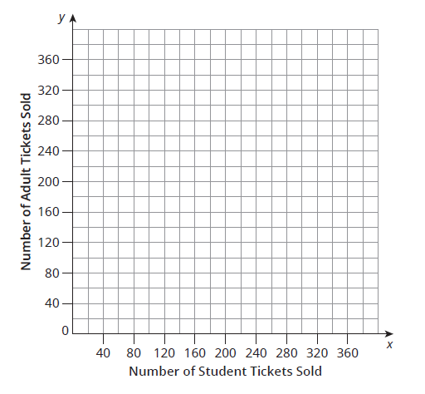
Standard Form of a Linear Equation (6 of 16)
Use the x-intercept and y-intercept to graph the equation of the line.
Notes:
Questions to Support Discourse – Seeing Structure:
Describe the structure of this equation.
Why can’t both A and B be 0?
Why is standard form appropriate to use for this problem situation?
Why is it difficult to tell which quantity is independent and which quantity is dependent?
Questions to Support Discourse – Gathering:
Use the graph to identify another coordinate pair that makes sense in this situation.
Questions to Support Discourse – Probing:
How did you determine the slope? What is another way?

Slide 39
Standard Form of a Linear Equation (7 of 16)
Determine the slope of this line. Interpret the meaning of the slope in this problem situation.
Notes:
Questions to Support Discourse – Seeing Structure:
Describe the structure of this equation.
Why can’t both A and B be 0?
Why is standard form appropriate to use for this problem situation?
Why is it difficult to tell which quantity is independent and which quantity is dependent?
Questions to Support Discourse – Gathering:
Use the graph to identify another coordinate pair that makes sense in this situation.
Questions to Support Discourse – Probing:
How did you determine the slope? What is another way?

Slide 40
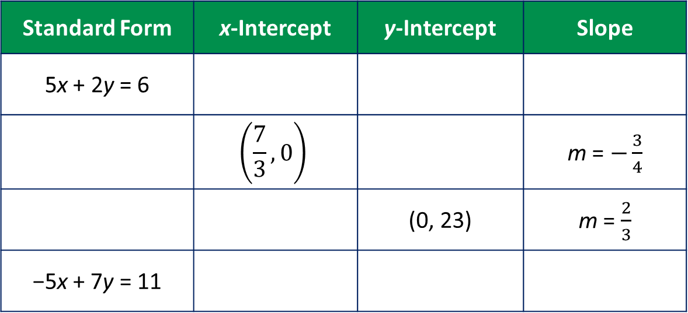
Standard Form of a Linear Equation (8 of 16)
Complete the table.
Standard Form | x-Intercept | y-Intercept | Slope
5x + 2y = 6
 | $$\left(\frac{7}{3}, 0\right)$$ |  | m = $−\frac{3}{4}$
 |  | (0, 23) | m = $\frac{2}{3}$
−5x + 7y = 11
Notes:
Questions to Support Discourse – Probing:
Explain how you determined the slope.
Questions to Support Discourse – Gathering:
What are the integers A, B, and C in this equation?
Questions to Support Discourse – Probing:
Label the x-intercept, y-intercept, and slope with the variables A, B, and C.

Slide 41
Standard Form of a Linear Equation (9 of 16)
What do you notice about the relationship between the integers A, B, and C from the standard form and
  the x-intercepts?
  the y-intercepts?
  the slope?
Notes:
Questions to Support Discourse – Probing:
Explain how you determined the slope.
Questions to Support Discourse – Gathering:
What are the integers A, B, and C in this equation?
Questions to Support Discourse – Probing:
Label the x-intercept, y-intercept, and slope with the variables A, B, and C.

Slide 42
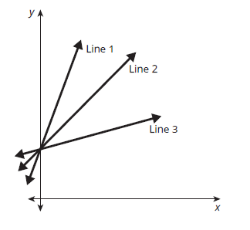
Standard Form of a Linear Equation (10 of 16)
Match each graph with the correct equation written in standard form. Explain your reasoning.
Notice that there are no values on the x- and y-axis. What strategies
can you use to determine which graph goes with which equation?
3x – 12y = −60
6x – 2y = −10
9x – 9y = −45
Notes:
Questions to Support Discourse – Probing:
Show the steps using the formula in Question 8 to identify the slope of each line.
How did you use the slopes to identify each line?
Questions to Support Discourse – Gathering:
Use the graph to identify another coordinate pair that makes sense in this situation.
Questions to Support Discourse – Probing:
Is it incorrect to reverse the axes on your graph? Why not?

Slide 43
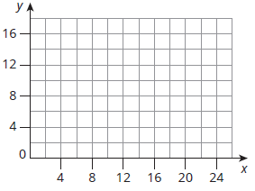
Standard Form of a Linear Equation (11 of 16)
Define variables for each problem situation. Then, write an equation in standard form and use the intercepts to graph the linear relationship.
Nia burns 20 calories for every 5 minutes she jumps rope and 50 calories for every 5 minutes she runs. On Tuesday, Nia burned a total of 500 calories.
Ask Yourself…
Why is the standard form of a linear equation appropriate to represent this situation?
Notes:
Questions to Support Discourse – Probing:
Show the steps using the formula in Question 8 to identify the slope of each line.
How did you use the slopes to identify each line?
Questions to Support Discourse – Gathering:
Use the graph to identify another coordinate pair that makes sense in this situation.
Questions to Support Discourse – Probing:
Is it incorrect to reverse the axes on your graph? Why not?

Slide 44
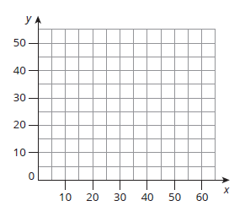
Standard Form of a Linear Equation (12 of 16)
For the show choir’s holiday performance, they are selling tickets for $5 per student and $6.00 per adult. On the night of their final performance, they collect $270 in ticket sales.
Notes:
Questions to Support Discourse – Probing:
Show the steps using the formula in Question 8 to identify the slope of each line.
How did you use the slopes to identify each line?
Questions to Support Discourse – Gathering:
Use the graph to identify another coordinate pair that makes sense in this situation.
Questions to Support Discourse – Probing:
Is it incorrect to reverse the axes on your graph? Why not?

Slide 45
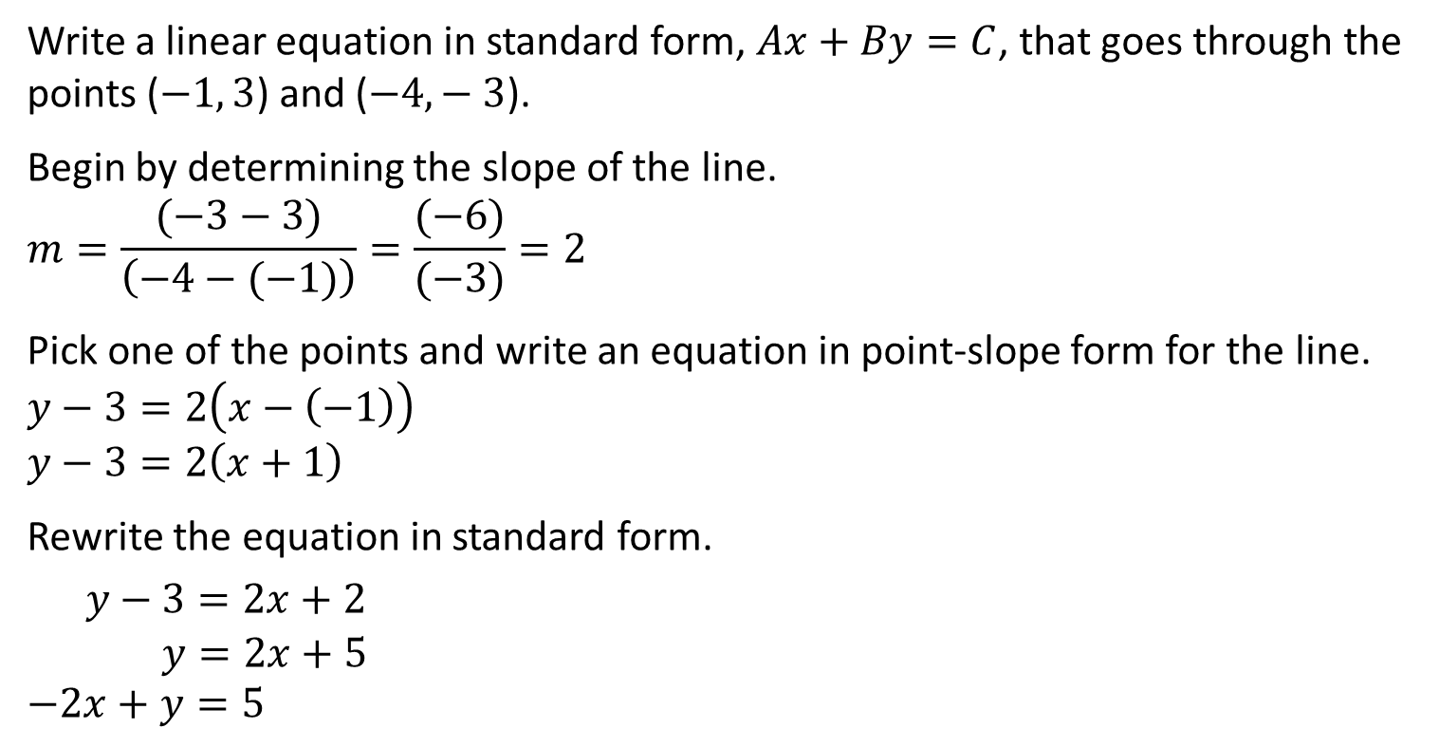
Standard Form of a Linear Equation (13 of 16)
Write a linear equation in standard form, $Ax+By=C$, that goes through the points ($−1, 3$) and ($−4,− 3$).
Begin by determining the slope of the line.
$$m=\frac{(−3−3)}{\left(−4−(−1)\right)}=\frac{(−6)}{(−3)}=2$$
Pick one of the points and write an equation in point-slope form for the line.
$$y−3=2\left(x−\left(−1\right)\right)$$
$$y−3=2\left(x+1\right)$$
Rewrite the equation in standard form.
$y−3=2x+2$
$$y=2x+5$$
$$−2x+y=5$$

Slide 46
Standard Form of a Linear Equation (14 of 16)
Write a linear equation in standard form given two points on the line.
a. (0, −4) and (2, 2)
b. (1, −5) and (−2, 7)
c. (12, 10) and (16, 12)
In standard form, A, B, and
C are integers.
Notes:
Questions to Support Discourse – Gathering:
What is the equation for the standard form of a linear equation?
Questions to Support Discourse – Probing:
How did you use the other forms of linear equations to write the equation in standard form?
What is the slope of the line? Why do you need to determine the slope?
Questions to Support Discourse – Reflecting and Justifying:
Which form of a linear equation do you prefer to write when given two points? Explain your reasoning.

Slide 47
Standard Form of a Linear Equation (15 of 16)
Let’s revisit the Essential Question and summarize our learning from Activity 5.3!
Essential Question: Is there a more efficient method to graphing a linear relationship? Can you use the equation of a linear relationship to create a graphical representation?
Notes:
Note: To close Day 2, have students reread the Essential Question and then read the Stamp the Learning summary aloud.
Activity 5.3 Summary:
The standard form of a linear equation is $Ax+By=C$, where A, B, and C are integers and A and B are not both zero. An equation in standard form can be graphed by calculating and graphing the intercepts.

Slide 48
Standard Form of a Linear Equation (16 of 16)
Notes:
Note: This slide is blank for optional use with displaying work.

Slide 49
Day 3
3
Notes:
Note: Total suggested pacing for Day 3 is 45 minutes.

Slide 50
Essential Question (3 of 3)
Is there a more efficient method to graphing a linear relationship? Can you use the equation of a linear relationship to create a graphical representation?
Notes:
Note: To begin Day 3, have a student read the Essential Question aloud.

Slide 51
Activity 5.4
5.4
20–25
Notes:
Note: Total time of 20-25 minutes allotted for Activity 5.4.

Slide 52

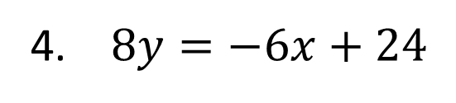

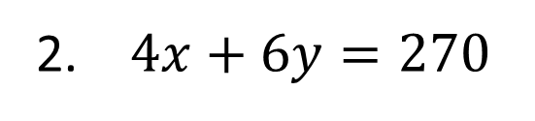
Identifying Slope and y-Intercept (1 of 4)
Each equation represents a linear relationship. Examine each and determine the slope and the y-intercept. Write the y-intercept as an ordered pair.
$y=11x−9$
$4x+6y=270$
$y=5(2x−9)$
$8y=−6x+24$
Notes:
Questions to Support Discourse – Probing:
How did you determine the slope? What is another way?
How did you determine the y-intercept? What is another way?
Questions to Support Discourse – Seeing structure:
Why doesn’t this line have a y-intercept?

Slide 53

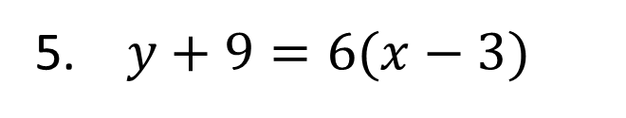
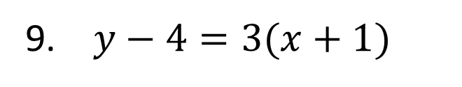
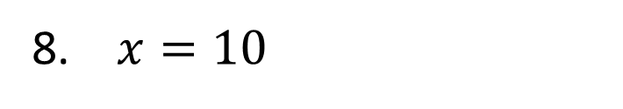

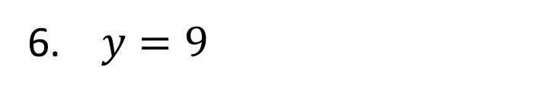
Identifying Slope and y-Intercept (2 of 4)
$y+9=6(x−3)$
$y=9$
$4x−12y=48$
$x=10$
$y−4=3(x+1)$
$y=9−\frac{1}{2}x$
Notes:
Questions to Support Discourse – Probing:
How did you determine the slope? What is another way?
How did you determine the y-intercept? What is another way?
Questions to Support Discourse – Seeing structure:
Why doesn’t this line have a y-intercept?

Slide 54
Identifying Slope and y-Intercept (3 of 4)
Let’s summarize our learning from Activity 5.4!
Notes:
Activity 5.4 Summary:
The slope of an equation can be identified directly when equations are written in slope-intercept or point-slope form; it can be calculated using $−\frac{A}{B}$ in the standard form equation, $Ax+By=C$. The y-intercept can be identified by using substitution of $x=0$in any form.

Slide 55
Identifying Slope and y-Intercept (4 of 4)
Notes:
Note: This slide is blank for optional use with displaying work.

Slide 56
Talk the Talk
20–25
Notes:
Note: Total time of 20-25 minutes allotted for the Talk the Talk.

Slide 57
Choose Your Medium (1 of 7)
For each context, complete each task:
Write an equation in slope-intercept, point-slope, or standard form.
State the form of the equation you used and your reason for using it.
Graph the line using any method.
Explain the graphing method you used and your reason for using it.
Match each transformed graph to the equation in the table, written in terms of f(x).
Ask Yourself…
What tools or strategies can you use to solve this problem?

Slide 58
Choose Your Medium (2 of 7)
On a math quiz, students earned 2 points for every correct multiple-choice question and 3 points for every correct short answer question. Joey earned a total of 36 points on the quiz.
  Let x = number of correct multiple-choice questions
  Let y = number of correct short answer questions
Notes:
Questions to Support Discourse – Gathering:
Does $2x+3y=36$ or $3x+2y=36$ represent this situation?
Which axis represents the number of correct multiple-choice questions, and which represents the number of correct short answer questions?
Does $y=5x+20$ or $y=5x−20$ represent this situation?
Is $y=5x+20$ written in slope-intercept form or point-slope form?
Which axis represents the number of weeks, and which represents the total savings?
What are the coordinates of the intercepts in each situation?

Slide 59
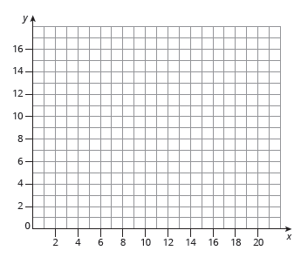
Choose Your Medium (3 of 7)
Equation:
Reasoning:
Reasoning:
Notes:
Questions to Support Discourse – Gathering:
Does $2x+3y=36$ or $3x+2y=36$ represent this situation?
Which axis represents the number of correct multiple-choice questions, and which represents the number of correct short answer questions?
Does $y=5x+20$ or $y=5x−20$ represent this situation?
Is $y=5x+20$ written in slope-intercept form or point-slope form?
Which axis represents the number of weeks, and which represents the total savings?
What are the coordinates of the intercepts in each situation?

Slide 60
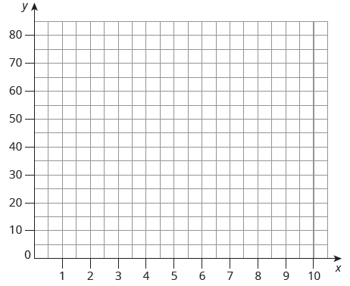
Choose Your Medium (4 of 7)
Nicky has $20, and he plans to save an additional $10 every two weeks.
  Let x = number of weeks
  Let y = Nicky’s total savings
Equation:
Reasoning:
Reasoning:
Notes:
Questions to Support Discourse – Gathering:
Does $2x+3y=36$ or $3x+2y=36$ represent this situation?
Which axis represents the number of correct multiple-choice questions, and which represents the number of correct short answer questions?
Does $y=5x+20$ or $y=5x−20$ represent this situation?
Is $y=5x+20$ written in slope-intercept form or point-slope form?
Which axis represents the number of weeks, and which represents the total savings?
What are the coordinates of the intercepts in each situation?

Slide 61
Choose Your Medium (5 of 7)
What are the advantages and disadvantages of using each form of a linear equation?
  Slope-intercept form
  Point-slope form
  Standard form
Notes:
Questions to Support Discourse – Gathering:
Does $2x+3y=36$ or $3x+2y=36$ represent this situation?
Which axis represents the number of correct multiple-choice questions, and which represents the number of correct short answer questions?
Does $y=5x+20$ or $y=5x−20$ represent this situation?
Is $y=5x+20$ written in slope-intercept form or point-slope form?
Which axis represents the number of weeks, and which represents the total savings?
What are the coordinates of the intercepts in each situation?

Slide 62
Choose Your Medium (6 of 7)
Let’s answer the Essential Question and summarize our learning from the Talk the Talk!
Essential Question: Is there a more efficient method to graphing a linear relationship? Can you use the equation of a linear relationship to create a graphical representation?
Notes:
Note: To close Day 3, have students read and answer the Essential Question and then read the Stamp the Learning summary aloud.
Essential Question:
Sample answer: The point-slope form of a linear equation is $y−y_{1}=m(x−x_{1})$, where m is the slope of the line and $(x_{`1, }y_{1}$) is a point on the line. The slope of a horizontal line is 0. The slope of a vertical line is undefined.
Talk the Talk Summary:
Different forms of equations, such as standard form, slope-intercept form, and point-slope form can be used to represent linear relationships.

Slide 63
Choose Your Medium (7 of 7)
Notes:
Note: This slide is blank for optional use with displaying work.

Slide 64
Prepare
Notes:
How can you identify whether students are ready for new learning? ​
Depending on available time, you can assign the Prepare section of the Lesson Assignments as homework or as a warm-up to identify students' prior knowledge for the upcoming lesson's activities.

Slide 65
Prepare for Module 2 Topic 1 Lesson 6
Determine the slope of the line between each pair of points.
(0, 10) and (3, 12)
(−1, 4.5) and (1, −4.5)
(21, 0) and (0, 12)

Slide 66
Acknowledgment and Notice

Slide 67
BLMATH_AlgI_M2_T1_L5_DCS_ENG

