Slide 1
Making Sense of Different Representations of a Linear Function
Algebra I | Module 2 | Topic 1 | Lesson 6
Notes:
Note: Total suggested pacing for this lesson is three 45-minute sessions.

Slide 2
Objectives
Determine whether a scenario, equation, table, or graph represents a linear relationship.
Calculate the average rate of change from a table.
Write functions given a table of values.
Interpret expressions that represent different quantities in terms of a context and a graph.
Compare different equation representations of linear functions.
Notes:
TEKS:
A.1A: apply mathematics to problems arising in everyday life, society, and the workplace.
A.1B: use a problem-solving model that incorporates analyzing given information, formulating a plan or strategy, determining a solution, justifying the solution, and evaluating the problem-solving process and the reasonableness of the solution.
A.1F: analyze mathematical relationships to connect and communicate mathematical ideas.
A.2C: write linear equations in two variables given a table of values, a graph, and a verbal description.
A.2D: write and solve equations involving direct variation.
A.3A: determine the slope of a line given a table of values, a graph, two points on the line, and an equation written in various forms, including y = mx + b, Ax + By = C , and y − y₁ = m(x − x₁).
A.3C: graph linear functions on the coordinate plane and identify key features, including x-intercept, y-intercept, zeros, and slope, in mathematical and real-world problems.
A.3E: determine the effects on the graph of the parent function f(x) = x when f(x) is replaced by af(x), f(x) + d, f(x − c), f(bx) for specific values of a, b, c, and d.
A.3F: graph systems of two linear equations in two variables on the coordinate plane and determine the solutions if they exist.
A.12A: decide whether relations represented verbally, tabularly, graphically, and symbolically define a function.
A.12B: evaluate functions, expressed in function notation, given one or more elements in their domains.
ELPS:
1.H: develop and expand repertoire of learning strategies such as reasoning inductively or deductively, looking for patterns in language, and analyzing sayings and expressions commensurate with grade-level learning expectations.
3.C: speak using a variety of grammatical structures, sentence lengths, sentence types, and connecting words with increasing accuracy and ease as more English is acquired.
4.D: use prereading supports such as graphic organizers, illustrations, and pretaught topic-related vocabulary and other prereading activities to enhance comprehension of written text.

Slide 3
Key Terms (1 of 4)
polynomial [polinomio]: a mathematical expression involving the sum of powers in one or more variables multiplied by coefficients
Example
  The expression 3x³ + 5x − 6x + 1 is a polynomial.
Notes:
Note: Polynomial is introduced on Day 2.

Slide 4
Key Terms (2 of 4)
degree: the degree of a polynomial is the greatest variable exponent in the expression
Example
Polynomial Function | Degree
Constant | P(x) = 7 | 0
Linear | P(x) = 2x – 5 | 1
Quadratic | P(x) = 3x² – 2x + 4 | 2
Cubic | P(x) = 4x³ – 2 | 3
Notes:
Note: Degree is introduced on Day 2.

Slide 5
Key Terms (3 of 4)
leading coefficient: the leading coefficient of a polynomial is the numeric coefficient of the term with the greatest power
Example
  In the polynomial −7x² + x + 25, the value −7 is the
  leading coefficient.
Notes:
Note: Leading coefficient is introduced on Day 2.

Slide 6
Key Terms (4 of 4)
zero of a function [cero de una función]: a real number that makes the value of the function equal to zero, or f(x) = 0
Example
  The zero of the linear function f(x) = 2(x − 4) is (4, 0).
Notes:
Note: Zero of a function is introduced on Day 2.

Slide 7
Essential Question (1 of 3)
You know how to determine whether a relationship represents a linear function, and you know how to write an equation for the function.
How can you use the structure of the equation to identify characteristics of the function?
Notes:
Setting the Stage:
Tap into your student’s prior learning by reading the narrative statement.
Provide a sense of direction by reading the Essential Question.

Slide 8
Day 1
1
Notes:
Note: Total suggested pacing for Day 1 is 45 minutes.

Slide 9
Getting Started
10–15
Notes:
Note: Total time of 10-15 minutes allotted for the Getting Started.

Slide 10
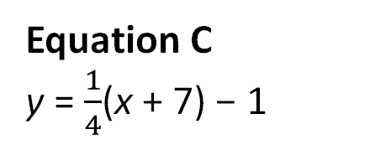
Well, Are Ya or Aren’t Ya? (1 of 5)
Determine whether each representation models a linear or nonlinear function. Explain your reasoning.
Scenario A
A tree grows 3.5 inches each year.
Scenario B
The strength of a medication decreases by 50% each hour it is in the patient’s system.
Scenario C
The area of a
square depends on
its side length.
Equation A
y = 14 − 9x
Equation B
y = 2^{x} + 1
Equation C
y = $\frac{1}{4}$(x + 7) − 1
Notes:
Questions to Support Discourse – Probing:
How can you tell whether each scenario describes a linear function?
Did you create a table for any scenario? If so, explain your results.
What is another way to describe decreases by 50% each hour?
Which feature identifies whether an equation is a linear function?
Describe why Table B is a linear function and Table A is not.
What strategy can you use to identify whether Table C represents a linear function?
What table does Graph C model? Why isn’t this line a linear function?

Slide 11
Well, Are Ya or Aren’t Ya? (2 of 5)
Table A
Table B
Table C
x | y
1 | 3
1 | 4
1 | 5
x | y
3 | 1
4 | 1
5 | 1
x | y
−9 | 45
−8 | 30
−7 | 15
Notes:
Questions to Support Discourse – Probing:
How can you tell whether each scenario describes a linear function?
Did you create a table for any scenario? If so, explain your results.
What is another way to describe decreases by 50% each hour?
Which feature identifies whether an equation is a linear function?
Describe why Table B is a linear function and Table A is not.
What strategy can you use to identify whether Table C represents a linear function?
What table does Graph C model? Why isn’t this line a linear function?

Slide 12
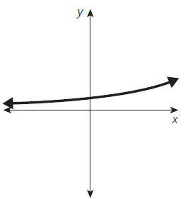
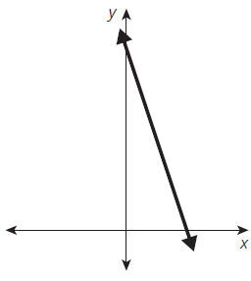
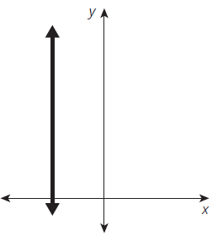
Well, Are Ya or Aren’t Ya? (3 of 5)
Graph A
Graph B
Graph C
Notes:
Questions to Support Discourse – Probing:
How can you tell whether each scenario describes a linear function?
Did you create a table for any scenario? If so, explain your results.
What is another way to describe decreases by 50% each hour?
Which feature identifies whether an equation is a linear function?
Describe why Table B is a linear function and Table A is not.
What strategy can you use to identify whether Table C represents a linear function?
What table does Graph C model? Why isn’t this line a linear function?

Slide 13

Well, Are Ya or Aren’t Ya? (4 of 5)
Let’s summarize our learning from the Getting Started!
Notes:
Getting Started Summary:
Methods exist to determine whether a context, equation, table, or graph represents a linear function.

Slide 14
Well, Are Ya or Aren’t Ya? (5 of 5)
Notes:
Note: This slide is blank for optional use with displaying work.

Slide 15
Activity 6.1
6.1
25–30
Notes:
Note: Total time of 25-30 minutes allotted for Activity 6.1.

Slide 16
Interpreting Linear Functions (1 of 10)
Each table of values in the previous activity had consecutive input values. Tables in this format allow you to use differences to determine whether the representation is linear. Often, input values are in intervals other than 1, and sometimes the input values are in random order. To determine whether these tables represent linear functions, you need to make sure the slope, or average rate of change, is constant between all given points.
Ask Yourself…
Is there a pattern in the input values?

Slide 17
Interpreting Linear Functions (2 of 10)
Remember . . .
In a linear relationship,
when the value of the
dependent variable is
directly proportional
to the value of the
independent variable,
the relationship is
a direct variation.
Another way to say
this is that in a direct
variation the value
of the dependent
variable varies directly
with the independent
value. You can
use these phrases
interchangeably.
Determine whether each table represents a linear function. If so, write the function.
a.
b.
x | y
−2 | 5.5
1 | 4.75
4 | 4
7 | 3.25
x | y
0 | 5
2 | 13
4 | 21
8 | 29
Notes:
Questions to Support Discourse – Probing:
Why can’t you use first differences to determine whether these tables represent linear functions?
How can you tell whether a table with non-consecutive values represents a linear function?
How did you determine the y-intercept for the table in part (a)?
What is the difference between y-values in part (b)? Then why doesn’t this table represent a linear function?
How can the column titles help you relate the slope to the context?
What equation represents this table?
How do you know whether the slope represents the price of a ticket or the entrance fee?
How can you calculate the entrance fee?
How did you figure out the number of ride tickets Nakota can buy?
Why doesn’t tripling the table results for 6 result in $20?
Did you use the table or equation to determine the tank’s capacity?
How can you represent the empty tank mathematically?
How did you calculate when the tank will be empty?

Slide 18
Interpreting Linear Functions (3 of 10)
Analyze each situation represented as a table of values.
Nakota sells pretzels at festivals on the weekends. The table shown is a record of past sales.
  What does this table tell you about his sales?
  Determine whether the amount of money Nakota earns is directly proportional to the number of pretzels sold. Justify your reasoning.
Number of Pretzels sold | Amount of Money Earned (dollars)
15 | 37.5
42 | 105
58 | 145
29 | 72.5
Notes:
Questions to Support Discourse – Probing:
Why can’t you use first differences to determine whether these tables represent linear functions?
How can you tell whether a table with non-consecutive values represents a linear function?
How did you determine the y-intercept for the table in part (a)?
What is the difference between y-values in part (b)? Then why doesn’t this table represent a linear function?
How can the column titles help you relate the slope to the context?
What equation represents this table?
How do you know whether the slope represents the price of a ticket or the entrance fee?
How can you calculate the entrance fee?
How did you figure out the number of ride tickets Nakota can buy?
Why doesn’t tripling the table results for 6 result in $20?
Did you use the table or equation to determine the tank’s capacity?
How can you represent the empty tank mathematically?
How did you calculate when the tank will be empty?

Slide 19
Interpreting Linear Functions (4 of 10)
  Write an equation to represent the situation.
  How much money does Nakota earn when he sells 75 pretzels?
Notes:
Questions to Support Discourse – Probing:
Why can’t you use first differences to determine whether these tables represent linear functions?
How can you tell whether a table with non-consecutive values represents a linear function?
How did you determine the y-intercept for the table in part (a)?
What is the difference between y-values in part (b)? Then why doesn’t this table represent a linear function?
How can the column titles help you relate the slope to the context?
What equation represents this table?
How do you know whether the slope represents the price of a ticket or the entrance fee?
How can you calculate the entrance fee?
How did you figure out the number of ride tickets Nakota can buy?
Why doesn’t tripling the table results for 6 result in $20?
Did you use the table or equation to determine the tank’s capacity?
How can you represent the empty tank mathematically?
How did you calculate when the tank will be empty?

Slide 20
Interpreting Linear Functions (5 of 10)
Alejandra and her friends recently went to the community fair. They had to pay an entrance fee and then purchase 1 ticket for each ride. Lauren is going to the fair tomorrow and wants to know the cost of each ride ticket. Alejandra and her friends help Lauren by writing down how much money they spent and the number of tickets they purchased.
  What does this table tell you about the cost to go to the fair and ride the rides?
Number of Ride Tickets | Amount of Money Spent (dollars)
2 | 7.5
4 | 9
6 | 10.5
11 | 14.25
Notes:
Questions to Support Discourse – Probing:
Why can’t you use first differences to determine whether these tables represent linear functions?
How can you tell whether a table with non-consecutive values represents a linear function?
How did you determine the y-intercept for the table in part (a)?
What is the difference between y-values in part (b)? Then why doesn’t this table represent a linear function?
How can the column titles help you relate the slope to the context?
What equation represents this table?
How do you know whether the slope represents the price of a ticket or the entrance fee?
How can you calculate the entrance fee?
How did you figure out the number of ride tickets Nakota can buy?
Why doesn’t tripling the table results for 6 result in $20?
Did you use the table or equation to determine the tank’s capacity?
How can you represent the empty tank mathematically?
How did you calculate when the tank will be empty?

Slide 21
Interpreting Linear Functions (6 of 10)
  Determine whether the amount of money Alejandra and her friends spend varies directly with the number of ride tickets they purchased. Justify your reasoning.
  Write an equation to represent the situation.
  If Lauren has $20 to spend, how many ride tickets can she buy?
Notes:
Questions to Support Discourse – Probing:
Why can’t you use first differences to determine whether these tables represent linear functions?
How can you tell whether a table with non-consecutive values represents a linear function?
How did you determine the y-intercept for the table in part (a)?
What is the difference between y-values in part (b)? Then why doesn’t this table represent a linear function?
How can the column titles help you relate the slope to the context?
What equation represents this table?
How do you know whether the slope represents the price of a ticket or the entrance fee?
How can you calculate the entrance fee?
How did you figure out the number of ride tickets Nakota can buy?
Why doesn’t tripling the table results for 6 result in $20?
Did you use the table or equation to determine the tank’s capacity?
How can you represent the empty tank mathematically?
How did you calculate when the tank will be empty?

Slide 22
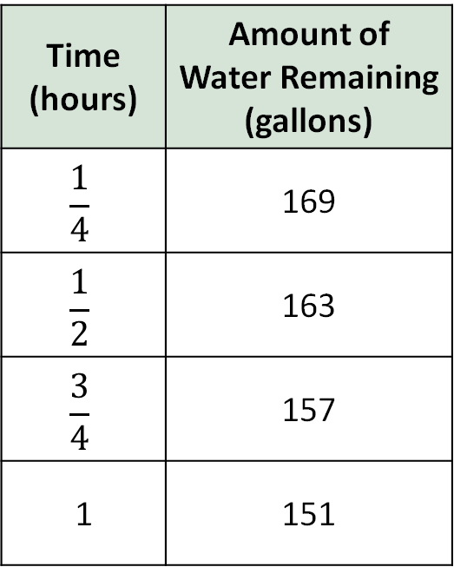
Interpreting Linear Functions (7 of 10)
The local pet store has a fish tank on display at the community fair. Darren is responsible for draining the tank at the end of the fair. The pet store manager provides him with this information from when they drained the tank at the end of the fair last year.
  Determine whether the amount of water remaining is directly proportional to the
  time the drain spent draining the tank.
  Justify your reasoning.
Time (hours) | Amount of Water Remaining (gallons)
$$\frac{1}{4}$$ | 169
$$\frac{1}{2}$$ | 163
$$\frac{3}{4}$$ | 157
1 | 151
Notes:
Questions to Support Discourse – Probing:
Why can’t you use first differences to determine whether these tables represent linear functions?
How can you tell whether a table with non-consecutive values represents a linear function?
How did you determine the y-intercept for the table in part (a)?
What is the difference between y-values in part (b)? Then why doesn’t this table represent a linear function?
How can the column titles help you relate the slope to the context?
What equation represents this table?
How do you know whether the slope represents the price of a ticket or the entrance fee?
How can you calculate the entrance fee?
How did you figure out the number of ride tickets Nakota can buy?
Why doesn’t tripling the table results for 6 result in $20?
Did you use the table or equation to determine the tank’s capacity?
How can you represent the empty tank mathematically?
How did you calculate when the tank will be empty?

Slide 23
Interpreting Linear Functions (8 of 10)
  How many gallons did the fish tank hold?
  Write an equation to represent the situation.
  When will the tank be empty?
Notes:
Questions to Support Discourse – Probing:
Why can’t you use first differences to determine whether these tables represent linear functions?
How can you tell whether a table with non-consecutive values represents a linear function?
How did you determine the y-intercept for the table in part (a)?
What is the difference between y-values in part (b)? Then why doesn’t this table represent a linear function?
How can the column titles help you relate the slope to the context?
What equation represents this table?
How do you know whether the slope represents the price of a ticket or the entrance fee?
How can you calculate the entrance fee?
How did you figure out the number of ride tickets Nakota can buy?
Why doesn’t tripling the table results for 6 result in $20?
Did you use the table or equation to determine the tank’s capacity?
How can you represent the empty tank mathematically?
How did you calculate when the tank will be empty?

Slide 24
Interpreting Linear Functions (9 of 10)
Let’s revisit the Essential Question and summarize our learning from Activity 6.1!
Essential Question: How can you use the structure of the equation to identify characteristics of the function?
Notes:
Note: To close Day 1, have students reread the Essential Question and then read the Stamp the Learning summary aloud.
Activity 6.1 Summary:
If a table represents a linear function, the slope, or average rate of change, is constant between all given points.

Slide 25
Interpreting Linear Functions (10 of 10)
Notes:
Note: This slide is blank for optional use with displaying work.

Slide 26
Day 2
2
Notes:
Note: Total suggested pacing for Day 2 is 45 minutes.

Slide 27
Essential Question (2 of 3)
How can you use the structure of the equation to identify characteristics of the function?
Notes:
Note: To begin Day 2, have a student read the Essential Question aloud.

Slide 28
Activity 6.2
6.2
20–25
Notes:
Note: Total time of 20-25 minutes allotted for Activity 6.2.

Slide 29
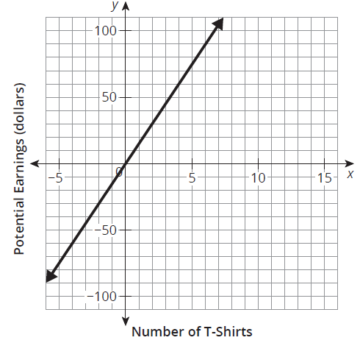
Interpreting Graphs of Linear Functions (1 of 11)
Gracie sells silk screened T-shirts for her mom at
local festivals. After each festival, she returns whatever money she earns to her mom. The graph shown represents her potential earnings based on the number of T-shirts she sells.
Ask Yourself…
What is the meaning of the slope, x- and
y-intercepts, domain, and range in terms of this situation?

Slide 30
Interpreting Graphs of Linear Functions (2 of 11)
Analyze and interpret the graph. List as many facts as you can about the scenario based on what you see in the graph and describe how they relate to the scenario.
Notes:
Questions to Support Discourse – Probing:
How much money does Gracie’s mom earn for each T-shirt sold?
Questions to Support Discourse – Seeing Structure:
Did you use one or two points on the graph to calculate the earnings per T-shirt sold? Explain the relationship between the two strategies.
Questions to Support Discourse – Probing:
Why doesn’t the equation have a constant value?

Slide 31
Interpreting Graphs of Linear Functions (3 of 11)
Interpret the meaning of the x- and y-intercept.
Write a function, E(t), to model Gracie’s potential earnings given the number of T-shirts she sells.
What does (t, E(t)) represent in terms of the function and the graph?
Ask Yourself…
Does the function E(t) represent a direct variation? Explain your reasoning.
Notes:
Questions to Support Discourse – Probing:
How much money does Gracie’s mom earn for each T-shirt sold?
Questions to Support Discourse – Seeing Structure:
Did you use one or two points on the graph to calculate the earnings per T-shirt sold? Explain the relationship between the two strategies.
Questions to Support Discourse – Probing:
Why doesn’t the equation have a constant value?

Slide 32
Interpreting Graphs of Linear Functions (4 of 11)
Evaluate each and interpret the meaning in terms of the equation, the graph, and the scenario.
a. E(2) b. E(5) c. E(2.75)
Notes:
Questions to Support Discourse – Probing:
How much money does Gracie’s mom earn for each T-shirt sold?
Questions to Support Discourse – Seeing Structure:
Did you use one or two points on the graph to calculate the earnings per T-shirt sold? Explain the relationship between the two strategies.
Questions to Support Discourse – Probing:
Why doesn’t the equation have a constant value?

Slide 33

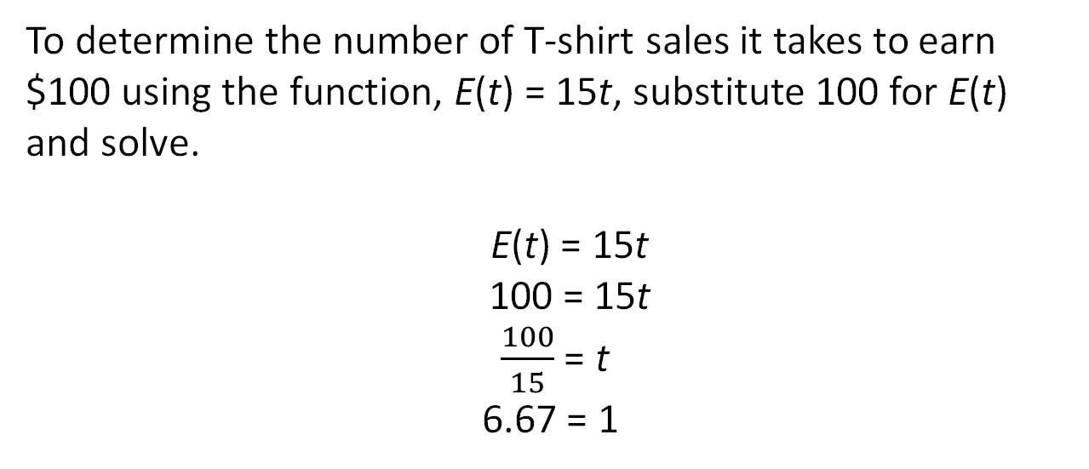
Interpreting Graphs of Linear Functions (5 of 11)
Gracie has a goal to earn $100 at the festival. Let’s consider how to determine the number of T-shirts she needs to sell to meet her goal.
To determine the number of T-shirt sales it takes to earn $100 using the function, E(t) = 15t, substitute 100 for E(t) and solve.
E(t) = 15t
100 = 15t
$\frac{100}{15}$ = t
6.67 = 1

Slide 34
Interpreting Graphs of Linear Functions (6 of 11)
Consider the Worked Example.
  Interpret the meaning of t = 6.67.
  Why can you substitute 100 for E(t)?
Remember . . .
The graph of an equation plotted on the coordinate plane represents the set of all its solutions.
Notes:
Questions to Support Discourse – Probing:
How do you know whether to substitute the given value for t or f(t)?
How did you decide that Gracie needed to sell 7 T-shirts instead of 6 T-shirts?
How much money will Gracie earn selling 6 T-shirts? 7 T-shirts?
Why does it make sense to rely on technology when using a graph?
How could you solve this equation using a table with technology?

Slide 35
Interpreting Graphs of Linear Functions (7 of 11)
You can also use the graph to determine the number of T-shirts Gracie needs to sell to earn $100.
To determine the number of T-shirts sales it takes to earn $100 using your graph, you need to determine the intersection of the two lines represented by the equation 100 = 15t.
First, graph the function defined by each side of the equation, and then determine the intersection point of the two graphs.

Slide 36
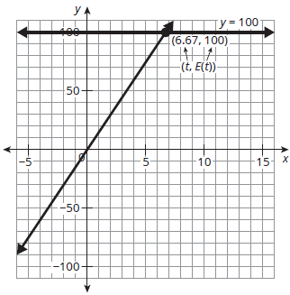
Interpreting Graphs of Linear Functions (8 of 11)
h(t) = 15t
100 = 15t
y = 100 y = 15x
Solution: (6.67, 100)
In terms of the graph, Gracie needs to sell 6.67 T-shirts to earn $100. In terms of the context, she needs to sell 7 T-shirts.

Slide 37
Interpreting Graphs of Linear Functions (9 of 11)
Consider the equation and graphical representations. What are the limitations of using each to answer questions about the number of T-shirts sold or the amount of money earned?
a. Equation b. Graph
Notes:
Questions to Support Discourse – Probing:
How do you know whether to substitute the given value for t or f(t)?
How did you decide that Gracie needed to sell 7 T-shirts instead of 6 T-shirts?
How much money will Gracie earn selling 6 T-shirts? 7 T-shirts?
Why does it make sense to rely on technology when using a graph?
How could you solve this equation using a table with technology?

Slide 38
Interpreting Graphs of Linear Functions (10 of 11)
Let’s summarize our learning from Activity 6.2!
Notes:
Activity 6.2 Summary:
An equation or a graph can be used to determine the value of an independent variable. Sometimes a graph can only give an approximate answer; however, using an equation always results in an exact answer.

Slide 39
Interpreting Graphs of Linear Functions (11 of 11)
Notes:
Note: This slide is blank for optional use with displaying work.

Slide 40
Activity 6.3
6.3
20–25
Notes:
Note: Total time of 20-25 minutes allotted for Activity 6.3.

Slide 41
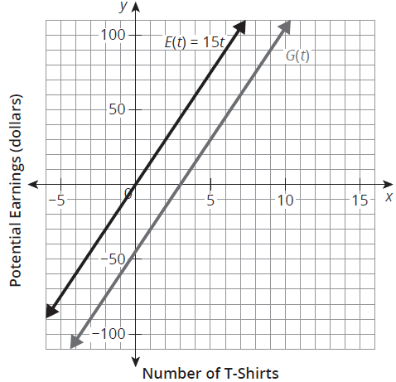
Interpreting Changes to the Graph of a Linear Function (1 of 15)
For the next festival, Gracie’s mom suggests that she still sells each T-shirt for $15, but should give away 3 T-shirts in a raffle. This new relationship, G(t), is shown on the graph.
Compare the two graphs. What do
you notice?
  How do the graphs show the selling price per T-shirt remains the same?
Notes:
Questions to Support Discourse – Probing:
How do the parallel lines relate to the context?
Does this notation represent the x-intercept or y-intercept?
Which property did you apply to show the equations are equivalent?
Explain how Brianna’s and Hailey’s perspectives are different.
How did you interpret the solution in terms of the context?
Compare this question and response to the Worked Example in Activity 2.

Slide 42
Interpreting Changes to the Graph of a Linear Function (2 of 15)
Determine and interpret the meaning of y = G(0) in terms of the graph and this scenario. Label the point on the graph.
Determine and interpret the meaning of G(t) = 0 in terms of the graph and this scenario. Label the point on the graph.
Ask Yourself…
Does G(t) vary directly with t?
Notes:
Questions to Support Discourse – Probing:
How do the parallel lines relate to the context?
Does this notation represent the x-intercept or y-intercept?
Which property did you apply to show the equations are equivalent?
Explain how Brianna’s and Hailey’s perspectives are different.
How did you interpret the solution in terms of the context?
Compare this question and response to the Worked Example in Activity 2.

Slide 43
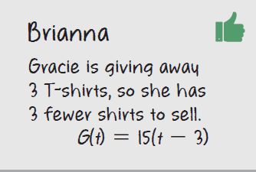
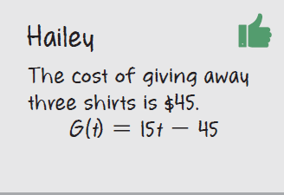
Interpreting Changes to the Graph of a Linear Function (3 of 15)
Brianna and Hailey each wrote an equation to describe the effect of giving away three T-shirts.

Slide 44
Interpreting Changes to the Graph of a Linear Function (4 of 15)
Verify the two equation representations are equivalent.
How many T-shirts will Gracie need to sell to earn $100? Use the graph and an equation.
Notes:
Questions to Support Discourse – Probing:
How do the parallel lines relate to the context?
Does this notation represent the x-intercept or y-intercept?
Which property did you apply to show the equations are equivalent?
Explain how Brianna’s and Hailey’s perspectives are different.
How did you interpret the solution in terms of the context?
Compare this question and response to the Worked Example in Activity 2.

Slide 45
Interpreting Changes to the Graph of a Linear Function (5 of 15)
Consider the expressions in the first two rows that define the quantities of the function and then the parts of each equation written by Brianna and Hailey to complete the table. First, determine the unit of measure for each expression. Then, describe the contextual meaning and the mathematical meaning of each part of the function.
Notes:
Questions to Support Discourse – Probing:
How do the parallel lines relate to the context?
Does this notation represent the x-intercept or y-intercept?
Which property did you apply to show the equations are equivalent?
Explain how Brianna’s and Hailey’s perspectives are different.
How did you interpret the solution in terms of the context?
Compare this question and response to the Worked Example in Activity 2.

Slide 46
Interpreting Changes to the Graph of a Linear Function (6 of 15)
What It Means
Expression | Unit | Contextual Meaning | Mathematical Meaning
t
G(t)
15
(t − 3)
15t
−45
Notes:
Questions to Support Discourse – Probing:
How do the parallel lines relate to the context?
Does this notation represent the x-intercept or y-intercept?
Which property did you apply to show the equations are equivalent?
Explain how Brianna’s and Hailey’s perspectives are different.
How did you interpret the solution in terms of the context?
Compare this question and response to the Worked Example in Activity 2.

Slide 47
Interpreting Changes to the Graph of a Linear Function (7 of 15)
The linear functions that Brianna and Hailey each wrote are equivalent; however, they are written in different forms. The linear function G(t) = 15(t − 3) is written in factored form and G(t) = 15t − 45 is written in general form.
A linear function can also be referred to as a polynomial function. A polynomial is a mathematical expression involving the sum of powers in one or more variables multiplied by coefficients. The degree of a polynomial is the greatest variable exponent in the expression. The leading coefficient of a polynomial is the numeric coefficient of the term with the greatest power.
Polynomial comes
from poly- meaning
“many” and -nomial
meaning “term,” so it means “many terms.”

Slide 48
Interpreting Changes to the Graph of a Linear Function (8 of 15)
A few examples of polynomial functions.
When you graph
a polynomial the
degree tells you the
maximum number of times the graph can cross the x-axis.
Polynomial Functions
Degree
Constant | P(x) = 7 | 0
Linear | P(x) = 2x − 5 | 1
Quadratic | P(x) = 3x² − 2x + 4 | 2
Cubic | P(x) = 4x³ − 2 | 3

Slide 49
Interpreting Changes to the Graph of a Linear Function (9 of 15)
The structure of each linear function tells you important information about the graph. Let’s consider the general form of a linear function,
f(x) = ax + b, where a and b are real numbers
and a ≠ 0 . In this form, the a-value is the leading coefficient, which describes the steepness and direction of the line. The b-value describes the
y-intercept.
The variables used
to represent any
real number in the
general linear form
are irrelevant. Think
about the position of
the number as either
the leading coefficient
or a constant and the
potential effect on
the function.

Slide 50
Interpreting Changes to the Graph of a Linear Function (10 of 15)
You know the form y = mx + b as slope-intercept form, where m represents the slope and b represents the y-intercept. Notice that the general form has the same structure. The general form shows that a linear equation is a polynomial of degree 1. You will learn more about polynomials as you progress through future mathematical courses.

Slide 51
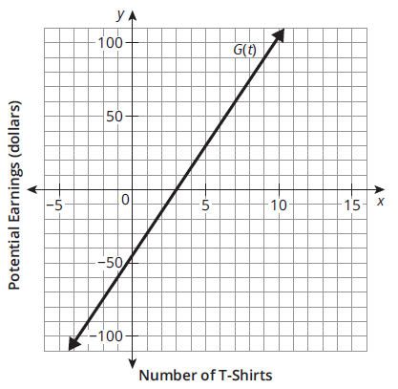
Interpreting Changes to the Graph of a Linear Function (11 of 15)
Consider the general form of the linear function G(t).
  Label a on the graph.
  Label b on the graph.
Notes:
Questions to Support Discourse – Probing:
Rewrite the constant 7 with a variable and exponent.
What is the exponent of the variable in a linear function?
What is an example of a linear function with a coefficient of 1?
Write an example of a cubic function with four terms.
Explain how your label for a makes sense.
Where is another possible location for a?
Explain how you solved for c.
What information do general form and factored form both provide?
Questions to Support Discourse – Seeing Structure:
What information is available in general form that is not available in factored form?
What information is available in factored form that is not available in general form?

Slide 52
Interpreting Changes to the Graph of a Linear Function (12 of 15)
Next, consider the factored form of a linear function, f(x) = a(x − c),
where a and c are real numbers and a ≠ 0. When a polynomial is in
factored form, the value of x that makes the factor (x − c) equal to zero is the x-intercept. This value is called the zero of the function. A zero of a function is a real number that makes the value of the function equal to zero, or f(x) = 0.
You can set (x − c) equal to zero and determine the point where the
graph crosses the x-axis.

Slide 53
Interpreting Changes to the Graph of a Linear Function (13 of 15)
Consider the factored form of the linear function G(t).
  Label a on the graph.
  Label c on the graph.
What is the zero of G(t)?
Explain your reasoning.
Notes:
Questions to Support Discourse – Probing:
Rewrite the constant 7 with a variable and exponent.
What is the exponent of the variable in a linear function?
What is an example of a linear function with a coefficient of 1?
Write an example of a cubic function with four terms.
Explain how your label for a makes sense.
Where is another possible location for a?
Explain how you solved for c.
What information do general form and factored form both provide?
Questions to Support Discourse – Seeing Structure:
What information is available in general form that is not available in factored form?
What information is available in factored form that is not available in general form?

Slide 54
Interpreting Changes to the Graph of a Linear Function (14 of 15)
Let’s revisit the Essential Question and summarize our learning from Activity 6.3!
Essential Question: How can you use the structure of the equation to identify characteristics of the function?
Notes:
Note: To close Day 2, have students reread the Essential Question and then read the Stamp the Learning summary aloud.
Activity 6.3 Summary:
The general form of a linear function and the factored form of a linear function each have a structure that identifies characteristics of the graph of the linear function it models.

Slide 55
Interpreting Changes to the Graph of a Linear Function (15 of 15)
Notes:
Note: This slide is blank for optional use with displaying work.

Slide 56
Day 3
3
Notes:
Note: Total suggested pacing for Day 3 is 45 minutes.

Slide 57
Essential Question (3 of 3)
How can you use the structure of the equation to identify characteristics of the function?
Notes:
Note: To begin Day 3, have a student read the Essential Question aloud.

Slide 58
Activity 6.4
6.4
15–20
Notes:
Note: Total time of 15-20 minutes allotted for Activity 6.4.

Slide 59
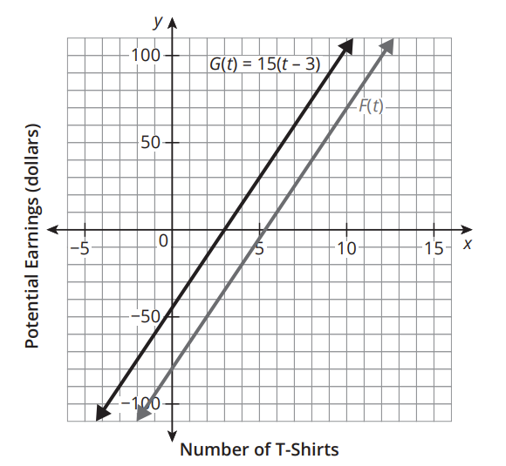
Interpreting More Changes to the Graph of a Linear Function (1 of 7)
The next festival that Gracie is attending charges a $35 fee to rent a booth. She is still selling her mom’s T-shirts for $15 each and giving 3 away in a raffle. The graph shows this new relationship, F(t).
Ask Yourself…
Is F(t) directly proportional to t?

Slide 60
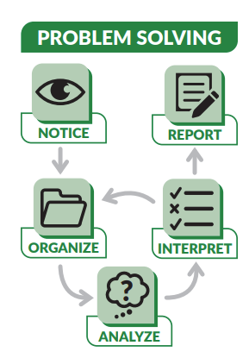
Interpreting More Changes to the Graph of a Linear Function (2 of 7)
Consider the relationship between graphs of G(t) and F(t).
  How do the graphs show that the selling price per
  T-shirt remains the same?
  How did the new booth fee of $35 change the graph?
Notes:
Questions to Support Discourse – Probing:
Explain what the coordinates of the new y-intercept mean in this context.
How did the $35 fee affect how many T-shirts Gracie needs to sell to earn $100?
How can you rewrite the equation in general form to create the equation in factored form?
How can you use what you know about factored form to determine the factor $\left(\frac{t−16}{3}\right)$?

Slide 61
Interpreting More Changes to the Graph of a Linear Function (3 of 7)
How many T-shirts will Gracie need to sell before she will have any money to return to her mom? Explain your reasoning.
How many T-shirts will Gracie need to sell to earn $100?
Notes:
Questions to Support Discourse – Probing:
Explain what the coordinates of the new y-intercept mean in this context.
How did the $35 fee affect how many T-shirts Gracie needs to sell to earn $100?
How can you rewrite the equation in general form to create the equation in factored form?
How can you use what you know about factored form to determine the factor $\left(\frac{t−16}{3}\right)$?

Slide 62
Interpreting More Changes to the Graph of a Linear Function (4 of 7)
Consider the relationship between the equations of G(t) and F(t).
  Write the function F(t) in terms of G(t).
  Rewrite F(t) in general form. Then describe how the a- and b-values are represented on the graph.
The general form of a linear function is
f(x) = ax + b.
Notes:
Questions to Support Discourse – Probing:
Explain what the coordinates of the new y-intercept mean in this context.
How did the $35 fee affect how many T-shirts Gracie needs to sell to earn $100?
How can you rewrite the equation in general form to create the equation in factored form?
How can you use what you know about factored form to determine the factor $\left(\frac{t−16}{3}\right)$?

Slide 63
Interpreting More Changes to the Graph of a Linear Function (5 of 7)
  Rewrite F(t) in factored form. Use a fraction to represent the c-value. Then describe how the a- and c-values are represented on the graph.
The factored form of a linear function is
f(x) = a(x − c).
The values a, b, and c are real numbers and a ≠ 0.
Notes:
Questions to Support Discourse – Probing:
Explain what the coordinates of the new y-intercept mean in this context.
How did the $35 fee affect how many T-shirts Gracie needs to sell to earn $100?
How can you rewrite the equation in general form to create the equation in factored form?
How can you use what you know about factored form to determine the factor $\left(\frac{t−16}{3}\right)$?

Slide 64

Interpreting More Changes to the Graph of a Linear Function (6 of 7)
Let’s summarize our learning from Activity 6.4!
Notes:
Activity 6.4 Summary:
In the general form of a linear function, f(x) = ax + b, a is the slope and b is the y-intercept. In the factored form of a linear function, f(x) = a(x − c), a is the slope and c is the x-intercept or zero of the function.

Slide 65
Interpreting More Changes to the Graph of a Linear Function (7 of 7)
Notes:
Note: This slide is blank for optional use with displaying work.

Slide 66
Talk the Talk
20–25
Notes:
Note: Total time of 20-25 minutes allotted for the Talk the Talk.

Slide 67
Reading Between the Lines (1 of 9)
Complete each “I can” sentence using always, sometimes, or never.
  Suppose you are given a dependent value and need to calculate an independent value of a linear function.
I can __________ use a table to determine an
approximate value.
I can __________ use a table to calculate an
exact value.
Notes:
Questions to Support Discourse – Probing:
How did you know that each function is linear?
How did you calculate the slope and y-intercept?
Explain how to determine the value of x for a given f(x).

Slide 68
Reading Between the Lines (2 of 9)
I can __________ use a graph to determine an
approximate value.
I can __________ use a graph to calculate an
exact value.
I can __________ use an equation to determine an approximate value.
I can __________ use an equation to calculate an
exact value.
Notes:
Questions to Support Discourse – Probing:
How did you know that each function is linear?
How did you calculate the slope and y-intercept?
Explain how to determine the value of x for a given f(x).

Slide 69
Reading Between the Lines (3 of 9)
Write the function that models each table of values. Then, evaluate the function for each independent and dependent value.
x | 1 | 2 | 3 | 4 | 5
f(x) | −20 | 5 | 30 | 55 | 80
f(x) =
f(12) =
f(x) = −145
Notes:
Questions to Support Discourse – Probing:
How did you know that each function is linear?
How did you calculate the slope and y-intercept?
Explain how to determine the value of x for a given f(x).

Slide 70
Reading Between the Lines (4 of 9)
x | 1 | 3 | 5 | 7 | 9
g(x) | 18 | 6 | −6 | −18 | −30
g(x) =
g(−9) =
g(x) = −54
Notes:
Questions to Support Discourse – Probing:
How did you know that each function is linear?
How did you calculate the slope and y-intercept?
Explain how to determine the value of x for a given f(x).

Slide 71
Reading Between the Lines (5 of 9)
Complete the graphic organizer located at the end of this lesson for the linear function f(x) = 2x – 8.
  Write f(x) in general form. Then, describe the information given in this form.
  Write f(x) in factored form. Then, describe the information given in this form.
Notes:
Note: The graphic organizer is on a slide toward the end of this deck.
Questions to Support Discourse – Probing:
How did you know that each function is linear?
How did you calculate the slope and y-intercept?
Explain how to determine the value of x for a given f(x).

Slide 72
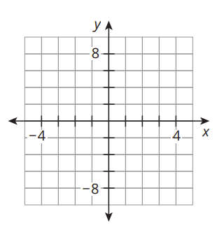
Reading Between the Lines (6 of 9)
  Graph f(x). Describe how you know this graph can cross the x-axis only one time.
Notes:
Questions to Support Discourse – Probing:
How did you know that each function is linear?
How did you calculate the slope and y-intercept?
Explain how to determine the value of x for a given f(x).

Slide 73
Reading Between the Lines (7 of 9)
  Create a table of values for f(x).
x | y
Notes:
Questions to Support Discourse – Probing:
How did you know that each function is linear?
How did you calculate the slope and y-intercept?
Explain how to determine the value of x for a given f(x).

Slide 74
Reading Between the Lines (8 of 9)
Let’s answer the Essential Question and summarize our learning from the Talk the Talk!
Essential Question: How can you use the structure of the equation to identify characteristics of the function?
Notes:
Note: To close Day 3, have students read and answer the Essential Question and then read the Stamp the Learning summary aloud.
Essential Question:
Sample answer: The general form of a linear function is f(x) = ax + b, where a and b are real numbers and a ≠ 0. In this form, the a-value is the leading coefficient that describes the steepness and direction of the line. The b-value describes the y-intercept. The factored form of a linear function is f(x) = a(x – c), where a and c are real numbers and a ≠ 0. In this form, the a-value is the slope and the value of x that makes the factor (x – c) equal to zero is the x-intercept.
Talk the Talk Summary:
Both the general and factored form of a linear function relate to the graph and table of the function they model. The equation always provides exact answers, while the graph and table sometimes may only be able to provide approximate values.

Slide 75
Reading Between the Lines (9 of 9)
Notes:
Note: This slide is blank for optional use with displaying work.

Slide 76
Graphic Organizer

Slide 77
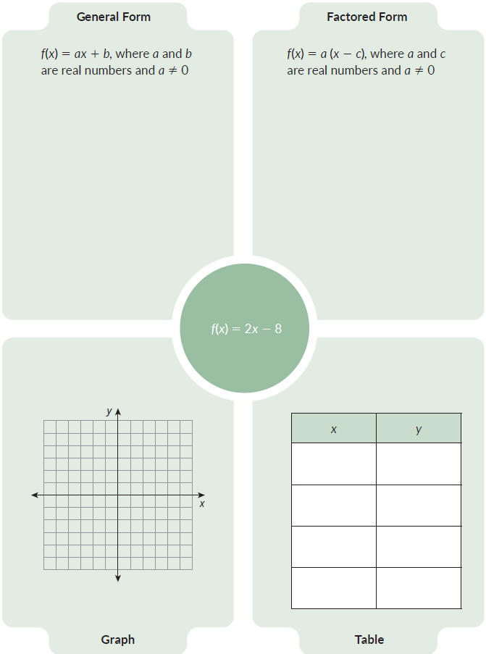
Graphic Organizer (1 of 1)

Slide 78
Prepare
Notes:
How can you identify whether students are ready for new learning? ​
Depending on available time, you can assign the Prepare section of the Lesson Assignments as homework or as a warm-up to identify students' prior knowledge for the upcoming lesson's activities.

Slide 79
Prepare for Module 2 Topic 2 Lesson 1
Determine each value, given the function h(x) = −2x – 5.
h(3)
2 ∙ h(−2)
−1 ∙ h(1) + 5
5 ∙ h(0) + 5

Slide 80
Acknowledgment and Notice

Slide 81
BLMATH_AlgI_M2_T1_L6_DCS_ENG

