Slide 1
Design algorithm
Meite Aboubacar Sidick
PROJECT : BMI sorting users
Dr Lebi Jean Marc

Slide 2
OUTLINE
Introduction (topic , problem )
The solution and the algorithm
Java Code , interface

Slide 3
Introduction
TOPIC AND CONTEXT
The topic I chose is an app for sorting users so that we can avoid disorder . Recently I witnessed an uncomfortable situation in a drug station, where a group of people came to use the tool’s design for analyzing the body’s max index giving the weight, the sugar, and all of this stuff. Since they all come at the same time, nobody wants to go last so, they argued a lot, and the responsible say it wasn’t the first time. So, the problem here was to find a way to order things based on something that people will agree with since they all came at the same time.

Slide 4
Solution AND ALGO
Solution
Create a kind of list where people have to put their name and weight, maybe their age if there is a difference between them.
Create a user interface to input these details such as name, weight, and age.
After completion, we have to sort based on one technique according to what we want to sort like the name, the weight, or the age of people. We could have sorted by the time of arrival but we assume they all come at the same time.
After sorting, we will display the sorting list that will indicate the order, that people will use to pass for use the machine
The next part is about the machine that will calculate the body mass index

Slide 5
Solution AND ALGO
ALGO
Initialize an empty list to store the people's information.
Prompt the user to input their name, weight, and age using a user interface.
Store the input in a dictionary with keys 'name', 'weight', and 'age'.
Add the dictionary to the list.
Ask the user if they want to add more people. If yes, repeat steps 2-4. If no, continue to step 6.
Ask the user how they want to sort the list: by name, weight, or age.
Sort the list using the chosen sorting technique.
For the age: The algorithm used is a simple sorting algorithm known as "Selection Sort". Selection sort works by repeatedly finding the minimum element from the unsorted part of the array and moving it to the beginning of the sorted part of the array. In this code, the unsorted part of the array consists of the indices of the people, and the sorted part of the array is the order in which the people will be displayed in the result field.

Slide 6
Solution AND ALGO
ALGO
For the weight: The algorithm used for sorting by weight is also a simple selection sort algorithm. It starts by creating an array of indices, where each index corresponds to a person in the original arrays. Then it iterates over the indices and compares the weights of the corresponding people, swapping the indices if necessary to sort the array. Finally, it displays the sorted list of people in the result field.
For the name: This code sorts the names array alphabetically using bubble sort.
Display the sorted list with an indication of the order for people to use the machine.
For each person in the sorted list, calculate their body mass index (BMI) using the following formula:
BMI = weight (kg) / (height (m)) ^2
where height is assumed to be 1.75m for all people.
Display the BMI for each person in the sorted list.

Slide 7
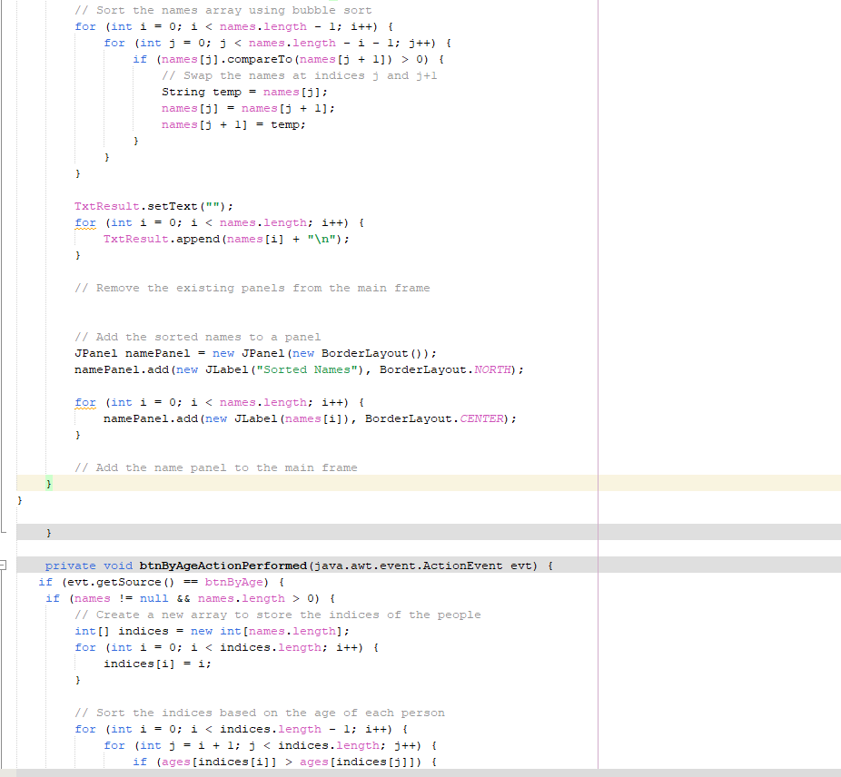
JAVA CODE & INTERFACE

Slide 8
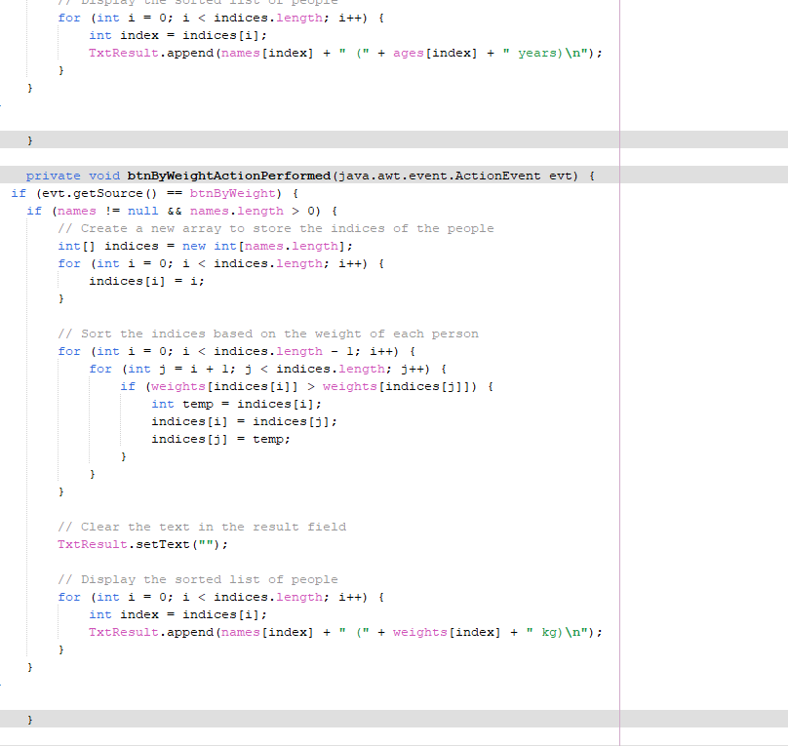

Slide 9
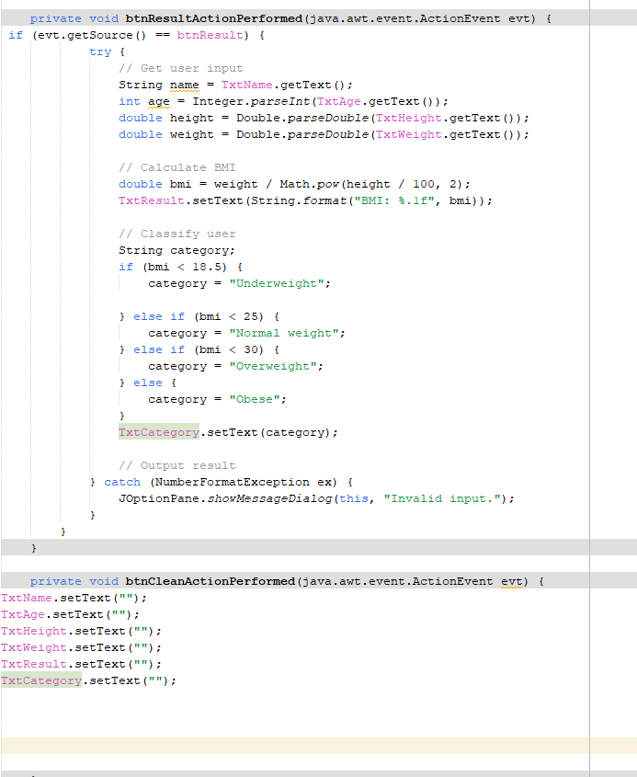

Slide 10


Slide 11
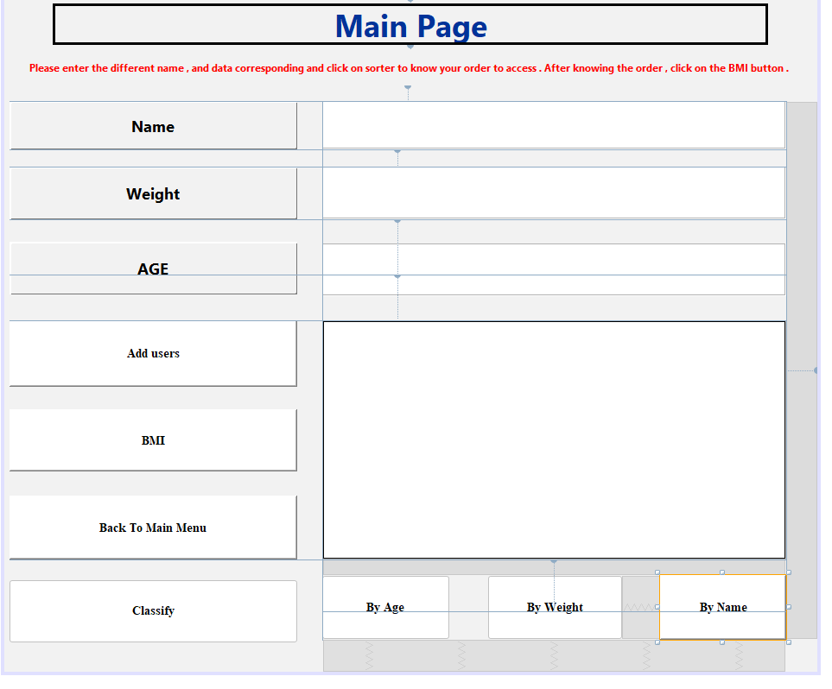

Slide 12
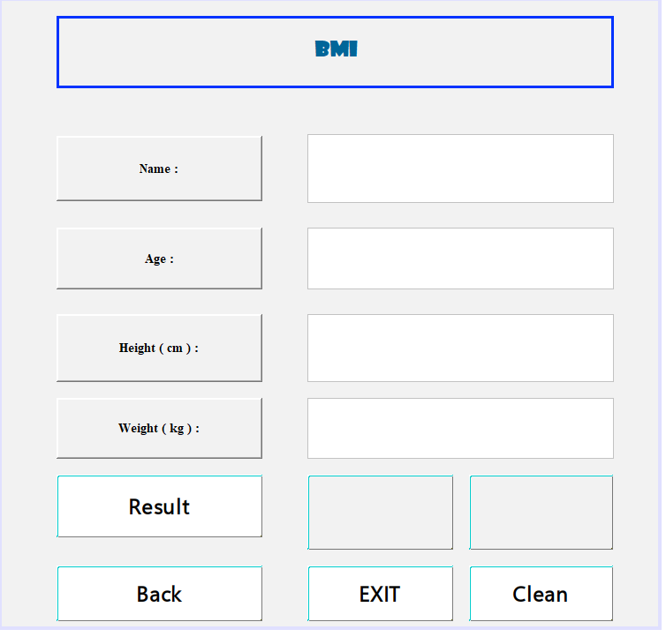

Slide 13
CONCLUSION
In conclusion, my project is finished and from now I will do a real demonstration

