Slide 1
Machine Learning in Business, 3rd Edition
Chapter 6: Supervised Learning: Neural Networks

Slide 2
A Simple ANN (Artificial Neural Network), Figure 6.1

Slide 3
Activation Functions
H is not related directly to the features
There is a hidden layer with neurons
H is related to the V_{k}
The V_{k} are related to the features
Activation functions define the relationships

Slide 4
One possible set of equations for the house price example (13 parameters)

Slide 5
Another Example, 19 parameters (Figure 6.3)

Slide 6

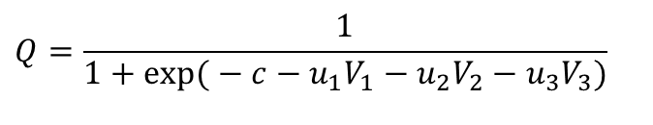
One possible set of equations for the loan example
$$v_{1}=\frac{1}{1+\exp{(}−a_{1}−w_{11}x_{1}−w_{21}x_{2}−w_{31}x_{3}−w_{41}x_{4})}$$
$$v_{2}=\frac{1}{1+\exp{(}−a_{2}−w_{12}x_{1}−w_{22}x_{2}−w_{32}x_{3}−w_{42}x_{4})}$$
$$v_{3}=\frac{1}{1+\exp{(}−a_{3}−w_{13}x_{1}−w_{23}x_{2}−w_{32}x_{3}−w_{41}x_{4})}$$
$$Q=\frac{1}{1+\exp{(}−c−u_{1}V_{1}−u_{2}V_{2}−u_{3}V_{3})}$$

Slide 7
A General Neural Network (Figure 6.4)

Slide 8
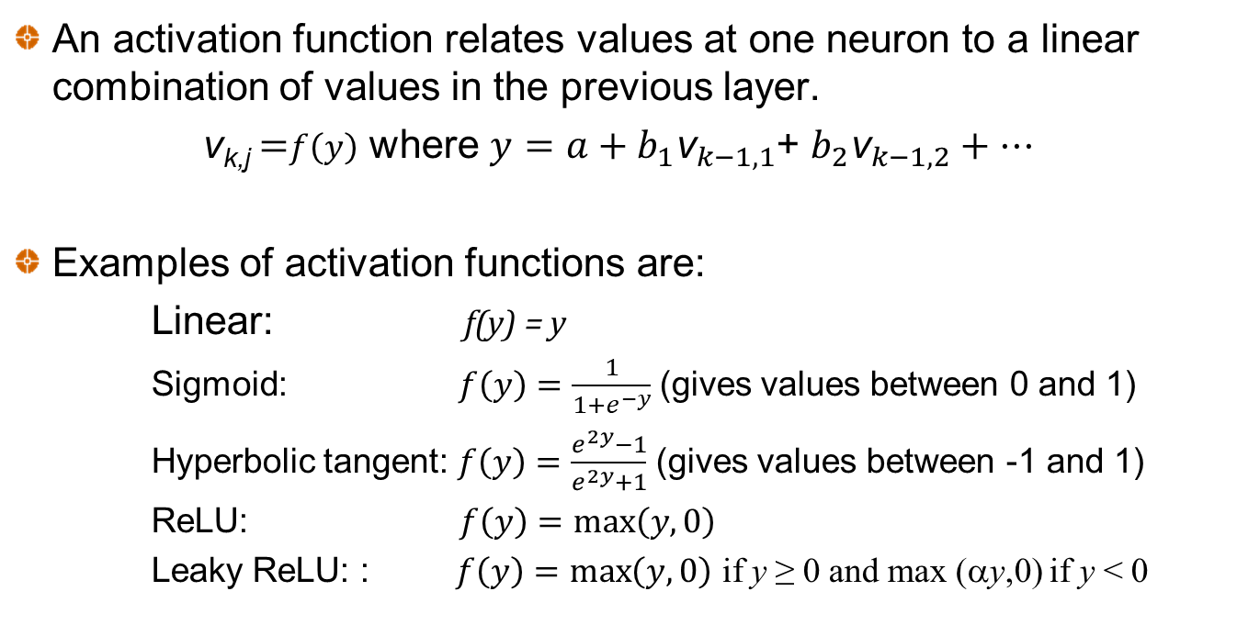
Activation Functions
An activation function relates values at one neuron to a linear combination of values in the previous layer.
v_{k,j} =$f\left(y\right)$ where $y=a+b_{1}{\text{v}}_{k−1,1}$+ $b_{2}{\text{v}}_{k−1,2}+…$
Examples of activation functions are:
Linear: f(y) = y
Sigmoid: $f\left(y\right)=\frac{1}{1+e^{−y}}$ (gives values between 0 and 1)
Hyperbolic tangent: $f\left(y\right)=\frac{e^{2y}−1}{e^{2y}+1}$ (gives values between -1 and 1)
ReLU: $f\left(y\right)=\max\left(y,0\right)$
Leaky ReLU: : $f\left(y\right)=\max\left(y,0\right)$ if y ≥ 0 and max (αy,0) if y < 0
Notes:
Y=

Slide 9
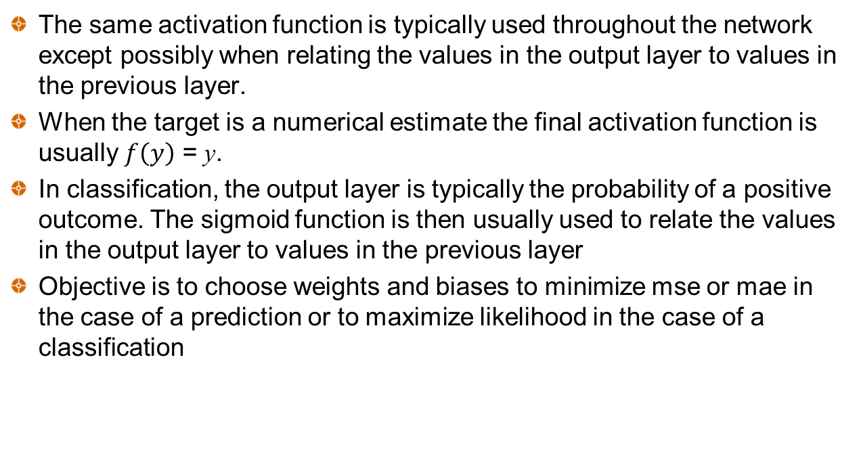
Activation Functions continued
The same activation function is typically used throughout the network except possibly when relating the values in the output layer to values in the previous layer.
When the target is a numerical estimate the final activation function is usually $f\left(y\right)$ = y.
In classification, the output layer is typically the probability of a positive outcome. The sigmoid function is then usually used to relate the values in the output layer to values in the previous layer
Objective is to choose weights and biases to minimize mse or mae in the case of a prediction or to maximize likelihood in the case of a classification

Slide 10
Universal Approximation Theorem
Any continuous function can be approximated to arbitrary accuracy with one hidden layer (See K. Hornik: Neural Networks, 1991, 4:251-257)
But this may require a very large number of neurons.
Using several hidden layers can be computationally more efficient

Slide 11
Number of Parameters
Neural networks can have a very large number of parameters
If there are F features, H hidden layers, M neurons in each hidden layer and T targets the number of parameters is
(F+1)M+M(M+1)(H-1)+(M+1)T
The simple house price neural network has 13 parameters and the simple loan decision neural network has 19 parameters
But in practice a small neural network might have 4 features, 3 hidden layers, 30 neurons per layer and one target for a total of 2,041 parameters.
Larger neural networks have tens, or even hundreds, of thousands of parameters

Slide 12
Gradient Descent and Neural Nets
Suppose that there are N parameters. An objective function (e.g., mse or one based on maximum likelihood estimates) is minimized for training set data
A gradient descent algorithm starts with a set of values for the N parameters, calculates the direction of steepest descent down the valley, takes a step, calculates a new direction of steepest descent, takes another step, and so on
The partial derivatives with respect to the parameters are calculated by a procedure known as backpropagation. This involves working back through the network using the chain rule. (See Rumelhart, Hinton, and Williams, Nature, 1986, 323, 533-536)
The size of the step is determined by the “learning rate”. If the step is too small the algorithm will be very slow. If it is too large there are liable to be oscillations:
Increase in variable = −learning rate × gradient

Slide 13
Very Simple Example: Calculating the value of x that minimizes y when y=x²−8x+20
g(x)
25
20
Starting point, x=1
15
After first step, x=2.2
After second step, x=2.92
10
5
x
0
0
1
2
3
4
5
6
7
8
9

Slide 14
When Learning Rate is 0.2

Slide 15
When Learning Rate is 0.02

Slide 16
When Learning Rate is 1.2

Slide 17
Other Details
Use mini batches of data to calculate gradients. (One epoch is one complete use of training set.)
Use a momentum strategy
Adaptively calculate the learning rate (Adam)
Learning rate decay
Dropouts

Slide 18
Local Minima
Important to try and avoid local minima
A
B
C
Parameter Value

Slide 19
Stopping Rule
Because applications have many parameters it is important to use a stopping rule to avoid over-fitting
We calculate results for the validation set at the same time as the training set.
When the results for the validation set start to get worse we stop

Slide 20
Black-Scholes-Merton Application
We generated 10,000 call option prices using the Black-Scholes-Merton model and then added a normally distributed error of 0.15 to the price.
The parameters were sampled randomly from uniform distributions
The model had three hidden layers and 20 neurons per layer

Slide 21
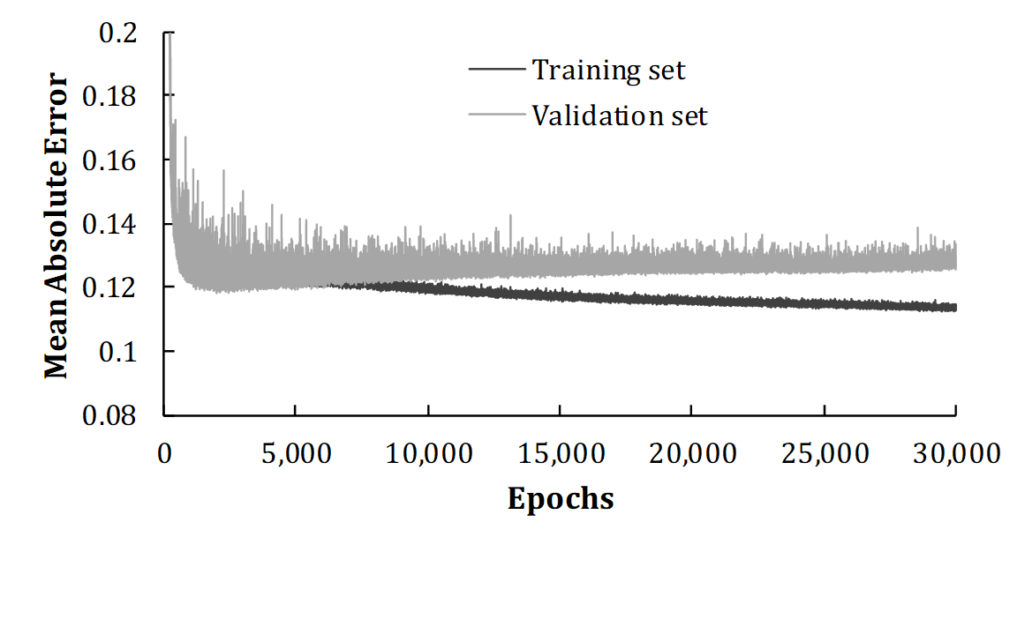
Training set and validation set mse as the epochs of training is increased

Slide 22
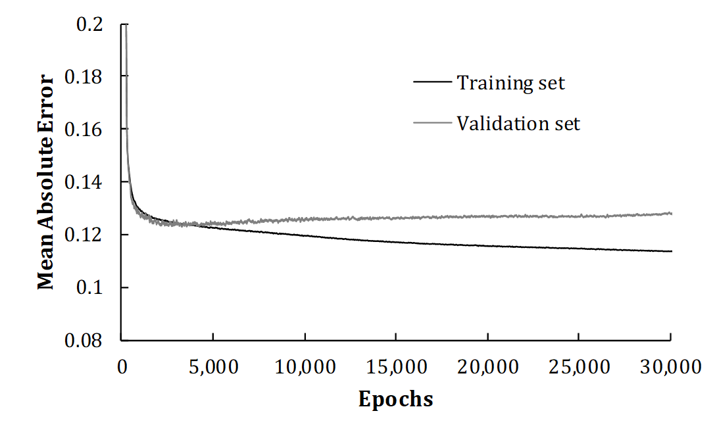
Smoothed mse (Moving Average over 50 epochs) Stop after 2575 epochs

Slide 23
Results
With only 10,000 observations the neural network imitated the Black-Scholes-Merton model well
It eliminated much of the random noise we added to the BSM prices.

Slide 24
Using a similar idea to value exotic derivatives
Some “exotic” derivatives are valued using Monte Carlo simulation which is slow
Neural networks can be used as follows:
Do an initial analysis to generate a large amount of data relating prices to input variables
Construct a neural network to replicate prices
Obtain fast pricing by working forward through network
Useful for scenario analysis

Slide 25
Another Application of ANN: Understanding implied volatilities
The implied volatility of an option is the volatility that, when substituted into Black-Scholes-Merton formula, gives the price of the option in the market

Slide 26
Implied volatilities continued
If Black-Scholes-Merton was used for pricing, all options on an asset would have the same implied volatility
In fact, there is quite a variation in implied volatilities
Nevertheless implied volatilities are used to communicate prices and it is therefore important for traders to monitor implied volatilities
The volatility surface shows implied volatilities as a function of
Moneyness or how likely the option is to be exercised (Traders measure this by the delta, the sensitivity of the option to the underlying asset’s price)
Time to maturity, T

Slide 27
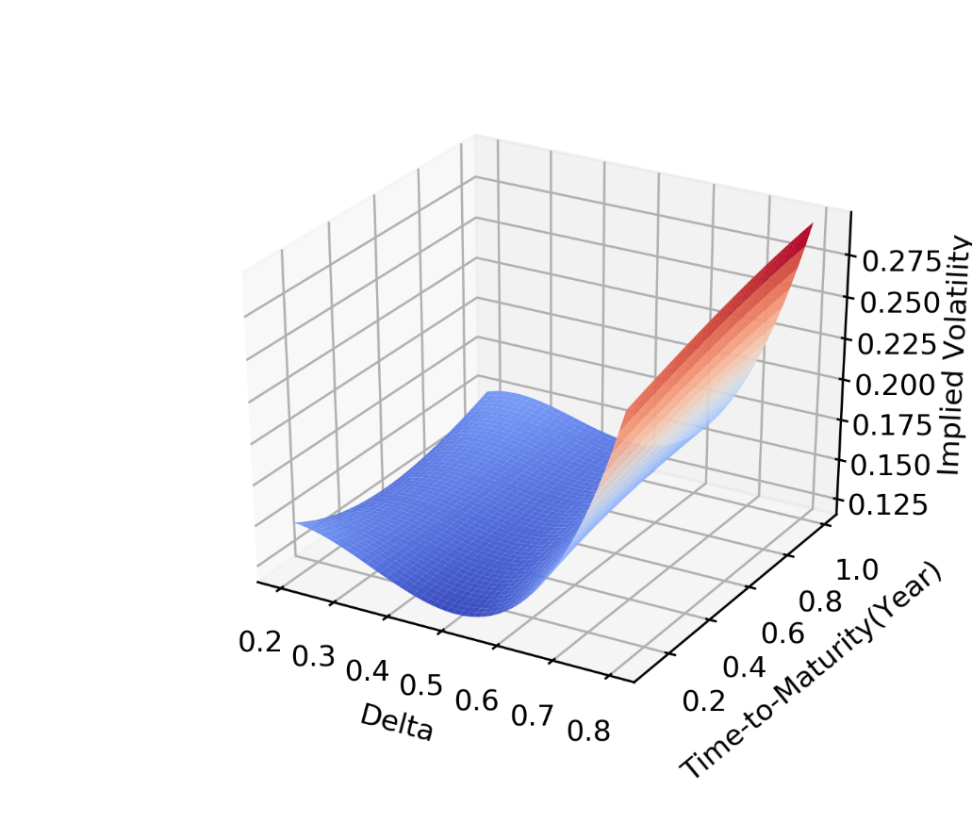
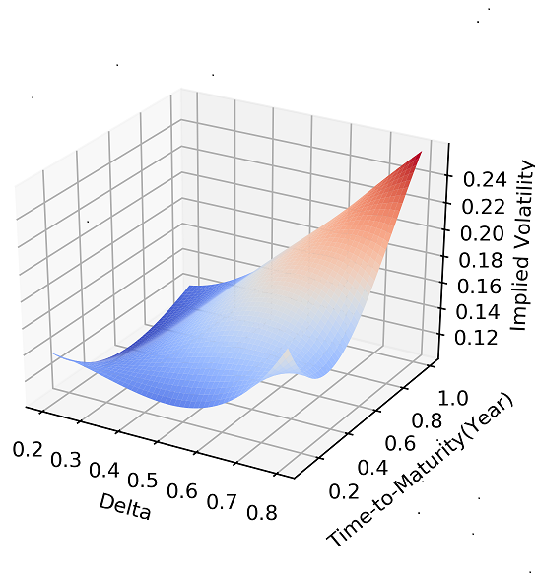
Volatility Surfaces for S&P 500
Jan 31, 2019
June 25, 2019

Slide 28
Understanding Volatility Surface Movements
To understand volatility surface movements we used data on S&P 500 call options to construct a neural network
Input layer:
Daily asset price return
Moneyness (measured by delta)
Time to maturity
Output layer:
Change in implied volatility

Slide 29
Details
3 hidden layers
20 neurons per layer
Observations from 2014-2019
Randomly sampled 100 options per day
125,700 options in total
60% for training set
20% for validation set
20% for test set
Z-score scaling

Slide 30
Sample of raw data
After scaling:

Slide 31
Mean Squared Error (Training stopped after 5,826 epochs)

Slide 32
Results
Test set gave a modest 14% improvement over a simple analytic model proposed by Hull and White in 2017
However, when the VIX index on Day t was used as a feature to predict changes between Day t and Day t+1 there was a considerable improvement
The behavior of the volatility surface is different in high and low volatility environments

