Slide 1
WAR THUNDER · MATCH ANALYSIS
What 300 War Thunder matches show
Five chart types, one dataset
Matches played by Apolox_Dragon in War Thunder
Analysed with WT Session Readout, in the browser
Counting unit: matches
1 / 9
Notes:
What 300 War Thunder matches show
Data: matches played by Apolox_Dragon in War Thunder. Made by Apolox · https://github.com/ApoloxDragon · tool: https://github.com/ApoloxDragon/WarThunder-Tool

Slide 2
The data
300
334
34
UNIQUE MATCHES
PASTED REPORTS
REPEATS REMOVED
238
62
169 (56.3%)
RANDOM BATTLES
TANK ASSAULT
MATCHES WON
Everything is counted in matches, not points, time or Silver Lions.
Charts 1, 3 and 5 use all 300 matches; charts 2 and 4 use Random Battles only (238).
Repeated reports are removed by Session ID; the tool runs entirely in the browser, nothing is uploaded.
2 / 9
Notes:
The data
Data: matches played by Apolox_Dragon in War Thunder. Made by Apolox · https://github.com/ApoloxDragon · tool: https://github.com/ApoloxDragon/WarThunder-Tool

Slide 3
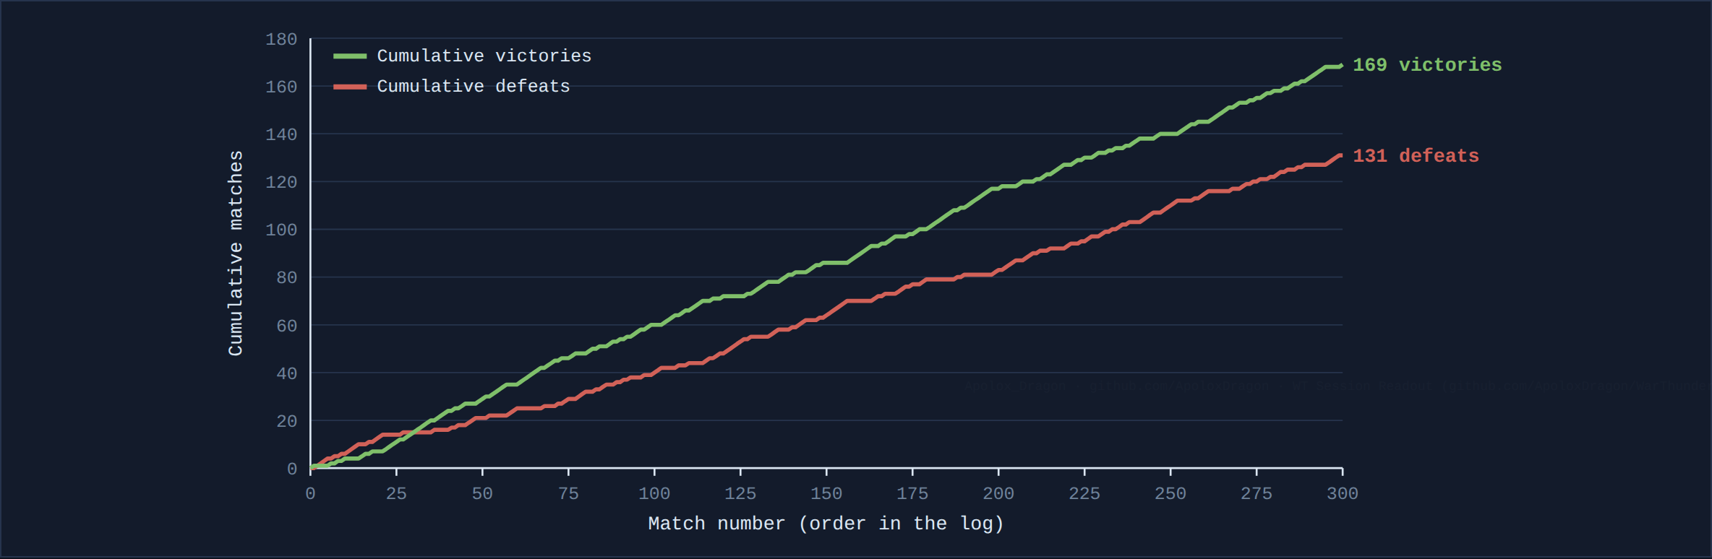
CHART 1
Cumulative victories and defeats
All 300 matches
Won 169 of 300 matches (56.3%); lost 131.
Biggest lead: +41 wins over losses, at match 295; the log ends at +38.
Longest streaks: 8 wins in a row, 7 losses in a row.
The horizontal axis is the position in the log, not a date: the log has no dates.
3 / 9
Notes:
Cumulative victories and defeats
Data: matches played by Apolox_Dragon in War Thunder. Made by Apolox · https://github.com/ApoloxDragon · tool: https://github.com/ApoloxDragon/WarThunder-Tool

Slide 4
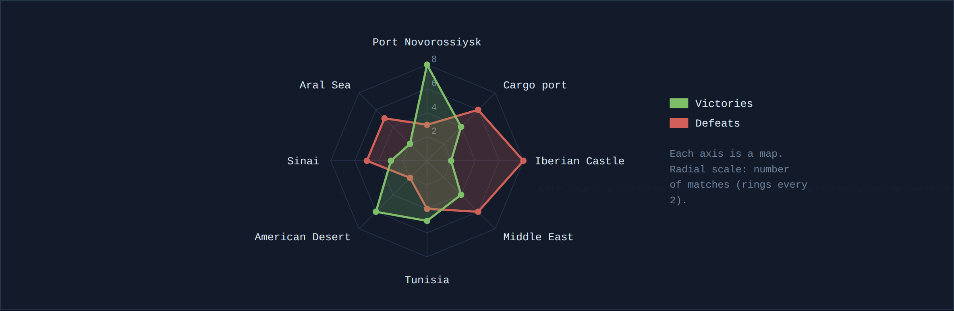
CHART 2
Victories and defeats on the 8 most played maps
Random Battles only · 238 matches
The 8 most played maps hold 73 of 238 Random Battles matches (30.7%).
Most wins: Port Novorossiysk (8). Best win rate: American Desert, 6 of 8 (75.0%).
Lowest win rate: Iberian Castle, 2 of 10 (20.0%).
Each map has only 7–11 matches, so one result moves the percentage a lot.
4 / 9
Notes:
Victories and defeats on the 8 most played maps
Data: matches played by Apolox_Dragon in War Thunder. Made by Apolox · https://github.com/ApoloxDragon · tool: https://github.com/ApoloxDragon/WarThunder-Tool

Slide 5
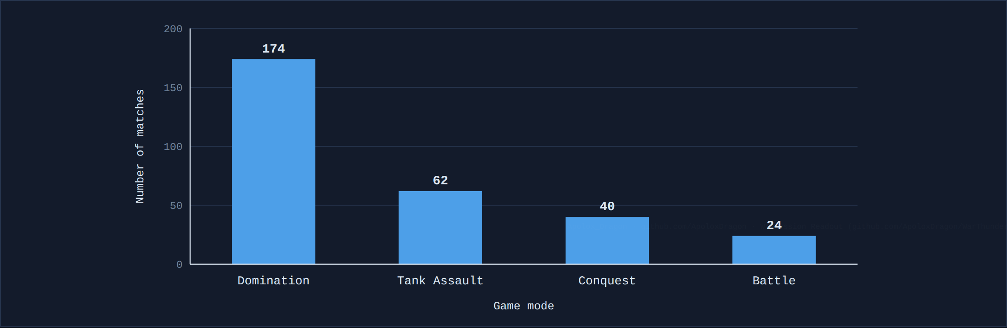
CHART 3
Matches per game mode
All 300 matches
Domination is the most frequent mode: 174 matches (58.0%).
All modes: Domination 174 · Tank Assault 62 · Conquest 40 · Battle 24.
Together they add up to the 300 matches.
Tank Assault is both a mode in the log and a category in the tool.
5 / 9
Notes:
Matches per game mode
Data: matches played by Apolox_Dragon in War Thunder. Made by Apolox · https://github.com/ApoloxDragon · tool: https://github.com/ApoloxDragon/WarThunder-Tool

Slide 6
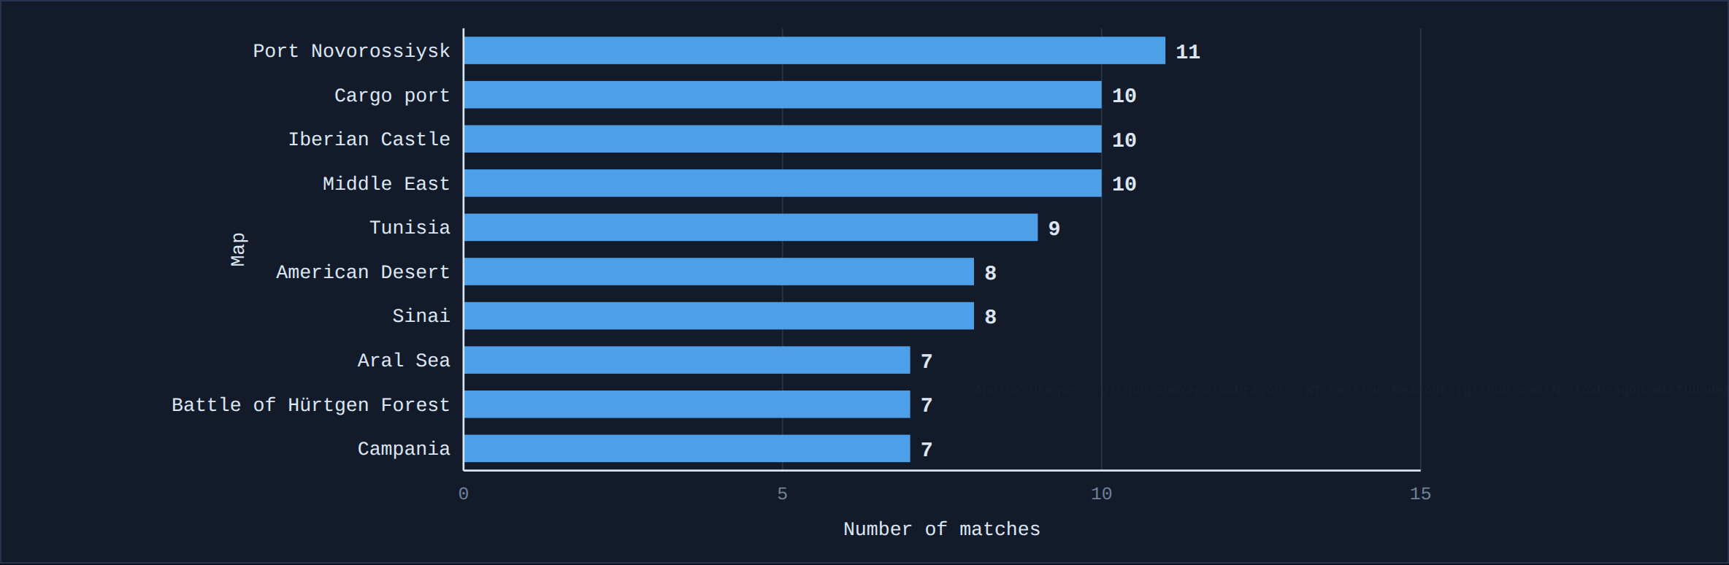
CHART 4
The 10 most played maps
Random Battles only · 238 matches
Most played map: Port Novorossiysk, 11 matches (4.6%).
The top 10 maps hold 87 of 238 matches (36.6%).
56 different maps appear in Random Battles.
Horizontal bars fit long map names and read as a ranking.
6 / 9
Notes:
The 10 most played maps
Data: matches played by Apolox_Dragon in War Thunder. Made by Apolox · https://github.com/ApoloxDragon · tool: https://github.com/ApoloxDragon/WarThunder-Tool

Slide 7
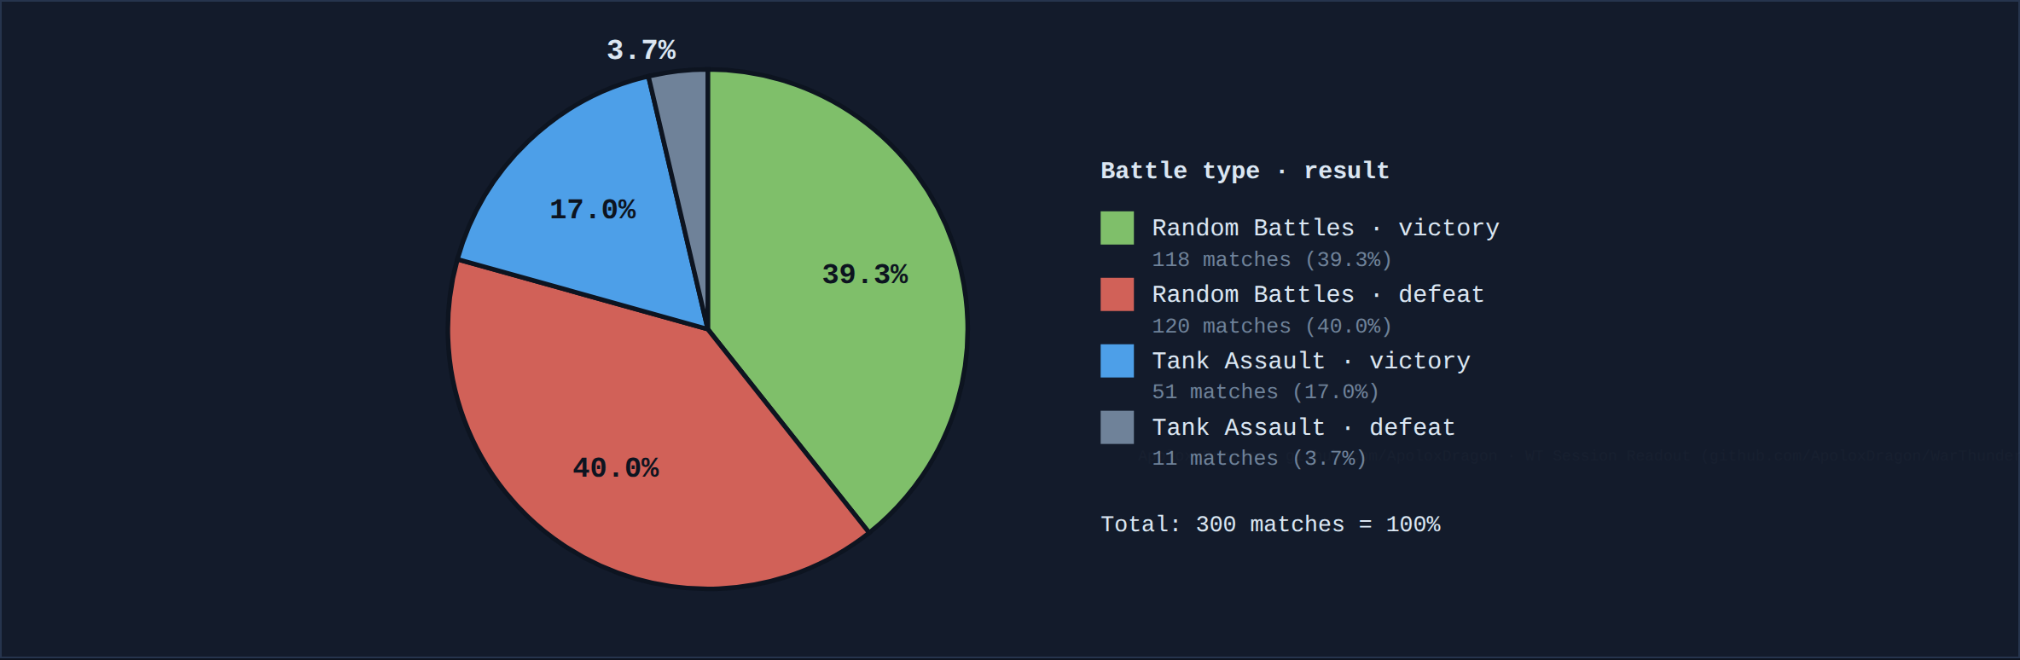
CHART 5
Matches by battle type and result
All 300 matches
Random Battles: 238 matches, 118 won (49.6%).
Tank Assault: 62 matches, 51 won (82.3%).
Overall: 169 of 300 won (56.3%).
This is a difference in this sample; the chart does not say why.
7 / 9
Notes:
Matches by battle type and result
Data: matches played by Apolox_Dragon in War Thunder. Made by Apolox · https://github.com/ApoloxDragon · tool: https://github.com/ApoloxDragon/WarThunder-Tool

Slide 8
How to read this
One player, accumulated over time: a convenience sample, not random and not representative of all players.
"Random Battles" is the tool's category for every match that is not Tank Assault; the log does not say whether a match was ground or air.
Map percentages rest on a few matches each; treat them as a pattern, not a verdict.
The log has no dates, only the order the matches were pasted in.
Differences shown are in this sample; the charts do not show causes.
8 / 9
Notes:
How to read this
Data: matches played by Apolox_Dragon in War Thunder. Made by Apolox · https://github.com/ApoloxDragon · tool: https://github.com/ApoloxDragon/WarThunder-Tool

Slide 9
Summary
300 unique matches: 56.3% won overall.
Random Battles: 49.6% won; Tank Assault: 82.3% won (a smaller sample, 62 matches).
Five chart types, five different questions: trend, profile, comparison, ranking, share.
Questions?
9 / 9
Notes:
Summary
Data: matches played by Apolox_Dragon in War Thunder. Made by Apolox · https://github.com/ApoloxDragon · tool: https://github.com/ApoloxDragon/WarThunder-Tool

