Slide 1
RShiny

Slide 2
What is Rshiny?
An R package that allows you to build interactive web apps straight from R.
Web apps contain clients and a server
Shiny compiles your R code into CSS, HTML & Javascript
Deploy to the cloud with shinyapps.io or or to your own server
To run shiny:
install.packages(“shiny”)

Slide 3
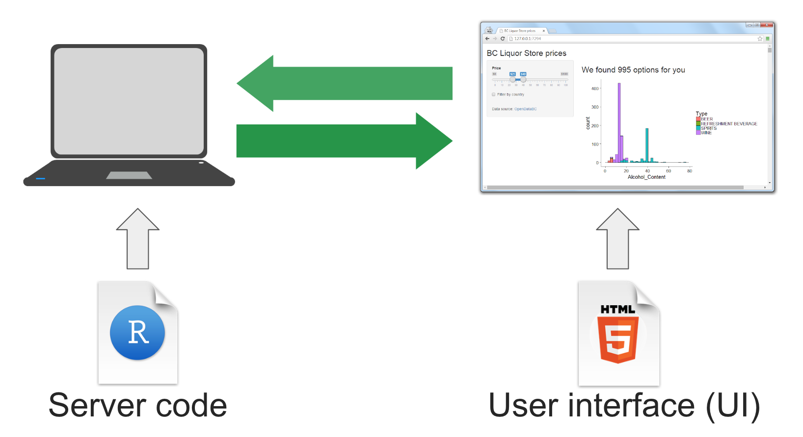
What is Rshiny?
Notes:
Rshiny is based on the client-server model.
Client server model - where the client requests and sends back a response
UI - the UI is the frontend that accepts user input values
Server - the server is the backend that processes these input values to finally produce output results that are displayed on your website

Slide 4
Structure of a Shiny web app
Comprises of 3 components:
User interface
Server function
shinyApp function (combines the server and user components)
User Interface - is the frontend that accepts user values
Server - the backend that process these values to produce output
ShinyApp function – combines the server and user interface to make a shiny object

Slide 5
Examples
Shiny Gallery
https://shiny.rstudio.com/gallery/

