Slide 1
Customer Behaviour
Analytics
An end-to-end portfolio project turning 3,900 customer records into a decision-support workflow with Python, SQL Server, and Power BI.

Slide 2



This project connects technical work to business decisions
Raw data becomes an analysis-ready story for business users.
Understand value
Prepare the evidence
Communicate clearly
Across demographics, products, discounts, shipping, subscriptions, and loyalty.
Move beyond isolated tool demos with reliable data and focused business questions.
Use an interactive dashboard to turn analysis into decisions.

Slide 3
DATA FOUNDATION
3,900 records became a reliable analysis base
3,900
37
0
customer records
missing review ratings
duplicate customer records
18 original fields across demographics, products, purchase value, satisfaction, shipping, discounts, loyalty, and payment.
Filled with category-level medians. Frequency labels were standardized for consistent analysis.
Purchase amounts ranged from $20 to $100; ages ranged from 18 to 70. A redundant promo-code field was identified.

Slide 4
PYTHON / PANDAS
Python made the dataset analysis-ready
A repeatable preparation layer connects the CSV to business analysis.
01
02
03
04
Profile
Clean
Engineer
Load
Inspect shape, types, distributions, missing values, and unique values with Pandas.
Impute ratings by category, harmonize frequency labels, validate IDs, and standardize column names.
Create the business-friendly features age_group and purchase_freq_in_days.
Move the prepared table into SQL Server through SQLAlchemy and pyodbc.

Slide 5





SQL SERVER / BUSINESS QUESTIONS
SQL translated business questions into repeatable analysis
Revenue by gender and age group.
Subscriber versus non-subscriber spend and revenue.
Discounted customers with above-average purchase value.
Top-rated products and products with the highest discount penetration.
Shipping type, customer segments, repeat buyers, and top products within each category.
Aggregation · subqueries · CASE logic · CTEs · conditional percentages · ROW_NUMBER() ranking

Slide 6





The analysis is designed to reveal customer value patterns
Segment customers as New, Returning, or Loyal using previous-purchase thresholds.
Test whether repeat buyers are more likely to subscribe.
Compare average purchase value across shipping types and subscription status.
Identify high-rated products and category-level best sellers for merchandising opportunities.
Separate productive discounting from potential promotion dependency.

Slide 7
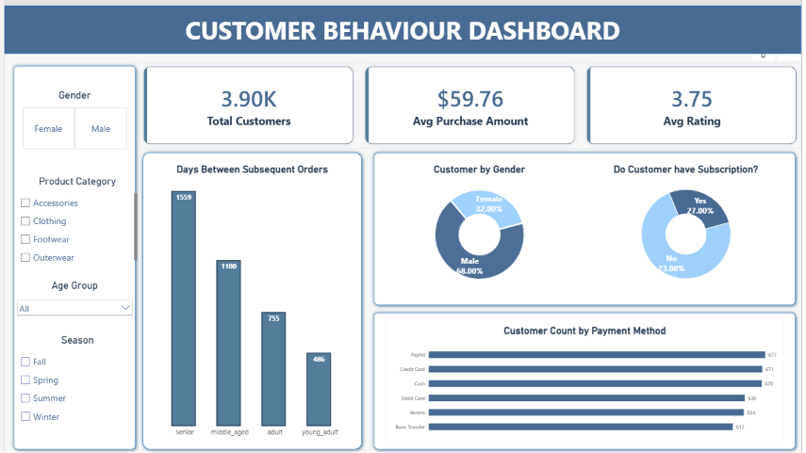

Power BI turned analysis into an interactive reporting layer
Move from high-level customer and revenue patterns into product, demographic, discount, subscription, and loyalty analysis.
POWER BI · REPORTNG LAYER

Slide 8
END-TO-END WORKFLOW
One pipeline, three tools, one decision-support workflow
01
02
03
04
CSV
Python / Pandas
Data Cleaning
Feature Engineering
05
06
07
08
SQL Server
Business Analysis
Power BI Dashboard
Business Insights
Python
SQL
Power BI
Improves reliability and analytical usability.
Structures questions and makes analysis reproducible.
Makes results accessible for exploration and reporting.

Slide 9





The recommendations are built around action, not just description
Differentiate retention strategies by customer segment.
Evaluate discount penetration against margin and incremental value.
Use high-rated products for merchandising, cross-sell, and promotion tests.
Target subscription offers toward repeat buyers when the economics support it.
Use age and gender patterns as inputs to targeted marketing, not as standalone decisions.
Validate premium-shipping and purchase-value relationships before using delivery as an upsell.

Slide 10
LIMITATIONS
Strong foundation, with clear next steps
NEXT STEP
Move from description toward testing and prediction.
No transaction date
True time-series and cohort analysis are not possible.
History is proxied
Previous Purchases is a proxy for customer history, not transaction-level history.
No invented outputs
The report documents SQL logic and intended interpretations, but does not include numerical query outputs.
Add dated transactions, margin, campaign exposure, and cohort metrics.

