Slide 1
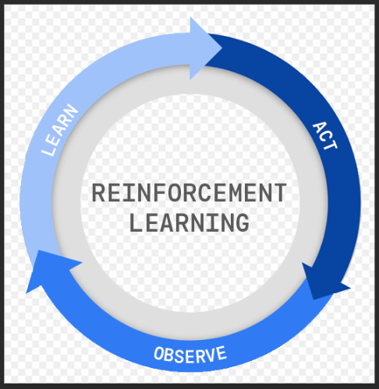

Slide 2
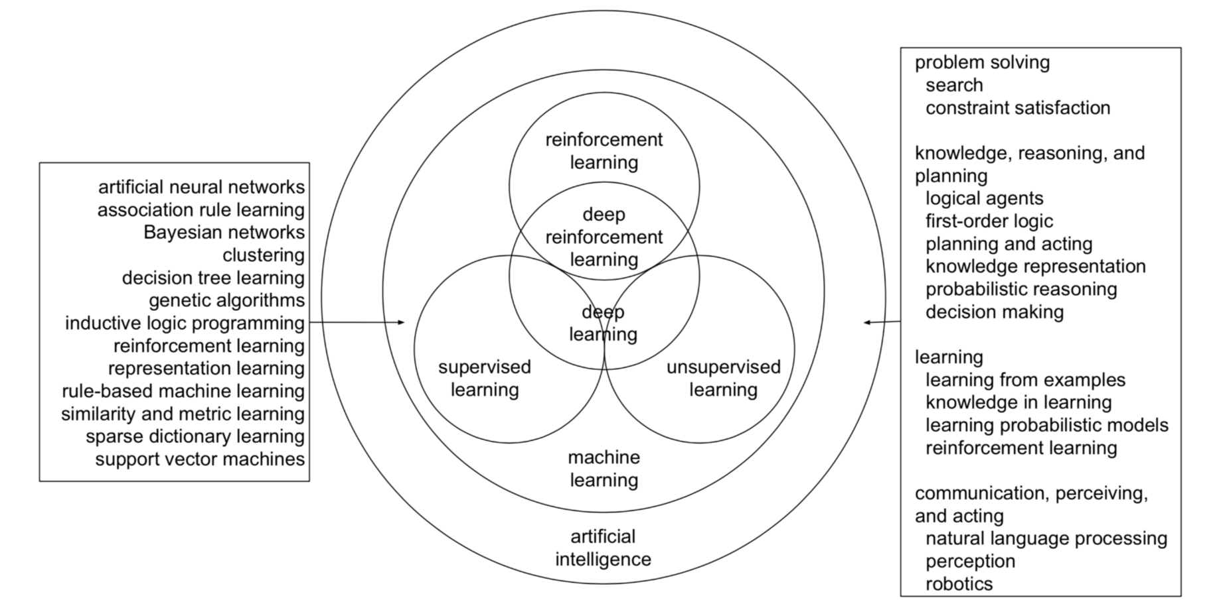
AI, ML, DL, RL

Slide 3
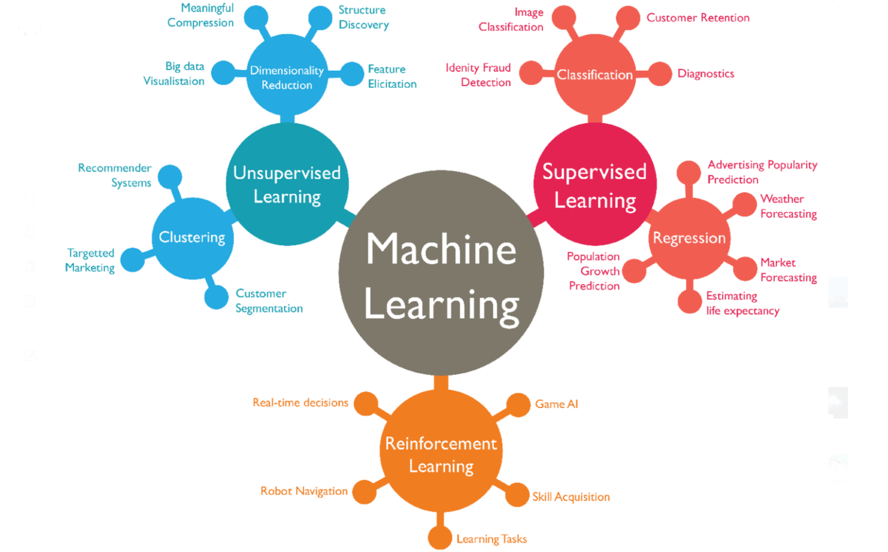

Slide 4
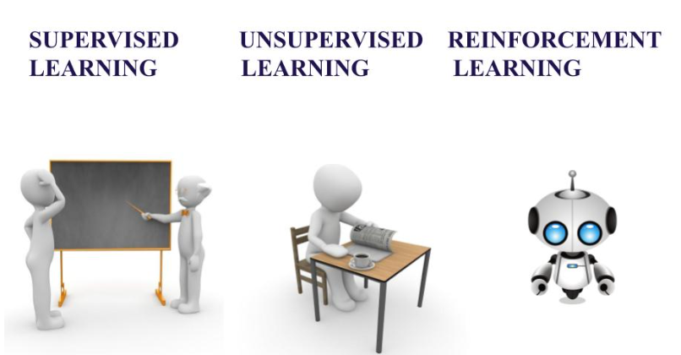

Slide 5
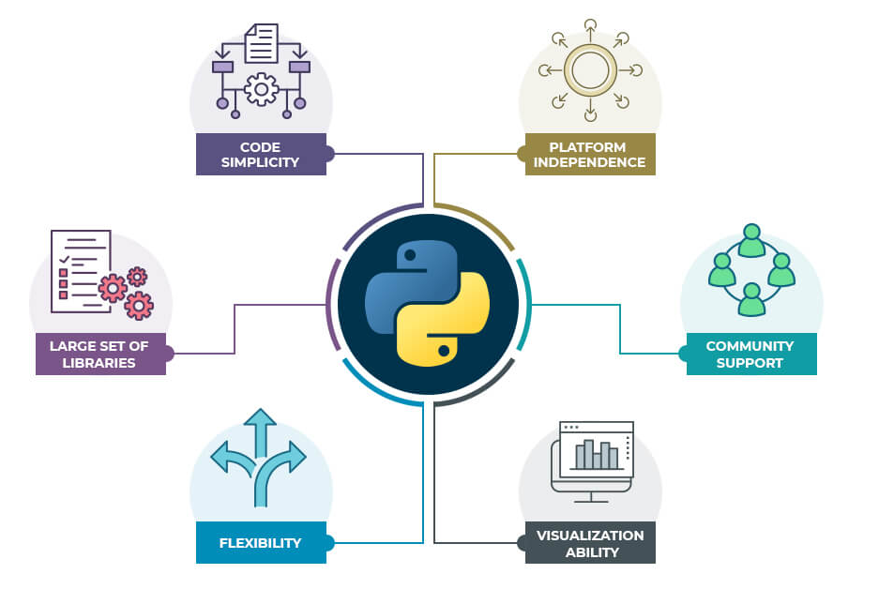
Why Python ??

Slide 6
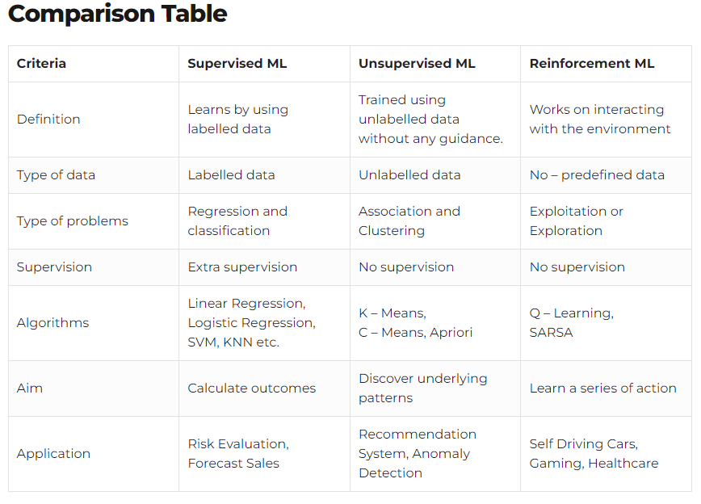

Slide 7
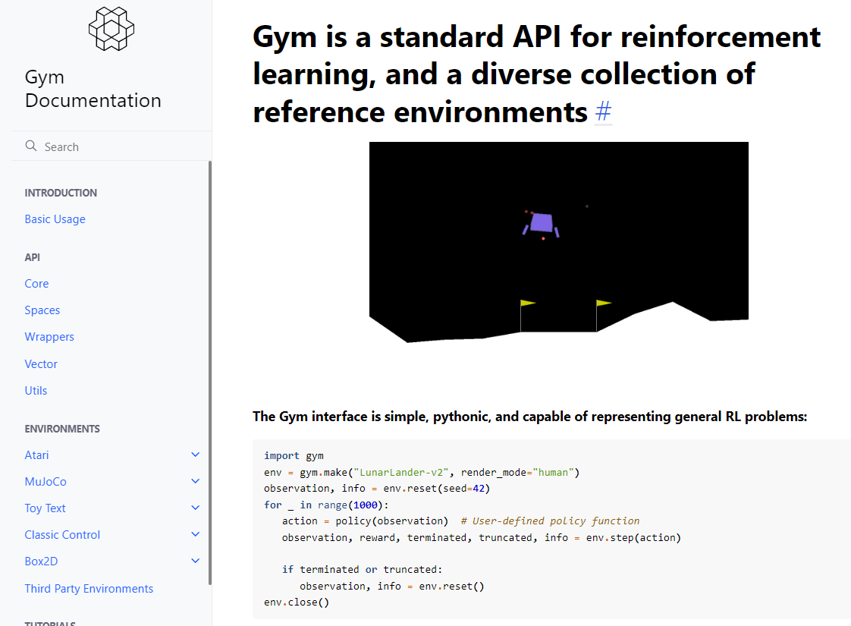
RL Environments
Agent will give actions into environments in order to maximize the notion of cumulative reward.
When the agents give action to the environment, then the environment will update its state as the input to the agents to calculate the reward and update the action.
In the control term, we can imagine agents as the controller and environments as the system we want to control.

Slide 8


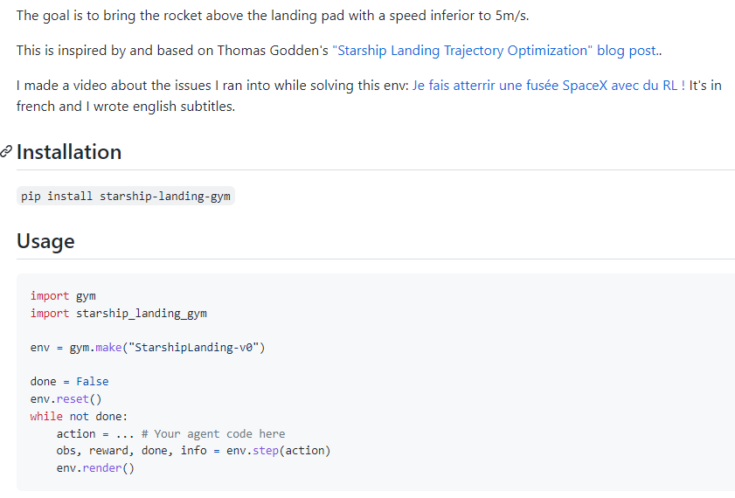

Slide 9
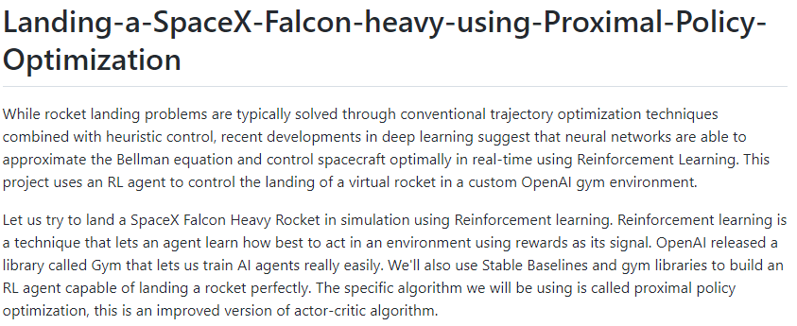

Custom RL Environments

Slide 10
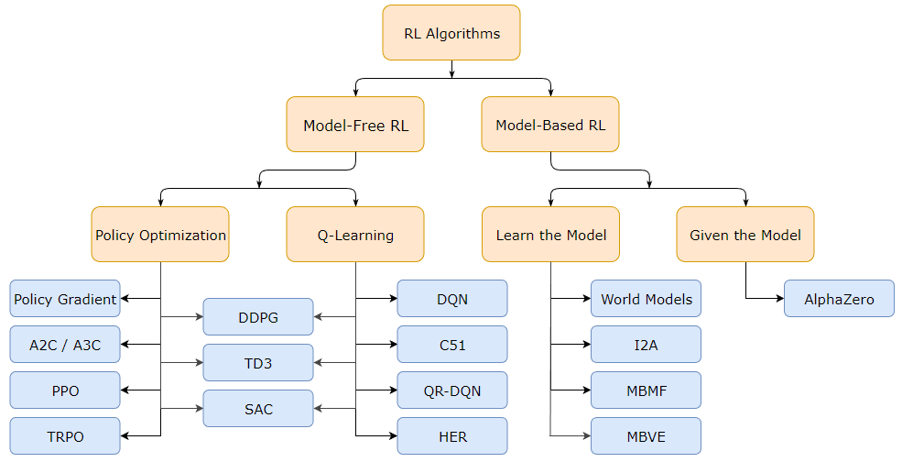
A Taxonomy of RL Algorithms

Slide 11
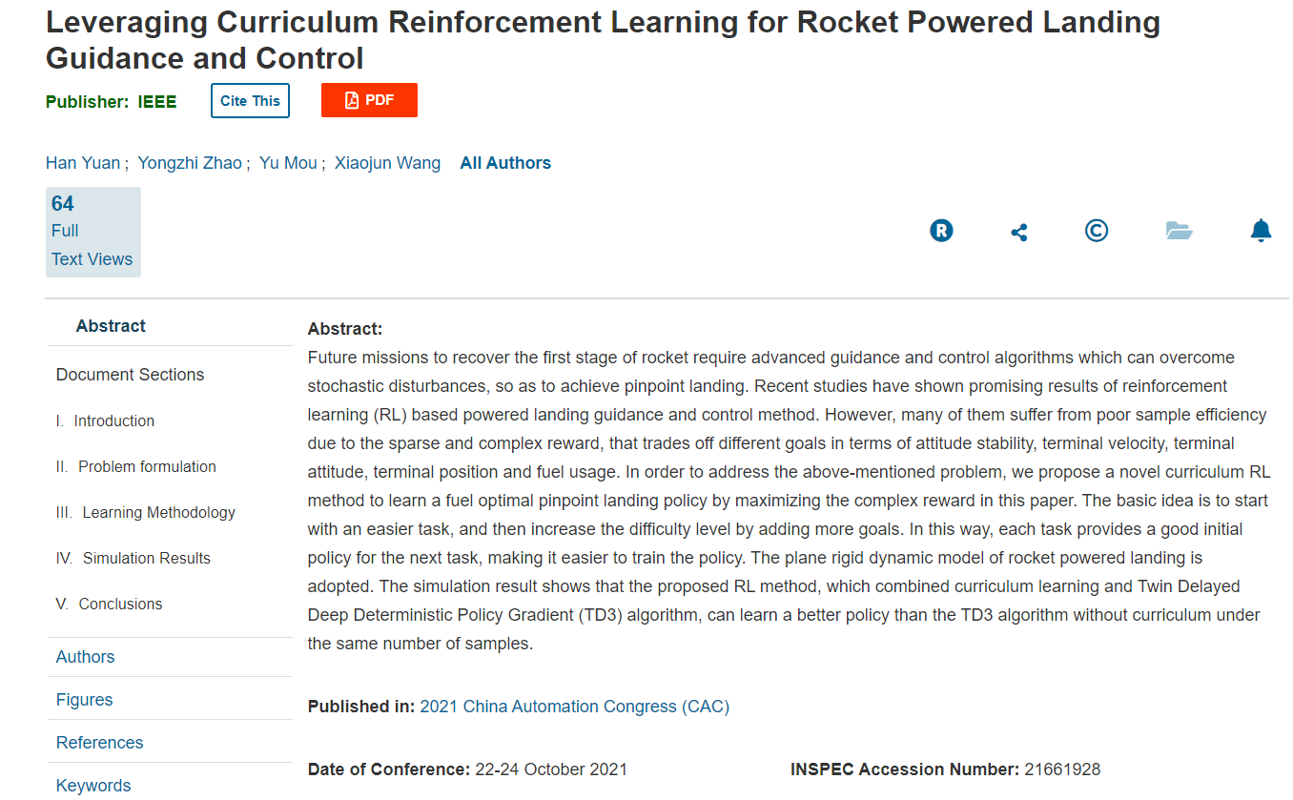

Slide 12
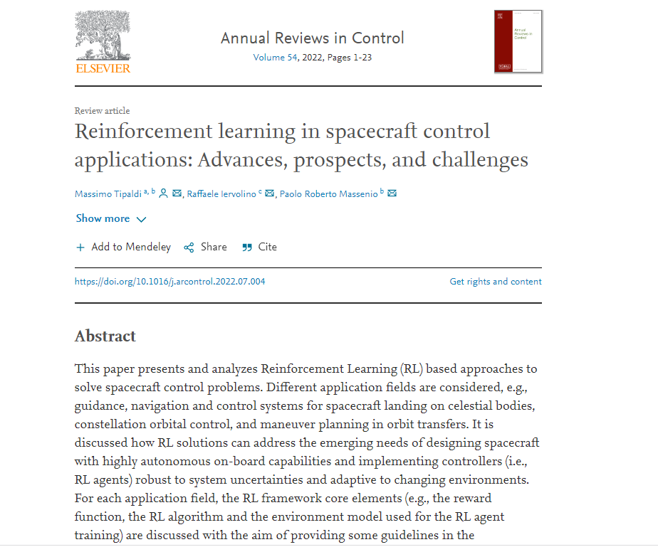

Slide 13
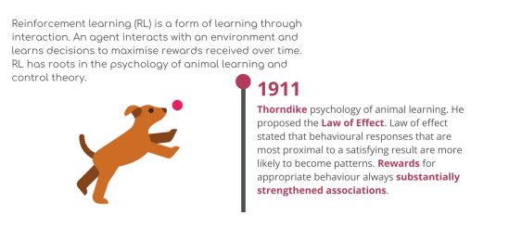
Reinforcement learning (RL) is an exciting and rapidly developing area of machine learning that significantly impacts the future of technology and our everyday lives.
RL is a field separate from supervised and unsupervised learning focusing on solving problems through a sequence or sequences of decisions optimized by maximizing the accrual of rewards received by taking correct decisions.
RL originates from animal learning in experimental psychology and optimal control theory whilst also drawing from and contributing to neuroscience.
ORIGINS IN ANIMAL LEARNING

Slide 14
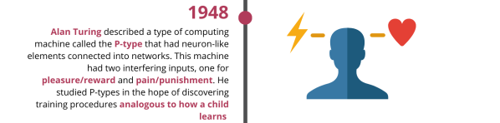
In 1948, Alan Turing presented a visionary survey of the prospect of constructing machines capable of intelligent behaviour in a report called “Intelligent Machinery”.
Turing may have been the first to suggest using randomly connected networks of neuron-like nodes to perform computation and proposed the construction of large, brain-like networks of such neurons capable of being trained as one would teach a child. Turing called his networks “unorganized machines”
Turing described three types of unorganized machines. A-type and B-type unorganized machines consist of randomly connected two-state neurons.
The P-type unorganized machines, which are not neuron-like, have “only two interfering inputs, one for pleasure or reward and the other for pain or punishment”. Turing studied P-type machines to try and discover training procedures analogous to children learning. He stated that by applying “appropriate inference, mimicking education”, a B-type machine can be trained to “do any required job, given sufficient time and provided the number of units is sufficient”.
TURING’s UNORGANIZED MACHINES

Slide 15
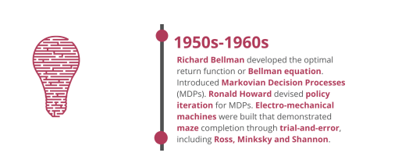
Optimal Control research began in the 1950s as a formal framework to define optimization methods to derive control policies in continuous time control problems, as shown by Pontryagin and Neustadt in 1962.
Richard Bellman developed dynamic programming as both a mathematical optimization and computer programming method to solve control problems. The process defines a functional equation using the dynamic system’s state and returns what is referred to as an optimal value function.
The optimal function is commonly referred to as the Bellman equation. Bellman introduced the Markovian Decision Process (MDP), which we define as a discrete stochastic version of the optimal control problem. Ronald Howard, in 1960 devised the policy iteration method for MDPs. All of these are essential elements underpinning the theory and algorithms of modern reinforcement learning.
ORIGINS IN OPTIMAL CONTROL

Slide 16
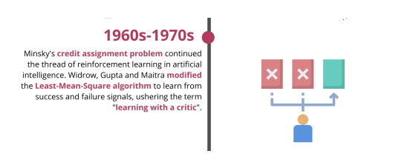
In the early 1960s, research in learning automata commenced and can be traced back to Michael Lvovitch Tsetlin in the Soviet Union. A learning automaton is an adaptive decision-making unit situated in a random environment that learns the optimal action through repeated interactions with its environment.
The steps are chosen according to a specific probability distribution, based on the response from the environment. Learning automata are considered as policy iterators in RL. Tsetlin devised the Tsetlin Automaton, which is regarded as an even more fundamental and versatile learning mechanism than the artificial neuron.
The Tsetlin Automaton is one of the pioneering solutions to the well-known multi-armed bandit problem and continues to be used for pattern classification and formed the core of more advanced learning automata designs, including decentralized control and equi-partitioning and faulty dichotomous search.
LEARNING AUTOMATA

Slide 17
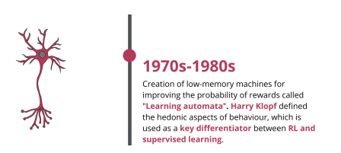
In the late 1970s and early 1980s, Harry Klopf was dissatisfied with the focus on equilibrium-seeking processes for explaining natural intelligence and providing a basis for machine intelligence.
These include homeostasis and error-correction learning commonly associated with supervised learning. He argued that systems that try to maximize a quantity are qualitatively different from equilibrium seeking systems.
This hypothesis produces a significant distinction between supervised learning, which is essentially an equilibrium-seeking process and reinforcement learning, which is effectively an evaluation-driven system where the learner’s decisions evolve in response to its experiences. Both error correction and RL are optimization processes, but error correction is more restricted, and RL is generalized and motivated by maximizing rewards through action optimization.
Hedonistic Neurons

Slide 18
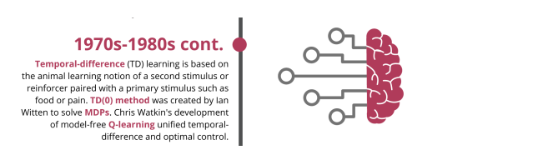
Temporal difference (TD) learning is inspired by mathematical differentiation and aims to build accurate reward predictions from delayed rewards.
TD tries to predict the combination of immediate reward and its reward prediction at the next time step. When the next time step arrives, the latest prediction is compared against what it was expected to be with new information.
If there is a difference, the algorithm calculates the error, which is the “temporal difference” to adjust the old prediction towards the latest forecast. The algorithm aims to bring the old and new predictions closer together at every time step, ensuring the entire chain of predictions incrementally becomes more accurate.
Temporal difference (TD) learning

Slide 19
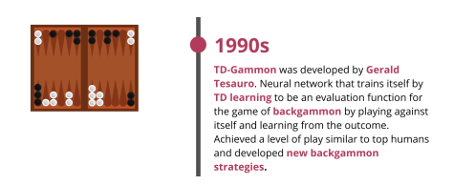
In 1992, Gerry Tesauro developed a programme that required little backgammon knowledge yet learned to play the game at the grandmaster level. The learning algorithm combined the TD-lambda algorithm and a nonlinear function approximation using a multilayer neural network trained by backpropagating TD errors.
Based on TD-Gammon’s success and further analysis, the best human players now play the unconventional opening positions learned by the algorithm.
TD Gammon

Slide 20
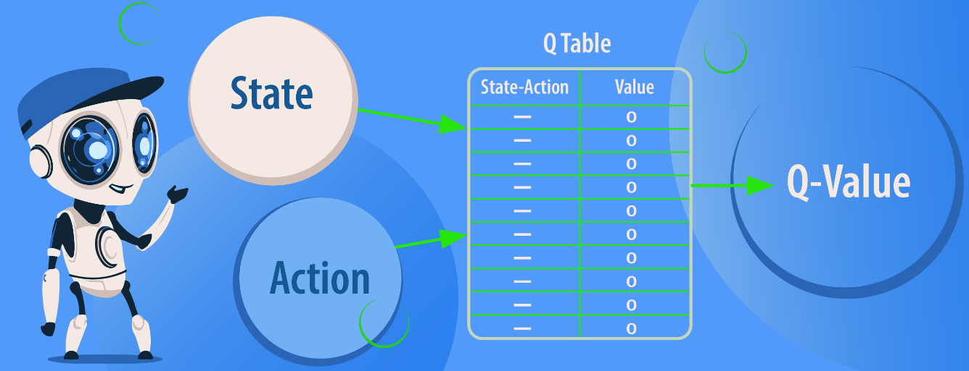
Chris Watkins introduced Q-learning in 1989 in his PhD thesis “Learning from Delayed Rewards”, which introduced a model of reinforcement learning as incrementally optimizing control of a Markovian Decision Process and proposed Q-learning as a way to learn optimal control directly without modelling the transition probabilities or expected rewards of the Markovian Decision Process.
Watkins and Peter Dayan presented a convergence proof in 1992. A Q-value function shows us how good a specific action is, given a state for an agent following a policy. Q-learning is the process of iteratively updating Q-values for each state-action pair using the Bellman Equation until the Q-function eventually converges to Q*.Q-learning is a model-free reinforcement learning algorithm and can handle stochastic transitions and rewards without adaptations.

Slide 21
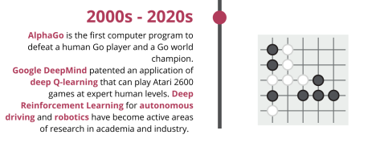
Around 2013, DeepMind developed deep Q-learning, a combination of convolution neural network architecture and Q-learning. Deep Q-learning facilitates Experience Replay, which stores and replays states and allows the network to learn in small batches to avoid skewing training and speed up implementation.
They tested the system on video games such as Space Invaders and Breakout. Without altering the code, the network learns how to play the game and, after several iterations, surpasses human performance. DeepMind published further research on their system surpassing human abilities in other games like Seaquest and Q*Bert.
In 2014, DeepMind published research on the computer program able to play Go. In October 2015, a computer Go program called AlphaGo beat the European Go champion, Fan Hui. This event was the first time artificial intelligence defeated a professional Go player.

Slide 22
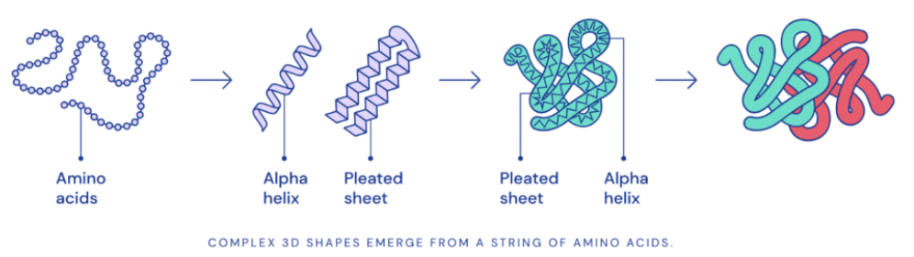
Modern Developments
The research community is still in the early stages of understanding thoroughly how practical deep reinforcement learning is to other domains. Alpha Fold, developed by DeepMind, applies artificial intelligence to amino acid folding, one of the most important goals pursued by computational biology and is essential for medicinal applications such as drug design and biotechnology such as novel enzyme design.
Deep reinforcement learning has shown extreme proficiency in solving problems within constrained environments. Potential real-life applications include robotics, processing of structured medical images, self-driving cars.
Developments have been made into making deep reinforcement learning more efficient. Google Brain proposed Adaptive Behavior Policy Sharing, an optimization strategy that allows for selective information sharing across a pool of agents. DeepMind published research in 2020, exploring the Never Give Up strategy, which uses k-nearest neighbours over the agent’s recent experience to train the directed exploratory policies to solve complex exploration games.

Slide 23
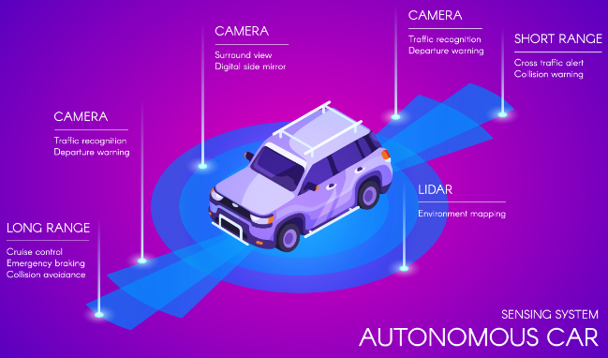
Applications of Reinforcement Learning
Autonomous/Self-Driving Cars
Automatic Traffic Light Control System
Robotic Surgeons
NLP Applications such as text summarization, question-answering systems, etc.
Customized Recommendation Systems
Space Tech GNC
Missiles GNC
Time Series Forecasting (Finance Domain)

Slide 24
What is autonomous?
In artificial intelligence and robotics, the term ‘autonomous’ refers to the capacity of an artificial agent to operate independently of human guidance. It is assumed that the agent has a fixed goal or utility function concerning its actions’ appropriateness. The autonomous pattern is complicated as there is a need for the machine to do something in the real world without a human in the loop—for example, Self-driving Cars, Chatbots, etc
Autonomous Reinforcement Learning
Reinforcement learning where the agent not only learns through its own experience, but also contends with lack of human supervision to reset between trials.
A simulated benchmark around this framework, containing a set of diverse and challenging simulated tasks reflective of the hurdles introduced to learning when only a minimal reliance on extrinsic intervention can be assumed.
Standard approaches to episodic RL and existing approaches struggle as interventions are minimized, underscoring the need for developing new algorithms for reinforcement learning with a greater focus on autonomy.

Slide 25
Challenges in Reinforcement Learning
Although Reinforcement Learning has appeared as a new touchstone in the Machine Learning arena and has been the centre of attention for researchers, it happens to face specific challenges that are enlisted below:
1. Large Datasets: Since Reinforcement Learning Models are complex, they need massive datasets to make better decisions.
2. Environment Dependency: As we know that the Reinforcement Learning Models learn based on the agent’s interactions with the environment – it causes hindrance in the training of the model; the agent learns based on the current state of the environment, and for a constantly changing environment, it becomes difficult for the agent to get trained.
3. Design of Reward Structure: For any real worlds use case of RL, one needs to analyze the problem statement and devise an appropriate structure as to when the model should be awarded and when should it be penalized. This remains another problem that the researchers are constantly in the face of.

Slide 26
Scope of RL
Given its extensive applications, one can quite presciently say that Reinforcement Learning stares into a bright future. Unlike other Machine Learning methods, RL does not require labelled datasets and makes real-life decisions based on a reward system – mimicking the human behaviour to the closest.
It serves as an impeccable resolve for situations when the target our problem statement is trying to accomplish is clear, but the way of getting there is not.
Though, as of now, in 2022, the real-world applications of RL are limited and are not in constant circulation in our daily lives, With the tenacious and committed researchers constantly digging deep into the field of RL, we’ll surely break through all the challenges and resistance the current studies face and revolutionize the Artificial Intelligence sphere.

