Slide 1
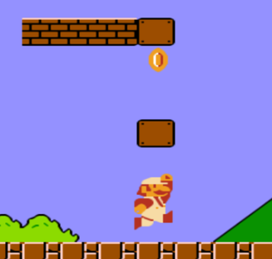
Key Elements of RL
Agent
An agent is a software program that learns to make intelligent decisions. We can say that an agent is a learner in the RL setting. For instance, a chess player can be considered an agent since the player learns to make the best moves (decisions) to win the game.
Similarly, Mario in a Super Mario Bros video game can be considered an agent since Mario explores the game and learns to make the best moves in the game.
Environment
The environment is the world of the agent. The agent stays within the environment. For instance, coming back to our chess game, a chessboard is called the environment since the chess player (agent) learns to play the game of chess within the chessboard (environment).
Similarly, in Super Mario Bros, the world of Mario is called the environment.

Slide 2
State and action
A state is a position or a moment in the environment that the agent can be in. We learned that the agent stays within the environment, and there can be many positions in the environment that the agent can stay in, and those positions are called states. For instance, in our chess game example, each position on the chessboard is called the state. The state is usually denoted by s.
The agent interacts with the environment and moves from one state to another by performing an action. In the chess game environment, the action is the move performed by the player (agent). The action is usually denoted by a.
Reward
We learned that the agent interacts with an environment by performing an action and moves from one state to another. Based on the action, the agent receives a reward. A reward is nothing but a numerical value, say, +1 for a good action and -1 for a bad action.
How do we decide if an action is good or bad?
In our chess game example, if the agent makes a move in which it takes one of the opponent's chess pieces, then it is considered a good action and the agent receives a positive reward. Similarly, if the agent makes a move that leads to the opponent taking the agent's chess piece, then it is considered a bad action and the agent receives a negative reward. The reward is denoted by r.

Slide 3
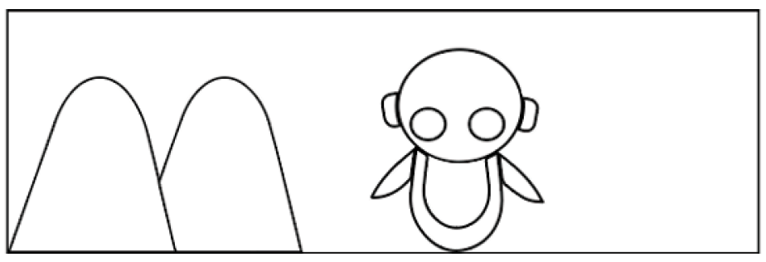
The basic idea of RL
Let's suppose we want to teach a robot (agent) to walk without hitting a mountain.
We will not teach the robot explicitly to not go in the direction of the mountain. Instead, if the robot hits the mountain and gets stuck, we give the robot a negative reward, say -1. So, the robot will understand that hitting the mountain is the wrong action, and it will not repeat that action
Similarly, when the robot walks in the right direction without hitting the mountain, we give the robot a positive reward, say +1. So, the robot will understand that not hitting the mountain is a good action,and it will repeat that action.
Thus, in the RL setting, the agent explores different actions and learns the best action based on the reward it gets. Now that we have a basic idea of how RL works, in the upcoming sections, we will go into more detail and also learn the important concepts involved in RL.

Slide 4
The RL algorithm
The steps involved in a typical RL algorithm are as follows:
1. First, the agent interacts with the environment by performing an action.
2. By performing an action, the agent moves from one state to another.
3. Then the agent will receive a reward based on the action it performed.
4. Based on the reward, the agent will understand whether the action is good or bad.
5. If the action was good, that is, if the agent received a positive reward, then the agent will prefer performing that action, else the agent will try performing other actions in search of a positive reward.
RL is basically a trial and error learning process. Now, let's revisit our chess game example. The agent (software program) is the chess player. So, the agent interacts with the environment (chessboard) by performing an action (moves). If the agent gets a positive reward for an action, then it will prefer performing that action; else it will find a different action that gives a positive reward.
Ultimately, the goal of the agent is to maximize the reward it gets. If the agent receives a good reward, then it means it has performed a good action. If the agent performs a good action, then it implies that it can win the game. Thus, the agent learns to win the game by maximizing the reward.

Slide 5
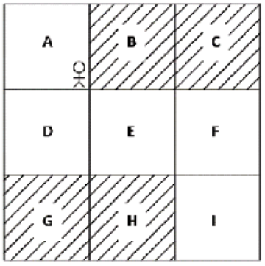
RL agent in the grid world
Consider the following grid world environment:
The positions A to I in the environment are called the states of the environment.
The goal of the agent is to reach state I by starting from state A without visiting the shaded states (B, C, G, and H).
Thus, in order to achieve the goal, whenever our agent visits a shaded state, we will give a negative reward (say -1) and when it visits an unshaded state, we will give a positive reward (say +1).
The actions in the environment are moving up, down, right and left. The agent can perform any of these four actions to reach state I from state A.
The first time the agent interacts with the environment (the first iteration), the agent is unlikely to perform the correct action in each state, and thus it receives a negative reward.
That is, in the first iteration, the agent performs a random action in each state, and this may lead the agent to receive a negative reward.
But over a series of iterations, the agent learns to perform the correct action in each state through the reward it obtains, helping it achieve the goal.

Slide 6
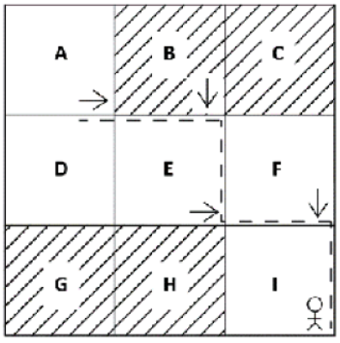
Iteration 1
In the first iteration, the agent performs a random action in each state. In the first iteration, the agent moves right from state A and reaches the new state B. But since B is the shaded state, the agent will receive a negative reward and so the agent will understand that moving right is not a good action in state A. When it visits state A next time, it will try out a different action instead of moving right.
From state B, the agent moves down and reaches the new state E. Since E is an unshaded state, the agent will receive a positive reward, so the agent will understand that moving down from state B is a good action.
From state E, the agent moves right and reaches state F. Since F is an unshaded state, the agent receives a positive reward, and it will understand that moving right from state E is a good action.
From state F, the agent moves down and reaches the goal state I and receives a positive reward, so the agent will understand that moving down from state F is a good action.

Slide 7
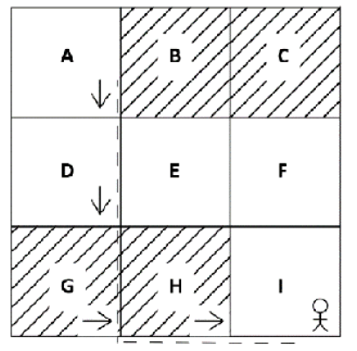
Iteration 2
In the second iteration, from state A, instead of moving right, the agent tries out a different action as the agent learned in the previous iteration that moving right is not a good action in state A.
In this iteration the agent moves down from state A and reaches state D. Since D is an unshaded state, the agent receives a positive reward and now the agent will understand that moving down is a good action in state A
from state D, the agent moves down and reaches state G. But since G is a shaded state, the agent will receive a negative reward and so the agent will understand that moving down is not a good action in state D, and when it visits state D next time, it will try out a different action instead of moving down.
From G, the agent moves right and reaches state H. Since H is a shaded state, it will receive a negative reward and understand that moving right is not a good action in state G.
From H it moves right and reaches the goal state I and receives a positive reward, so the agent will understand that moving right from state H is a good action.

Slide 8
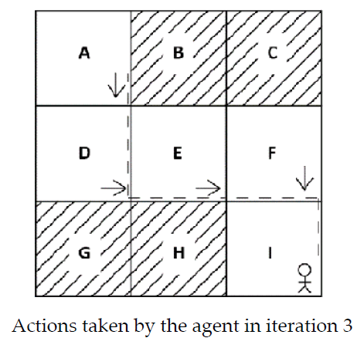
Iteration 3
In the third iteration, the agent moves down from state A since, in the
second iteration, our agent learned that moving down is a good action in state A. So, the agent moves down from state A and reaches the next state, D.
Now, from state D, the agent tries a different action instead of moving down since in the second iteration our agent learned that moving down is not a good action in state D. So, in this iteration, the agent moves right from state D and reaches state E.
From state E, the agent moves right as the agent already learned in the first iteration that moving right from state E is a good action and reaches state F.
Now, from state F, the agent moves down since the agent learned in the first iteration that moving down is a good action in state F, and reaches the goal state I.
Agent has successfully learned to reach the goal state I from state A without visiting the shaded states based on the rewards.Note that these iterations are called episodes in RL terminology.

Slide 9
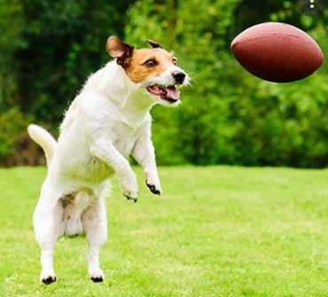
How RL differs from other ML paradigms??
In supervised learning, the machine learns from training data. The training data consists of a labeled pair of inputs and outputs. So, we train the model (agent) using the training data in such a way that the model can generalize its learning to new unseen data.It is called supervised learning because the training data acts as a supervisor, since it has a labeled pair of inputs and outputs, and it guides the model in learning the given task.
Consider the dog and ball analogy,
In supervised learning, to teach the dog to catch a ball, we will teach it explicitly by specifying turn left, go right, move forward seven steps, catch the ball, and so on in the form of training data. But in RL, we just throw a ball, and every time the dog catches the ball, we give it a cookie (reward). So, the dog will learn to catch the ball while trying to maximize the cookies (reward) it can get.

Slide 10
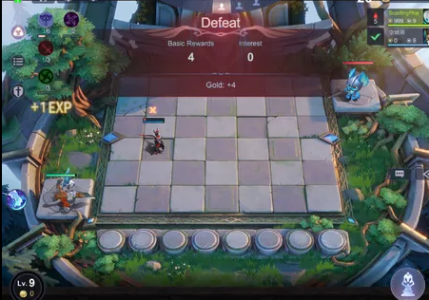
Say we want to train the model to play chess using supervised learning
In this case, we will have training data that includes all the moves a player can make in each state, along with labels indicating whether it is a good move or not. Then, we train the model to learn from this training data, whereas in the case of RL, our agent will not be given any sort of training data; instead, we just give a reward to the agent for each action it performs. Then, the agent will learn by interacting with the environment and, based on the reward it gets, it will choose its actions.

Slide 11
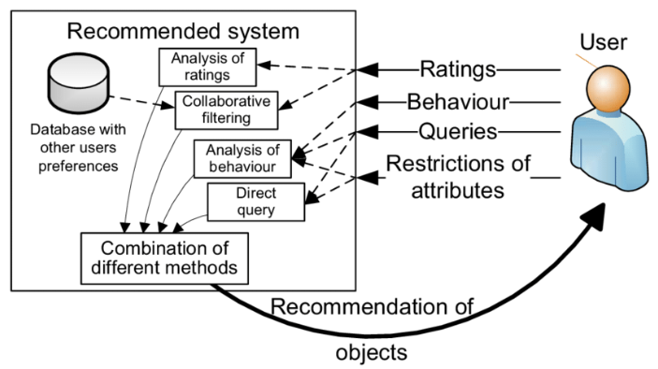
In the case of unsupervised learning, the training data does not contain any labels; that is, it consists of only inputs and not outputs. The goal of unsupervised learning is to determine hidden patterns in the input.
There is a common misconception that RL is a kind of unsupervised learning, but it is not. In unsupervised learning, the model learns the hidden structure, whereas, in RL, the model learns by maximizing the reward.
For instance, consider a movie recommendation system. Say we want to recommend a new movie to the user. With unsupervised learning, the model (agent) will find movies similar to the movies the user (or users with a profile similar to the user) has viewed before and recommend new movies to the user.

Slide 12
With RL, the agent constantly receives feedback from the user. This feedback represents rewards (a reward could be ratings the user has given for a movie they have watched, time spent watching a movie, time spent watching trailers, and so on). Based on the rewards, an RL agent will understand the movie preference of the user and then suggest new movies accordingly.
Since the RL agent is learning with the aid of rewards, it can understand if the user's movie preference changes and suggest new movies according to the user's changed movie preference dynamically.
Thus, we can say that in both supervised and unsupervised learning the model (agent) learns based on the given training dataset,whereas in RL the agent learns by directly interacting with the environment. Thus, RL is essentially an interaction between the agent and its environment.

Slide 13
Approaches to implement Reinforcement Learning
There are mainly three ways to implement reinforcement-learning in ML, which are:
Value-based: The value-based approach is about to find the optimal value function, which is the maximum value at a state under any policy. Therefore, the agent expects the long-term return at any state(s) under policy π.
Policy-based: Policy-based approach is to find the optimal policy for the maximum future rewards without using the value function. In this approach, the agent tries to apply such a policy that the action performed in each step helps to maximize the future reward. The policy-based approach has mainly two types of policy:
Deterministic: The same action is produced by the policy (π) at any state.
Stochastic: In this policy, probability determines the produced action.
Model-based: In the model-based approach, a virtual model is created for the environment, and the agent explores that environment to learn it. There is no particular solution or algorithm for this approach because the model representation is different for each environment.

Slide 14
Policy: A policy can be defined as a way how an agent behaves at a given time. It maps the perceived states of the environment to the actions taken on those states. A policy is the core element of the RL as it alone can define the behavior of the agent. In some cases, it may be a simple function or a lookup table, whereas, for other cases, it may involve general computation as a search process. It could be deterministic or a stochastic policy.
For deterministic policy: a = π(s) , For stochastic policy: π(a | s) = P[At =a | St = s]
Reward Signal: The goal of reinforcement learning is defined by the reward signal. At each state, the environment sends an immediate signal to the learning agent, and this signal is known as a reward signal. These rewards are given according to the good and bad actions taken by the agent. The agent's main objective is to maximize the total number of rewards for good actions. The reward signal can change the policy, such as if an action selected by the agent leads to low reward, then the policy may change to select other actions in the future.

Slide 15
Value Function: The value function gives information about how good the situation and action are and how much reward an agent can expect. A reward indicates the immediate signal for each good and bad action, whereas a value function specifies the good state and action for the future. The value function depends on the reward as, without reward, there could be no value. The goal of estimating values is to achieve more rewards.
Model: The last element of reinforcement learning is the model, which mimics the behavior of the environment. With the help of the model, one can make inferences about how the environment will behave. Such as, if a state and an action are given, then a model can predict the next state and reward.
The model is used for planning, which means it provides a way to take a course of action by considering all future situations before actually experiencing those situations. The approaches for solving the RL problems with the help of the model are termed as the model-based approach. Comparatively, an approach without using a model is called a model-free approach.

