Slide 1
Markov Decision Processes
The Markov Decision Process (MDP) provides a mathematical framework for solving the RL problem.
Almost all RL problems can be modeled as an MDP.
MDPs are widely used for solving various optimization problems.

Slide 2
The Markov Property and Markov Chain
The Markov property states that the future depends only on the present and not on the past.
The Markov chain, also known as the Markov process, consists of a sequence of states that strictly obey the Markov property; that is, the Markov chain is the probabilistic model that solely depends on the current state to predict the next state and not the previous states, that is, the future is conditionally independent of the past.
For example, if we want to predict the weather and we know that the current state is cloudy, we can predict that the next state could be rainy. We concluded that the next state is likely to be rainy only by considering the current state (cloudy) and not the previous states,which might have been sunny,windy, and so on.
However, the Markov property does not hold for all processes. For instance, throwing a dice (the next state) has no dependency on the previous number that showed up on the dice (the current state).

Slide 3


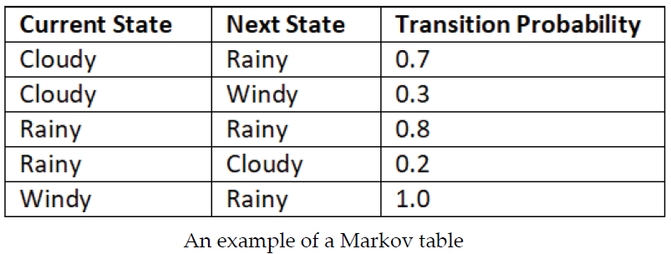
Transition Probabilities and Markov Table
Moving from one state to another is called a transition, and its probability is called a transition probability. We denote the transition probability by . It indicates the probability of moving from the state s to the next state
Say we have three states (cloudy,rainy, and windy) in our Markov chain. Then we can represent the probability of transitioning from one state to another using a table called a Markov table.
From the state cloudy, we transition to the state rainy with 70% probability and to the state windy with 30% probability.
From the state rainy, we transition to the same state rainy with 80% probability and to the state cloudy with 20% probability.
From the state windy, we transition to the state rainy with 100% probability.

Slide 4
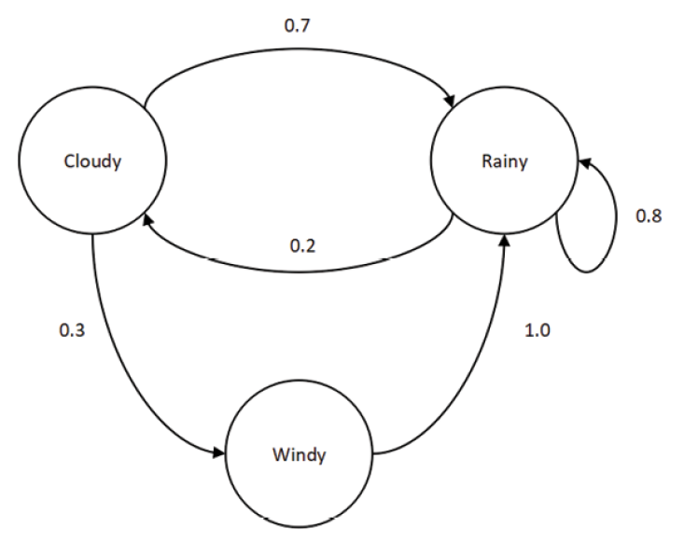
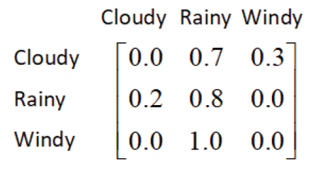
We can also represent this transition information of the Markov chain in the form of a state diagram.
We can also formulate the transition probabilities into a matrix called the transition matrix,

Slide 5

Markov Reward Process
The Markov Reward Process (MRP) is an extension of the Markov chain with the reward function. That is, we learned that the Markov chain consists of states and a transition probability. The MRP consists of states, a transition probability, and also a reward function.
A reward function tells us the reward we obtain in each state. For instance, based on our previous weather example, the reward function tells us the reward we obtain in the state cloudy, the reward
we obtain in the state windy, and so on. The reward function is usually denoted by R(s).
Thus, the MRP consists of states s, a transition probability , and a reward function R(s).

Slide 6
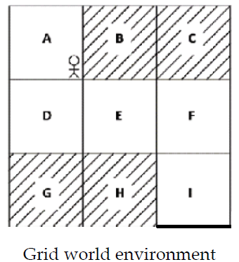
MDP in Grid World Environment
The Markov Decision Process (MDP) is an extension of the MRP with actions.
RL environment, the agent makes decisions only based on the current state and not based on the past states. So, we can model an RL environment as an MDP.
Grid world environment, and the goal of the agent is to reach state I from state A without visiting the shaded states.
An agent makes a decision (action) in the environment only based on the current state the agent is in and not based on the past state.So, we can formulate our environment as an MDP.

Slide 7



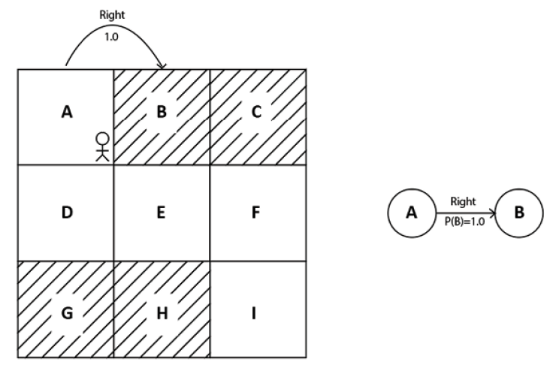
States – A set of states present in the environment. Thus, in the grid world environment, we have states A to I.
Actions – A set of actions that our agent can perform in each state.An agent performs an action and moves from one state to another.Thus, in the grid world environment, the set of actions is up, down,left, and right.
Transition probability – The transition probability is denoted by . It implies the probability of moving from a state s to the next state while performing an action a. If you observe, in the MRP, the transition probability is just ,that is, the probability of going from state s to state , and it doesn't include actions.
For example, in grid world environment, say the transition probability of moving from state A to state B while performing an action right is 100%. This can be expressed as P(B|A, right) = 1.0

Slide 8
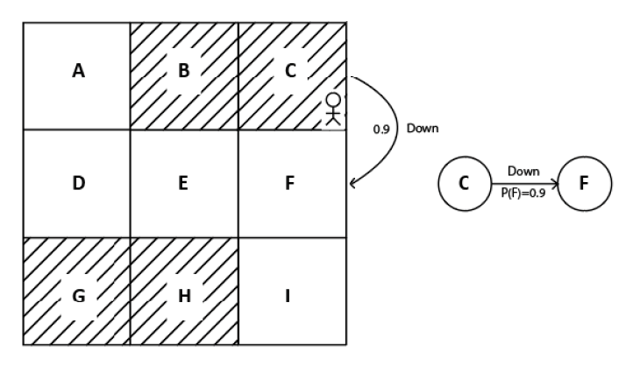


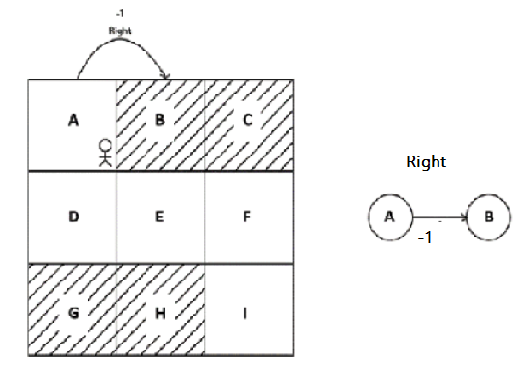
Suppose our agent is in state C and the transition probability of moving from state C to state F while performing the action down is 90%, then it can be expressed as P(F|C, down) = 0.9
Reward function - The reward function is denoted by . It represents the reward our agent obtains while transitioning from state s to state while performing an action a.
Say the reward we obtain while transitioning from state A to state B while performing the action right is -1, then it can be expressed as R(A, right, B) = -1.

Slide 9
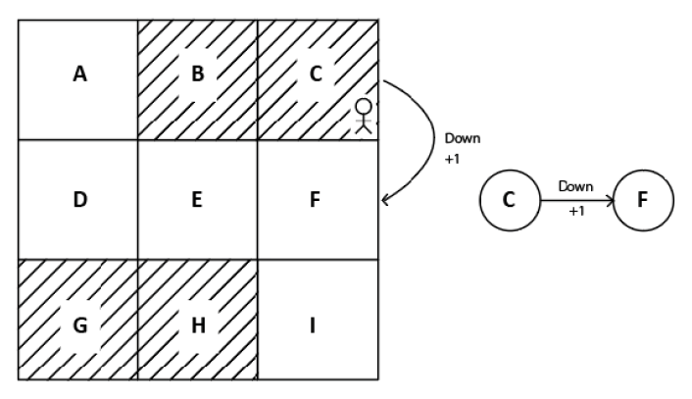
Suppose our agent is in state C and say the reward we obtain while transitioning from state C to state F while performing the action down is +1, then it can be expressed as R(C, down, F) = +1.
What is the use of representing the RL environment using the MDP?
We can solve the RL problem easily once we model our environment as the MDP. For instance, once we model our grid world environment using the MDP, then we can easily find how to reach the goal state I from state A without visiting the shaded states.

Slide 10
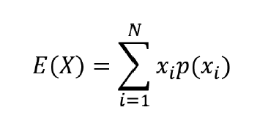
Expectation (Math Essential)
let's suppose X is a random variable. The random variable takes values based on a random experiment, such as throwing dice,tossing a coin, and so on. The random variable takes different values with some probabilities. Let's suppose we are throwing a fair dice, then the possible outcomes (X) are 1, 2, 3, 4, 5, and 6 and the probability of occurrence of each of these outcomes is 1/6.
Compute the average value of the random variable X
Since each value has a probability of an occurrence, we can't just take the average. So, instead, we compute the weighted average, that is, the sum of values of X multiplied by their respective probabilities,and this is called expectation.
The expectation of a random variable X can be defined as:
Thus, the expectation or expected value of the random variable X is
E(X) = 1(1/6) +2(1/6) + 3(1/6) + 4(1/6) + 5 (1/6) + 6(1/6) =3.5.
Thus when we say expectation or the expected value of a random variable, it basically means the weighted average.

Slide 11
Action Space
In the grid world environment, the goal of the agent is to reach state I starting from state A without visiting the shaded states.
In each of the states, the agent can perform any of the four actions— up, down, left, and right—to achieve the goal. The set of all possible actions in the environment is called the action space.
We can categorize action spaces into two types:
Discrete action space
Continuous action space
Discrete action space:
When our action space consists of actions that are discrete, then it is called a discrete action space. For instance, in the grid world environment, our action space consists of four discrete actions, which are up, down, left, right, and so it is called a discrete action space.
Continuous action space:
When our action space consists of actions that are continuous, then it is called a continuous action space. For instance, let's suppose we are training an agent to drive a car, then our action space will consist of several actions that have continuous values, such as the speed at which we need to drive the car, the number of degrees we need to rotate the wheel, and so on. In cases where our action space consists of actions that are continuous, it is called a continuous action space.

Slide 12
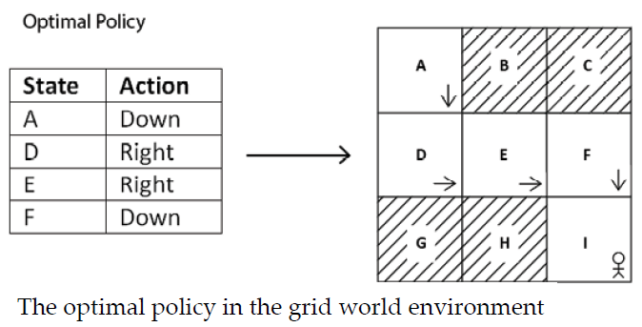
Policy
A policy defines the agent's behavior in an environment. The policy tells the agent what action to perform in each state. For instance, in the grid world environment, we have states A to I and four possible actions. The policy may tell the agent to move down in state A, move right in state D, and so on.
To interact with the environment for the first time, we initialize a random policy, that is, the random policy tells the agent to perform a random action in each state.
Thus, in an initial iteration, the agent performs a random action in each state and tries to learn whether the action is good or bad based on the reward it obtains.Over a series of iterations, an agent will learn to perform good actions in each state, which gives a positive reward.
Thus, we can say that over a series of iterations, the agent will learn a good policy that gives a positive
reward.This good policy is called the optimal policy.

Slide 13


Deterministic policy
Thus the deterministic policy maps the state to one particular action and is often denoted by . Given a state s at a time t, a deterministic policy tells the agent to perform one particular action a. It can be expressed as
For instance, consider our grid world example. Given state A, the deterministic policy tells the agent to perform the action down.This can be expressed as,
Thus, according to the deterministic policy, whenever the agent visits state A, it performs the action down.
Stochastic policy
Unlike a deterministic policy, a stochastic policy does not map a state directly to one particular action; instead, it maps the state to a probability distribution over an action space.(i.e) the agent performs different actions each time based on a probability distribution returned by the stochastic policy.
we know that our grid world environment's action space consists of four actions, which are [up, down, left, right]. Given a state A, the stochastic policy returns the probability distribution over the action space as [0.10,0.70,0.10,0.10].
Now, whenever the agent visits state A, instead of selecting the same particular action every time, the agent selects up 10% of the time, down 70% of the time, left 10% of the time, and right 10% of the time.

Slide 14


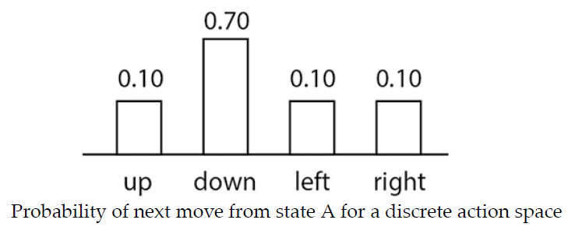
Types of Stochastic policy
The stochastic policy maps the state to a probability distribution over the action space and is often denoted by . Say we have a state s and action a at a time t, then we can express the stochastic policy as:
or
We can categorize the stochastic policy into two types:
Categorical policy
Gaussian policy
A stochastic policy is called a categorical policy when the action space is discrete. That is, the stochastic policy uses a categorical probability distribution over the action space to select actions when the action space is discrete.
For instance, in the grid world environment from the previous example, we select actions based on a categorical probability distribution (discrete distribution) as the action space of the environment is discrete.

Slide 15
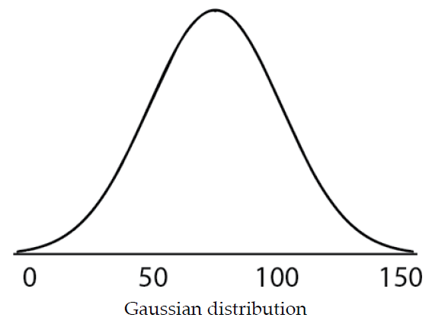
Gaussian policy
A stochastic policy is called a Gaussian policy when our action space is continuous. That is, the stochastic policy uses a Gaussian probability distribution over the action space to select actions when the action space is continuous.
Let's understand this with a simple example. Suppose we are training an agent to drive a car and say we have one continuous action in our action space. Let the action be the speed of the car, and the value of the speed of the car ranges from 0 to 150 kmph. Then, the stochastic policy uses the Gaussian distribution over the action space to select an action.

