Slide 1
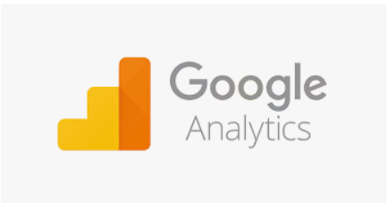
Acquisition Report
APOORV

Slide 2
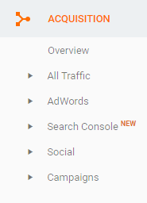
Acquisition Reports

Slide 3
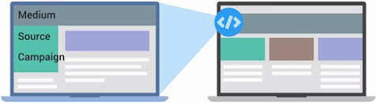
Acquisition Reports
Acquisition reports can provide insight about how users get to your website, and how well your
digital marketing and advertising works across different channels like email, search, and display ads.
Acquisition reports is used to compare the performance of different marketing channels and discover which sources send you the highest quality traffic and conversions.
This can help you make better decisions about where to focus your marketing efforts.
When a user lands on your site, the Google Analytics tracking code automatically captures several attributes (or dimensions) about where the user came from.

Slide 4
Acquisition Reports
Some common examples of mediums are:
Organic
Is used to identify traffic that arrived on your site through
unpaid search like a non-paid Google Search result.
CPC
Indicates traffic that arrived through a paid search campaign like Google AdWords text ads.
Referral
It is used for traffic that arrived on your site after the user clicked on a website other than a search engine.
Email
represents traffic that came from an email marketing campaign.
Direct
is applied for users that come directly to your site by typing your URL directly into a browser.

Slide 5
Acquisition Reports
“Source” provides more information about the medium.
For example, if the medium is “referral,” then the source will be the URL of the website that referred
the user to the site.
If the medium is “organic,” then the source will be the name of the search engine such as “google.”
Traffic should be “high quality,” meaning that users who arrive from a source engage with the website or complete a conversion.
A good indicator of traffic quality can be bounce rate.
We can click into the comparison view and select the metric “bounce rate” to compare bounce rate
for each source/medium combination to the site average.

Slide 6
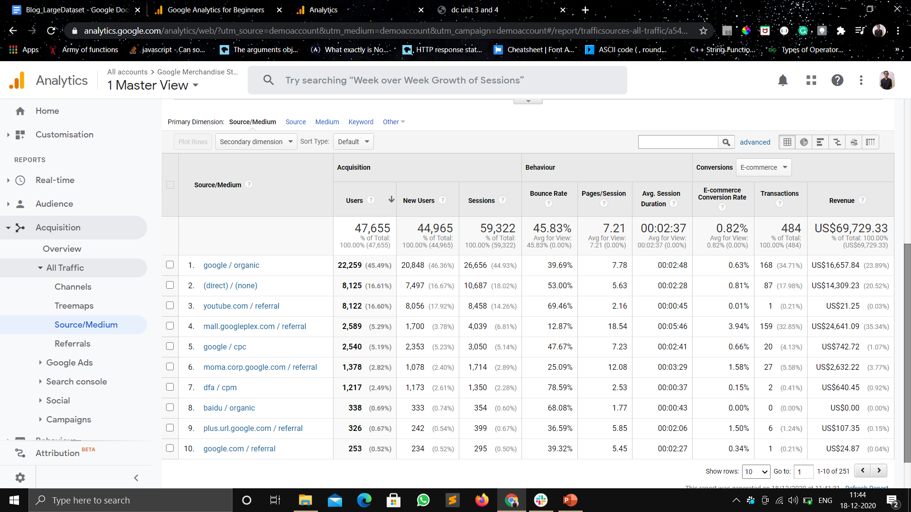

Slide 7
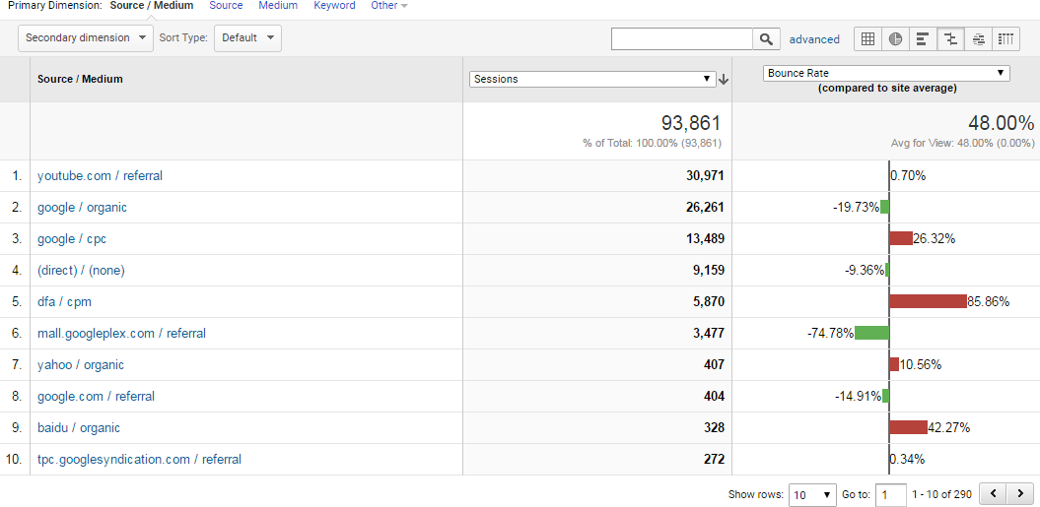
Acquisition Reports

Slide 8
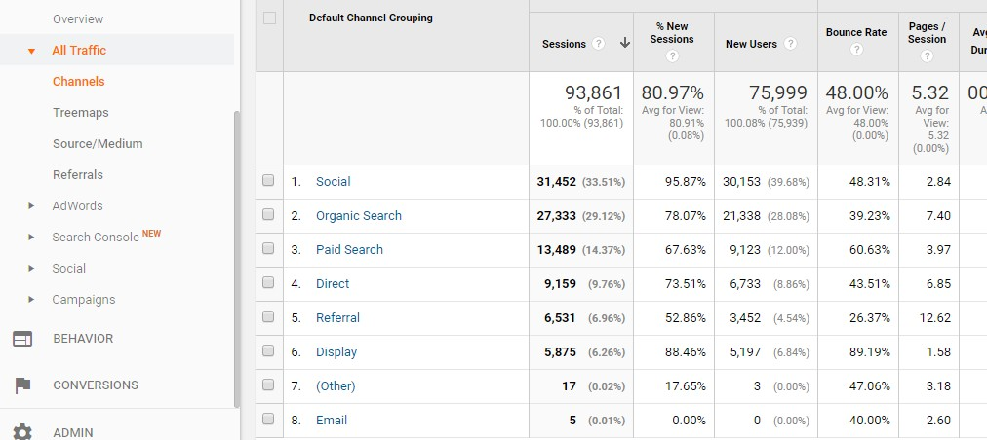
Acquisition Reports
Channels Report
There are other ways to view which traffic sources bring the most engaged users to the site.
Using the “Channels” report, we could view traffic which bundles the sources together under each medium. Traffic sources are automatically grouped into basic categories (or channels) like Organic, Social, Direct, Referral, Display, etc.

Slide 9
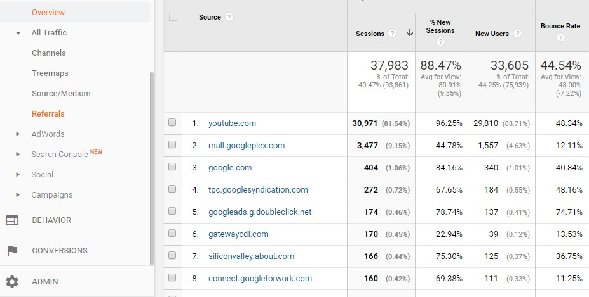
Acquisition Reports
Referrals Report
If you want to view your traffic organized by which sites have linked to yours, you can look at the
“Referrals” report.

Slide 10
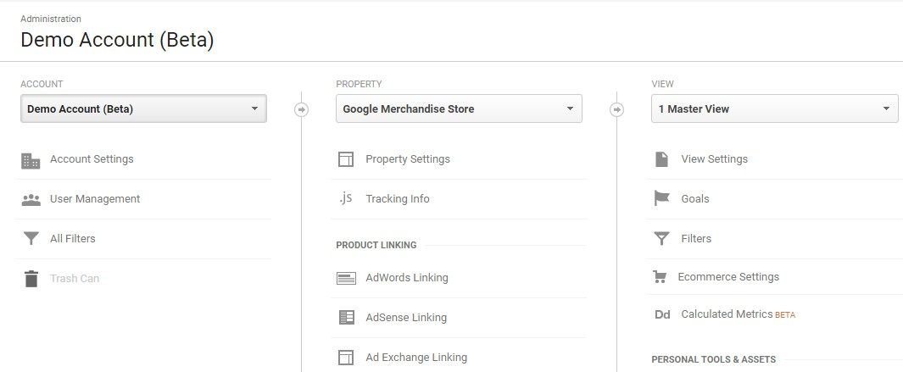
How to use Analytics with AdWords
To link Google Analytics with AdWords, first make sure you are logged into Analytics using the same
email as your AdWords account.

Slide 11
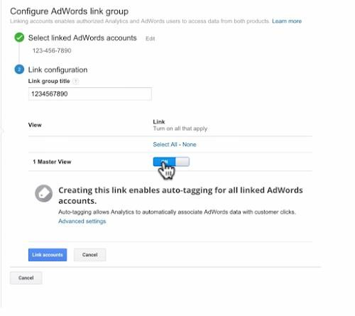
Adword Linking
Under the Property section, select
“AdWords linking.” Click the button “New link group.”
Check which account you wish to link and click “continue.” Next, type in a “Link Group Title.”
Now select the view in which you want the AdWords data to appear and select “Link accounts.”

Slide 12
Auto-Tagging
When you link your Google Analytics and AdWords accounts, campaign data is shared between the
two systems, but it still requires campaign tracking.
You can manually add campaign tracking tags to AdWords URLs using the URL Builder.
AdWords can automatically add a special campaign tag to your AdWords URLs through a feature called auto-tagging.
Auto tagging is required to get specific AdWords dimensions into Google Analytics.

Slide 13
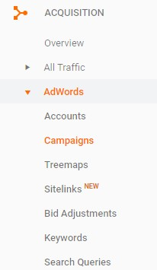
Campaigns
If we click on the “Campaigns” report, we can see how well our various
AdWords campaigns are performing.
you can use the Acquisition metrics to see how the clicks for each campaign and the total amount paid for those clicks.
CPC shows the average cost for each click.
Under Behavior, you can see user engagement for each campaign.
And under Conversions, you can see
the conversion rate,
the number of actual goal completions,
and how much these conversions worth to your business for each AdWords campaign using the pulldown menu.

Slide 14
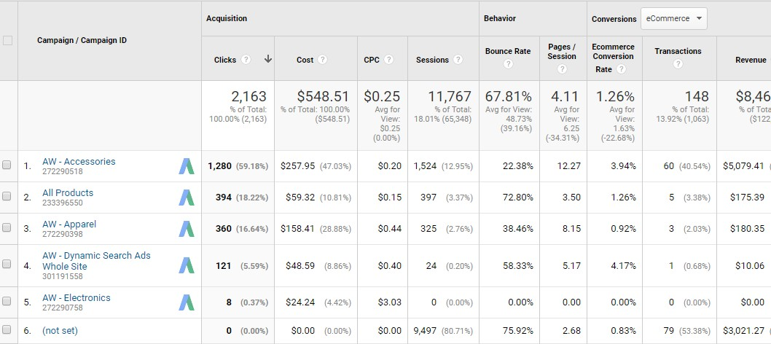
Campaigns

Slide 15
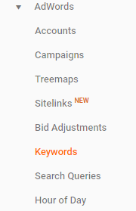
Keywords
This can help you understand how well keywords and individual ads are
performing.
For example, if a keyword is bringing in a lot of traffic but has a high bounce rate, it might indicate a disconnect between the ad and landing page content.
If you have a keyword with a high conversion rate but low number of impressions, you may want to raise your bid for that keyword, so the ad is shown more often and reaches a larger audience.
You could also add “Device Category” as a secondary dimension to break out these keywords by the kinds of devices that users were on when they clicked your ad and visited your site.

Slide 16
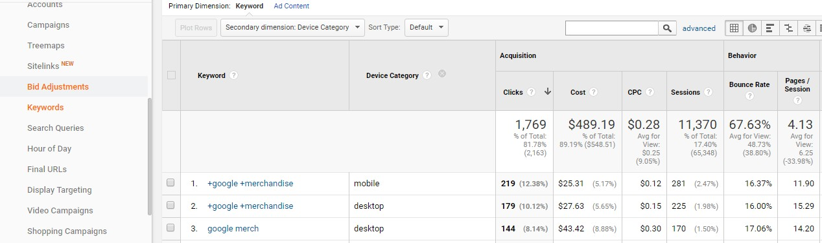
Keywords

Slide 17
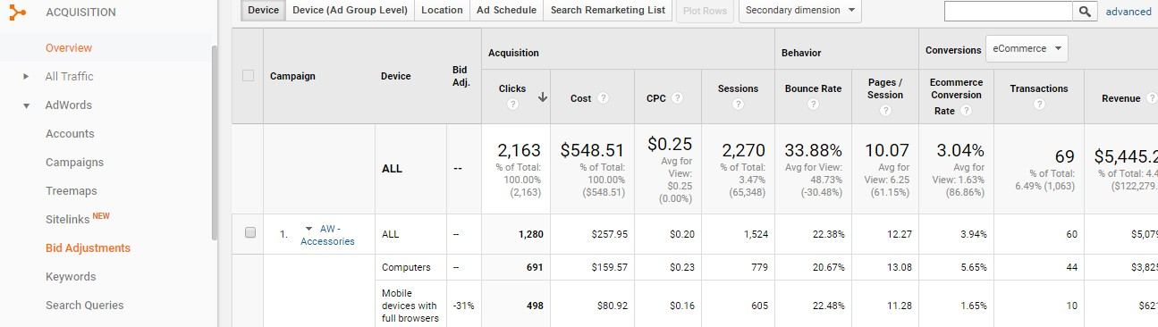
Bid Adjustments
Bid adjustments are an AdWords feature used to automatically adjust keyword bids based on a user’s
device, location, or time of day.
You can use the selector at the top of the table to evaluate campaign performance by the device, location, time of day, and remarketing list bid adjustments.

Slide 18
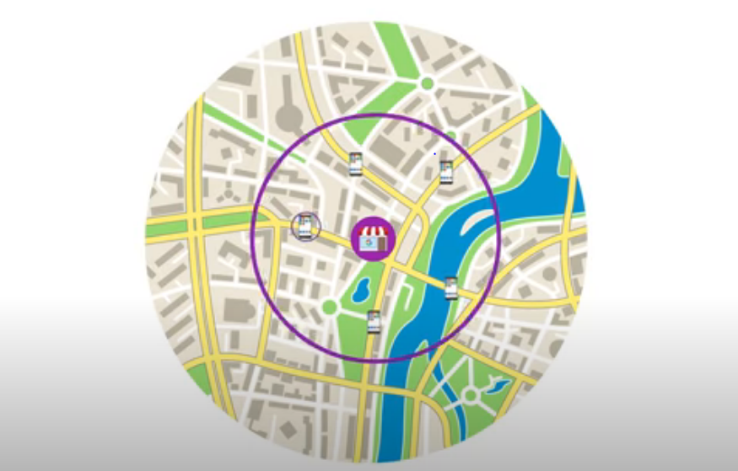

Slide 19


