Slide 1
Brazilian E- Commerce Company Data Warehousing
Final Project Submission
Group 1
MIS 633
Professor Joseph Morabito
By:
Apoorv Akhouri, Arvina Alung, Ilesh Sharda, Longyue Guan, Shelly Gulati

Slide 2
About the Company
It was created in 2007 with the mission of becoming a huge marketplace for artisans in Brazil
In 2016, they pivoted to the 'Marketplace of Marketplaces' model
Olist connects small businesses from all over Brazil to channels without hassle and with a single contract
Those merchants are able to sell their products through the Olist Store and ship them directly to the customers using Olist logistics partners.
After a customer purchases the product from Olist Store a seller gets notified to fulfill that order. Once the customer receives the product, or the estimated delivery date is due, the customer gets a satisfaction survey by email where he can give a note for the purchase experience and write down some comments.
The orders dataset that we have used in our project for the purpose of developing a warehousing model and the other adjoining datasets in the database have information of 100K orders from 2016 to 2018 at multiple marketplaces in Brazil

Slide 3
Warehouse Design Overview
Our presentation regarding the data warehousing design consists of four basic steps to dimensional modelling. They are as follows:
1. High Level Design
2. Logical Dimensional Modeling
3. Cube Design
4. Visualizations and Dashboards
To break down every step, here are the details:
High Level Design
High Level Business Matrix
Opportunity Matrix
Prioritization Grid
Detailed Business Matrix
Logical Dimensional Modelling
Logical Fact Table
Star Schema
Conformed Dimensions
Transformation Rules
Aggregate Tables
The Cube
Concepts
Our Model
Example
Implementation
Data Visualizations and Dashboards

Slide 4
High Level Bus Matrix
Business Process | Date | Customer | Order | Seller | Delivery | Location
Customer Sales Transaction | X | X |  | X
Order Processing | X | X | X | X |  | X
Delivery Process | X | X | X | X | X | X
Application/ website management | X |  |  | X
Return Process | X | X | X | X | X | X

Slide 5
Opportunity Matrix
Business Process | Marketing | Finance | Operations/ Logistics | Customer Service | IT operations | Strategic Management
Customer Sales Transaction | X | X | X | X | X | X
Order Processing |  |  | X |  | X
Delivery Process |  |  | X | X | X | X
Application/ website management |  |  |  |  | X | X
Return Process |  | X | X | X | X

Slide 6
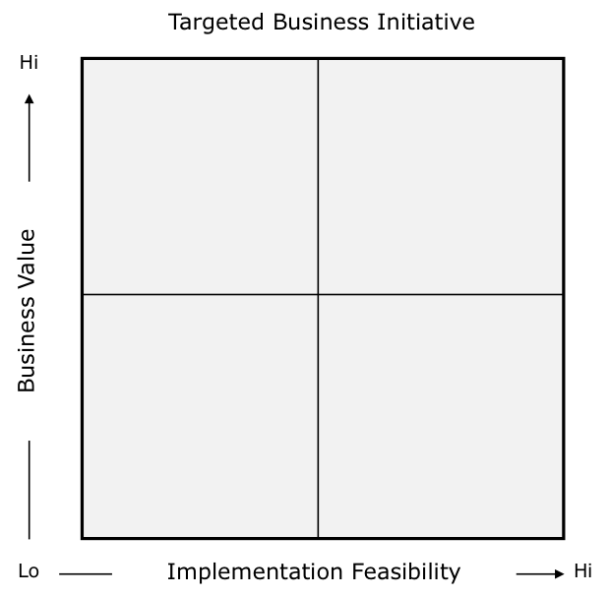
Prioritization Grid
A prioritization grid facilitates the discussion between the business and the IT departments for specification of the business use case and which one to begin with.
The ones with meaningful business value and reasonable timeline of successful implementation are worked on first
Targeting of the business initiatives in this way also provides easily recognizable key performance indicators for the business process, the critical success factors and the execution time frame
It is critical in this process to capture the reasoning for the positioning of each business process in the matrix
Application/ Website management
Customer Sales Transaction
Delivery Process
Return Process
Order Processing

Slide 7
Steps to Dimensional Modelling
Step 1: Identifying the business objective
The first step is to identify the business objective. Since it is the most importance step of data modelling, the selection of business objectives must also depend on the quality of data available for that process. For our case, the business objective is sales transaction. That sales business unit has been chosen as the fact table.
Step 2: Identifying Granularity
Granularity is the lowest level of information stored in the table. The level of detail for business problem and its solution is described by Grain. In our model the granularity is one transaction per order per fact table.
Step 3:Identifying Dimensions & its attributes
Dimensions categorize and describe data warehouse facts and measures in a way that supports meaningful answers to business questions. In our model attributes are customer, sales, warehouse, seller, product etc which we will cover in more detail later
Step 4:Identifying Facts
The measurable data is held by the fact table. Most of the fact table rows are numerical values like price or cost per unit, etc. In our model facts our Cost price, selling price, discounts, tax and Net profit.

Slide 8
Detailed Bus Matrix
e-commerce business process | fact tables | granularity | fact | Date​ | Customer​ | Order​ | Vendor​ | Delivery​ | Location​
Customer Sales Transaction | sales transaction | Per sales item | Order ID Seller ID Product ID Payment ID | x | x | x | x | x | x
 | Seller information | Per Seller item | Seller ID Product ID Location ID | x |  | x | x | x | x
Order Processing | Delivery Partner | Per sales item | Delivery partner ID Order ID Location ID | x | x |  | x | x
 | Customer Billing | Per order | Date Time ID Order ID Product table ID Payment ID … | x | x |  | x |  | x

Slide 9
Detailed Bus Matrix (Contd.)
e-commerce business process | fact tables | granularity | fact | Date​ | Customer​ | Order​ | Vendor​ | Delivery​ | Location​
Delivery Process | Delivery process (From vendor) | Per sales item | Date time ID Delivery ID Delivery Partner ID Location ID Seller ID | x | x | x | x | x | x
 | delivery process (To customer) | Per sales item | tracking ID shipping date ID delivery date ID Delivery partner ID …. | x | x | x |  | x | x
Application/ website management | Seller information management | Per Seller | Seller ID Seller location ID Seller product table ID …. | x |  |  | x | x | x
 | Delivery partner information management | Per delivery partner | Delivery partner ID Partner location table ID | x | x |  | x | x | x
Return Process | Return from customer to warehouse | Per return item | Return ID Product ID Customer ID …. | x | x | x |  | x | x
 | Return from warehouse to Seller | Per return order | Return_Seller ID Product table ID Seller ID | x |  | x | x | x | x

Slide 10
Logical Fact Table –Sales Transaction
Date Time Stamp
Product
Sales B2C Fact Table
Grain: One transaction per line
Order
Warehouse
Customer
Promotion
Seller
Payment
Carrier
Delivery Location

Slide 11
Detailed Fact Table
The fact table here shows the dimensions of the table, the basic facts and the derived facts
Dimensions: Dimensions are the foundation of the fact table and is where the data for the fact table is collected.
Foreign Key: Foreign key is a column that creates a relationship between two tables. The purpose of foreign key is to maintain data integrity and allow navigation between two different instances of an entity
Grain: The grain of a fact table represents the most atomic level by which the facts may be defined. It is the finest level of detail that is implied when the fact and dimension tables are joined
Basic Numerical Dimensions
Derived Numerical Dimensions
Sales B2C Fact Table
Sales_ID
Order_ID
Customer_ID
Seller_ID
Warehouse_ID
Product_ID
Promotion_ID
Payment_ID
Delivery_Location_ID
Datetime_ID
Carrier_ID
Cost_Price
Selling_Price
Sales_Tax
Discounts
Profits

Slide 12
Detailed Fact Table - Dimensions
A Dimension tables is one of the companion tables to a fact table in the star schema. However, the fact table is a primary table in a dimensional model
It contains measurements/facts and foreign key to dimension table
Fact table helps to store report labels whereas Dimension table contains detailed data
It helps the user to investigate the business dimensions that helps the user in call taking to enhance the business
It contains all the primary keys of the dimension and associated facts
Dimensions are the key aspects related to the fact table
And as we mentioned on the last slide, we have 16 dimensions in total in the sales fact table
The dimension tables for sales fact table are Order, Customer, Seller, Warehouse, Product, Promotion, Payment, Delivery Location, Datetime and Carrier
In Seller, Warehouse, Promotion, Order and Carrier tables, we also create bridge tables for each of them
The Bridge Tables are including Manager for Warehouse, Seller type for Seller, Delivery Agent for Carrier, Order item for Order and Promotion type for Promotion

Slide 13
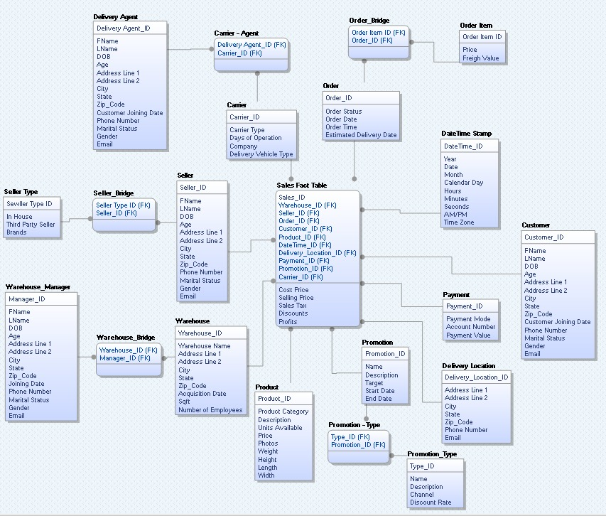
Star Schema of Sale Transaction

Slide 14
Differences between Fact and Dimension Table
Parameter | Fact | Dimension
Definition | Measurements, metrics or facts about a business process | Companion table to the fact table contains descriptive attributes
Characteristic | Located at the center surrounded by dimensions | Located at the edges of a fact table
Task | measurable event for which dimension table data is collected and is used for analysis and reporting | Collection of reference information about a business
Type of Data | Facts tables could contain information like sales against a set of dimensions like Product and Date | Every dimension table contains attributes which describe the details of the dimension.
Hierarchy | Does not contain hierarchies | Contains hierarchies
Storage | Helps to store report labels and filter domain values in dimension tables | Load detailed atomic data into dimensional structures
Design | Defined by their grain or its most atomic level | Should be wordy, descriptive, complete, and quality assured

Slide 15
What are Slowly Changing Dimensions?
A Slowly Changing Dimension (SCD) is a dimension that change slowly over time, rather than changing on regular schedule.
It tracks the history of dimension records.
There are multiple approaches of how to deal with SCDs. The most popular ones are as follows:
Type 0: The passive method: No special action is performed upon dimensional changes.
Type 1: Overwriting the old value. No history of dimension change is kept in the database
Type 2: Creating a new additional record. All history of dimension change is kept in the database.
Type 3: Adding a new column. In this type usually only the current and previous value of the dimension is kept
Type 4: Using historical table. In this method a separate historical table is used to track all dimension’s attribute changes for each of the dimensions
Type 5: Combine approaches 1, 2, 3.
For our analysis, we will look at the seller dimension attribute detail diagram where we will tackle the slowly changing dimension policy and the type
Notes:
Reference: https://www.datawarehouse4u.info/SCD-Slowly-Changing-Dimensions.html

Slide 16
Seller Dimension Attribute Detail Description
Attribute Name | Attribute Description | Cardinality | SCD Policy | Sample Values
Seller_ID | Seller ID that | 3095 | Not Updatable | 3442f8959a84dea7ee197c632cb2df15
Frst Name | The full descriptive first name of seller | 3095 | Type 1 | Michael
Last Name | The full descriptive last name of seller | 3095 | Type 2 | Patel
DOB | Seller’s date of birth | 3095 | Not Updateable | 11/12/1996
AGE | The number of seller’s age | 2050 | Type 2 | 25
Address Line 1 | The full descriptive detail address of seller for first line | 3095 | Type 2 | 210 river road
Address Line 2 | The full descriptive detail address of seller for second line | 3095 | Type 2 | APT 2201
City | The full descriptive the city of seller | 3095 | Type 2 | Hoboken
State | The full descriptive the state of seller | 3095 | Type 2 | NJ

Slide 17
Seller Dimension Attribute Detail Description
Attribute Name | Attribute Description | Cardinality | SCD Policy | Sample Values
Zip Code | The number of seller’s address zip code | 3095 | Type 2 | 07030
Phone Number | The number of seller’s phone number | 3095 | Type 2 | 201-230-2100
Marital Status | The descriptive of seller marital status | 7 | Not Updatable | Single
Gender | Description of seller’s gender | 3 | Not Updatable | Male
Seller Type ID | Type ID that uniquely identifies each type of seller | 2050 | Not Updatable | 7bc2406110b926393aa56f80a40eba40
Email | The number of seller’s email address | 3095 | Type 1 | micheal.patel@gmail.com

Slide 18
Seller Dimension Detailed Diagram
Seller
Types (3)
Gender (3)
Seller Background Information (3095)
Marital Status (7)
Age (2050)
Seller Address Info (3095)

Slide 19
Conformed Dimensions
Conformed dimensions are dimension shared by multiple stars
It has the same meaning to every fact table that it relates
Allows facts and measures to be categorized and described in the same way across multiple facts or data marts
It can exist as a single dimension table that relates to multiple fact tables
It is a dimension that means the same thing with every possible fact table in the schema
They are either identical or strict mathematics subsets of most granular detailed dimensions
In our schema we have just one fact table
In cases where there is just one fact table all the dimensions would be conformed dimensions
Date and time are the most common conformed dimension as they are nearly the same for every fact table
In our case all our dimensions are conformed dimensions.
The conformed dimensions for our data warehousing model in the Brazilian ecommerce dataset are:
Order
Customer
Seller
Warehouse
Product
Promotion
Payment
Delivery Location
Datetime
Carrier
Reference: https://www.vskills.in/certification/tutorial/snowflake-schema-aggregate-fact-tables-and-families-of-stars/

Slide 20
Transformation Rules
Data transformation is the process of changing the format, structure, or values of the data
Transformation is the middle step of the ETL process that is conducted in a warehousing exercise
Nowadays, organizations use cloud-based data warehouses.
The scale of the cloud platforms lets them skip preload transformations and instead do them after loading – a model called extract-load-transform (ELT)
Data transformation maybe constructive (adding, copying, replicating data), destructive (deleting fields and records), aesthetic (standardizing), or structural (renaming, moving, combining columns)
Data transformation rules for our data warehousing model look broadly as shown in the table. There are several more rules that might be along with it. This is just an example of a few
Reference: stitchdata.com/resources/data-transformation/
Transformation Rule | Function
Ingestion | Extracting information from a data source and copying data to its destination
Parse | Parsing fields out of comma delimited log data for loading to a relational database
Reading | Allows to update any dimension while reading
Mapping and translation | Mapping to apt data types and using formats apt in one system for a different system as well
Aggregations | Converting a time series of customer transactions to hourly or daily sales counts
Ordering | Ordered logically to suit a data storage schema
Anonymization and encryption | Encryption of private data like payment or card details would be encrypted
Notes:
Reference: https://www.stitchdata.com/resources/data-transformation/

Slide 21
Aggregation Table
Product
Product_ID
Product category Description Units_available Price Photos Weight Height Length Width
Aggregation tables are tables that aggregate or roll up the data to one level higher than a base or derived table
They contain new metrics derived from one or more aggregate functions
These new metrics called 'aggregate facts' or 'summary statistics' are stored and maintained in a data warehouse database in special fact tables at the grain of the aggregation
The corresponding dimensions are also rolled up and condensed to match the new grain of the fact table
These tables are used as substitutes whenever possible for returning user queries because it increases the speed of querying
While performing aggregations we are provided with the opportunity to perform aggregate functions on the dimensions itself and store the results as new attributes.
The aggregate table that we make will use the fact table and dimensions as given in the figure
Sales B2C
Sale_ID
Date_ID (FK) Product_ID (FK) Promotion_ID (FK) Customer_ID (FK) ------------------------- Units_Sold NetProfit_Total
Customer
Customer_ID
Customer_ID Fname Lname Dob Age Addressline1 Addressline2 City State Zipcode Cust_join_date Phone Marital Gender Email
Reference: https://www.vskills.in/certification/tutorial/snowflake-schema-aggregate-fact-tables-and-families-of-stars/

Slide 22
Aggregation Table
Business Process: Online Sales Transaction
Fact Table: Sales B2C
Dimensions: Product, Customer
Granularity: One transaction per line
Objective: To calculate the Profits per customer per product
Row in fact table: Sum the total net profit for each customer and each product.
Two-Way Aggregation Table - when you rise to higher level in the hierarchies of two dimensions and keep other dimensions at the lowest level, then you create two-way aggregate.
SQL Code:
SELECT Customer_ID, Product_ID,SUM (Profits) as Total_profits
FROM Sales
GROUP BY Customer_ID, Product_ID
Aggregate Table
Profits per Customer per Product
Customer ID(FK)
Product ID(FK)
Total_profits

Slide 23
The cube
Dimension | Type | Sparsity
Sales | Fact | Dense: Every project will have
Product | Dimension | Dense: Every project will have
Time | Dimension | Dense: Every project will have
Customer | Dimension | Dense: Every project will have
Order | Dimension | Dense: Every project will have
Region | Dimension | Dense: Every project will have
Warehouse | Dimension | Low (Not every project will have)
Carriers | Dimension | Low: (Not every project will have)
Seller | Dimension | Dense: Every project will have
Payment | Dimension | Low: (Not every project will have)
Notes:
Reference: https://www.stitchdata.com/resources/data-transformation/

Slide 24
The cube
Data cube is a structure that enable OLAP to achieves the multidimensional functionality
The data cube is used to represent data along some measure of interest
Data Cubes are an easy way to look at the data ( allow us to look at complex data in a simple format)
Although called a "cube", it can be 2-dimensional, 3- dimensional, or higher-dimensional
Data cubes have categories of data called dimensions and measures
Measure : represents some fact (or number) such as cost or units of service
Dimension: represents descriptive categories of data such as time or location
Notes:
Reference: https://www.stitchdata.com/resources/data-transformation/

Slide 25
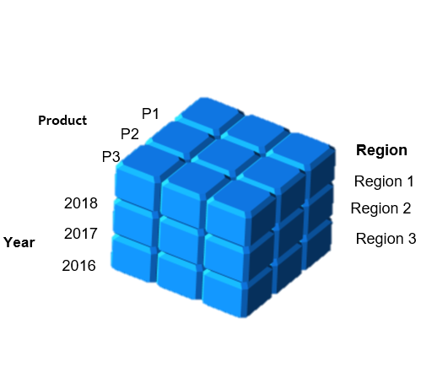
The cube
Database design for OLAP and efficiency in data storage
Data cube design is for efficiency in data retrieval (ensures report optimization).
The cube is comparable to a table in a relational database.
Though we can represent n dimensions in the cube but since on paper we can only show 3-D version of the cube
In this example we are taking the 3 dimensions: Products Region Year
Notes:
Reference: https://www.stitchdata.com/resources/data-transformation/

Slide 26
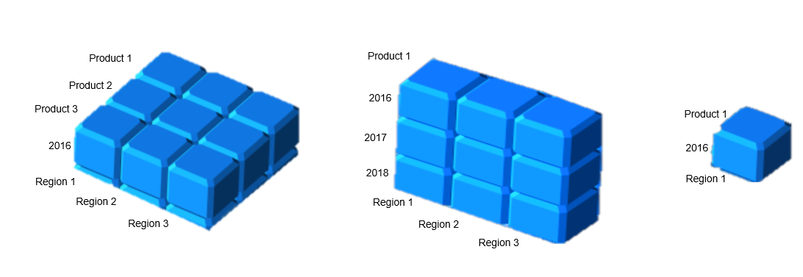
The cube
Three important concepts are associated with the cubes:
Slicing: the term slice most often subset of a multidimensional array corresponding to a single value for one or more members of the dimensions not in the subset
Dicing: In dicing, we define a sub cube of the original cube, which provides you the smallest available slice
Pivoting: Rotating changes the dimensional orientation of the report from the cube data. Rotating may consist of swapping the rows and columns, or moving one of the row dimensions into the column dimension
An example of Slicing & Dicing
Notes:
Reference: https://www.stitchdata.com/resources/data-transformation/

Slide 27
Examples of Ad-Hoc Report Generation & operations on the cube
Eg:1: Suppose you want to generate a report showing the sales 10 least performing products the for the year 2017.
Operations performed: Drill-down.
Explanation: In this scenario we will first select the year for which the report is to be generated i.e. year 2017.
Secondly, since there can be multiple least performing products for the given region hence, we will need to go with the drill-down approach to get to the bottom 10 least performing products against the region. The report will be generated showing the details of the 10 least performing products against the regions for the given year,.
Example of data cube of least 10 performing products by revenue in 2017 shown in a MOLAP tool.
Notes:
Reference: https://www.stitchdata.com/resources/data-transformation/

Slide 28
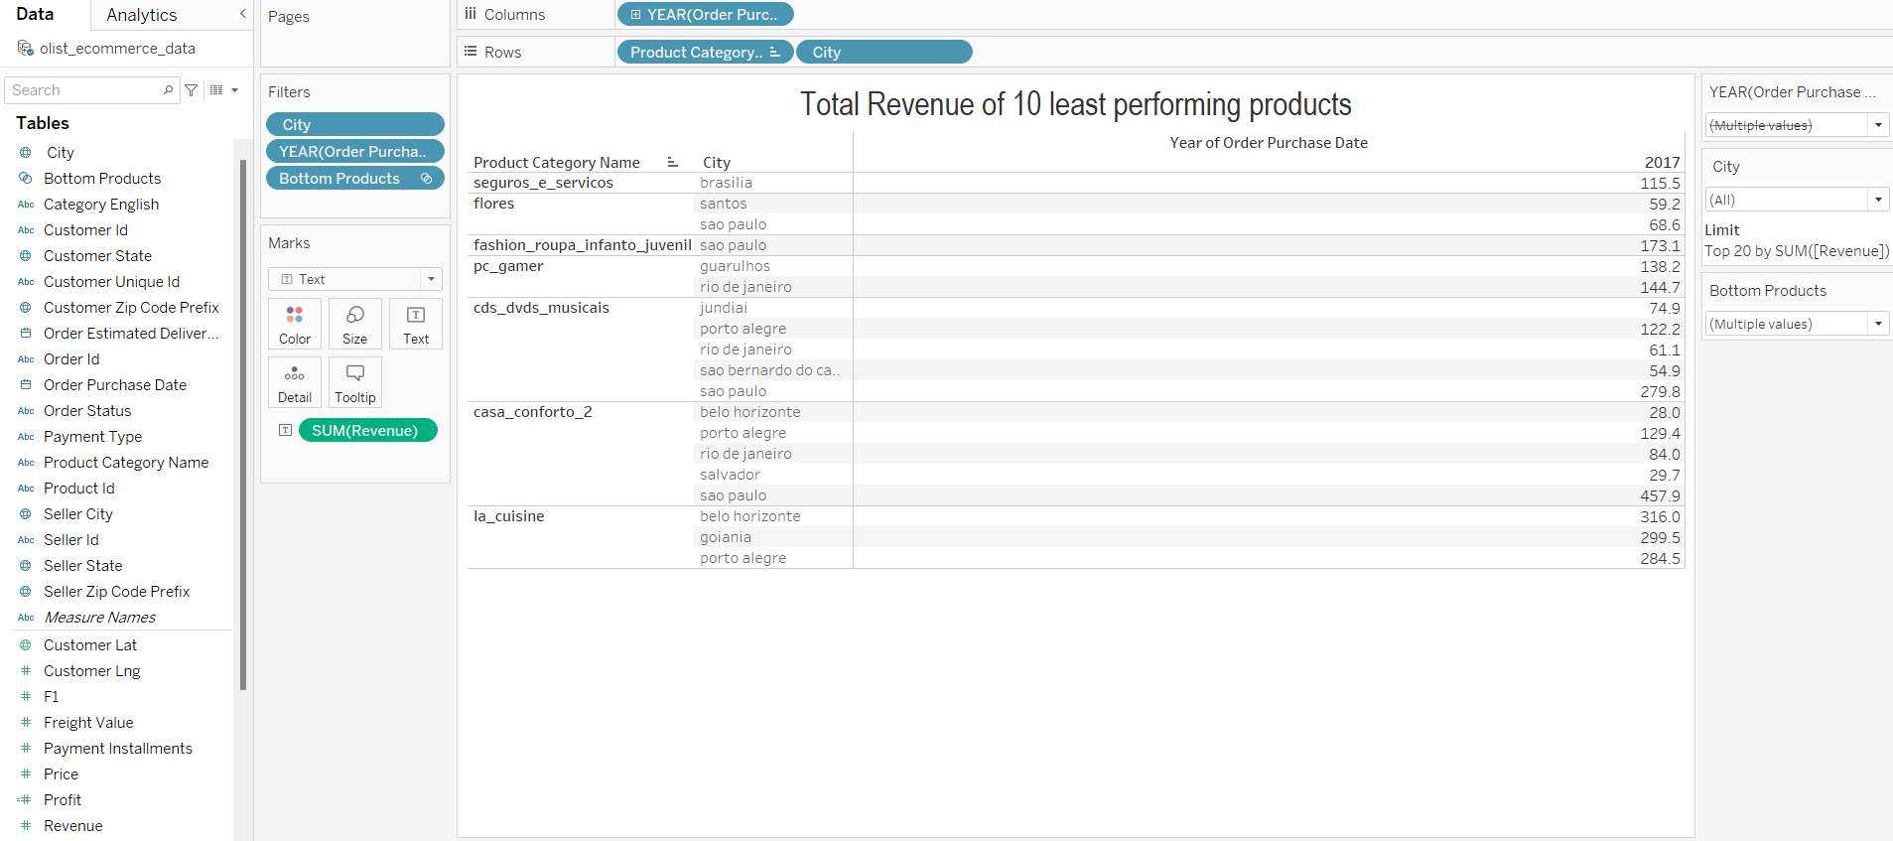
Example of the cube on a MOLAP
Notes:
Reference: https://www.stitchdata.com/resources/data-transformation/

Slide 29
User Roles and Deliveries
User | Delivery | Value
Power User | OLAP, MOLAP, Portal | Advance Adhoc reporting analysis
Mid-Level Executives | OLAP, Portal | Adhoc reporting analysis
Senior Executives / Leaders | Portal, Report Summary | High level analysis, Report summary
Notes:
Reference: https://www.stitchdata.com/resources/data-transformation/

Slide 30
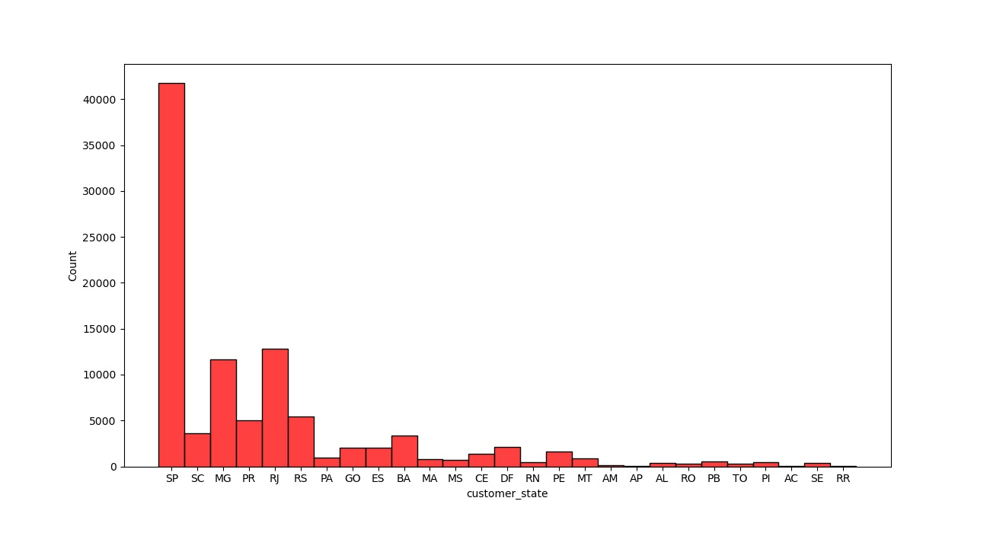
Visualizations
By the chart on our left, we see that most customers come from Sao Paulo, followed by Rio de Jenerio state & so on.
For a better understanding:
sao paulo 15540 rio de janeiro 6882 belo horizonte 2773 brasilia 2131 curitiba 1521 campinas 1444 porto alegre 1379 salvador 1245 guarulhos 1189 sao bernardo do campo 938
Notes:
Reference: https://www.stitchdata.com/resources/data-transformation/

Slide 31
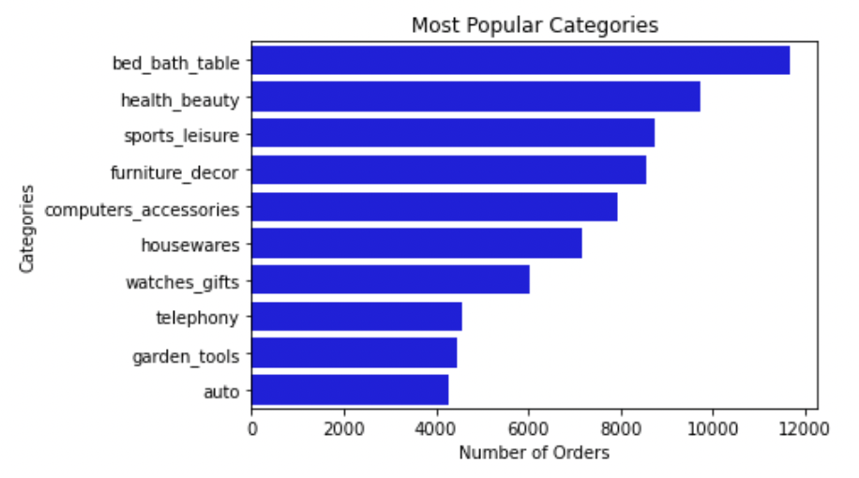
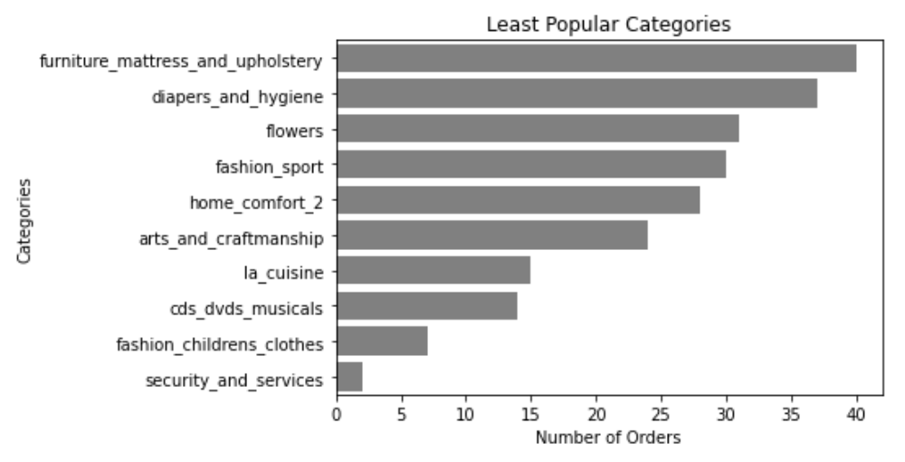
Visualizations
We check this by number of orders placed from a particular category of items.
Here we see products from Bed Bath Table have received the most orders whereas products from security & services received the least orders.
Between the ~4.2k orders from 'auto' category & the 40 orders from 'furniture' category lie the remaining 52 categories which did not qualify for the most or the least popular charts.
One thing to notice is that a popular necessity like 'diapers & hygiene' received less than 40 orders online so thus, the local retail stores selling items from this category would be getting good revenue.
Notes:
Reference: https://www.stitchdata.com/resources/data-transformation/

Slide 32
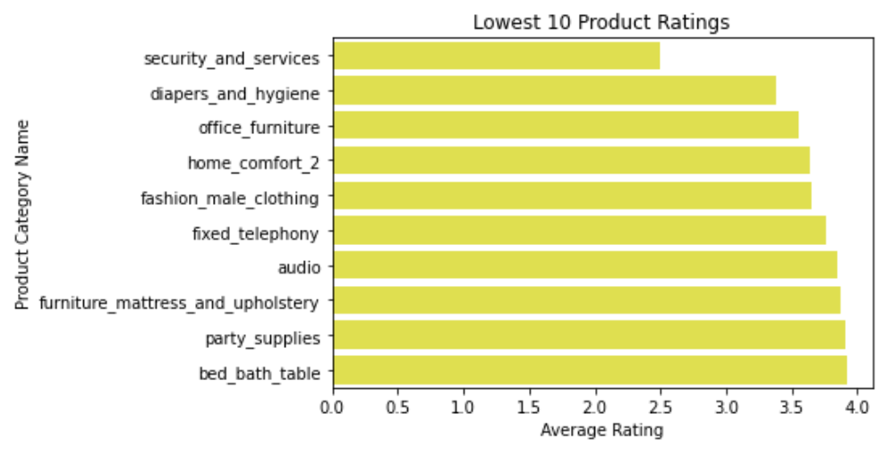
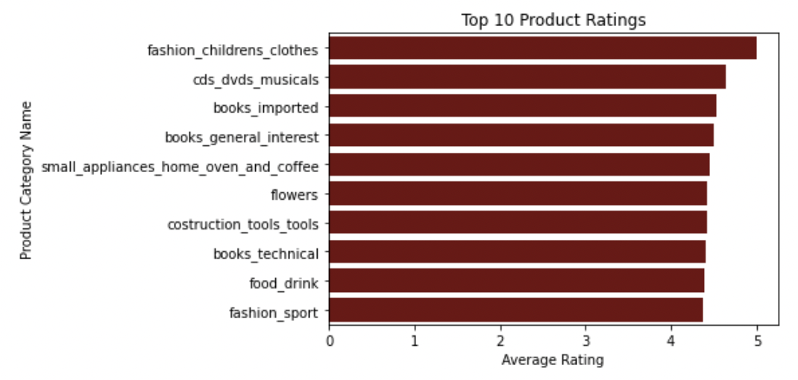
Visualizations
On further analysis, we see that security & services have the least number of orders because the platform lacks in quality of products in this particular category.
The same probably could be said about diapers & hygiene products, home comfort 2 & furniture categories.
Surprisingly, bed bath table, which has the most number of orders, did qualify for the lowest rated products.
This can be due to the scale of orders the category receives, thus the average of a little lesser than 4 can be considered good enough.
Notes:
Reference: https://www.stitchdata.com/resources/data-transformation/

Slide 33
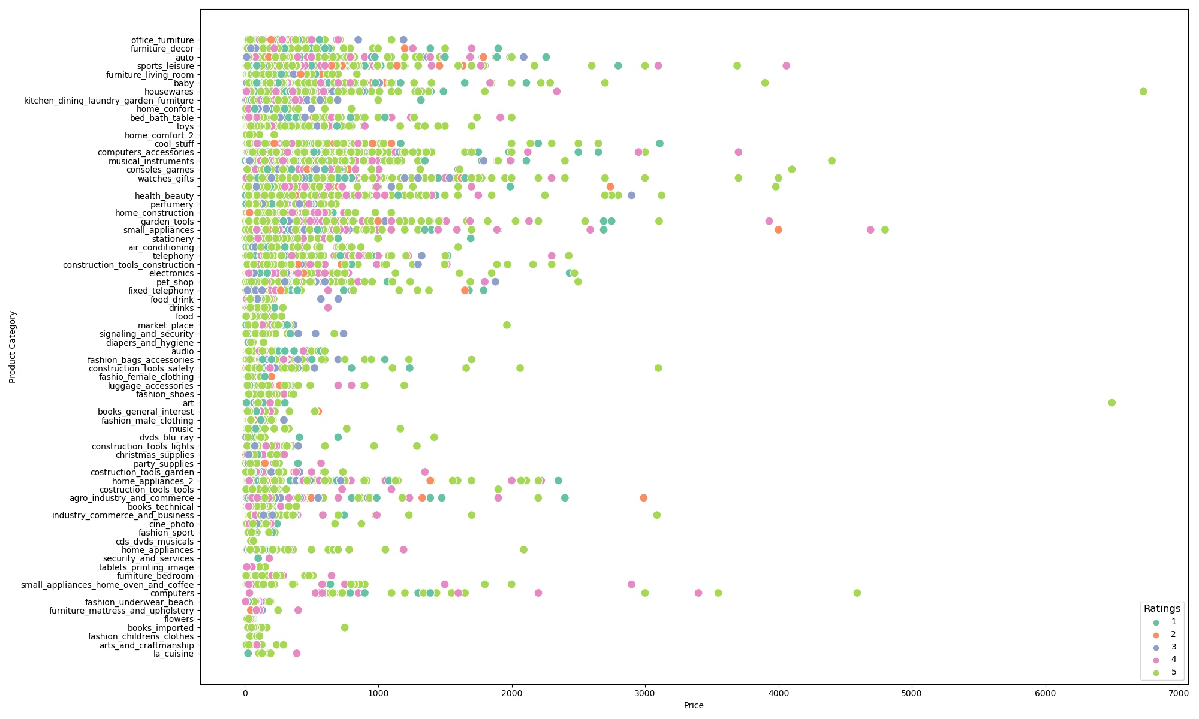
Visualizations
To understand how the products are being rated, we made a scatter plot of price vs product category where each dot is an order & the color of the dots represent the rating it got.
We see a lot of 5 star ratings being given to products from Olist.
Although we do also see items costing more than 2000 or even 3000, that got 1 star ratings which is something Olist should look at & work upon.
Notes:
Reference: https://www.stitchdata.com/resources/data-transformation/

Slide 34
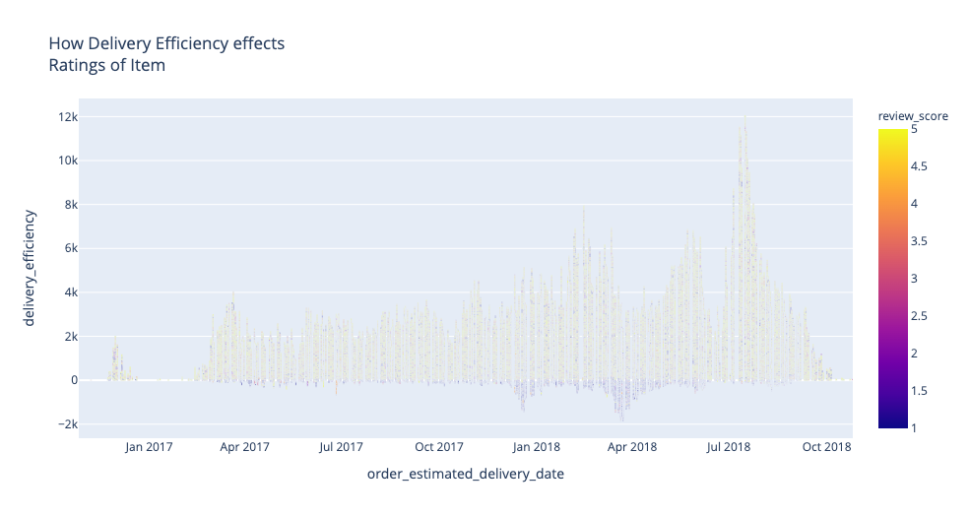
Visualizations
Delivery Efficiency is calculated by subtracting Actual Delivery Date from Estimated Delivery Date.​
We compare this efficiency with the review score given to these products.​
Upon comparing we notice that most orders which got delivered after the estimated delivery date received a low rating.​
Olist can use this, & the previous chart to understand where the product or the logistics is lacking quality.​
[Delivery Efficiency is shown in minutes]
Notes:
Reference: https://www.stitchdata.com/resources/data-transformation/

Slide 35
Thank You

