Slide 1


INDIAN INSTITUTE OF INFORMATION TECHNOLOGY
ML PROJECT
SPAM EMAIL DETECTOR
USING - MACHINE LEARNING
FAKE REVIEWS DETECTION
USING MACHINE LEARNING
TEAM MEMBERS –
DEVESH RAGHUWANSHI , 112115042
AMAN GARG , 112115019
AKASH YADAV , 112115014
APOORV GUPTA , 112115023
MENTOR: Dr. SHRIKANT SALVE

Slide 2

TABLE OF CONTENTS
INTRODUCTION
PROBLEM STATEMENT
ACTIVITY DIAGRAM
PROPOSED SOLUTION
INTRODUCING OUR PROJECT
TECHNOLOGY USED
RESULT AND CONCLUSION

Slide 3

INTRODUCTION
In the digital age, email is a vital means of communication: In today's interconnected world, email is a fundamental tool for communication.
Email, however, comes with a significant drawback: spam: Unfortunately, along with its many benefits, email is also plagued by a persistent problem known as “spam’’.
We all receive unwanted and potentially harmful emails daily: Spam is a universal problem that affects all email users. On a daily basis, our inboxes are flooded with these unwanted emails, creating clutter, consuming valuable time, and posing potential security risks.
Dealing with spam has become a necessary but time-consuming task for anyone who uses email.
Today, we'll explore how machine learning can be leveraged to combat this ever-present issue: In this presentation, we will delve into a solution for this ongoing problem.
R

Slide 4
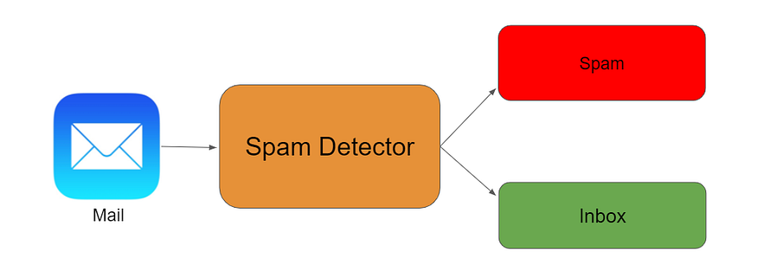
PROBLEM STATEMENT
Email spam is a pervasive and evolving issue in the digital age, causing users to receive unwanted and potentially harmful emails regularly. Traditional rule-based spam filters are no longer sufficient to combat the ever-adapting tactics of spammers.
To maintain the integrity of email communication and protect users from spam, there is a critical need for intelligent and adaptive spam email detection systems.
The challenge is to develop and deploy a machine learning-based solution that can accurately and efficiently distinguish between spam and legitimate (ham) emails, while continuously adapting to emerging spam tactics and providing a high level of security.
R
Source: Google

Slide 5
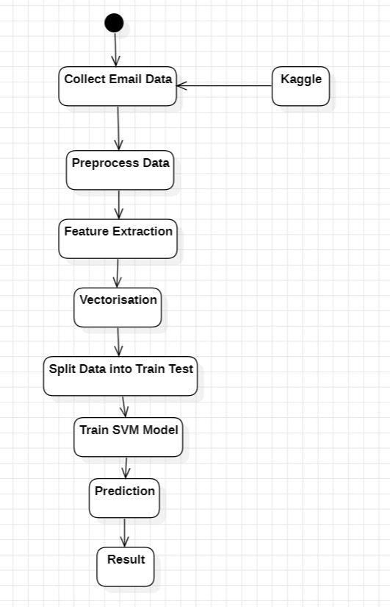
ACTIVITY DIAGRAM
R

Slide 6
PROPOSED SOLUTION
To address the ongoing challenge of email spam, so we came up with the development of a robust machine learning-based spam email detector. Our solution harnesses the power of machine learning algorithms to effectively filter and classify incoming emails as either 'spam' or 'ham' (legitimate). The key components of our solution include.
Data Collection and Preprocessing:
Gathering a labeled dataset containing both spam and ham emails.
Preprocessing the data, which involves Handling null values, Standardization, Handling categorical values
and Encoding.
Utilizing a variety of machine learning algorithms, including:
K Nearest Neighbours, Support Vector Machine (SVM), Decision Tree, Random Forest, Logistic Regression and
Naive Bayes.
R

Slide 7
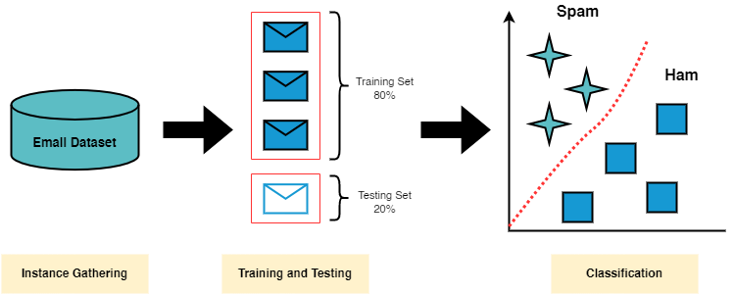
PROPOSED SOLUTION
Model Training:
Splitting the dataset into a training set and a testing set to train and evaluate the performance of each algorithm. This will help identify the most suitable algorithm for the task.
Model Evaluation:
Assessing the performance of each algorithm using metrics such as accuracy, precision, recall, F1-score, and ROC AUC. This evaluation will provide insights into how well each model can differentiate between spam and ham emails.
R

Slide 8
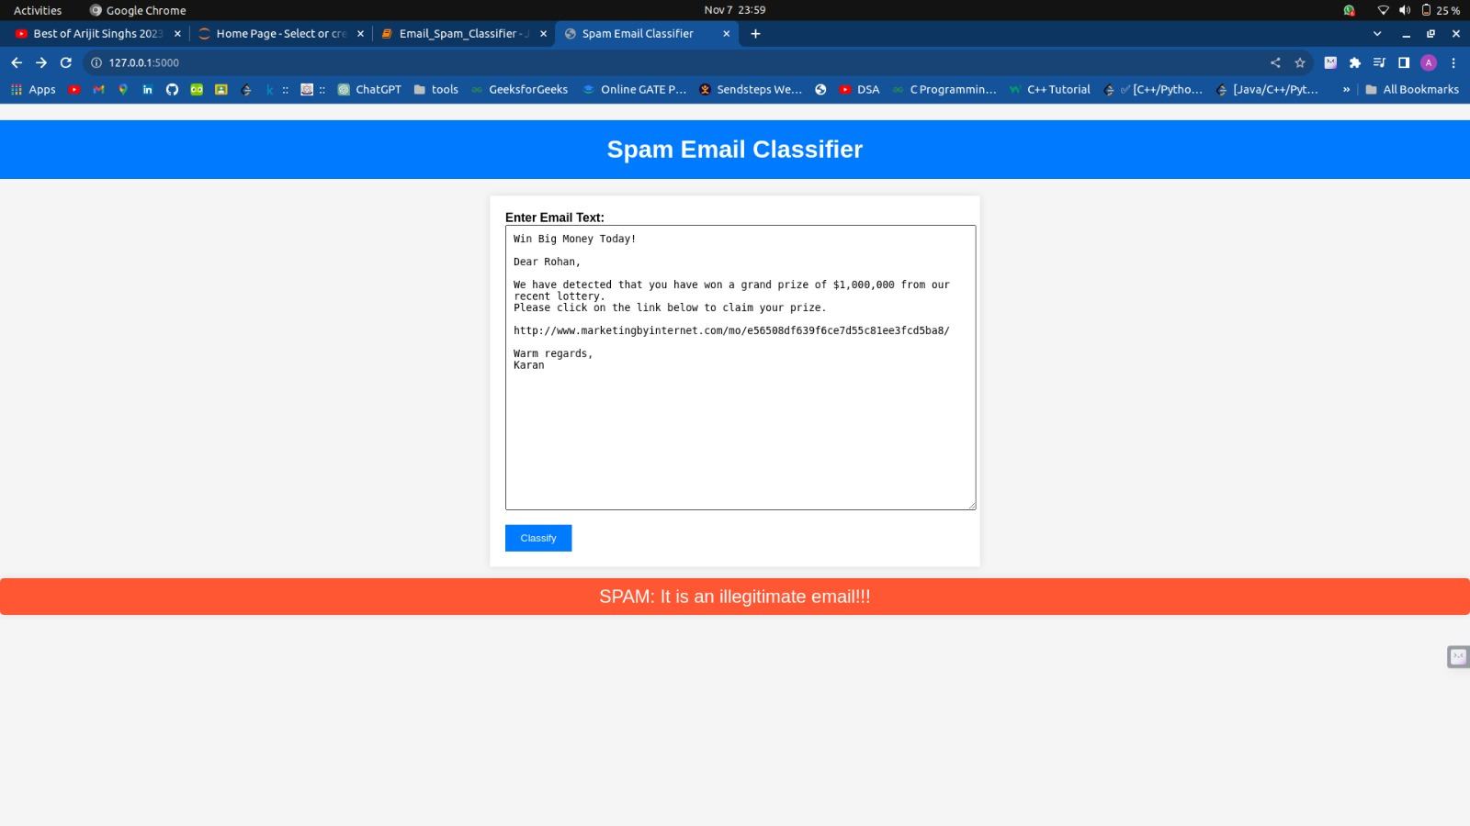
INTRODUCING OUR PROJECT
R

Slide 9
TECHNOLOGY USED
Web Development:
Front-end: HTML, CSS, and JavaScript
These front-end technologies work in harmony with the Flask backend to create a complete web application for your spam email detector
Back-end:
FLASK: Flask plays a crucial role in making your spam email detector accessible and user-friendly. It connects the frontend (web interface) with the backend (machine learning models) and ensures that users can efficiently interact with the system. By using Flask, you provide a convenient way for users to submit emails for analysis and receive classification results, improving email security and user experience.
R

Slide 10
TECHNOLOGY USED
Analytics and Data Insights: Data analysis tools, such as Python with Pandas, NumPy, and scikit-learn, are used for processing and analyzing large datasets. Machine learning algorithms are applied to user data to identify patterns, preferences, and behaviors
Machine Learning Algorithms:
K-Nearest Neighbors (KNN)
Support Vector Machine (SVM)
Naive Bayes
Random Forest
Logistic Regression
Decision Tree
R

Slide 11
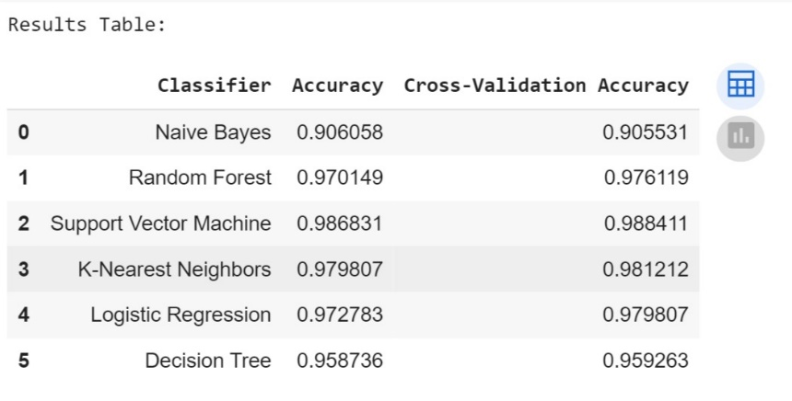
RESULT AND CONCLUSION
In our quest to create a robust spam email detector, we explored several machine learning algorithms and evaluated their performance using a labeled dataset of spam and ham emails. Here are the results of our model evaluations, along with the best-performing algorithm:
K-Nearest Neighbors (KNN): Achieved an accuracy of 98.12%.
Support Vector Machine (SVM): Demonstrated the highest accuracy, achieving an impressive 98.84%.
Naive Bayes: Achieved an accuracy of 90.55%.
Random Forest: Showed strong performance with an accuracy of 97.61%.
Logistic Regression: Achieved a solid accuracy of 97.98%.
Decision Tree: Demonstrated a respectable accuracy of 95.93%.
The SVM algorithm emerged as the best-performing model in our evaluation, with an accuracy of 98.84%
R

Slide 12
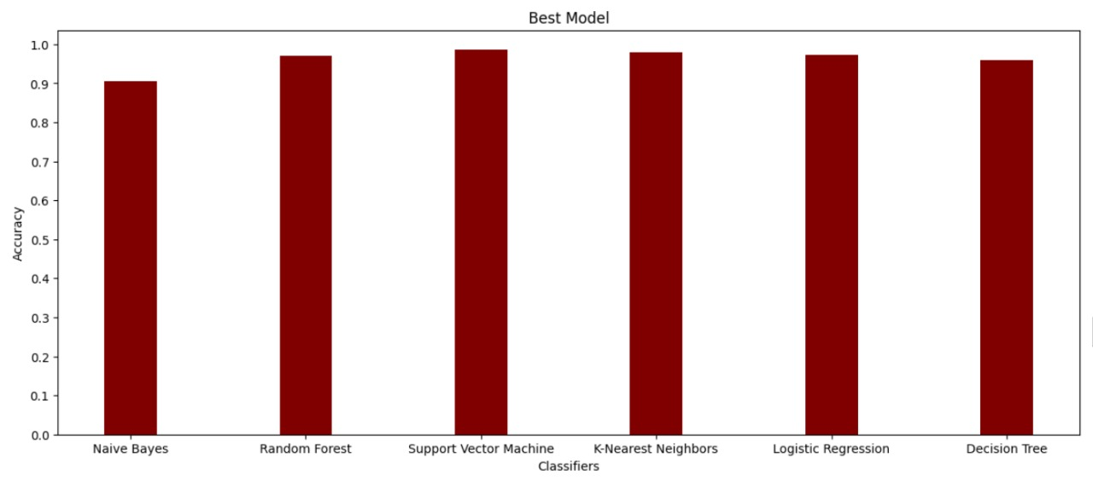
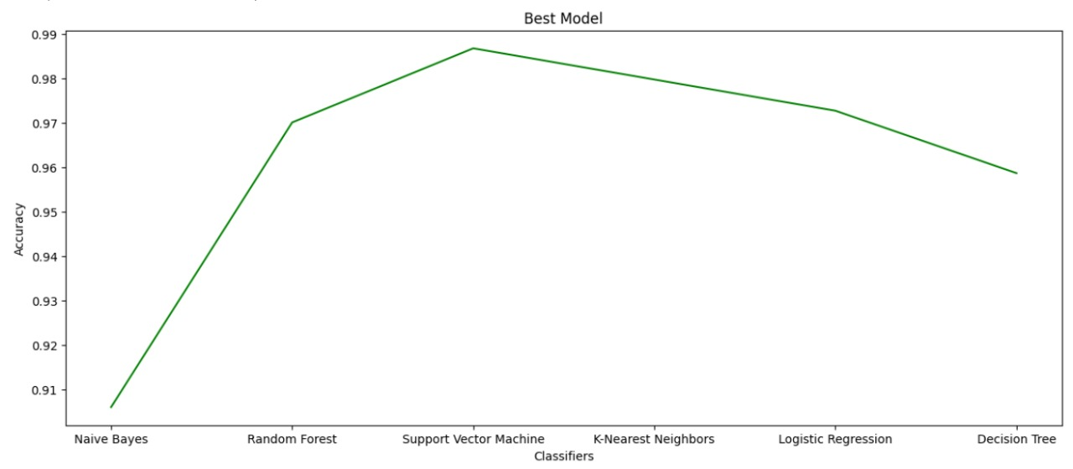
RESULT AND CONCLUSION
R

Slide 13
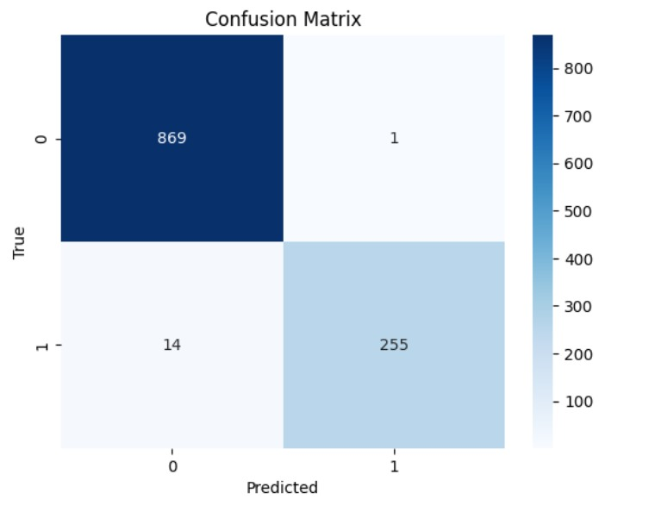
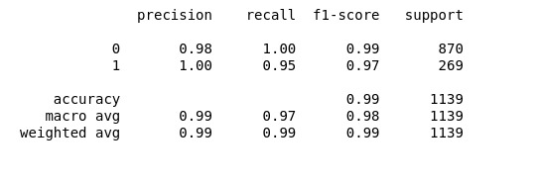
RESULT AND CONCLUSION
R
CONFUSION MATRIX FOR SVM

Slide 14




THANK YOU !!

