Slide 1
SYSTEM ARCHITECTURE · CONFIRMED FROM SOURCE
DataVault Platform
Traced across client-service, backup-service, and DataValut-Middleware-App — every diagram, table, and claim sourced from direct code inspection.
client-service · EC2 backup-service · ECS Fargate DataValut-Middleware-App · EMR Serverless

Slide 2
SECTION 1
Executive Summary
DataVault is a two primary Node.js/TypeScript runtime services, plus the Java/Spark EMR processing application that backs up, archives, and restores Salesforce org data into a Hudi-based data lake on S3.
— Two runtime services exist: client-service (EC2, PM2) and backup-service (ECS Fargate, Docker).
— client-service is the API/orchestration/auth layer — Salesforce OAuth, RBAC, config/metadata CRUD, EMR job submission, Athena restore-preview.
— backup-service is the data-movement worker — Bulk API extraction, raw CSV/JSON staging to S3, Glue registration, restore ingestion.
— Salesforce connects via OAuth 2.0 with PKCE plus a pre-packaged External Client App (ECA) via the Metadata API.
— The two services talk over HTTPS with a shared-secret header (X-Internal-Secret, timingSafeEqual compare).
— The Hudi write path runs as a Java/Spark job on EMR Serverless — record key Id, precombine LastModifiedDate, Copy-on-Write, Hudi 1.1.0 / Spark 4.0.2.
— Storage of record/config state is DynamoDB exclusively.
— Scheduling is node-cron + EventBridge Scheduler + a lightweight interval sweeper for stale-job cleanup.
DataVault Architecture · 01

Slide 3
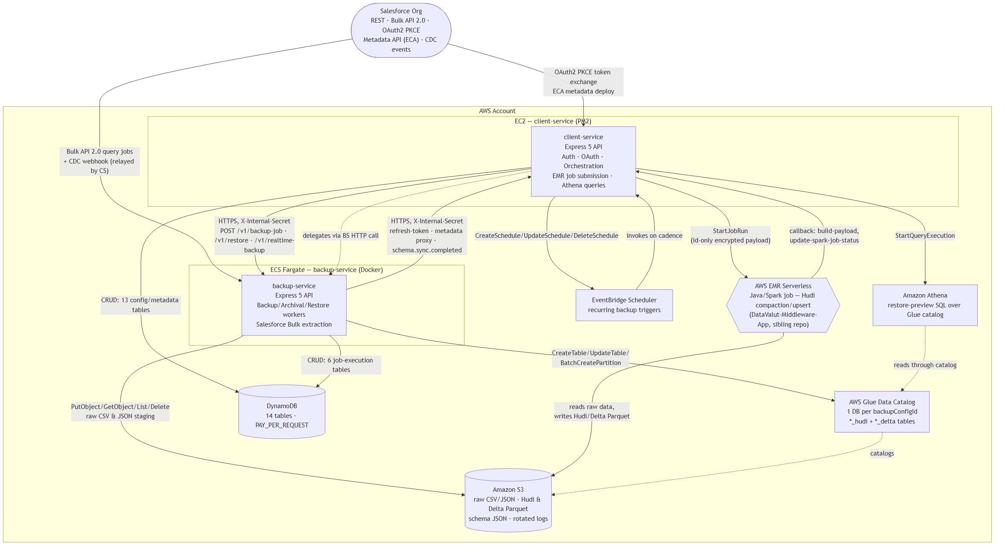
SECTION 2 · DIAGRAM 1
Executive Architecture
DataVault Architecture · 02

Slide 4
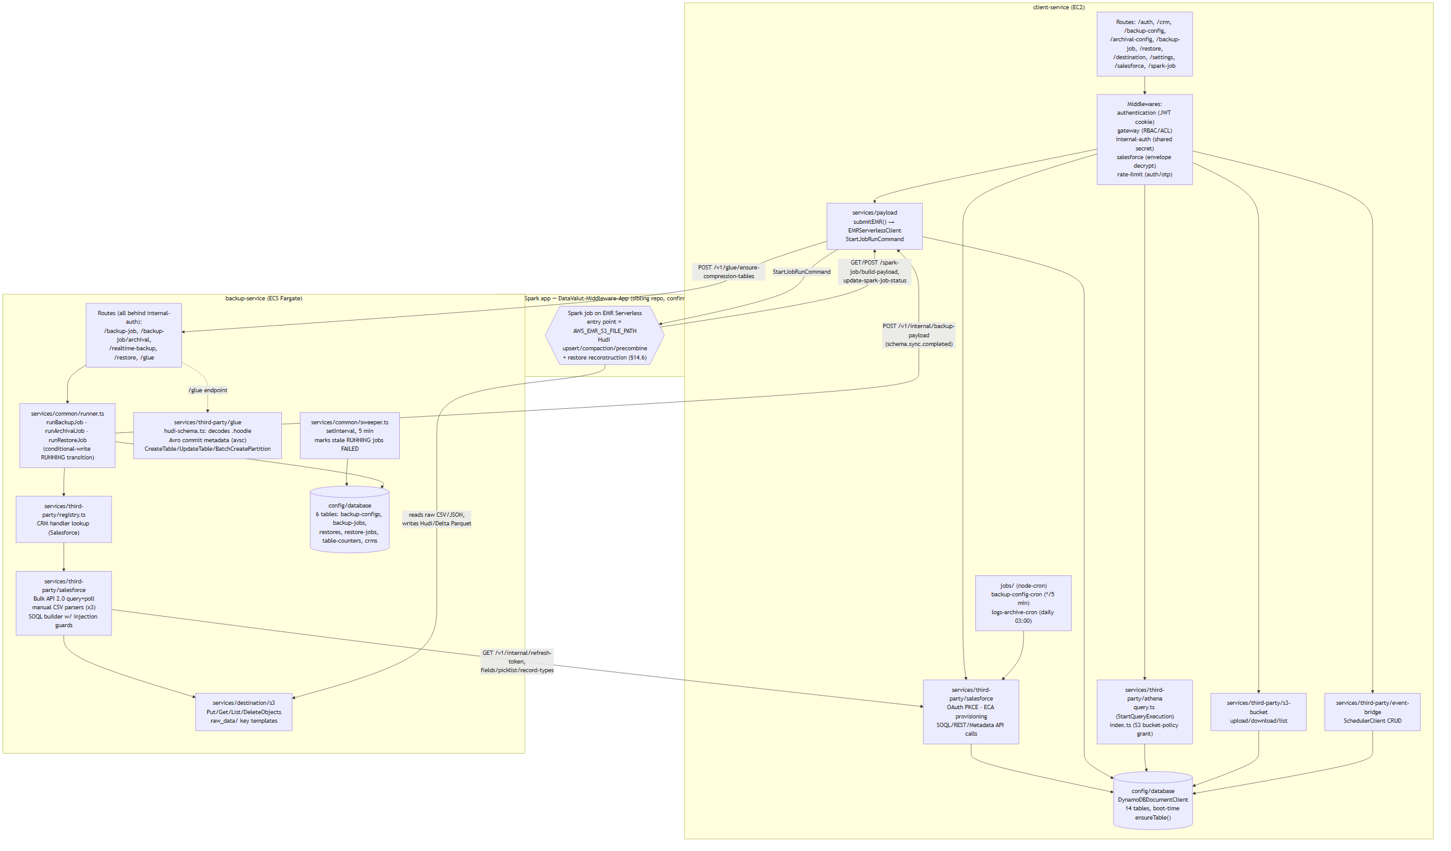
SECTION 3 · DIAGRAM 2
Detailed Service Architecture
client-service's services/spark-job/index.ts does not submit the EMR job — that happens in services/payload/index.ts (submitEMR). spark-job/index.ts is instead an HTTP client that calls backup-service's /v1/glue/ensure-compression-tables after Spark reports success.
DataVault Architecture · 03

Slide 5
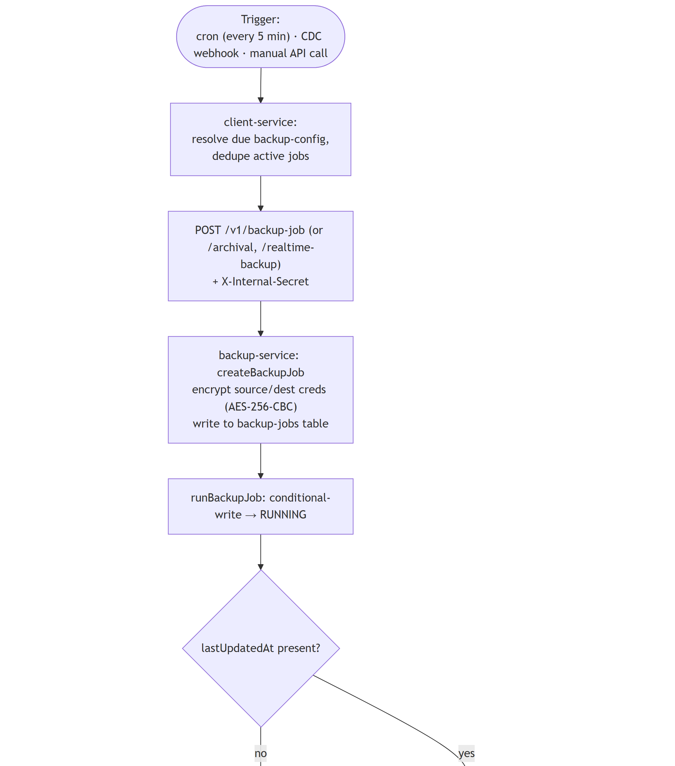
SECTION 4 · DIAGRAM 3
Backup Data Flow (1 of 3)
DataVault Architecture · 04

Slide 6
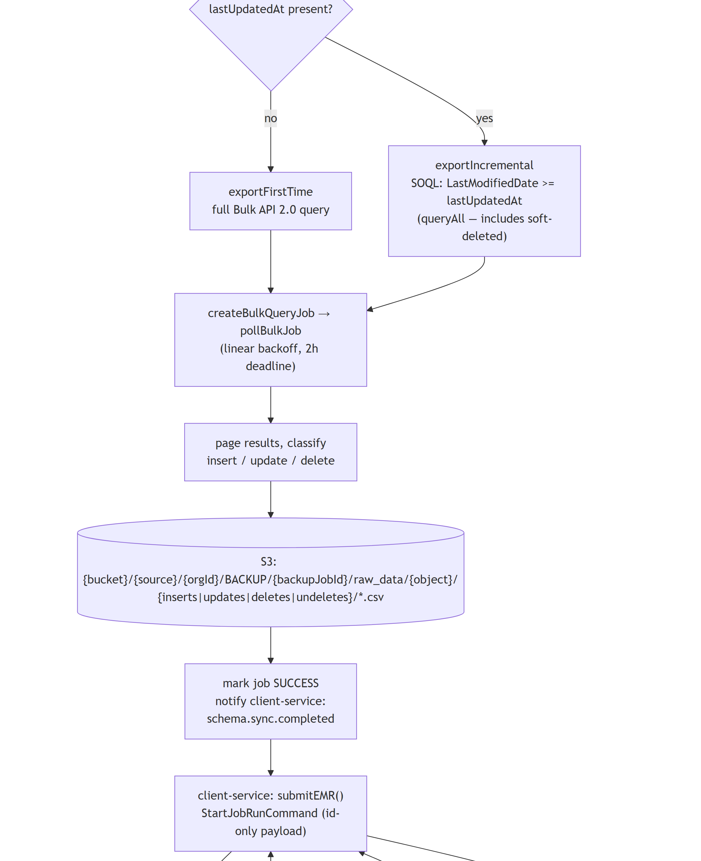
SECTION 4 · DIAGRAM 3
Backup Data Flow (2 of 3)
DataVault Architecture · 05

Slide 7
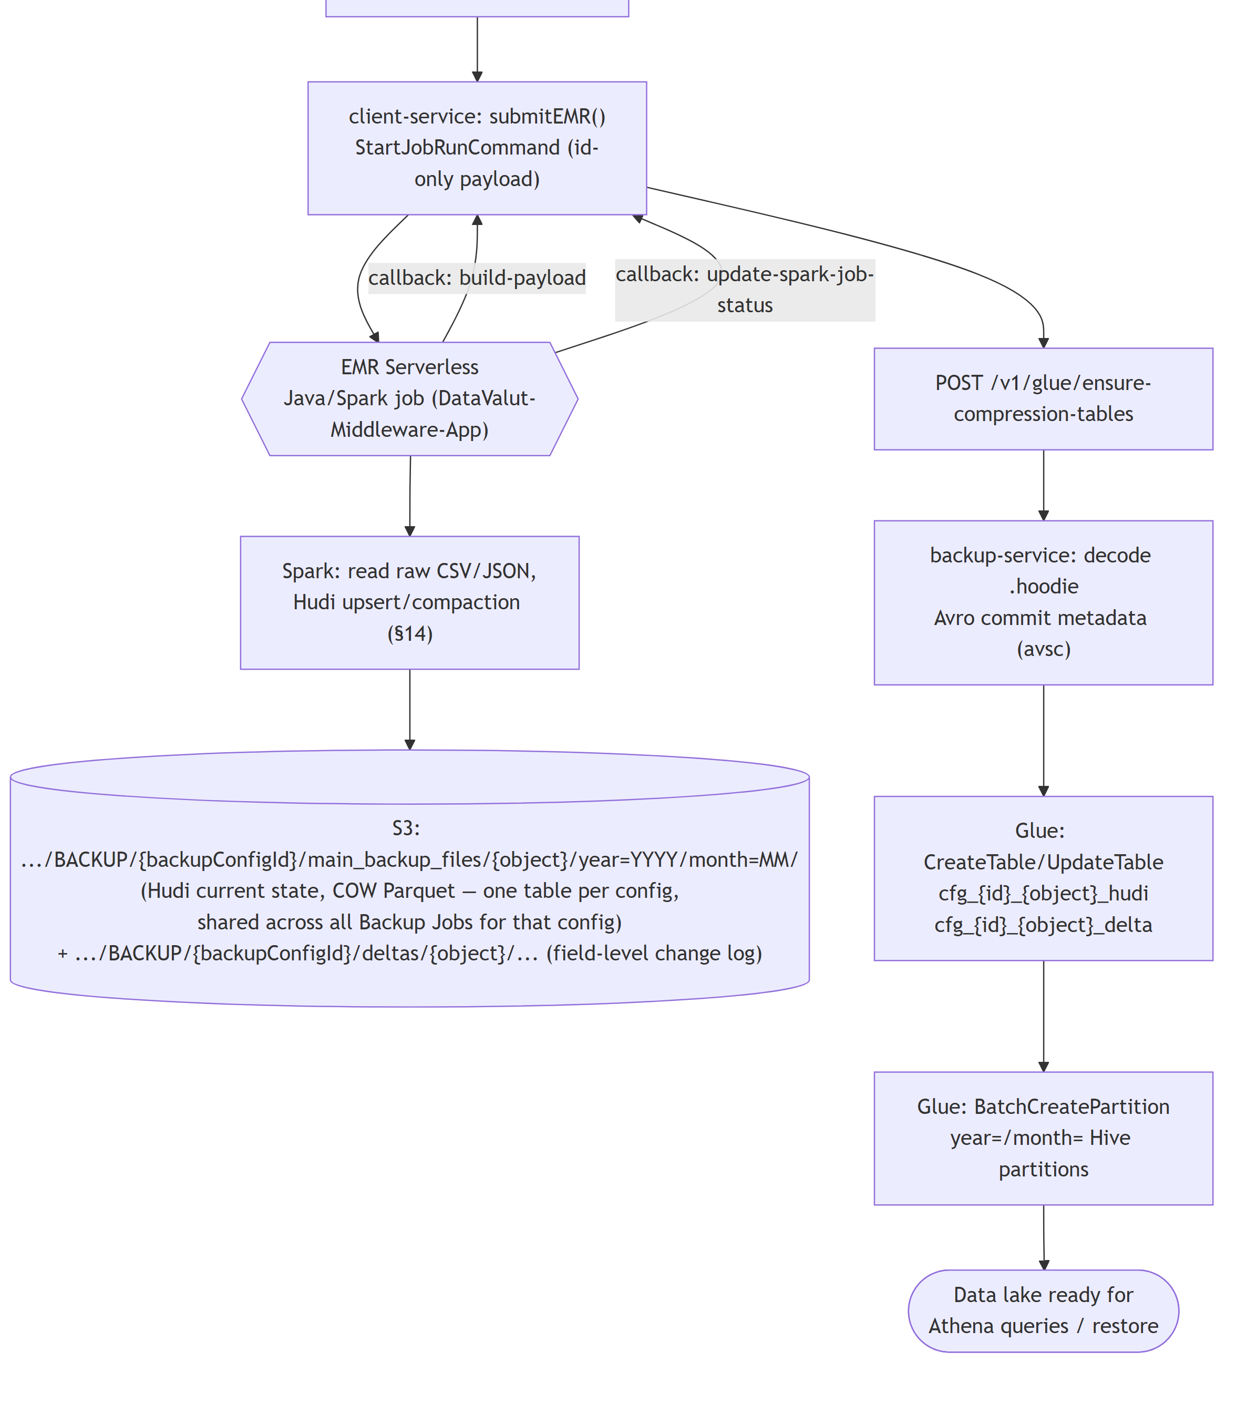
SECTION 4 · DIAGRAM 3
Backup Data Flow (3 of 3)
DataVault Architecture · 06

Slide 8
SECTION 4
Format-per-Object Clarification
— Scheduled/archival backups query Salesforce Bulk API 2.0, which natively returns CSV — only manual CSV parsing is needed for classification.
— Real-time (CDC webhook) backups write JSON directly (Buffer.from(JSON.stringify(records))) — confirmed in services/third-party/salesforce/realtime/index.ts.
— Restore is a two-stage pipeline spanning both repos: client-service submits an EMR job keyed by restoreConfigId; the Java/Spark app reconstructs records from the Hudi main + delta tables and writes a fresh CSV to restore/{restoreConfigId}/csv/{object}/restore.csv; backup-service streams that CSV for the Bulk API ingest into Salesforce.
DataVault Architecture · 07

Slide 9
SECTION 5 · DIAGRAM 4
Update / Delta Architecture
"Delta" in this system means two related things, both traced to source:
1. Application-level delta (incremental sync window) — a plain SOQL date filter computed by backup-service per job.
2. Hudi "delta" table — a field-level change-log Hudi table ({object}_delta) maintained by the EMR Java/Spark job, record-keyed on delta_id = "{Id}|{LastModifiedDate}". Separate from the current-state Hudi table (main_backup_files/).
DataVault Architecture · 08

Slide 10
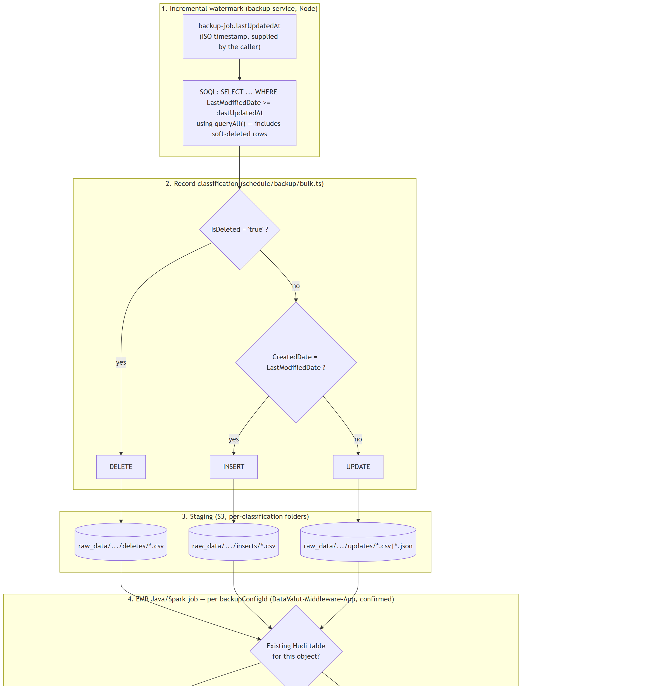
SECTION 5 · DIAGRAM 4
Update / Delta — Hudi Write Mechanism (1 of 2)
DataVault Architecture · 09

Slide 11
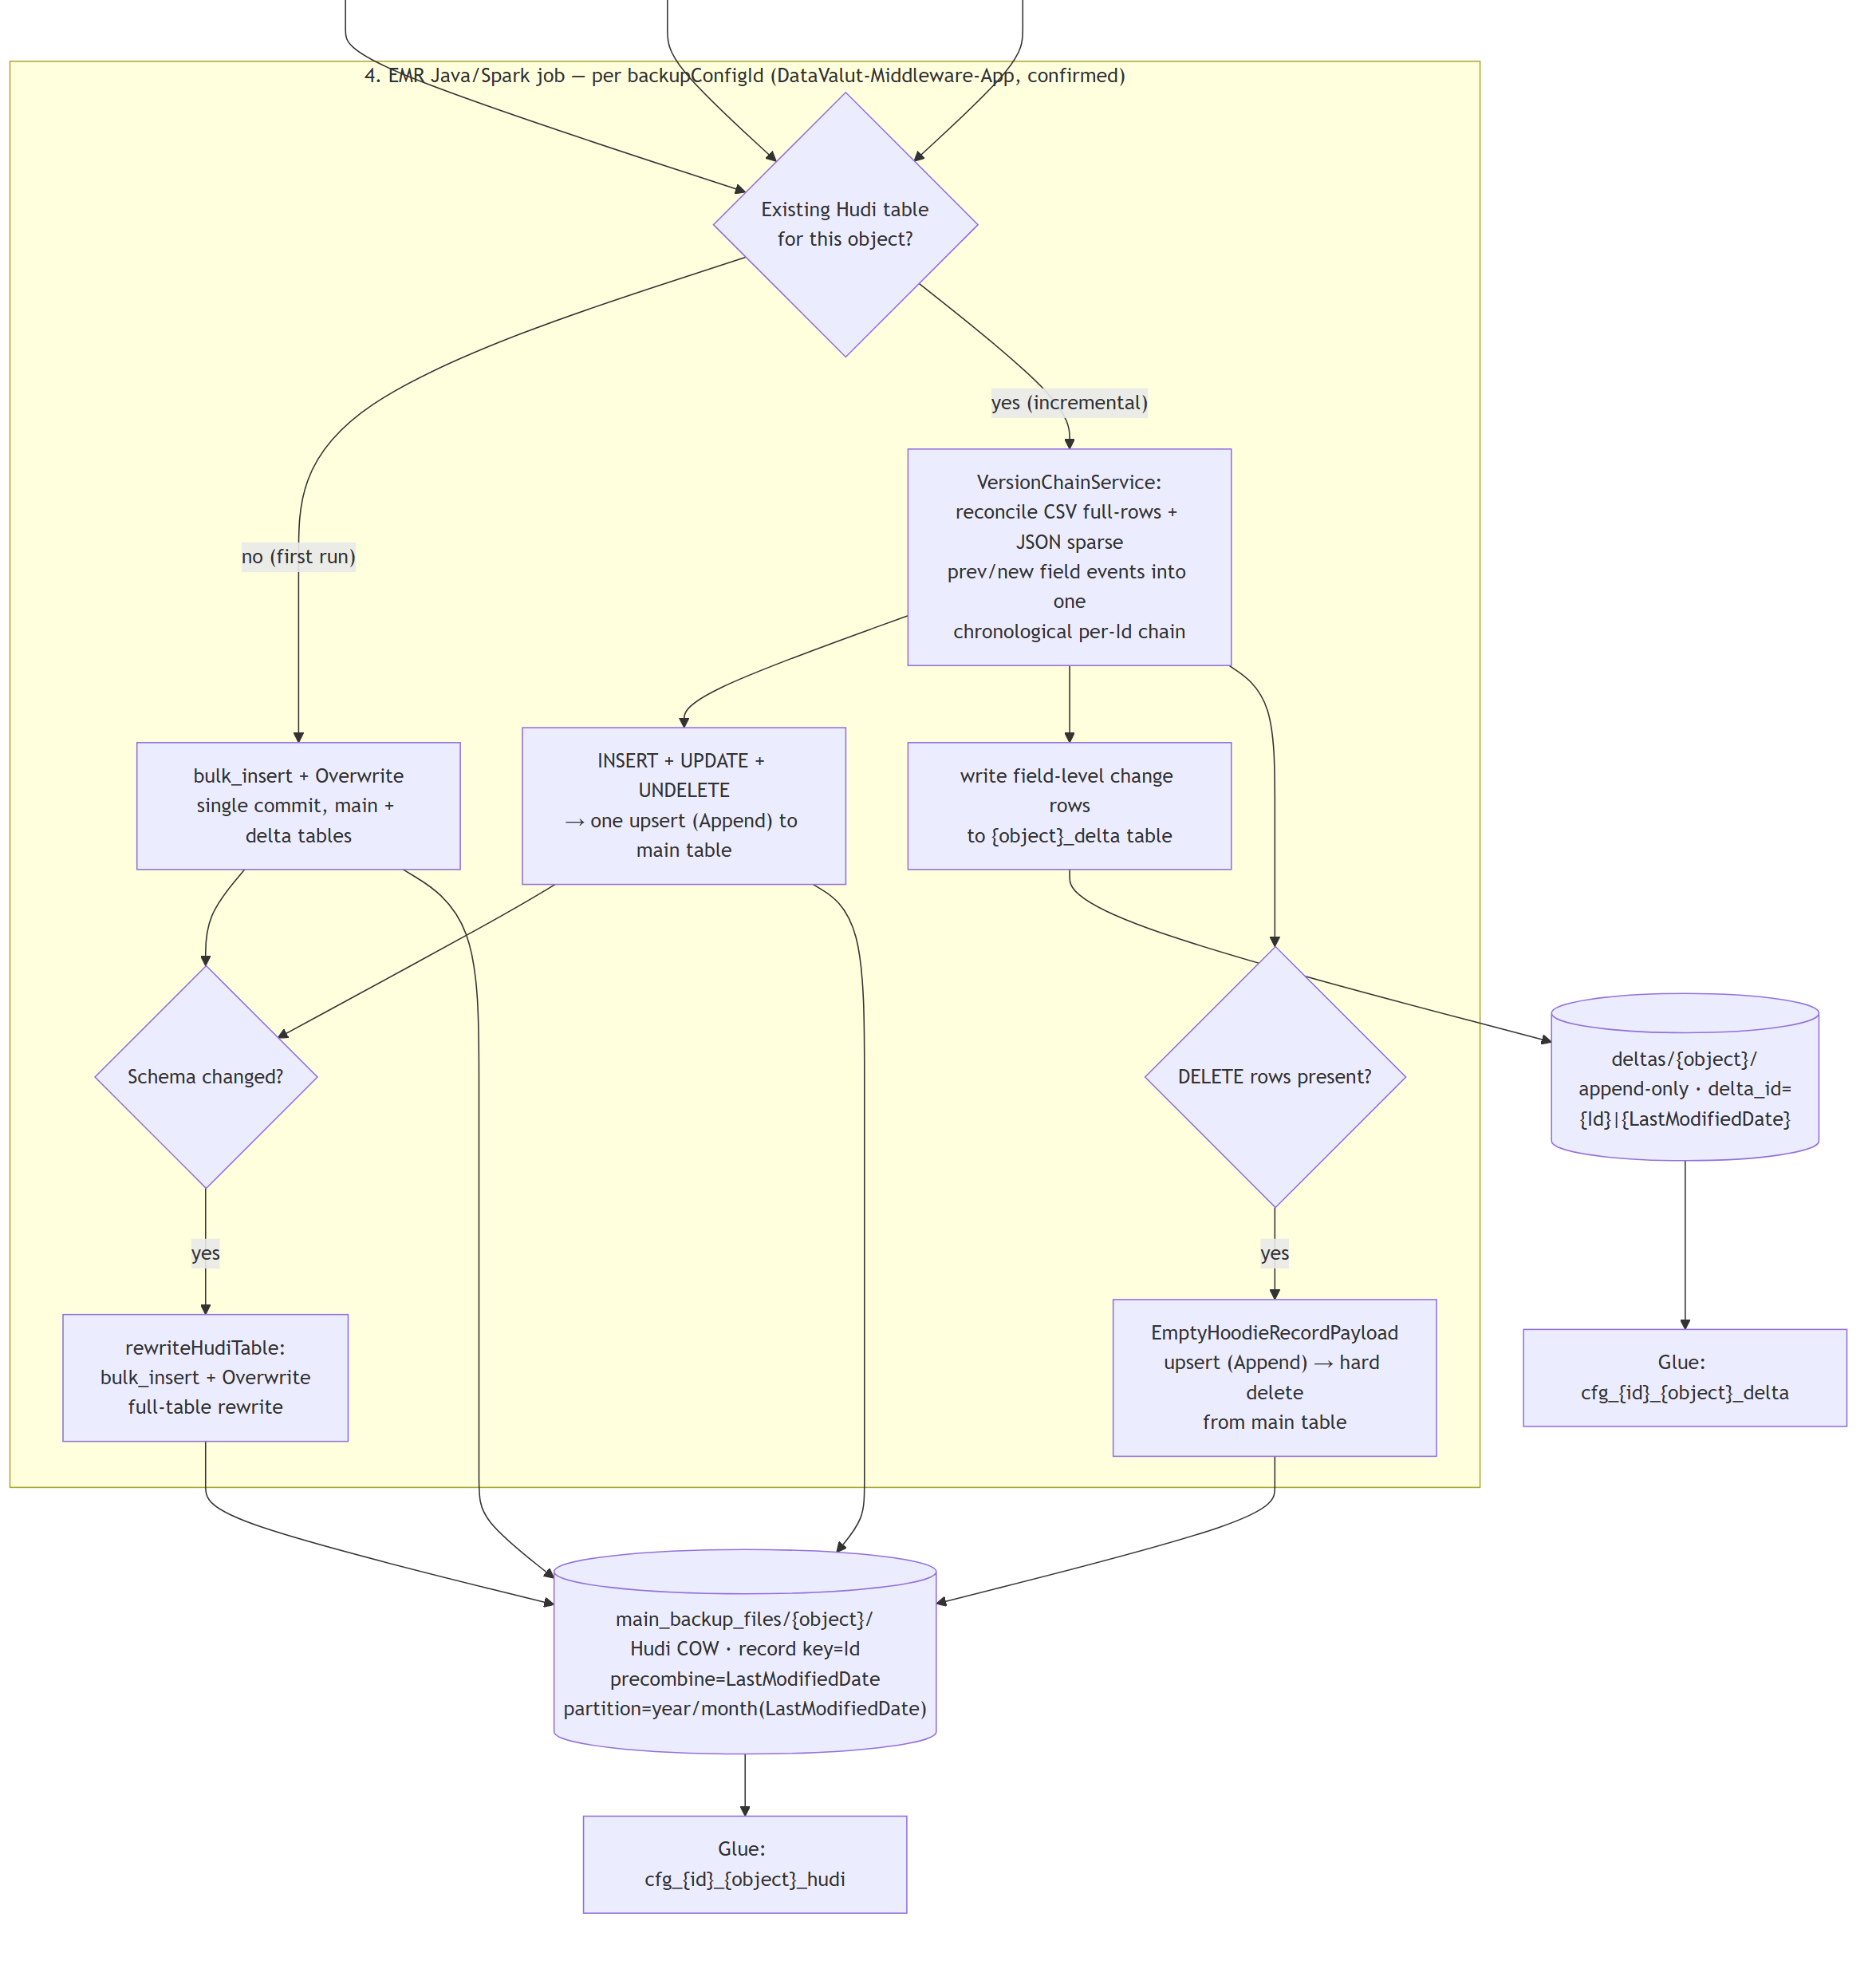
SECTION 5 · DIAGRAM 4
Update / Delta — Hudi Write Mechanism (2 of 2)
DataVault Architecture · 10

Slide 12
SECTION 5
Update / Delta — Supporting Notes
— UNDELETE is folded into the same upsert as INSERT/UPDATE — a classification VersionChainService's chronological reconciliation produces, not a distinct Hudi write path.
— Global-bloom + mutable-partition-path indexing: the main table's partition key (LastModifiedDate) changes on every update, so GLOBAL_BLOOM with hoodie.bloom.index.update.partition.path=true relocates the record instead of leaving a stale duplicate behind.
— Cascade delete (REALTIME only — CascadeDeleteService): a deleted parent either hard-deletes matching children or nullifies their lookup field, per an isCascadeDelete flag on the relationship.
— Archival flow differs on both sides: Node Phase 2 hard-deletes purged records from the live org; the Java side has no delta table at all — only inserts + schema-change operations, partitioned by CreatedDate.
DataVault Architecture · 11

Slide 13
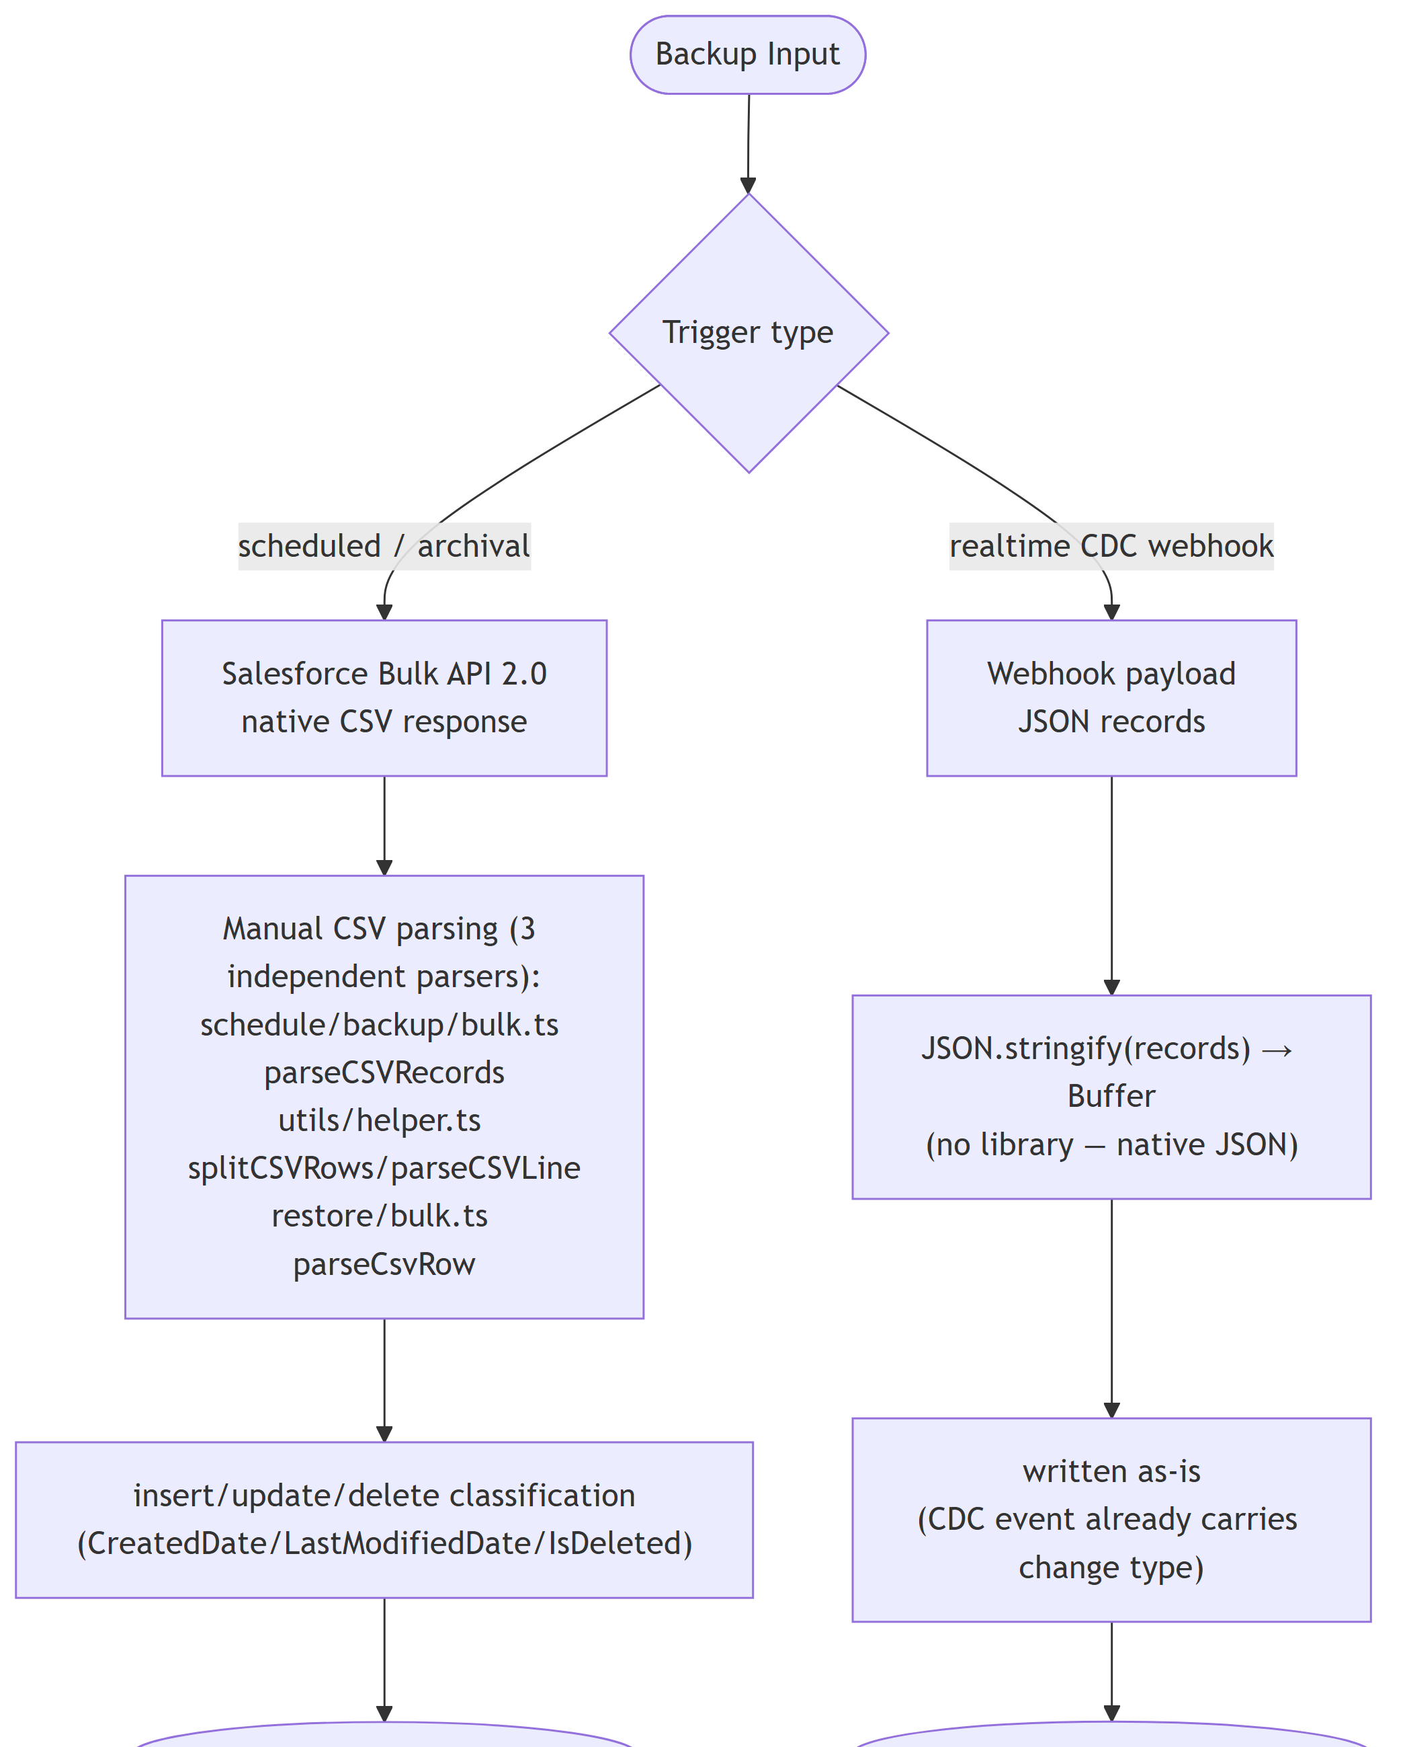
SECTION 6
CSV vs JSON Processing (1 of 2)
DataVault Architecture · 12

Slide 14
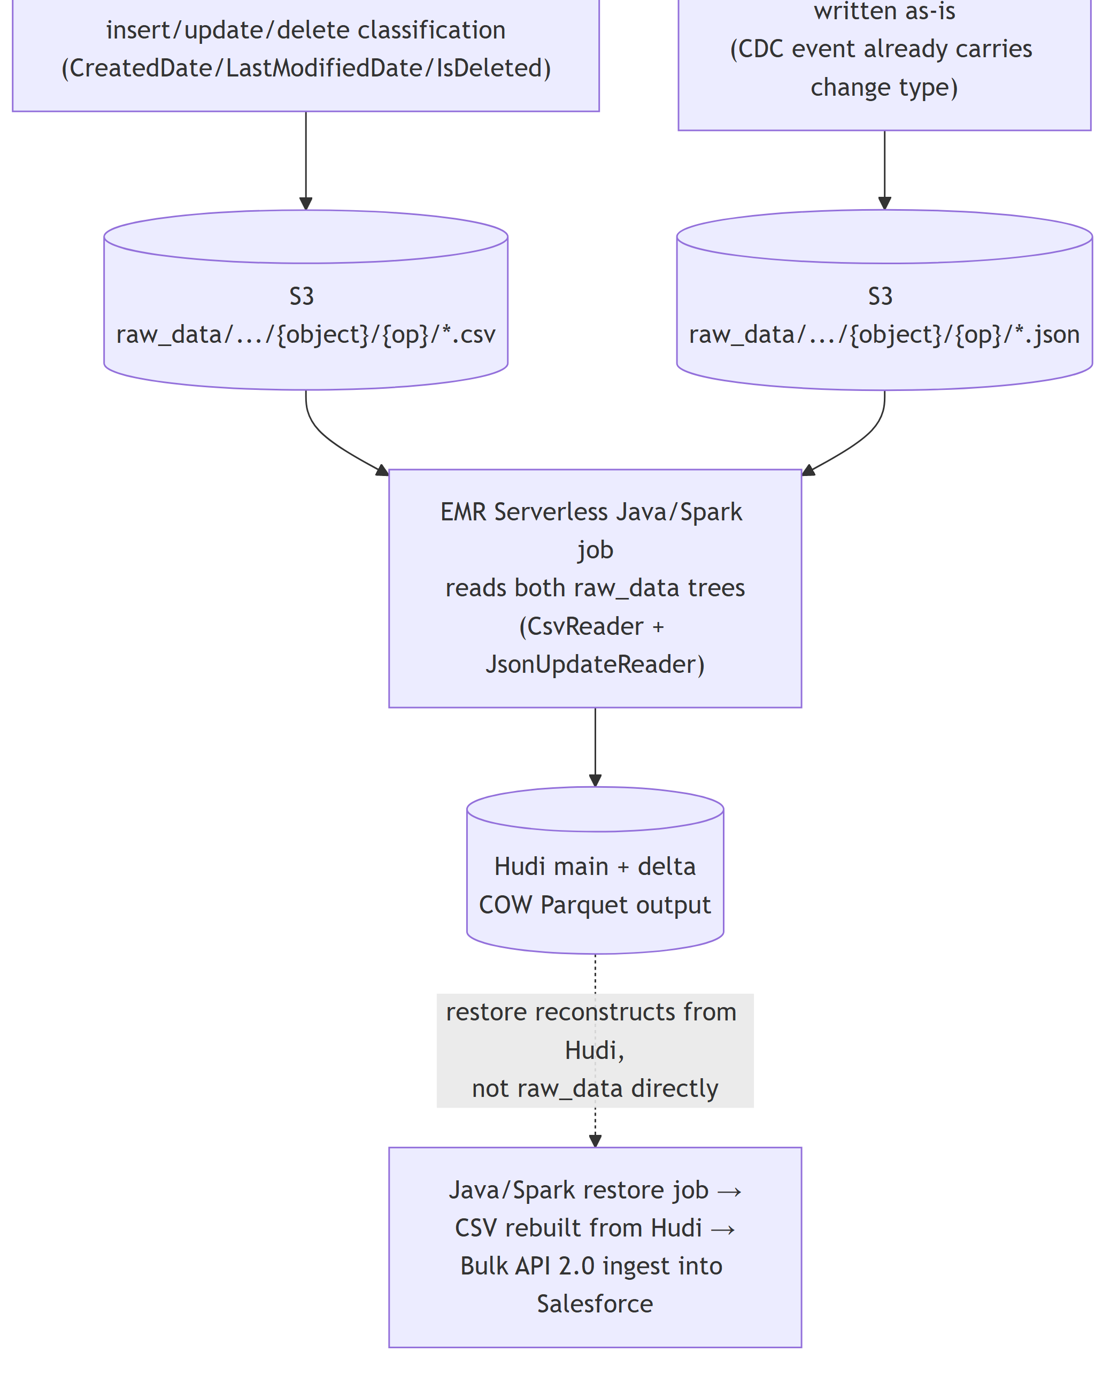
SECTION 6
CSV vs JSON Processing (2 of 2)
DataVault Architecture · 13

Slide 15
SECTION 6
CSV vs JSON — How They Converge
They converge at the EMR Serverless Java/Spark job, which reads both raw_data trees directly. JSON updates are not unioned with CSV rows as-is: they carry a sparse {Id, LastModifiedDate, prev, new} shape (only changed fields; explicit-null vs. absent-key is distinguished via an explicit map schema) and are reconciled against existing Hudi state by VersionChainService before being merged into the main-table upsert. Restore, once triggered, reads the already-reconciled Hudi tables.
DataVault Architecture · 14

Slide 16
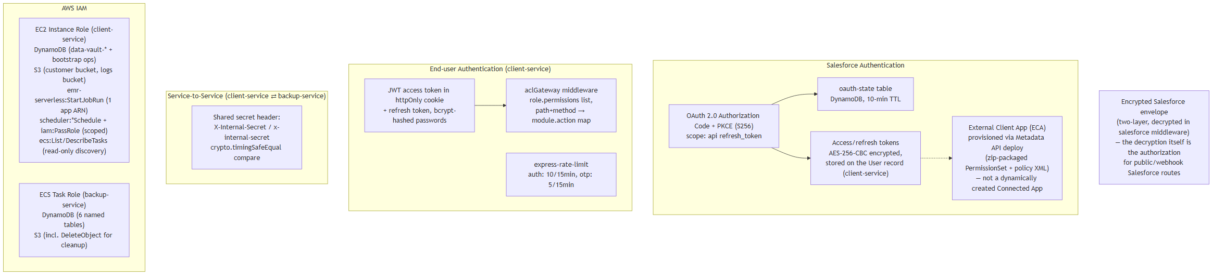
SECTION 7 · DIAGRAM 5
Security & Connectivity
— Salesforce OAuth: PKCE authorization-code flow; state + code verifier persisted in DynamoDB with a 10-minute TTL. Tokens are AES-256-CBC encrypted before persisting.
— ECA provisioning: deploys a PermissionSet + policy metadata against a pre-packaged External Client App via the SOAP Metadata API, then assigns the admin user via a custom Apex REST callout.
— Inter-service auth: a shared-secret header compared with crypto.timingSafeEqual — symmetric, gating /internal/* and all of backup-service's /v1/* routes.
— IAM: two distinct roles (EC2 instance role, ECS task role), each scoped to the specific AWS actions that service calls.
DataVault Architecture · 15

Slide 17
SECTION 8
Infrastructure Boundaries
Boundary | Status
Salesforce org (external system) | Confirmed
AWS Account | Confirmed — region us-east-2.
EC2 (client-service host) | Confirmed
ECS Fargate (backup-service) | Confirmed — awsvpc networking, task has its own public IP
S3, Glue, EMR Serverless, DynamoDB, EventBridge Scheduler, Athena | Confirmed via SDK client instantiation in source
DataVault Architecture · 16

Slide 18
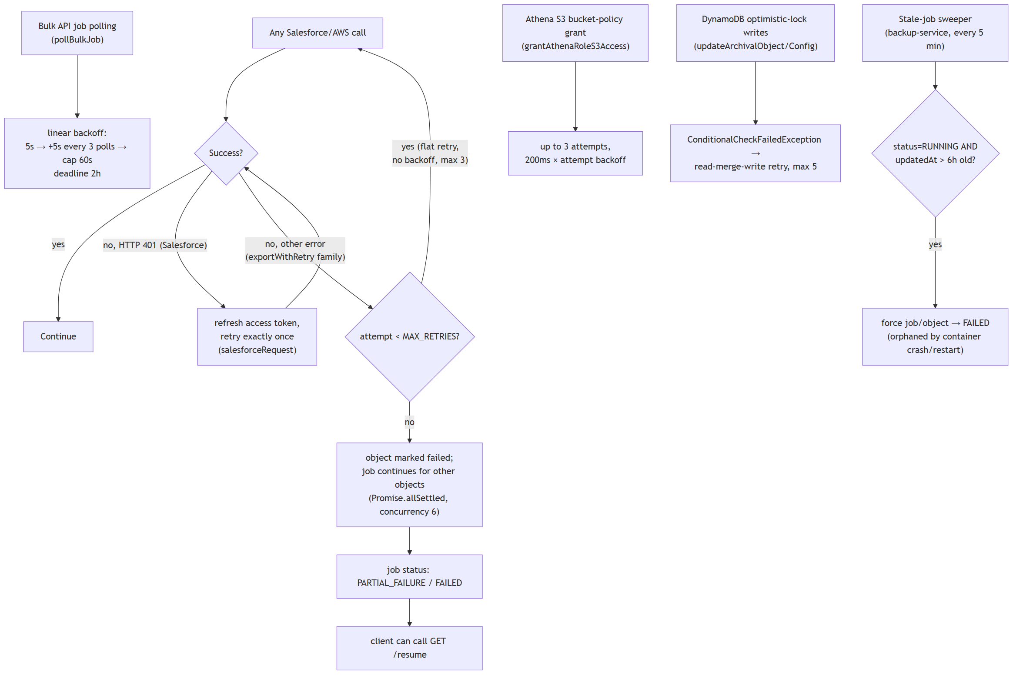
SECTION 9
Failure & Retry Paths
Glue writes rely on catching AlreadyExistsException for idempotency, alongside the AWS SDK's own default retry behavior.
DataVault Architecture · 17

Slide 19
SECTION 10
Service Responsibility Matrix (1 of 2)
Component | Deployment | Responsibility | Why Used | Communicates With
Salesforce | External | System of record for CRM data | Source system being backed up | client-service, backup-service
client-service | EC2 (PM2, nginx) | Auth, RBAC, OAuth/ECA, config CRUD, EMR submission, Athena preview, scheduling | Long-lived stateful process suits PM2/EC2 | Salesforce, backup-service, DynamoDB, S3, Athena, EMR, EventBridge
backup-service | ECS Fargate | Backup/archival/restore execution, Bulk extraction, staging, Glue registration | Stateless, horizontally-scalable worker workload | Salesforce, client-service, DynamoDB, S3, Glue
DynamoDB | AWS (regional) | Config, job, session, metadata storage — 14 tables | Serverless key-value store; PAY_PER_REQUEST avoids capacity planning | client-service (13), backup-service (6)
S3 | AWS (regional) | Raw CSV/JSON, Hudi/Delta Parquet, schema JSON, rotated logs | Durable, cheap substrate for a Hudi data lake | backup-service, EMR Spark job, Glue, client-service
DataVault Architecture · 18

Slide 20
SECTION 10
Service Responsibility Matrix (2 of 2)
Component | Deployment | Responsibility | Why Used | Communicates With
AWS Glue | AWS (regional) | Data Catalog only — table/partition metadata | Lets Athena discover schema/partitions without a hand-maintained metastore | backup-service (writes), Athena (reads)
AWS EMR Serverless | AWS (regional) | Runs the Java/Spark job that performs Hudi upsert/compaction and restore reconstruction | Serverless avoids managing a persistent cluster for bursty, job-triggered work | client-service, S3
EMR Java/Spark app | EMR Serverless (sibling repo) | Hudi writes, delta generation, schema evolution, cascade delete, restore reconstruction | Distributed Copy-on-Write Hudi merges at org scale, own JVM/Spark runtime | client-service, S3, Glue (indirect)
Athena | AWS (regional) | Ad-hoc SQL over Glue-cataloged Hudi/Delta tables for restore-preview | Serverless query engine — no dedicated database needed | client-service, Glue
EventBridge Scheduler | AWS (regional) | Recurring invocation of scheduled backup configs | Managed cron replacement that survives EC2 restarts | client-service
DataVault Architecture · 19

Slide 21
SECTION 11 · TRIGGER → PROCESSING → STORAGE → RESULT
Flow A — Scheduled (Cron-Driven) Backup
1. Trigger — jobs/backup-config-cron.ts fires every 5 minutes, finds due backup-configs, skips any with an active job.
2. Processing — client-service calls POST /v1/backup-job; backup-service runs exportFirstTime/exportIncremental against Bulk API 2.0 and classifies each row.
3. Storage — classified CSV pages land in S3 under raw_data/{backupJobId}/{object}/{op}/.
4. Result — client-service submits an EMR Spark job that turns raw CSV into Hudi/Delta Parquet; backup-service registers the result in Glue.
DataVault Architecture · 20

Slide 22
SECTION 11 · TRIGGER → PROCESSING → STORAGE → RESULT
Flow B — Real-Time (Salesforce CDC Webhook) Backup
1. Trigger — Salesforce fires a webhook that client-service's attachDecryptedSalesforceRequest middleware decrypts and validates.
2. Processing — processRealtimeWebhook fans out one POST /v1/realtime-backup call per matching REALTIME-schedule backup-config.
3. Storage — backup-service writes the CDC payload directly as JSON to raw_data/{backupJobId}/{object}/{op}/*.json — no Bulk API round-trip.
4. Result — same downstream Spark/Glue path as the scheduled flow; because Hudi merges both CSV and JSON sources, this data is fully available the next time a restore reads Hudi.
DataVault Architecture · 21

Slide 23
SECTION 11 · TRIGGER → PROCESSING → STORAGE → RESULT
Flow C — Archival Backup (Backup-Then-Purge)
1. Trigger — same as scheduled, via /v1/backup-job/archival.
2. Processing — Phase 1 exports matching records exactly like a normal backup; Phase 2 issues a Salesforce Bulk API delete job against the same record set.
3. Storage — export lands in S3 identically to a normal backup; deletion failures are logged to error_logs/{backupJobId}/{object}/{objectId}.
4. Result — the org's live data is purged while the archived copy is retained in the data lake.
DataVault Architecture · 22

Slide 24
SECTION 11 · TRIGGER → PROCESSING → STORAGE → RESULT
Flow D — Restore
1. Trigger — user selects records via the Athena-backed restore-preview UI, then POST /v1/restore-retrieve, which calls createRestoreJob then initalizeRestoreTransform.
2. EMR/Hudi reconstruction — the Java/Spark app fetches the full restore config, compresses any un-merged backup data into Hudi, then reads the Hudi main + delta tables and reconstructs the requested records per RestoreConfigs.SourceType.
3. Handoff — the Java app writes reconstructed rows to restore/{restoreConfigId}/csv/{object}/restore.csv, calls back /update-spark-job-status, and client-service triggers backup-service's /v1/restore.
4. Ingest & result — backup-service streams that Spark-generated CSV and re-uploads it through a Salesforce Bulk API 2.0 ingest job (insert/update).
Restore is Hudi-sourced end-to-end: the CSV backup-service reads is generated fresh from the Hudi tables for that specific request — reflecting bulk, archival, and realtime/CDC sources alike.
DataVault Architecture · 23

Slide 25
SECTION 12
Why Each Technology Is Used (1 of 2)
— Salesforce — The system of record. All backup/restore semantics exist to protect and reproduce data that lives here; connectivity is OAuth2/PKCE + REST + Bulk API 2.0, plus CDC webhooks for near-real-time capture.
— EC2 / client-service — Hosts the long-lived, stateful API/auth/orchestration surface — a persistent-process model (PM2) fits this better than a stateless container fleet.
— ECS / backup-service — Isolates the data-movement workload from the API/auth surface so it can be redeployed and scaled independently; matches its stateless, horizontally-scalable nature.
— S3 — Durable, scalable object storage for every stage: raw CSV/JSON, the Hudi current-state table, the Delta change-log table, schema JSON, and archived logs.
— AWS Glue — Used exclusively as a Data Catalog (no ETL jobs): one database per backupConfigId, two tables per object (_hudi, _delta), Hive-style partitions via BatchCreatePartition.
DataVault Architecture · 24

Slide 26
SECTION 12
Why Each Technology Is Used (2 of 2)
— EMR Serverless — Runs the Spark job that performs the actual Hudi write. Serverless avoids managing a persistent cluster for a bursty, job-triggered workload.
— Hudi — Record-level upsert/delete semantics and a change timeline: record key Id, precombine LastModifiedDate, Copy-on-Write, GLOBAL_BLOOM index, ZSTD compression, inline clustering every 5 commits.
— Athena — A serverless SQL engine over the Glue-cataloged Hudi tables, used to preview records before committing to a restore.
— DynamoDB — The sole operational datastore for both services (14 tables): configs, jobs, sessions, users, roles, OAuth state, counters. PAY_PER_REQUEST avoids capacity planning.
— EventBridge Scheduler — Durable, managed recurring triggers for scheduled backup-configs — survives EC2 restarts, unlike an in-process cron for long intervals.
DataVault Architecture · 25

Slide 27
SECTION 14
EMR Java/Spark Service — Confirmed Internals
DataValut-Middleware-App
Everything in this section is sourced from direct inspection of the sibling repository DataValut-Middleware-App/src (Java, Spark, package com.example.*). This is the code client-service's submitEMR() triggers via StartJobRunCommand.
› 14.1 Job intake & credential flow
› 14.2 Schema evolution
› 14.3 S3 path layout
› 14.4 Retry & checkpointing
› 14.5 CSV vs JSON input (Java side)
› 14.6 Restore reads Hudi, not raw CSV
› 14.7 Library versions & write-config defaults
DataVault Architecture · 27

Slide 28
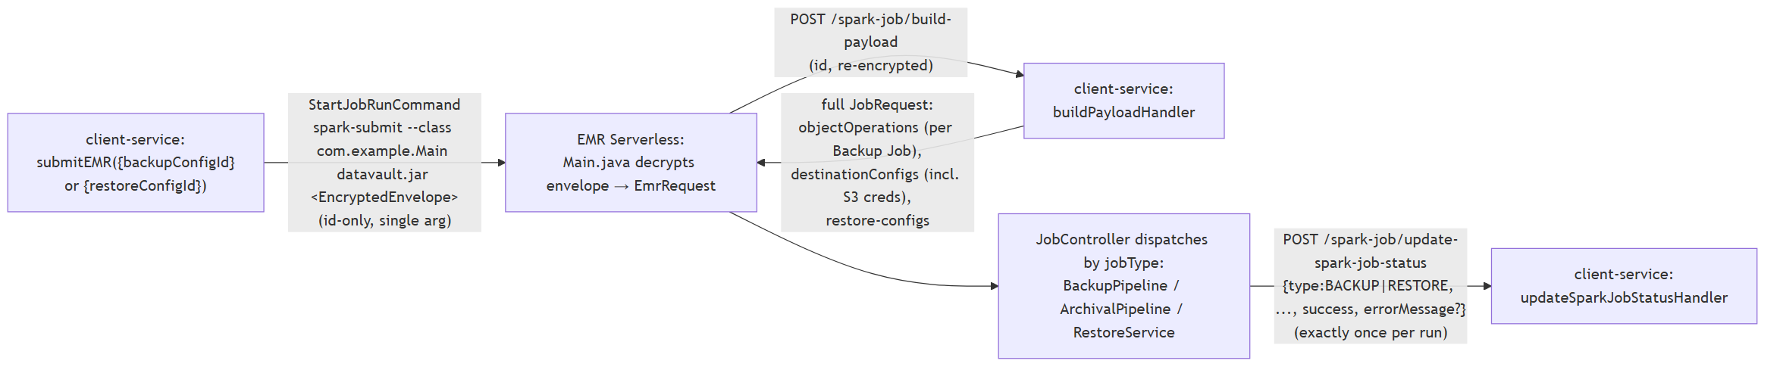
SECTION 14.1
Job Intake & Credential Flow
— The EMR step's only argument is a Base64-encrypted envelope carrying exactly one of backupConfigId or restoreConfigId — an id-only payload.
— Backup Job IDs are not in that argument — they arrive as the keys of objectOperations in the /build-payload response.
— AWS credentials for the Spark session are delivered per-job inside that same payload, not baked into the EMR application.
DataVault Architecture · 28

Slide 29
SECTION 14.2
Schema Evolution
Schema comparison/versioning is handled by SchemaComparator, SchemaDeltaService, SchemaService, DataFrameCaster, and SchemaCatalog/SchemaIO. A detected schema change (field added/dropped/retyped) triggers rewriteHudiTable — a full-table bulk_insert + Overwrite — and produces its own schema-change delta rows (SchemaDeltaService, one row per changed field element, not per affected record). This is the same rewrite path referenced in "Schema changed?" branch.
DataVault Architecture · 29

Slide 30
SECTION 14.3
S3 Path Layout
{bucket}/{sourceName}/{orgId}/BACKUP/{backupJobId}/raw_data/{object}/{op}/ ← input, per Backup Job
{bucket}/{sourceName}/{orgId}/BACKUP/{configId}/main_backup_files/{object}/ ← Hudi main (year=/month= inside)
{bucket}/{sourceName}/{orgId}/BACKUP/{configId}/deltas/{object}/ ← Hudi delta (flat)
{bucket}/{sourceName}/{orgId}/BACKUP/{configId}/schemas/{object}/ ← schema parquet (not Hudi)
{bucket}/{sourceName}/{orgId}/archival/{jobId}/main_archival_files/{object}/ ← archival Hudi
{bucket}/{sourceName}/{orgId}/restore/{restoreConfigId}/csv/{object}/restore.csv ← restore output CSV
Backup Hudi output is scoped by backupConfigId, not backupJobId — multiple Backup Jobs feed one shared per-config Hudi table.
DataVault Architecture · 30

Slide 31
SECTION 14.4
Retry & Checkpointing
Policy | Attempts | Backoff
HUDI_WRITE | 3 | 2s, ×2, cap 30s
S3_READ | 4 | 1s, ×2, cap 15s
NODE_API | 4 | 1s, ×2, cap 15s
OBJECT_PIPELINE | 2 | fixed 5s
NO_RETRY | — | —
RetryExecutor + RetryPolicy retry only TRANSIENT/INFRASTRUCTURE failures (via ErrorClassifier). Separately, StageCheckpoint persists which pipeline stage last completed (e.g. FIRST_RUN_MAIN_WRITE, DELTA_WRITE, SCHEMA_REWRITE, MAIN_UPSERT, HARD_DELETE) so a retried job resumes rather than re-executing already-committed Hudi writes.
DataVault Architecture · 31

Slide 32
SECTION 14.5
CSV vs JSON Input (Confirmed, Java Side)
CsvReader reads raw_data/{inserts,updates,deletes,undeletes} as all-String columns, sanitizes dot-containing column names for Hudi/Parquet compatibility, and dedupes by (Id, LastModifiedDate). JsonUpdateReader reads the updates/ folder's {Id, LastModifiedDate, prev, new} shape via an explicit map schema, so "absent key" is distinguishable from "null value". Both feed VersionChainService, which unifies CSV full-row updates and JSON sparse field-level events into one chronological per-Id change chain (forward-fill via last(ignoreNulls=true) + lag()), producing both the delta rows and the final accumulated row used for the main-table upsert.
DataVault Architecture · 32

Slide 33
SECTION 14.6
Restore Reads Hudi, Not Raw CSV
— Restore first compresses any un-merged backup data into Hudi, so Hudi always reflects the latest state before reconstruction begins.
— It reads the Hudi main + delta tables for each object — spark.read().format("hudi").load(mainHudiPath).
— RestoreConfigs.SourceType supports ENTIRE, PARTIAL/default (delta-reconstructed), CHANGED_BETWEEN a date window, and DELETED_ONLY.
— Handles parent resurrection from DELETE deltas, inactive-owner reassignment, record-type mapping, required-field defaults, and merge rules.
— Writes CSV per object to restore/{restoreConfigId}/csv/{object}/restore.csv; isDemoOnly=true runs a dry-run record-count preview.
client-service (initalizeRestoreTransform → EMR) → Java/Spark app (Hudi → restore.csv in S3) → client-service (/update-spark-job-status → tiggerRestoreJob) → backup-service (streamCsvLinesFromS3 → Salesforce Bulk API ingest).
DataVault Architecture · 33

