Slide 1


k
Upgrade
Apoorv
Welcome
Our Team
Introduction
Spotify Hit Predictor
Background
Dataset
Model
Insights
Play
Follow

Slide 2




Upgrade
Apoorv
Welcome
Our Team
Introduction
Our Team
Background
Dataset
Model
Insights
Xialu Liu
Antara More
Apoorv V
Arpita Rane
Guide
Member
Member
Member

Slide 3


Upgrade
Apoorv
Welcome
Our Team
Introduction
Introduction
Background
Dataset
Model
In a world filled with music, what sets a song apart?
Insights
Let's unravel the mystery behind musical success.
The Quest:
Deciphering the Formula:
What makes a song a hit?
Unlocking the secrets of musical captivation.

Slide 4
Upgrade
Apoorv
Welcome
Our Team
Introduction
Background
Background
Dataset
Model
Every year, thousands of songs are released, but only a few become chart-topping hits. Have you ever wondered what sets these hit songs apart from the rest?
To answer this question, we're using a dataset of music tracks collected from Kaggle.
By analyzing this data, we aim to uncover the hidden patterns and characteristics that distinguish hit songs from flop songs.
Insights

Slide 5
Upgrade
Apoorv
Welcome
About Us
Our Team
Dataset
Background
Dataset
The dataset is a tapestry of musical elements, poised for a deep dive into the attributes that may influence a track's journey to fame or obscurity. Let's explore the nuanced distribution of these features and uncover the patterns that define hit potential.
Model
6.4K
Total records
19
Total variables
Insights
13
15
Quantitative variables
Total Predictors
06
Qualitative variables
01
Target Variable

Slide 6
Upgrade
Arpita
Welcome
Attributes and Their Descriptions
About Us
Track
Song name.
Our Teams
Background
Artist
Singer or group name
Dataset
Danceability
How suitable the song is for dancing, from 0 to 1.
Energy
Intensity and activity level of the song, from 0 to 1.
Model
Key
Musical key of the song, represented by numbers.
Insights
Loudness
Overall volume of the song in decibels (dB).
Liveness
Likelihood that the song was performed live, from 0 to 1.
Speechiness
Presence of spoken words in the song, from 0 to 1.
Acousticness
Likelihood that the song is acoustic, from 0 to 1.

Slide 7
Upgrade
Arpita
Welcome
Attributes and Their Descriptions
About Us
Valence
How positive or negative the song sounds, from 0 to 1.
Our Teams
Background
Tempo
Speed of the song in beats per minute (BPM).
Dataset
Duration
Length of the song in milliseconds.
Model
Time signature
Number of beats per bar in the song.
Insights
Chorus Hit
Estimated timestamp of the chorus start (in milliseconds).
Sections
Number of sections in the song.
Target
Whether the song is a "hit" (1) or "flop" (0) based on its popularity and other criteria.
Instrumentalness
Likelihood that the song contains no vocals, from 0 to 1.

Slide 8







Upgrade
Arpita
Welcome
HitMaker Criteria
FlopFormula Factors
About Us
Lower Energy
Our Team
Energetic
Background
Moderate Duration
Brief Duration
Dataset
Positive Valence
Lower Valence
Model
High Danceability
Lower Danceability
Insights
Louder Volume
Quieter Volume
Vocal Dominance
Less Vocal Dominance
Lower Acousticness
Higher
Acousticness

Slide 9
Upgrade
Arpita
Welcome
About Us
Our Team
Background
Summary Statistics of Hit Parameters
Dataset
Model
 | energy | duration_ms | valence | danceability | loudness | instrumentalness | acousticness
Mean | 0.68 | 220502.66 | 0.49 | 0.64 | -5.88 | 0.01 | 0.16
Median | 0.70 | 216573.00 | 0.49 | 0.65 | -5.57 | 0.00 | 0.07
Mode | 0.79 | 229573.00 | 0.44 | 0.65 | -5.13 | 0.00 | 0.11
Standard Deviation | 0.17 | 43628.03 | 0.22 | 0.14 | 2.20 | 0.05 | 0.21
Sample Variance | 0.03 | 1903405166.86 | 0.05 | 0.02 | 4.85 | 0.00 | 0.04
Range | 0.93 | 629066.00 | 0.94 | 0.78 | 22.31 | 0.96 | 0.99
Minimum | 0.06 | 59387.00 | 0.04 | 0.20 | -23.02 | 0.00 | 0.00
Maximum | 0.99 | 688453.00 | 0.98 | 0.98 | -0.72 | 0.96 | 0.99
Insights

Slide 10
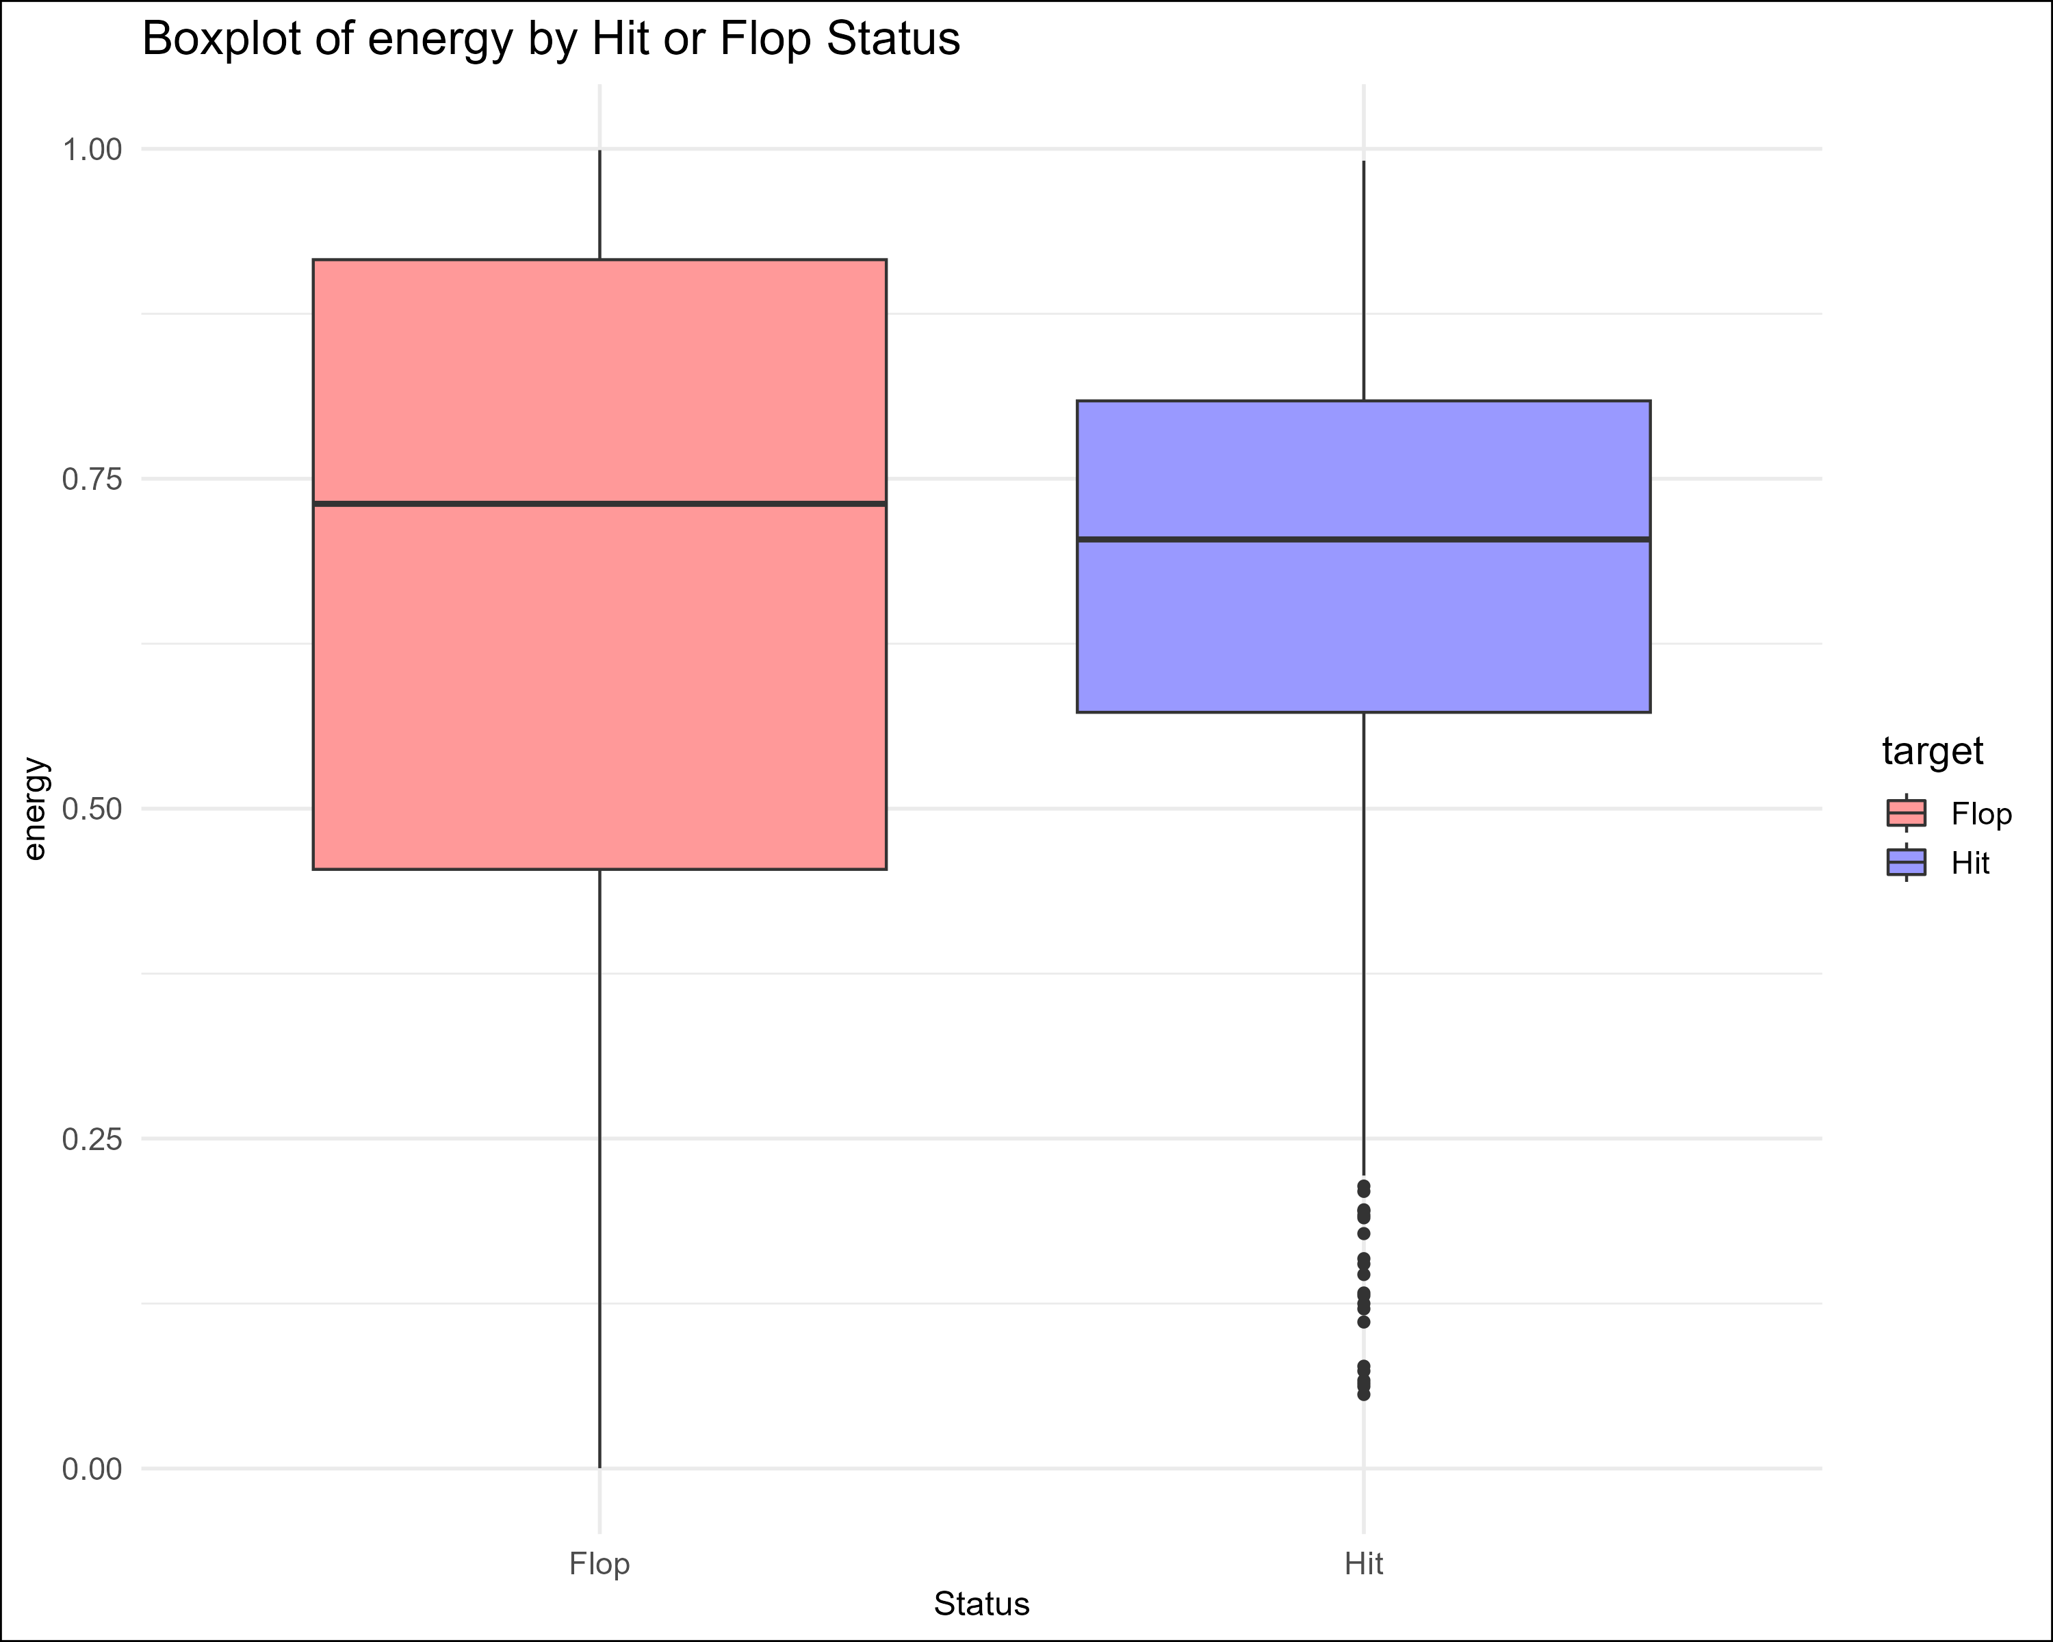
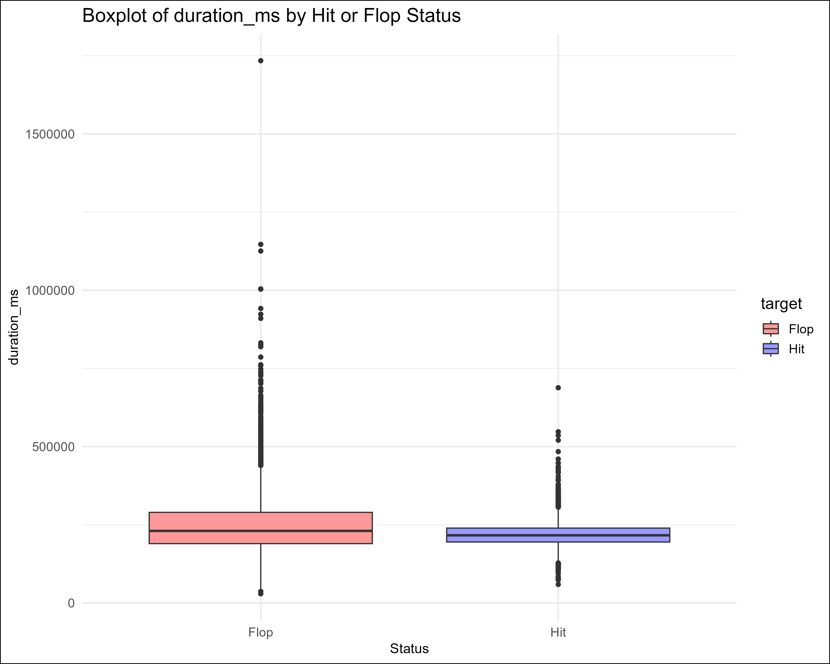
Upgrade
Arpita
Welcome
EDA
About Us
Our Team
Background
Dataset
Model
Insights

Slide 11
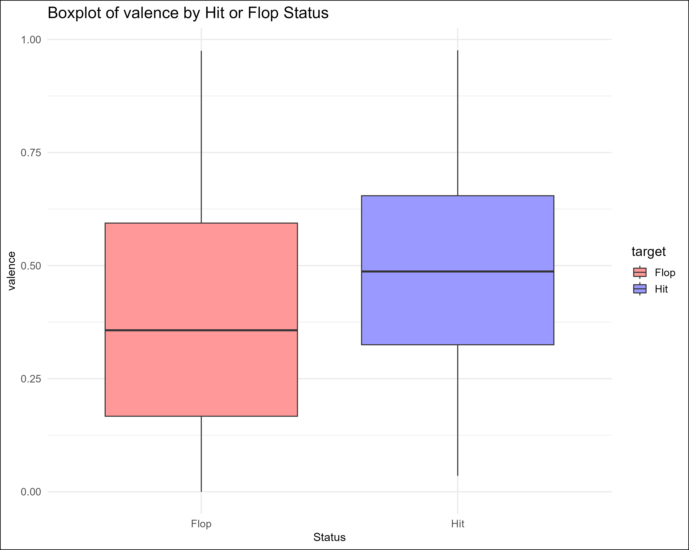
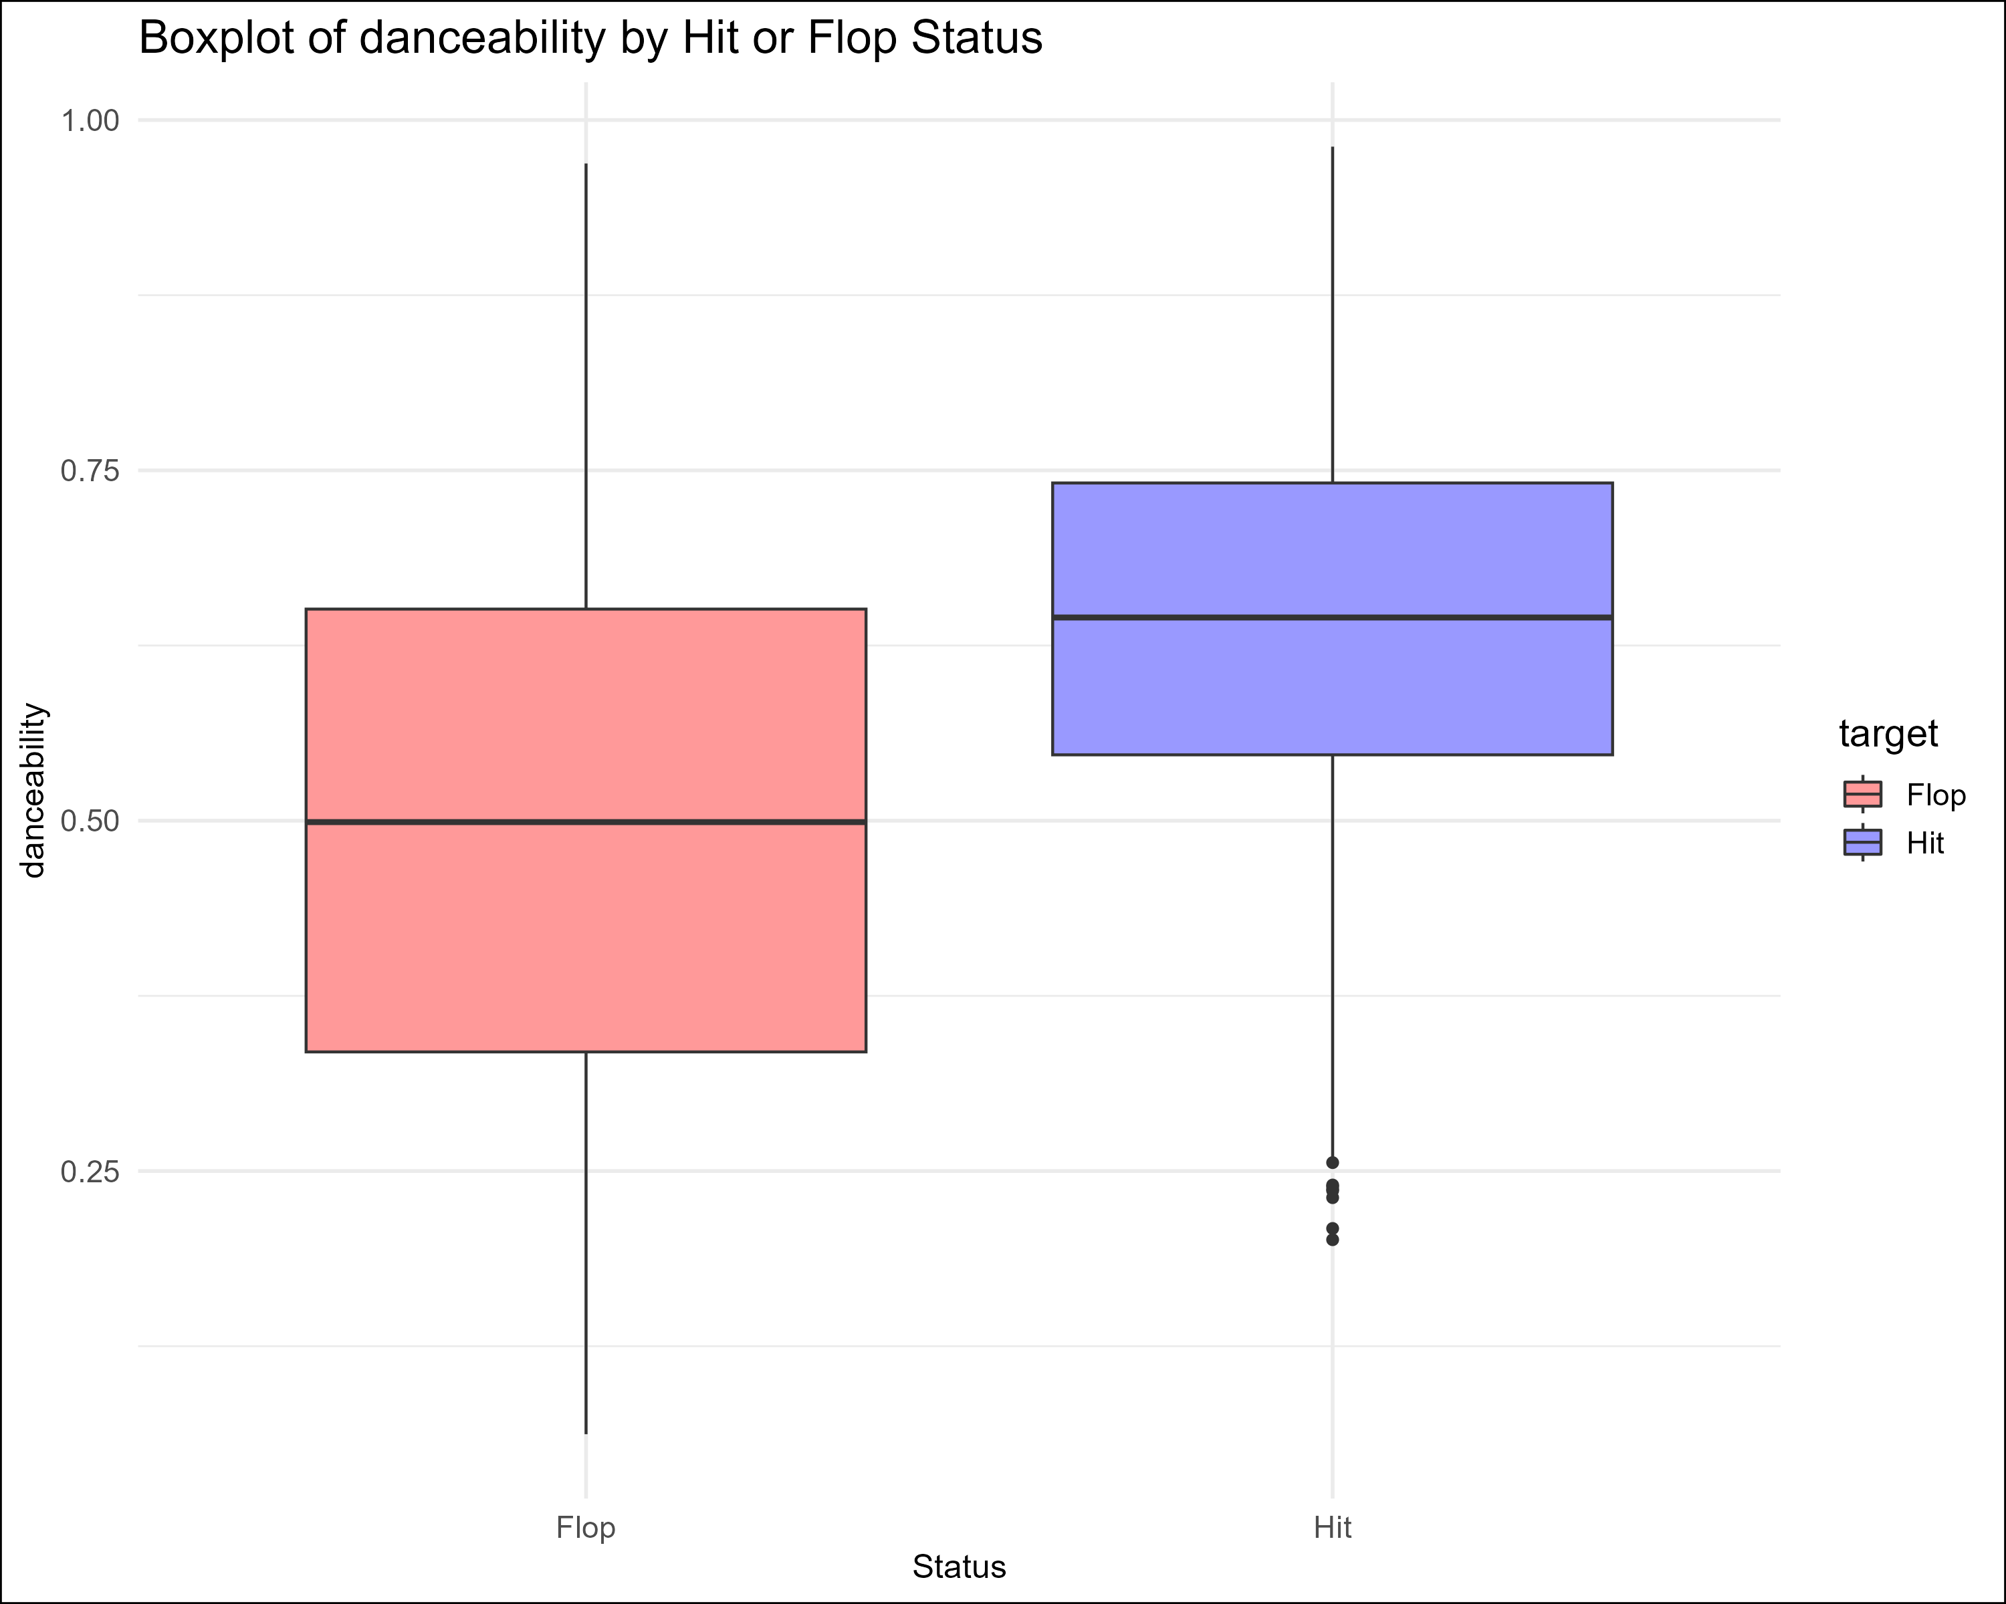
Upgrade
Arpita
Welcome
EDA
About Us
Our Team
Background
Dataset
Model
Insights

Slide 12
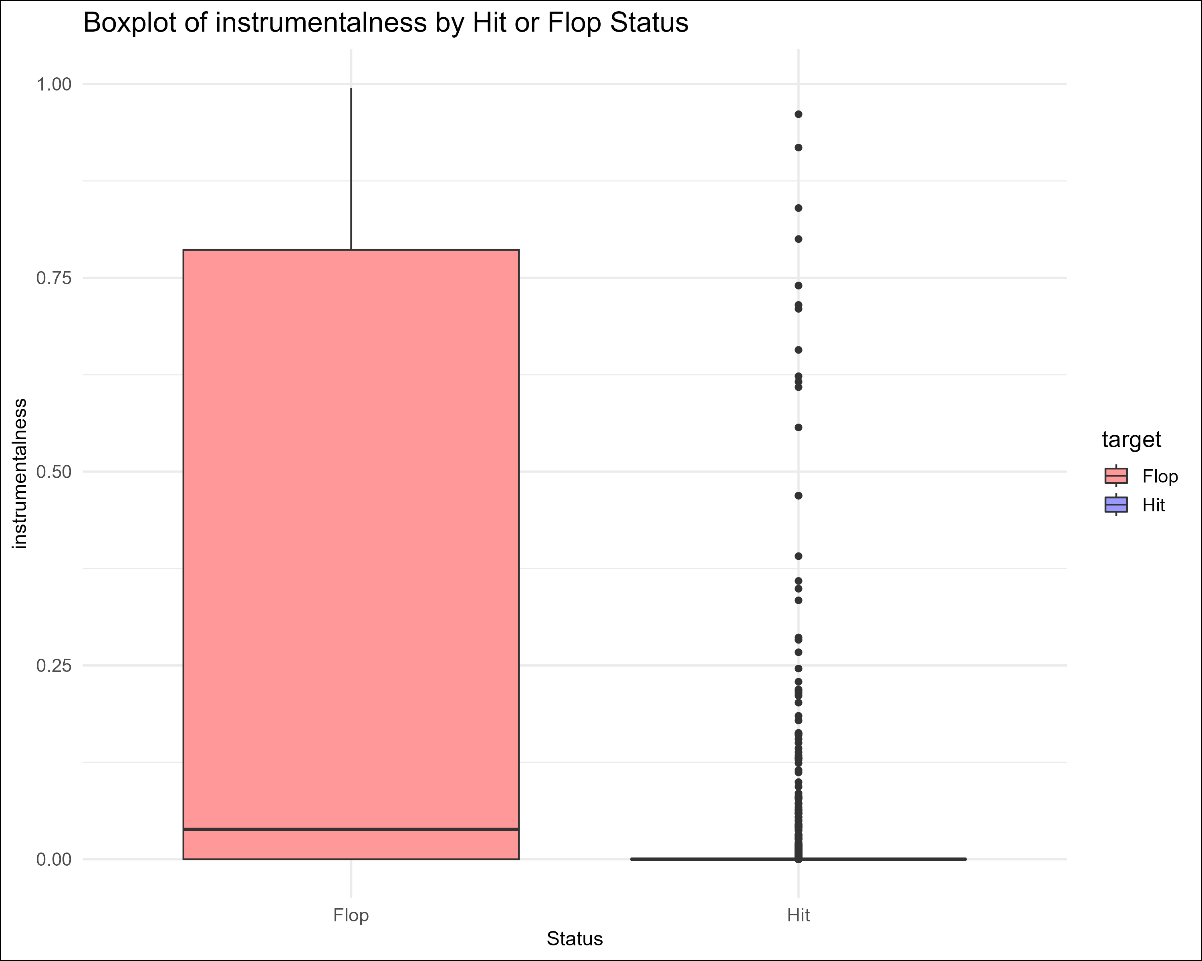
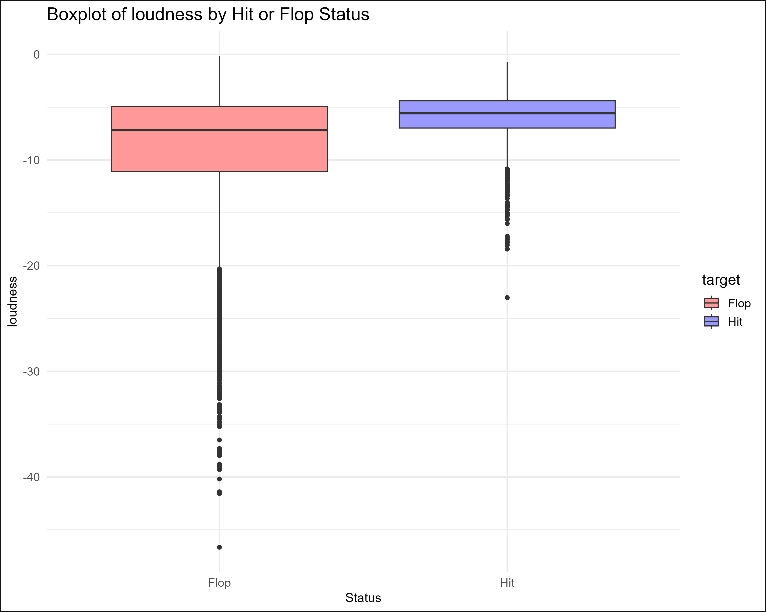
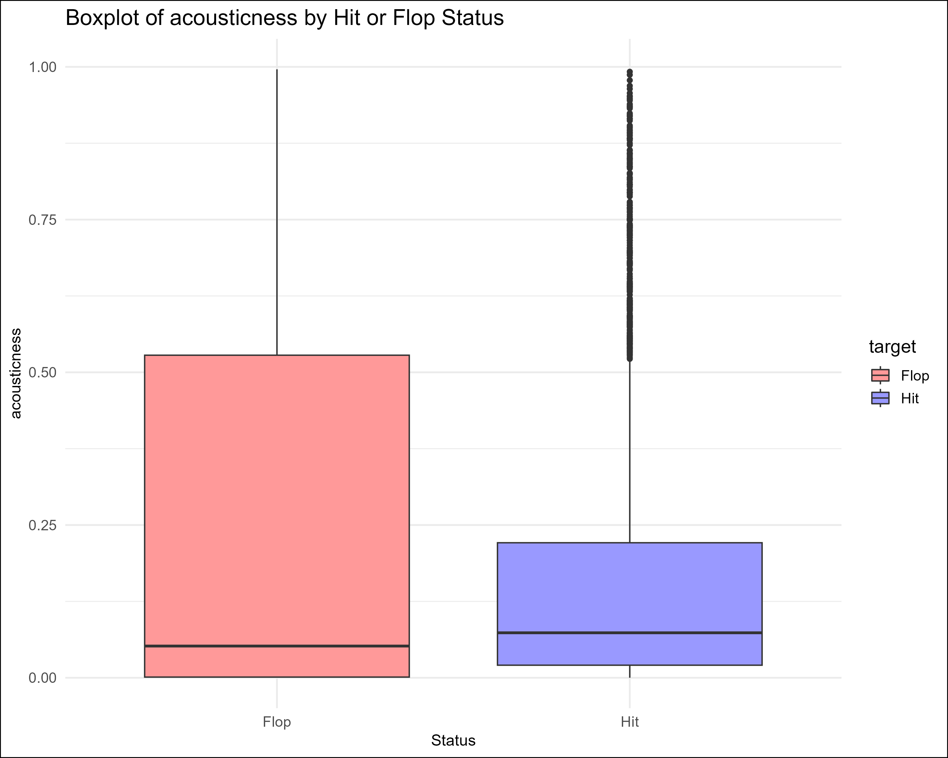
Upgrade
Arpita
Welcome
EDA
About Us
Our Team
Background
Dataset
Model
Insights

Slide 13
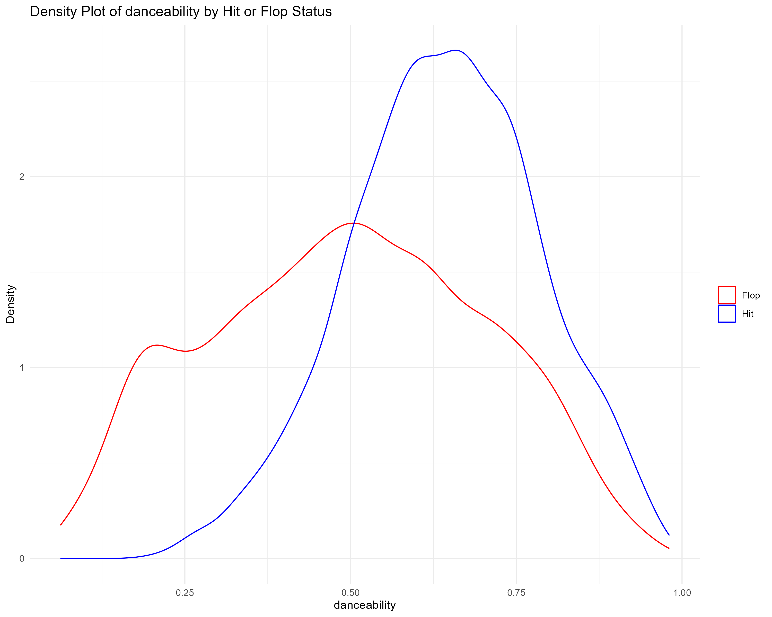
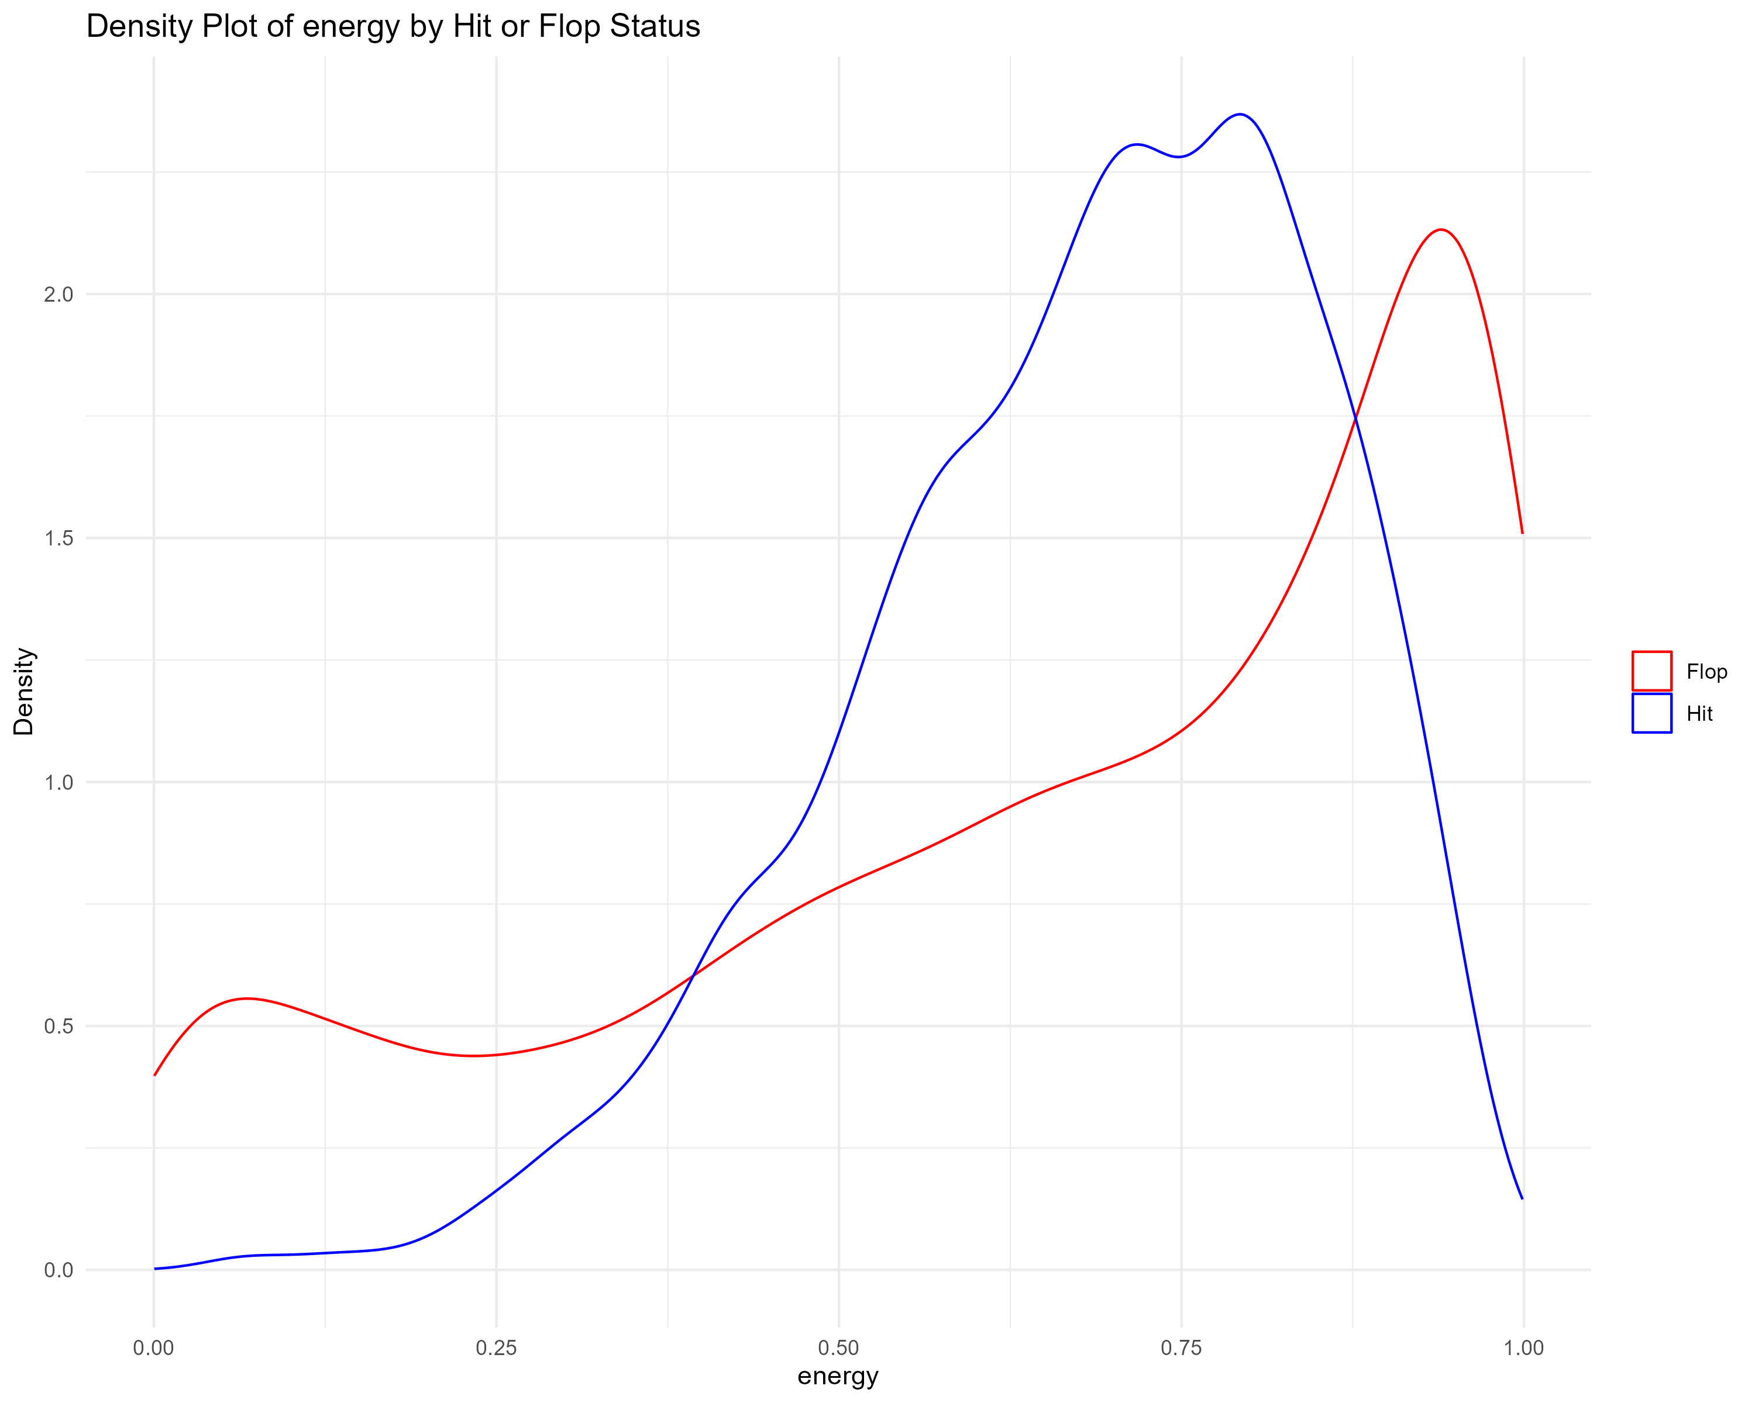
Upgrade
Arpita
Welcome
EDA
About Us
Our Team
Background
Dataset
Model
Insights

Slide 14
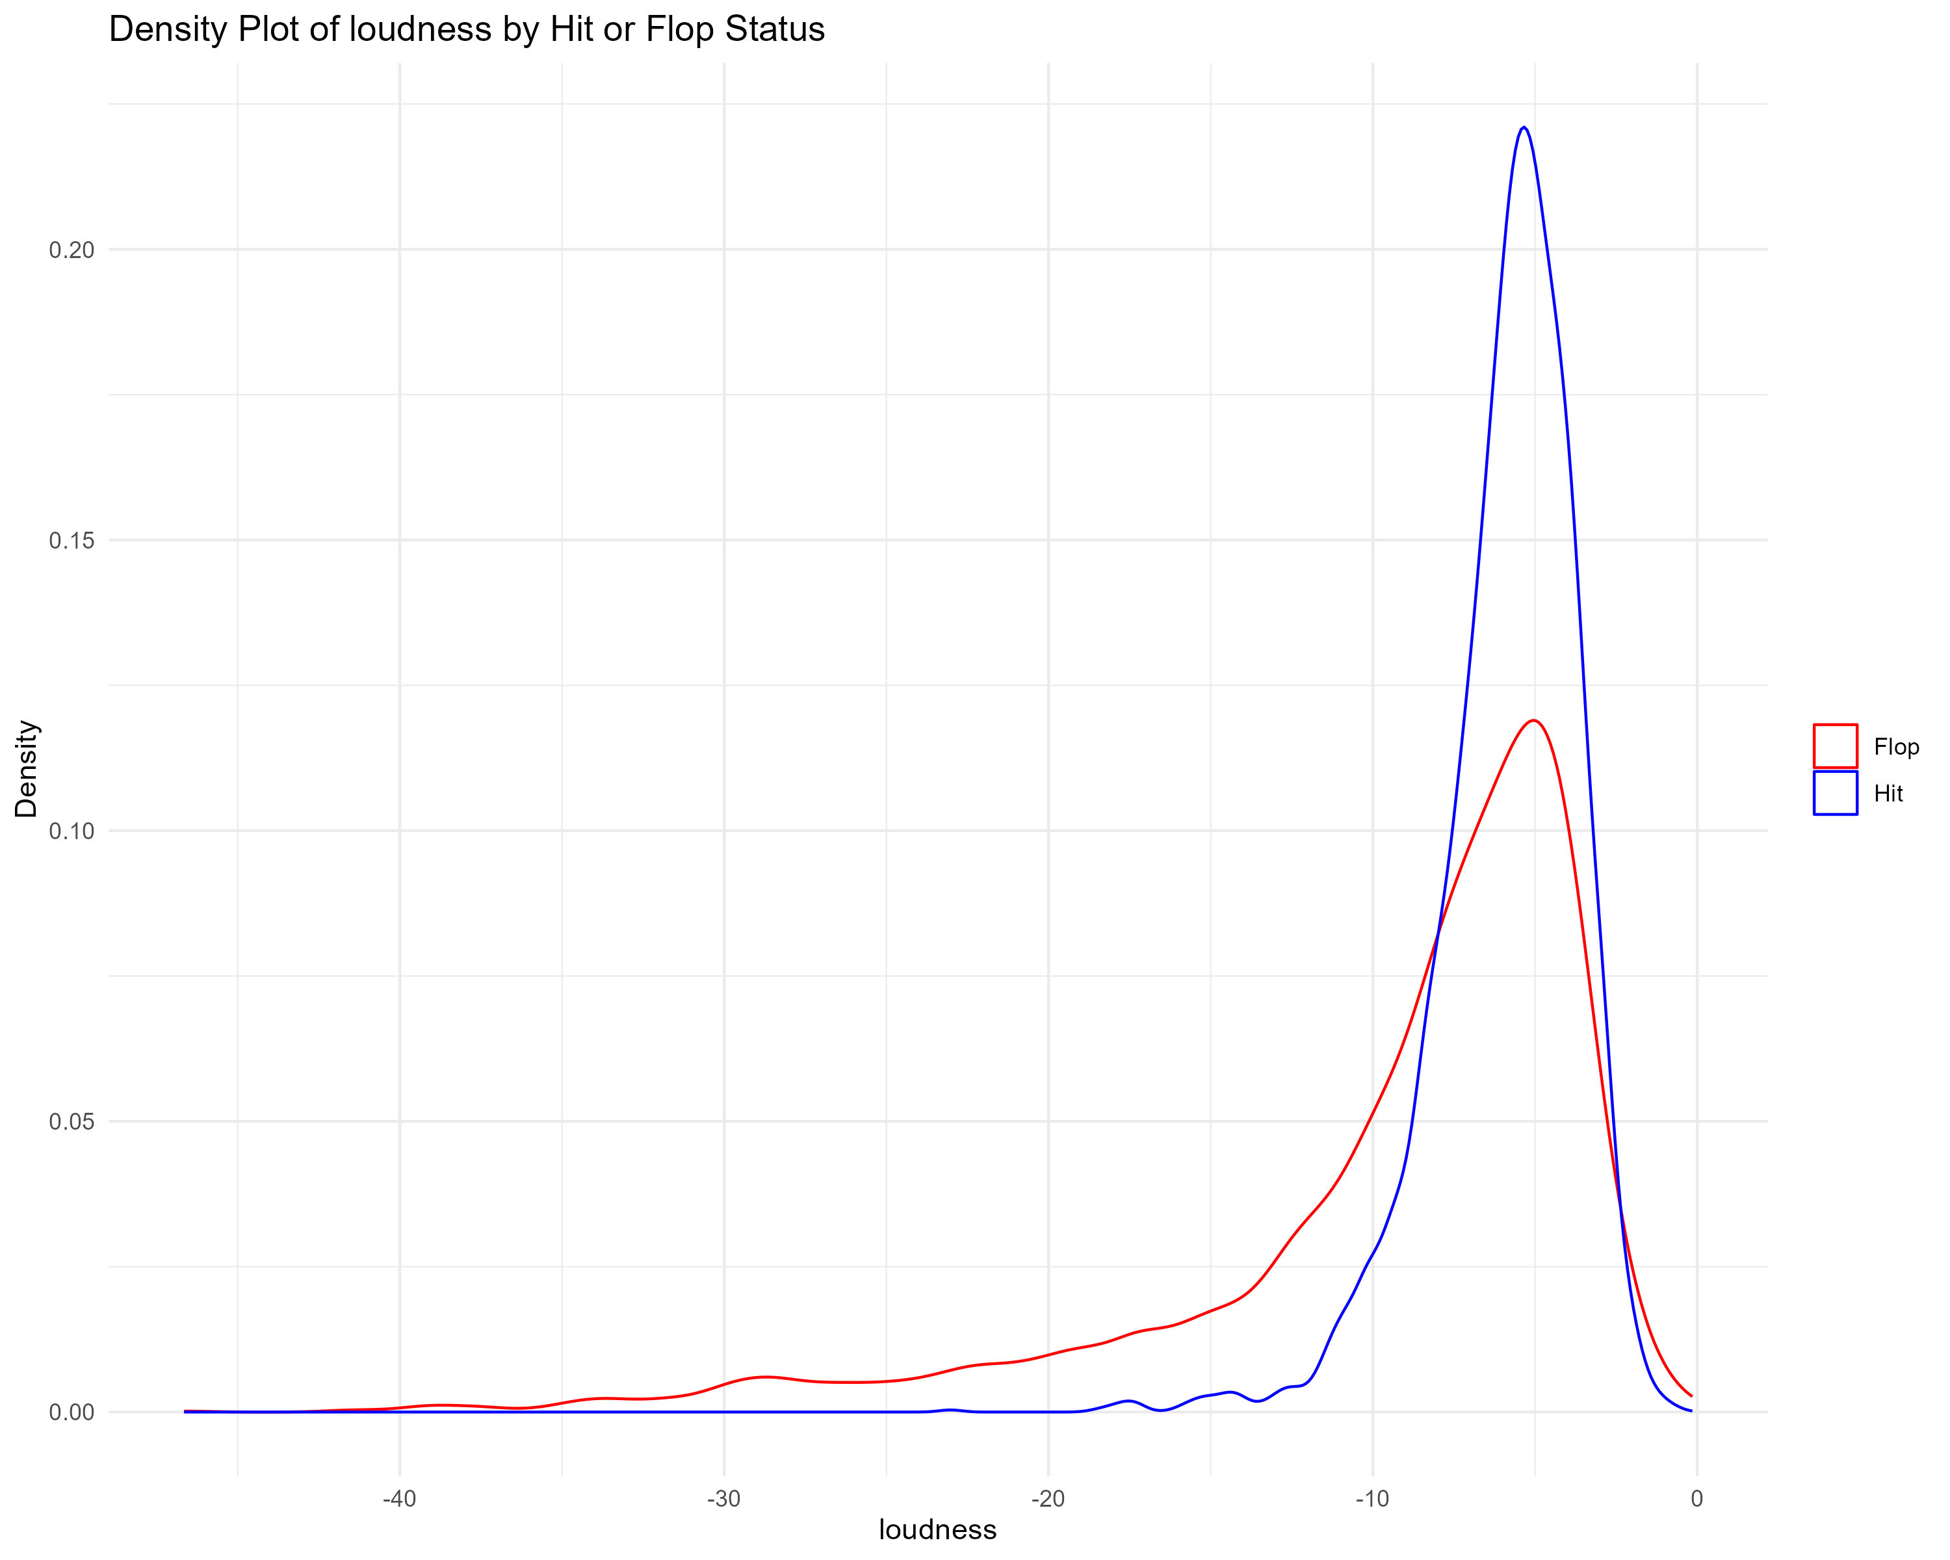
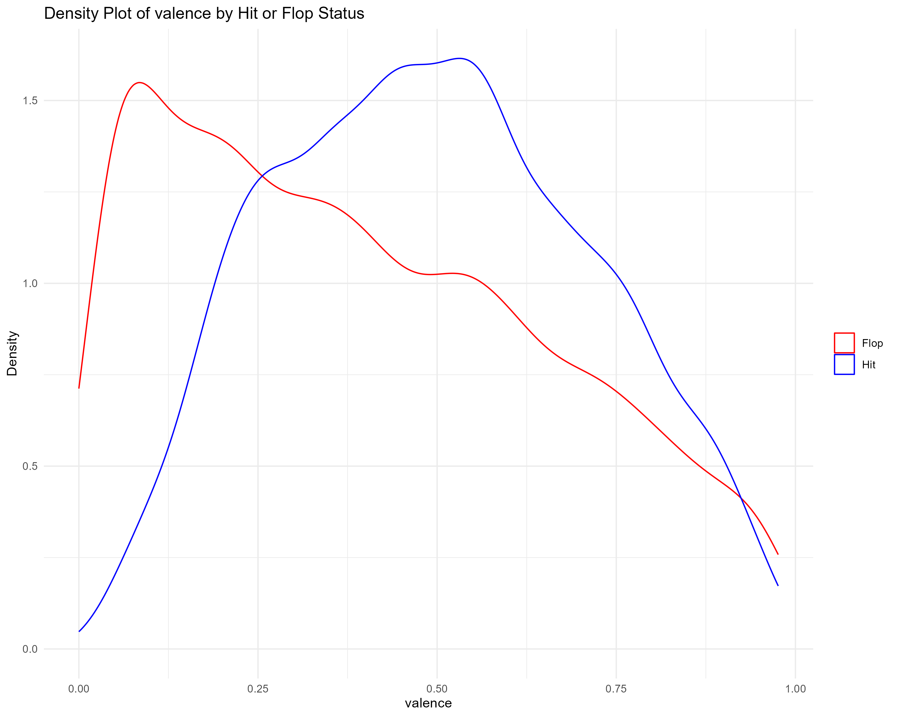
Upgrade
Arpita
Welcome
EDA
About Us
Our Team
Background
Dataset
Model
Insights

Slide 15
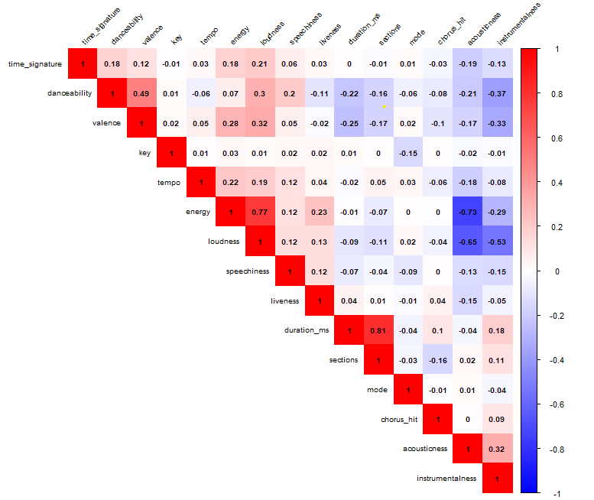
Upgrade
Arpita
Welcome
EDA
About Us
Our Team
Background
Dataset
Model
Insights

Slide 16
Upgrade
Arpita
Welcome
About Us
Outliers
Our Team
Background
Dataset
Model
Insights

Slide 17
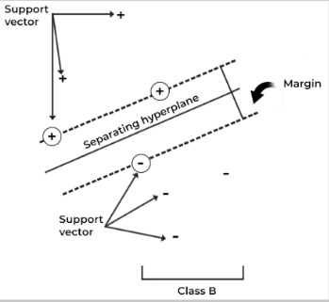
Upgrade
Arpita
Welcome
About Us
Support Vector Machine
Model
Our Team
Background
Dataset
Support Vector Machine (SVM) model, known for its effectiveness in classification tasks.
Types:
Radial
Linear
Polynomial
Model
Insights

Slide 18
Upgrade
Arpita
Welcome
About Us
Our Team
Background
Dataset
Performance Metrics
Model
Insights

Slide 19
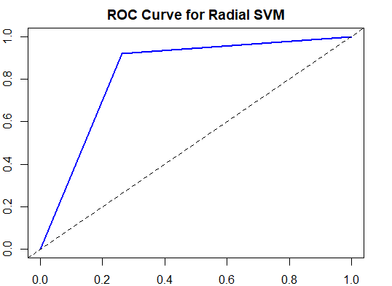
Upgrade
Arpita
Welcome
About Us
ROC Curve
Our Team
Background
Dataset
Model
Insights

Slide 20
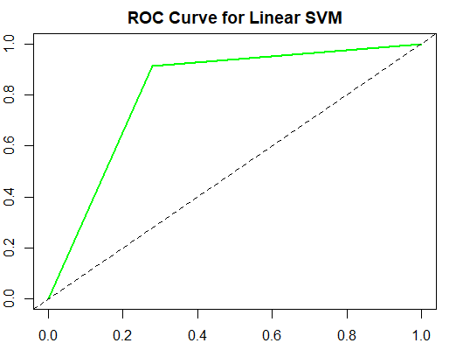
Upgrade
Arpita
Welcome
About Us
ROC Curve
Our Team
Background
Dataset
Model
Insights

Slide 21
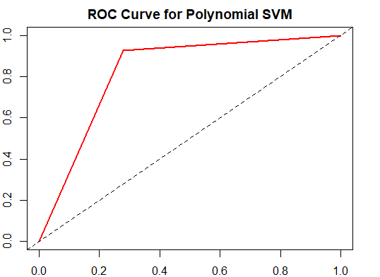
Upgrade
Arpita
Welcome
About Us
ROC Curve
Our Team
Background
Dataset
Model
Insights

Slide 22



Upgrade
Arpita
Welcome
About Us
Our Team
Insights
Background
Dataset
Model
Insights
20k
50+
15+
Juju On That Beat (TZ Anthem)
Surf Board
Wild Things
Highest Danceability
Lowest Acousticness
Highest Valence

Slide 23

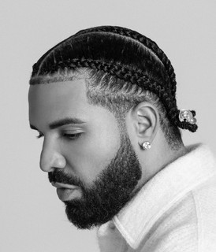




Upgrade
Arpita
Welcome
Top 3 Artists with the Most Hits
About Us
Our Team
1st
2nd
3rd
Background
Dataset
Drake
Glee Cast
Taylor Swift
Model
50 Hits
41 Hits
35 Hits
Insights
3355 Artists
6398 Tracks

Slide 24
Upgrade
Arpita
Welcome
References
About Us
1. Predicting Hit Songs with Machine Learning
Our Teams
https://www.diva-portal.org/smash/get/diva2:1214146/FULLTEXT01.pdf
Background
2. Hit songs prediction: A review on machine learning perspective
Dataset
https://www.researchgate.net/publication/377712319_Hit_songs_prediction_A_review_on_machine_learning_perspective
Model
Insights
3. Spotify: A Study For ML-Based Song Hit Prediction Using Spotify
https://arxiv.org/pdf/2301.07978
Reference
4. A Machine Learning Approach for Modeling Time-Varying Hit Song Preferences
https://ieeexplore.ieee.org/document/9904376

Slide 25
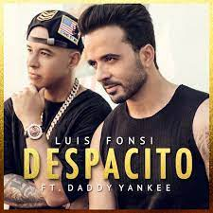

Thank You
Despacito
Luis Fonsi, Daddy Yankee
0:23
-3:25

