Slide 1
Final PROJECT
Ece 5553 – Autonomy in vehicles
Project Statement: Choose a shuttle vehicle that can accommodate 6-12 passengers. You can use the shuttles used by May Mobility or use a shuttle like the one used by Easymile or a shuttle of your choice. Obtain or estimate (if not easily available) the longitudinal and lateral dynamics parameters of your chosen shuttle. Tabulate your results. Your table should include where you obtained the data or how you estimated it
05/01/2020
Apoorva Ramani

Slide 2
SHUTTLE PARAMETERS

Slide 3
Easy Mile EZ10
Vehicle Model Parameter
Parameter Name | Value [Units] | Description | Source
Mass of the vehicle | 2130 kg | 2130 kg weight is for the empty vehicle. Vehicle capacity upto 15 passengers | https://easymile.com/solutions-easymile/ez10-autonomous-shuttle-easymile/
Wheelbase | 9.2 feet | the distance between the front and rear axles of a vehicle. | https://www.transportation.gov/sites/dot.gov/files/docs/policy-initiatives/automated-vehicles/351471/73-adrian.pdf
Dimensions(L X W X H) | 13.2 X 6.5 X 9.4 ft | Vehicle dimensions | https://www.transportation.gov/sites/dot.gov/files/docs/policy-initiatives/automated-vehicles/351471/73-adrian.pdf
Maximum speed | 45 km/h, electronically limited to 25 km/h | Maximum Speed at which the vehicle can run | https://easymile.com/solutions-easymile/ez10-autonomous-shuttle-easymile/
Minimum turning radius | 5m | Minimum turning radius of vehicle | https://easymile.com/solutions-easymile/ez10-autonomous-shuttle-easymile/
Transmission Efficiency | 0.9 | Efficiency of the gear box to transmit the engine torque | Homework 1 sample parameter (As it was very similar to the parameters of EasyMile EZ10)

Slide 4
Easy Mile EZ10
Vehicle Model Parameter
Parameter Name | Value [Units] | Description | Source
Gear Ratio | 1.0 | Gear Ratio of 4th gear | Homework 1 sample parameter (As it was very similar to the parameters of EasyMile EZ10)
Final Drive Ratio | 4.1 | Final transmission ratio | Homework 1 sample parameter (As it was very similar to the parameters of EasyMile EZ10)
Inertia of the Wheel | 1 [kgm²] | Wheel mass moment of inertia | Homework 1 sample parameter (As it was very similar to the parameters of EasyMile EZ10)
Wheel Radius | 0.3 [m] | Effective wheel radius | Homework 1 sample parameter (As it was very similar to the parameters of EasyMile EZ10)
Equivalent Mass Factor | M_{eq}=0.1M g_{m}=1.1 | Rotational inertia as a percentage of the mass of the vehicle | Homework 2 sample parameter (As it was very similar to the parameters of EasyMile EZ10)
Drag coefficient | 0.29 | Aerodynamic drag coefficient | Homework 2 sample parameter (As it was very similar to the parameters of EasyMile EZ10)

Slide 5
Easy Mile EZ10
Vehicle Model Parameter
Parameter Name | Value [Units] | Description | Source
Air density | 1.225 [kg/m3] | mass per unit volume of Earth's atmosphere | Homework 1 sample parameter (As it was very similar to the parameters of EasyMile EZ10)
Frontal area | 2.8 [m2] | Effective frontal area of vehicle | Homework 1 sample parameter (As it was very similar to the parameters of EasyMile EZ10)
Gravitational constant | 9.81 [N/m2] | Gravitational constant for earth | Homework 1 sample parameter (As it was very similar to the parameters of EasyMile EZ10)
Rolling resistance coefficient | 0.015 | Constant term in the rolling resistance coefficients | Homework 1 sample parameter (As it was very similar to the parameters of EasyMile EZ10)
Longitudinal Stiffness | 3e5 [N] | Given value is for a performance tire. Winter tires have 1.5e5 and for non-performance tires the value can go up to 5e5. You may need to multiply this or the corresponding force by two, if there are two tires being represented by the model you are using. | Homework 1 sample parameter (As it was very similar to the parameters of EasyMile EZ10)

Slide 6
Easy Mile EZ10
Vehicle Model Parameter
Parameter Name | Value [Units] | Description | Source
Distance between the axles | 2.85 [m] | Inter axle distance | Homework 1 sample parameter (As it was very similar to the parameters of EasyMile EZ10)
Distance from the center of gravity of the vehicle (CG) to the front axle | 1.3 [m] | Distance to front axle | Homework 1 sample parameter (As it was very similar to the parameters of EasyMile EZ10)
Distance from the center of gravity of the vehicle (CG) to the rear axle | 1.55 [m] | Distance to rear axle | Homework 1 sample parameter (As it was very similar to the parameters of EasyMile EZ10)
Cornering Stiffness of Front and Rear Tires | 2x1.5e5 [N/rad] | Multiply by two as there are two tires in the front (and the rear). Cornering stiffness will have different values for the front and rear due to weight distribution. | Homework 1 sample parameter (As it was very similar to the parameters of EasyMile EZ10)
Inertia moment around z axis | 3700 [kg/m2] | Yaw moment of Inertia | Homework 1 sample parameter (As it was very similar to the parameters of EasyMile EZ10)

Slide 7
Autonomous Architecture

Slide 8
localization and perception sensors and computer system for control and decision making.
Sensor | Characteristics | Quantity
4 LMS (Safety LiDARs) (There is currently no certified LiDAR on the market, which is why EasyMile has chosen to include redundant sensor coverage sourced from different suppliers) | 270-degree horizontal scanning Range of 130 feet Strategically positioned 12 inches off the ground One at each corner of the vehicle Single layer LiDAR Used for obstacle detection by high-level software, used for obstacle detection by the Safety Chain and Used for navigation by the high-level software | 4
2 LDRMS (Localization LiDARs on the EZ10) | 110-degree horizontal scanning 3.2-degree vertical opening Range of 720 feet 4 layers | 2
2 VLP16 (3D LiDARs on the EZ10) | 180-degree horizontal scanning 32-degree vertical opening Range of 260 feet LiDARs 16 layers | 2
Cameras | EZ10 has indoor and outdoor cameras. EasyMile completes the development and validation of the use of these cameras for navigation and environmental detection. | many
Differential GPS | The EZ10 is equipped with a GNSS antenna from the Canadian manufacturer Novatel. This antenna allows the EZ10 to find its way through space thanks to the constellations of GPS, Glonass and Galileo satellites. EasyMile also uses the services of a GNSS - Real Time Kinematic correction provider referred to as "SmartNet" to refine the vehicle's position, with centimeter accuracy. GNSS corrections are received via the 3/4G network, and are determined using a set of SmartNet reference bases. | 1

Slide 9
localization and perception sensors and computer system for control and decision making.
Sensor | Characteristics | Quantity
Inertial Measurement Unit (/MU) - | The EZ10 is equipped with an inertial unit capable of integrating the vehicle's movements (acceleration and angular velocity) to estimate its orientation (roll, pitch and heading angles), linear velocity and position. | 1
Odometric Estimation | The EZ10 has sensors on the wheels to measure the vehicle's movement. Odometry is based on the measurement of wheel movements to reconstruct the overall movement of the vehicle. Starting from a known initial position and integrating the measured displacements, the current position of the vehicle can be calculated at any time. | Many
Computer system - EZ Fleet | Features: Known Environment and Pre-Programmed Paths Data Fusion and Interpretation Intersection Management Obstacle Detection and Appropriate Behavior Safely proceeding when the route ahead is blocked Safety chain | -

Slide 10
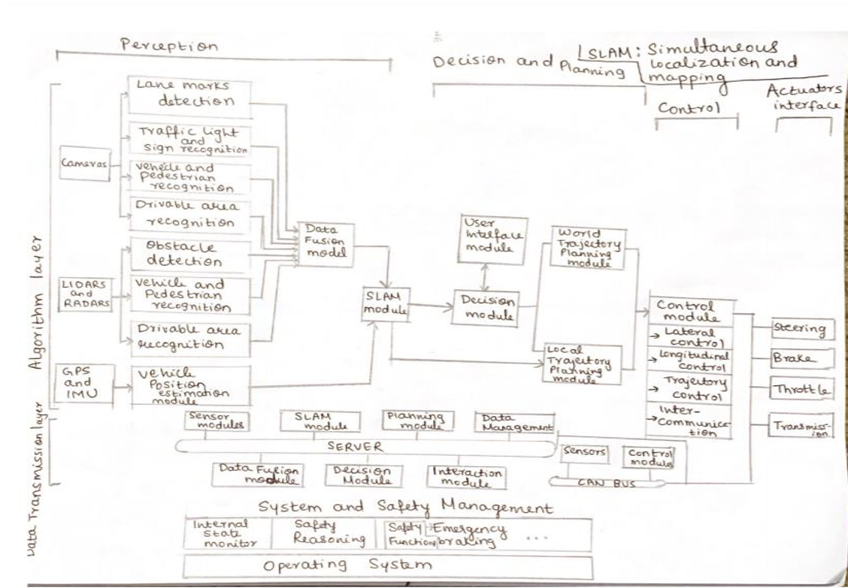
Architecture Diagram

Slide 11
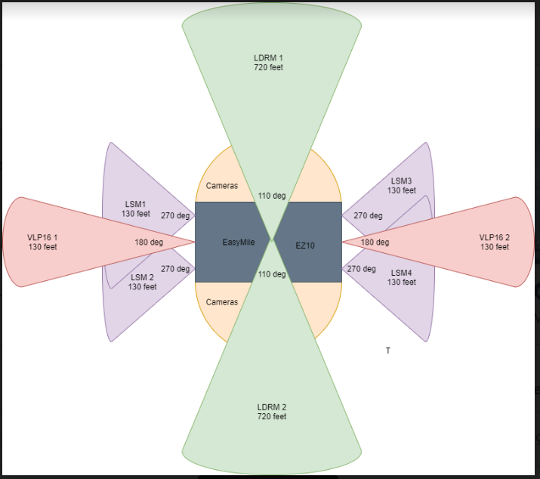
Sensor coverage diagram

Slide 12
TECHNICAL CHALENGES

Slide 13
Low level longitudinal control

Slide 14
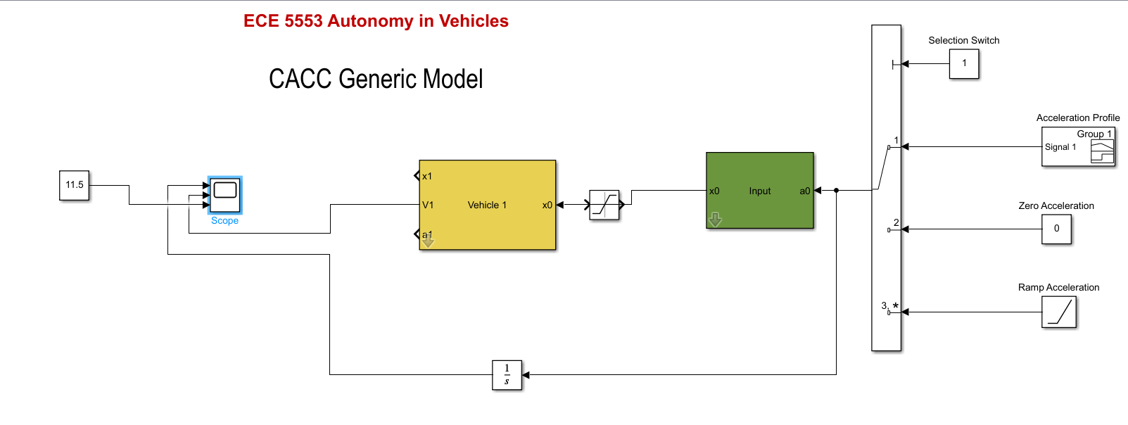
MODEL

Slide 15
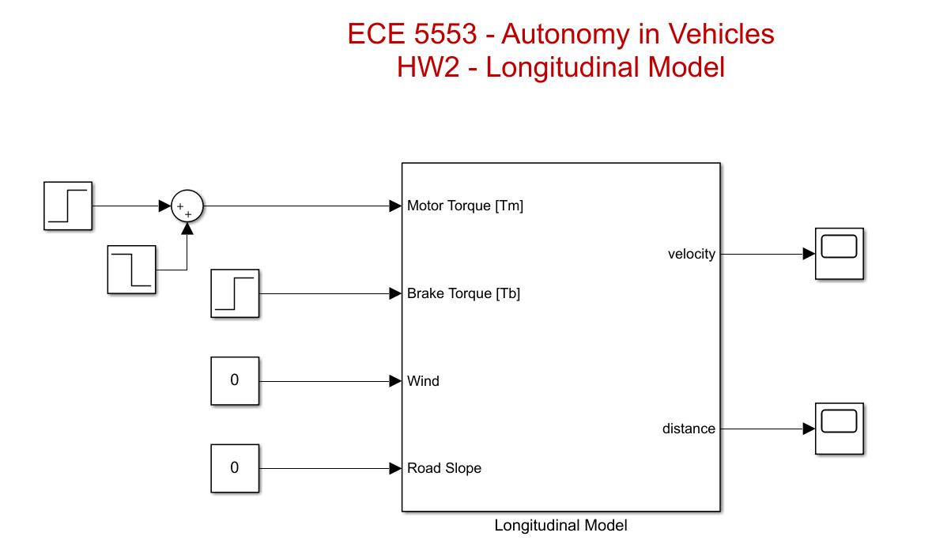
Longitudinal model

Slide 16
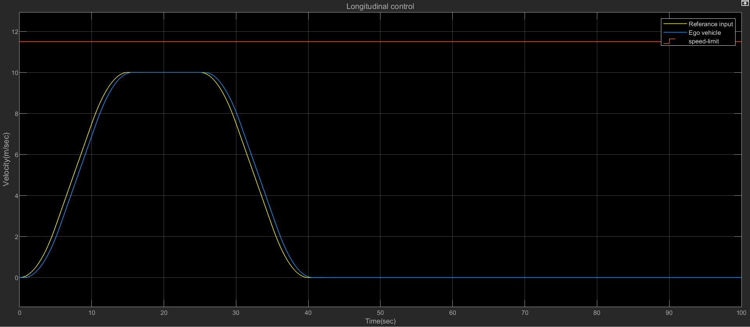
Velocity following response
It can be observed that the ego vehicle exactly follows the path of the reference input. The maximum speed for the vehicle at which there will be saturation is 11.5 m/s.

Slide 17
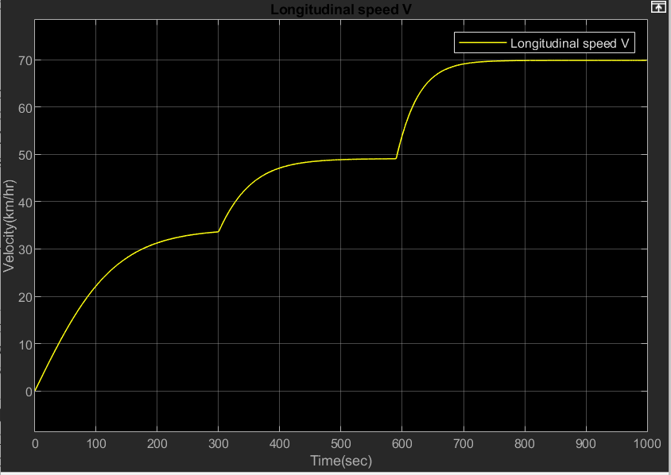
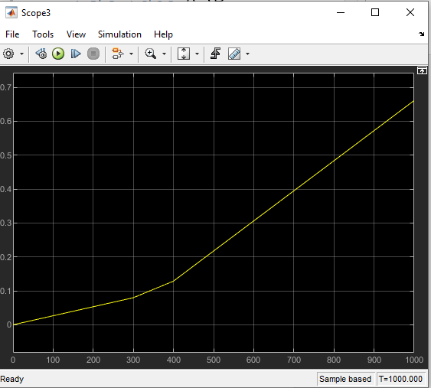
Longitudinal vehicle model
Time(sec)
The new plot obtained after estimating the values of k and tow is nothing but the distance versus time plot of the model

Slide 18
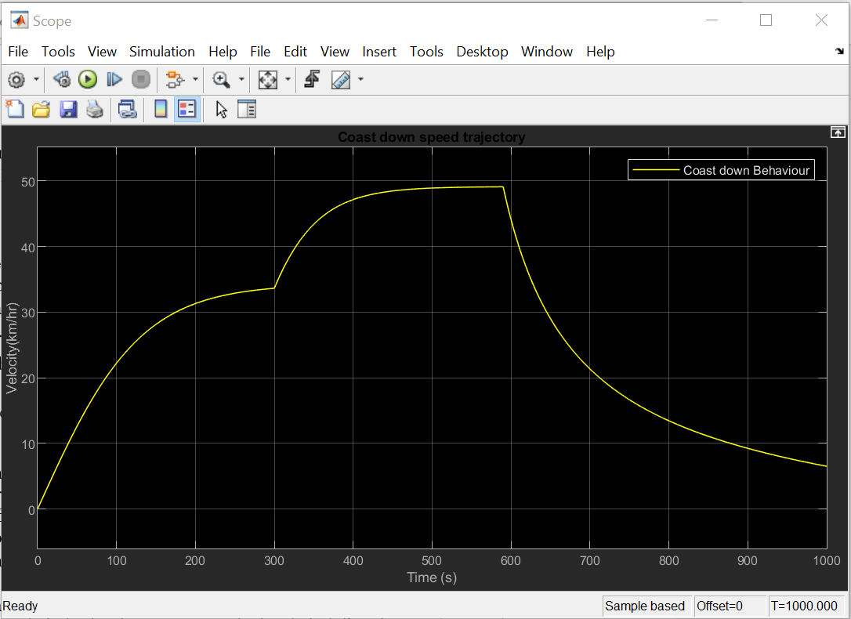
TO PLOT THE COAST DOWN BEHAVIOUR AND SECOND ORDER POLYNOMIAL OF LONGITUDINAL MODEL
Trajectories for the uphill case that result when the car starts slightly faster and slightly slower than the equilibrium velocity.
This demonstrates that the car exhibits asymptotic stability at the equilibrium point and can be related to how a car behaves on hill.
The second order polynomial and its co-efficients are-

Slide 19
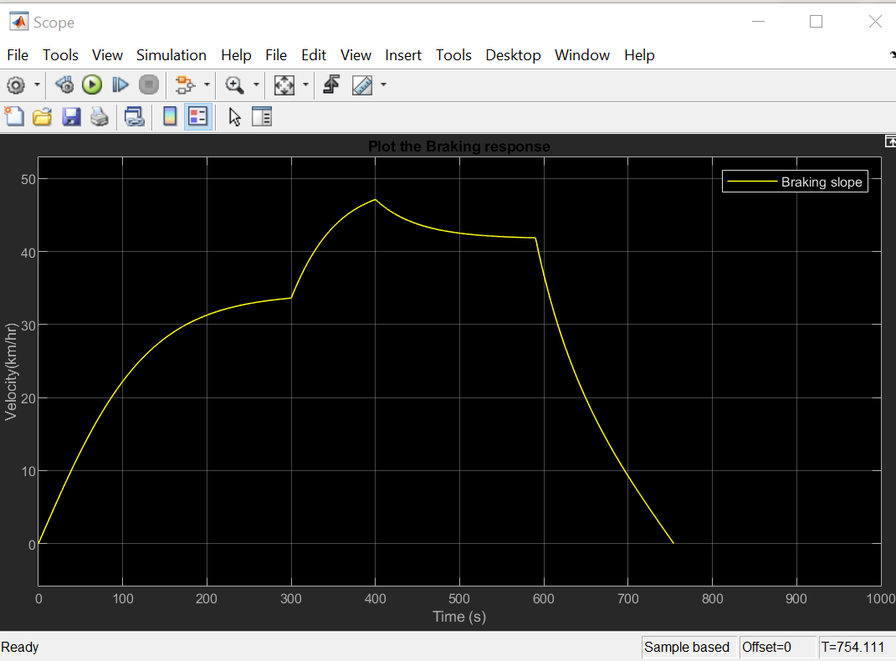
Braking response OF LONGITUDINAL MODEL
It means that the value of the coefficient of cohesion of the tyres with the surface of the road passed through the peak of the curve φx(t) and their locking started. At that time, ABS (Automatic braking system) is activated and it releases the brakes. When the speed of the wheels increases again, the brakes are activated again.
The above-described process is further repeated until the vehicle is braked to the desired speed. The purpose of ABS is keeping the maximum value of cohesion of tyres with the surface of the road.

Slide 20
Low level lateral controL

Slide 21
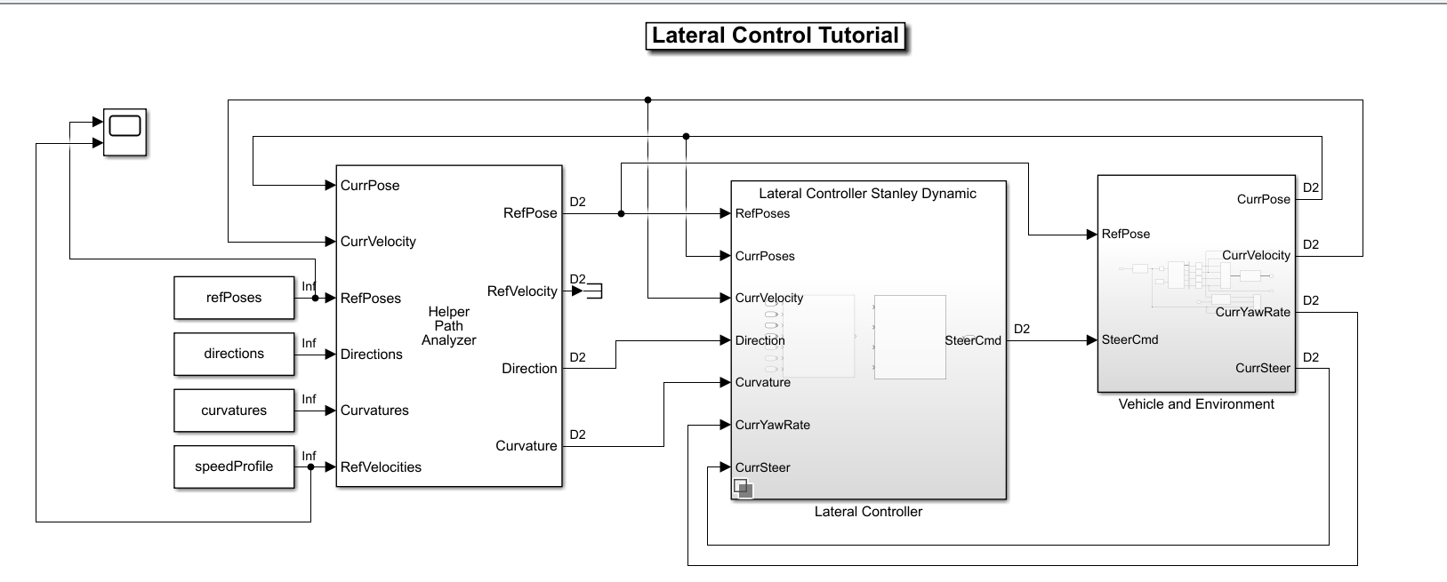
LOW LEVEL LATERAL CONTROL MODEL

Slide 22
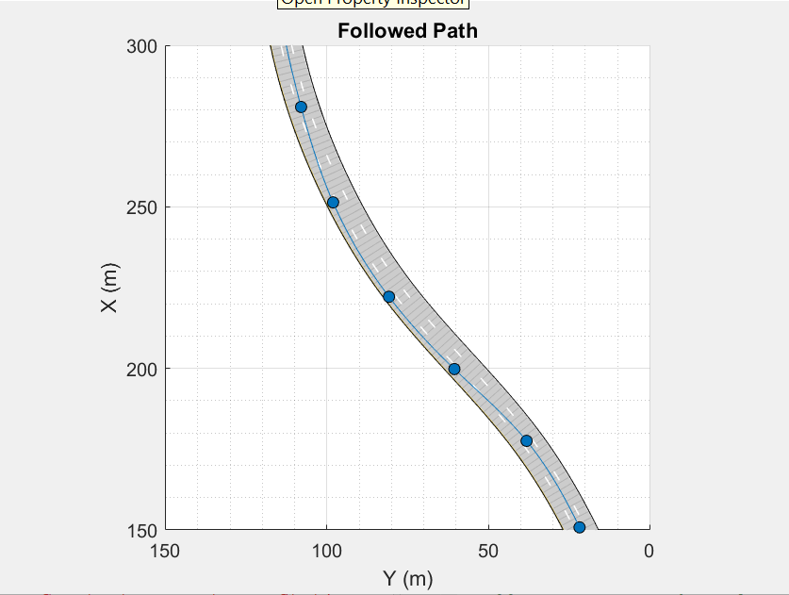
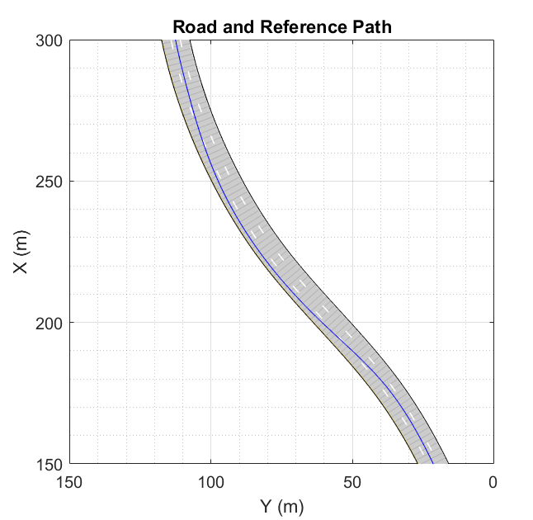
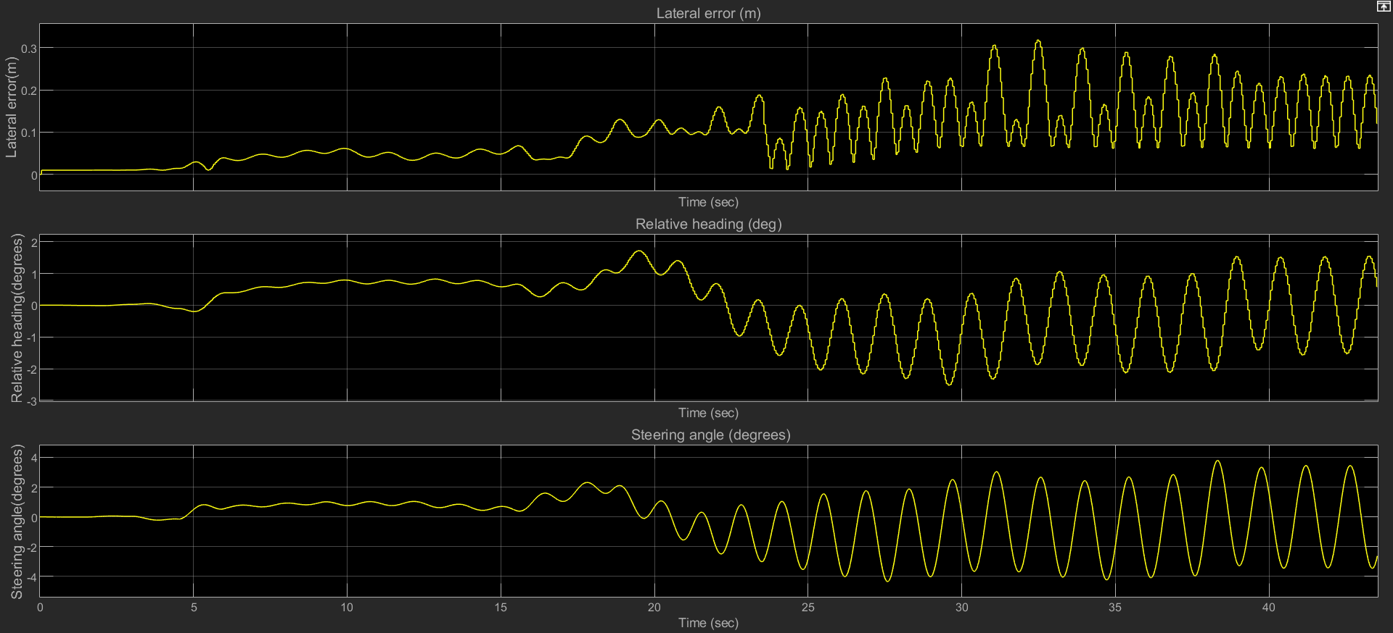
PLOTS for low level lateral control
I have tried to show that path is being followed by the lateral model by creating a small path. The graph depicts the lateral error(m), relative heading(deg) and steering angle(deg). The maximum lateral deviation is close to 0.3 m.

Slide 23
Path planning and following

Slide 24
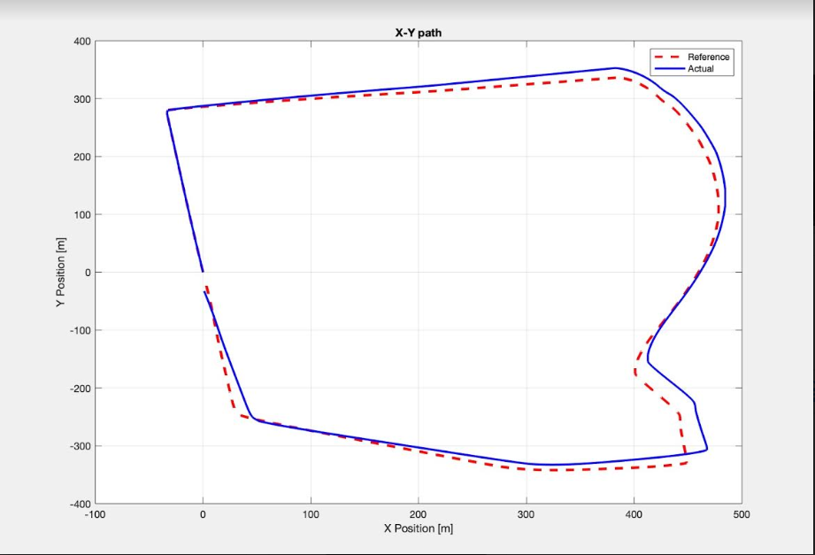
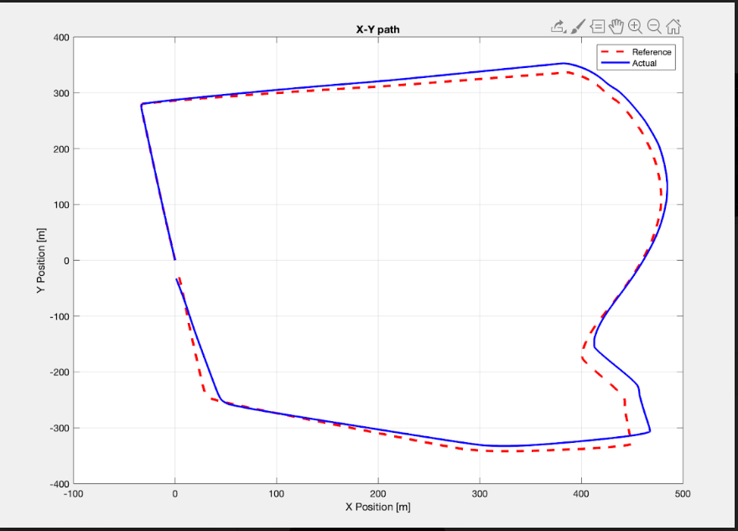
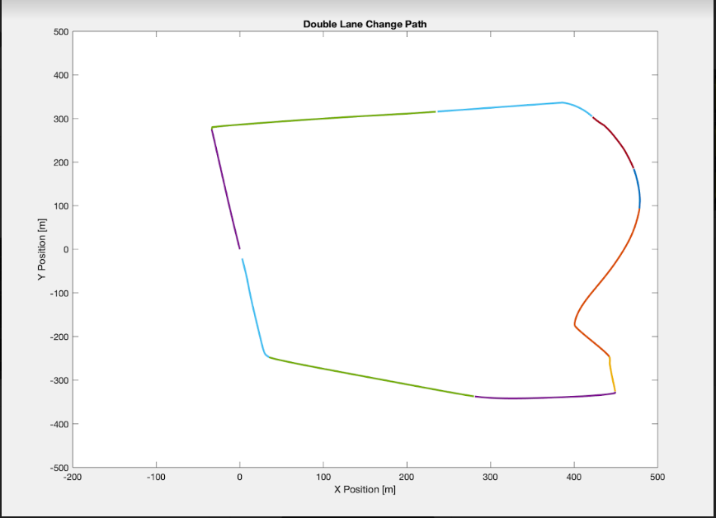
SIMULATION RESULTS
The 3 diagrams indicate the actual vehicle path tracking with reference path tracking after the PID controller

Slide 25
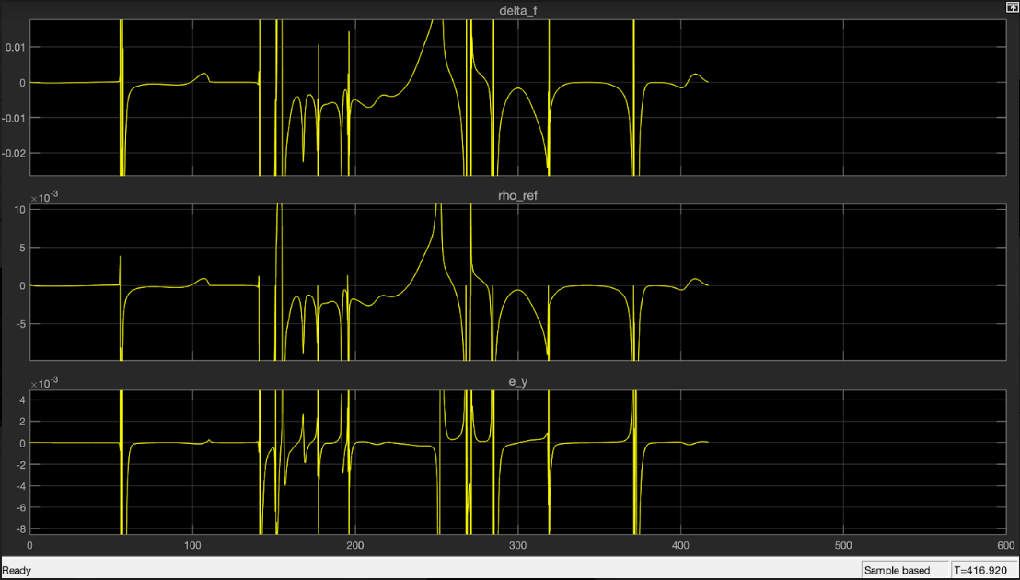
THE STEERING ANGLE, ROAD CURVATURE DISTURBANCE AND ERROR RESPONSES
It shows the behavior of a e Double lane change maneuver after simulation. The steering angle, road curvature disturbance and error are significantly less than 0.02 after tuning the PID controller and changing the points for optimum path following behavior.

Slide 26
Collision avoidance

Slide 27
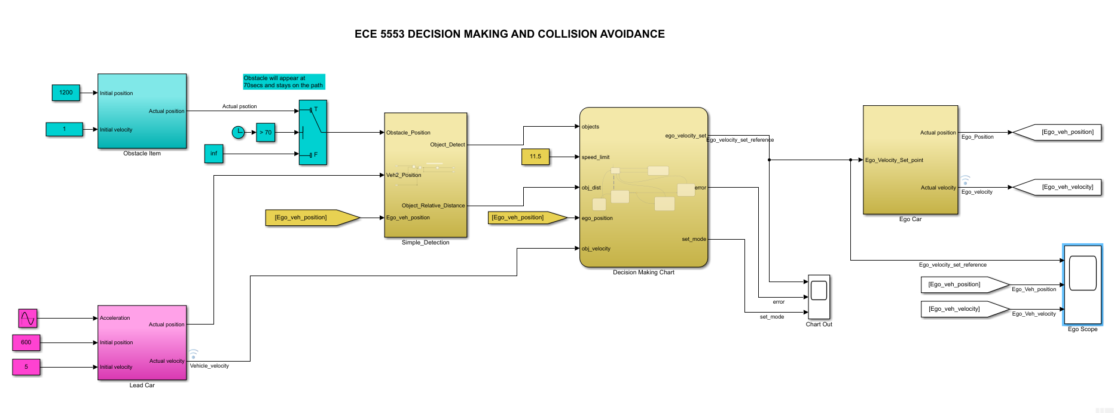
DECISION MAKING AND COLLISION AVOIDANCE MODEL

Slide 28
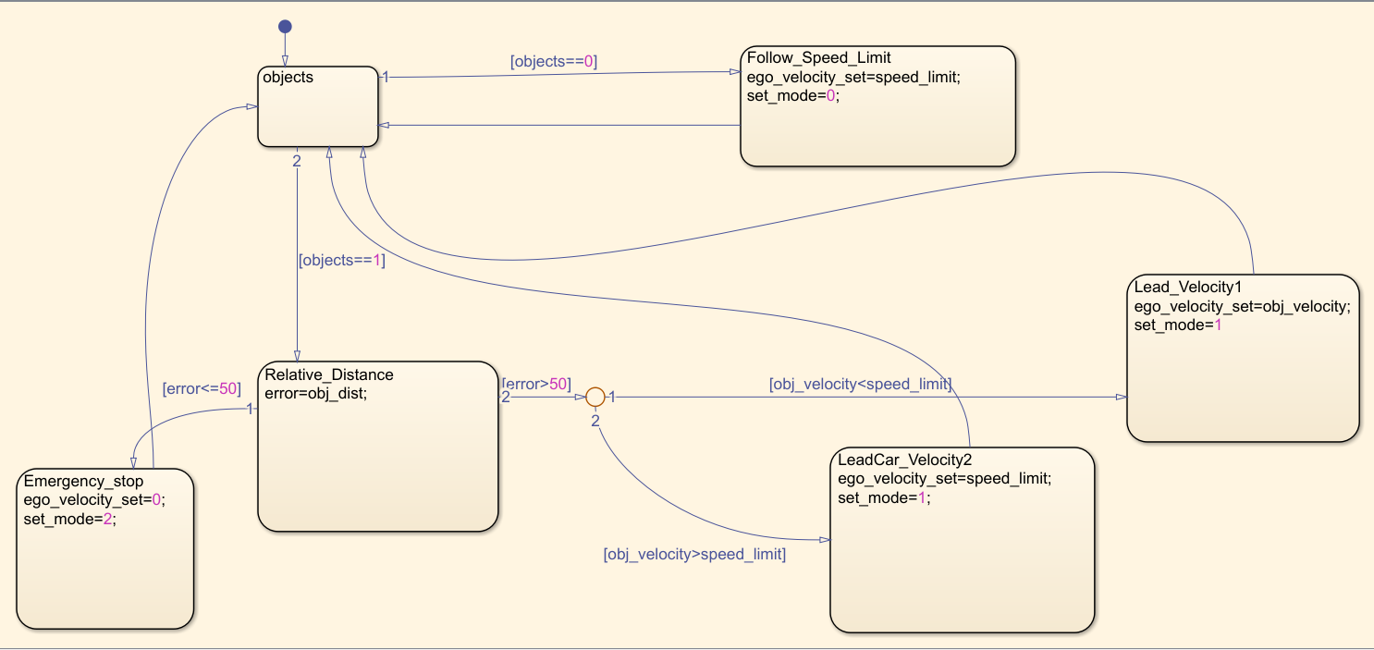
STATE FLOW DIAGRAM

Slide 29
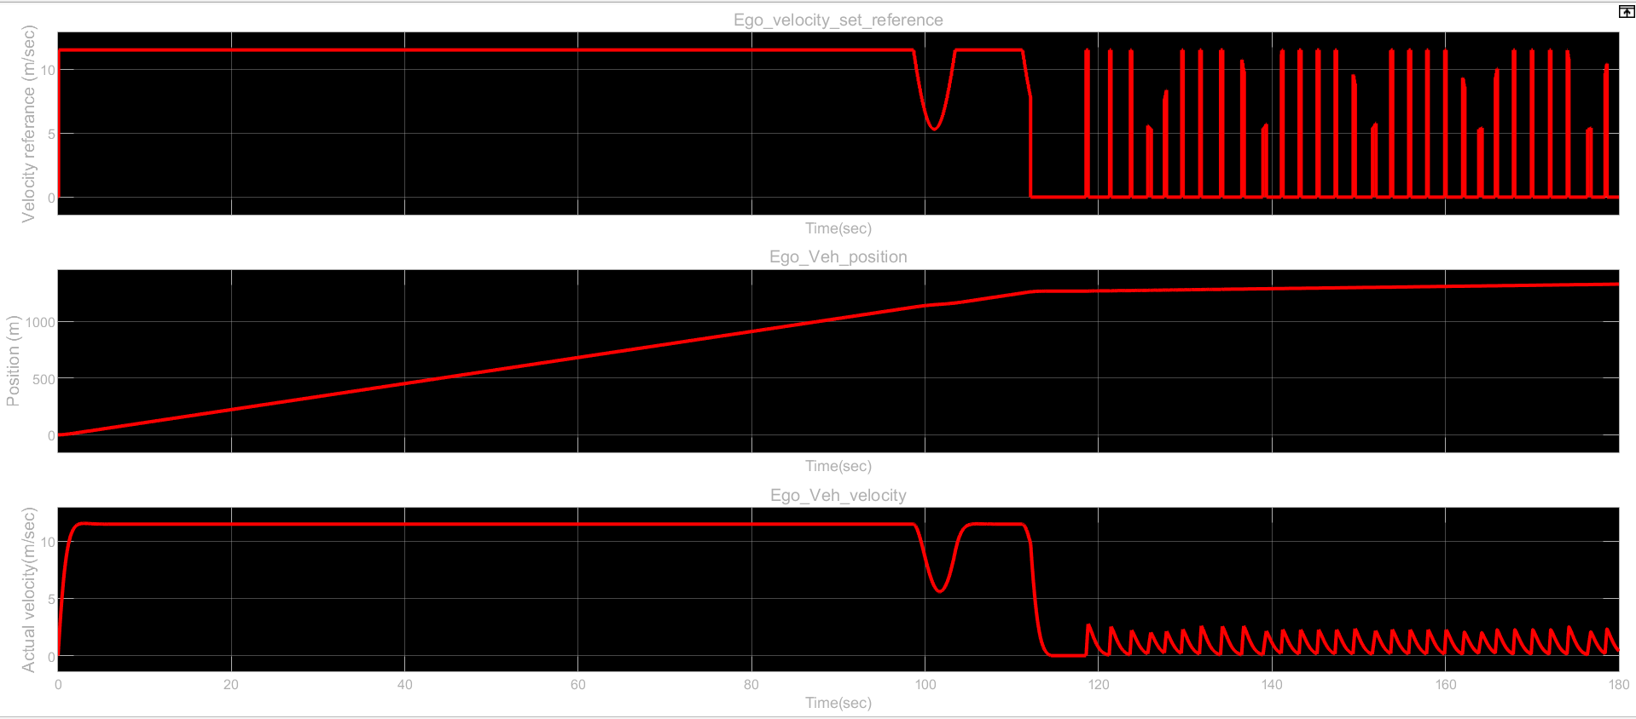
Ego scope output
From t=0 to t=100 sec, the vehicle is in the speed following limit mode. From t=100 sec to 120 sec, the vehicle is in the following the lead vehicle. And finally at t=120 sec, emergency braking mode is achieved. The plots shown describe the Ego vehicle behavior.
Here, the speed limit input is given as 11.5 m/s. We can see that; the vehicle position is relatively constant as soon as an obstacle is detected at 1200 meters.

Slide 30
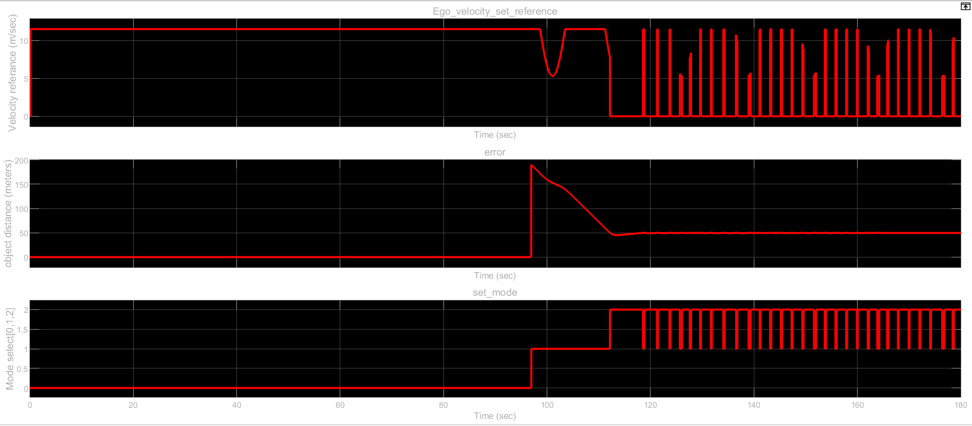
Chart out scope output
The Chart out scope shows the outputs for Ego_velocity_reference, error and set_mode. The Ego_velocity_reference graph is the same as that for the ego car. The error detects the obstacle distance from the car as soon as the car is in the car following mode. The set_mode has 3 step values of 0,1 and 2 depicting the speed control, car follow and emergency braking mode respectively.

Slide 31
Localization and perception (cars and pedestrians)

Slide 32
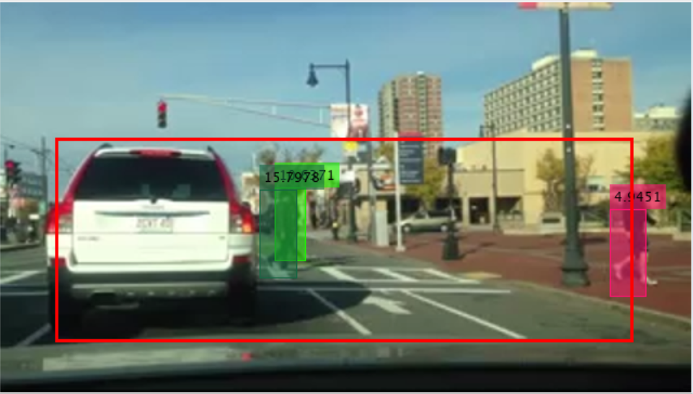
LOCALIZATION AND PERCEPTION MODELS
Pedestrian tracking: https://www.mathworks.com/help/vision/examples/tracking-pedestrians-from-a-moving-car.html
This example shows how to perform automatic detection and tracking of people in a video from a moving camera. It demonstrates the flexibility of a tracking system adapted to a moving camera, which is ideal for automotive safety applications. It include people detection, customized non-maximum suppression, and heuristics to identify and eliminate false alarm tracks.

Slide 33
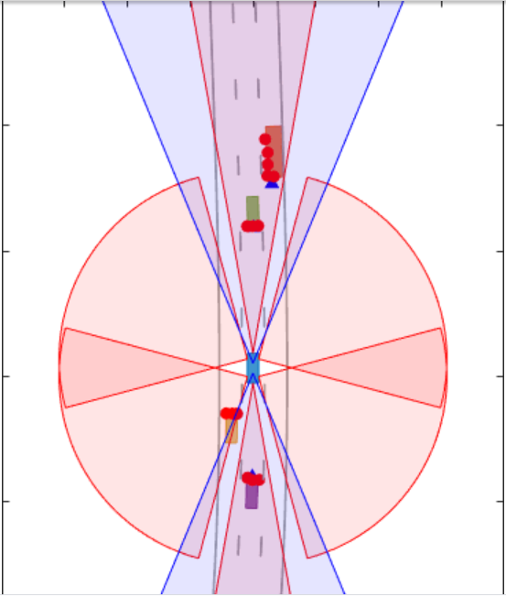
LOCALIZATION AND PERCEPTION MODELS
Extended object tracking: https://www.mathworks.com/help/driving/examples/extended-object-tracking.html
This example shows you how to track extended objects. Extended objects are objects whose dimensions span multiple sensor resolution cells. As a result, the sensors report multiple detections of the extended objects in a single scan. In this example, you will use different techniques to track extended objects and evaluate the results of their tracking performance.

Slide 34
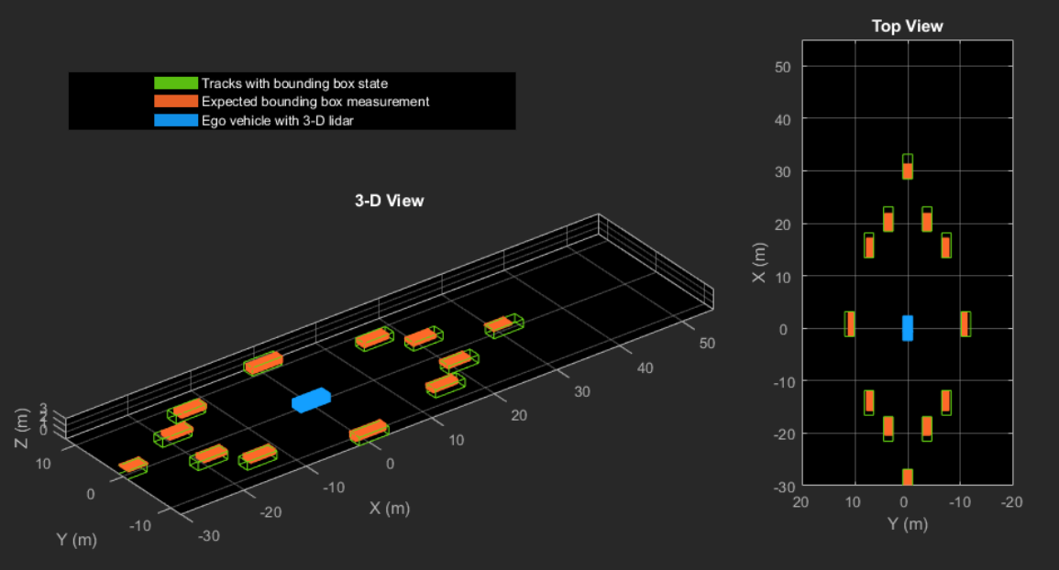
LOCALIZATION AND PERCEPTION MODELS
Tracking vehicles using Lidar: https://www.mathworks.com/help/fusion/examples/track-vehicles-using-lidar.html
This example shows you how to track vehicles using measurements from a lidar sensor mounted on top of an ego vehicle. Lidar sensors report measurements as a point cloud. The lidar data used in this example is recorded from a highway driving scenario. In this example, you use the recorded data to track vehicles with a joint probabilistic data association (JPDA) tracker and an interacting multiple model (IMM) .

Slide 35
Stateflow decision making

Slide 36
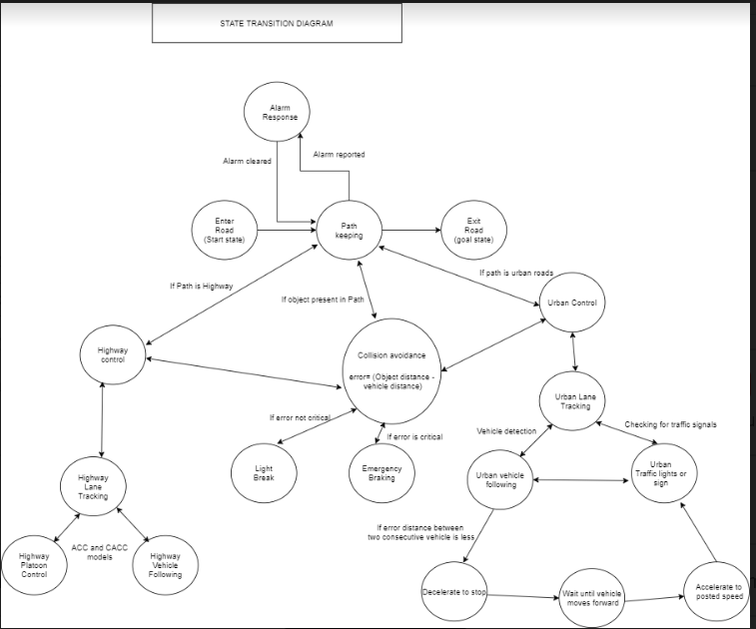
Stateflow decision making

Slide 37
Explanation
The main aim is to make sure that the ego vehicle stays on path from the time it enters the road to the time the goal position is reached. In between these states, if the path is a Highway, then highway lane tracking is activated. Based on the output of highway lane tracking Highway platoon control and highway vehicle following is implemented. Similarly, if the path is urban roads, then urban lane tracking is activated. In case a vehicle is detected in this scenario, vehicle following algorithm is implemented. In case the vehicle comes close to the lead car, then the ego car decelerates to stop. It will wait until vehicle moves forward. As soon as the vehicle moves forward, the ego car starts to accelerate again and checks for traffic lights and again comes back to urban lane tracking scenario. For collision avoidance, error is calculated as show in the diagram. If the error is not critical then a light break is applied, otherwise emergency break is applied. In case an alarm is raised in path keeping, then an alarm response is generated. After it gets cleared, it returns to the state of path following.

Slide 38
List of real-world implementation challenges

Slide 39
Real world challenges
Challenges | Severity
Driving involves interactions with other drivers, cyclists and pedestrians. In many of those situations, humans rely on generalized intelligence and common sense that robots still very much lack complex social interactions, which is still tough for robots. | This situation is currently being worked upon. It will always remain a challenge in case of Level 5 autonomy.
Bad weather makes everything difficult and is a major challenge for self-driving vehicles. It is when sensors don’t agree, or when the environment makes them ineffective, that humans must grab the wheel again. | Its effects can be severe.
We may have to design regulations before we know how safe self-driving cars really are. Before self-driving cars can hit the roads, regulators are going to have to approve them for use. One thing they're going to want to ask is: How safe are these things, anyway? Once the autonomous vehicle perceives its surroundings, it then needs to make decisions. Every possible decision needs to be validated to ensure safety. | Safety is a very important parameter to and hence can give rise to the most severe situation.
Cybersecurity | As vehicles get smarter and more connected, there are more ways to get into them and disrupt what they're doing

Slide 40
Real world challenges
Challenges | Severity
There are potential conflicts between user and community goals in autonomous vehicle design and programming. For example, if programmed to maximize passenger comfort they may reduce traffic speeds, and if programmed to protect occupants they may increase crash risk to other road users. Some benefits (reduced congestion and possibly pollution emissions) require dedicated autonomous vehicle lanes, which raise fairness, pricing and enforcement concerns. | The effects of situations can be mitigated with optimized planning.
There are also potential planning conflicts. By increasing total vehicle travel, encouraging dispersed development, and displacing public transit, autonomous vehicles could exacerbate congestion, sprawl and inequity problems. Shared vehicles reduce parking demand but increase the need for passenger loading facilities | By design trade-offs this situation can be improved.

Slide 41
References
https://www.transportation.gov/sites/dot.gov/files/docs/policy-initiatives/automated-vehicles/351471/73-adrian.pdf
https://www.ansys.com/blog/challenges-level-5-autonomous-vehicles
https://www.vox.com/2016/4/21/11447838/self-driving-cars-challenges-obstacle
https://www.vtpi.org/avip.pdf
https://www.mathworks.com/help/driving/examples/lateral-control-tutorial.html

Slide 42
THANK YOU
Name: Apoorva Ramani
Email id: ramani.20@buckeyemail.osu.edu

