Slide 1
YOLOv5
How does it work?

Slide 2
Object Detection
uses Neural Network
detect objects in images in bounding boxes.
detection and localization of objects in an image that belongs to a predefined set of classes.
Two step object detection: Fast-RCNN, Faster-RCNN, RFCN, Mask R-CNN
Drawback: slows down the detection speed
One step object detection: YOLO, SSD
Advantage: increased speed (45FPS), better union of the bounding boxes, increased accuracy

Slide 3
About YOLOv5
YOLO – You Only Look Once
object detection algorithm that divides images into a grid system.
uses an end-to-end neural network that makes predictions of bounding boxes and class probabilities all at once.
Uses Pytorch framework.
Author: Glenn Jocher Released: 18 May 2020

Slide 4
YOLO vs. other detectors
RPN like Faster RCNN:
1. detecting possible regions of interest using the Region Proposal Network.
2. perform recognition on those regions separately,
3. output is fed to a classifier that classifies the regions into classes.
4. performs multiple iterations for the same image.
YOLO:
1. performs all of its predictions with the help of a single fully connected layer.
2. single iteration for each image

Slide 5
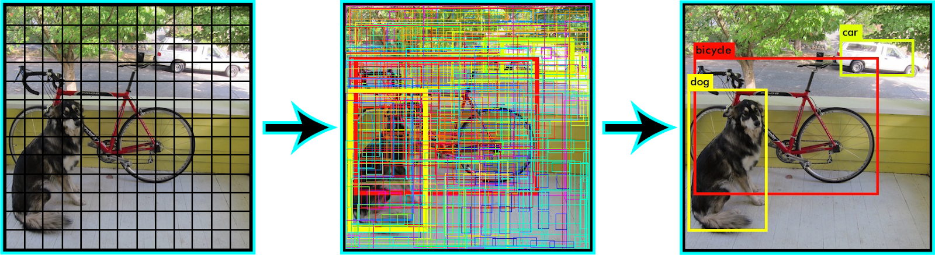
How does YOLO work?
divide the image into N grids of equal dimensions.
Each grid is responsible for the detection and localization of the object it contains.
Each grid predicts bounding box coordinates relative to their cell coordinates with object label and probability of the object being present in the cell.

Slide 6
Lowers computation as both detection and recognition are handled by cells
Lot of duplicate predictions - multiple cells predict the same object with different bounding box predictions.
To fix this issue - Non-Maximal Suppression
* suppresses all bounding boxes that have lower probability scores.
* suppresses the bounding boxes having the largest Intersection over Union with the current high probability bounding box.
This step is repeated till the final bounding boxes are obtained.

Slide 7
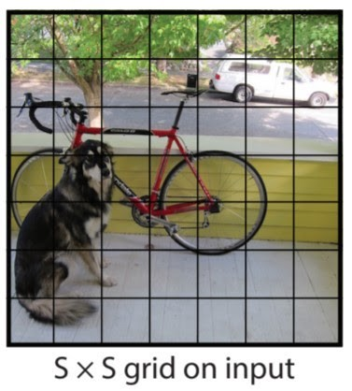
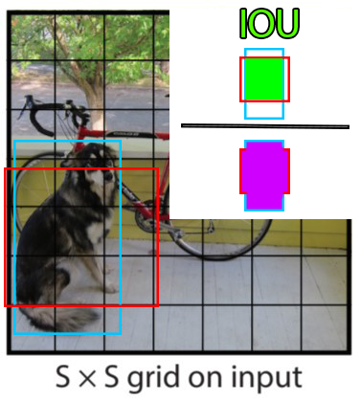
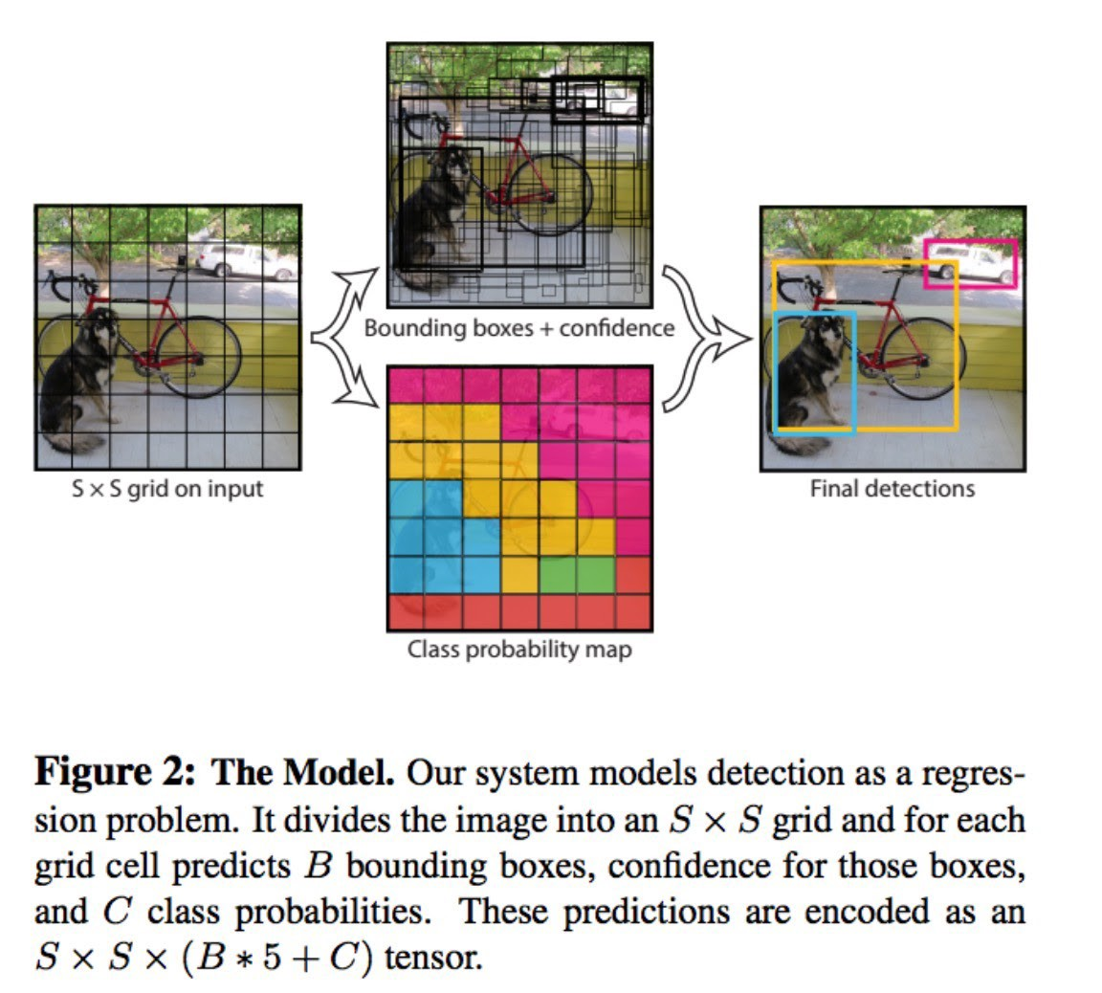
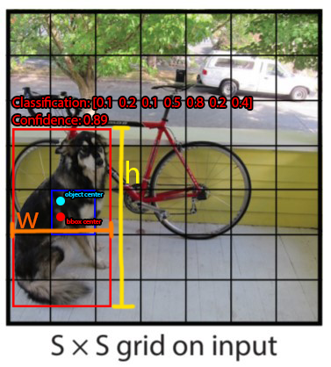

Slide 8
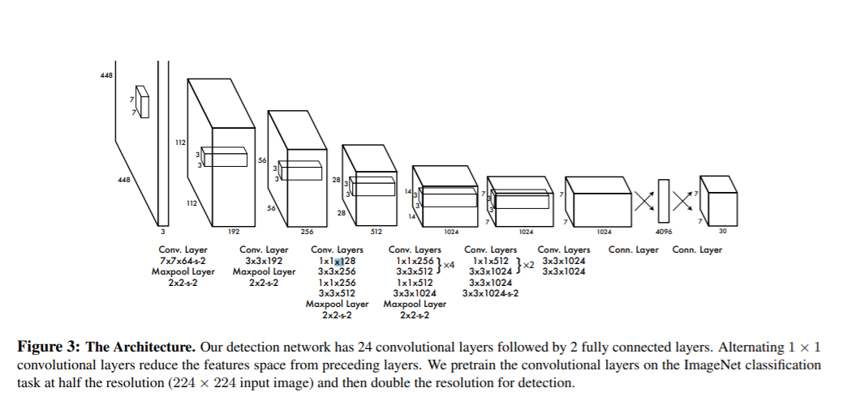
YOLO Architecture
YOLO’s architecture has a total of 24 convolutional layers with 2 fully connected layers at the end.
initial convolutional layers of the network extract features from the image.
fully connected layers predict the output probabilities and coordinates.
uses 1 × 1 reduction layers followed by 3 × 3 convolutional layers

Slide 9
YOLO Limitations
struggles with small objects that appear in groups, such as flocks of birds
struggles to generalize objects in new or unusual aspect ratios or configurations.
loss function treats errors the same in small bounding boxes versus large bounding boxes due to incorrect localization.

Slide 10
Thank You

