Slide 1
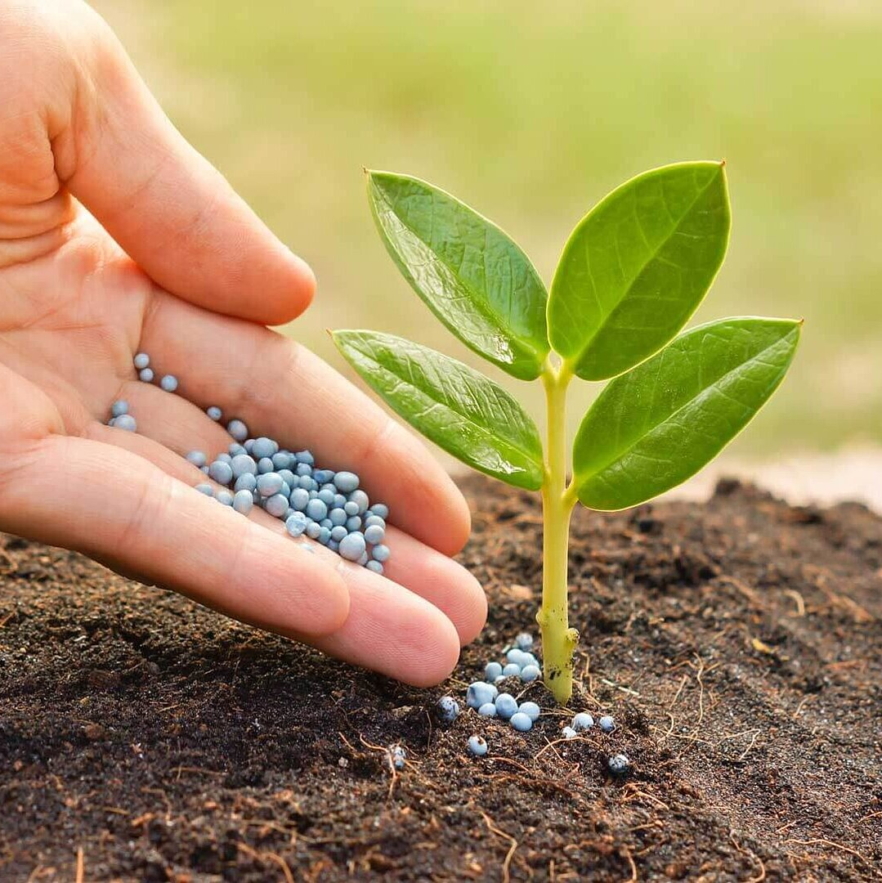
AgriAdvisor
Apoorva Gonegari
Chandana Kolluru
Dheeraj Chetti

Slide 2
Introducing a Greener Tomorrow: Empowering Agriculture with AI
Imagine a world where every farmer, regardless of their experience, can make informed decisions that boost crop yields, reduce waste, and ensure healthier plants.
In today's fast-paced world, agriculture faces an incredible challenge: how to feed a growing global population while conserving resources and minimizing environmental impact.
Traditional farming methods can be resource-intensive and often lead to unpredictable outcomes. This is where our project steps in.
Welcome to the future of agriculture, where data science and AI are revolutionizing farming practices.

Slide 3
Harnessing the Power of Data
We've scoured vast datasets, such as the Crop Recommendation Dataset and supplementary sources like fertilizer suggestions dataset.
We've also tapped into the rich and diverse New Plant Diseases Dataset to gather insights into crop health.
Our approach is holistic. It's not just about identifying diseases and suggesting treatments. It's about recognizing the entire ecosystem of farming, where art and science come together to nurture crops, ensure food security, and sustain livelihoods.

Slide 4
Methodologies
Our approach is a harmonious blend of art and science. On one hand, we harness the power of state-of-the-art technologies like ResNet-9, Support Vector Machines, Random Forest, Gaussian Naïve Bayes, and XGBoost to decode plant diseases from images. These cutting-edge techniques allow us to provide accurate and data-driven insights.
Through our advanced algorithms, we extract valuable insights from images of plant leaves. We can identify diseases, assess their severity, and recommend suitable treatments.
These insights are based on rigorous data analysis, ensuring precision and reliability.

Slide 5
What to Expect
Picture this: a farmer inputs their soil data into our system. In seconds, it recommends the best crop for their land. No more guesswork, just science-backed decisions that optimize yield.
Moving on to fertilizer recommendations, our AI considers the crop type and soil conditions. It pinpoints deficiencies or excesses, offering precise suggestions for improvement.
And for the final act, the plant disease prediction application. Farmers upload an image of a diseased plant leaf, and our AI springs into action. It identifies the disease, provides background information, and suggests remedies. It's like having a plant doctor at your fingertips.
Join us on this journey to empower agriculture with AI. Together, we can cultivate a greener, more sustainable future for generations to come. The seeds of change have been sown, and we invite you to be a part of the harvest.

