Slide 1
2-BIT ALU MC Activity
Team 4A17
TEAM MEMBERS:
Anusha Raikar 01FE18BCS043
Apoorva Jinde 01FE18BCS044(Team Leader)
Archana Badagi 01FE18BCS045
Ashwini Banagar 01FE18BCS054

Slide 2
Problem Analysis
Functionalities:
1) The ALU is a fundamental building block of the central processing unit (CPU) of a computer.
2) The ALU is capable of performing two classes of operations: arithmetic and logic. The set of arithmetic operations that a particular ALU supports may be limited to addition and subtraction, or might include multiplication, division.
3) Logic operations involve : AND, OR, XOR, and NOT, right shift, left shift, xnor , Increment , Decrement . These can be useful for creating complicated conditional statements and processing Boolean logic.
The proposed solution try to solve this problem by, having keypad system to get the input from the user, lcd to display the desired output.
This can be done by interfacing lcd , keypad with microcontroller 8051.

Slide 3
Multiple Design Solutions
There are two solutions for this particular problem:
1) By using only logic gates and providing the output in the binary form. However, this will be difficult for a user to get his/her desired output.
2) By minimizing the usage of no of logic gates and designing a particular keypad for getting input from user to operate and lcd to display the output.
We are going to implement the second solution i.e minimizing the logic gate use using Proteus 8 Professional

Slide 4
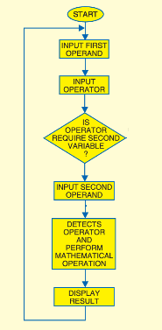
Block Diagram

Slide 5
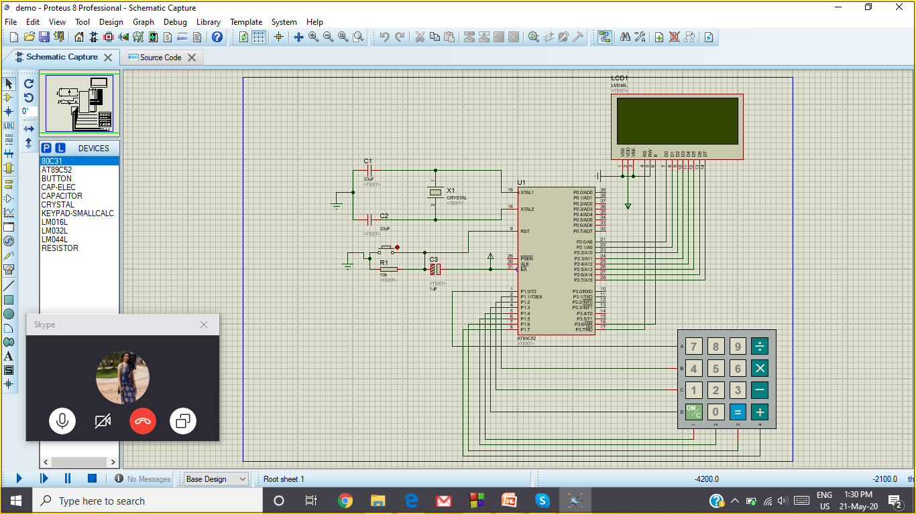
Circuit Diagram

Slide 6
Methodology
An ALU system has been development by sequence of operations. To active a successful ALU design we use following methodologies:
First the single digit operand A is taken as input from the keypad.
Then the operator to be selected from the keypad.
Then the operand B to be selected.(if it is not binary operation only)
Then “=“ operator to be pressed in the keypad.
The result is shown on the lcd

Slide 7
Applications in Real World
1)For the computational calculations ALU is an important component in Central Processing Unit and this CPU is a major part of Computers.
2)ALU is an important component in Toys.
3)In TV remotes .
4)In Fan Regulators.
5)Simple to complex Calculators.
6)In speedometers, measuring gauges.
7)Scientific measuring devices like microscope electron-microscope for precision

Slide 8
Future Scope
In near future we see that technology would be able to do
Calculation in a single clock: a very complex ALU that calculates a square root in one operation.
Calculation pipeline: a group of simple ALUs that calculates a square root in stages, with intermediate results passing through ALUs arranged like a factory production line. This circuit can accept new operands before finishing the previous ones and produces results as fast as the very complex ALU, though the results are delayed by the sum of the propagation delays of the ALU stages. For more information, see the article on instruction pipelining.
Iterative calculation: a simple ALU that calculates the square root through several steps under the direction of a control unit.
So any of the above three can be performed efficiently to achieve the following
1. Our purpose is to reduce the delay time.
2. To make the circuit complex free and less expensive.
3. To implement the circuit by applying latest version of the renown
software.
4. Minimizing the logic gate as much as possible.

Slide 9
Conclusion
In this project we designed and implement ALU. We have used Proteus. Different type of simulation are performed on it like addition, subtraction, multiplication, division and so on. It has given satisfactory and successful outcomes.
ADVANTAGES:
2 bit ALU has minimum delay time to implementation.
Minimize the logic gate.
Less expensive due to using minimum gate.
DISADVANTAGES:
Complex circuit diagram.
They have no memory.

Slide 10
Thank You

Slide 11
Cheat Sheet
1)Arithematic
+ is +, - is -, * is *, / is /
-------------------------------------------------------------------------------------
2)Logical
+ is bitwise or “|”
- is bitwise xor “^”
* is bitwise and “&”
/ is bitwise xnor “~^”
--------------------------------------------------------------------------------------
3)Single operator
+ is incrementation
- is decrementation
* is negation(twos complement)
---------------------------------------------------------------------------------------------
4)Shift
+ is left shift
- is right shift

