Slide 1
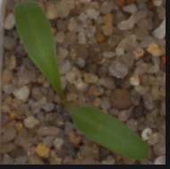
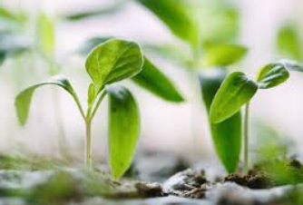
V2 PLANT SEEDLINGS DATASET
COURSE : MACHINE LEARNING
COURSE CODE: 17ECSC306
TEAM - A6
ANUSHA RAIKAR 01FE18BCS043 143
APOORVA JINDE 01FE18BCS044 144
ARCHANA BADAGI 01FE18BCS045 145
RACHANA PATIL 01FE18BCS060 160

Slide 2
INTRODUCTION
Agriculture is vital for human survival and remains a major driver of several economies around the world more so in underdeveloped and developing economies.
With increasing demand for food and cash crops, due to a growing global population and the challenges posed by climate change, there is a pressing need to increase farm outputs while incurring minimal costs
One major reason for reduction in crop yield is weed invasion on farmlands. Weeds generally have no
useful value in terms of food, nutrition or medicine yet they have accelerated growth and parasitically
compete with actual crops for nutrients and space
Inefﬁcient processes such as hand weeding has led to signiﬁcant losses and increasing costs due to
manual labour
The robots and the vision machines need to be able to precisely and reliably detect a weed from the useful plants. Machine vision technologies developed for selective weeding have faced the challenge of reliable and accurate weed detection.

Slide 3
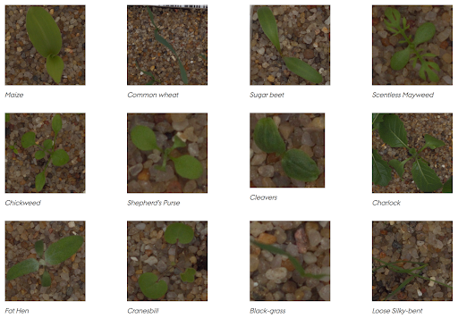
2. PROBLEM STATEMENT
The goal of project is to distinguish between the different weed seeding and the crop of 12 different plant species, hence it is a multi-classification problem
3. DATASET
This dataset contains 5,539 images of crop and weed seedlings.
The images are grouped into 12 classes as shown in the
pictures. Of the 12 classes, 3 classes are crop seedlings
and 9 are weed seedlings.
These classes represent common plant species in Danish
agriculture. Each class contains rgb images that show
plants at different growth stages. The images are in various
sizes and are in png format.

Slide 4
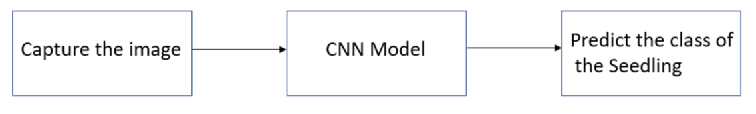
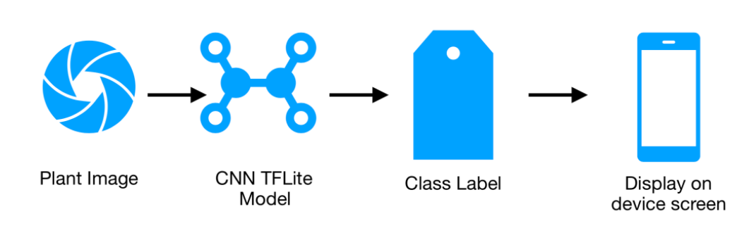
4. METHODOLOGY
CNNs are really effective for image classification
Hence, we propose CNN to adopted for plant seedling classification to automatically discriminate between weed species and crops at early growth stages
App :

Slide 5
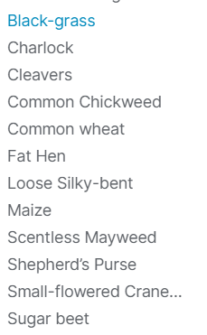
5. DATA PRE-PROCESSING
Data Preprocessing has to be done on the dataset some of the data preprocessing techniques used are:
1] Transforming Images (Resize:The images are in diﬀerent sizes. We will resize all images to 96x96 and use only 250 images from each class)
2] Splitting data for training and Validation .
We have to choose an appropriate model to train on the dataset. Then the task is to classify the plant seedling.

Slide 6
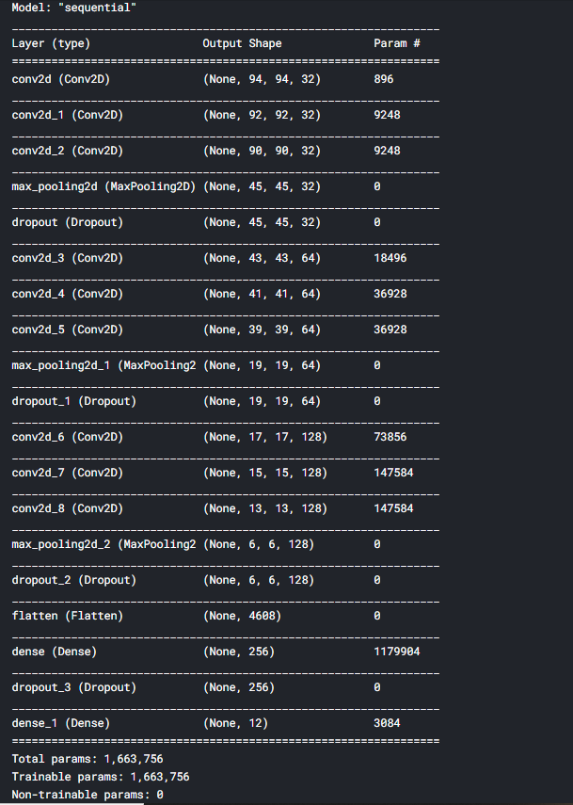
6. TRAINING THE MODEL
We implemented a CNN model to classify plant seedlings into its respective labels. We built the model with convolutional layers(Conv2D, MaxPooling)
We train the model with train and val batch size of 10
We use Adam optimizer with 0.0001 learning rate
Loss function used is categorical_crossentropy
Model structure (optimizer: Adam):
1]Input
2](Conv2D*3 – MaxPool2D – Dropout) X3 – (ﬁlters = 16, 32, 64)
3]Flatten
4]Dense (256)
5]Dropout
6]Output

Slide 7
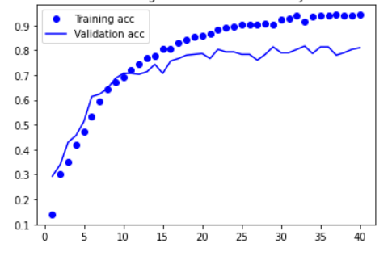
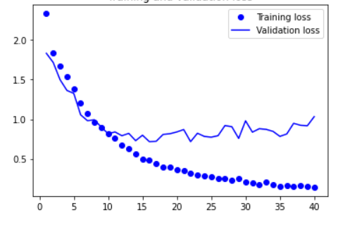
7. RESULTS
These are results obtained.
For training dataset - accuracy is 0.9468 ,for validation dataset - accuracy is 0.8100
For training dataset - loss is 0.1320 ,for validation dataset - loss is 1.0334
Accuracy for training and validation dataset
Loss for training and validation dataset

Slide 8
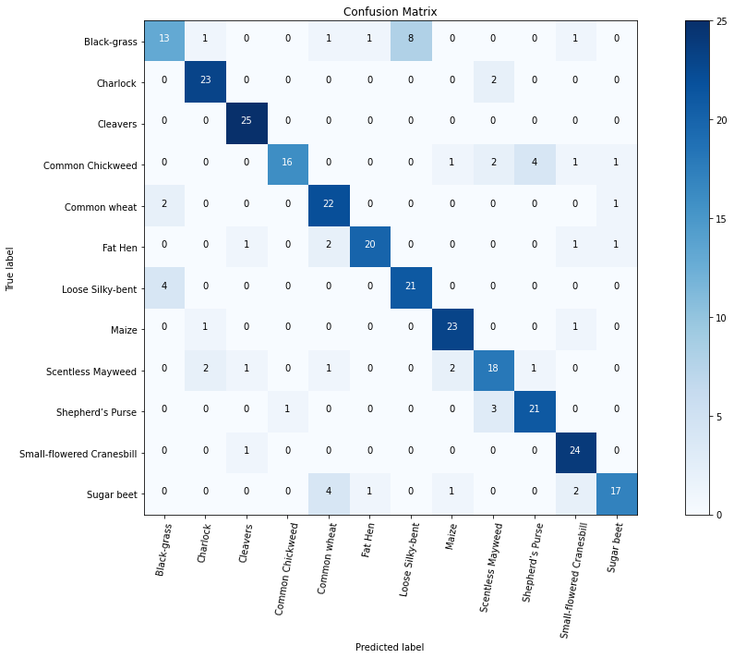
8. CONCLUSION
The model we built was with the aim of identifying weed plants in initial stages. Let us see the confusion matrix and analyze the performance.
1] Model did ﬁnd hard time in identifying Black-Grass from Loose Silky Bent.
2] Model did very good job in detecting Cleavers with very accuracy withf1-score of 0.94.

Slide 9
9. REFERENCES
[1] Ashqar, Belal AM, Bassem S. Abu-Nasser, and Samy S. Abu-Naser. ”Plant seedlings classiﬁcation using deep learning.” (2019).
[2] Alimboyong, Catherine R., Alexander A. Hernandez, and Ruji P. Medina. ”Classiﬁcation of plant seedling images using deep learning.” TENCON 2018-2018 IEEE Region 10 Conference. IEEE, 2018.
[3] Alimboyong, Catherine R., and Alexander A. Hernandez. ”An improved deep neural network for classiﬁcation of plant seedling images.” 2019 IEEE 15th International Colloquium on Signal Processing Its Applications (CSPA). IEEE, 2019.
[4] Dyrmann, Mads, Henrik Karstoft, and Henrik Skov Midtiby. ”Plant species classiﬁcation using deep convolutional neural network.” Biosystems Engineering 151 (2016): 72-80.
[5] Silva, L. O. L. A., et al. ”Comparative assessment of feature selection and classiﬁcation techniques for visual inspection of pot plant seedlings.” Computers and electronics in agriculture 97 (2013): 47-55.

