Slide 1
ELEARNING WEBSITE

Slide 2
INTRODUCTION
Team Members
Akshara
Anjana
Arpitha N
Arpita S
Ankita
Apoorva – Scrum Master
Bindu
Chaitanya
ELearning Website Link - http://elearningm1.upskills.in/
Exploratory testing
Noted down the functionalities of website

Slide 3
FUNCTIONALITIES OF FACULTY
Faculty Register/Login
After login
HOMEPAGE
Inbox
Compose
Pending Invitation
Personal Data
Edit Profile
MY COURSES
Create a course
Sort courses
Course History
Course catalog
PERSONAL AGENDA
Calendar
Agenda list
Session plan calendar
REPORTING
Overview
Learners
SOCIAL NETWORK
Home
Messages
Invitations
My shared profile
Friends
Social groups
Search
My files
Personal data
SKILLS
My skills
My certificates

Slide 4
FUNCTIONALITIES OF STUDENT
Student Register/Login
After login
HOMEPAGE
Inbox
Compose
Pending Invitation
Personal Data
Edit Profile
MY COURSES
Sort courses
Course History
Course catalog
PERSONAL AGENDA
Calendar
Agenda list
Session plan calendar
PROGRESS
Course Progress
SOCIAL NETWORK
Home
Messages
Invitations
My shared profile
Friends
Social groups
Search
My files
Personal data
SKILLS
My skills
My certificates

Slide 5
MANUAL TESTING DURING SPRINT 1​
Activities​
Planning-User stories in Jira​
Work allocation- Assign JIRA tasks to team members to create test cases​
Test design process-​
Scenarios- categorised based on business risks​
Test cases​
Pre-conditions and specification for data creation​
Test design techniques is applied wherever necessary ​
Review process and baseline of testcases​

Slide 6
JIRA WORKFLOW​
Number of User Stories created – 9
Number of tasks allocated to team members for creating test cases – 14
Number of subtasks created for reviewing the testcases – 11
Each test case is reviewed by team members
Defects were logged into defect log – 8 defects
Issue log is created

Slide 7
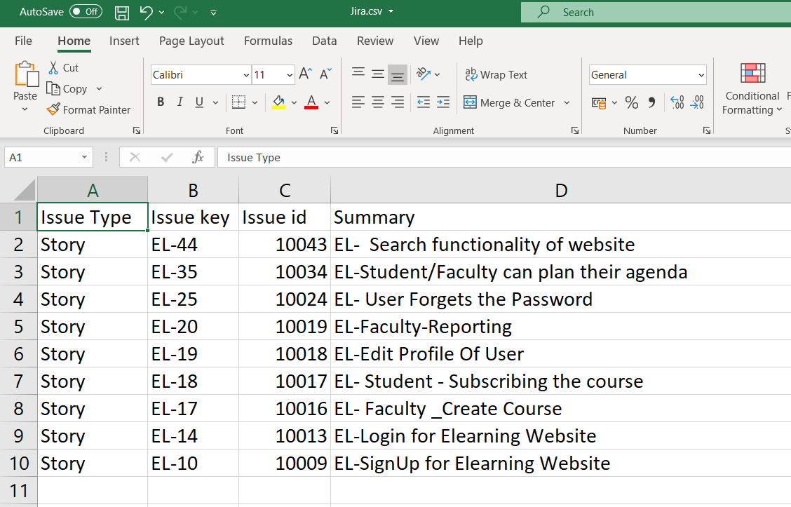
Stories created in JIRA

Slide 8
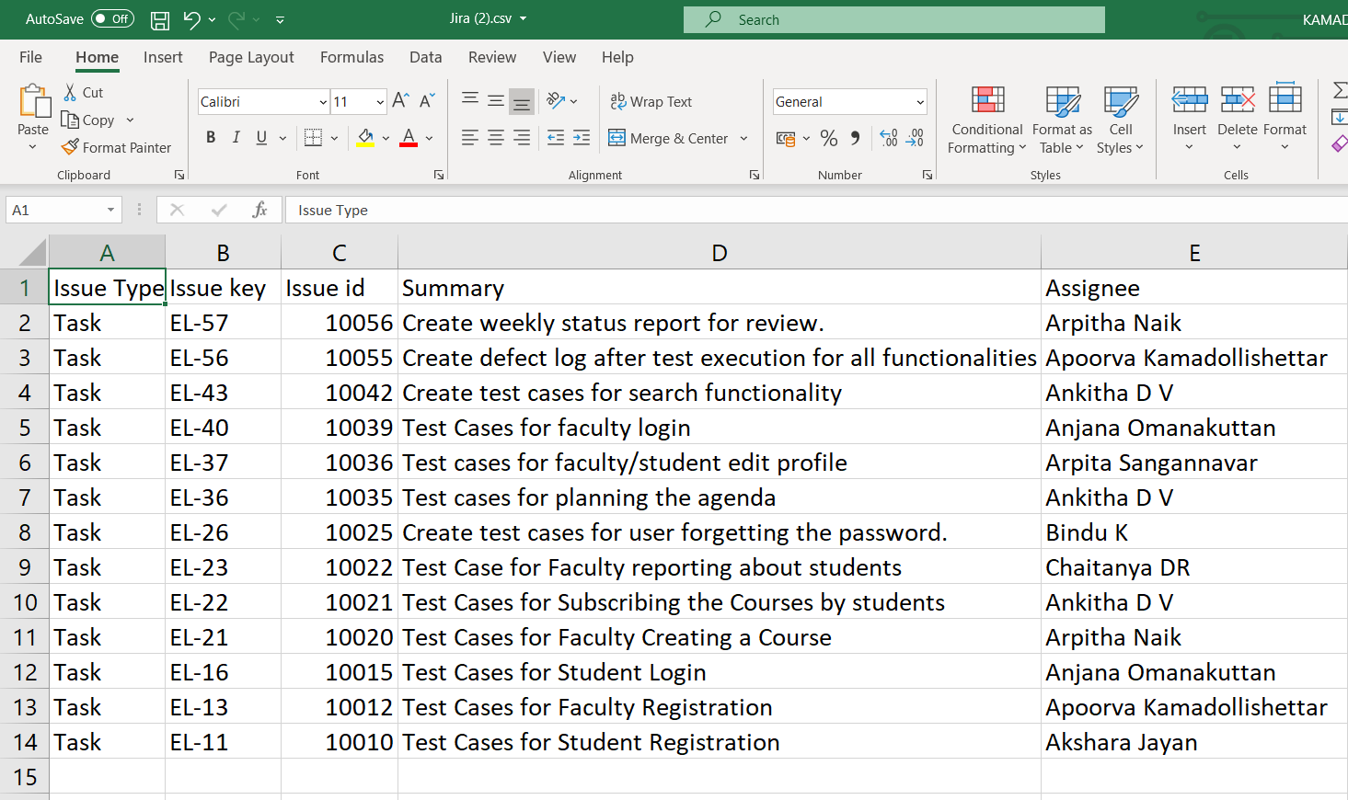
Tasks created and assigned to team members in JIRA for creating testcases

Slide 9
TEST EXECUTION​
Preparation of test data​
Smoke test including pre-condition check​
Start of Test execution​
Defect logging if any –2 cycles​
Follow ups​
Bug allocation to development team​
Updation of issue log​

Slide 10
TEST METRICS​
Module wise number of test cases is written
Category wise defect analysis based on priority, severity, status ​
Causal analysis using fishbone diagram and 5 why analysis​
Pareto chart 80-20 graph based on defect causes​
Checklist for test case review is submitted
Weekly status report is created

Slide 11
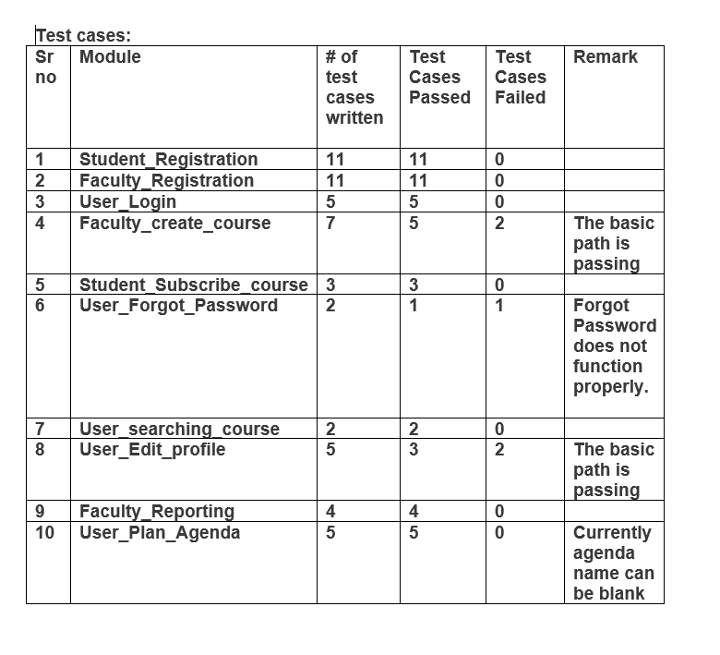

Slide 12
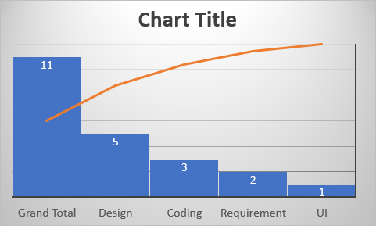

Slide 13
POST EXECUTION ACTIVITIES​
Like to have features in application communicated to developers.​
On going issues discussed during the pre-production move of release 1.​
Review of acceptance criteria.​
Planning for regression test cases using manual/automation approach.​

Slide 14
SPRINT 2 – AUTOMATION TESTING​
Planning activities
Selection of test cases for automation testing
Smoke test​
Sanity test​
Regression test​

Slide 15
JIRA WORKFLOW – SPRINT2
Task allocation for testers in JIRA to automate testcases
Regression test | Name
Student SignUp | Arpitha N
Faculty create course | Arpitha N
Student subscribing course | Akshara J
Edit profile by student | Anjana
search functionality of user | Chaitanya
Faculty reporting | Chaitanya
Faculty marking attendence | Bindu
Faculty create new test | Bindu
Sanity test | Name
Faculty login | Ankita DV
Faculty SignUp | Ankita DV
User Plan agenda | Arpita S
Faculty Unsubscribing courses | Anjana
User changing password in edit-profile | Arpita S
Faculty making announcements | Apoorva
Student able to unsubscribe courses | Akshara J
Broken LinkChecker | Apoorva
Smoke Test | Name
Home page is loaded | Arpitha N
Course list pages | Apoorva

Slide 16
TECHNIQUES USED FOR TESTING​
Selenium + Java – Selenium framework is used to automate web pages, test scripts are written in java
Selenium IDE – It is a record/run tool that a test case developer uses to develop Selenium Test cases
Selenium Webdriver –This tool is used for automating web-based application testing to verify that it performs expectedly. Test scripts are written in JAVA and is run in web browsers
Maven – It is a project management tool which uses POM concept. Using pom.xml(Maven) dependencies are configured for building testing and running code.
Page Object Model(POM) pattern is followed
Locating elements by id, name, linkText, cssSelector, xpath
Data is provided using excel, TestNG parameters, files
TestNG & Extent Reports – Using these tools reports are generated in test-output and TestReport
Cucumber is also implemented for some tests
Screenshots of failing testcases are implemented
Broken Link Checker - broken links (or dead links) in a website are links that are not reachable and do not work as expected

Slide 17
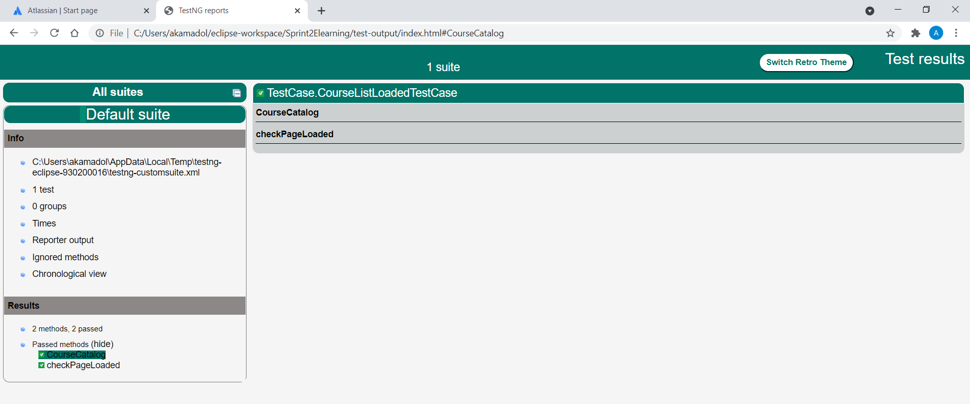
SPRINT 2​
TestNG Reports - index

Slide 18
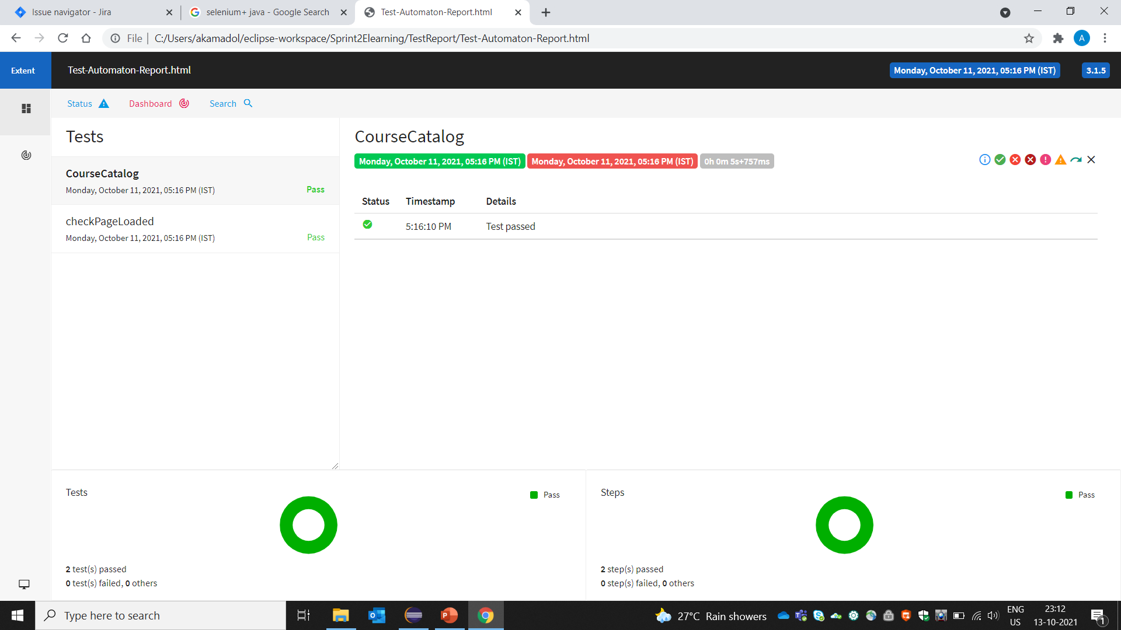
SPRINT 2​
Extent Reports - Test-Automaton-Report

Slide 19
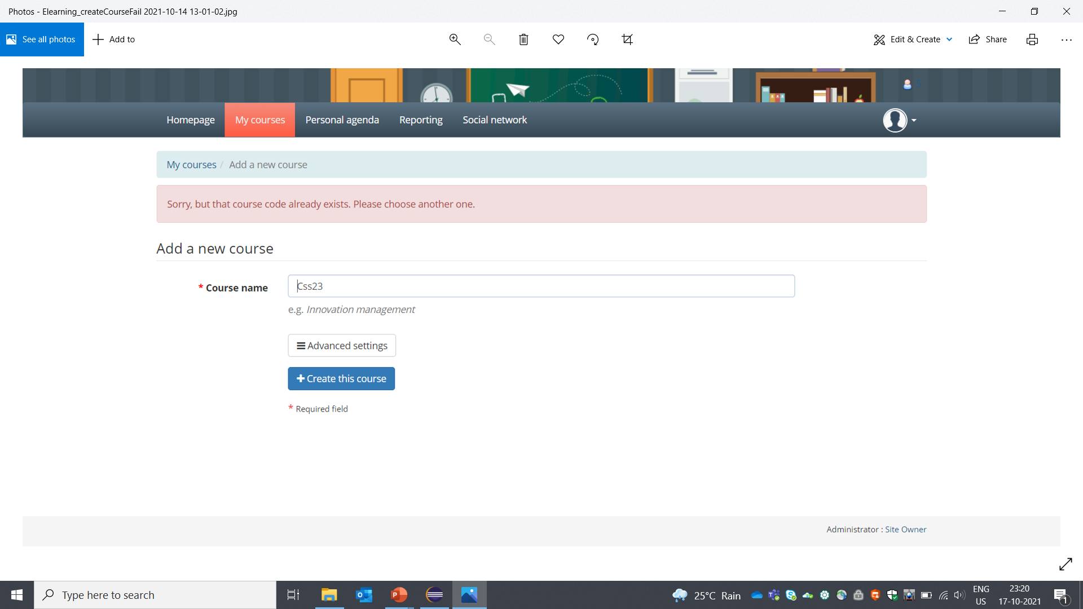
SPRINT 2​
Screenshot of testcase failing - Elearning_createCourseFail%202021-10-14%2013-01-02

Slide 20
SPRINT 2​
Automated testcases scripts are uploaded in Github and linked in JIRA
Defect log is updated
Consolidation of codes and the same is uploaded in Github

