Slide 1
Raitha-Mithra Government Kisan Schemes Notification Portal

Slide 2
Company Name : DELL R & D, Bagmane Tech Park, Bangalore
Technologies learnt : JavaServer Pages (JSP), Java Servlet, JDBC, Python
Team members :
Anusha N 1SI16CS018
Apoorva K V 1SI16CS019
Ayesha Rabbani 1SI16CS024
Chandana H S 1SI16CS030
Chinmayi P 1SI16CS031
D Shreya Kishore 1SI16CS032
Gagana R S 1SI16CS038
Kavyashree B S 1SI16CS049
Likitha R 1SI16CS056
M Suchitra 1SI16CS057
Nischitha Jain R 1SI16CS071
Rakshitha N 1SI16CS080
Ramya N R 1SI16CS082
Lavanya S 1SI17CS407
Manjula M N 1SI17CS411
Nalini N N 1SI17CS413

Slide 3
Contents
About the company
Introduction to project
Motivation and Problem Statement
Existing Solution
Proposed Soluton
Tools and Technologies
Implementation
Expected Results

Slide 4
About the company
Dell is a US multinational computer technology company that develops, sells, repairs, and supports computers and related products and services.
Named after its founder, Michael Dell, the company is one of the largest technological corporations in the world, employing more than 145,000 people in the U.S. and around the world (Annual report 2018).
Dell sells personal computers (PCs), servers, data storage devices, network switches, software, computer peripherals, HDTVs, cameras, printers, MP3 players, and electronics built by other manufacturers.

Slide 5
Introduction to Project
Project titled “Farmer Notification System” is a web application which is developed to notify Indian citizens regarding the schemes released by the government for their benefits. This system includes benefits like:
Gives the information regarding the schemes released by the government.
Notifies the Indian citizens about the schemes that they are applicable to, either through email or through SMS in their respective regional languages.

Slide 6
Problem Statement
Most of the farmers are illiterates, they don’t get the proper information about the schemes which are usually announced through any Government websites.

Slide 7
Existing Solution
There are few websites to provide details related to respective citizens like “Raitha mitra” for farmers, “Fastweb.com” for students regarding student scholarships, etc.
These websites doesn’t notify them the details regarding the schemes.
So they might miss the benefits they get.
People are manually trying to know the details regarding the schemes, villagers are visiting their respective panchayat office to get the details.

Slide 8
Proposed Solution
A Web application to provide information regarding all the government schemes provided for Indian citizen belonging to various fields like farmers, students, widows, girl children, women, etc. A system which facilitates to notify respective individuals regarding the schemes they are applicable to.
In the feild of farmers,this sytem works as :
Initially collect details of the Farmers mainly unique phone numvers in the respective Zilla Panchayat offices by the zilla panchayat officer.
Once officers receive the information of any new schemes, they will send a normal auto generated text messages to the registered farmers.So as soon as farmers get to know about the schemes, they will make use of it in a proper way at a proper time.

Slide 9
Tools and Technologies
1.JSP : JavaServer Pages (JSP) is a technology that helps software developers create dynamically generated web pages based on HTML, XML or other document types.
2.Java Servlet : A Java servlet is a Java program that extends the capabilities of a server. Although servlets can respond to any types of requests, they most commonly implement applications hosted on Web servers.
3.Apache Tomcat : It is often referred to as Tomcat Server, is an open-source Java Servlet Container developed by the Apache Software Foundation (ASF). Tomcat implements several Java EE specifications including Java Servlet, JavaServer Pages (JSP), Java EL, and WebSocket, and provides a "pure Java" HTTP web server environment in which Java code can run.
4.JDBC : Java Database Connectivity (JDBC) is an application programming interface (API) for the programming language Java, which defines how a client may access a database.

Slide 10
Implementation
A web application to provide information regarding all the government schemes provided for Indian citizen.
A farmer will be able to get all relevant information on specific subjects around his village/block /district or state about schemes. This information will be delivered in the form of text, SMS in the language he or she understands.
Farmers will also be able to ask specific queries as well as give valuable feedback through the Feedback module specially developed for the purpose.
Software details:
For Modelling the project we have used MySQL database.
For Viewing the project we have used HTML, CSS, JSP, JS, BOOTSTRAP.
For Controlling the project we have used JAVA.
Python for Web services.

Slide 11
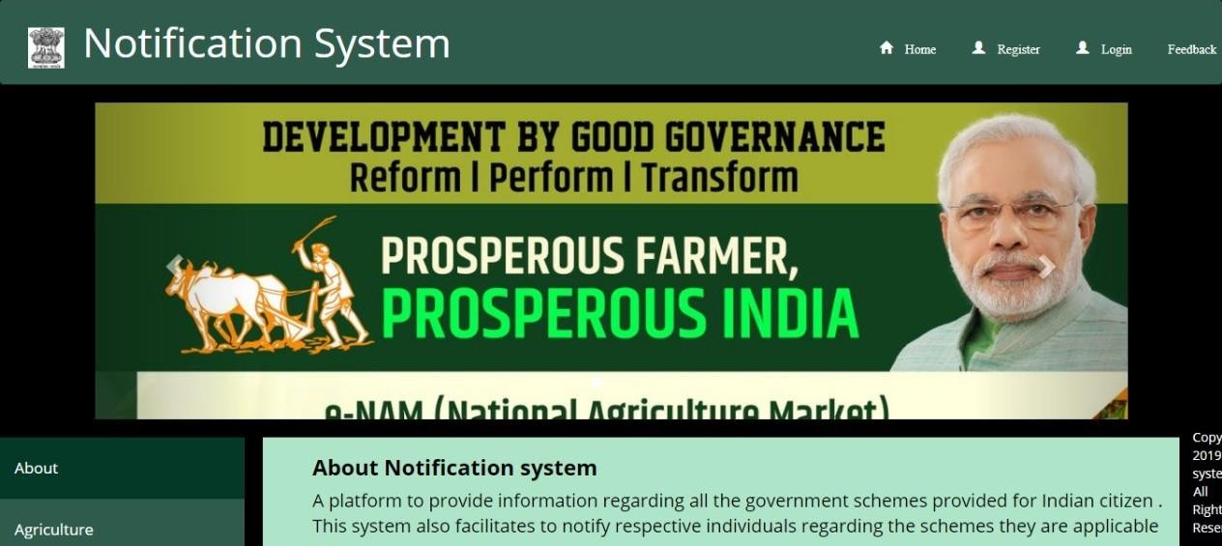
Expected Results
Figure.1 Home page

Slide 12
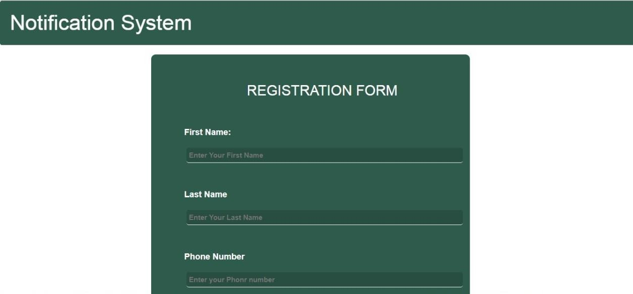
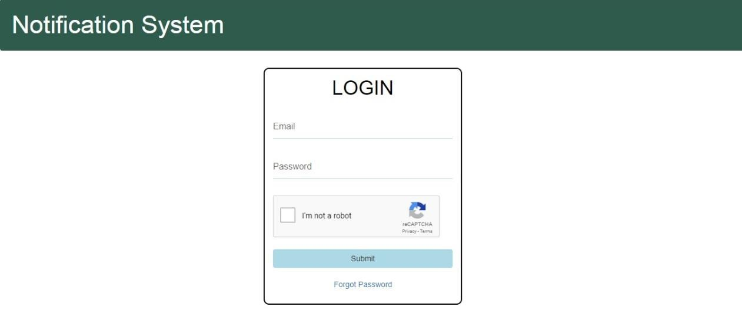
Expected Results
Figure.2 Registration form
Figure.3 Login form for ZP officer

Slide 13
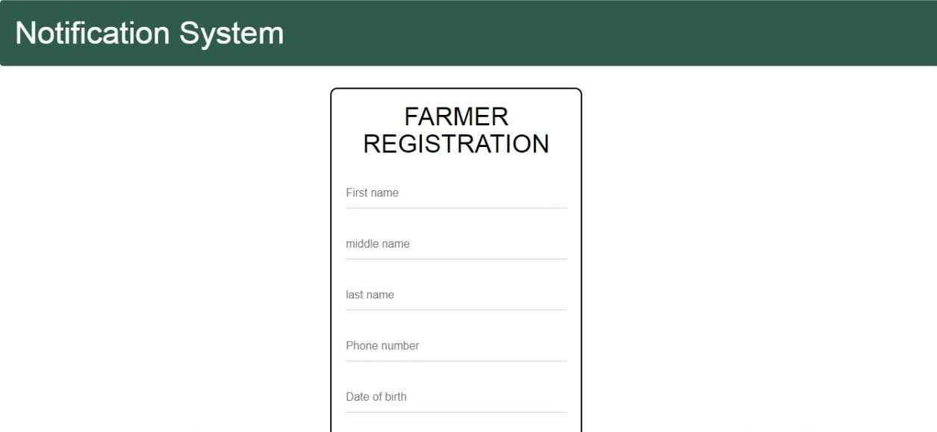
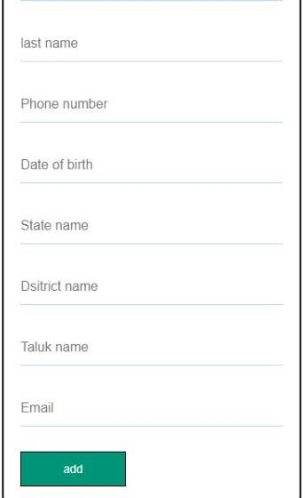
Expected Results
Figure.4 & 5 Registration form for farmers

Slide 14
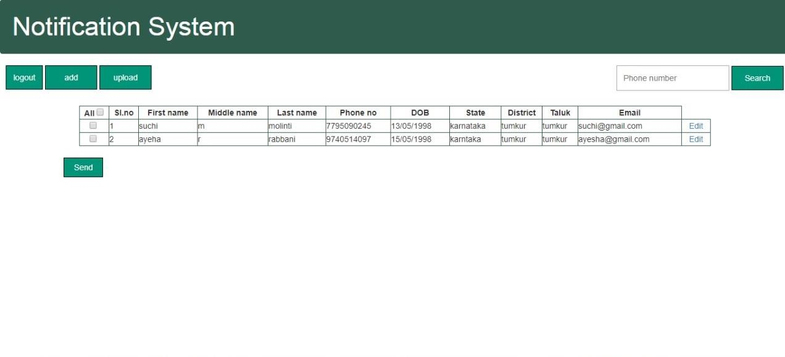
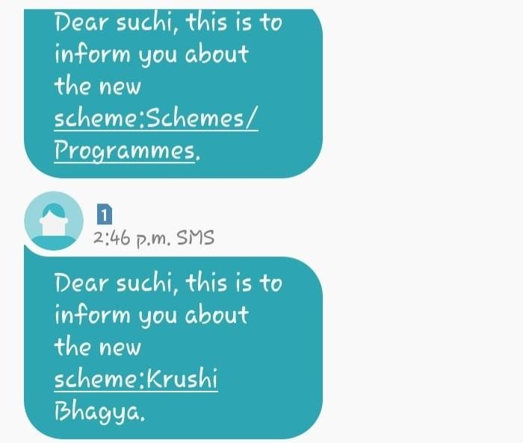
Expected Results
Figure.6 data of the farmers Figure.7 message Received by the farmers

Slide 15
THANK YOU

