Slide 1
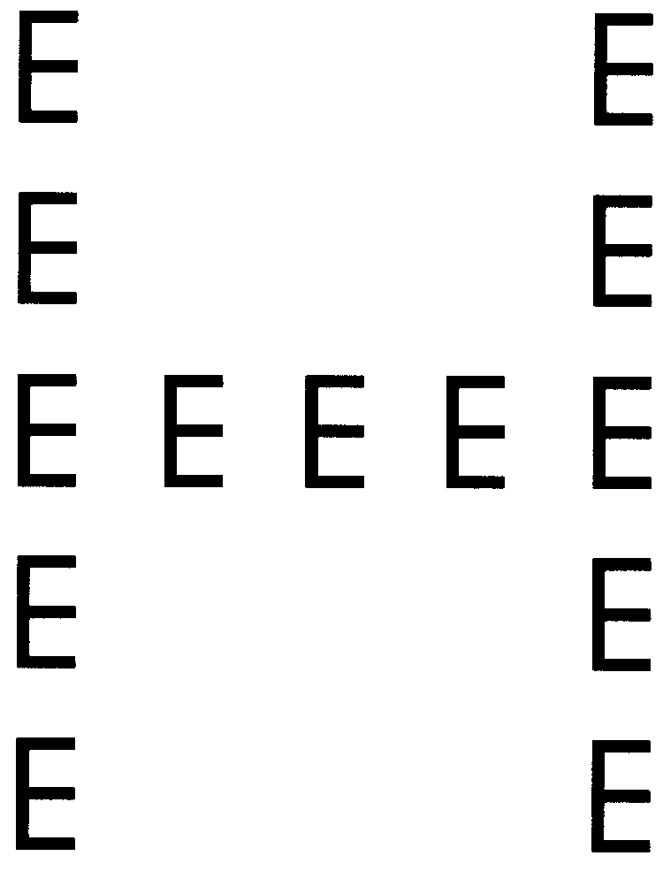
Welcome to the Experiment!
This is a simple experiment where you will be shown Global and Local images followed by the bunch of dots. All you need is to count the number of dots as soon as possible. At the end of the trial, you will be asked to judge the presented letter in global and local stimulus condition and press the corresponding alphabet on the keyboard. The example of the Global and Local Condition is given below.
Global= H
Local= E
Global= Big “H” is made-up of E
Local= Big H is made-up of small “E”

Slide 2


