Slide 1
Effect of Global and Local Processing on Numerosity Estimation
Apoorva Srivastava (2019702014)
Surabhi Gupta (2019701024)
Anuj Shukla (Mentor)

Slide 2
Background
Spatial attention deals with Global and Local Processing of the stimulus.
Numerosity is processed spatially.

Slide 3
Objective
“Based on the background, we want to find whether Global/Local Processing affects the Numerosity Estimation or not.”

Slide 4
Motivation
Estimation is the activity we perform in daily life, almost in every task.
It is automatic and performed in fraction of seconds.
Knowing how our estimation capability is affected by Global/Local Processing may help us to estimate better.

Slide 5
“Global Processing”
Vs
“Local Processing”

Slide 6
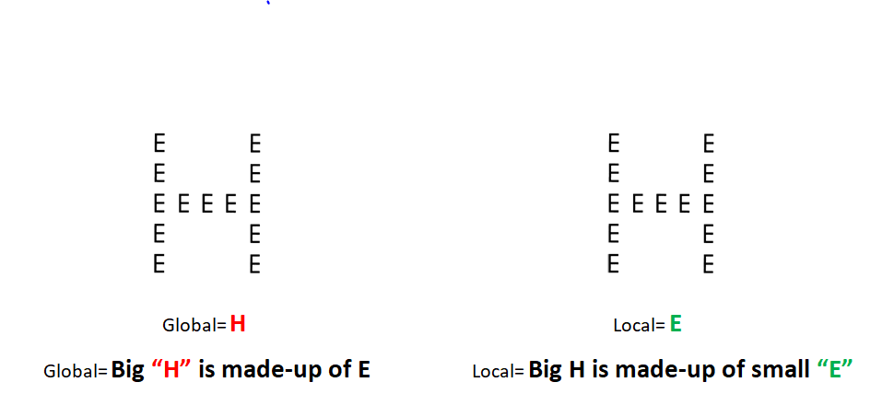

Slide 7
Estimate
the number of dots??

Slide 9
This is
Numerosity Estimation

Slide 10
HYPOTHESIS
Null Hypothesis: Global/Local Processing has no effect on the accuracy of the Numerosity Estimation and Reaction Time.
Alternate Hypothesis: Global/Local Processing has differential effect on the accuracy of the Numerosity Estimation and Reaction Time.

Slide 11
Research Instrument & Setup
MATLAB and PsychtoolBox
Research Methodology
Trial Definition
Dots Definition
Images for Global Local Processing
Experiment Instructions
Participants
Experimental Setup

Slide 12
Research Methodology:
Participants were primed with Global and Local Processing
Just after the priming, participants were asked to enumerate the number of dots shown for 100 ms
After enumerating the dots, participants were confirmed for their priming
Their responses and the reaction time were recorded
They were analyzed separately for Global and Local Cases

Slide 13
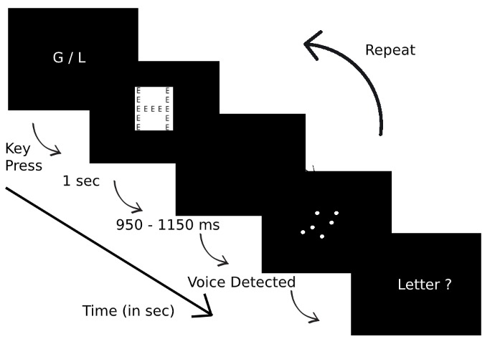
Trial Definition

Slide 14
Dots Definition
Numbers of Dots Selected: 1,2,3,4,5,6,24,26,28,30,32,34
Dot Size: 1 degree with respect to 57cm distance from Screen
Dot Color: White with Black Background
Position of Occurrence on Screen: Center of the Screen

Slide 15
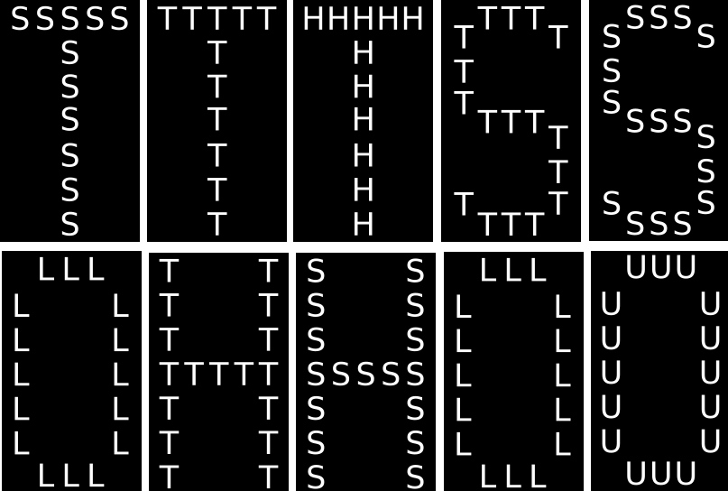
Images for Global and Local Processing

Slide 16

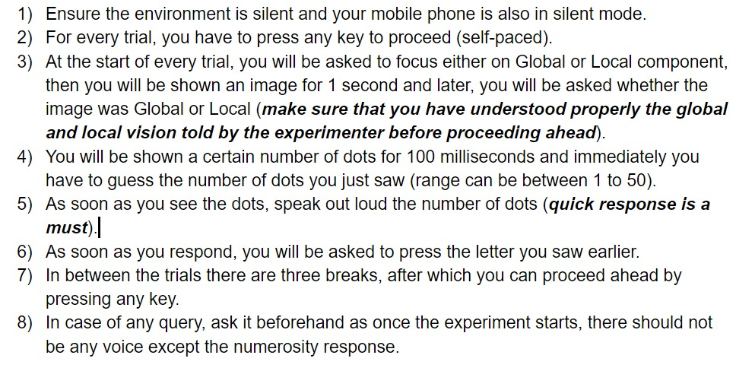
Experiment Instructions

Slide 17
Participants
Demo was provided to every participant to train them for the task beforehand
Randomly 25 IIIT Hyderabad students were chosen
Age range was between 20-28 years
All were from Research Background
Experiment was of 30 minutes
Water Breaks were provided at equal interval to prevent fatigue
Approximately equal number of participants from both the genders

Slide 18
Experimental Setup
Silent Room
Same System setup for each participant
Same number of breaks for each participant at equal gaps for performing through 240 trials
Participants were made to sit on stable chair at fixed distance from the screen
Same mic array with equal threshold were used to record the reaction time
Response were recorded both manually and automatically to avoid errors

Slide 19
5. Data Analysis
Analysis was done only on correct trials based on Global/Local processing
Repeated ANOVA Test was used
Plots were made for comparing Average Reaction time and Average difference in numerosity response for Global Processing and Local Processing for different Numerosities.

Slide 20
Analysis Results
Data was analyzed using Repeated ANOVA measure.
Main Effect of Global/Local Condition : F(1,22)=1.136 and p=0.298
Effect of Numerosity: F(11,242)=36.206 and p<0.001
Interaction Effect of Condition and Numerosity: F(11,242)=.291 and p=0.987

Slide 21
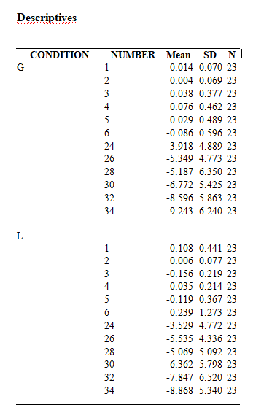

Slide 22
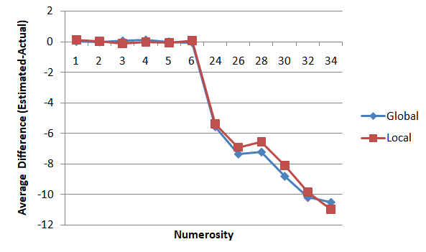
Average Estimation Range vs Numerosity

Slide 23
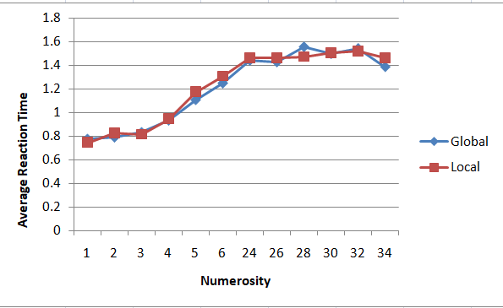
Average Reaction Time vs Numerosity

Slide 24
5. Conclusion
Alternate Hypothesis is “Rejected”
Null Hypothesis “Holds True”
Hence, “Global/Local Processing has no effect on the accuracy of the Numerosity Estimation and Reaction Time.”

Slide 25
Possible Explainations for Null Result
It may be a possibility that there is no relation between Numerosity Estimation and Global/ Local Processing.
It may be possible that there was high task load on the working memory as both G/L information and Numerosity were getting stored in working memory at the same time which affected the estimation.
It may be possible that participants didn’t put effort for estimating the number of dots, rather they chose their favorite numbers to estimate and repeated them.

Slide 26
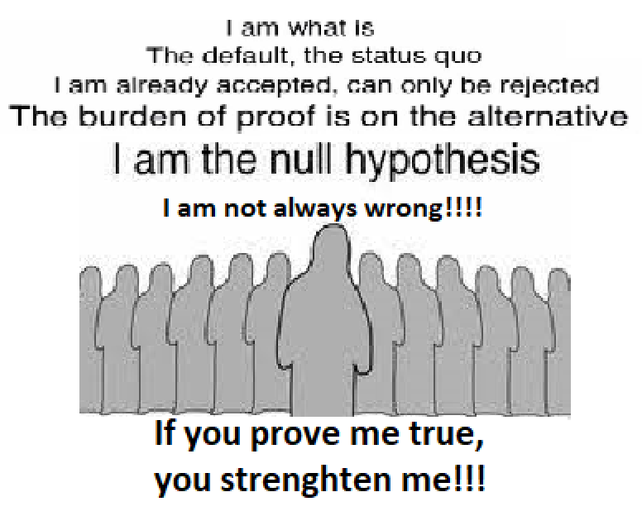

Slide 27
References
https://www.ncbi.nlm.nih.gov/pmc/articles/PMC2903696/
https://www.ncbi.nlm.nih.gov/pubmed/11892776
Research Methodology Class Slides
https://www.statisticssolutions.com/conduct-interpret-repeated-measures-anova

Slide 28
Thank You

