Slide 1

TRANSACTION
-Module 03
Apoorva V C
Aishwarya B S
POOJA P SHETTY

Slide 2

TASKS DONE BY OUR MODULe
Customer Login
Add a new Payee
Modify existing payee
Make a new Payment
List all available Payee’s

Slide 3

Common task
List all available Payee’s of the customer who logged in
Done using SOAP web service
.
MY TASK
.
Make a new Transaction:
Make a new payment to any of the available Payee’s
Insert a new transaction record in the transaction table
Done using REST web service
.

Slide 4
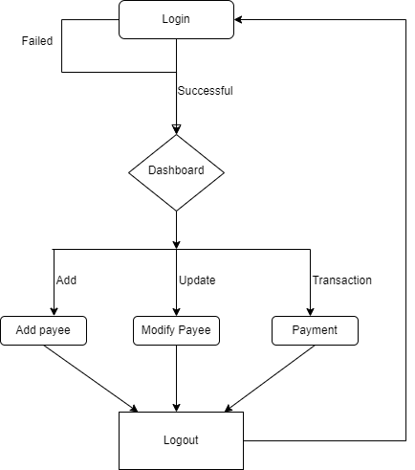

FLOW CHART
.

Slide 5
.
THANK YOU

