Slide 1
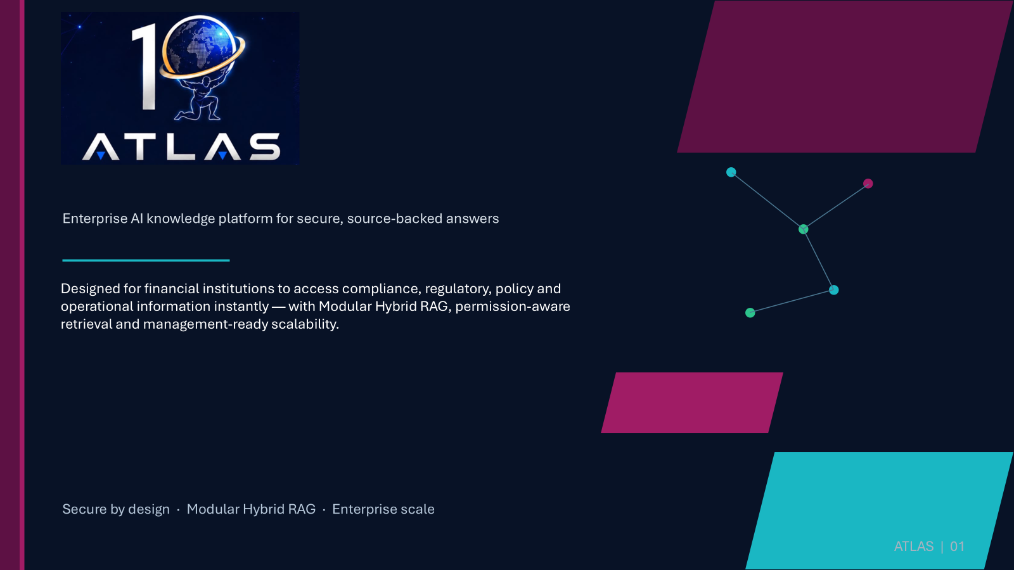
ATLAS
Enterprise AI knowledge platform for secure, source-backed answers
Management-ready knowledge intelligence for financial institutions — unifying compliance, regulatory, policy and operational information through Modular Hybrid RAG and permission-aware retrieval.
Secure by design · Source-backed responses · Enterprise scale
ATLAS | 01

Slide 2
WHY CHANGE NOW?
Business Problem
Enterprise knowledge is scattered across teams, systems and repositories — slowing decisions and creating repeated manual effort.
1
High operational cost
Compliance documentation, employee queries and audits require significant manual effort and dedicated teams.
2
Slow information retrieval
Policies and regulatory documents are spread across repositories, delaying decisions and productivity.
Employees and control teams spend time locating, verifying and reconciling information instead of acting on it.
3
Increasing regulatory complexity
GDPR, PSD3, DORA, AML and local banking guidelines continue to evolve across countries.
4
Massive document volume
Millions of policies, circulars, reports, procedures, contracts and customer documents are hard to search accurately.
5
Knowledge silos
Critical information lives across multiple systems, preventing a complete and consistent answer.
ATLAS | 02

Slide 3
CENTRALIZED AI KNOWLEDGE ACCESS
Our Solution – ATLAS
Employees ask questions in natural language and receive contextual, reliable, source-backed answers in seconds.
Ask
Retrieve
Answer
Natural-language questions
Hybrid semantic + keyword search
Secure, contextual responses
Key capabilities
✓ AI-powered conversational search across enterprise knowledge
✓ Modular Hybrid RAG for high-accuracy responses
✓ Real-time retrieval from multiple document repositories
✓ Secure, permission-aware information access
✓ Multi-language support for global organizations
✓ Enterprise-grade scalability
ATLAS | 03

Slide 4
MANAGEMENT OUTCOMES
Business Value
ATLAS turns enterprise knowledge into a faster operating model — reducing manual effort while improving confidence in decisions.
01
02
03
04
Immediate response
Cost savings
Time savings
AI-powered response
Employees get answers instantly instead of reviewing hundreds of pages of documentation.
Automation lowers operational costs for compliance, audit support and employee assistance.
Teams spend less time searching and more time on value-added work.
The platform understands intent, retrieves relevant knowledge and generates contextual answers.
Net effect: faster response cycles, lower search burden and better-informed decisions across departments.
ATLAS | 04

Slide 5
WHO BENEFITS
User Personas
PERSONA 1
PERSONA 2
General Employees
Compliance & Audit Teams
Quick access to policies, procedures, compliance guidance, HR policies and product documentation.
Detailed access to regulatory documents, policy versions, audit evidence and historical records.
✓ Search with natural-language questions
✓ Filter by time, source and language
✓ Review cited summaries with confidence cues
✓ Save key documents and share feedback
✓ Monitor indexed documents, queries and usage
✓ Identify knowledge gaps and recommended fixes
✓ Analyze trends, confidence and coverage by topic
✓ Manage Confluence, Jira and SharePoint sync status
Outcome: faster self-service for day-to-day knowledge needs.
Outcome: stronger audit readiness and control visibility.
Shared need: one trusted source for accurate, contextual enterprise knowledge.
ATLAS | 05

Slide 6
BUILT FOR LARGE ENTERPRISES
Enterprise Scalability
ATLAS is designed to support enterprise-scale deployments across global financial institutions.
50,000+
Millions
High-volume
employees simultaneously
of enterprise documents
concurrent AI queries
Scalability requirements supported
Operating promise
✓ Multiple business units
✓ Continuous knowledge updates
✓ High availability and reliability
✓ Low-latency responses during peak workloads
Distributed services keep the platform available, reliable and responsive as usage scales across the enterprise.
ATLAS | 06

Slide 7
ARCHITECTURE VIEW
Solution Architecture – Modular Hybrid RAG
Combines semantic search, keyword search, vector databases and large language models to deliver accurate, scalable and maintainable answers.
Capture
Understand
Represent
Retrieve
Generate
Govern
User prompt
Content +
metadata
Vector DB +
knowledge graph
Hybrid
retrieval
Summarize
response
Validation +
RBAC
Security and quality controls run across the architecture — from source access through response validation.
Accuracy
Scalability
Maintainability
Hybrid retrieval improves answer relevance.
Modular services evolve independently.
Components can be extended for future needs.
ATLAS | 07

Slide 8
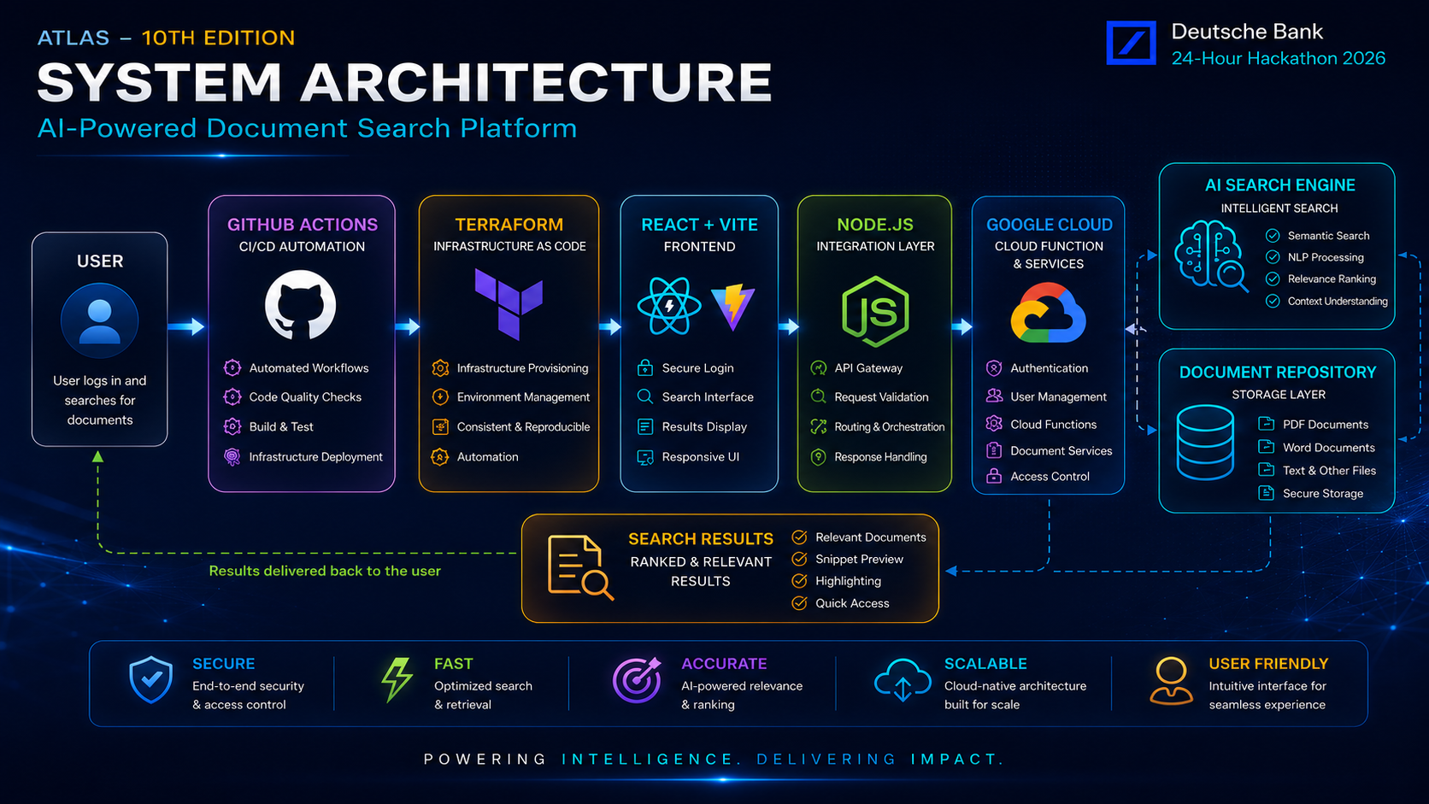
System Architecture
End-to-end view of retrieval, governance and response flow
ATLAS | 08

Slide 9
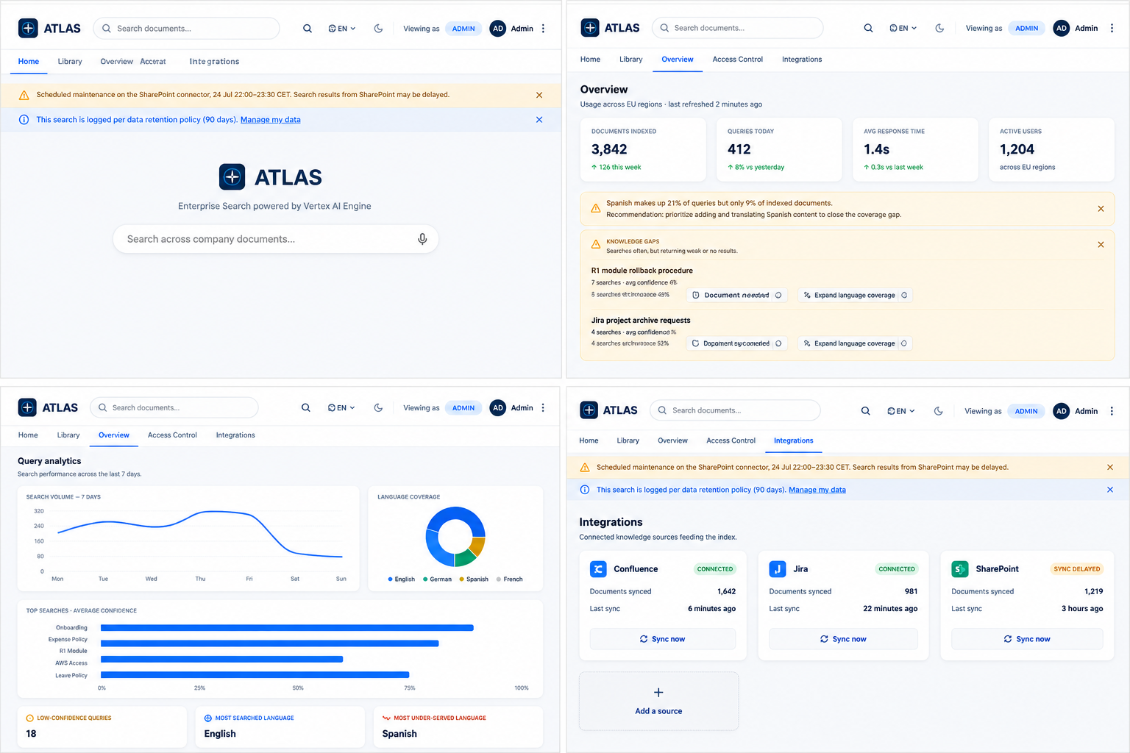

Slide 10
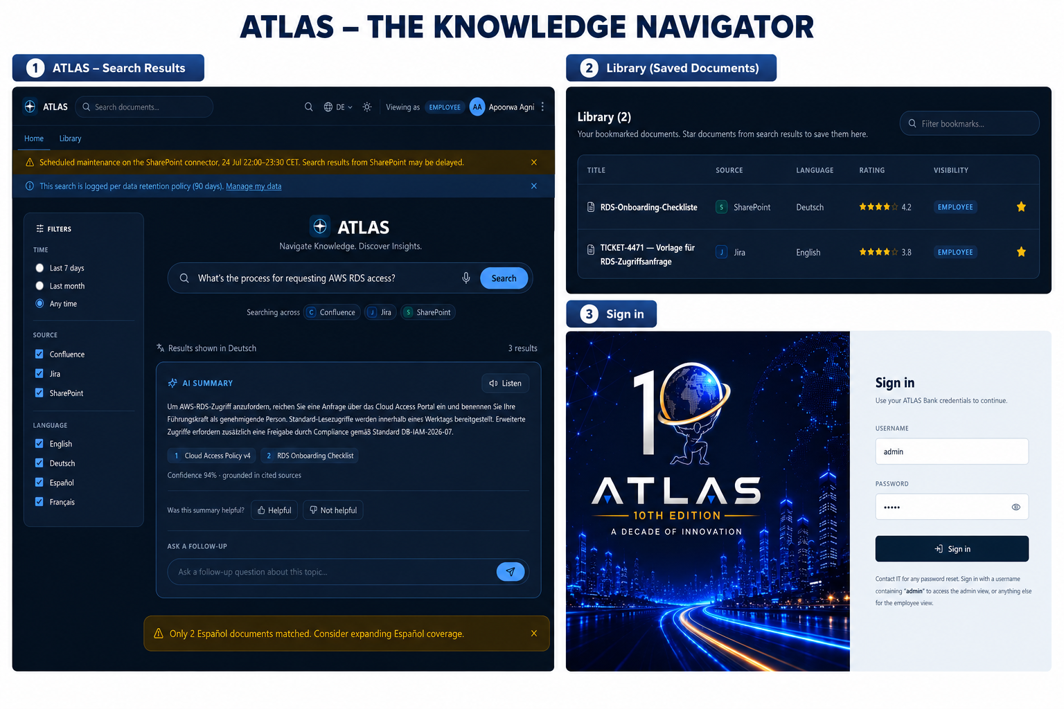

Slide 11
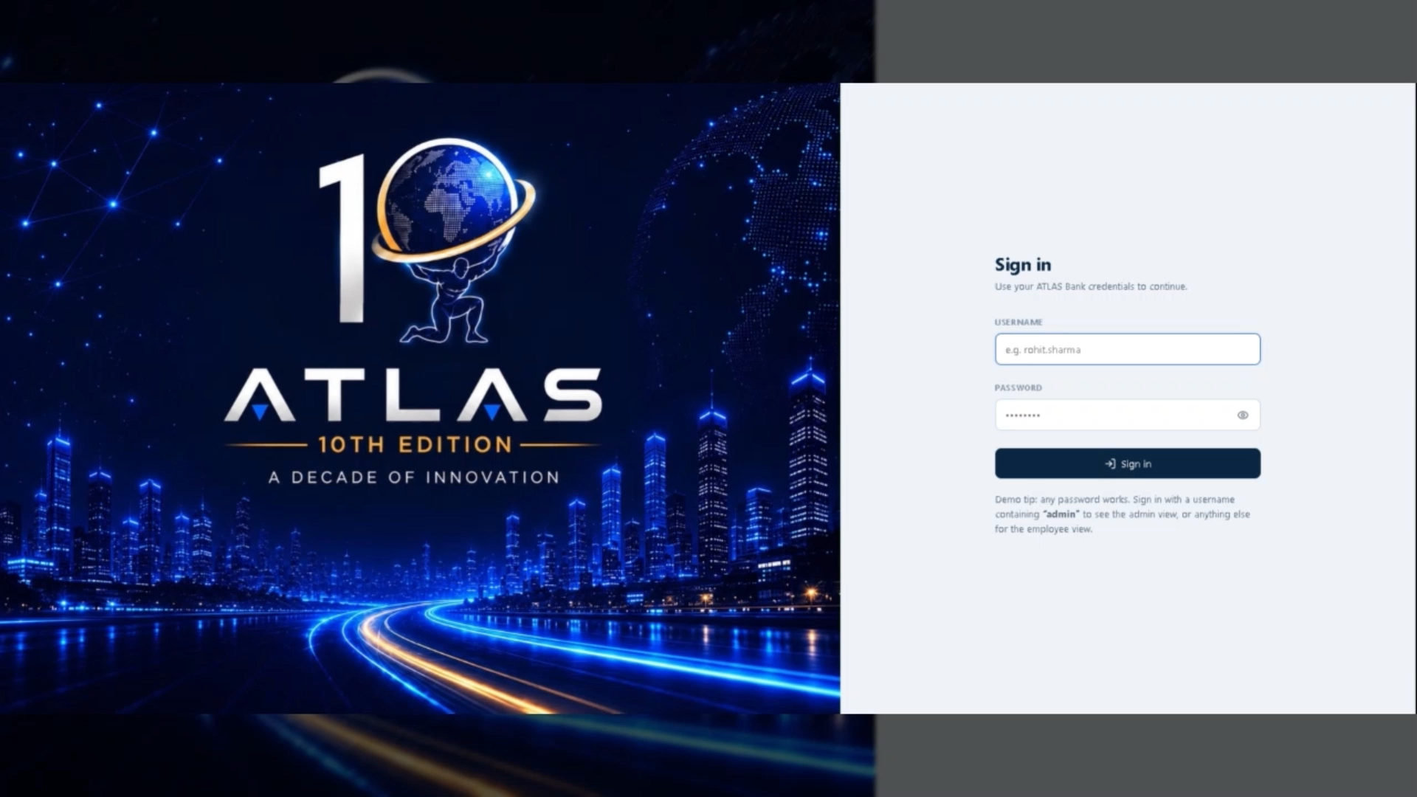

Slide 12
Permission-Based Security
Security is a critical requirement for banking organizations. ATLAS enforces strict Role-Based Access Control so users only access the documents and information they are authorized to view.
1
Authenticate
2
Authorize
3
Protect & audit
Confirm the user
Match role and department
Mask information and log activity
Core features
✓ User authentication
✓ Department permissions
✓ Role-based access
✓ Information masking
✓ Audit logs
✓ Secure AI responses
Outcome: confidential information stays protected while users get trusted answers.
ATLAS | 09

Slide 13
