Slide 1
SQLite
Different storage options in android are shared preferences, internal storage, external storage, SQLite storage, etc. to store and retrieve the application data based on the requirements.
In applications Shared Preferences, Internal Storage and External Storage options are useful to store and maintain a small amount of data.
In case, if we want to deal with large amounts of data, then SQLite database is the preferable option to store and maintain the data in a structured format.
SQLite is a Structure query base database, open source, light weight, no network access and standalone database
Android has built in SQLite database implementation.

Slide 2
SQLite
The database created is saved in a directory: data/data/APP_Name/databases/DATABASE_NAME.
Just like we save the files on the device’s internal storage, Android stores our database in a private disk space that’s associated with our application and the data is secure, because by default this area is not accessible to other applications.
The package android.database.sqlite contains all the required APIs to use an SQLite database in our android applications.

Slide 3
SQLite
Creating And Updating Database In Android
For creating, updating and other operations you need to create a subclass or SQLiteOpenHelper class.
SQLiteOpenHelper is a helper class to manage database creation and version management.
It provides two methods :
onCreate(SQLiteDatabase db)
onUpgrade(SQLiteDatabase db, int oldVersion, int newVersion).
The SQLiteOpenHelper is responsible for opening database if exist, creating database if it does not exists and upgrading if required.
The SQLiteOpenHelper only require the DATABASE_NAME to create database.
After extending SQLiteOpenHelper you will need to implement its methods onCreate, onUpgrade and constructor.

Slide 4
SQLite
Creating And Updating Database In Android
onCreate(SQLiteDatabase sqLiteDatabase) method is called only once throughout the application lifecycle.
It will be called whenever there is a first call to getReadableDatabase() or getWritableDatabase() function available in super SQLiteOpenHelper class.
So SQLiteOpenHelper class call the onCreate() method after creating database and instantiate SQLiteDatabase object. Database name is passed in constructor call.
onUpgrade(SQLiteDatabase db,int oldVersion, int newVersion) is only called whenever there is a updation in existing version. So to update a version we have to increment the value of version variable passed in the superclass constructor.

Slide 5
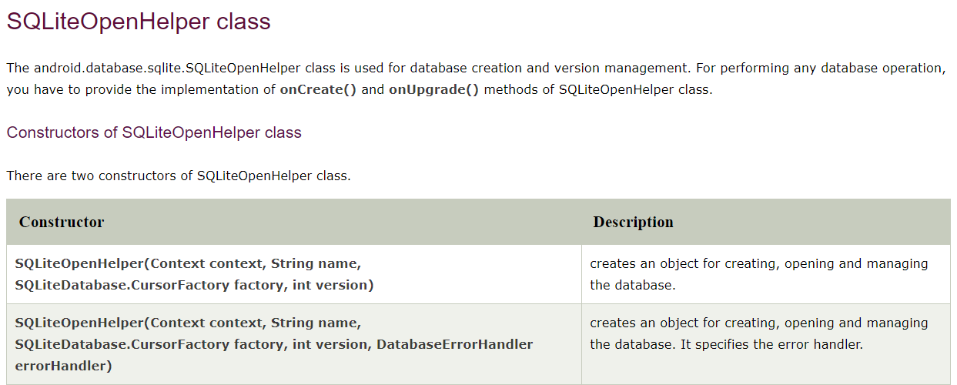
SQLite

Slide 6
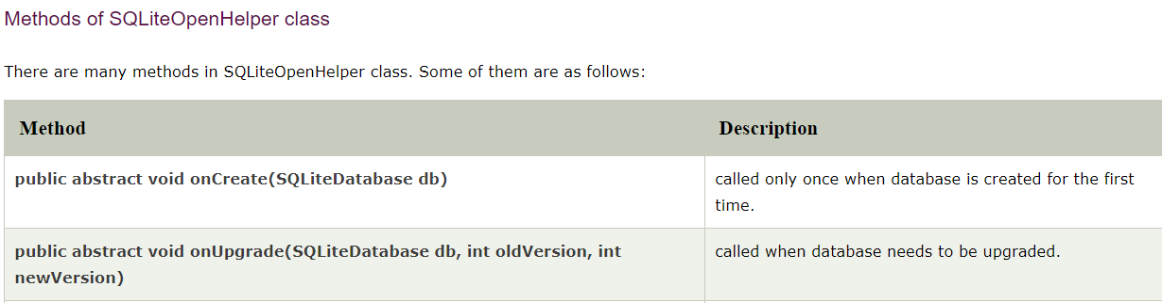
SQLite

Slide 7
SQLite
Constructor : This takes the Context (e.g., an Activity), the name of the database, an optional cursor factory and an integer representing the version of the database schema you are using (typically starting from 1 and increment later).
public DatabaseHelper(Context context) {
super(context, DB_NAME, null, DB_VERSION);
}
Cursor factory is used to allow returning sub-classes of Cursor when calling query. It is usually null here.

Slide 8
SQLite
onCreate(SQLiteDatabase db) : It’s called when there is no database and the app needs one. It passes us a SQLiteDatabase object, pointing to a newly-created database, that we can populate with tables and initial data.
onUpgrade(SQLiteDatabase db, int oldVersion, int newVersion) : It’s called when the schema version we need does not match the schema version of the database, It passes us a SQLiteDatabase object and the old and new version numbers. Hence we can figure out the best way to convert the database from the old schema to the new one.
We define a DBManager class to perform all database CRUD(Create, Read, Update and Delete) operations.
Before performing any database operations like insert, update, delete records in a table, first open the database connection by calling getWritableDatabase() method.

Slide 9
SQLite
Android SQLite Cursor
A Cursor represents the entire result set of the query. Once the query is fetched a call to cursor.moveToFirst() is made. Calling moveToFirst() does two things:
It allows us to test whether the query returned an empty set (by testing the return value)
It moves the cursor to the first result (when the set is not empty).

Slide 10
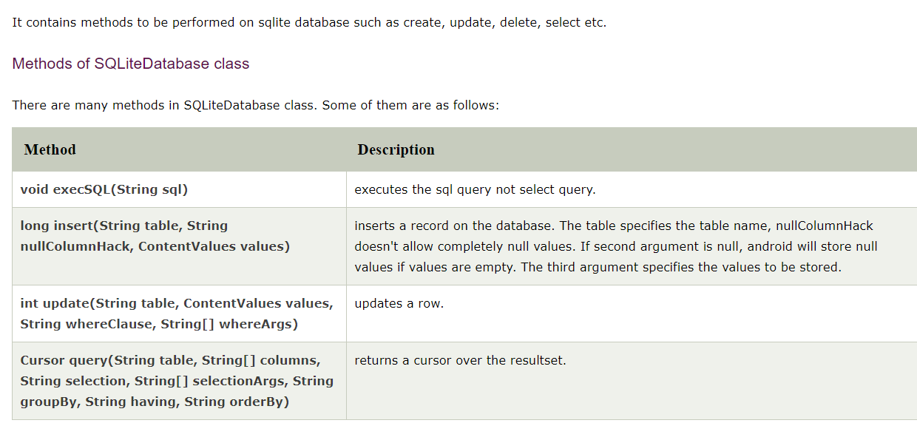
SQLite
SQLite Database class

Slide 11
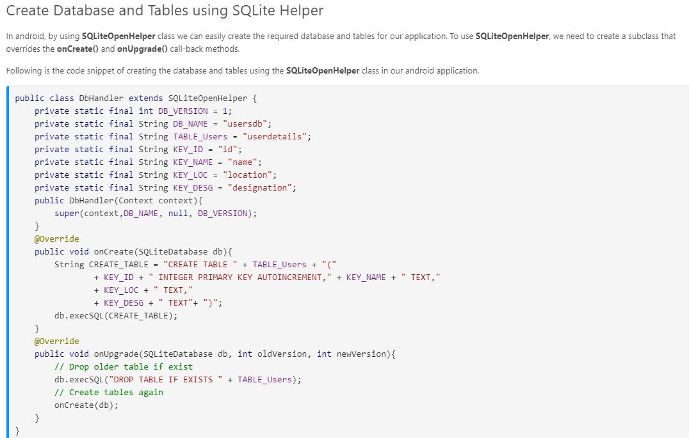
SQLite

Slide 12
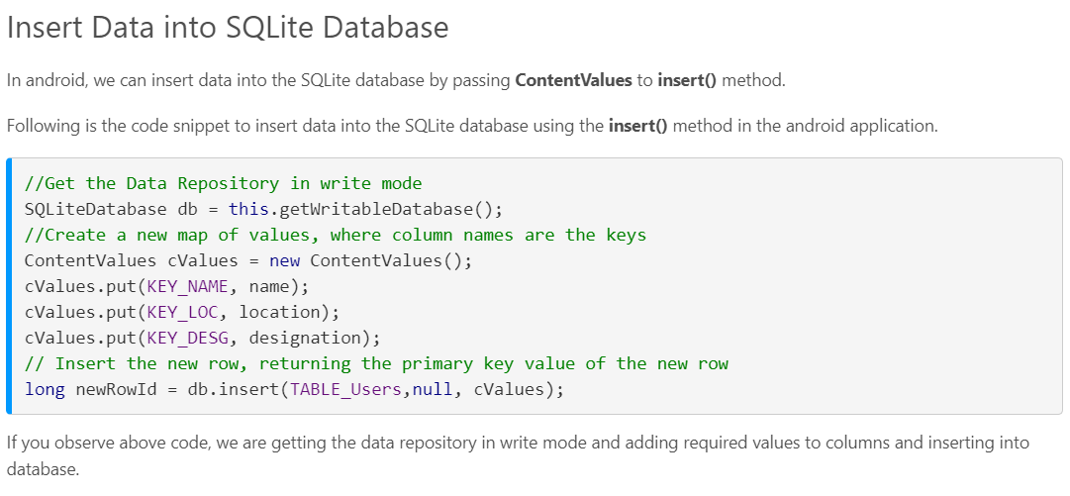
SQLite

Slide 13
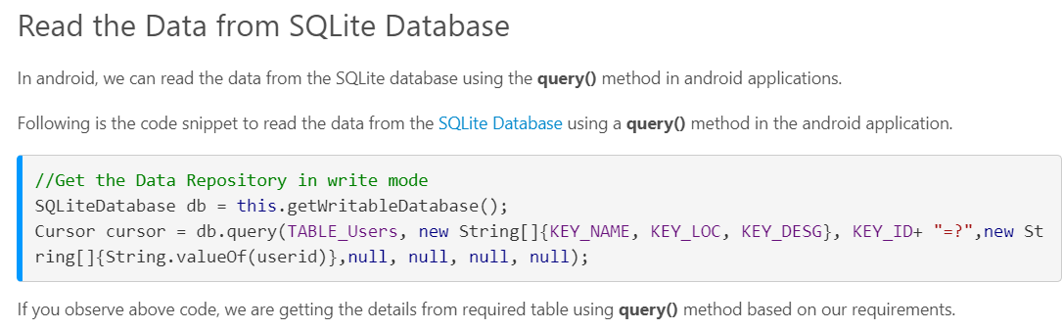
SQLite

Slide 14
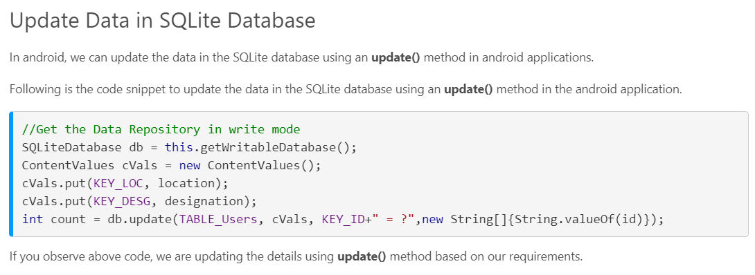
SQLite

Slide 15
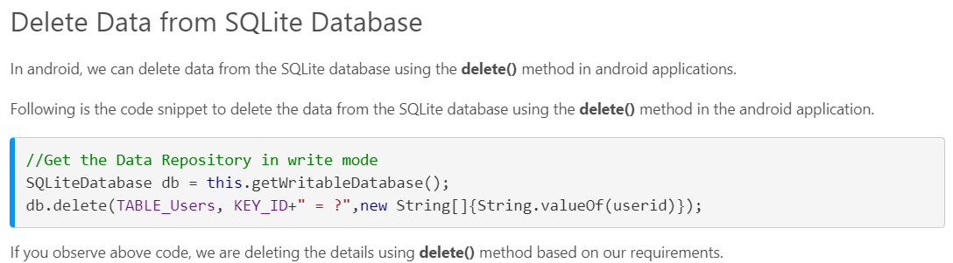
SQLite
https://www.tutlane.com/tutorial/android/android-sqlite-database-with-examples

Slide 16
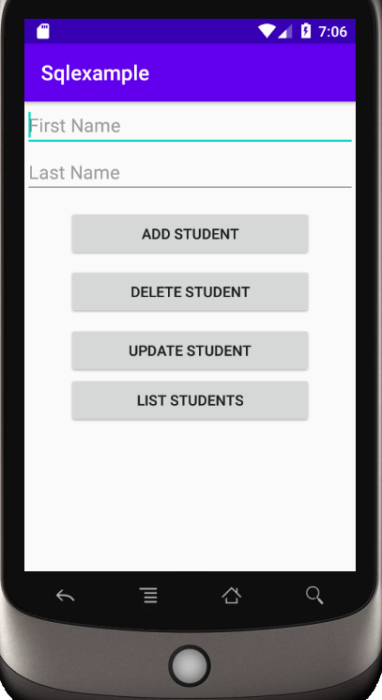
SQLite

Slide 17
SQLite
ActivityMain.xml
<?xml version="1.0" encoding="utf-8"?>
<RelativeLayout xmlns:android="http://schemas.android.com/apk/res/android"
xmlns:app="http://schemas.android.com/apk/res-auto"
xmlns:tools="http://schemas.android.com/tools"
android:layout_width="match_parent"
android:layout_height="match_parent"
tools:context=".MainActivity">
<EditText
android:id="@+id/fname"
android:layout_width="match_parent"
android:layout_height="wrap_content"
android:layout_alignParentStart="true"
android:layout_alignParentLeft="true"
android:layout_alignParentTop="true"
android:ems="10"
android:inputType="textPersonName"
android:hint="First Name" />
<EditText
android:id="@+id/lname"
android:layout_width="match_parent"
android:layout_height="wrap_content"
android:layout_alignParentStart="true"
android:layout_alignParentLeft="true"
android:layout_below="@+id/fname"
android:ems="10"
android:inputType="textPersonName"
android:hint="Last Name" />

Slide 18
SQLite
ActivityMain.xml
<Button
android:id="@+id/btnadd"
android:layout_width="236dp"
android:layout_height="wrap_content"
android:layout_alignParentTop="true"
android:layout_centerHorizontal="true"
android:layout_marginTop="103dp"
android:text="Add Student"
android:onClick="btn_click" />
<Button
android:id="@+id/btndel"
android:layout_width="236dp"
android:layout_height="wrap_content"
android:layout_alignParentTop="true"
android:layout_centerHorizontal="true"
android:layout_marginTop="159dp"
android:text="Delete Student"
android:onClick="btn_click" />

Slide 19
SQLite
ActivityMain.xml
<Button
android:id="@+id/btnupd"
android:layout_width="236dp"
android:layout_height="wrap_content"
android:layout_alignParentTop="true"
android:layout_centerHorizontal="true"
android:layout_marginTop="216dp"
android:text="Update Student"
android:onClick="btn_click" />
<Button
android:id="@+id/btnlis"
android:layout_width="236dp"
android:layout_height="wrap_content"
android:layout_below="@+id/btnupd"
android:layout_centerHorizontal="true"
android:onClick="btn_click"
android:text="List Students" />
<TextView
android:id="@+id/textView"
android:layout_width="302dp"
android:layout_height="180dp"
android:layout_below="@+id/btnlis"
android:layout_centerHorizontal="true" />
</RelativeLayout>

Slide 20
SQLite
MainActivity.Java
import androidx.appcompat.app.AlertDialog;
import androidx.appcompat.app.AppCompatActivity;
import android.content.DialogInterface;
import android.os.Bundle;
import android.view.View;
import android.widget.EditText;
import android.widget.TextView;
public class MainActivity extends AppCompatActivity {
EditText fname,lname;
TextView list;
dbController dbc;
@Override
protected void onCreate(Bundle savedInstanceState) {
super.onCreate(savedInstanceState);
setContentView(R.layout.activity_main);
fname = findViewById(R.id.fname);
lname = findViewById(R.id.lname);
list = findViewById(R.id.textView);
dbc = new dbController(this, "", null, 1);
}

Slide 21
SQLite
public void btn_click(View v)
{switch(v.getId())
{
case R.id.btnadd:
dbc.insert(fname.getText().toString(),lname.getText().toString());
break;
case R.id.btndel:
dbc.delete(fname.getText().toString());
break;

Slide 22
SQLite
case R.id.btnupd:
AlertDialog.Builder dialog = new AlertDialog.Builder(MainActivity.this);
dialog.setTitle("Enter Firstname");
final EditText newFname = new EditText(this);
dialog.setView(newFname);
dialog.setPositiveButton("OK", new DialogInterface.OnClickListener() {
@Override
public void onClick(DialogInterface dialog, int which) {
dbc.update(fname.getText().toString(),newFname.getText().toString());
}
});
dialog.show();
break;
case R.id.btnlis:
dbc.list(list);
break;
}
}
}

Slide 23
SQLite
dbController.java
import android.content.ContentValues;
import android.content.Context;
import android.database.Cursor;
import android.database.sqlite.SQLiteDatabase;
import android.database.sqlite.SQLiteOpenHelper;
import android.widget.TextView;
import androidx.annotation.Nullable;
public class dbController extends SQLiteOpenHelper {
public dbController(@Nullable Context context, @Nullable String name, @Nullable SQLiteDatabase.CursorFactory factory, int version) {
super(context, "Test1.db", factory, version);
}
@Override
public void onCreate(SQLiteDatabase db) {
db.execSQL("CREATE TABLE STUDENT(FNAME TEXT,LNAME TEXT);");
}

Slide 24
SQLite
@Override
public void onUpgrade(SQLiteDatabase db, int oldVersion, int newVersion) {
db.execSQL("DROP TABLE IF EXISTS STUDENT");
onCreate(db);
}
public void insert(String a, String b)
{
ContentValues cv = new ContentValues();
cv.put("FNAME",a);
cv.put("LNAME",b);
this.getWritableDatabase().insert("STUDENT","",cv);
}
public void delete(String a) {
this.getWritableDatabase().delete("STUDENT", "FNAME='"+a+"'", null);
}

Slide 25
SQLite
public void update(String a, String aa)
{
this.getWritableDatabase().execSQL("UPDATE STUDENT SET FNAME = '"+aa+"' WHERE FNAME = '"+a+"';");
}
public void list(TextView tv) {
tv.setText("");
Cursor c = this.getReadableDatabase().rawQuery("SELECT * FROM STUDENT", null);
while (c.moveToNext()) {
tv.append(c.getString(0) + " " + c.getString(1) + "\n");
}
}
}

