Slide 1
View Animation
This is the simplest animation used in Android.
It define the properties of our Views that should be animated using a technique called Tween Animation.
It take the following parameters i.e. size, time duration , rotation angle, start value , end value, and perform the required animation on that object.
You can execute the animation by specifying transformations on your View. This can be done in XML resource files or programmatically.
The drawback of this mechanism is that it can only be applied to Views

Slide 2
How To Create Anim Folder & Animation File In Android Studio [Step by Step]
How To Create Anim Folder & Animation File In Android Studio [Step by Step]
Step 1: Right click the res folder.
Then Go to res>New>Android resource directory as shown below:

Slide 3
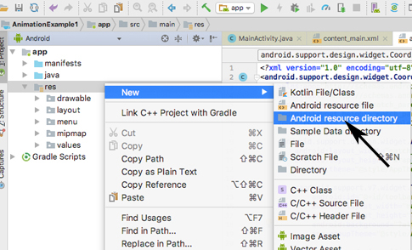
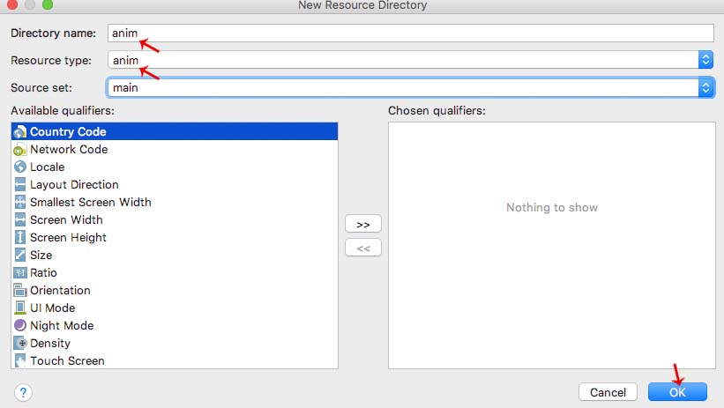
Step 2: Give the directory name as anim and change the resource type to anim or animator according to your choice

Slide 4
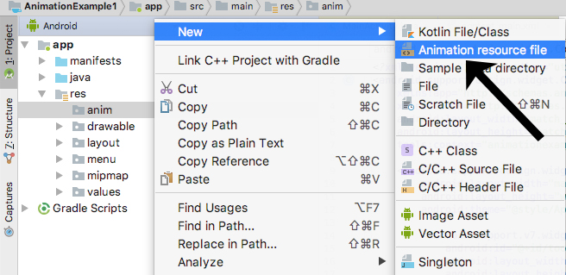
Step 3: Now anim folder is created. Right click on the anim. Then go to anim > New> Animation resource file.

Slide 5
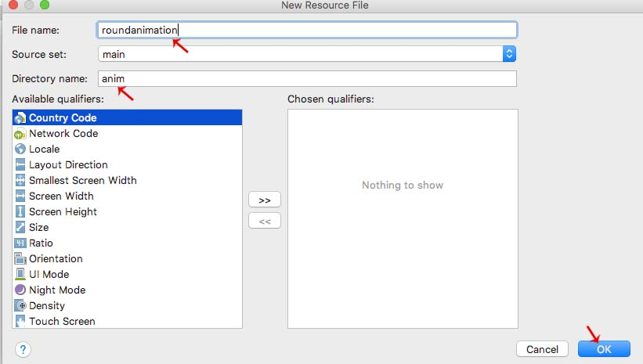
Step 4: Give the file any name and click OK. In our case we named it as roundanimation.xml

Slide 6
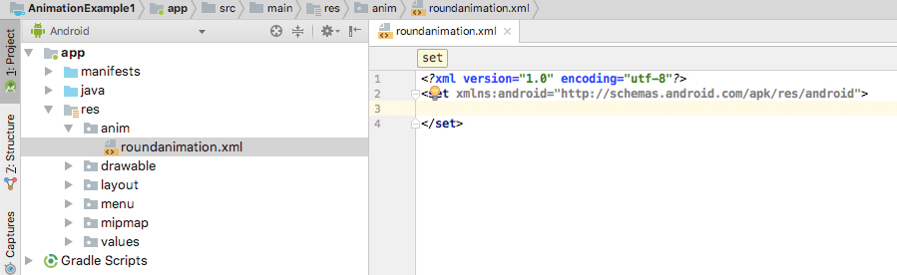
Step 5: Now our roundanimation.xml is created.

Slide 7
Tween Animation
Tween Animation takes some parameters such as start value , end value, size , time duration , rotation angle e.t.c and perform the required animation on that object. It can be applied to any type of object. So in order to use this , android has provided us a class called Animation.
In order to perform animation in android , we are going to call a static function loadAnimation() of the class AnimationUtils.
We are going to receive the result in an instance of Animation Object. Its syntax is as follows −
Animation animation = AnimationUtils.loadAnimation(getApplicationContext(), R.anim.myanimation);
Note the second parameter. It is the name of the our animation xml file.

Slide 8
Important XML Animation Attributes In Android:
android:duration: The duration in which animation is completed is referred to as duration attribute.
It refers to the ideal duration to show the transition on the screen.
android:duration="1500"
2. android:fillAfter: This attribute defines whether the view should be visible or not at the end of the animation.
We have set its value true in our animation. If it would set to false then element changes comes to its previous state after the animation.
android:fillAfter="true"
3. android:interpolator: This property refers to the rate of change in animation. You can define your own interpolators using the time as the constraint.
In this animation we have used an inbuilt interpolator i.e. linear interpolator.
android:interpolator="@android:anim/linear_interpolator"
4. android:startOffset: It refers to the waiting time before an animation starts.
android:startOffset="2000"
5. android:repeatMode: When user wants the animation to be repeated then this attribute is used
android:repeatMode="restart"
6. android:repeatCount: This attribute defines the number of repetitions on animation.
android:repeatCount="infinite"

Slide 9
In order to apply this animation to an object , we will just call the startAnimation() method of the object. Its syntax is −
ImageView image1 = (ImageView)findViewById(R.id.imageView1);
image.startAnimation(animation);

Slide 10
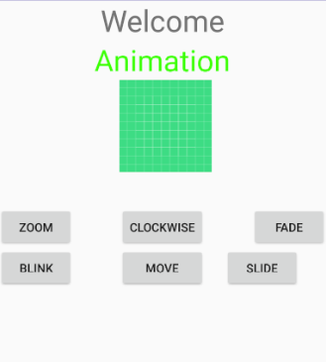
Animation

Slide 11
Animation
ActivityMain.xml
<RelativeLayout xmlns:android="http://schemas.android.com/apk/res/android" xmlns:tools="http://schemas.android.com/tools" android:layout_width="match_parent" android:layout_height="match_parent" tools:context=".MainActivity"> <TextView android:layout_width="wrap_content" android:layout_height="wrap_content" android:text="Welcome" android:id="@+id/textView" android:textSize="35dp" android:layout_alignParentTop="true" android:layout_centerHorizontal="true" /> <TextView android:layout_width="wrap_content" android:layout_height="wrap_content" android:text="Animation" android:id="@+id/textView2" android:textColor="#ff3eff0f" android:textSize="35dp" android:layout_below="@+id/textView" android:layout_centerHorizontal="true" /> <ImageView android:layout_width="wrap_content" android:layout_height="wrap_content" android:id="@+id/imageView" android:src="@drawable/ic_launcher_background" android:layout_below="@+id/textView2" android:layout_alignRight="@+id/textView2" android:layout_alignEnd="@+id/textView2" android:layout_alignLeft="@+id/textView" android:layout_alignStart="@+id/textView"/>

Slide 12
Animation
<Button
android:layout_width="wrap_content"
android:layout_height="wrap_content"
android:text="zoom"
android:id="@+id/button"
android:layout_below="@+id/imageView"
android:layout_alignParentLeft="true"
android:layout_alignParentStart="true"
android:layout_marginTop="40dp"
android:onClick="clockwise"/>
<Button
android:layout_width="wrap_content"
android:layout_height="wrap_content"
android:text="clockwise"
android:id="@+id/button2"
android:layout_alignTop="@+id/button"
android:layout_centerHorizontal="true"
android:onClick="zoom"/>
<Button
android:layout_width="wrap_content"
android:layout_height="wrap_content"
android:text="fade"
android:id="@+id/button3"
android:layout_alignTop="@+id/button2"
android:layout_alignParentRight="true"
android:layout_alignParentEnd="true"
android:onClick="fade"/>

Slide 13
Animation
<Button
android:layout_width="wrap_content"
android:layout_height="wrap_content"
android:text="blink"
android:onClick="blink"
android:id="@+id/button4"
android:layout_below="@+id/button"
android:layout_alignParentLeft="true"
android:layout_alignParentStart="true" />
<Button
android:layout_width="wrap_content"
android:layout_height="wrap_content"
android:text="move"
android:onClick="move"
android:id="@+id/button5"
android:layout_below="@+id/button2"
android:layout_alignRight="@+id/button2"
android:layout_alignEnd="@+id/button2"
android:layout_alignLeft="@+id/button2"
android:layout_alignStart="@+id/button2" />
<Button
android:layout_width="wrap_content"
android:layout_height="wrap_content"
android:text="slide"
android:onClick="slide"
android:id="@+id/button6"
android:layout_below="@+id/button3"
android:layout_toRightOf="@+id/textView"
android:layout_toEndOf="@+id/textView" />
</RelativeLayout>

Slide 14
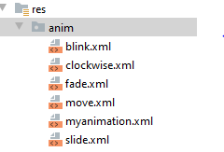
Animation
Create an anim folder under resource folder and create the animation xml files

Slide 15
Animation
MainActivity.Java
import androidx.appcompat.app.AppCompatActivity;
import android.os.Bundle;
import android.app.Activity;
import android.os.Bundle;
import android.view.View;
import android.view.animation.Animation;
import android.view.animation.AnimationUtils;
import android.widget.ImageView;
import android.widget.Toast;
public class MainActivity extends Activity {
@Override
protected void onCreate(Bundle savedInstanceState) {
super.onCreate(savedInstanceState);
setContentView(R.layout.activity_main);
}
public void clockwise(View view){
ImageView image = (ImageView)findViewById(R.id.imageView);
Animation animation = AnimationUtils.loadAnimation(getApplicationContext(),
R.anim.myanimation);
image.startAnimation(animation);
}

Slide 16
Animation
public void zoom(View view){
ImageView image = (ImageView)findViewById(R.id.imageView);
Animation animation1 = AnimationUtils.loadAnimation(getApplicationContext(),
R.anim.clockwise);
image.startAnimation(animation1);
}
public void fade(View view){
ImageView image = (ImageView)findViewById(R.id.imageView);
Animation animation1 =
AnimationUtils.loadAnimation(getApplicationContext(),
R.anim.fade);
image.startAnimation(animation1);
}
public void blink(View view){
ImageView image = (ImageView)findViewById(R.id.imageView);
Animation animation1 =
AnimationUtils.loadAnimation(getApplicationContext(),
R.anim.blink);
image.startAnimation(animation1);
}

Slide 17
Animation
public void move(View view){
ImageView image = (ImageView)findViewById(R.id.imageView);
Animation animation1 =
AnimationUtils.loadAnimation(getApplicationContext(), R.anim.move);
image.startAnimation(animation1);
}
public void slide(View view){
ImageView image = (ImageView)findViewById(R.id.imageView);
Animation animation1 =
AnimationUtils.loadAnimation(getApplicationContext(), R.anim.slide);
image.startAnimation(animation1);
}
}

Slide 18
Animation
Blink.xml
<?xml version="1.0" encoding="utf-8"?>
<set xmlns:android="http://schemas.android.com/apk/res/android">
<alpha android:fromAlpha="0.0"
android:toAlpha="1.0"
android:interpolator="@android:anim/accelerate_interpolator"
android:duration="600"
android:repeatMode="reverse"
android:repeatCount="infinite"/>
</set>

Slide 19
Animation
Clockwise.xml
<?xml version="1.0" encoding="utf-8"?>
<set xmlns:android="http://schemas.android.com/apk/res/android">
<rotate xmlns:android="http://schemas.android.com/apk/res/android"
android:fromDegrees="0"
android:toDegrees="360"
android:pivotX="50%"
android:pivotY="50%"
android:duration="5000" >
</rotate>
<rotate xmlns:android="http://schemas.android.com/apk/res/android"
android:startOffset="5000"
android:fromDegrees="360"
android:toDegrees="0"
android:pivotX="50%"
android:pivotY="50%"
android:duration="5000" >
</rotate>
</set>

Slide 20
Animation
fade.xml
<?xml version="1.0" encoding="utf-8"?>
<set xmlns:android="http://schemas.android.com/apk/res/android"
android:interpolator="@android:anim/accelerate_interpolator" >
<alpha
android:fromAlpha="0"
android:toAlpha="1"
android:duration="2000" >
</alpha>
<alpha
android:startOffset="2000"
android:fromAlpha="1"
android:toAlpha="0"
android:duration="2000" >
</alpha>
</set>

Slide 21
Animation
move.xml
<?xml version="1.0" encoding="utf-8"?>
<set
xmlns:android="http://schemas.android.com/apk/res/android"
android:interpolator="@android:anim/linear_interpolator"
android:fillAfter="true">
<translate
android:fromXDelta="0%p"
android:toXDelta="75%p"
android:duration="800" />
</set>

Slide 22
Animation
myanimation.xml
<?xml version="1.0" encoding="utf-8"?>
<set xmlns:android="http://schemas.android.com/apk/res/android">
<scale xmlns:android="http://schemas.android.com/apk/res/android"
android:fromXScale="0.5"
android:toXScale="3.0"
android:fromYScale="0.5"
android:toYScale="3.0"
android:duration="5000"
android:pivotX="50%"
android:pivotY="50%" >
</scale>
<scale xmlns:android="http://schemas.android.com/apk/res/android"
android:startOffset="5000"
android:fromXScale="3.0"
android:toXScale="0.5"
android:fromYScale="3.0"
android:toYScale="0.5"
android:duration="5000"
android:pivotX="50%"
android:pivotY="50%" >
</scale>
</set>

Slide 23
Animation
slide.xml
<?xml version="1.0" encoding="utf-8"?>
<set xmlns:android="http://schemas.android.com/apk/res/android"
android:fillAfter="true" >
<scale
android:duration="500"
android:fromXScale="1.0"
android:fromYScale="1.0"
android:interpolator="@android:anim/linear_interpolator"
android:toXScale="1.0"
android:toYScale="0.0" />
</set>

