Slide 1
Fragments
Fragment is a part of an activity which enable more modular activity design.
Fragment is a kind of sub-activity.
It represents a behavior or a portion of user interface in an Activity.
We can combine multiple Fragments in single Activity to build a multi pane UI and reuse a Fragment in multiple Activities.
A fragment must always be embedded in an activity and the fragment’s life-cycle is directly affected by the host activity’s life-cycle.
In Android, Fragments have their own life cycle very similar to an Activity but it has extra events that are particular to the Fragment’s view hierarchy, state and attachment to its activity.

Slide 2
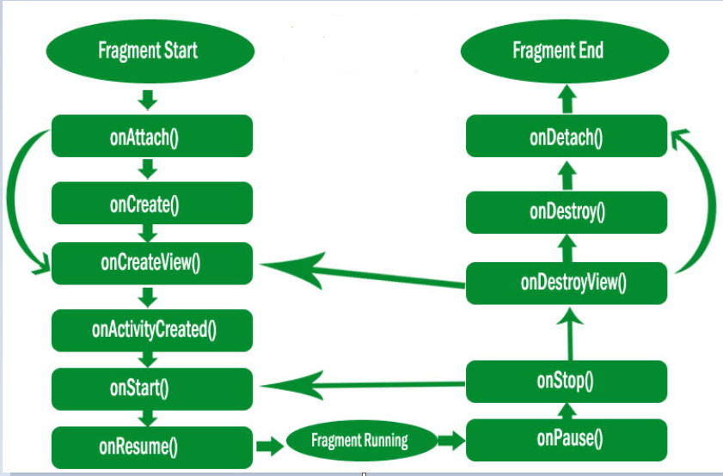
Fragments

Slide 3
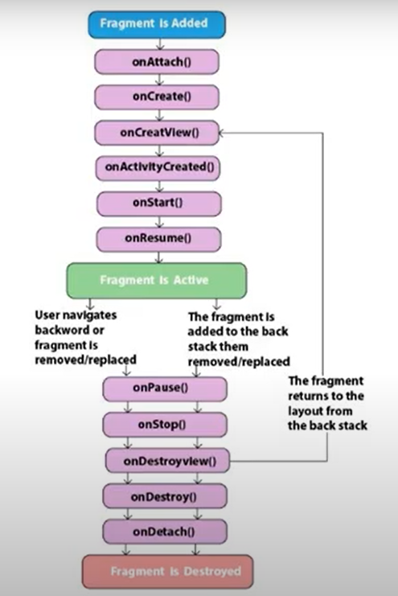

Slide 4
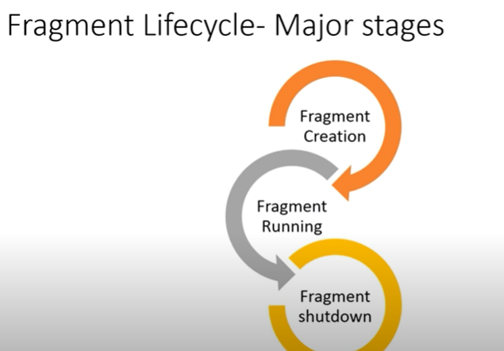
Fragments

Slide 5
Fragments
onAttach(): The fragment instance is associated with an activity instance. This method is called first, even before onCreate() method. This method let us know that our Fragment has been attached to an activity.
onCreate(): This will be called when creating the fragment. It means when a new fragment instance initializes, which always happens after it attaches to the host.
onCreateView(): The will be called when it’s time for the fragment to draw its UI(user interface) for the first time. To draw a UI for our fragment we must return a View component from this method that is the root of our fragment’s layout. We can also return null if the fragment does not provide a UI.
onViewCreated(): This will be called after onCreateView() method. This method is particularly useful when inheriting the onCreateView() method implementation but we need to configure the resulting views such as with a ListFragment and when to set up an adapter.

Slide 6
Fragments
onActivityCreated(): This method is called after the onCreateView() method when the host activity is created. This method indicates that the activity’s onCreate() has completed.
onStart(): This method is called once the fragment gets visible.
onResume(): This method is called when the Fragment is visible and interactable.
onPause(): This method is the first indication that the user is leaving the current fragment or fragment is no longer interactable. It occurs when any Fragment Transition processed or Fragment is removed.
onStop(): This method is called after onPause() method. Fragment going to be stopped by calling onStop(). This method calls when the Fragment is no longer visible. it occurs either after the fragment is about to be removed or Fragment Transition is processed(replace Fragment) or when the host activity stops.
onDestroyView(): This method is called when the view and other related resources created in onCreateView() method is removed from the activity’s view hierarchy and destroyed.

Slide 7
Fragments
onDestroy(): This method is called to do final clean up of the Fragment’s state but not guaranteed to be called by the Android platform. This method called after onDestroyView() method.
onDetach(): This method called after onDestroy() method to notify that the fragment has been disassociated from its hosting activity means Fragment is detached from its host Activity.

Slide 8
Fragments Activity Life Cycle
Fragment Lifecycle Example In Android Studio:
Below is the example of Fragment Life Cycle. In this example we show the use of Different callback methods of Fragment. In this we create a Activity and define a Fragment in Activity using <fragment> tag. In our Fragment i.e TestFragment we override all the methods and in each method we set a message that displays in our Log file.

Slide 9
Fragments Activity Life Cycle
Activitymain.xml
<RelativeLayout xmlns:android="http://schemas.android.com/apk/res/android"
xmlns:tools="http://schemas.android.com/tools"
android:layout_width="match_parent"
android:layout_height="match_parent"
tools:context=".MainActivity">
<!-- Take a fragment in our activity -->
<fragment
android:id="@+id/test_fragment"
class="com.sindhu.fraglifecycle.TestFragment"
android:layout_width="match_parent"
android:layout_height="match_parent"
tools:layout="@layout/fragment_test" />
</RelativeLayout>

Slide 10
Fragments Activity Life Cycle
Fragment_test.xml
<?xml version="1.0" encoding="utf-8"?>
<LinearLayout xmlns:android="http://schemas.android.com/apk/res/android"
android:layout_width="match_parent"
android:layout_height="match_parent"
android:orientation="vertical">
<!-- Create a TextView -->
<TextView
android:layout_width="match_parent"
android:layout_height="match_parent"
android:gravity="center"
android:text="Please Check Logcat.!!!"
android:textColor="#000"
android:textSize="25sp" />
</LinearLayout>

Slide 11
Fragments Activity Life Cycle
MainActivity.java
package com.sindhu.fraglifecycle;
import androidx.appcompat.app.AppCompatActivity;
import android.os.Bundle;
public class MainActivity extends AppCompatActivity {
@Override
protected void onCreate(Bundle savedInstanceState) {
super.onCreate(savedInstanceState);
setContentView(R.layout.activity_main);
}
}

Slide 12
Fragments Activity Life Cycle
TestFragment.java
package com.sindhu.fraglifecycle;
import android.annotation.TargetApi;
import android.app.Activity;
import android.app.Fragment;
import android.os.Build;
import android.os.Bundle;
import android.util.Log;
import android.view.LayoutInflater;
import android.view.View;
import android.view.ViewGroup;
public class TestFragment extends Fragment {
private void printLog(String s) {
// display a message in Log File
Log.d("LifeCycle:", s);
}

Slide 13
Fragments Activity Life Cycle
@Override
public void onActivityCreated(Bundle savedInstanceState) {
super.onActivityCreated(savedInstanceState);
printLog("onActivityCreated Called");
}
@Override
public View onCreateView(LayoutInflater inflater, ViewGroup container, Bundle savedInstanceState) {
View v = inflater.inflate(R.layout.fragment_test, container, false);
printLog("onCreateView Called");
return v;
}

Slide 14
Fragments Activity Life Cycle
@Override
public void onViewCreated(View view, Bundle savedInstanceState) {
super.onViewCreated(view, savedInstanceState);
printLog("onViewCreated Called");
}
@Override
public void onAttach(Activity activity) {
super.onAttach(activity);
printLog("onAttach Called");
}

Slide 15
Fragments Activity Life Cycle
@Override
public void onCreate(Bundle savedInstanceState) {
super.onCreate(savedInstanceState);
printLog("onCreate Called");
}
@Override
public void onDestroy() {
super.onDestroy();
printLog("onDestroy Called");
}

Slide 16
Fragments Activity Life Cycle
@Override
public void onDestroyView() {
super.onDestroyView();
printLog("onDestroyView Called");
}
@Override
public void onDetach() {
super.onDetach();
printLog("onDetach Called");
}
@Override
public void onPause() {
super.onPause();
printLog("onPause Called");
}

Slide 17
Fragments Activity Life Cycle
@Override
public void onResume() {
super.onResume();
printLog("onResume Called");
}
@Override
public void onStart() {
super.onStart();
printLog("onStart Called");
}
@Override
public void onStop() {
super.onStop();
printLog("onStop Called");
}
}

Slide 18
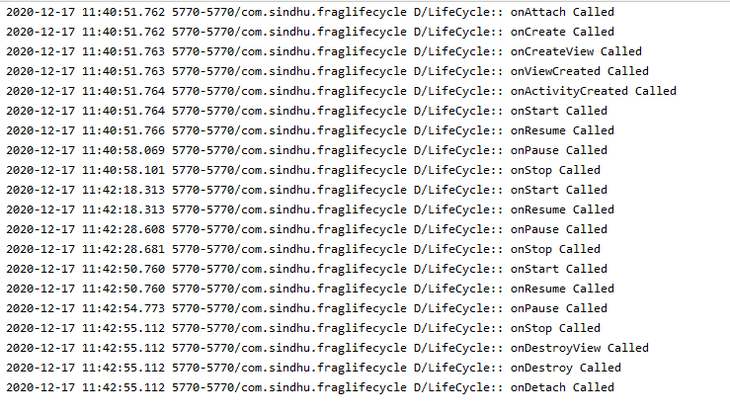
Fragments Activity Life Cycle

Slide 19
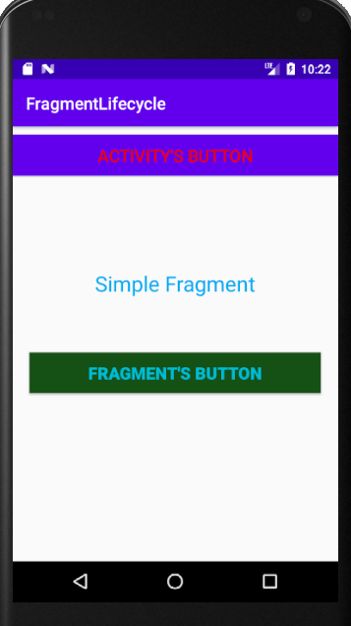
Fragments – Ex1

Slide 20
Fragments
Activitymain.xml
<LinearLayout xmlns:android="http://schemas.android.com/apk/res/android"
xmlns:tools="http://schemas.android.com/tools"
android:layout_width="match_parent"
android:layout_height="match_parent"
android:orientation="vertical"
tools:context=".MainActivity">
<!-- display a Button and a Fragment -->
<Button
android:id="@+id/activity_button"
android:layout_width="match_parent"
android:layout_height="wrap_content"
android:layout_marginTop="10dp"
android:background="@color/colorPrimary"
android:text="Activity's Button"
android:textColor="#EE0800"
android:textSize="20sp" />
<fragment
android:id="@+id/fragments"
android:name="com.sindhu.fragmentlifecycle.SimpleFragment"
android:layout_width="match_parent"
android:layout_height="match_parent"
android:layout_marginTop="10dp" />
</LinearLayout>

Slide 21
Fragments
fragmentsimple.xml
<?xml version="1.0" encoding="utf-8"?>
<RelativeLayout
xmlns:android="http://schemas.android.com/apk/res/android" android:layout_width="match_parent"
android:layout_height="match_parent">
<TextView
android:layout_width="wrap_content"
android:layout_height="wrap_content"
android:layout_centerHorizontal="true"
android:layout_marginTop="100dp"
android:text="Simple Fragment"
android:textColor="#03A9F4"
android:textSize="25sp" />
<Button
android:id="@+id/firstButton"
android:layout_width="fill_parent"
android:layout_height="wrap_content"
android:layout_centerInParent="true"
android:layout_marginLeft="20dp"
android:layout_marginRight="20dp"
android:background="#125014"
android:text="Fragment's Button"
android:textColor="#00BCD4"
android:textSize="20sp"
android:textStyle="bold" />
</RelativeLayout>

Slide 22
Fragments
Mainacitivty.java
package com.sindhu.fragmentlifecycle;
import android.os.Bundle;
import android.view.View;
import android.widget.Button;
import android.widget.Toast;
import androidx.appcompat.app.AppCompatActivity;
public class MainActivity extends AppCompatActivity {
Button activityButton;
@Override
protected void onCreate(Bundle savedInstanceState) {
super.onCreate(savedInstanceState);
setContentView(R.layout.activity_main);
activityButton = (Button) findViewById(R.id.activity_button);
activityButton.setOnClickListener(new View.OnClickListener() {
@Override
public void onClick(View v) {
Toast.makeText(getApplicationContext(), "Activity's Button", Toast.LENGTH_LONG).show();
}
});
}
}

Slide 23
Fragments
SimpleFragment.java
package com.sindhu.fragmentlifecycle;
import android.os.Bundle;
import android.view.LayoutInflater;
import android.view.View;
import android.view.ViewGroup;
import android.widget.Button;
import android.widget.Toast;
import androidx.fragment.app.Fragment;
public class SimpleFragment extends Fragment {
View view;
Button firstButton;
@Override
public View onCreateView(LayoutInflater inflater, ViewGroup container,Bundle savedInstanceState) {
// Inflate the layout for this fragment
view = inflater.inflate(R.layout.fragment_simple, container, false);
firstButton = (Button) view.findViewById(R.id.firstButton);
firstButton.setOnClickListener(new View.OnClickListener() {
@Override
public void onClick(View v) {
Toast.makeText(getActivity(), "Fragment's Button", Toast.LENGTH_LONG).show();
}
});
return view;
}
}

Slide 24
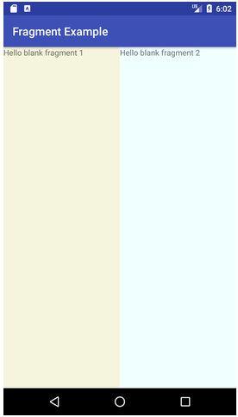
Fragments – Ex2

Slide 25
Fragments
Activitymain.xml
<?xml version="1.0" encoding="utf-8"?>
<LinearLayout xmlns:android="http://schemas.android.com/apk/res/android"
xmlns:app="http://schemas.android.com/apk/res-auto"
xmlns:tools="http://schemas.android.com/tools"
android:layout_width="fill_parent"
android:layout_height="fill_parent"
tools:context=".MainActivity">
<fragment
android:id="@+id/fragment1"
android:name=" com.sindhu.fragmentlifecycle. Fragment1"
android:layout_width=“match_parent"
android:layout_height="match_parent"
android:layout_weight="1"
/>
<fragment
android:id="@+id/fragment2"
android:name=" com.sindhu.fragmentlifecycle.Fragment2"
android:layout_width=“match_parent"
android:layout_height="match_parent"
android:layout_weight="1"
/>
</LinearLayout>

Slide 26
Fragments
fragment1.xml
<FrameLayout xmlns:android="http://schemas.android.com/apk/res/android"
xmlns:tools="http://schemas.android.com/tools"
android:layout_width="match_parent"
android:layout_height="match_parent"
android:background="#F5F5DC"
tools:context=".fragment1">
<!-- TODO: Update blank fragment layout -->
<TextView
android:layout_width="match_parent"
android:layout_height="match_parent"
android:text="@string/hello_blank_fragment" />
</FrameLayout>

Slide 27
Fragments
fragment2.xml
<FrameLayout xmlns:android="http://schemas.android.com/apk/res/android"
xmlns:tools="http://schemas.android.com/tools"
android:layout_width="match_parent"
android:layout_height="match_parent"
android:background="#F0FFFF"
tools:context=".Fragment2">
<!-- TODO: Update blank fragment layout -->
<TextView
android:layout_width="match_parent"
android:layout_height="match_parent"
android:text="@string/hello_blank_fragment" />
</FrameLayout>

Slide 28
Fragments
Fragment1.java
public class Fragment1 extends Fragment {
@Override
public void onCreate(Bundle savedInstanceState) {
super.onCreate(savedInstanceState);
}
@Override
public View onCreateView(LayoutInflater inflater, ViewGroup container,
Bundle savedInstanceState) {
// Inflate the layout for this fragment
return inflater.inflate(R.layout. fragment1, container, false);
}
}

Slide 29
Fragments
Fragment2.java
public class Fragment2 extends Fragment {
@Override
public void onCreate(Bundle savedInstanceState) {
super.onCreate(savedInstanceState);
}
@Override
public View onCreateView(LayoutInflater inflater, ViewGroup container,
Bundle savedInstanceState) {
// Inflate the layout for this fragment
return inflater.inflate(R.layout. fragment2, container, false);
}
}

