Slide 1
Menu
Menus are a common user interface component in many types of applications.
There are 3 types of menus in Android:
Option Menu
Context Menu
Pop-up Menu

Slide 2
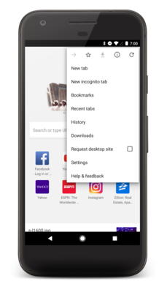
Menu
Options Menu
The options menu is the primary collection of menu items for an activity.
It's where you should place actions that have a overall impact on the app, such as Search, Compose Email and Settings.

Slide 3
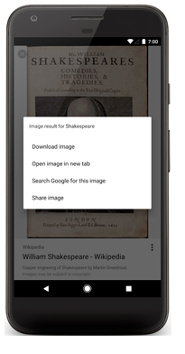
Menu
Context Menu
A context menu is a floating menu that appears when the user performs a long-click on an element.
It provides actions that affect the selected content or context frame.

Slide 4
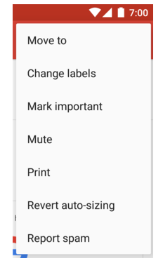
Menu
PopUp Menu
A popup menu displays a list of items in a vertical list that is anchored(sticked) to the view that invoked the menu.

Slide 5
Menu
How to create a Menu?
For all menu types mentioned above, Android provides a standard XML format to define menu items.
Instead of building a menu in your activity's code, you should define a menu and all its items in an XML menu resource.
You can then inflate the menu resource i.e load the XML files as a Menu object in your activity.

Slide 6
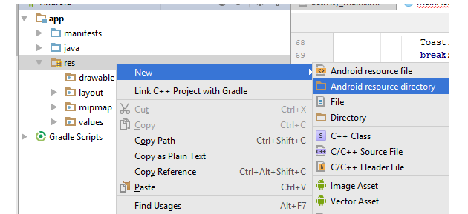
Menu
How to create a menu_file.xml file in menu directory?
To define the menu_file.xml file, first create a menu directory under res folder. This is done by right clicking on res --> new --> Android resource directory.

Slide 7
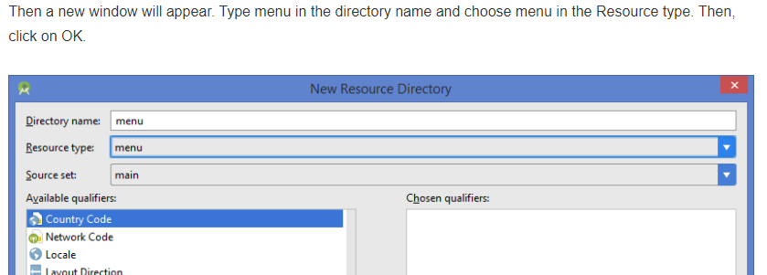
Menu

Slide 8
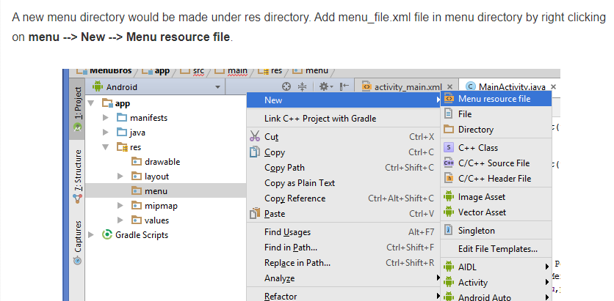
Menu

Slide 9
Menu
Give the name as menu_file.xml and click on Ok. The menu_file.xml file contains the following tags:
<menu>It defines a Menu, which is a container for menu items. A <menu> element must be the root node for the file and can hold one or more <item> and <group> elements.
<item>It creates a MenuItem, which represents a single item in a menu. This element may contain a nested <menu> element in order to create a submenu.
<group>It is an optional, invisible container for <item> elements. It allows you to categorize menu items so they share properties such as active state and visibility.

Slide 10
Options Menu
To make an option menu, we need to Override onCreateOptionsMenu() method as follows:
@Override
public boolean onCreateOptionsMenu(Menu menu) {
MenuInflater inflater = getMenuInflater();
inflater.inflate(R.menu.menu_file, menu);
return true;
}
MenuInflater inflater = getMenuInflater();
This gives a MenuInflater object that will be used to inflate(convert our XML file into Java Object)
inflater.inflate(R.menu.menu_file, menu);
inflate() method is used to inflate the menu_file.xml file.

Slide 11
Options Menu
Handling Click Events
When the user selects an item from the options menu, the system calls your activity's onOptionsItemSelected() method.
This method passes the MenuItem selected. You can identify the item by calling getItemId() method, which returns the unique ID for the menu item (defined by the android:id attribute in the menu resource).
You can match this ID against known menu items to perform the appropriate action.

Slide 12
Options Menu
@Override
public boolean onOptionsItemSelected(MenuItem item) {
//Handle item selection
switch (item.getItemId()) {
case R.id.i1:
//perform any action;
return true;
case R.id.a:
//perform any action;
return true;
case R.id.b:
//perform any action;
return true;
default:
return super.onOptionsItemSelected(item);
}
}

Slide 13
Options Menu
<?xml version="1.0" encoding="utf-8"?> <menu xmlns:android="http://schemas.android.com/apk/res/android" > <item android:id="@+id/search_item" android:title="Search" /> <item android:id="@+id/upload_item" android:title="Upload" /> <item android:id="@+id/copy_item" android:title="Copy" /> <item android:id="@+id/print_item" android:title="Print" /> <item android:id="@+id/share_item" android:title="Share" /> <item android:id="@+id/bookmark_item" android:title="BookMark" /> </menu>

Slide 14
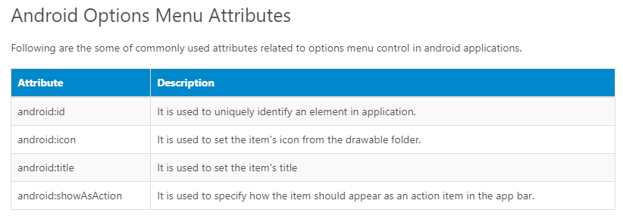
Options Menu

Slide 15
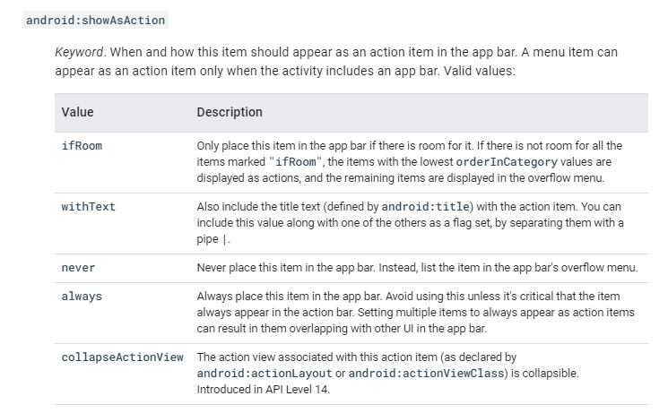
Options Menu

Slide 16
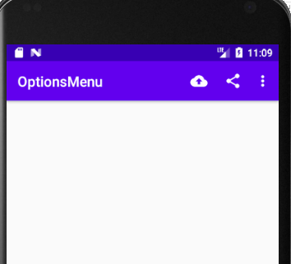
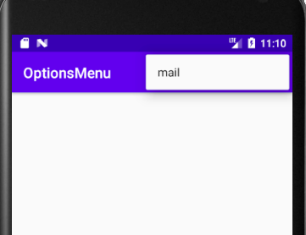
Options Menu - Example

Slide 17
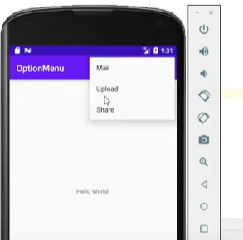
Options Menu - Example
<?xml version="1.0" encoding="utf-8"?>
<menu xmlns:app="http://schemas.android.com/apk/res-auto"
xmlns:android="http://schemas.android.com/apk/res/android">
<item android:id="@+id/mail"
android:title="mail"
/>
<item android:id="@+id/upload"
android:title="upload"
/>
<item android:id="@+id/share"
android:title="share"
/>
</menu>

Slide 18
Options Menu - Example
package com.sindhu.optionsmenu;
import androidx.annotation.NonNull;
import androidx.appcompat.app.AppCompatActivity;
import android.os.Bundle;
import android.view.ContextMenu;
import android.view.Menu;
import android.view.MenuInflater;
import android.view.MenuItem;
import android.widget.Toast;
public class MainActivity extends AppCompatActivity {
@Override
protected void onCreate(Bundle savedInstanceState) {
super.onCreate(savedInstanceState); setContentView(R.layout.activity_main);
}
@Override
public boolean onCreateOptionsMenu(Menu menu) {
MenuInflater inflater = getMenuInflater();
inflater.inflate(R.menu.optionmenu,menu);
return true;
}

Slide 19
Options Menu - Example
@Override
public boolean onOptionsItemSelected(@NonNull MenuItem item) {
switch (item.getItemId())
{
case R.id.mail : display("mail");
return true;
case R.id.upload : display("upload");
return true;
case R.id.share : display("share");
return true;
default:
return super.onOptionsItemSelected(item);
}}
void display(String text)
{ Toast.makeText(getApplicationContext(),text,Toast.LENGTH_LONG).show();
}}

Slide 20
Options Menu - Example
<?xml version="1.0" encoding="utf-8"?>
<menu xmlns:app="http://schemas.android.com/apk/res-auto"
xmlns:android="http://schemas.android.com/apk/res/android">
<item android:id="@+id/mail"
android:icon="@drawable/mail"
android:title="mail"
/>
<item android:id="@+id/upload"
android:icon="@drawable/upload"
android:title="upload"
app:showAsAction="ifRoom" />
<item android:id="@+id/share"
android:icon="@drawable/share"
android:title="share"
app:showAsAction="ifRoom" />
</menu>

Slide 22
Context Menu
To make a floating context menu, you need to follow the following steps:
Register the View to which the context menu should be associated by calling registerForContextMenu() and pass it the View.
If your activity uses a ListView or GridView and you want each item to provide the same context menu, you can register all items for a context menu by passing the ListView or GridView object to registerForContextMenu() method.
Implement the onCreateContextMenu() method in your Activity.
When the registered view receives a long-click event, the system calls your onCreateContextMenu() method. This is where you define the menu items, usually by inflating a menu resource.

Slide 23
Context Menu
@Override
public void onCreateContextMenu(ContextMenu menu, View v,
ContextMenuInfo menuInfo) {
super.onCreateContextMenu(menu, v, menuInfo);
MenuInflater inflater = getMenuInflater();
inflater.inflate(R.menu.menu_file, menu);
}
MenuInflater allows you to inflate the menu_file.xml file from a menu resource.
The method parameters include the View that the user selected and aContextMenu.
ContextMenuInfo object provides additional information about the item selected.
If your activity has several views such that each provide a different context menu, you might use these parameters to determine which context menu to inflate.

Slide 24
Context Menu
@Override
public void onCreateContextMenu(ContextMenu menu, View v,
ContextMenuInfo menuInfo) {
super.onCreateContextMenu(menu, v, menuInfo);
MenuInflater inflater = getMenuInflater();
inflater.inflate(R.menu.menu_file, menu);
}

Slide 25
Context Menu
Handling Click Events
When the user selects a menu item, the system calls onContextItemSelected() method so that you can perform the appropriate action.
@Override
public boolean onContextItemSelected(MenuItem item) {
switch (item.getItemId()) {
case R.id.i1:
//Perform any action;
return true;
case R.id.a:
//Perform any action;
return true;
case R.id.b:
//Perform any action;
return true;
default:
return super.onContextItemSelected(item);
}
}

Slide 26
Context Menu - Example
Activitymain.xml
<?xml version="1.0" encoding="utf-8"?>
<androidx.constraintlayout.widget.ConstraintLayout xmlns:android="http://schemas.android.com/apk/res/android"
xmlns:app="http://schemas.android.com/apk/res-auto"
xmlns:tools="http://schemas.android.com/tools"
android:layout_width="match_parent"
android:layout_height="match_parent"
tools:context=".MainActivity">
<TextView
android:id="@+id/text_view"
android:layout_width="wrap_content"
android:layout_height="wrap_content"
android:text="Hello World!"
android:textSize="20sp"
app:layout_constraintBottom_toBottomOf="parent"
app:layout_constraintLeft_toLeftOf="parent"
app:layout_constraintRight_toRightOf="parent"
app:layout_constraintTop_toTopOf="parent" />
</androidx.constraintlayout.widget.ConstraintLayout>

Slide 27
Context Menu - Example
Contextmenu.xml
<?xml version="1.0" encoding="utf-8"?>
<menu xmlns:android="http://schemas.android.com/apk/res/android">
<item
android:id="@+id/option1"
android:title="Option1"/>
<item
android:id="@+id/option2"
android:title="Option2"/>
</menu>

Slide 28
Context Menu - Example
import androidx.annotation.NonNull;
import androidx.appcompat.app.AppCompatActivity;
import android.os.Bundle;
import android.view.ContextMenu;
import android.view.MenuItem;
import android.view.View;
import android.widget.TextView;
import android.widget.Toast;
public class MainActivity extends AppCompatActivity {
@Override
protected void onCreate(Bundle savedInstanceState) {
super.onCreate(savedInstanceState);
setContentView(R.layout.activity_main);
TextView textView = findViewById(R.id.text_view);
registerForContextMenu(textView);
}

Slide 29
Context Menu - Example
@Override
public void onCreateContextMenu(ContextMenu menu, View v, ContextMenu.ContextMenuInfo menuInfo) {
super.onCreateContextMenu(menu, v, menuInfo);
menu.setHeaderTitle("Choose your option");
getMenuInflater().inflate(R.menu.contextmenu, menu);
}

Slide 30
Context Menu - Example
@Override
public boolean onContextItemSelected(@NonNull MenuItem item) {
switch (item.getItemId()) {
case R.id.option1:
Toast.makeText(getApplicationContext(), "option1 selected", Toast.LENGTH_SHORT).show();
return true;
case R.id.option2:
Toast.makeText(getApplicationContext(), "option2 selected", Toast.LENGTH_SHORT).show();
return true;
default:
return super.onContextItemSelected(item);
}
}
}

Slide 31
Popup Menu - Example
<?xml version="1.0" encoding="utf-8"?>
<androidx.constraintlayout.widget.ConstraintLayout xmlns:android="http://schemas.android.com/apk/res/android"
xmlns:app="http://schemas.android.com/apk/res-auto"
xmlns:tools="http://schemas.android.com/tools"
android:layout_width="match_parent"
android:layout_height="match_parent"
tools:context=".MainActivity">
<Button
android:layout_width="wrap_content"
android:layout_height="wrap_content"
android:text="show popup"
android:onClick="showpopup"
app:layout_constraintBottom_toBottomOf="parent"
app:layout_constraintLeft_toLeftOf="parent"
app:layout_constraintRight_toRightOf="parent"
app:layout_constraintTop_toTopOf="parent" />
</androidx.constraintlayout.widget.ConstraintLayout>

Slide 32
Popup Menu
Popupmenu.xml
<?xml version="1.0" encoding="utf-8"?>
<menu xmlns:android="http://schemas.android.com/apk/res/android">
<item
android:id="@+id/item1"
android:title="Item1"/>
<item
android:id="@+id/item2"
android:title="Item2"/>
</menu>

Slide 33
Popup Menu
package com.example.popupmenu;
import androidx.appcompat.app.AppCompatActivity;
import android.os.Bundle;
import android.view.MenuInflater;
import android.view.MenuItem;
import android.view.View;
import android.widget.PopupMenu;
import android.widget.Toast;
public class MainActivity extends AppCompatActivity implements PopupMenu.OnMenuItemClickListener {
@Override
protected void onCreate(Bundle savedInstanceState) {
super.onCreate(savedInstanceState);
setContentView(R.layout.activity_main);
}

Slide 34
Popup Menu
public void showpopup(View v)
{
PopupMenu popup = new PopupMenu(this, v);
popup.inflate(R.menu.popmenu);
popup.show();
popup.setOnMenuItemClickListener(this);
}

Slide 35
Popup Menu
@Override
public boolean onMenuItemClick(MenuItem item) {
switch (item.getItemId()) {
case R.id.item1:
Toast.makeText(getApplicationContext(), "option1 selected", Toast.LENGTH_SHORT).show();
return true;
case R.id.item2:
Toast.makeText(getApplicationContext(), "option2 selected", Toast.LENGTH_SHORT).show();
return true;
default:
return super.onContextItemSelected(item);
}
}
}

