Slide 1
About project2

Slide 2
Your task: predict the throughput
Input data: “training_data/trace*.json”. It consists of multiple records with the following fields
timestamp: the timestamp of the current record
speed: the normalized moving speed of the device (cell phone)
signal_strength: LTE signal strength (higher means stronger)
neighbour_cell_signal_strength: the signal strength of the neighbor cell
extra_event: the connectivity related event, can be “disconnected”, “handover-command” or “connection-request”
carrier_bandwidth: the available bandwidth measured inside the carrier, will not be affected by signal strength
throughput: the ground truth throughput, you need to predict this
During the testing, you will see all the fields EXCEPT the ground truth throughput. You need to generate your own prediction.

Slide 3
Introduction to timeline processing tool

Slide 4
Installation and running

Slide 5
Install the dependencies
The tool needs the following dependencies
Java runtime
Scala 2.13.8
Python3 with the following packages
notebook, pandas, numpy, matplotlib
We provide a helper script “install_dependency.sh” to install the dependencies
Use “bash install_dependency.sh” on your macbook/linux server will automatically install the dependencies for you
To check the installation, try opening a new shell and type “java” and “scala”

Slide 6
Run the example notebook
We provide an example jupyter notebook called “Example.ipynb”, you can run it with jupyter notebook
If you are not familiar with jupyter notebook
Navigate to the project folder, and type “python3 -m notebook”
It will try to automatically bring up your browser and show the notebook in the webpage

Slide 7
Overview of the tool

Slide 8
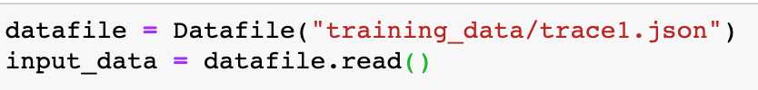
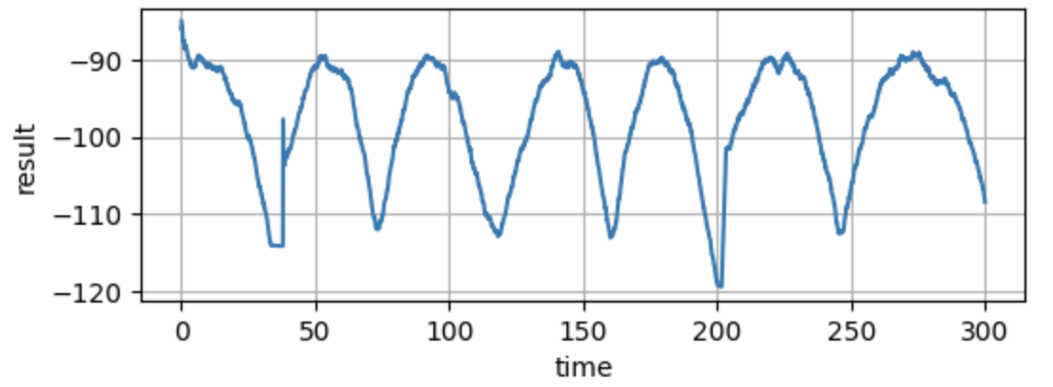

Overview
Read
Process
Visualize

Slide 9
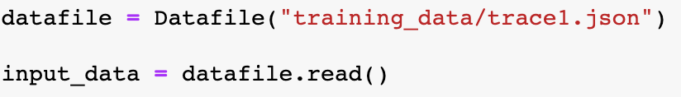
Open a data file for reading
The location of the file
The Datafile class, defined in data_parser.py
Read the datafile to an object of class “Timeline” (also defined in data_parser.py)

Slide 10
Get a field as a timeline (timeseries) from the datafile
Interface: “get()” method of a timeline object
Value type, can be one of “number”, “boolean” or “string” (case sensitive)
The field name you want to get
Returns a new Timeline object

Slide 11
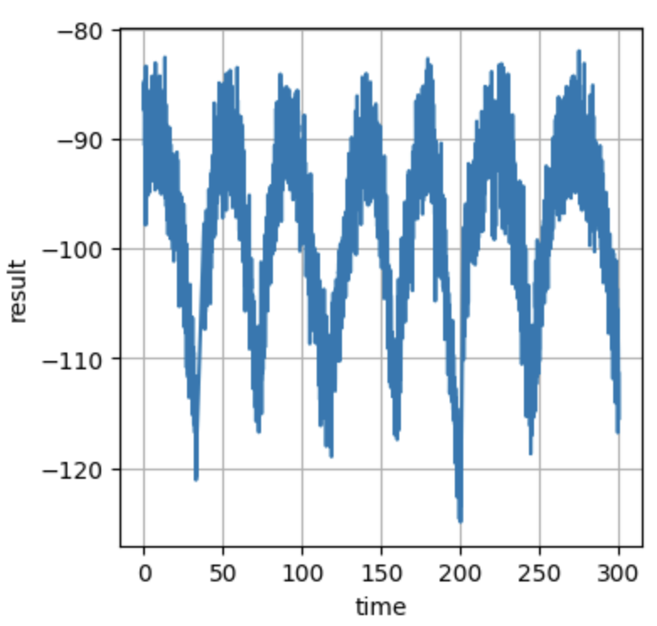
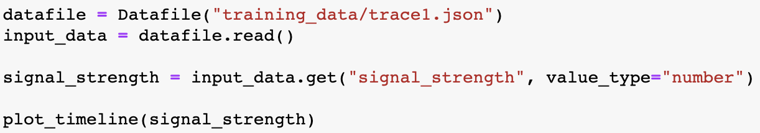
Visualize a single timeline
Function “plot_timeline(timeline: Timeline)”

Slide 12
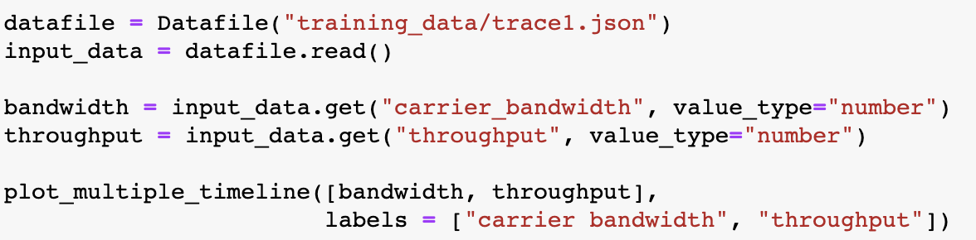
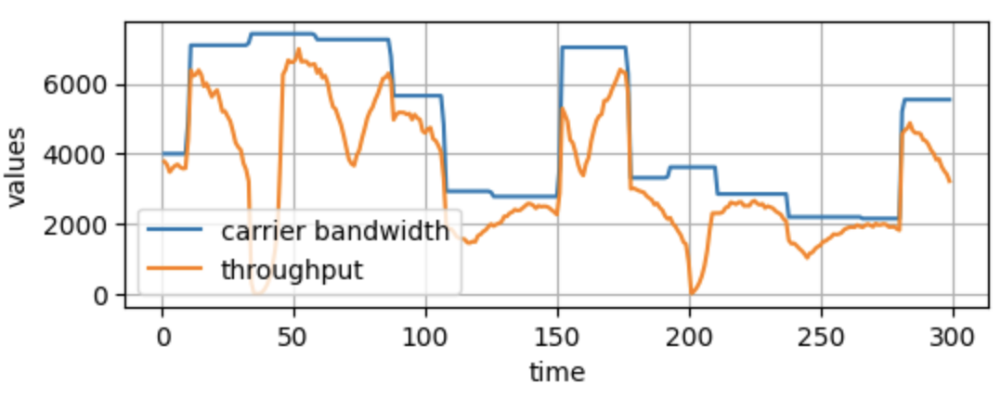
Visualize multiple timelines
Function “plot_multiple_timeline(timlines: List[Timeline], labels: list[String])”

Slide 13
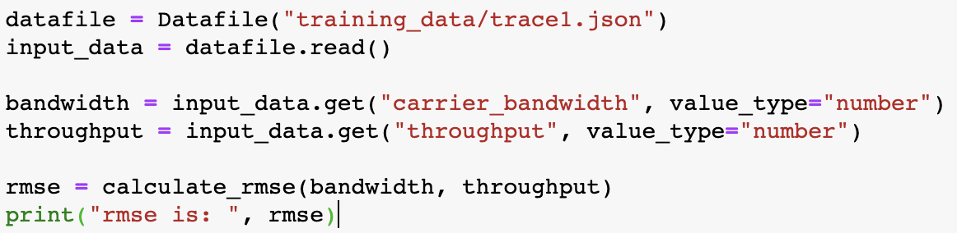
Compute the RMSE between 2 timelines
Function: “calculate_rmse(groundtruth: Timeline, prediction: Timeline)”
Output:
rmse is: 1970.3353746429768

Slide 14
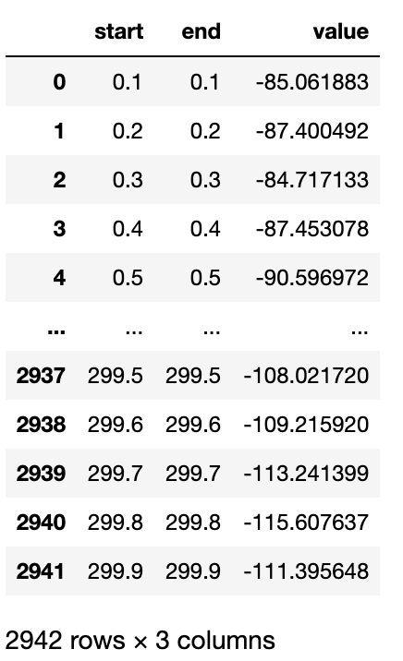
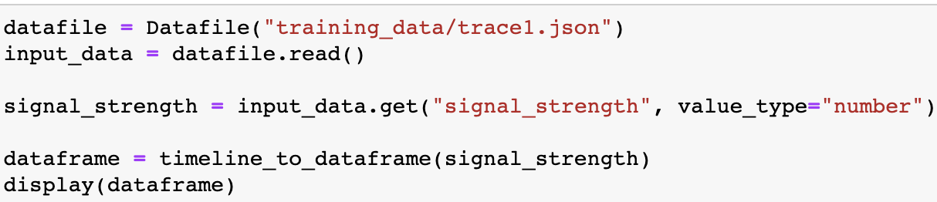
Convert a timeline object to pandas dataframe

Slide 15
Timeline operation references
Timeline operation usually takes 0 or 1 parameters, and returns a new timeline objects

Slide 16
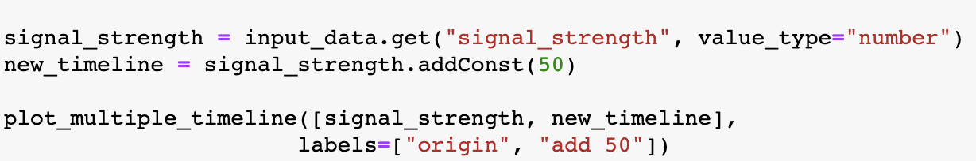
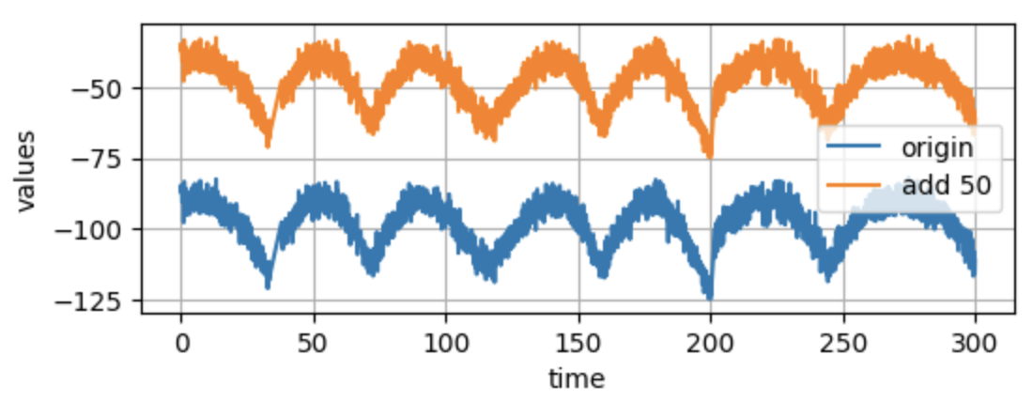
Timeline operation: addConst
Function: Timeline.addConst(value: float) -> Timeline
Add a const to the timeline

Slide 17
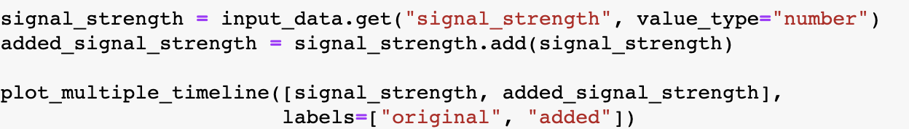
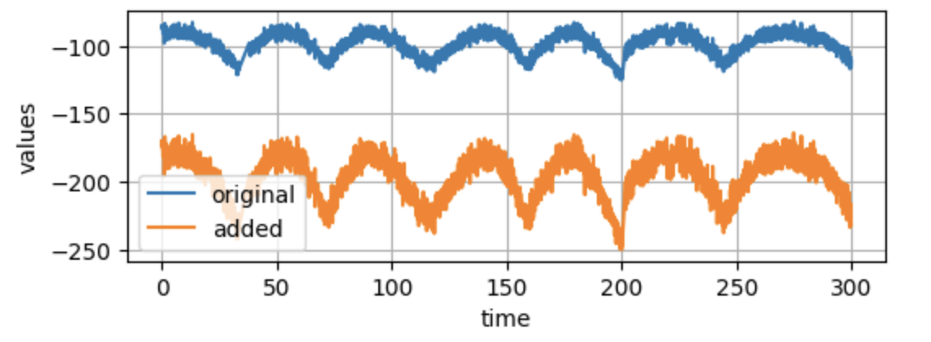
Timeline operation: add
Function: Timeline.add(other: Timeline) -> Timeline
Add to timelines together

Slide 18
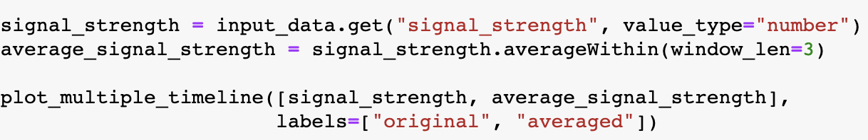
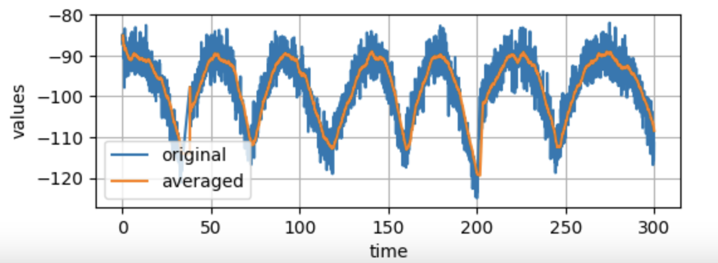

Timeline operation: averageWithin
Function: Timeline.averageWithin(window_len: float) -> Timeline
Compute the windowed average from $[t−window_len, t]$

Slide 19
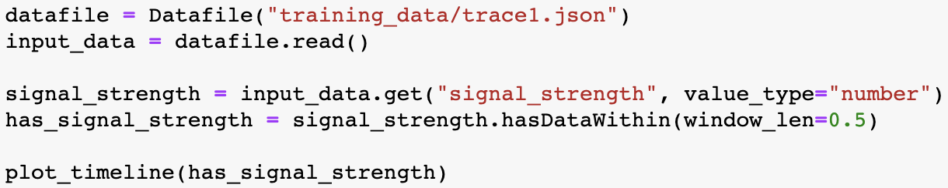
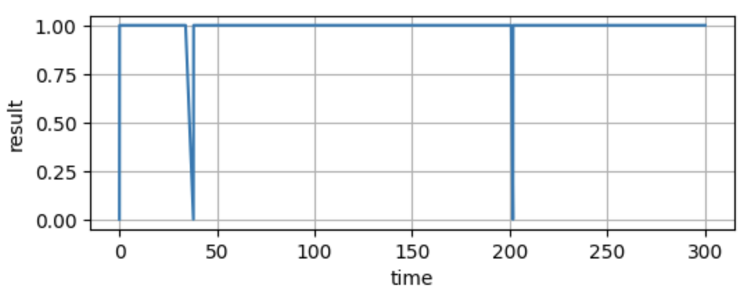

Timeline operation: hasDataWithin
Function: Timeline.hasDataWithin(window_len: float) -> Timeline
The value at time $t$ of the result timeline will be “True” if there is any datapoint in the old timeline within window$[t − window_len, t]$

Slide 20
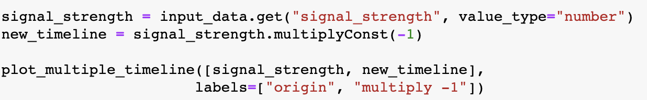
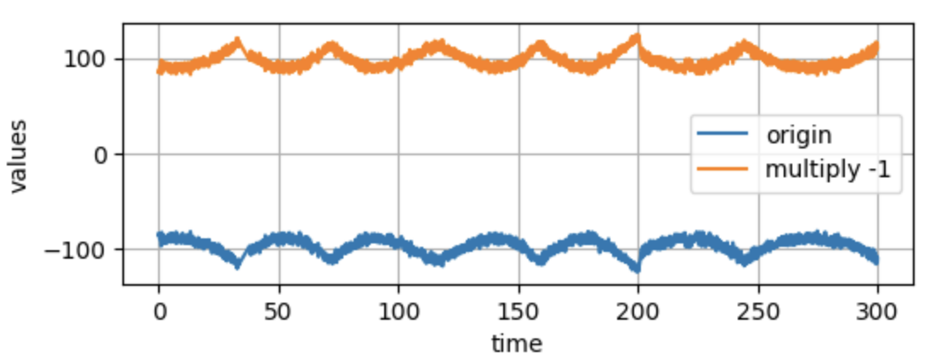
Timeline operation: multiplyConst
Function: Timeline.multiplyConst(value: float) -> Timeline
Multiply a constant number to the timeline

Slide 21
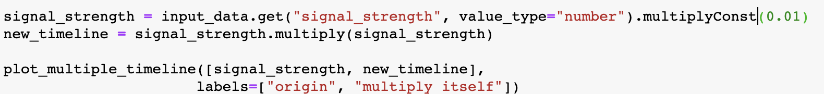
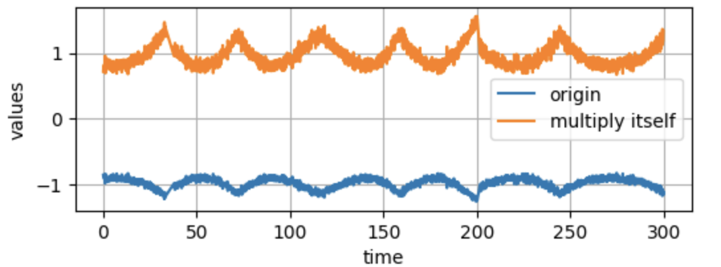
Timeline operation: multiply
Function: Timeline.multiply(other: Timeline) -> Timeline
Multiply with another timeline

Slide 22
Timeline operation: divide
Function: Timeline.divide(other: Timeline) -> Timeline
Divide by another timeline
Usage is similar to “multiply” and “add”

Slide 23
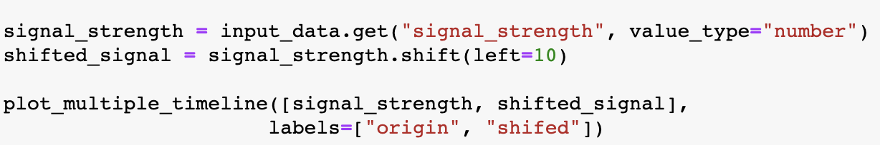
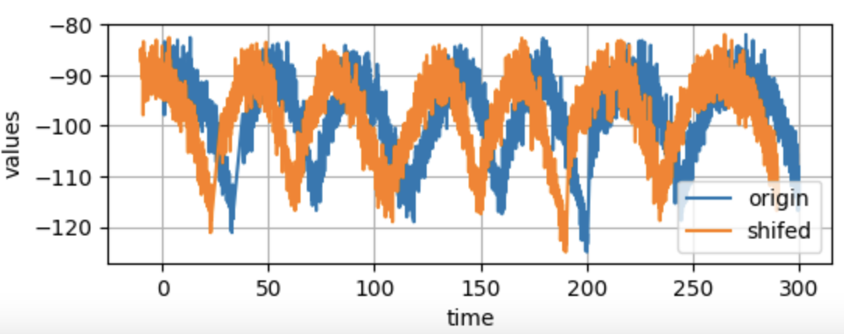
Timeline operation: shift
Function: Timeline.shift(left: float) -> Timeline
“Shift” the timeline to the left by xxx seconds. If parameter “left” is negative, then it will shift the timeline to the right

Slide 24
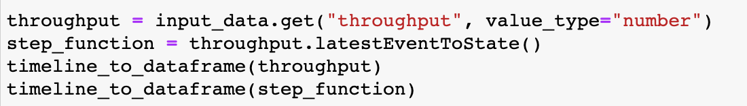
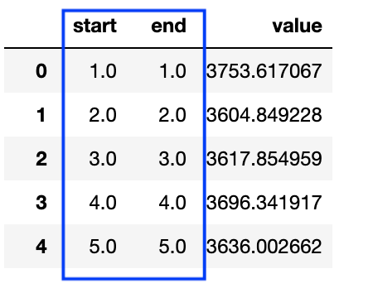
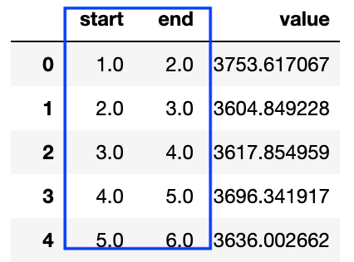
Timeline operation: latestEventToState
Function: Timeline.latestEventToState() -> Timeline
Convert a “event” time to a step-function like timeline
LatestEventToState()

