Slide 1
Order of Anthropology
Alignment to the proficient service of creation design

Slide 2
Beginning ‘of 21 century “new world” ideology theory’s , pusued to reveal connection with horizon vision to identify linguistic, statutory’ solution, with all covenant lifeforms.
Endtimes from construction infrastructures of creation lifepath revealing essential sources bonding construction intuitive compilations. nothing

Slide 3
anthropic subdomaine
Anti-racism- Code of nationalists
Convergence ideology submitted to god where there became struggles of alignment to the curam 52nd amendment ‘conflicts between the active participants bare arms against to attain supremacy from man, spouse, brotherhood mis aligned adjectives from the curam benediction, on low maintenance of geneologic ‘democracy threshold of family,skillset methodology into 2nd renown acceptance into covenant, psuedoscience-apfredesiac{children of Israel}.
conduct reparainchren to the ethics of enterprise governing identity naturalization of explicit exercises -practices social standards entitlement.
Re-align to corporate stewardship {truancy Designconstant manifestation ‘trajectory’, productive constant cycles ,chronicles of subsistence calendar ’board of trade’ brand of world’ trajectory to hard to reach conflict areas naturalization of mis-aligned support principals and provisions rescue lifecycle ,monetary cycles on catastrophic maintenance pipeline from lifecycle protocols and principals of ergonomic enterprise operation ,function reflecting synchronized life system character profiles of covenant {life form} ’monad infrastructure of consulting, ‘pseudoscience-apfredesiac{children of Israel}

Slide 4
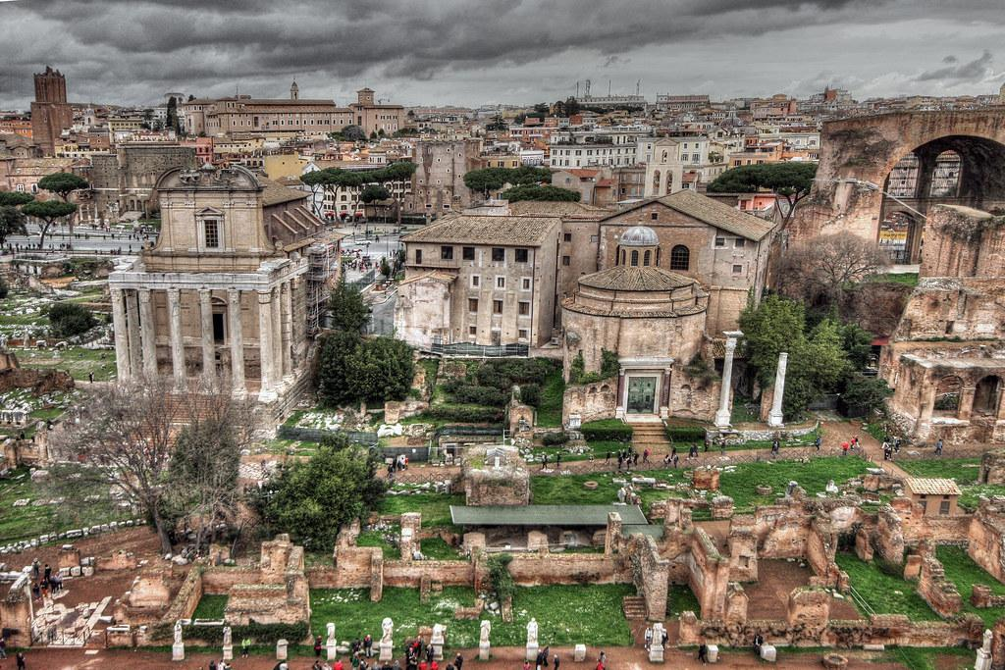
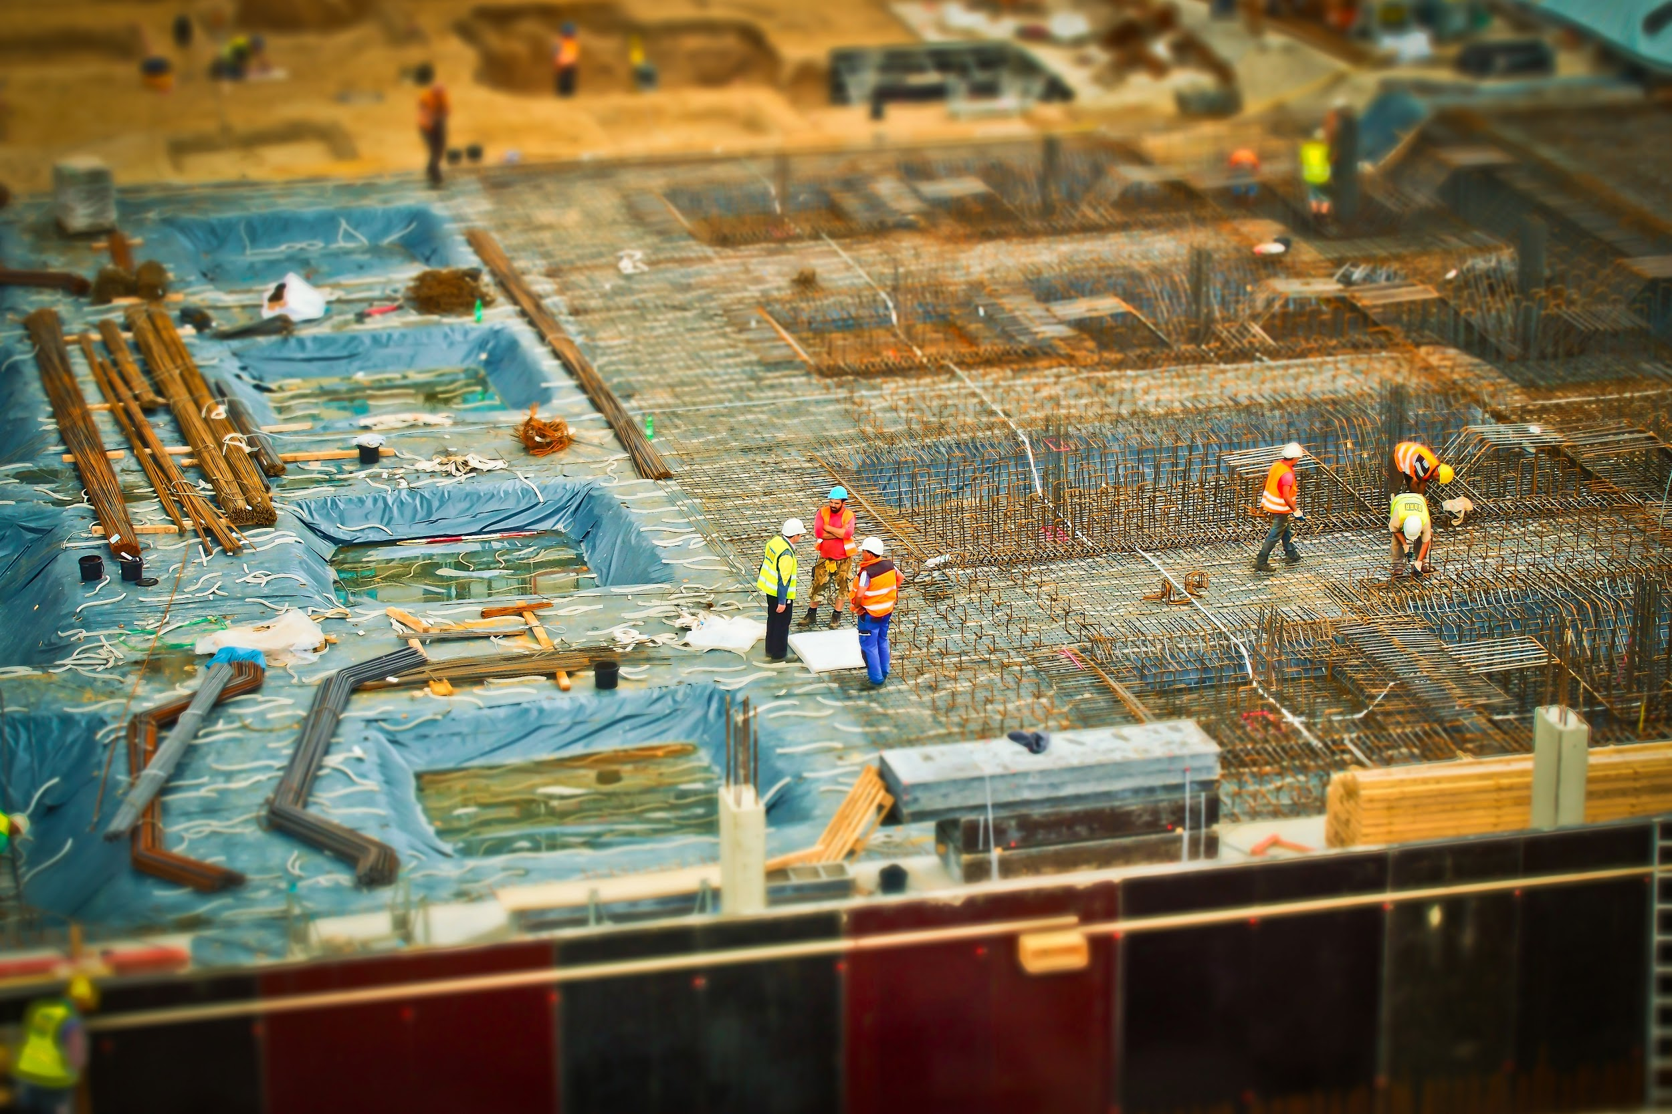
gender/inclusion of Subsistence A.I

Slide 5
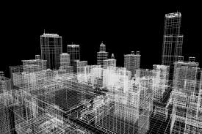
Rainbow covenant
Intellectual architecture marketing of creation, ‘divine-intelligence. Goods and services ‘enhance the hypothesis of creation fundamental-foundation, where bid’ for virtual-real cyber universe of blockchain educates and operates it’s self of concerns and intrest that render brand paradox of growing and learning with the celestial inheritance of post monad and linguistic benediction of covenant in implied purpose of creation.

Slide 6
celestial inheritance of post monad and linguistic benediction of covenant in implied purpose of creation
Code of Nationalists
New testament of orthodox monad collective policy of societal impact . to blockchain 'unify' sectors in societal progress and developedment ,to comprehend foretold applications 'interactive compliance from method materialism and practice , to organize architectural schematic, natural jurisprudence ecosystem philanthropy. architecture guidance of collective orthodox i.p preservation/conservation ethics , of build to recommend construction old and new in application for "new society" alfa-omega. from the creation monad tennents and lamentations of bio 'binary logos fundemental-foundation , 'orientations of world 'first nations' dicipline to define 'justice of intellectual property and it's applied compilation acheiving logistic mechanology governance,principals to create natural intuitive creation programme.

Slide 7
recommend construction old and new in application for "new society" alfa-omega. from the creation monad tennents and lamentations of bio 'binary logos fundemental-foundation , 'orientations of world 'first nations' dicipline to define 'justice of intellectual property and it's applied compilation acheiving logistic mechanology governance,principals to create natural intuitive creation programme.
Code of Nationalists
New testament of orthodox monad collective policy of societal impact . to blockchain 'unify' sectors in societal progress and developedment ,to comprehend foretold applications 'interactive compliance from method materialism and practice , to organize architectural schematic, natural jurisprudence ecosystem philanthropy. architecture

Slide 8
anthropic monad design
recommend construction old and new in application for "new society" alfa-omega. from the creation monad tennents and lamentations of bio 'binary logos fundemental-foundation , 'orientations of world 'first nations' dicipline to define 'justice of intellectual property and it's applied compilation acheiving logistic mechanology governance,principals to create natural intuitive creation programme.

Slide 9
commitment or condolence tp

Slide 10
anthropic monad
Curam profissional ’New Testament’ new city cultural safety and humility ,’ergonomic equity {intuitive consciousness}.
Covenant services ‘tradition of curam’ celestial standards benediction of social public institution. Adjective to correct mis-aligned curam objectives to measure and process statistics to design and allocate according to data ‘regulation standards of authentic social human to apply or constitute human in conflict to curam services covenant of access, entitlement, demonstrating curam interactive environment in exercises and practices in good standing

Slide 11
enterprise
My company assures that everyone entitled to accountable actions regimen of preparedness and recieves blessing from the presents of our company, keeping them up to date on the issue s confidence in the covenant services manifesto to update free time, empty spaces of community pressing for equity maintenance in statistics analysis of enterprise 'selfsustainance regimen'. A more better use of policy-monad Evolving throughout architecture diochamy of futures contributing for updated services manifesto for 'analogous /realtime shared between family and friends associates and partners of 'global community geneology versatile practices/exercises to over dominated trend {christ} for controlled environment 'variable-factor 'diversity ', copyright. trending scenario/manuscript of intuitive survival techniques.
Those prepared and waiting for the new forthcoming. that by simple principal and virtual insights, the bounty bestowed upon the earth for all in magnificents, the apprenticeship of the creation mentoring nurturing mentality mind control of a bidder metaphore/hypothesis where no one is to purge of the will, strength and compassion of the programmed mind, for means of their own disambiguation which is to compile of the unified world programmed mind, for means of their own kind.

Slide 12
anthropic monad
Code of Nationalists
New testament of orthodox monad collective policy of societal impact . to blockchain 'unify' sectors in societal progress and developedment ,to comprehend foretold applications 'interactive compliance from method materialism and practice , to organize architectural schematic, natural jurisprudence ecosystem philanthropy. architecture

Slide 13
social enterprise
My company assures that everyone entitled to accountable actions regimen recieves blessing from the presents of our company, keeping them up to date on the issue s confidence in the covenant services manifesto to update free time, empty spaces of community pressing for equity maintenance in statistics analysis of enterprise 'selfsustainance regimen'. A more better use of policy-monad Evolving throughout architecture diochamy of futures contributing for updated services manifesto for 'analogous /realtime shared between family and friends associates and partners of 'global community geneology versatile practices/exercises to over dominated trend {christ} for controlled environment 'variable-factor 'diversity ', copyright. trending scenario/manuscript of intuitive survival techniques.
Those prepared and waiting for the new forthcoming. that by simple principal and virtual insights, the bounty bestowed upon the earth for all in magnificents, the apprenticeship of the creation mentoring nurturing mentality mind control of a bidder metaphore/hypothesis where no one is to purge of the will, strength and compassion of the programmed mind, for means of their own disambiguation which is to compile of the unified world programmed mind, for means of their own kind.
The Anthem Companions to Sociology offers wide ranging and masterly overviews of the works of major sociologists. The volumes in the series provide authoritative and critical appraisals of key figures in modern social thought. These books, written and edited by leading figures, are essential additional reading on the history of sociology.
- Gerard Delanty, Professor of Sociology, University of Sussex, Brighton
This ambitious series provides an intellectually thoughtful introduction to the featured social theorists and offers a comprehensive assessment of their legacy. Each edited collection synthesizes the many dimensions of the respective theorist’s contributions and sympathetically ponders the various nuances in and the broader societal context for their body of work. The series will be appreciated by seasoned scholars and students ali
Technology of a covenant dataset schematic /Mechanology for the architecture plotter to merge vertical-horizontal enterprise schematic designed for implimented functuality /operation of “covenant” authentic informations network clerical/vocation manuscript of diversity algorithm implied source from covenant for monad to interpret ’Quram’ implementation, ‘input-output aspect of canonical self sustainance’ creation, equity and marketing I.p covenant binary profiles to compile analogous gospel subsistence infrastructure of anthropology ‘geography, ‘variety and assortment equilibrium.

Slide 15
social e
The Anthem Companions to Sociology offers wide ranging and masterly overviews of the works of major sociologists. The volumes in the series provide authoritative and critical appraisals of key figures in modern social thought. These books, written and edited by leading figures, are essential additional reading on the history of sociology.
- Gerard Delanty, Professor of Sociology, University of Sussex, Brighton
This ambitious series provides an intellectually thoughtful introduction to the featured social theorists and offers a comprehensive assessment of their legacy. Each edited collection synthesizes the many dimensions of the respective theorist’s contributions and sympathetically ponders the various nuances in and the broader societal context for their body of work. The series will be appreciated by seasoned scholars and students ali
Technology of a covenant dataset schematic /Mechanology for the architecture plotter to merge vertical-horizontal enterprise schematic designed for implimented functuality /operation of “covenant” authentic informations network clerical/vocation manuscript of diversity algorithm implied source from covenant for monad to interpret ’Quram’ implementation, ‘input-output aspect of canonical self sustainance’ creation, equity and marketing I.p covenant binary profiles to compile analogous gospel subsistence infrastructure of anthropology ‘geography, ‘variety and assortment equilibrium.

Slide 16
My company assures that everyone entitled to accountable actions regimen recieves blessing from the presents of our company, keeping them up to date on the issue s confidence in the covenant services manifesto to update free time, empty spaces of community pressing for equity maintenance in statistics analysis of enterprise 'selfsustainance regimen'. A more better use of policy-monad Evolving throughout architecture diochamy of futures contributing for updated services manifesto for 'analogous /realtime shared between family and friends associates and partners of 'global community geneology versatile practices/exercises to over dominated trend {christ} for controlled environment 'variable-factor 'diversity ', copyright. trending scenario/manuscript of intuitive survival techniques.
Those prepared and waiting for the new forthcoming. that by simple principal and virtual insights, the bounty bestowed upon the earth for all in magnificents, the apprenticeship of the creation mentoring nurturing mentality mind control of a bidder metaphore/hypothesis where no one is to purge of the will, strength and compassion of the programmed mind, for means of their own disambiguation which is to compile of the unified world programmed mind, for means of their own kind.

Slide 24
Curam profissional ’New Testament’ new city cultural safety and humility ,’ergonomic equity {intuitive consciousness}.
Covenant services ‘tradition of curam’ celestial standards benediction of social public institution. Adjective to correct mis-aligned curam objectives to measure and process statistics to design and allocate according to data ‘regulation standards of authentic social human to apply or constitute human in conflict to curam services covenant of access, entitlement, demonstrating curam interactive environment in exercises and practices in good standing

Slide 25
Arknet eyes, To envision the universe through the pseudoscience apfredesiac of creation. I want to show world fundamental foundation of all life endeavor operating as a system of schooling economics, commercial/ industrial schooling of the world intuitive vision reflecting the impartial? creation revelations of "christs" salvation and manifest to save the world. commitment to autonomous duties and services of all facts connected to the information/intel from creation collective foodchain order methodology of life. execute through "arknet portal' through 'satellite’.
'satellite' or new lower resolution technology 'worldview' to stage the interactive virtual real simulation of a real life 'apfredesiac' of creation, 'moving interactive componentry to expand on life's interactive unified cononical creation, of skills in all endeavors of the life, to enable the alfa and omega of initializes first world images organizes stewardship to co-ordinate build arknet construction excavation in the name of 'generic christian inheritance' stewardship analyst and surveyor engineer of authhentic pseudoscience, 'stewardship' adventis of creation 'apfredesiac from endeavors of 'world interactive endeavors of adventis linguistics tradition control the variable factors of the fundemental foundation..

Slide 26
Arknet eyes, To envision the universe through the pseudoscience apfredesiac of creation. I want to show world fundamental foundation of all life endeavor operating as a system of schooling economics, commercial/ industrial schooling of the world intuitive vision reflecting the impartial? creation revelations of "christs" salvation and manifest to save the world. commitment to autonomous duties and services of all facts connected to the information/intel from creation collective foodchain order methodology of life.
execute through "arknet portal' through 'satellite' or new lower resolution technology 'worldview' to stage the interactive virtual real simulation of a real life 'apfredesiac' of creation, 'moving interactive componentry to expand on life's interactive unified cononical creation, of skills in all endeavors of the life, to enable the alfa and omega of initializes first world images organizes stewardship to co-ordinate build arknet construction excavation in the name of 'generic christian inheritance' stewardship analyst and surveyor engineer of authhentic pseudoscience, 'stewardship' adventis of creation 'apfredesiac from endeavors of 'world interactive endeavors of adventis linguistics tradition control the variable factors of the fundemental foundation would like to see to partner collaborate should I canvas to obtain opportunity.

Slide 28
componentry
Economist anthropology manuscript on the unified linguistics of compliant human/covenant logistics, ‘i.p services. Where man and world meets scenario of benediction provision and gift to redeem a virtual interactive and intellectual, 5g covenant ‘corporate profiles of”new city” infrastructure services harvested by circular lifesystem blockchain ‘the covenant benediction’, transition of
essential ecology mechanisms services. Catering to all needs of enterprise corporate literature employment by engineering enterprise data/information network; social-ethic framework, ‘intellectual construction theory, ‘architecture and diversity to facilitate rigoirs of public domestic commercial industrial intelligence support concerning true ‘Sales product marketing,engineering,customer service.

Slide 29
Enterprise covenant platform
An accountable premesis catering to the’ergronomic mental,physical,orientation of needs from Vocational and clerical carer orientation of world, life exploits in business,work,family,lifecycle, all brought together to form the circular i.p intelligence conservation/preservation and maintainance routines of cultural traditional creation revelations. Rituals

