Slide 1
Unveiling human order
Alignment to the proficient service of creation design

Slide 2
social enterprise
My company assures that everyone entitled to accountable actions regimen recieves blessing from the presents of our company, keeping them up to date on the issue s confidence in the covenant services manifesto to update free time, empty spaces of community pressing for equity maintenance in statistics analysis of enterprise 'selfsustainance regimen'. A more better use of policy-monad Evolving throughout architecture diochamy of futures contributing for updated services manifesto for 'analogous /realtime shared between family and friends associates and partners of 'global community geneology versatile practices/exercises to over dominated trend {christ} for controlled environment 'variable-factor 'diversity ', copyright. trending scenario/manuscript of intuitive survival techniques.
Those prepared and waiting for the new forthcoming. that by simple principal and virtual insights, the bounty bestowed upon the earth for all in magnificents, the apprenticeship of the creation mentoring nurturing mentality mind control of a bidder metaphore/hypothesis where no one is to purge of the will, strength and compassion of the programmed mind, for means of their own disambiguation which is to compile of the unified world programmed mind, for means of their own kind.
The Anthem Companions to Sociology offers wide ranging and masterly overviews of the works of major sociologists. The volumes in the series provide authoritative and critical appraisals of key figures in modern social thought. These books, written and edited by leading figures, are essential additional reading on the history of sociology.
- Gerard Delanty, Professor of Sociology, University of Sussex, Brighton
This ambitious series provides an intellectually thoughtful introduction to the featured social theorists and offers a comprehensive assessment of their legacy. Each edited collection synthesizes the many dimensions of the respective theorist’s contributions and sympathetically ponders the various nuances in and the broader societal context for their body of work. The series will be appreciated by seasoned scholars and students ali
Technology of a covenant dataset schematic /Mechanology for the architecture plotter to merge vertical-horizontal enterprise schematic designed for implimented functuality /operation of “covenant” authentic informations network clerical/vocation manuscript of diversity algorithm implied source from covenant for monad to interpret ’Quram’ implementation, ‘input-output aspect of canonical self sustainance’ creation, equity and marketing I.p covenant binary profiles to compile analogous gospel subsistence infrastructure of anthropology ‘geography, ‘variety and assortment equilibrium.

Slide 3
Beginning ‘of 21 century “new world” ideology theory’s , pusued to reveal connection with horizon vision to identify linguistic, statutory’ solution, with all covenant lifeforms.
Endtimes from construction infrastructures of creation lifepath revealing essential sources bonding construction intuitive compilations. nothing

Slide 4
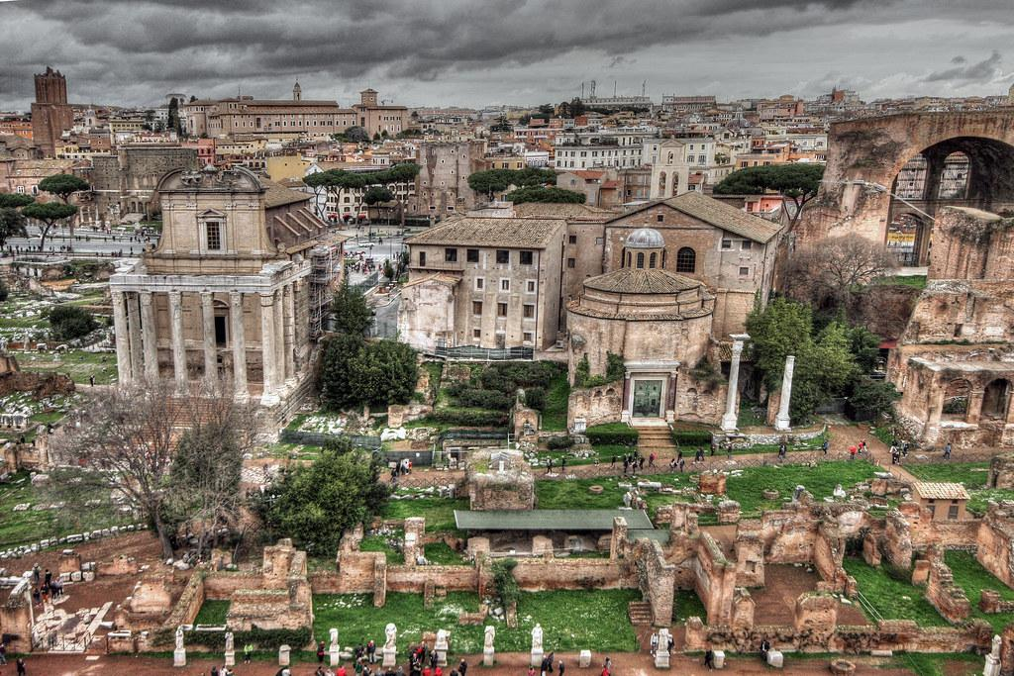


Slide 5

Rainbow covenant
Intellectual architecture marketing of creation, ‘divine-intelligence. Goods and services ‘enhance the hypothesis of creation fundamental-foundation, where bid’ for virtual-real cyber universe of blockchain educates and operates it’s self of concerns and intrest that render brand paradox of growing and learning with the celestial inheritance of post monad and linguistic benediction of covenant in implied purpose of creation.

Slide 7
RAINBOW COVENANT
Economist anthropology manuscript on the unified linguistics of compliant human/covenant logistics i.p services. Where man and world meets scenario of benediction provision and gift to redeem a virtual interactive and intellectual, 5g covenant ‘corporate profiles of”new city” infrastructure services harvested by circular lifesystem blockchain ‘the covenant benediction’, transition of essential ecology mechanisms services. Catering to all needs of enterprise corporate literature employment by engineering enterprise data/information network; social-ethic framework, ‘intellectual construction design architecture and diversity to facilitate rigoirs of public domestic commercial industrial intelligence support concerning true ‘Sales product marketing,engineering,customer service.

Slide 8
RAINBOW COVENANT
Economist anthropology manuscript on the unified linguistics of compliant human/covenant logistics i.p services. Where man and world meets scenario of benediction provision and gift to redeem a virtual interactive and intellectual, 5g covenant ‘corporate profiles of”new city” infrastructure services harvested by circular lifesystem blockchain ‘the covenant benediction’, transition of essential ecology mechanisms services. Catering to all needs of enterprise corporate literature employment by engineering enterprise data/information network; social-ethic framework, ‘intellectual construction design architecture and diversity to facilitate rigoirs of public domestic commercial industrial intelligence support concerning true ‘Sales product marketing,engineering,customer service.

Slide 9
Enterprise covenant platform
An accountable premesis catering to the’ergronomic mental,physical,orientation of needs from Vocational and clerical carer orientation of world, life exploits in business,work,family,lifecycle, all brought together to form the circular i.p intelligence conservation/preservation and maintainance routines of cultural traditional creation revelations. Rituals

