Slide 1
ECommerce Data Analysis
Bangladesh eshop

Slide 2
Interesting Facts about Bangladesh
One of the world's longest beaches.
Over 700 rivers that run through it.
70% of the population is engaged in agriculture.
Agriculture primary source of income and main employer.
8th in the world in terms of population.
Notes:
160.00.000 population
and Dhaka is the capital

Slide 3
Culture Facts about Bangladesh
Left handed is seen as impure.
Smile as a sign of immaturity.
Notes:
Left hand is seen as impure. When eating, sharing food, or distributing business cards, the right hand is employed

Slide 4
Overview of Dataset
1,000,000 total transactions.
Insights into:
Customer behavior
Sale trends
Product performance
Goal: Increase revenue

Slide 5
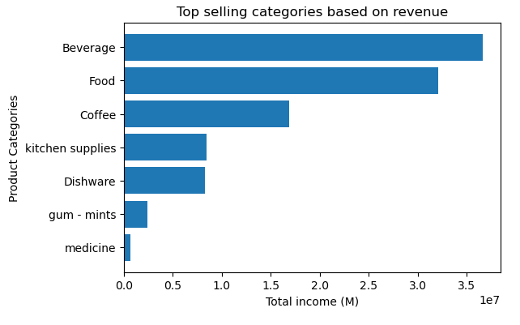
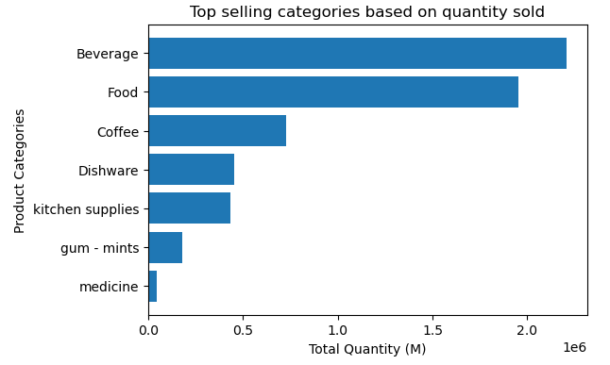
Top Selling Products Categories

Slide 6
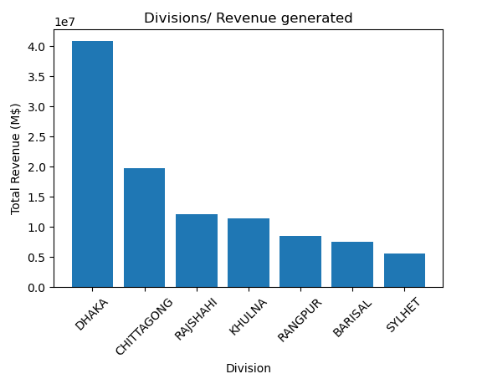
Division Revenue Distribution
Dhaka: ~40%
Chittagong: ~20%
Prioritize marketing in these districts

Slide 7
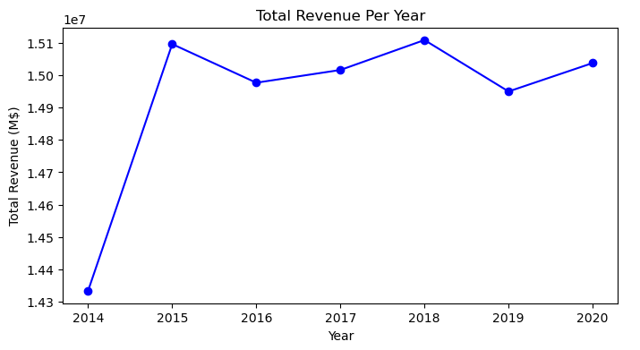
Annual Sales Trends and Stability
Sales remain relatively stable
No seasonality
Year-round engagement

Slide 8
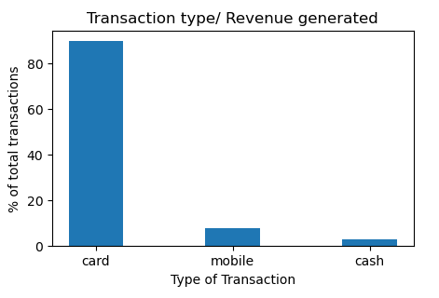
Preferred Payment Methods
Card based transactions
No preferred bank according to data
Partnerships with multiple banks

Slide 9
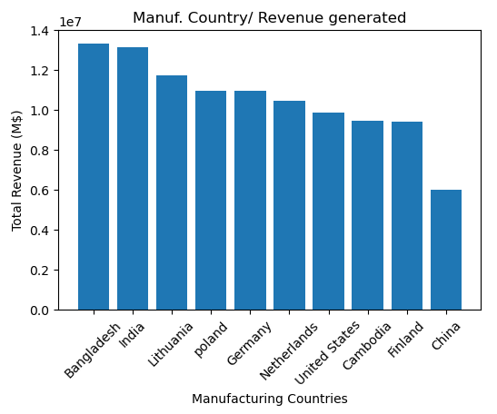
Manufacturing Countries and Sourcing Strategy
Benefits of sourcing locally:
Reduce shipping times
Reduce shipping costs
Increase profit margins

Slide 10
RFM Analysis
Last 2 years data
Recency - Frequency - Monetary
RFM Segments / clusters

Slide 11
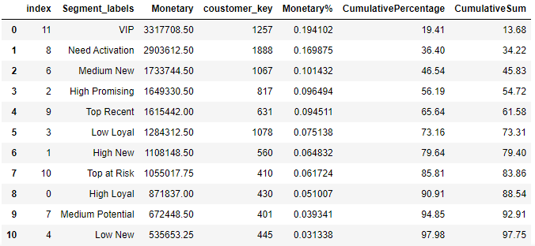
RFM Clusters - 80/20

Slide 12
Market Basket Analysis
Better understand customer behavior to increase sales.
Look for frequent combination of items.

Slide 13
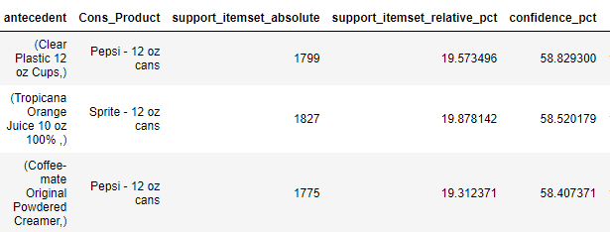
MΒΑ - Strong likelihood (nearly 59%)
if a customer buys plastic cups, they’ll also buy Pepsi.
Cups & Pepsi | Tropicana & Sprite | Coffee-mate & Pepsi

Slide 14
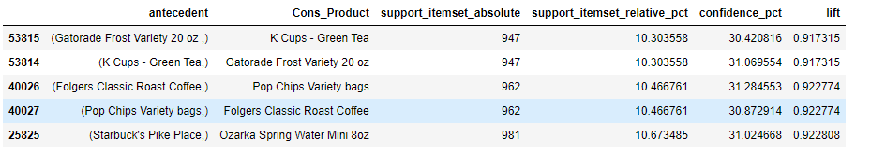
MBA - No product cannibalization
The lift values below 1 indicate these products do affect each other's sales,
but there isn't notable cannibalization happening between these products.

Slide 15
Key takeaways & proposed actions
The RFM segment ‘need activation’ is the 2nd biggest cluster.
> Re-engagement Campaigns
> Targeted Promos
> Improve Customer Experience
No product cannibalization
Many pairs of products with high confidence (increased likelihood to be bought together)
-> Train cashiers in cross-selling
-> Place associated products close to each other.

Slide 16
Key takeaways & proposed actions
> Inventory optimization for top selling products and categories
> Targeted promos in top districts
> Look for new suppliers to reduce shipping costs and shipping times.

