Slide 1
Bulletproof Transient Error Handling with Polly
Notes:
Abstract:
Connected applications only work when connected. What happens if the network breaks temporarily? Will your system recover smoothly or pitch a fit? Using an OSS project called Polly (available on GitHub) you can handle this and many other transient situations with elegance and fluency. Polly let’s you define resilience and load-handling policies such as retry, wait and retry, circuit breaker, bulkhead isolation and timeouts and more. Learn how to make your system bulletproof with Polly and a little know-how.

Slide 2

Notes:
Story of App vNext.

Slide 3
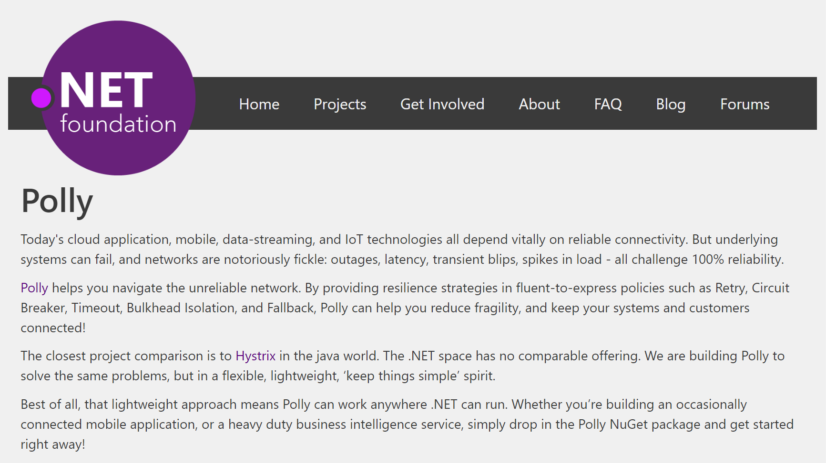
Notes:
Polly was accepted into the .NET Foundation in October, 2016!!

Slide 4
Transient Errors
Network outages
Service outages
Denial of Service attacks
IO locks
Connected device failures

Slide 5

Polly to the rescue!
.NET 4.0 / 4.5+ / PCL / .NET Standard / .NET Core
Fluently express transient exception handling policies:
Retry, Circuit Breaker, Timeout,
Bulkhead Isolation, Fallback
https://github.com/App-vNext/Polly
Nuget: Install-Package Polly

Slide 6
Polly offers multiple resilience strategies ...
Retry … ‘Maybe it’s just a blip’
Circuit Breaker … ‘That system is down / struggling’
Timeout … ‘Don’t wait forever!’
Bulkhead isolation … ‘One fault shouldn’t sink the whole ship’
Cache … ‘You’ve asked that one before!’
Fallback … ‘If all else fails … degrade gracefully’
All policies can be combined, for multiple protection!

Slide 7
History of Polly
2013 Michael Wolfenden invents Polly. 2014 Targets multi .NET versions including PCL. 2015 Scott Hanselman (Microsoft) recommends Polly! Thoughtworks (Martin Fowler et al) recommend Polly!
Nov 2015 App-vNext take stewardship Dec 2015 Full async support April 2016 Advanced circuit breaker. Circuit health reporting. June 2016 Handle return values as faults. July 2016 .NET Core / .NET Standard support. October 2016 Timeout, Bulkhead Isolation, Fallback, PolicyWrap

Slide 8
Step 1: Define Policy
var retryPolicy = Policy
.Handle<EndpointNotFoundException>()
.RetryForeverAsync();

Slide 9
Step 2: Execute with Policy
var response =
await retryPolicy.ExecuteAsync(() => DoSomething());

Slide 10
Retry Patterns
Retry immediately on failure. Specify number of retries.
Wait and Retry Retry with a timeout in between each try. Change the timeout between each retry, eg exponential back-off.
Retry Forever Keep retrying until succeeds.
Retry addresses ... ‘It’s probably a blip. Give it another go - it might succeed.’

Slide 11
Circuit Breaker
Circuit Breaker Breaks the circuit for a configured period if too many errors occur
Blocks calls while circuit is broken.
Protects downstream system - chance to recover.
Fail fast to the caller.
Circuit Breaker addresses … ‘Whoa, that system is struggling / down. Give it a break. And don’t hang around waiting for an answer that’s unlikely, right now!’

Slide 12
Timeout
Timeout Stop waiting once you think an answer will not come
Optimistic mode Co-operative timeout via CancellationToken
Pessimistic mode Enforces timeout (returns to caller) even when governed delegate doesn’t support timeouts/cancellation. Timeout ensures … calls can ‘walk away’ from a faulting downstream system, release blocked threads/connections etc.

Slide 13
Bulkhead Isolation
Bulkhead Prevents one operation from consuming more than its fair share of resources.
Imagine one stream of calls starts faulting slowly...
All threads in a caller could end up waiting on that system … until it starves the caller doing anything else.
Bulkhead prevents this, by limiting the resources (threads) used by separate call streams.
Bulkhead … ‘One fault shouldn’t sink the whole ship!’

Slide 14
Read-through Cache (Oct 16: forthcoming)
Cache A certain proportion of calls will be duplicates. Serve from cache if you can - reduce latency and save calls.
Pluggable interface - use any cache provider you like.
Supplied providers for Redis, Azure, Amazon Cache, etc.
Cache addresses … ‘You’ve asked that one before!’

Slide 15
Fallback
Fallback Specifies a substitute value to provide (or action to run) when an operation still fails.
Fallback addresses … ‘Failures will occur … prepare how you will respond when that happens’

Slide 16
Policy Wrap
PolicyWrap Combine any of the previous strategies into one concise policy.
PolicyWrap myResilience =
Policy.Wrap(fallback, retry, breaker, timeout);
myResilience.Execute(() => DoSomething());

Slide 17
Policy Basics
Define how transient exceptions should be handled
Fluent and concise
Thread-safe
Reusable across call sites
Sync and async
Chain policies together
Apply to any Action or Func (service calls, data stores, web requests, mobile connectivity)
Notes:
Full async support: accepts and honours cancellation tokens. Full control of continue-on-captured-context or not.

Slide 18
Demos
https://github.com/App-vNext/Polly-Samples

Slide 19
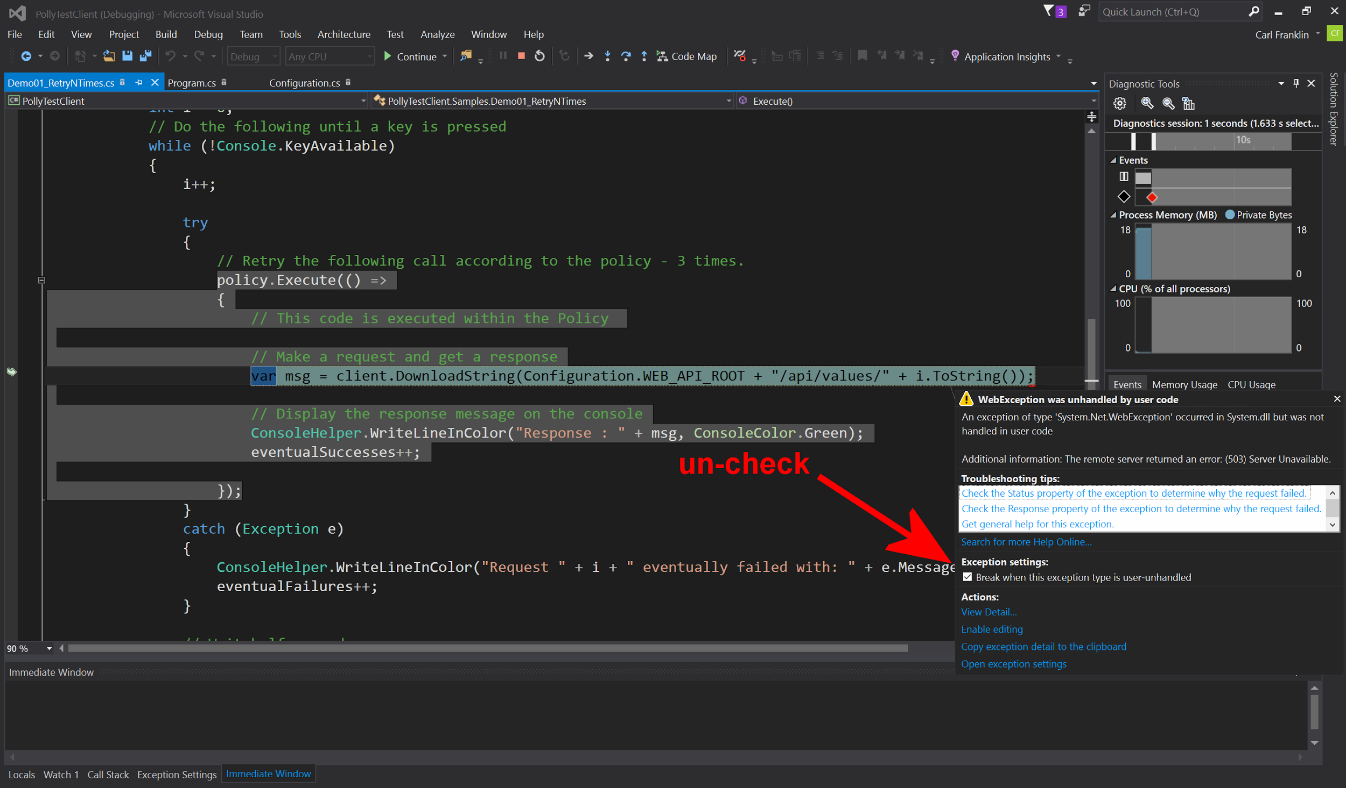
Notes:
Uncheck this tickbox if demoing the Samples out of Visual Studio simply by pressing F5 for Debug. Or ctrl-F5 for start-without-debug.

Slide 20
Further features
Handle multiple exception types in one policy; filter exceptions handled:
var policy = Policy.Handle<SqlException>(ex => ex.Number == 1205)
.Or<TimeoutException>();
Register delegates (onRetry, onBreak etc) to capture policy events, eg for logging.

Slide 21
Future roadmap?
Cache policy
Configure from config
Dynamic reconfiguration Tweak timeouts, circuit-breaker sensitivity etc in production
Telemetry Emit eg circuit health, latency to dashboards, for real-time monitoring
Notes:
All these resilience patterns are brilliantly covered in Michael Nygard’s book Release It!

Slide 22
App vNext Polly team
Carl Franklin .NET Rocks, Music to Code By
Joel Hulen Enterprise software and cloud architect
Dylan Reisenberger .NET coder and enterprise architect, special interest in microservices, messaging, resilience.
… and all you folks who want to make open-source contributions …
https://github.com/App-vNext/Polly/

Slide 23
Polly Wiki
Extended documentation
Configuration recommendations
Patterns
Future Roadmap
https://github.com/App-vNext/Polly/wiki

Slide 24
Polly Slack channel and Blog
http://www.pollytalk.org/ (slack)
Ask questions
Discuss the roadmap
http://www.thepollyproject.org/ (blog)
Project updates, the inside track

Slide 25
THANK YOU!
Notes:
Abstract:
Connected applications only work when connected. What happens if the network breaks temporarily? Will your system recover smoothly or pitch a fit? Using an OSS project called Polly (available on GitHub) you can handle this and many other transient situations with elegance and fluency. Polly let’s you define resilience and load-handling policies such as retry, wait and retry, circuit breaker, bulkhead isolation and timeouts and more. Learn how to make your system bulletproof with Polly and a little know-how.

