Slide 1
TOPIC RECAP

Slide 2
Tutorial 6
Question 1

Slide 3
Not again…?
A | B | C
P(S2); P(S1); x = x * 2; V(S1); | P(S1); x = x * x; V(S1); | P(S1); x = x + 3; V(S2); V(S1);
Initialization
S1 = 1; S2 = 0; x = 0;

Slide 4
B-C-A C-B-A C-A-B
A | B | C
P(S2); P(S1); x = x * 2; V(S1); | P(S1); x = x * x; V(S1); | P(S1); x = x + 3; V(S2); V(S1);
Initialization
S1 = 1; S2 = 0; x = 0;

Slide 5
Tutorial 6
Question 2

Slide 6
Barrier( N );

Slide 7
Barrier( N );
Barrier( N) {
}

Slide 9
Tutorial 6
Question 3

Slide 10

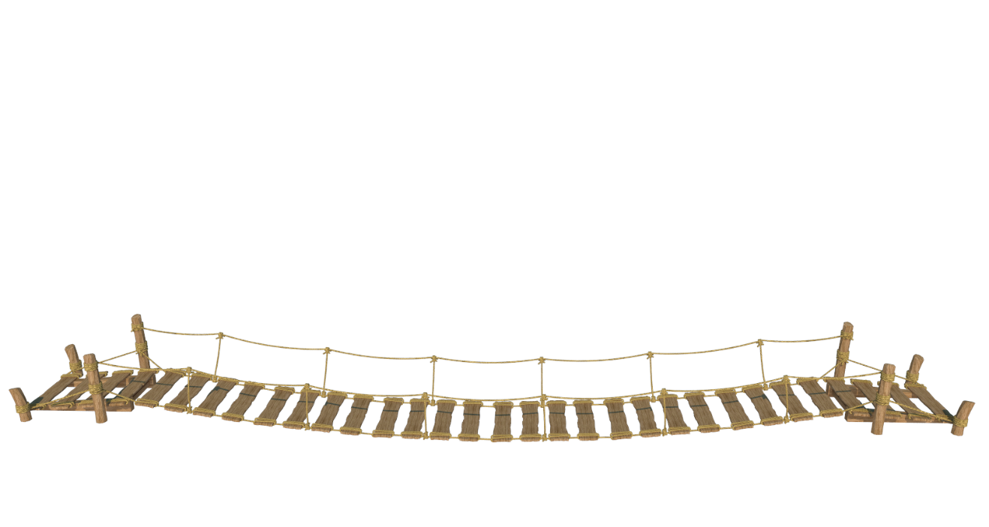




Welcome to StubbornVille!

Slide 11
Let's be civilized v1.0
Semaphore sem = 1;
void enter_bridge()
{
sem.wait();
}
void exit_bridge()
{
sem.signal();
}

Slide 12
Let's be civilized v2.0
int nCross = 0;
Semaphore sem = 1;
void enter_bridge_LR()
{
bool pass = false;
while (!pass) {
  sem.wait();
  if (nCross >= 0){
  nCross++;
  pass = true;
  }
  sem.signal();
  }
}
void exit_bridge_LR()
{
sem.wait();
nCross--;
sem.signal();
}

Slide 13
Let's be civilized v2.0
int nCross = 0;
Semaphore sem = 1;
void enter_bridge_LR()
{
bool pass = false;
while (!pass) {
  sem.wait();
  if (nCross >= 0){
  nCross++;
  pass = true;
  }
  sem.signal();
  }
}
void exit_bridge_LR()
{
sem.wait();
nCross--;
sem.signal();
}

Slide 14
Tutorial 6
Question 4

Slide 15
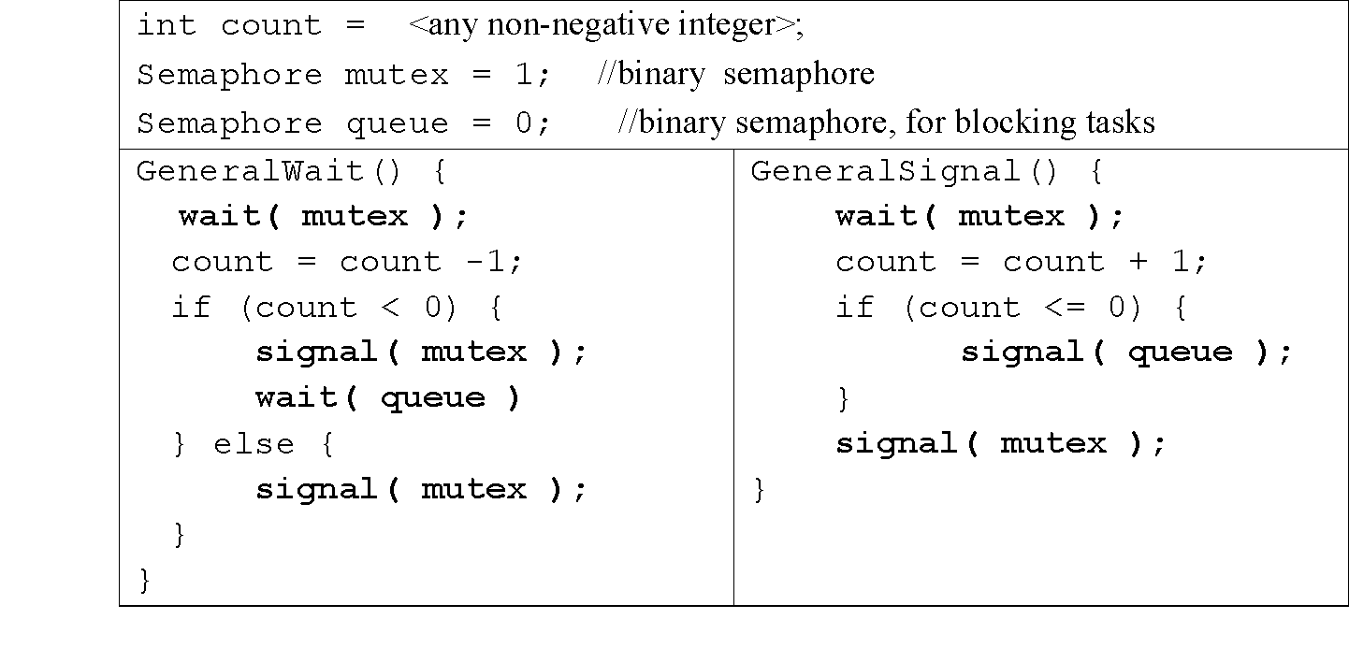
General Semaphore: Is it wrong?
Semaphore S
queue
count

Slide 16
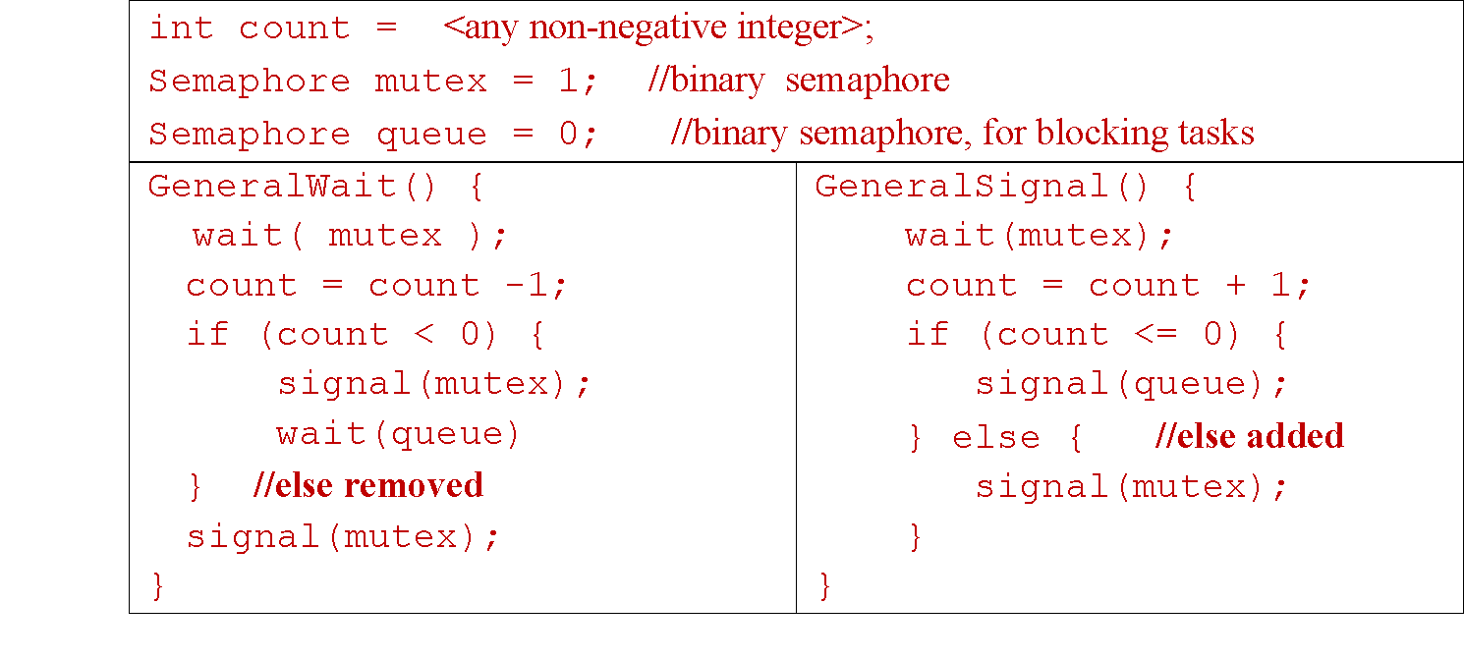
General Semaphore: Fixing the bug

Slide 17
Tutorial 6
Question 5

Slide 18
Right Handed Dining Philosophers
while (TRUE){
Think( );
//hungry, need food!
takeChpStck( LEFT );
takeChpStck( RIGHT );
Eat( );
putChpStck( LEFT );
putChpStck( RIGHT );
}
while (TRUE){
Think( );
//hungry, need food!
takeChpStck( RIGHT );
takeChpStck( LEFT );
Eat( );
putChpStck( RIGHT );
putChpStck( LEFT );
}

