Slide 1
Topic Summary

Slide 2
Tutorial 10
Question 1

Slide 3
a. Working Set W(T,Δ)
Time | 1 | 2 | 3 | 4 | 5 | 6 | 7 | 8 | 9 | 10 | 11 | 12
Page | 2 | 3 | 2 | 1 | 5 | 2 | 4 | 5 | 3 | 2 | 5 | 2
W( 9, 3 )
W( 11, 3 )
W( 9, 4 )
W(11, 4)

Slide 4
b. Usage
RAM 0
1
2
3
4
5
6
7
HDD 0
1
2
3
4
5
6
7
8
9
10
11
12
13
14
15
P_{W(T,Δ)}
Q_{W(T,Δ)}
R_{W(T,Δ)}
S_{W(T,Δ)}
.......
Notes:
Load W() pages when a process become runnable
Total W() exceeds physical frame# 🡺 Stop making more task runnable

Slide 5
c. Implementation
P#
0
1
… |  | ….
… |  | ….
…
…
… |  | ….
M⁰ | M¹ | M² | … | M^{K-2} | M^{K-1}
PTE has an additional K-bit, M₀, M₁, … M_{K-1}. All K-bit are initialized to '0'. Page P is referenced: M_{K-1} 🡨 M_{K-2} … M₂ 🡨 M₁ M₁ 🡨 M₀ M₀ 🡨 1 All other Non-P pages: M_{K-1} 🡨 M_{K-2} … M₂ 🡨 M₁ M₁ 🡨 M₀ M₀ 🡨 0

Slide 6
Tutorial 10
Question 2

Slide 7
a. One / Two Buffered File Operations?

Slide 8
b. That's Weird…?
Notes:
Demo (Linux uses 1024 bytes buffer by default)

Slide 9

b. That's Weird…?
printf("a");

Slide 10
b. That's Weird…?
printf("a\n");

Slide 11
c. Implement Buffered File Reader
BufferedFileRead( File, outArr, rSize )
If Buffer.available < rSize
read(File, Buffer,
Buffer.size – Buffer.available)
Buffer.available = Buffer.size
copy( outArr, Buffer, rSize )
Buffer.available -= rSize
Buffer
.available
.size
File
Notes:
Demo (Linux uses 1024 bytes buffer by default)

Slide 12
Tutorial 10
Question 3

Slide 13
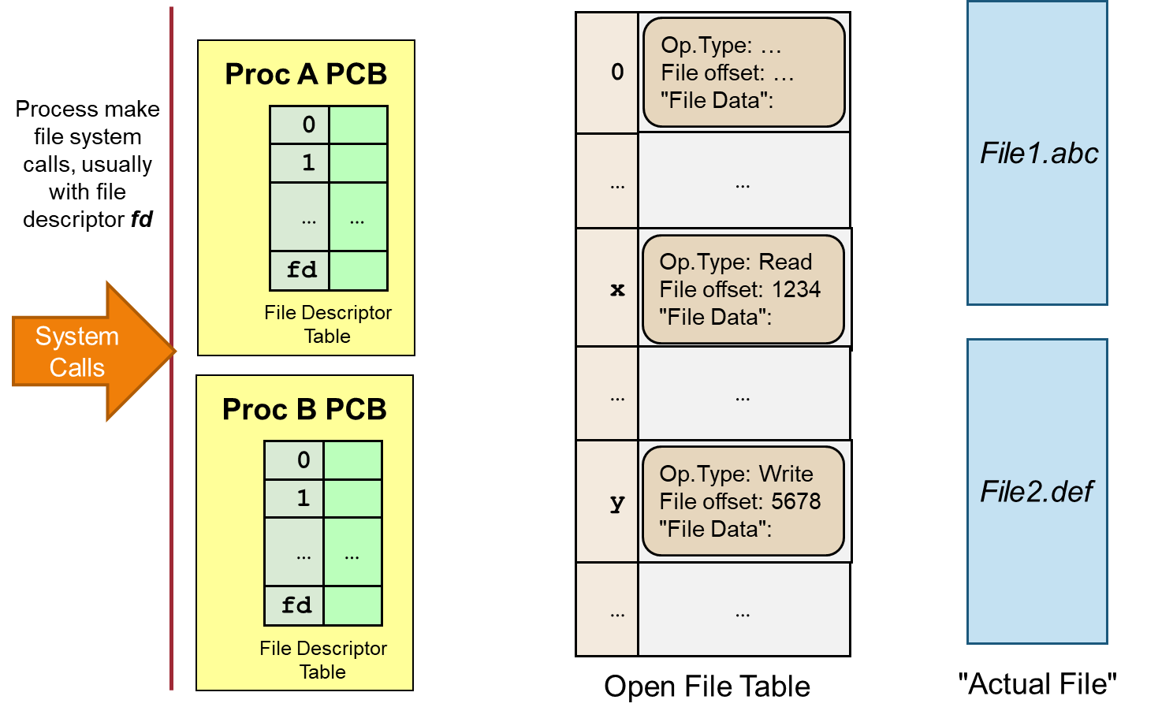
Open File Table: Overview
Notes:
Process A tries to open a file that is currently being written by Process B.
Process A tries to use a bogus file descriptor in a file-related system call.
Process A can never "accidentally" access files opened by Process B.
Process A and Process B reads from the same file. However, their reading should not affect each other.
Redirect Process A's standard input / output, e.g. " a.out < test.in > test.out". (Hint: *nix processes has 3 default file descriptors: 0 = stdin, 1 = stdout, 2 = stderr)

Slide 14
Open File Table: a. (B write then A open)
Notes:
Process A tries to open a file that is currently being written by Process B.
Process A tries to use a bogus file descriptor in a file-related system call.
Process A can never "accidentally" access files opened by Process B.
Process A and Process B reads from the same file. However, their reading should not affect each other.
Redirect Process A's standard input / output, e.g. " a.out < test.in > test.out". (Hint: *nix processes has 3 default file descriptors: 0 = stdin, 1 = stdout, 2 = stderr)

Slide 15
Open File Table: b. (A bogus fd)
Notes:
Process A tries to open a file that is currently being written by Process B.
Process A tries to use a bogus file descriptor in a file-related system call.
Process A can never "accidentally" access files opened by Process B.
Process A and Process B reads from the same file. However, their reading should not affect each other.
Redirect Process A's standard input / output, e.g. " a.out < test.in > test.out". (Hint: *nix processes has 3 default file descriptors: 0 = stdin, 1 = stdout, 2 = stderr)

Slide 16
Open File Table: c. (A access B's FD_{Table})
Notes:
Process A tries to open a file that is currently being written by Process B.
Process A tries to use a bogus file descriptor in a file-related system call.
Process A can never "accidentally" access files opened by Process B.
Process A and Process B reads from the same file. However, their reading should not affect each other.
Redirect Process A's standard input / output, e.g. " a.out < test.in > test.out". (Hint: *nix processes has 3 default file descriptors: 0 = stdin, 1 = stdout, 2 = stderr)

Slide 17
Open File Table: d. (A B reads from F)
Notes:
Process A tries to open a file that is currently being written by Process B.
Process A tries to use a bogus file descriptor in a file-related system call.
Process A can never "accidentally" access files opened by Process B.
Process A and Process B reads from the same file. However, their reading should not affect each other.
Redirect Process A's standard input / output, e.g. " a.out < test.in > test.out". (Hint: *nix processes has 3 default file descriptors: 0 = stdin, 1 = stdout, 2 = stderr)

Slide 18


Open File Table: e. (A < t.in > t.out)
0
Op.Type: …
File offset: …
"File Data":
Proc A PCB
0
1
…
…
2
…
…
x
fd
Op.Type: Read
File offset: 1234
"File Data":
File Descriptor
Table
…
…
t.in
Proc B PCB
0
y
Op.Type: Write
File offset: 5678
"File Data":
1
2
t.out
…
…
…
…
fd
File Descriptor
Table
Open File Table
"Actual File"

