Slide 1
Last Tutorial ☺
Please rename yourself to
  [Row#] Name 🡸

Slide 2
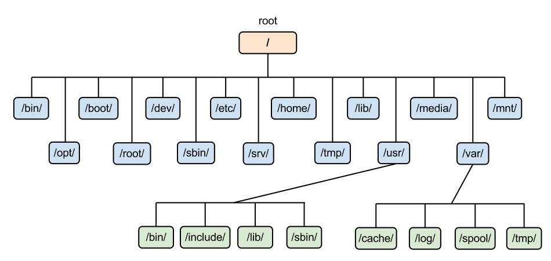

Topic Summary
Implementation:
File Info
  Linked List
  FAT
  Indexed
Partition Details
  Bitmap
  Linked list of disc blocks
Directory structure
  Linear List
  Hash Table
OS Boot Block
Partition Details
Directory Structure
Files Info
File Data
Notes:
Implementation:
File Info
Linked List
FAT
Indexed
Free Space
Bitmap
Linked list of disc blocks
Directory structure
Linear List
Hash Table

Slide 3
Tutorial 11
Question 1
(Discuss after Q2)

Slide 4
Tutorial 11
Question 2

Slide 5
Overview
Partition Details
Directory Structure
Files Info
File Data
0 (root) | 1 | 2 | 3
y |Dir | 3 f |File| 12| 2 x |Dir | 1 | g |File| 0| 31 z |Dir | 2 | k |File| 6| 6 | i |File| 1| 3 h |File|27|28
Directory
0 | 1 | 2 | 3 | 4 | 5 | 6 | 7 | 8 | 9 | 10 | 11 | 12 | 13 | 14 | 15
0 | 0 | 0 | 0 | 0 | 1 | 0 | 0 | 1 | 0 | 0 | 0 | 0 | 1 | 0 | 1
16 | 17 | 18 | 19 | 20 | 21 | 22 | 23 | 24 | 25 | 26 | 27 | 28 | 29 | 30 | 31
1 | 0 | 1 | 0 | 1 | 0 | 1 | 0 | 1 | 1 | 1 | 0 | 0 | 1 | 0 | 0
F.Data BM
0 | 1 | 2 | 3 | 4 | 5 | 6 | 7
11 AL | 9 TH | -1 S! | -1 ND | 23 GS | -1 SO | -1 :) | 10 TE
8 | 9 | 10 | 11 | 12 | 13 | 14 | 15
31 RE | 3 EE | 28 M: | 31 OH | 19 SE | 13 AH | 4 IN | 17 NO
16 | 17 | 18 | 19 | 20 | 21 | 22 | 23
30 YE | 2 OU | 1 ON | 17 RI | 26 EV | 14 AT | 21 DA | 7 YS
24 | 25 | 26 | 27 | 28 | 29 | 30 | 31
-1 HO | 18 ME | 0 AL | 30 OP | -1 -( | 5 LO | 21 ER | -1 A!
Actual File Data
Notes:
File Data Bitmap = (1 = FREE, 0 = OCCUPIED)

Slide 6
a. Free capacity & FS Overview
0 (root) | 1 | 2 | 3
y |Dir | 3 f |File| 12| 2 x |Dir | 1 | g |File| 0| 31 z |Dir | 2 | k |File| 6| 6 | i |File| 1| 3 h |File|27|28
Directory
0 | 1 | 2 | 3 | 4 | 5 | 6 | 7 | 8 | 9 | 10 | 11 | 12 | 13 | 14 | 15
0 | 0 | 0 | 0 | 0 | 1 | 0 | 0 | 1 | 0 | 0 | 0 | 0 | 1 | 0 | 1
16 | 17 | 18 | 19 | 20 | 21 | 22 | 23 | 24 | 25 | 26 | 27 | 28 | 29 | 30 | 31
1 | 0 | 1 | 0 | 1 | 0 | 1 | 0 | 1 | 1 | 1 | 0 | 0 | 1 | 0 | 0
F.Data BM
0 | 1 | 2 | 3 | 4 | 5 | 6 | 7
11 AL | 9 TH | -1 S! | -1 ND | 23 GS | -1 SO | -1 :) | 10 TE
8 | 9 | 10 | 11 | 12 | 13 | 14 | 15
31 RE | 3 EE | 28 M: | 31 OH | 19 SE | 13 AH | 4 IN | 17 NO
16 | 17 | 18 | 19 | 20 | 21 | 22 | 23
30 YE | 2 OU | 1 ON | 17 RI | 26 EV | 14 AT | 21 DA | 7 YS
24 | 25 | 26 | 27 | 28 | 29 | 30 | 31
-1 HO | 18 ME | 0 AL | 30 OP | -1 -( | 5 LO | 21 ER | -1 A!
Actual File Data

Slide 7
b. /y/i and /x/z/i
0 (root) | 1 | 2 | 3
y |Dir | 3 f |File| 12| 2 x |Dir | 1 | g |File| 0| 31 z |Dir | 2 | k |File| 6| 6 | i |File| 1| 3 h |File|27|28
Directory
0 | 1 | 2 | 3 | 4 | 5 | 6 | 7 | 8 | 9 | 10 | 11 | 12 | 13 | 14 | 15
0 | 0 | 0 | 0 | 0 | 1 | 0 | 0 | 1 | 0 | 0 | 0 | 0 | 1 | 0 | 1
16 | 17 | 18 | 19 | 20 | 21 | 22 | 23 | 24 | 25 | 26 | 27 | 28 | 29 | 30 | 31
1 | 0 | 1 | 0 | 1 | 0 | 1 | 0 | 1 | 1 | 1 | 0 | 0 | 1 | 0 | 0
F.Data BM
0 | 1 | 2 | 3 | 4 | 5 | 6 | 7
11 AL | 9 TH | -1 S! | -1 ND | 23 GS | -1 SO | -1 :) | 10 TE
8 | 9 | 10 | 11 | 12 | 13 | 14 | 15
31 RE | 3 EE | 28 M: | 31 OH | 19 SE | 13 AH | 4 IN | 17 NO
16 | 17 | 18 | 19 | 20 | 21 | 22 | 23
30 YE | 2 OU | 1 ON | 17 RI | 26 EV | 14 AT | 21 DA | 7 YS
24 | 25 | 26 | 27 | 28 | 29 | 30 | 31
-1 HO | 18 ME | 0 AL | 30 OP | -1 -( | 5 LO | 21 ER | -1 A!
Actual File Data

Slide 8
c. /x/z/k and /y/h
0 (root) | 1 | 2 | 3
y |Dir | 3 f |File| 12| 2 x |Dir | 1 | g |File| 0| 31 z |Dir | 2 | k |File| 6| 6 | i |File| 1| 3 h |File|27|28
Directory
0 | 1 | 2 | 3 | 4 | 5 | 6 | 7 | 8 | 9 | 10 | 11 | 12 | 13 | 14 | 15
0 | 0 | 0 | 0 | 0 | 1 | 0 | 0 | 1 | 0 | 0 | 0 | 0 | 1 | 0 | 1
16 | 17 | 18 | 19 | 20 | 21 | 22 | 23 | 24 | 25 | 26 | 27 | 28 | 29 | 30 | 31
1 | 0 | 1 | 0 | 1 | 0 | 1 | 0 | 1 | 1 | 1 | 0 | 0 | 1 | 0 | 0
F.Data BM
0 | 1 | 2 | 3 | 4 | 5 | 6 | 7
11 AL | 9 TH | -1 S! | -1 ND | 23 GS | -1 SO | -1 :) | 10 TE
8 | 9 | 10 | 11 | 12 | 13 | 14 | 15
31 RE | 3 EE | 28 M: | 31 OH | 19 SE | 13 AH | 4 IN | 17 NO
16 | 17 | 18 | 19 | 20 | 21 | 22 | 23
30 YE | 2 OU | 1 ON | 17 RI | 26 EV | 14 AT | 21 DA | 7 YS
24 | 25 | 26 | 27 | 28 | 29 | 30 | 31
-1 HO | 18 ME | 0 AL | 30 OP | -1 -( | 5 LO | 21 ER | -1 A!
Actual File Data

Slide 9
d. new /y/n with 5 blocks
0 (root) | 1 | 2 | 3
y |Dir | 3 f |File| 12| 2 x |Dir | 1 | g |File| 0| 31 z |Dir | 2 | k |File| 6| 6 | i |File| 1| 3 h |File|27|28
Directory
0 | 1 | 2 | 3 | 4 | 5 | 6 | 7 | 8 | 9 | 10 | 11 | 12 | 13 | 14 | 15
0 | 0 | 0 | 0 | 0 | 1 | 0 | 0 | 1 | 0 | 0 | 0 | 0 | 1 | 0 | 1
16 | 17 | 18 | 19 | 20 | 21 | 22 | 23 | 24 | 25 | 26 | 27 | 28 | 29 | 30 | 31
1 | 0 | 1 | 0 | 1 | 0 | 1 | 0 | 1 | 1 | 1 | 0 | 0 | 1 | 0 | 0
F.Data BM
0 | 1 | 2 | 3 | 4 | 5 | 6 | 7
11 AL | 9 TH | -1 S! | -1 ND | 23 GS | -1 SO | -1 :) | 10 TE
8 | 9 | 10 | 11 | 12 | 13 | 14 | 15
31 RE | 3 EE | 28 M: | 31 OH | 19 SE | 13 AH | 4 IN | 17 NO
16 | 17 | 18 | 19 | 20 | 21 | 22 | 23
30 YE | 2 OU | 1 ON | 17 RI | 26 EV | 14 AT | 21 DA | 7 YS
24 | 25 | 26 | 27 | 28 | 29 | 30 | 31
-1 HO | 18 ME | 0 AL | 30 OP | -1 -( | 5 LO | 21 ER | -1 A!
Actual File Data

Slide 10
Tutorial 11
Question 1
(Now we can discuss)

Slide 11
0 | 1 | 2 | 3
y |Dir | 3 f |File| 12| 2 x |Dir | 1 | g |File| 0| 31 z |Dir | 2 | k |File| 6| 6 | i |File| 1| 3 h |File|27|28
Directory
 | ReadExeDir dr-x------ | WriteExeDir d-wx------ | ExeOnlyDir d--x------
a. ls –l DDD | ok | nope | nope
b. cd DDD | ok | ok | ok
c. ls –l | ok | nope | nope
d. cat file.txt | ok | ok | ok
e. touch file.txt | ok | ok | ok
f. touch new.txt | nope | ok | nope
Notes:
Use the directory example in Q2 to illustrate

Slide 12
Tutorial 11
Question 3

Slide 13
Higher-Level I/O Scheduling
User processes submit file operation requests
operation( starting hard disk sector, number of bytes)
The OS sorts the requests by hard disk sector.
The OS merges requests that are nearby into a larger request
The OS issues the processed requests when the hard disk is ready.
a. How to decide to merge two user requests in step (iii)? Give two simple criteria.

Slide 14
Higher-Level I/O Scheduling
User processes submit file operation requests
operation( starting hard disk sector, number of bytes)
The OS sorts the requests by hard disk sector.
The OS merges requests that are nearby into a larger request
The OS issues the processed requests when the hard disk is ready.
b. Give one advantage of the algorithm above.

Slide 15
Higher-Level I/O Scheduling
User processes submit file operation requests
operation( starting hard disk sector, number of bytes)
The OS sorts the requests by hard disk sector.
The OS merges requests that are nearby into a larger request
The OS issues the processed requests when the hard disk is ready.
c. Give one disadvantage of the algorithm.
Suggest one solution.

Slide 16
Higher-Level I/O Scheduling
User processes submit file operation requests
operation( starting hard disk sector, number of bytes)
The OS sorts the requests by hard disk sector.
The OS merges requests that are nearby into a larger request
The OS issues the processed requests when the hard disk is ready.
d. OS intentionally delay in serving user I/O requests. Why? (use this algo as context)

Slide 17
Higher-Level I/O Scheduling
User processes submit file operation requests
operation( starting hard disk sector, number of bytes)
The OS sorts the requests by hard disk sector.
The OS merges requests that are nearby into a larger request
The OS issues the processed requests when the hard disk is ready.
e. Scheduling also done by hardware controller.
Explain how this algo may conflict.

