Slide 1
Three Methods for POS Tagging

Slide 2
Rule-Based Tagging
Basic Idea:
Each word is first assigned all possible POS tags by a morphological analyzer.
A large set of hand-written or machine-learned rules are then applied to remove incorrect tags.
Rules consider the context (previous and next words/tags) to disambiguate.
Process:
Lexical lookup: Assign possible tags (e.g., “flies” → Noun/Verb).
Constraint application: Use contextual rules to remove unlikely tags (e.g., if preceded by “the”, “flies” → Noun).
Example Rule:
If the preceding word is a determiner (e.g., “the”), then the current word is unlikely to be a verb.
Advantages:
High linguistic interpretability.
Performs well for languages with rich morphology.
Limitations:
Requires extensive manual rule writing (often >1000 rules).
Hard to adapt to new domains.

Slide 3
Example Sentence
“The flies are annoying.”
Step 1: Morphological Analysis
flies → {Noun, Verb}
Step 2: Apply Rules
Preceding word = “the” (determiner) → Remove Verb tag
✅ Final Tag: flies → Noun
Tag the following sentence using your own rules:
“Time flies like an arrow.” (Hint: Think about the context of “flies” and “like.”)

Slide 4
Stochastic (Statistical) Tagging
Basic Idea:
Uses probability models learned from annotated corpora.
Assigns the most likely tag sequence based on statistical evidence.
Common Models:
Hidden Markov Model (HMM) Tagger (most widely used).
Trigram Tagger, Bigram Tagger based on transition and emission probabilities.
Example (HMM):
P(T∣W)∝P(W∣T)P(T)
Where:
T: tag sequence
W: word sequence
The most probable tag sequence is found using the Viterbi algorithm.
Advantages:
Automatically learned from data.
Works well with large corpora.
Limitations:
Requires large annotated datasets.
Purely statistical; may ignore linguistic rules.

Slide 5
Transformation-Based (Hybrid) Tagging (TBL)
Basic Idea:
Combines rule-based and statistical approaches.
Begins with a baseline tagger (e.g., most frequent tag).
Then learns transformation rules automatically from training data that correct errors iteratively.
Process:
Assign initial tags using a simple method (e.g., most frequent tag for each word).
Apply learned correction rules like:
“If a word is tagged as NN (noun) but follows ‘to’, change it to VB (verb).”
Advantages:
Fewer rules than pure rule-based systems.
Automatically learned from data.
Combines linguistic intuition with statistical learning.
Limitations:
Slower training due to rule learning phase.
May not perform as well on highly ambiguous text.

Slide 6
Method | Principle | Example | Data Requirement | Interpretability | Adaptability
Rule-Based | Contextual rules remove invalid tags | EngCG, ENGTWOL | Low | High | Low
Statistical (HMM) | Probabilistic model of tag sequences | HMM Tagger | High | Medium | High
Transformation-Based (Hybrid) | Learns correction rules iteratively | Brill Tagger | Medium | High | Medium

Slide 7
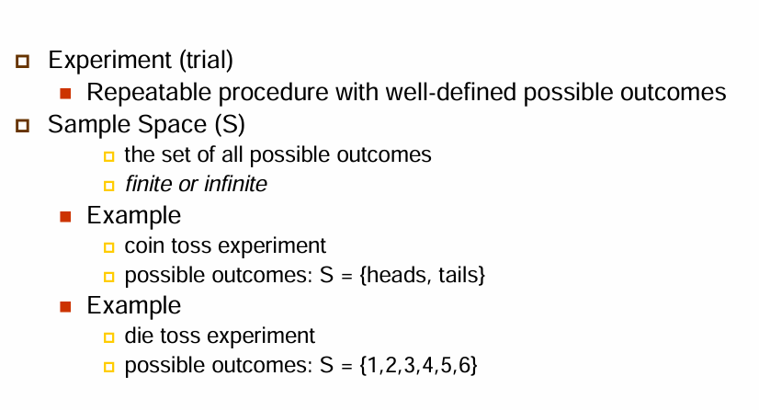
Introduction to Probability

Slide 8
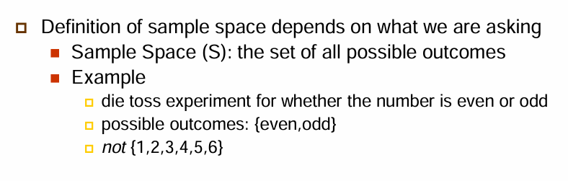
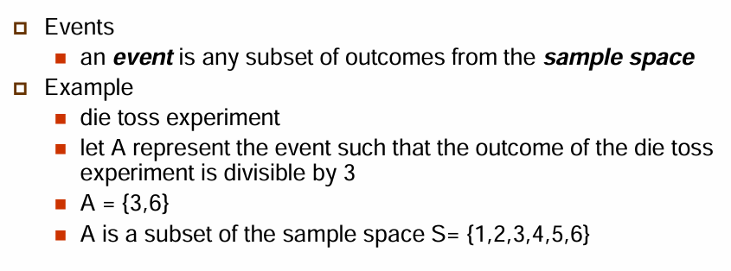

Slide 9
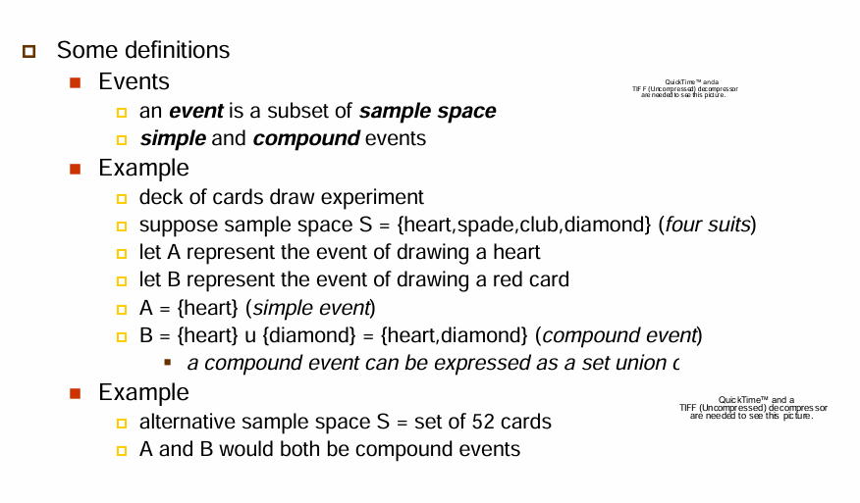

Slide 10
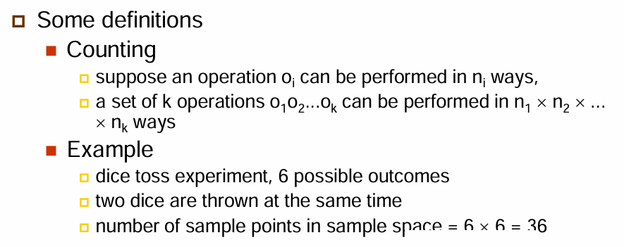

Slide 11
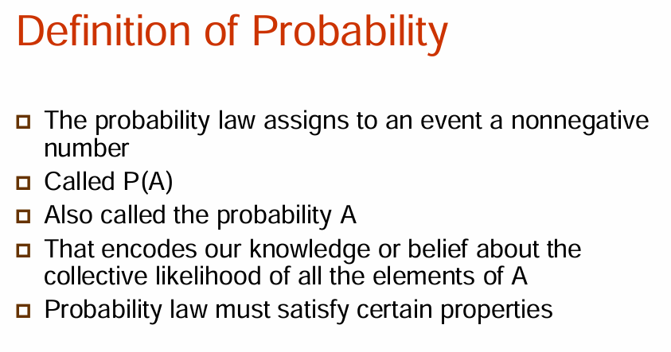
Probability is a measure of how likely an event is to happen. It always lies between 0 and 1.
0≤P(E)≤10
P(E) = 0 → event never happens.
P(E) = 1 → event always happens.
P(E) = 0.5 → event has equal chance of happening or not.

Slide 12
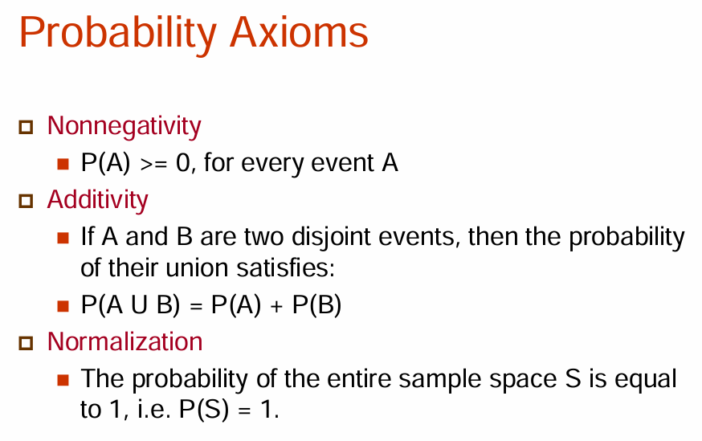

Slide 13
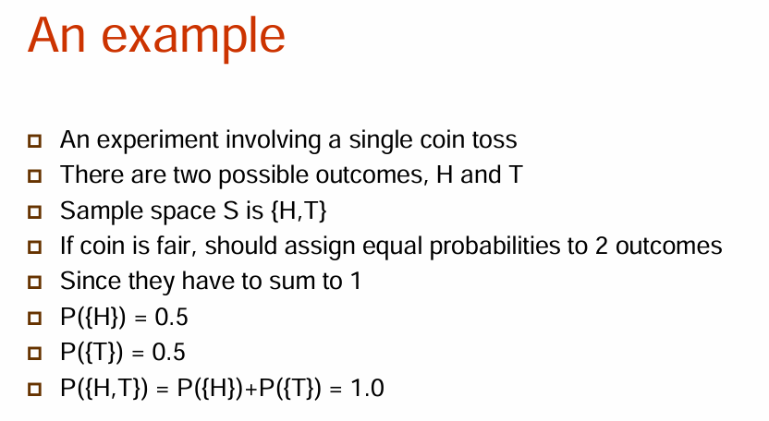

Slide 14
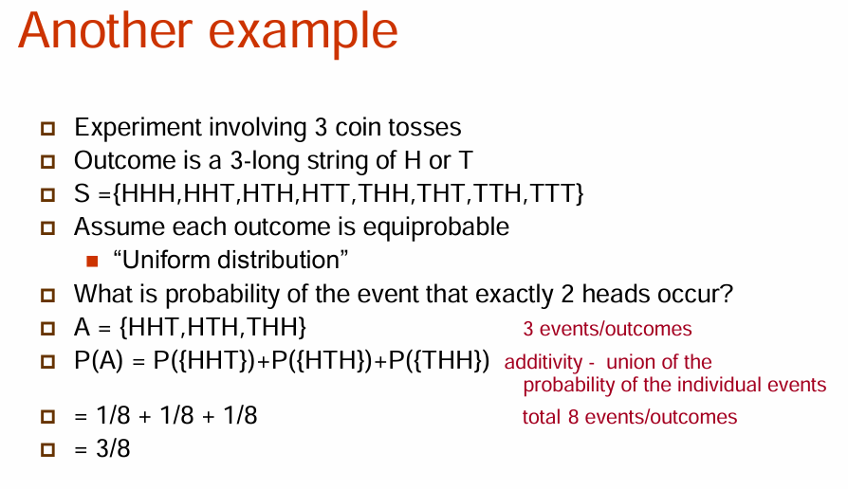

Slide 15
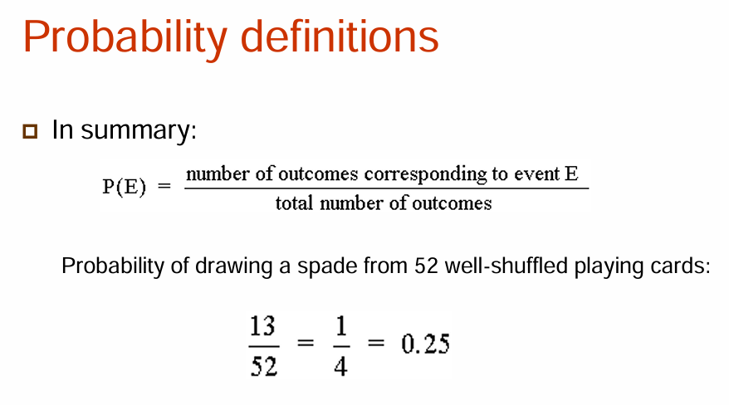

Slide 16
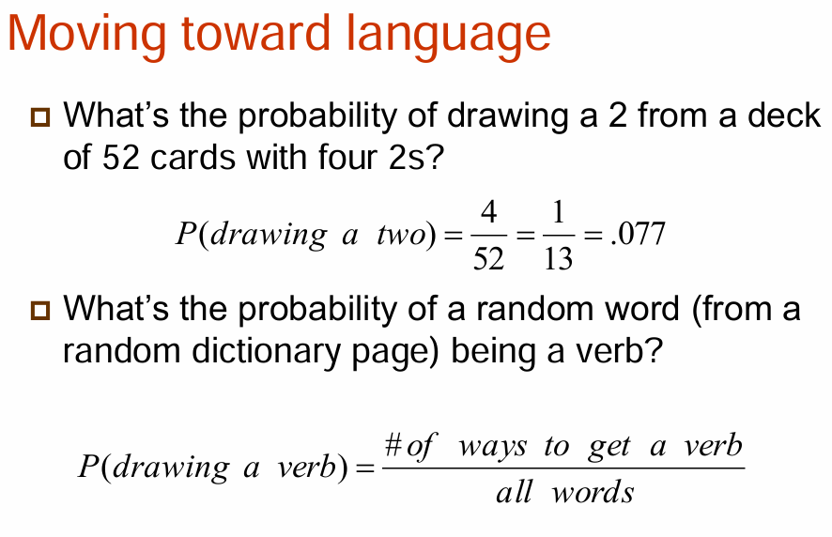

Slide 17
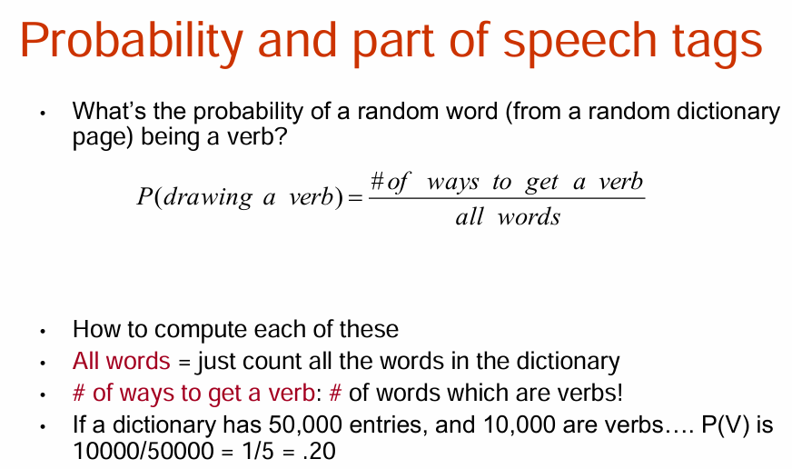

Slide 18
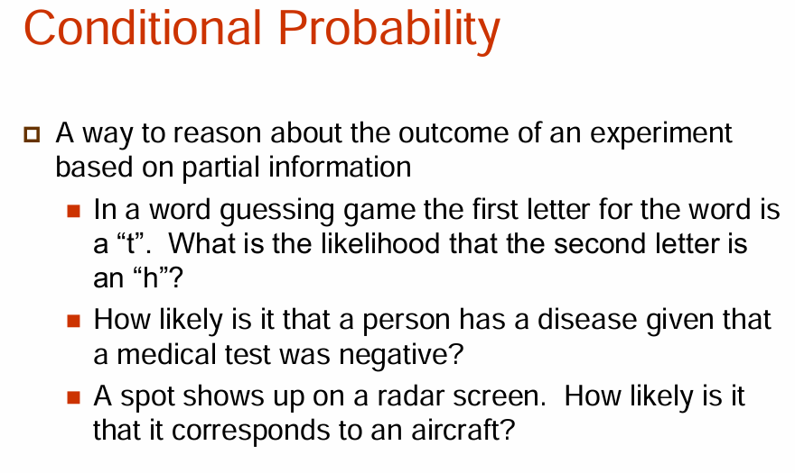

Slide 19
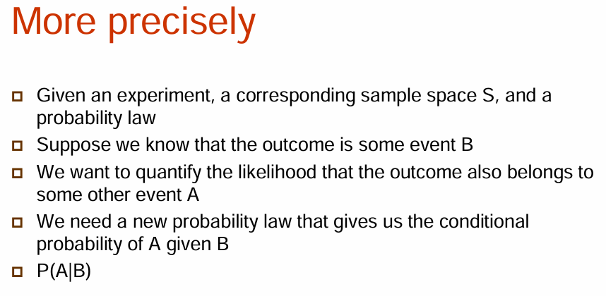

Slide 20
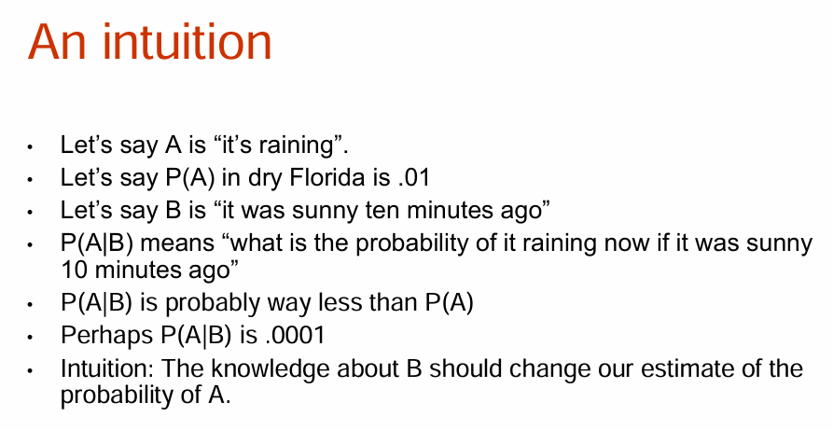

Slide 21
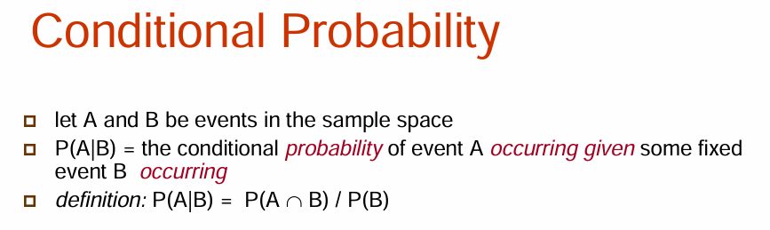

Slide 22
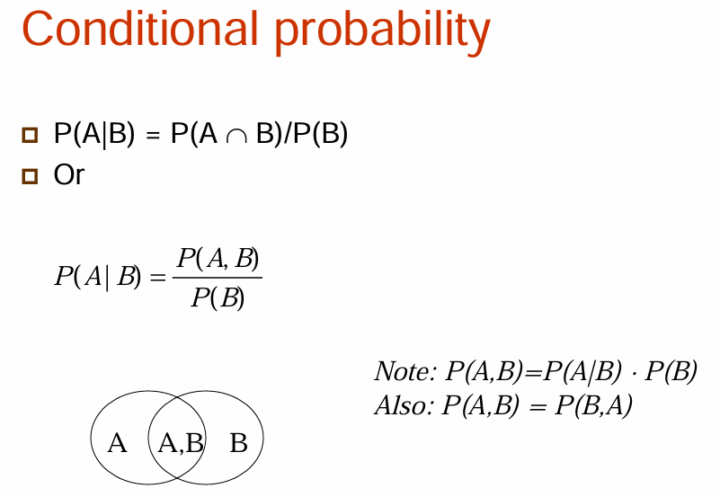

Slide 23
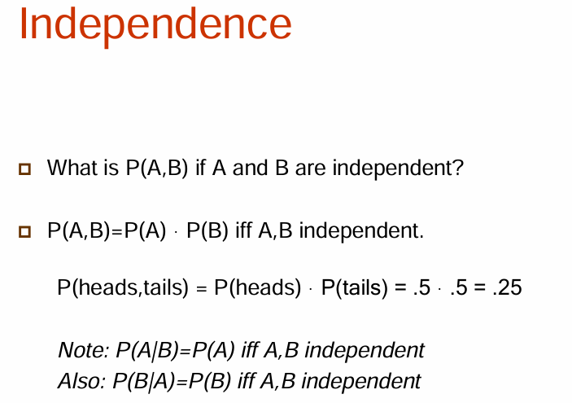

Slide 24
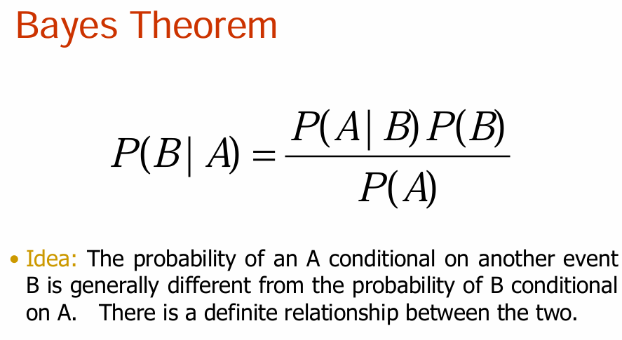

Slide 25
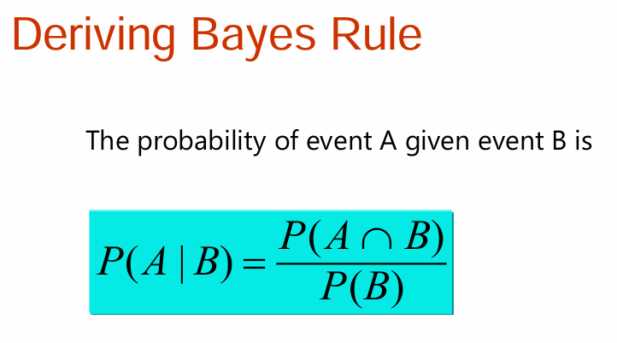

Slide 26
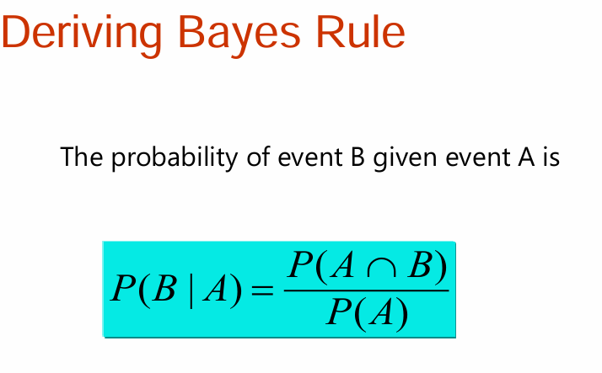

Slide 27
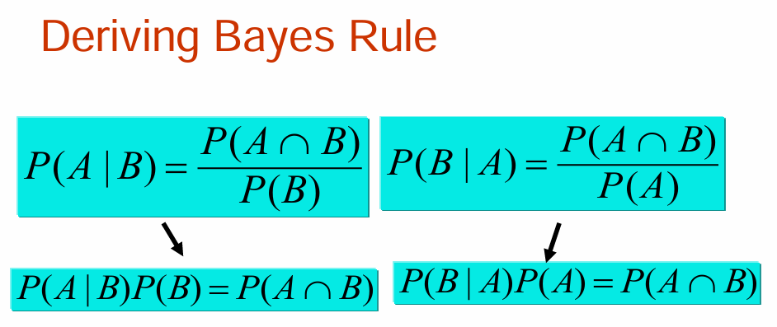

Slide 28
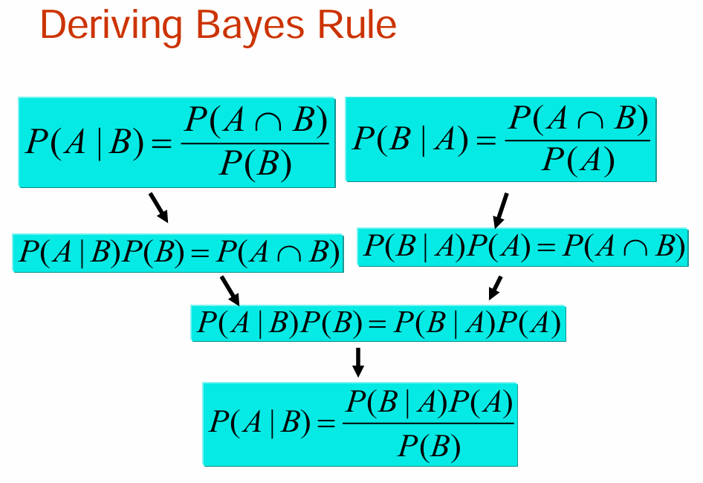

Slide 29
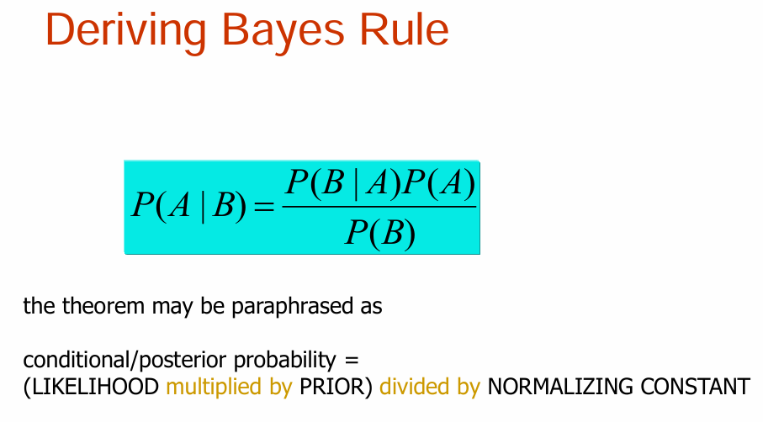

Slide 30
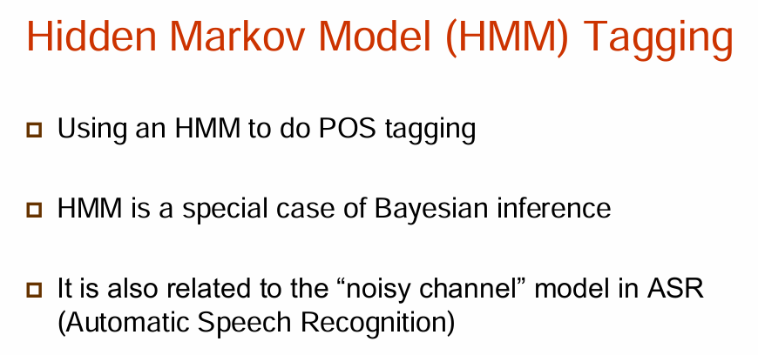

Slide 31
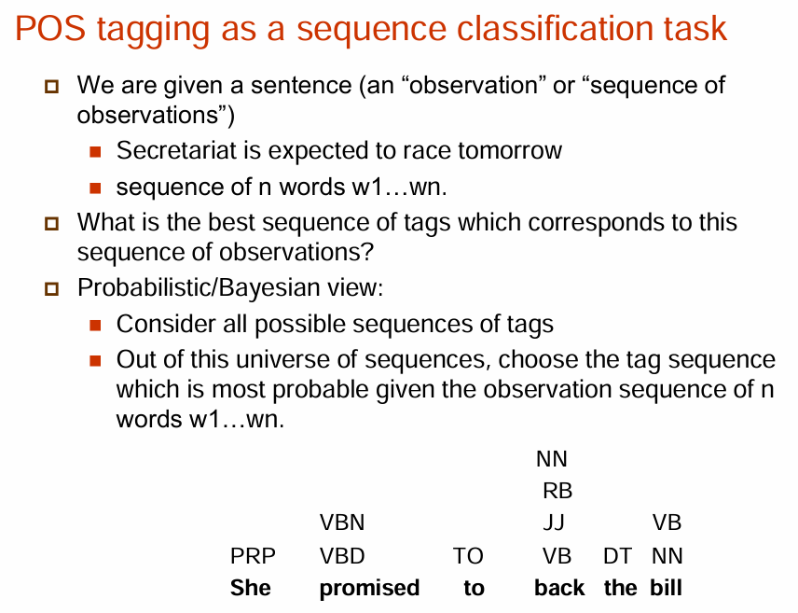

Slide 32
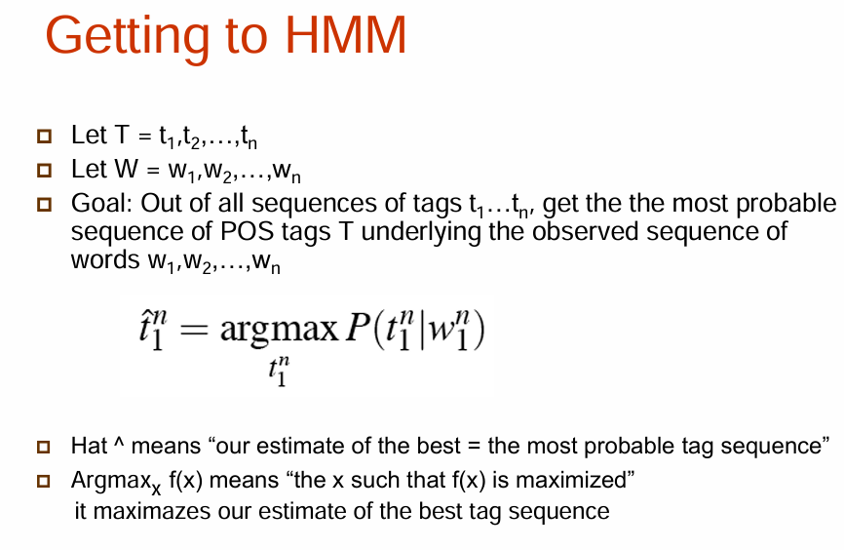

Slide 33
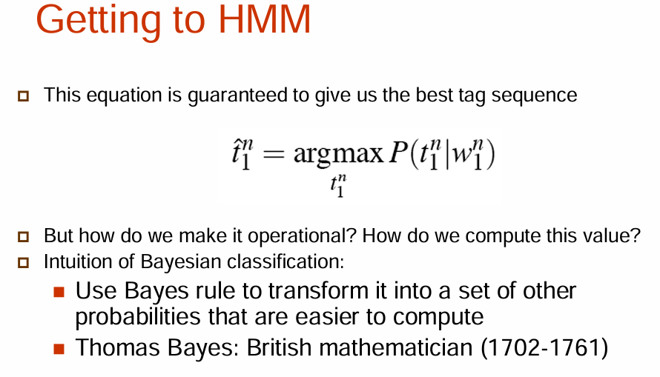

Slide 34
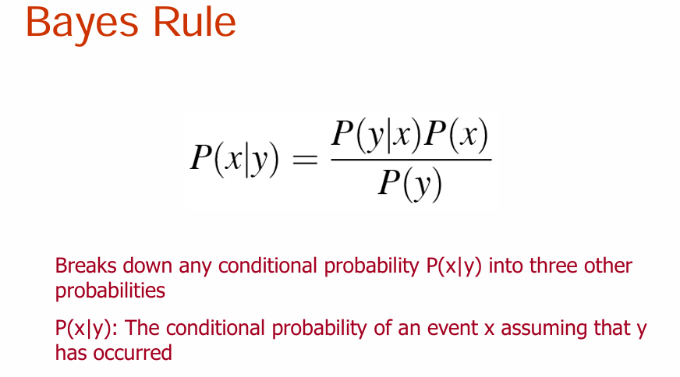

Slide 35
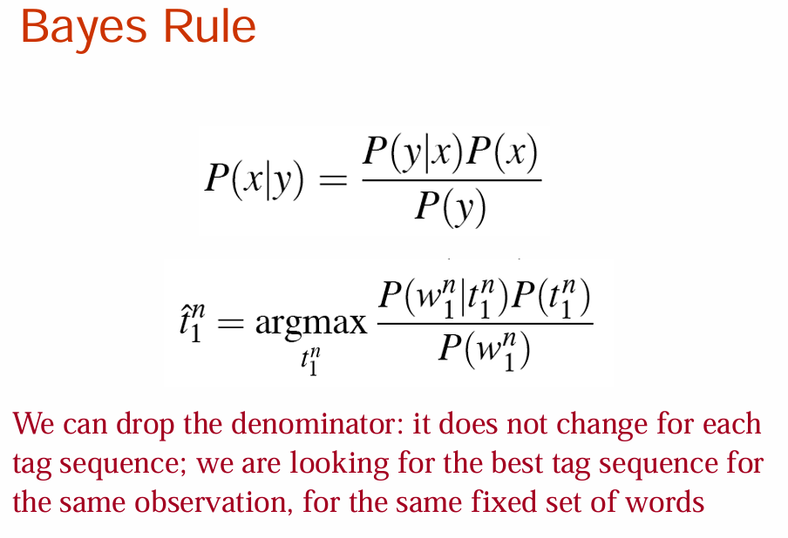

Slide 36
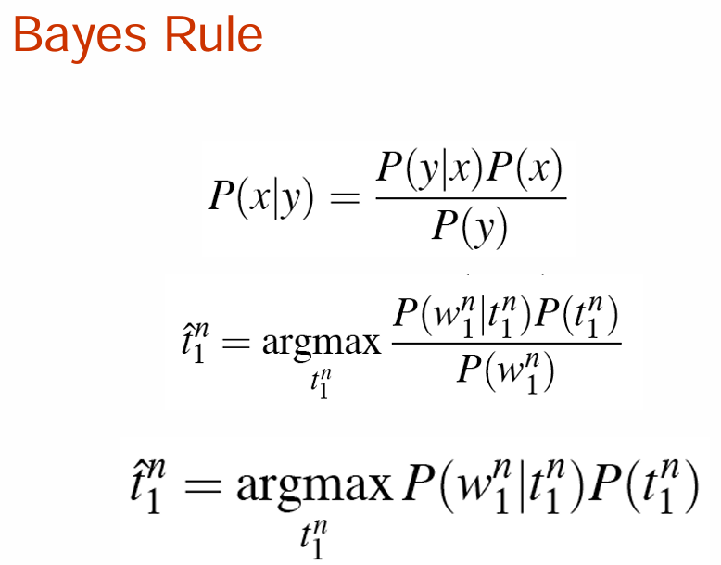

Slide 37
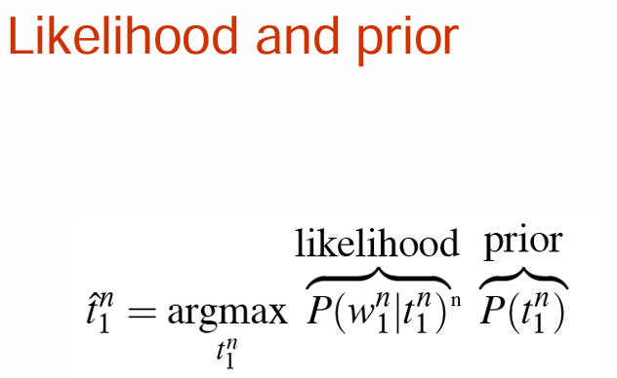

Slide 38
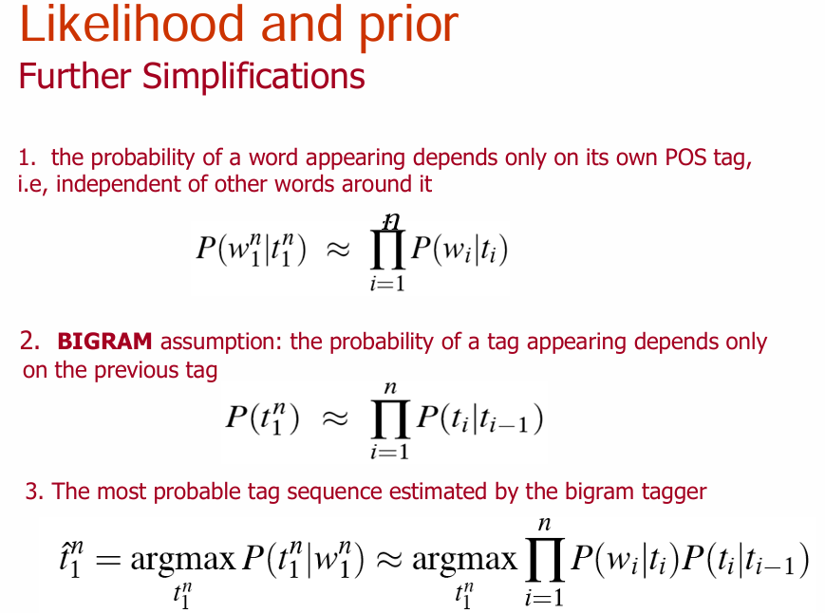

Slide 39
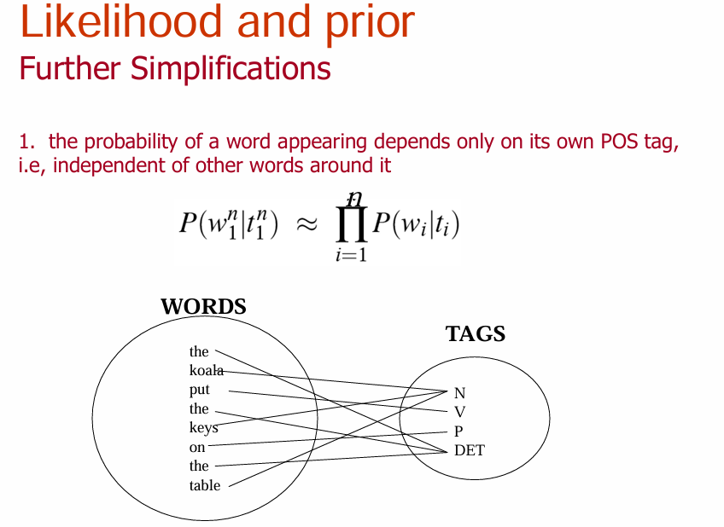

Slide 40
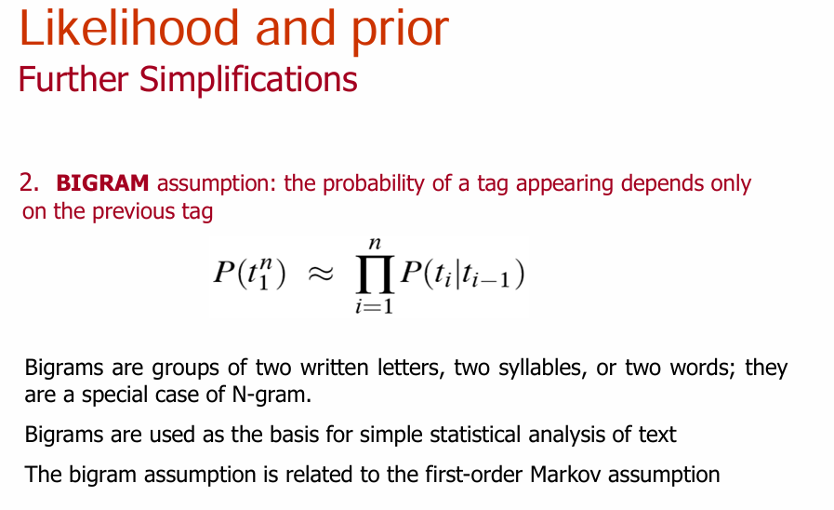

Slide 41
