Slide 1
mTherapy
Physiotherapy Using Smartphone

Slide 2
What is mTherapy
An app which uses the mobile’s accelerometer and gyroscope for physiotherapy treatment.

Slide 3
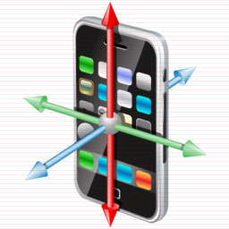
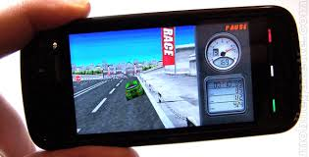
Mobile Accelerometer & Gyroscope
They are in-build in smartphone and used when we play 3D FPS games like car racing games in smartphones. I’ll will be using the same to measure angles of motion of joints.

Slide 4
Why mTherapy?
In rural areas, there are vaid’s, local doctors who can solve simple health problems like cough, cold, viral fever etc. But to treat problems like frozen shoulder, elbow pain, back pain etc a specialist like Orthopedician, physiotherapist are required for treatment. Usually specialist arenot available in rural areas. Also the tools used for exercise are expensive which can’t be affordable by the rural population.

Slide 5
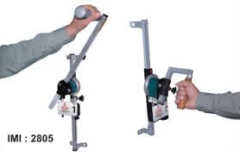
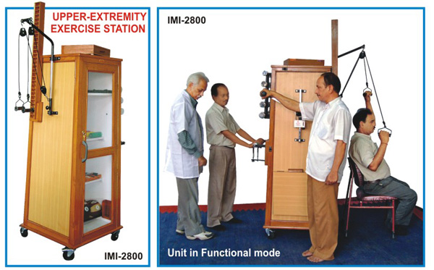
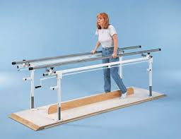
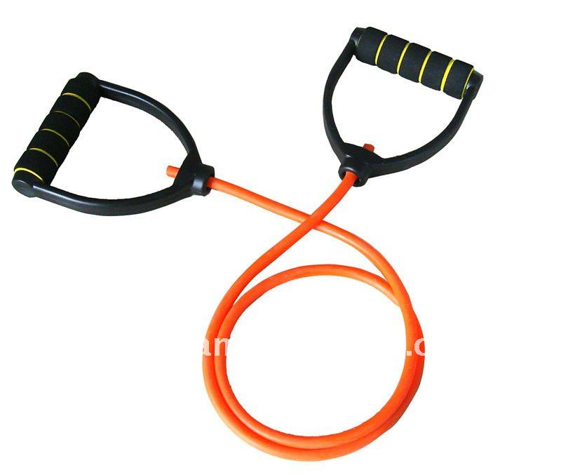
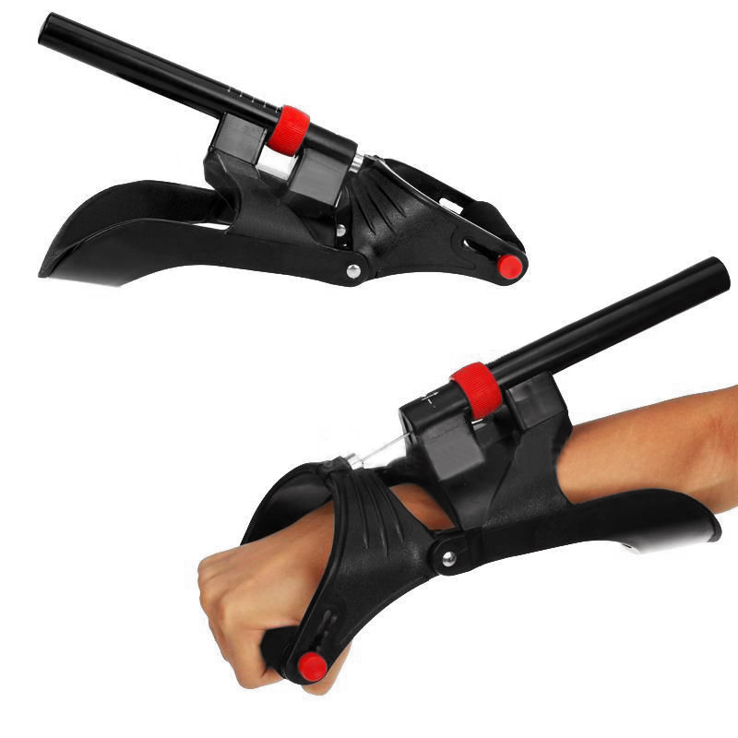

Slide 6
Prototype 1.0
This prototype can be attached to a person's arm and measure the angle of the shoulder, wrist and elbow

Slide 7

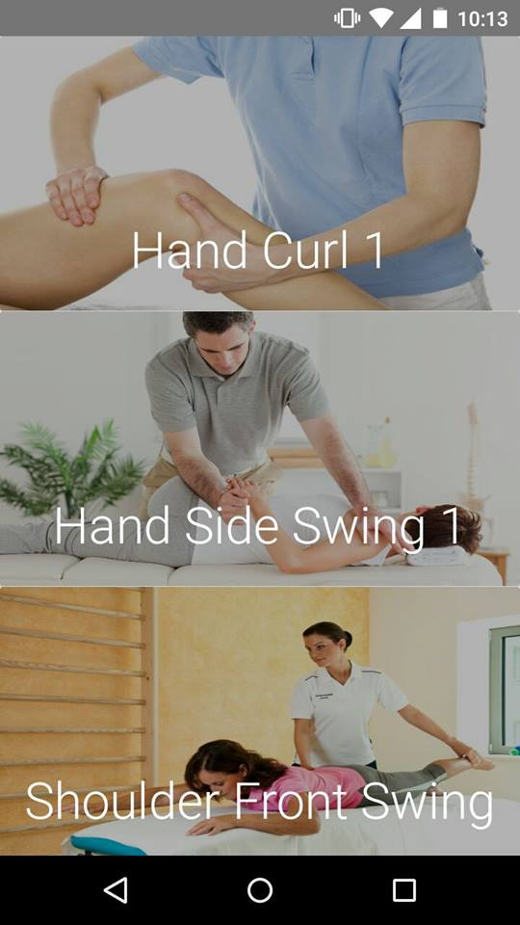
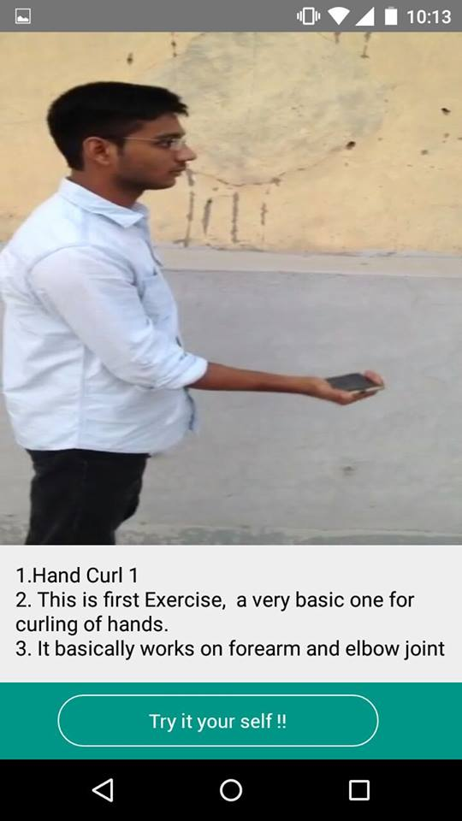

Slide 8
Prototype 1.0
The app can measure angles of different joints of the limbs and then if it finds some joint is stiff it will advice some exercises to the patient.
If there is a different complex problem, the app can send the angle measure to the specialist who can further advice treatment via telemedicine.

Slide 9
Thank You!
Karan Garg
Sarthak Sethi
Chetan Mann

