Slide 1
Double Instance Locking
A concurrency pattern with Lock-Free read operations
Pedro Ramalhete
Andreia Correia
November 2013

Slide 2
Contents
What is Double Instance Locking
Components
How does it work
Writer’s Algorithm
Reader’s Algorithm
How to make a RW-Lock out of it
Source Code
Performance Plots
Comparison Table
Correctness and Progress Conditions
Other Details
References
Tip: Watch in full screen to see animations

Slide 3
What is Double Instance Locking
It is a way to maintain up-to-date two replicas of a data structure, where there is always one replica that is available for read operations.
Does not need a language with automatic Garbage Collection.
Works on top of the most widely deployed synchronization mechanism: Locks.
It is Lock-Free for read operations.

Slide 4

Components
The Double Instance Locking pattern is composed of:
A mutual exclusion lock that serializes access of the mutable operations (Writers);
Two exact instances of the object or data structure that is being "protected;
Two Reader-Writer locks (one to protect each instance of the data structure) that support tryReadLock() and should have writer-preference;
writersMutex
RW-Lock 1
RW-Lock 2
Instance 1
Instance 2

Slide 5

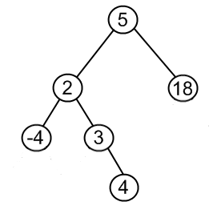
Writer’s algorithm Example with two AVL tree instances
W
Acquire the writer’s mutex to guarantee there is a single Writer at a time;
Acquire the write lock on the rw-lock of the first instance;
Execute the mutable operation on the first instance;
Release the write lock on the rw-lock of the first instance;
Acquire the write lock on the rw-lock of the second instance;
Execute exactly the same mutable operation;
Release the write lock on the rw-lock of the second instance;
Release the writer’s mutex;
writersMutex
RW-Lock 1
RW-Lock 2
W
W
9
9

Slide 6
Reader’s algorithm Scenario: Instance 1 is unlocked or read-locked
Do a try-read-lock on the RW-Lock of the first instance;
If the lock succeeds, do the read-only operation on the first instance;
Release the RW-Lock;
R
writersMutex
RW-Lock 1
RW-Lock 2
R

Slide 7
Reader’s algorithm Scenario: Instance 1 is write-locked
Do a try-read-lock on the RW-Lock of the first instance;
If the lock fails, do a try-read-lock on the RW-Lock of the second instance;
Do the read-only operation on the second instance;
Release the RW-Lock of the second instance;
R
writersMutex
RW-Lock 1
RW-Lock 2
W
R
W

Slide 8
Reader’s algorithm Scenario: Instance 1 is write-locked and Instance 2 is write-locked
Do a try-read-lock on the RW-Lock of the first instance;
If the lock fails, do a try-read-lock on the RW-Lock of the second instance;
If that also fails, then try the first lock again;
Repeat until one of the rw-locks is acquired;
R
writersMutex
RW-Lock 1
RW-Lock 2
W
W
W

Slide 9
How to make a RW-Lock out of it
The Double Instance Lock can be seen as a Reader-Writer Lock but requires an extra function, which we call writeToggle().
Moreover, we need an extra thread-local variable so that the readunlock() knows which of the two rw-locks was acquired by the readLock(). This can also be done with a pass by reference value that is filled by the readLock() and then passed to the readUnlock().
The API is defined as:
readLock() – Finds the first available instance for read-locking (and locks it) and returns the instance
readUnlock() – Unlocks the previously locked rw-lock
writeLock() – Locks the writer’s mutex, locks the first rw-lock, and returns a reference to the first instance
writeToggle() – Unlocks the first rw-lock, locks the second rw-lock, and returns a reference to the second instance
writeUnlock() – Unlocks the second rw-lock, and then the writer’s mutex

Slide 10
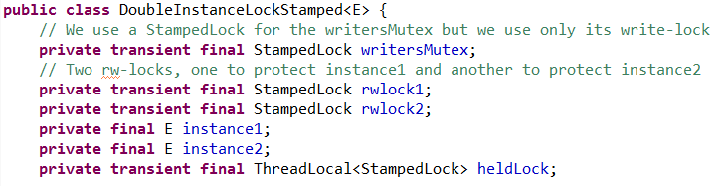
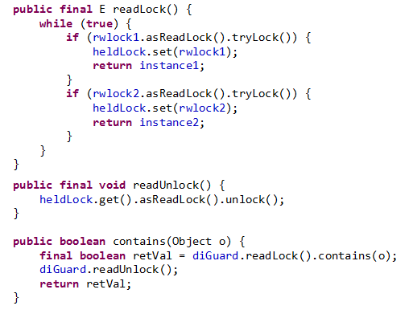
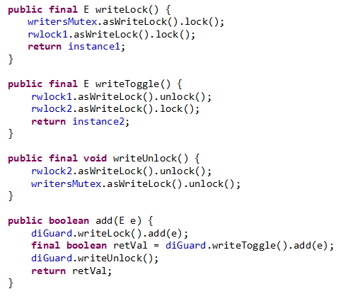
Code - Java

Slide 11
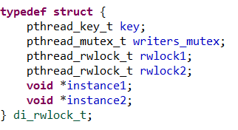
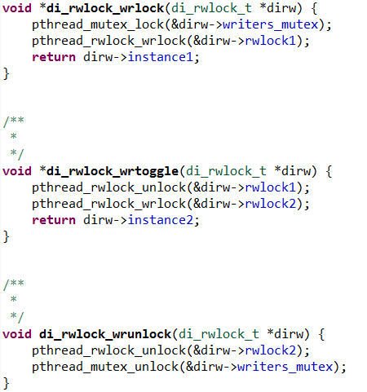
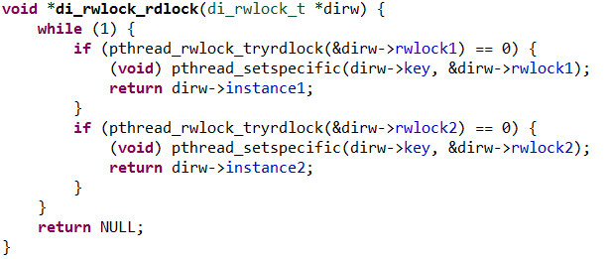

Code – C

Slide 12
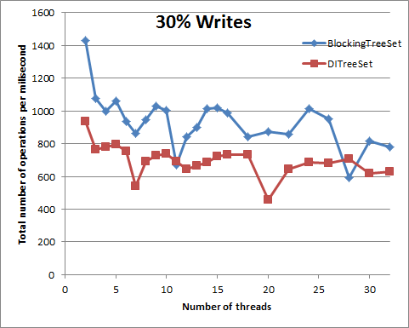
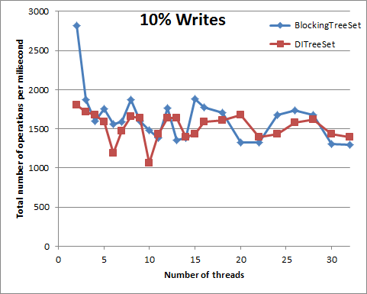
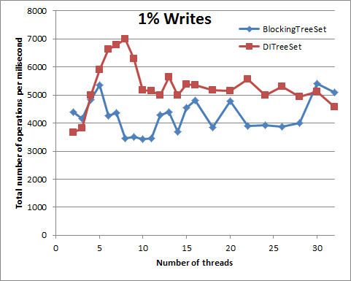
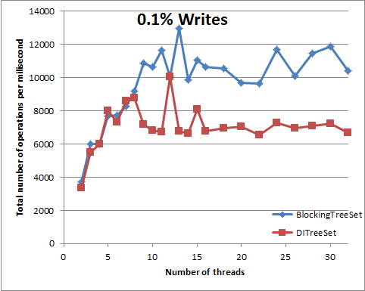
Performance Plots (mixed workload)
On the right side we show performance plots made in Java for a TreeSet protected with either a pure lock, or a TreeSet protected with a Double Instance Lock pattern.
Four different workloads are shown with 30%, 10%, 1%, and 0.1% write operations.
For a workload of 1% Writes the DITreeSet can sometimes be better than a pure Reader-Writer Lock.

Slide 13
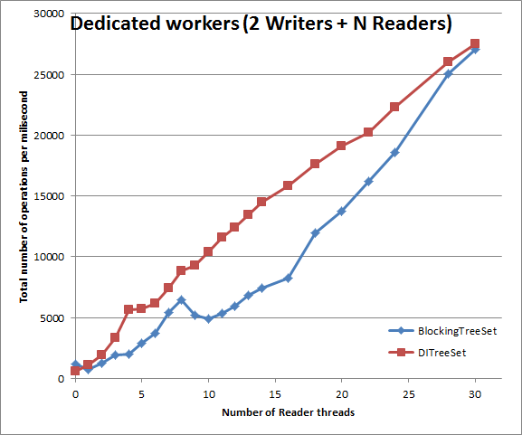
Performance Plots (dedicated workers)
Performance plots with two threads dedicated to doing write operations and then adding new Reader threads. Higher is better.
In applications where threads are assigned dedicated roles (Writer or Reader) the Double Instance Lock pattern can outperform the pure reader-writer lock
Notice that both the BlockingTreeSet and the DITreeSet use the same kind of reader-writer lock (namely, a LongAdderStampedRWLock), but BlockingTreeSet uses a single rw-lock, while the DITreeSet uses three locks (one mutex + two rw-locks).

Slide 14
Reader Latency Distribution
The table below shows the latency measurements for:
BlockingTreeSet: a java TreeSet protected with an RWLock (namely, LongAdderStampedRWLock)
DITreeSet: a java TreeSet protected with a Double Instance Locking that uses the same RWLock (LongAdderStampedRWLock)
As can be seen in the table below, the latency for the long tail of the distribution is an order of magnitude lower (better) for the DITreeSet. Low values of latency are better.
The table below can be read as follows: 99.9% of the calls to BlockingTreeSet.contains(x) take less than 44 microseconds to complete, and 99.9% of the calls to DITreeSet.contains(x) take less than 2 microsecond to complete.
Reader Latency Guarantee | Reader-Writer Lock (micro-seconds) | Double Instance Locking (micro-seconds)
90% | smaller than 1 | smaller than 1
99% | 40 | smaller than 1
99.9% | 44 | 2
99.99% | 75 | 13
99.999% | 160 | 23

Slide 15
Minimum operations
Minimum Operations | Reader-Writer Lock | Reader-Writer Lock with Optimistic Reads | Double Instance Locking | Copy-On-Write
Writer | rwlock.writeLock() rwlock.writeUnlock() | rwlock.writeLock() rwlock.writeUnlock() | writersMutex.lock() rwlock1.writeLock() rwlock1.writeUnlock() rwlock2.writeLock() rwlock2.writeUnlock() writersMutex.unlock() | atomicRef.CAS()
Reader | rwlock.readLock() rwlock.readUnlock() | rwlock.tryOptimisticRead() rwlock.validate() | rwlock1.readLock() rwlock1.readUnlock() | atomicRef.get()
We can look at the functions called when running with low/no contention to get an idea of the best-case performance of each technique.
The best is clearly the Copy-On-Write because it does a single Compare-And-Swap for the Writer, and an atomic load for the Reader. The worse is the Double Instance Locking that although similar to an RW-Lock for Readers, it has a higher overhead for Writers, and that is why it is more advantageous to use it in scenarios where the access is write-few-read-many.

Slide 16
Comparison table
The main advantage of the Double Instance Locking is that, although it is similar in use to a Reader-Writer lock, it is Lock-Free for Readers, which allows Readers to run at the same time as a Writer, each on a different instance.
The trade-offs are: memory consumption (twice the size of the data structure, but not the user data), and twice the work for write operations.
 | Reader-Writer Lock | Reader-Writer Lock with Optimistic Reads | Double Instance Locking | Copy-On-Write
Progress for Writers | Blocking | Blocking | Blocking | Lock-Free
Progress for Readers | Blocking | Lock-Free | Lock-Free | Wait-Free
Works in languages with GC (Java/Scala) | yes | yes | yes | yes
Works in languages without GC (C/C++) | yes | not if memory reclamation is needed | yes | not easily
Number of instances required | 1 | 1 | 2 | 1 to N_{Threads}
Writer and Readers can execute simultaneously | no | yes | yes | yes

Slide 17
Correctness and Progress Conditions
It is trivial to show that this technique is correct, in the sense that Writers are mutual exclusive with each other and with Readers for both instance1 and instance2. A Writer accessing instance x will first acquire the rw-lock x in write mode, and a Reader accessing instance x will first acquire the rw-lock x in read-only mode, thus preventing any possibility of simultaneous access by a Writer and a Reader to any particular instance.
The Writer’s progress condition is blocking, which is easy to see because all Writers start by acquiring the writersMutex exclusive lock, which serializes Writers.
We can show that the Reader’s progress condition is lock-free by showing that a thread loops beyond a finite number of times only if another thread (Writer) completes an operation. If there is no Writer currently active, a Reader will successfully acquire the rw-lock of the first instance. On the contrary, if there is a Writer holding the rw-lock of the first instance then the Reader will try instead to acquire the rw-lock of the second instance, and if that fails, it means that a Writer has completed its operation and a new Writer has acquired the rw-lock of the first instance. This procedure could theoretically go on indefinitely, but in that case, every time the Reader fails to acquire the lock on the first instance means that, the previous Writer has completed its operation and a new Writer has started a new one and, therefore, at least one other thread is making progress.

Slide 18
Other Details
This pattern can be implemented on any language that provides Reader-Writer Locks, like C99 (using Pthreads). Other possible languages are: C++, Scala, C#, F#, VB, Python.
It is recommended to use Reader-Writer Locks with a writer-preference or at least task-fairness. The reason being that when the Writer is waiting on one of the instance’s locks, it should wait as little as possible. For optimum performance, when there are already Readers holding the rw-lock, any new Readers trying to acquire the (read) lock after the Writer has started waiting, should fail their try-lock and go do the try-lock on the other instance.
Mutable operations can not have side effects. If the (Writer) mutable operation has a side effect, then, executing the operation twice (once on each of the two instances) could cause undesired/incorrect results.

Slide 19
Conclusions
This is a new and simple technique that can be implemented on any language that supports Reader-Writer Locks with try-locks.
For data structures that have an access pattern that is write-few-read-many, this technique can provide performance similar or sometimes better than a pure reader-writer lock.
When compared with a single Reader-Writer Lock, although it consumes twice the memory and requires twice the number of write operations, its lock-free properties for read operations give latency guarantees that no Reader-Writer Lock is currently able to match.

Slide 20
References
The original post for the Double Instance Locking
Source code in Java:
https://sourceforge.net/projects/ccfreaks/files/papers/DoubleInstance/DoubleInstanceLockStamped.java
Source code in C (99):
https://sourceforge.net/projects/ccfreaks/files/papers/DoubleInstance/di_rwlock.h
https://sourceforge.net/projects/ccfreaks/files/papers/DoubleInstance/di_rwlock.c
https://sourceforge.net/projects/ccfreaks/files/papers/DoubleInstance/di_rwlock_example.c
Double Instance Locking is based on the “Left-Right” mechanism which is a technique that is Wait-Free for Readers, but not as easy to understand. The Left-Right paper can be obtained here:
https://pramalheshared.s3.amazonaws.com/Concurrency/ppopp14-leftright.pdf
Many different scalable Reader-Writer Locks with writer-preference:
http://concurrencyfreaks.com/2013/09/scalable-rw-lock-with-single-longadder.html
http://concurrencyfreaks.com/2013/09/combining-stampedlock-and-longadder-to.html
http://concurrencyfreaks.com/2013/09/distributed-cache-line-counter-scalable.html
http://concurrencyfreaks.com/2013/02/a-scalable-rw-lock-with-2-state-readers.html
StampedLock can use optimistic read operations:
http://download.java.net/jdk8/docs/api/java/util/concurrent/locks/StampedLock.html#tryOptimisticRead--
http://concurrencyfreaks.com/2013/11/stampedlocktryoptimisticread-and.html
Hans Boehm presentation explaining some of the difficulties of implementing and using a Reader-Writer lock with optimistic reads:
http://concurrencyfreaks.com/2013/10/hans-boehm-on-reader-writer-locks.html
Source code to most of these ideas is available as part of the ConcurrencyFreaks Library:
https://sourceforge.net/projects/ccfreaks

Slide 21
END

