Slide 1
/28

Slide 2
Web
&Server Block Diagram
Sensor Block Diagram
App Block Diagram
Web
Client
Sensor
App
Client
/28
Notes:
Today cteam contents are block diagram of each part and what we did last week.
Web team will start first.

Slide 3
Web & Server Block Diagram
/28
Notes:
we made 8 block diagram per each but we don't have enough time. so today just show you about signup and history data. and if you give me some advice we will refer your feedback on all block diagram.

Slide 4
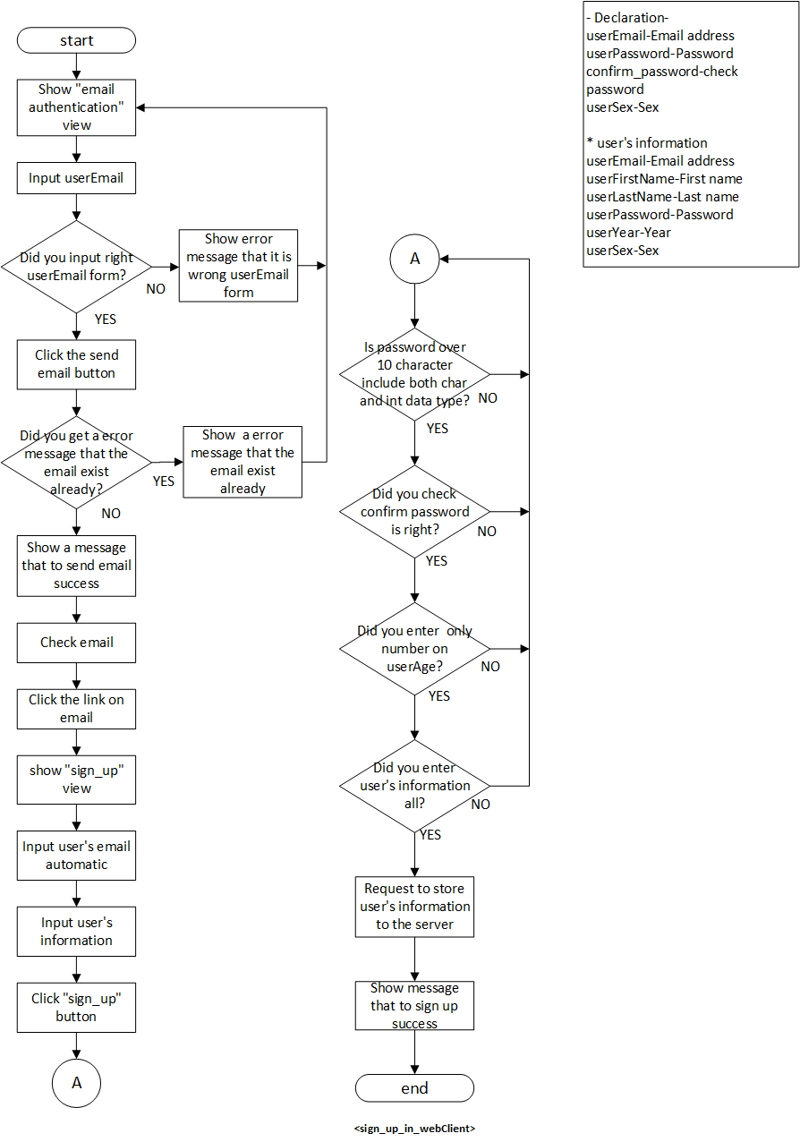
Web Block Diagram- sign up
/28
Notes:
We defined the parameters and data form we used in the diagram. Each diagram is declared differently.
We will identify four things.

Slide 5
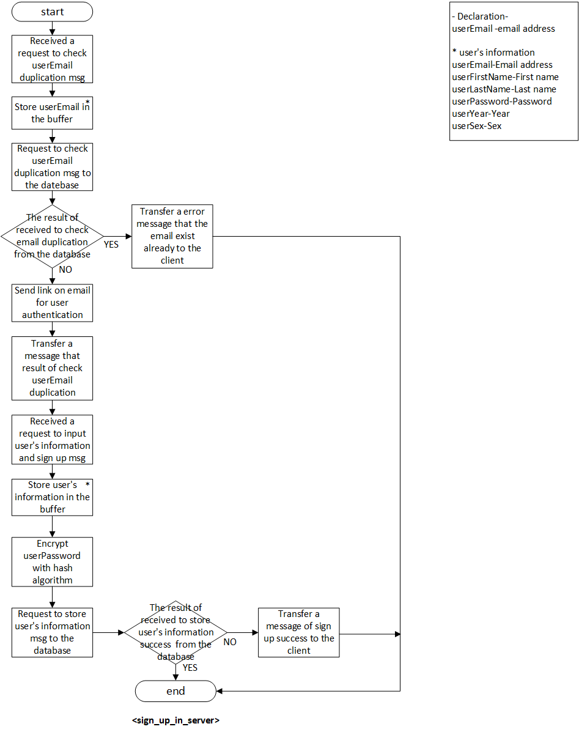
Server Block Diagram- sign up
/28

Slide 6
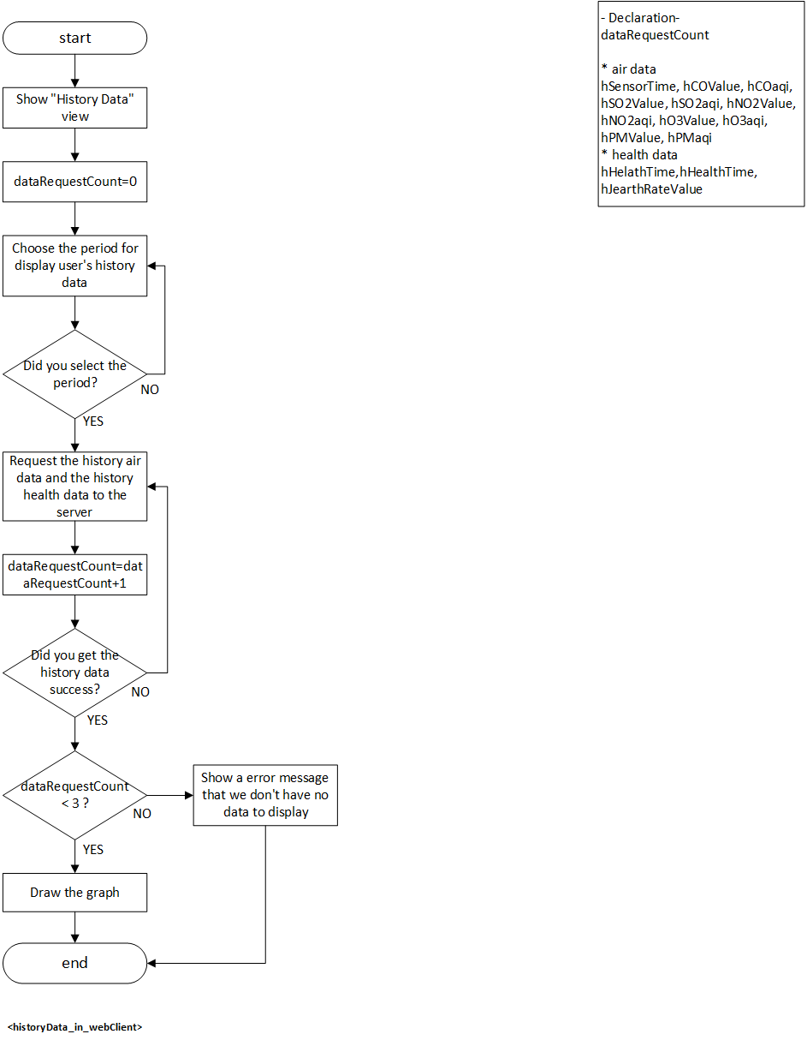
Web Block Diagram – history data
/28

Slide 7
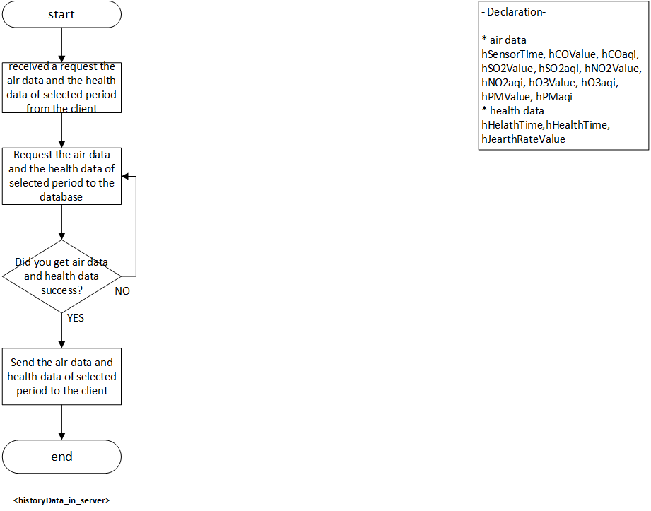
Server Block Diagram – history data
/28

Slide 8
Web Client
/28

Slide 9
Web Client
< 3 week>
Sign up
Sign in
Send email for authentication
<4 week>
Sign in session
Sign out session
Add the google map and google chart
Get the data from the database
<5 week>
- Real time date on the graph and the map
/28
Notes:
I will show the web demo.
But An error occurred while saving the data received from the application in the database and uploading the code to the server. We can solve this problem today.

Slide 10
About
Mux
/28

Slide 11
Mux
C15
C14
C13
C12
C11
SIG
A0
C10
S3
Pin 27
PM 2.5 OUTPUT
C9
S2
Pin 26
SO2 AE
C8
S1
Pin 25
SO2 WE
C7
S0
Pin 24
CO AE
C6
EN
5V
CO WE
C5
VCC
5V
O3 AE
C4
GND
GND, PT 1000 -
O3 WE
C3
NO2 AE
C2
NO2 WE
C1
PT 1000+
C0
/28

Slide 12
Sensor Block Diagram
/28

Slide 13
Sensor_Overall
/28

Slide 14
Sensor_Realtime Data
/28

Slide 15
Sensor_History Data
/28

Slide 16
Sensor_Bluetooth
/28

Slide 17
Modified Python Code
/28

Slide 18
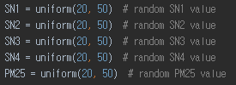



Python codes
- Read sensor data
- Use Mux
- Change temp volt to temp value
/28

Slide 19
App Client
C team
Qualcomm Institute
/28

Slide 20
Application Block Diagram (Realtime)
/28
Notes:
First, We show you about Block Diagram.
We draw 8 block diagram, I will explain two of them.
First diagram is realtime diagram.
If you go main home. Main home is real time view.
At real time view, you can see about Air data values and aqi. You need to turn on Bluetooth to see the air data. So you click the Bluetooth button, you can see Bluetooth device list. Then you choose UDOO Board. If you can’t connect with UDOO Board, you click the Bluetooth button again.
If you
로그인하고 1분이 지나면 After 1 minute of signing in

Slide 21
Application Block Diagram (Sign up)
/28

Slide 22
Application Block Diagram (Sign_out)
/28
Notes:
First, We show you about Block Diagram.
We draw 8 block diagram, I will explain two of them.
First diagram is realtime diagram.
If you go main home. Main home is real time view.
At real time view, you can see about Air data values and aqi. You need to turn on Bluetooth to see the air data. So you click the Bluetooth button, you can see Bluetooth device list. Then you choose UDOO Board. If you can’t connect with UDOO Board, you click the Bluetooth button again.
If you
로그인하고 1분이 지나면 After 1 minute of signing in

Slide 23
Application Block Diagram (history)
/28
Notes:
First, We show you about Block Diagram.
We draw 8 block diagram, I will explain two of them.
First diagram is realtime diagram.
If you go main home. Main home is real time view.
At real time view, you can see about Air data values and aqi. You need to turn on Bluetooth to see the air data. So you click the Bluetooth button, you can see Bluetooth device list. Then you choose UDOO Board. If you can’t connect with UDOO Board, you click the Bluetooth button again.
If you
로그인하고 1분이 지나면 After 1 minute of signing in

Slide 24
Application Block Diagram (forgottenPassword)
/28
Notes:
First, We show you about Block Diagram.
We draw 8 block diagram, I will explain two of them.
First diagram is realtime diagram.
If you go main home. Main home is real time view.
At real time view, you can see about Air data values and aqi. You need to turn on Bluetooth to see the air data. So you click the Bluetooth button, you can see Bluetooth device list. Then you choose UDOO Board. If you can’t connect with UDOO Board, you click the Bluetooth button again.
If you
로그인하고 1분이 지나면 After 1 minute of signing in

Slide 25
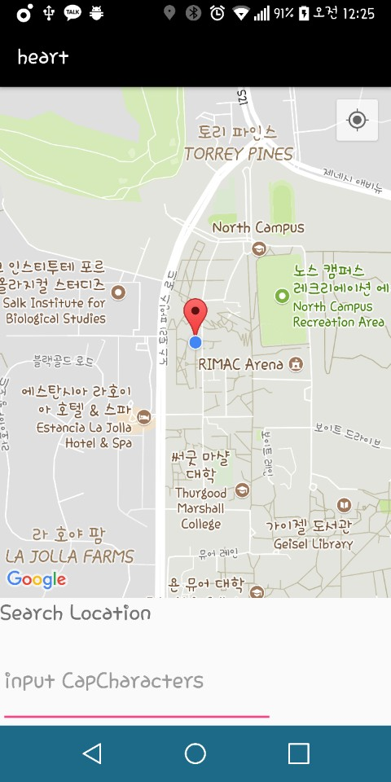

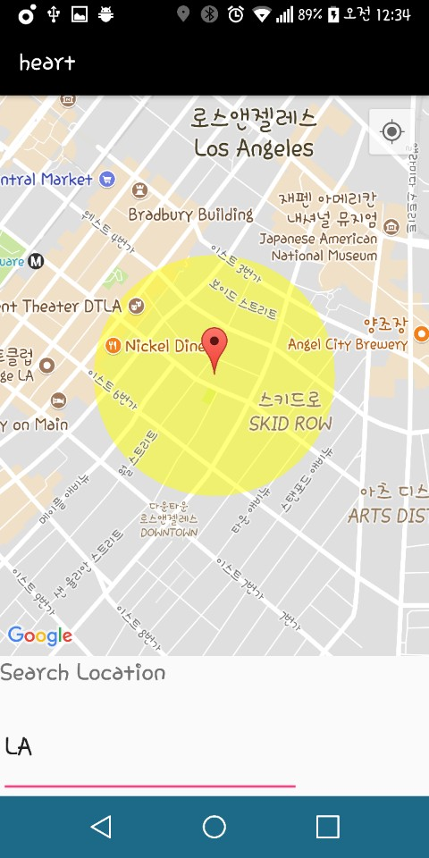

Application (Search map)
/28
Notes:
First, you input the city what you want to search. then, Calculates the latitude and longitude for the search city.
As a result, The marker moves to the corresponding region.

Slide 26

Application (Demo)
/28

