Slide 2
Function
Diagram
&
ER Diagram
Sequence
Diagram
App
Client
Web
Client
Sensor

Slide 3
Function Diagram & ER Diagram

Slide 4
Function Diagram

Slide 5
ER Diagram

Slide 6
Web Client

Slide 7
Web Client

Slide 8
Sequence Diagram

Slide 9
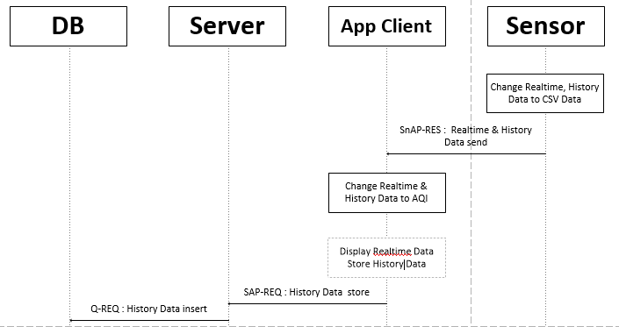
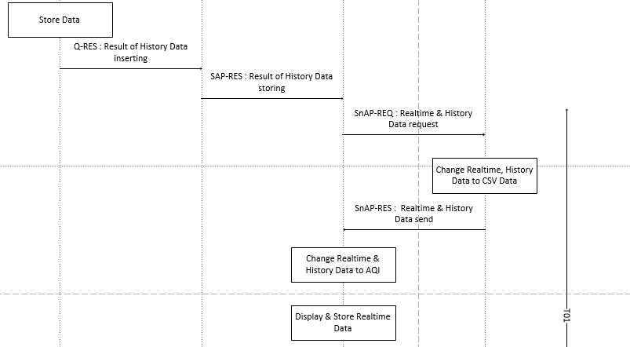
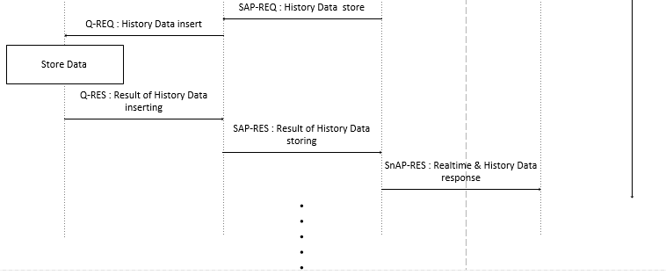
Data send Sequence Diagram
C team
/19

Slide 10
Data send Sequence Diagram
C team
/19

Slide 11
Data send Sequence Diagram
C team
/19

Slide 12
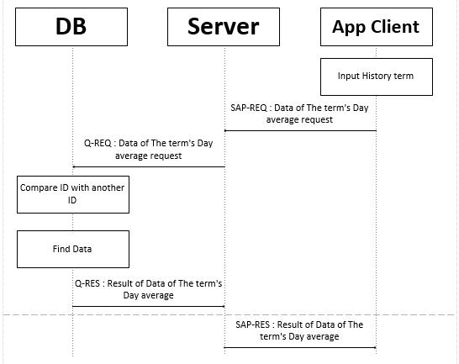
History Sequence Diagram
C team
/19

Slide 13
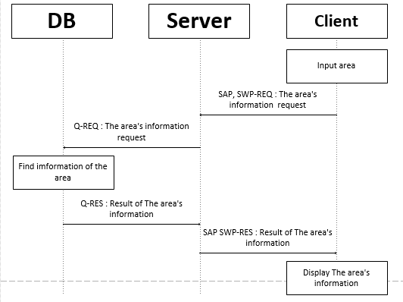
Map search Sequence Diagram
C team
/19

Slide 14
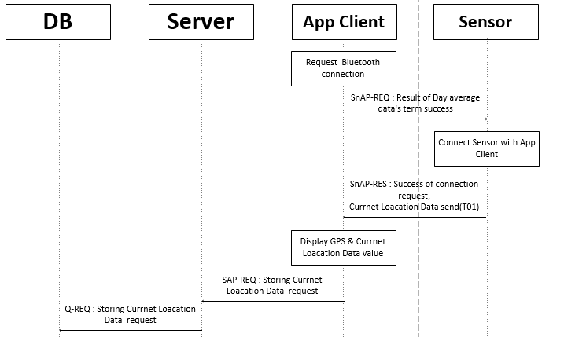
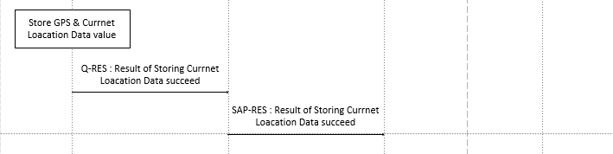
Map’s current location Sequence Diagram
C team
/19

Slide 15
Sensor Code
C team
Qualcomm Institute
/19

Slide 16


Modified Code in python
C team
/19

Slide 17
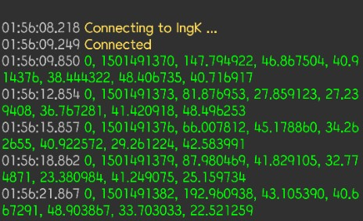
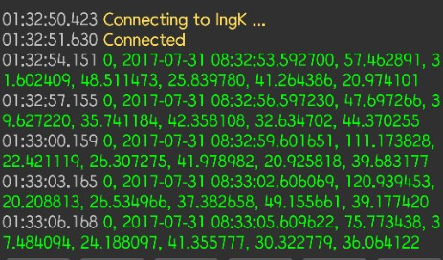
Result Code in python
C team
/19

Slide 18
App Client

