Slide 1
2 week presentation
CONTENTS
C team
Sequence
Diagram
ER
Diagram
Web
Client
Application
Qualcomm Institute
/19

Slide 2
Sequence Diagram
C team
Qualcomm Institute
/19
Notes:
- We already presented our sequence diagram in last weekly meeting, and we got some feedback so today just i will talk about change points of sequence diagram.
지난 발표에 해서 change point에 대해서

Slide 3
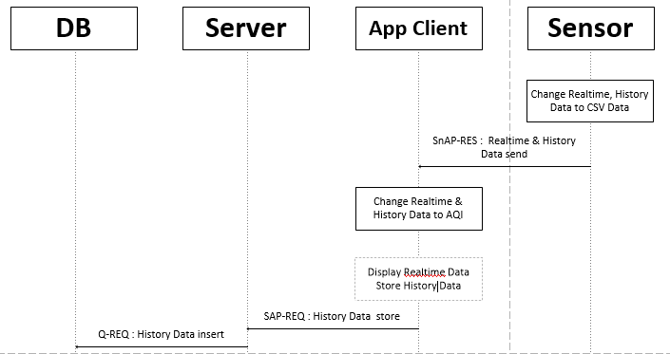
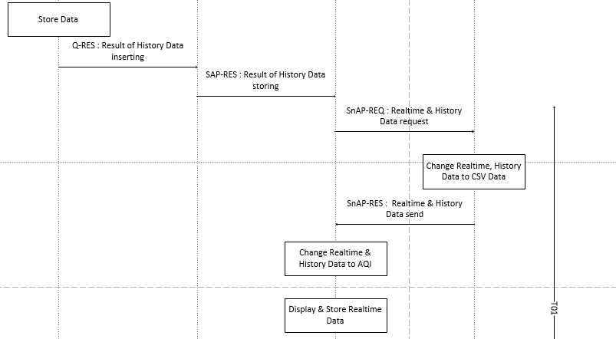
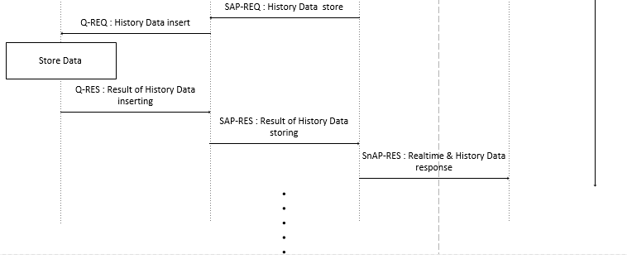
Data send Sequence Diagram
C team
/19

Slide 4
Data send Sequence Diagram
C team
/19

Slide 5
Data send Sequence Diagram
C team
/19

Slide 6
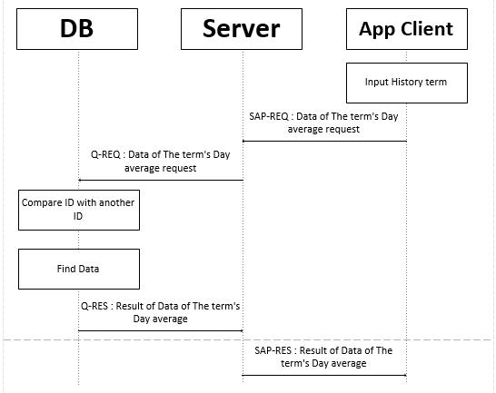
History Sequence Diagram
C team
/19

Slide 7
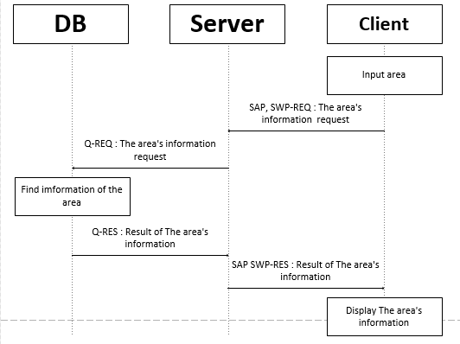
Map search Sequence Diagram
C team
/19

Slide 8
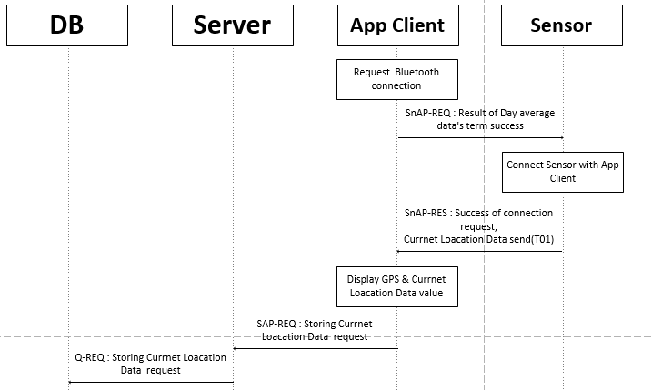
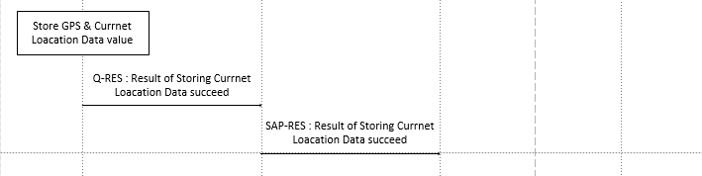
Map’s current location Sequence Diagram
C team
/19

Slide 9
Sensor Code
C team
Qualcomm Institute
/19

Slide 10


Modified Code in python
C team
/19

Slide 11
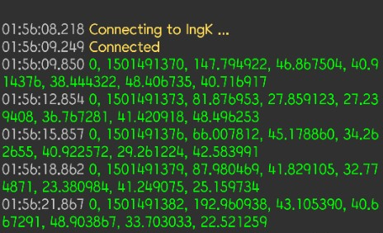
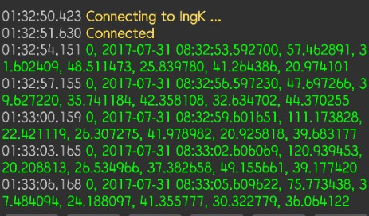
Result Code in python
C team
/19

