Slide 1
2 week presentation
CONTENTS
C team
Sequence
Diagram
ER
Diagram
Web
Client
Application
Qualcomm Institute
/19

Slide 2
Sequence Diagram
C team
Qualcomm Institute
/19
Notes:
- We already presented our sequence diagram in last weekly meeting, and we got some feedback so today just i will talk about change points of sequence diagram.
지난 발표에 해서 change point에 대해서

Slide 3
Change point of Sequence Diagram
C team
Delete duplicate information
Change authentication method in forgotten password situation
Change expression
/19
Notes:
we had different authentication method on forgotten password and registration but now they are same way to use authentication code
비밀번호 변경 방법이 이메일 인증에서 인증 코드로 바뀜
영어 표현 변경
중복 설명 제거
어떻게 변했는지 확인해 보자 (인증 코드 사용하는것으로 바꼈다)

Slide 4
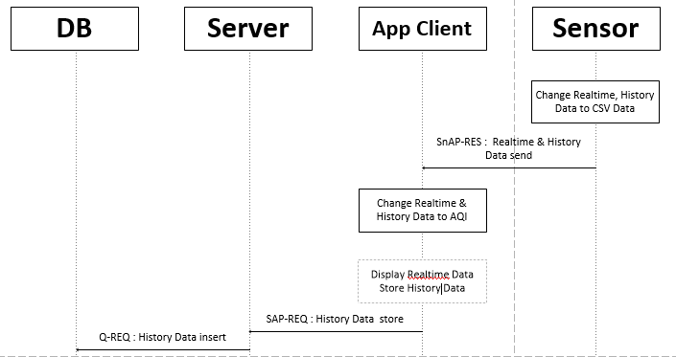
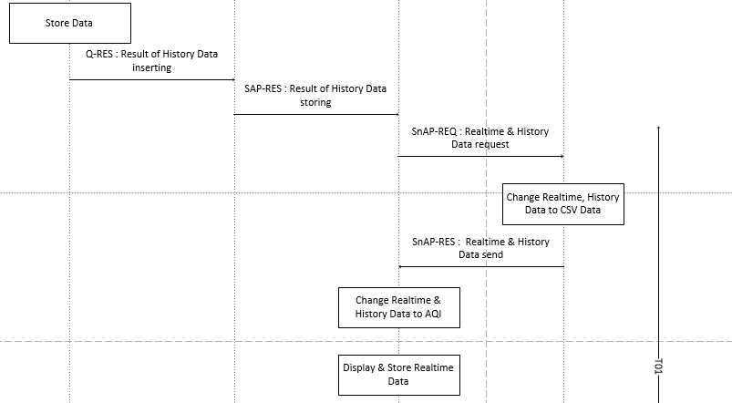
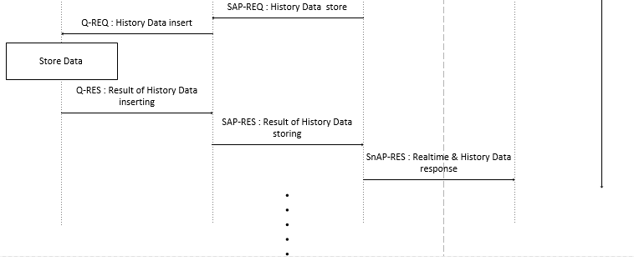
Data send Sequence Diagram
C team
/19

Slide 5
Data send Sequence Diagram
C team
/19

Slide 6
Data send Sequence Diagram
C team
/19

Slide 7
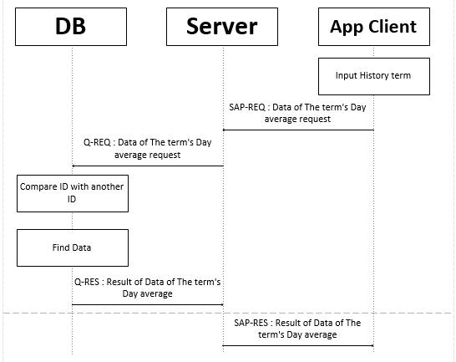
History Sequence Diagram
C team
/19

Slide 8
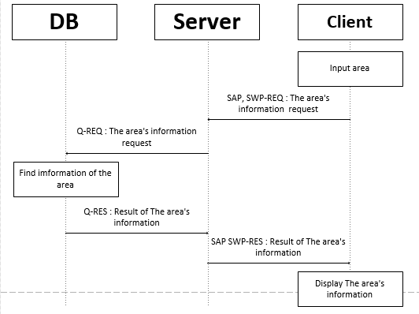
Map search Sequence Diagram
C team
/19

Slide 9
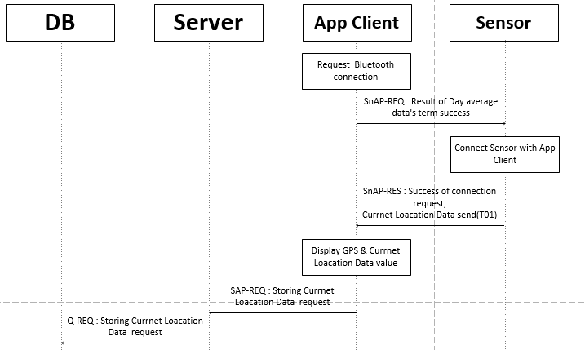
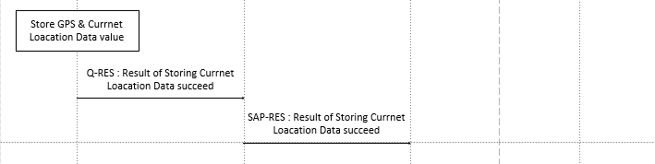
Map’s current location Sequence Diagram
C team
/19

Slide 10
Sensor Code
C team
Qualcomm Institute
/19

Slide 11


Modified Code in python
C team
/19

Slide 12
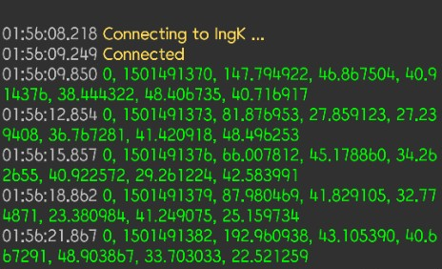
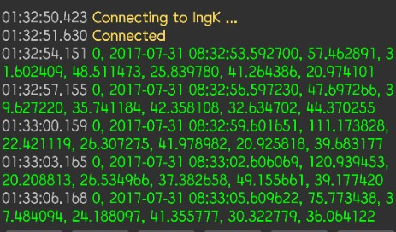
Result Code in python
C team
/19

