Slide 2
Web
&Server Block Diagram
Sensor Block Diagram
App Block Diagram
Web
Client
Sensor
App
Client
Notes:
Today cteam contents are block diagram of each part and what we did last week.
Web team will start first.

Slide 3
Web & Server Block Diagram
Notes:
we made 8 block diagram per each but we don't have enough time. so today just show you about signup and history data. and if you give me some advice we will refer your feedback on all block diagram.

Slide 4
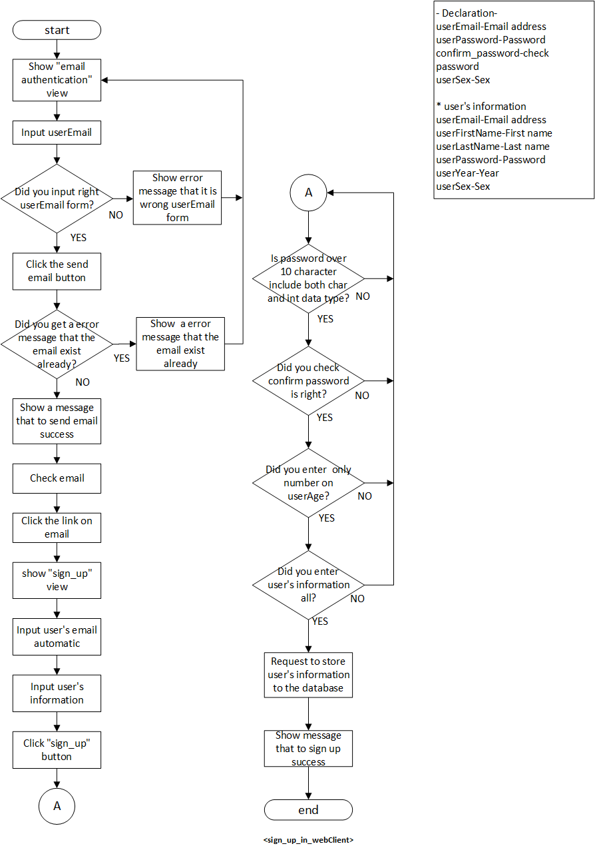
Web Block Diagram- sign up
Notes:
We defined the parameters and data form we used in the diagram. Each diagram is declared differently.

Slide 5
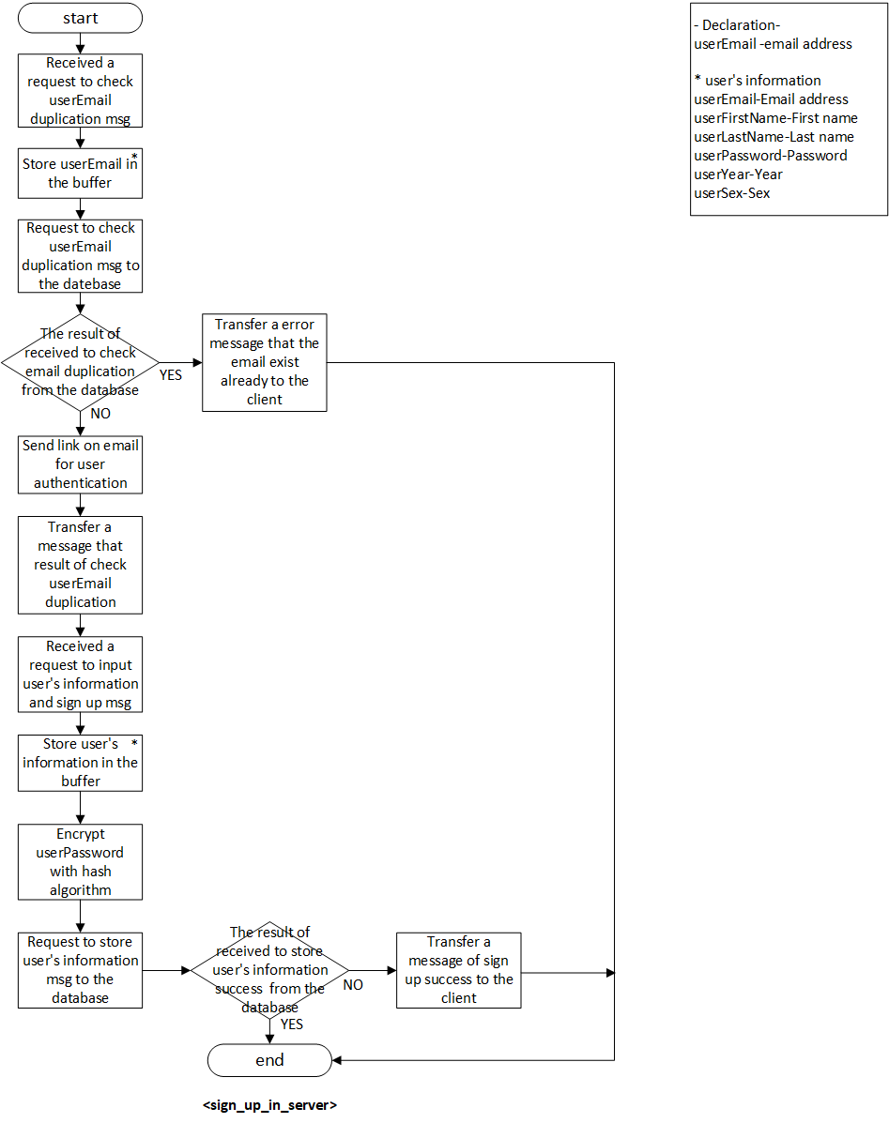
Server Block Diagram- sign up

Slide 6
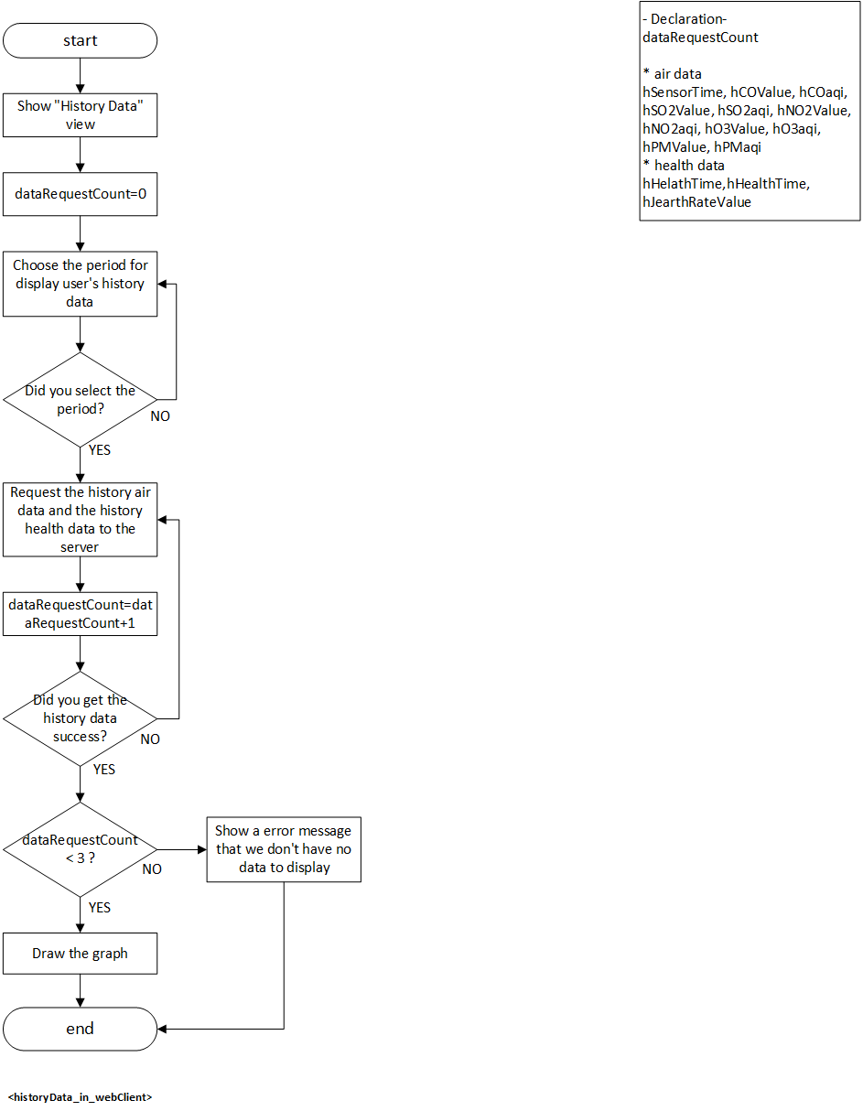
Web Block Diagram – history data

Slide 7
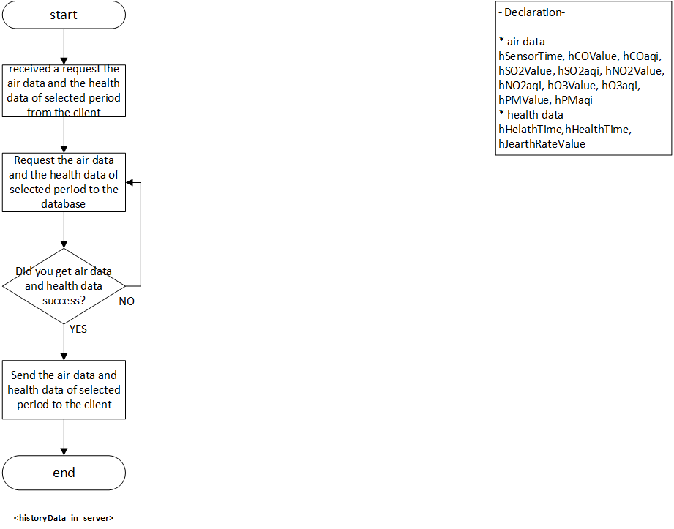
Server Block Diagram – history data

Slide 8
Web Client

Slide 9
Web Client

Slide 10
Sensor
Notes:
On and on we will announce the sensor part. Jim is next presenter

Slide 12
App Block Diagram

Slide 14
App Client

