Slide 1

Exploratory Data Analysis on AMCAT Data
Employment Outcome Analysis
Presented by: Appaji Yaddla

Slide 2
About me
Background
MSc Mathematics from Andhra University
Reason
To apply my mathematical skills and analytical mindset. To explore new career opportunities.
Work Experience
Software Engineer (Senior Content Developer)

Slide 3
Objective of the Analysis
Understanding the Profile: Gain insights into the demographic composition of the dataset, including gender distribution, education levels, and specialization.
Exploring Academic Performance: Analyze academic performance metrics, such as 10th and 12th-grade percentages, college GPA, and examine their distributions.
Unveiling Professional Attributes: Investigate key professional attributes like technical skills, cognitive skills, and personality traits.
Testing a Claim: Evaluate the claim made in a Times of India article regarding earnings potential for Computer Science Engineering graduates.
Examining Gender-Specialization Relationship: Explore if there is a significant relationship between gender and specialization preferences.

Slide 4
Dataset Overview
Key Columns and Data Types:
ID: Numeric identifier
Initial Observations/Challenges:
The dataset was released by Aspiring Minds from the Aspiring Mind Employment Outcome 2015 (AMEO).
Salary: Numeric, representing the salary of the individual
DOJ: Date of joining
DOL: Date of leaving
Designation: Job title or position
JobCity: City where the job is located
Gender: Categorical, indicating gender
DOB: Date of birth
10percentage: Numeric, percentage in grade 10
10board: Categorical, board for grade 10
12graduation: Numeric, year of graduation from grade 12
12percentage: Numeric, percentage in grade 12
12board: Categorical, board for grade 12
CollegeID: Numeric identifier for college
CollegeTier: Categorical, indicating the tier of the college
Degree: Categorical, representing the degree obtained
Specialization: Categorical, field of specialization
collegeGPA: Numeric, GPA in college
CollegeCityID: Numeric identifier for college city
CollegeCityTier: Categorical, indicating the tier of the college city
CollegeState: Categorical, state where the college is located
GraduationYear: Numeric, year of graduation from college
English, Logical, Quant, Domain: Numeric, scores in different domains
ComputerProgramming, ElectronicsAndSemicon, ComputerScience, MechanicalEngg, ElectricalEngg, TelecomEngg, CivilEngg: Numeric, scores in different engineering fields
conscientiousness, agreeableness, extraversion, neuroticism, openness_to_experience: Numeric, personality trait scores
The dataset comprises 3998 rows and 38 columns.
The dataset contains a diverse set of information ranging from academic performance to personality traits and work-related details.
Missing values, outliers, or inconsistent entries might be present and require further exploration.
It primarily focuses on standardized test scores in three distinct areas: cognitive skills, technical skills, and personality skills.

Slide 5
Data Cleaning & Manipulation
Drop Unnamed Column:
Dropped the 'Unnamed: 0' column as it appeared to be an unnecessary index.
Replace 'Present' with Current Date and Time:
Replaced occurrences of 'Present' in the 'DOL' (Date of Leaving) column with the current date and time.
Convert Date Columns to Datetime:
Converted 'DOJ' (Date of Joining), 'DOB' (Date of Birth), and 'DOL' datetime format for consistent date handling.
Create New Column - Experience:
Calculated the 'Experience' by subtracting 'DOJ' (Date of Joining) from 'DOL' (Date of Leaving).
This new column provides a clear representation of the experience duration for each individual.
Create New Column - Age:
Calculated the 'Age' by subtracting 'DOB' (Date of Birth) from 'DOJ' (Date of Joining).
This new column helps in understanding the age of individuals at the time of joining.

Slide 6


Slide 7
Univariate Analysis

Slide 8
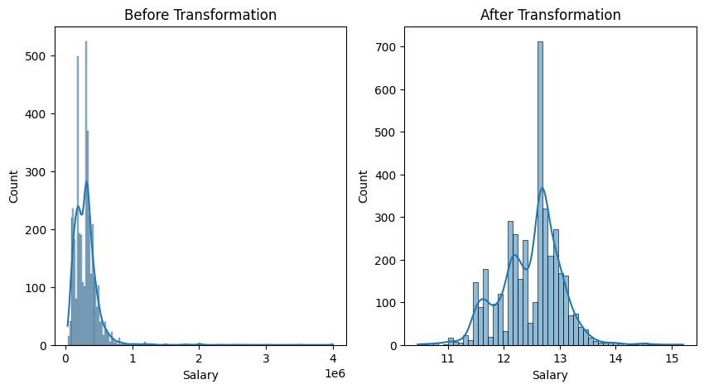
Salary Analysis
Target Feature:
The salary distribution exhibits a left-skewed pattern, indicating a higher concentration of employees earning below 10,00,000.
Applied a logarithmic transformation to achieve a more symmetrical, normal distribution of salary data.
Log transformation allows for more robust analysis, aligning with assumptions in certain statistical methods.

Slide 9
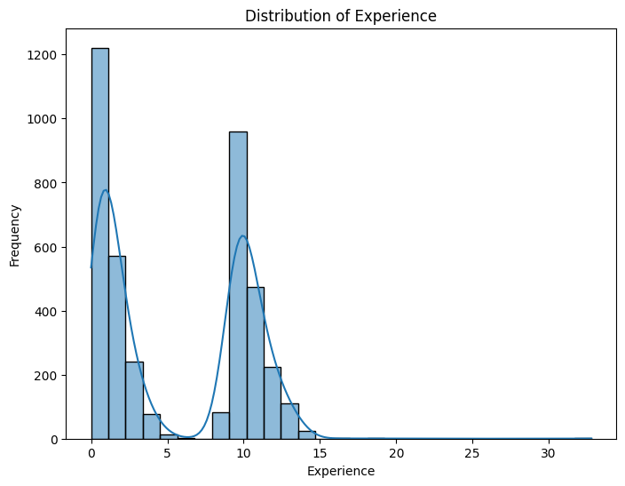
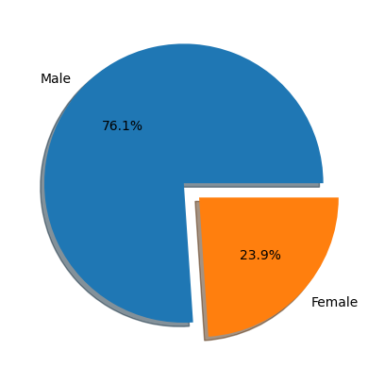
Grouped Data Observations
Experience:
The experience distribution showcases a bimodal pattern with two distinct peaks.
Beyond these peaks, the frequency gradually decreases as experience levels increase, aligning with the expectation of fewer individuals accumulating extensive work experience.
Gender:
Three-fourths of the dataset comprises males, indicating a male-dominant presence in Engineering fields.
Specifically, 76.1% of individuals are male, while females represent 23.9%.

Slide 10
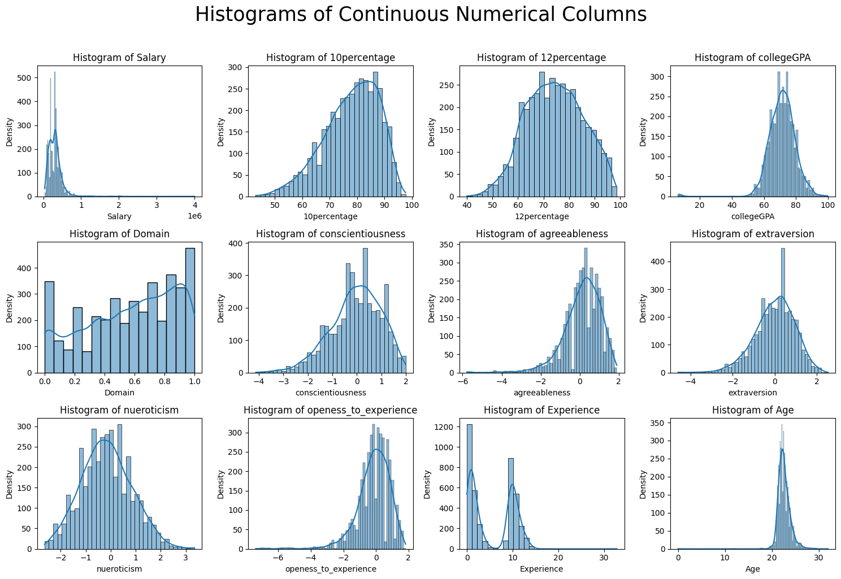

Slide 11
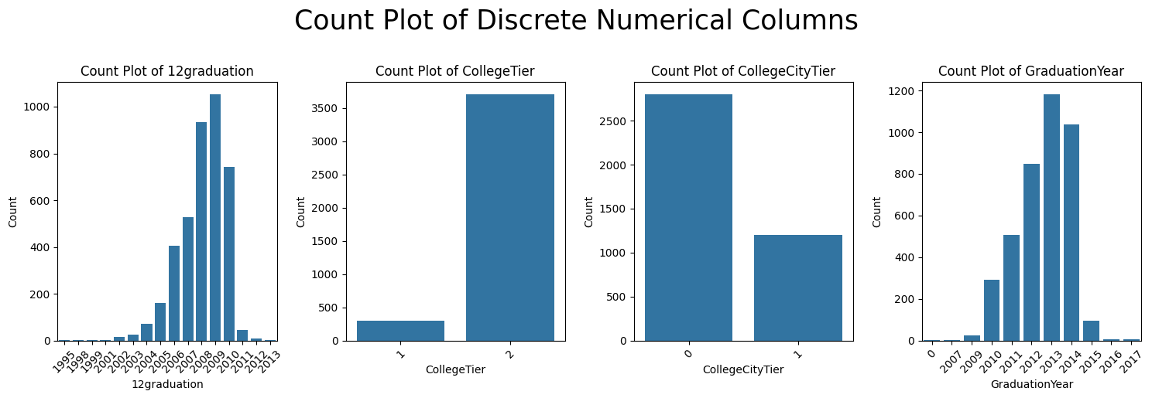

Slide 12
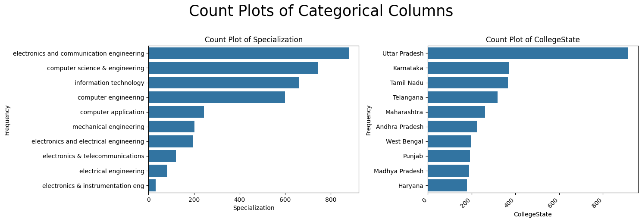

Slide 13
Bivariant Analysis

Slide 14
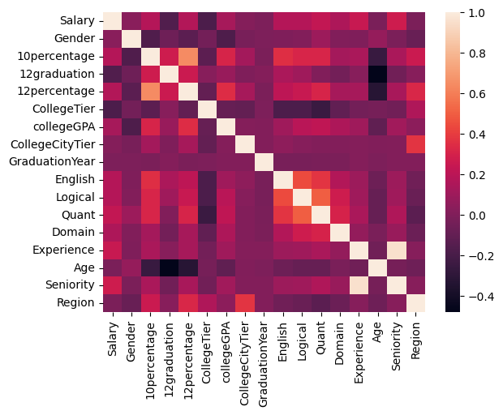
Correlation Analysis
The correlation analysis reveals a range from -0.4 to 1, suggesting a diverse relationship among variables.
Indicating no strong negative correlation
No strong positive correlation though unless related columns.

Slide 15
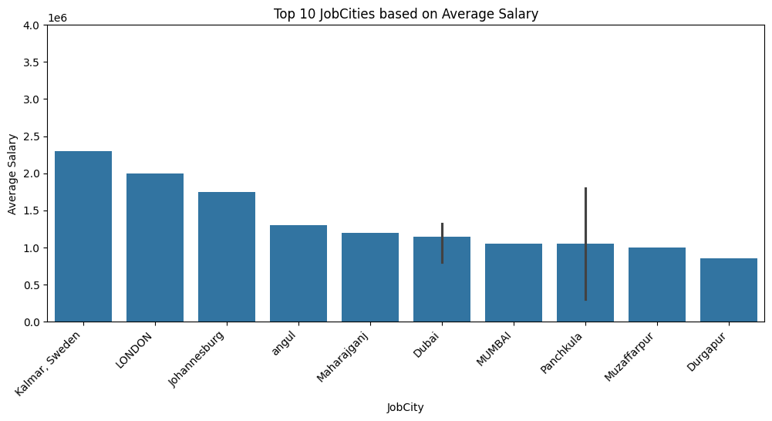
Top 10 Job Cities - Average Salary Analysis
The analysis focused on calculating the average salary for each of the top 10 job cities.
The selection of job cities is diverse, spanning international locations like Kalmar, Sweden, and Dubai, along with major Indian cities such as Mumbai and Panchkula.

Slide 16
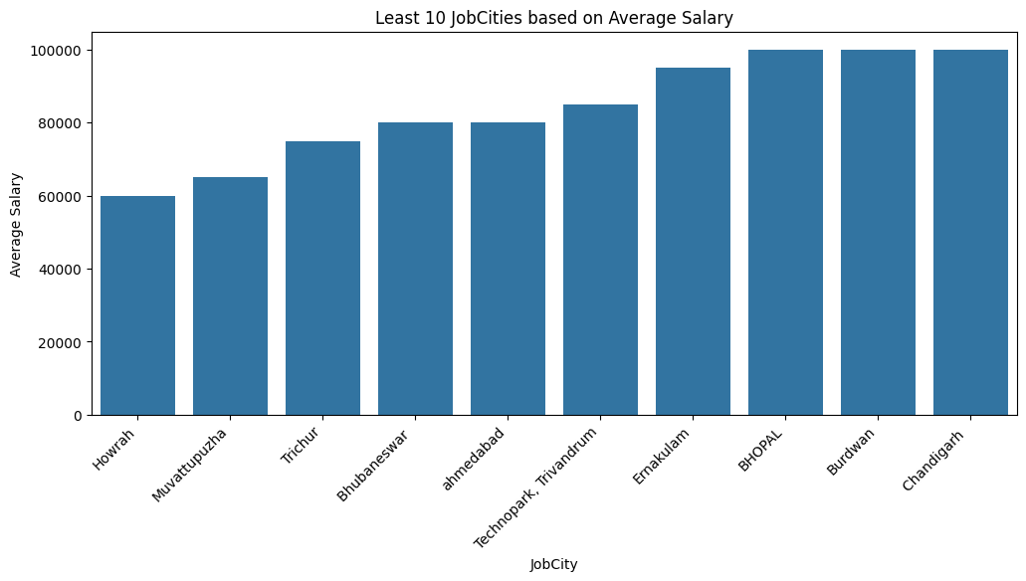
Least 10 Job Cities - Average Salary Analysis
The analysis centered on determining the mean salary for each of the ten cities with the lowest average salaries.
Four out of the ten cities with the lowest average salaries are located in Kerala

Slide 17
Multivariant Analysis

Slide 18
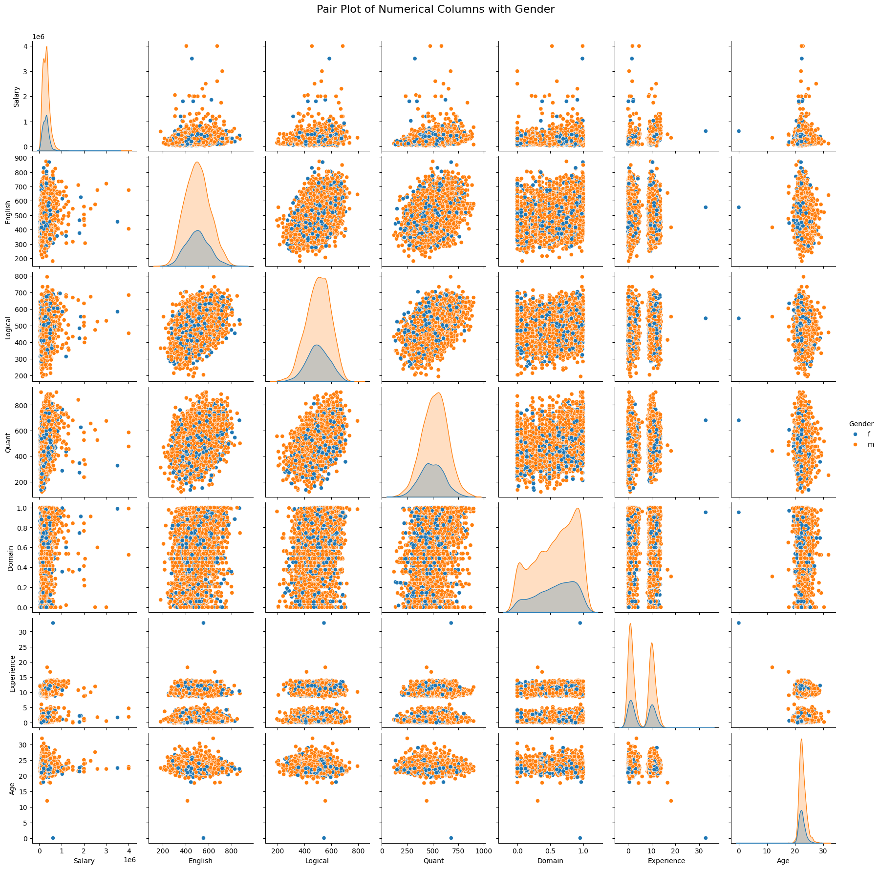
PairPlot with Gender
Age is primarily observed to be between 20 to 30 years in the dataset.
Despite women constituting 25% of the entire dataset, they still exhibit dominant percentages in both 10th and 12th-grade percentages.
This dominance by women is consistent across other exams such as Quantitative and Logical assessments.

Slide 19
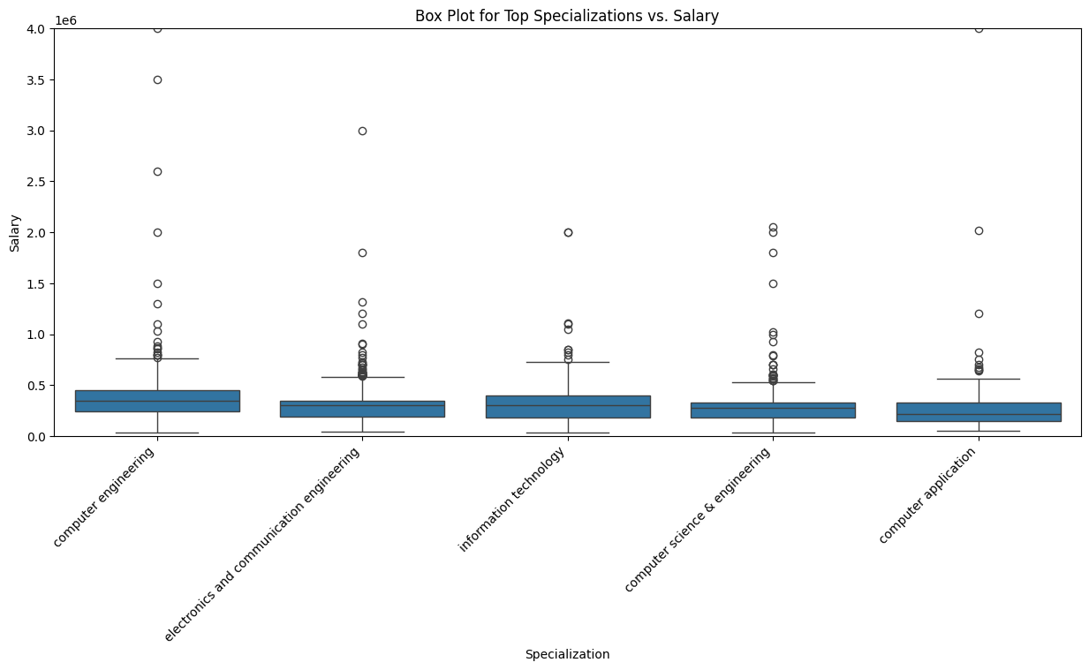
PairPlot with Gender - Salary Distribution Across Top Specializations
The box plot illustrates the salary distribution for the top 5 specializations in the dataset.
Specializations such as "Computer Engineering," and "Information Technology" show relatively higher median salaries and also wider salary range
Outliers are observed in various specializations, indicating some individuals earning significantly higher or lower salaries compared to the majority in their respective fields.

Slide 20
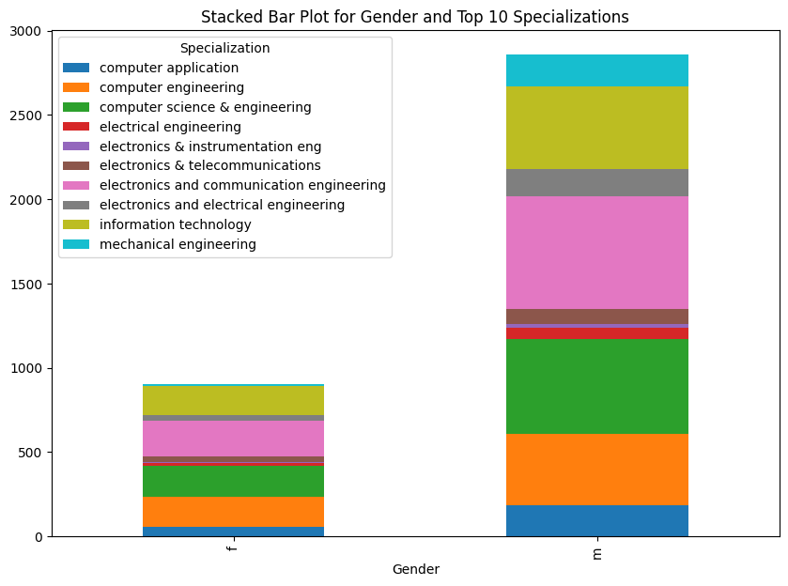
Stacked Bar Plot for Gender and Top 10 Specializations
Electronics and Communication Engineering:
This specialization has a higher representation of males compared to females.
It stands out as the most pursued specialization among the top 10, particularly by male candidates.
Computer Science & Engineering:
This specialization shows a significant gender gap, with a large number of males compared to females.
Despite the gender disparity, it remains one of the top choices for both male and female candidates.
Information Technology:
Similar to Computer Science & Engineering, Information Technology exhibits a substantial gender gap, with more male candidates.
It is among the top three specializations preferred by both male and female candidates.

Slide 21
Research Analysis

Slide 22
Claim1: Times of India article dated Jan 18, 2019 states that “After doing your Computer Science Engineering if you take up jobs as a Programming Analyst, Software Engineer, Hardware Engineer and Associate Engineer you can earn up to 2.5-3 lakhs as a fresh graduate.”

Slide 23
Data Preparation for Research Hypothesis
Created a list (CSE_specialization) containing various computer science-related specializations.
Combined similar specializations by replacing 'computer science and engineering' and 'computer science & engineering' with 'computer science and engineering' in the 'Specialization' column.
Selected rows where the 'Specialization' column contains any of the specified computer science-related substrings (CSE_specialization).
Filtered further to include only freshers (individuals with 1 year of experience or less).
Defined a list (desired_designations) of target designations, including 'programming analyst', 'programmer analyst', 'software engineer', 'hardware engineer', and 'associate engineer'.
Created a condition based on the specified designations using str.contains() on the 'Designation' column.
Applied the designation condition to filter the DataFrame, resulting in a subset (filtered_df) containing rows with the desired designations.
Created individual conditions for each designation and applied them to create a new column (Combined_Designation) indicating the combined designation for each individual.
Checked the value counts for the combined designations to understand the distribution of selected designations in the filtered data.

Slide 24
Testing Hypothesis: H_0: m<250000 H_1: m>=250000 with 95% confidence
Index | Designation | t_score | p-value | Critical value | Test result
0 | software engineer | 1.220 | 0.112 | 1.655 | Fail to Reject Null Hypothesis (H0)
1 | programmer analyst | 5.778 | 0.000 | 1.714 | Reject Null Hypothesis (H0)
2 | associate engineer | NaN | NaN | NaN | Fail to Reject Null Hypothesis (H0)
3 | hardware engineer | NaN | NaN | NaN | Fail to Reject Null Hypothesis (H0)
Except for the case of Programmer Analysts, there is no clear evidence that the salary for other designations among freshers is at least 2.5 lakhs.

Slide 25
Claim2: Gender and Specialization are Dependent

Slide 26
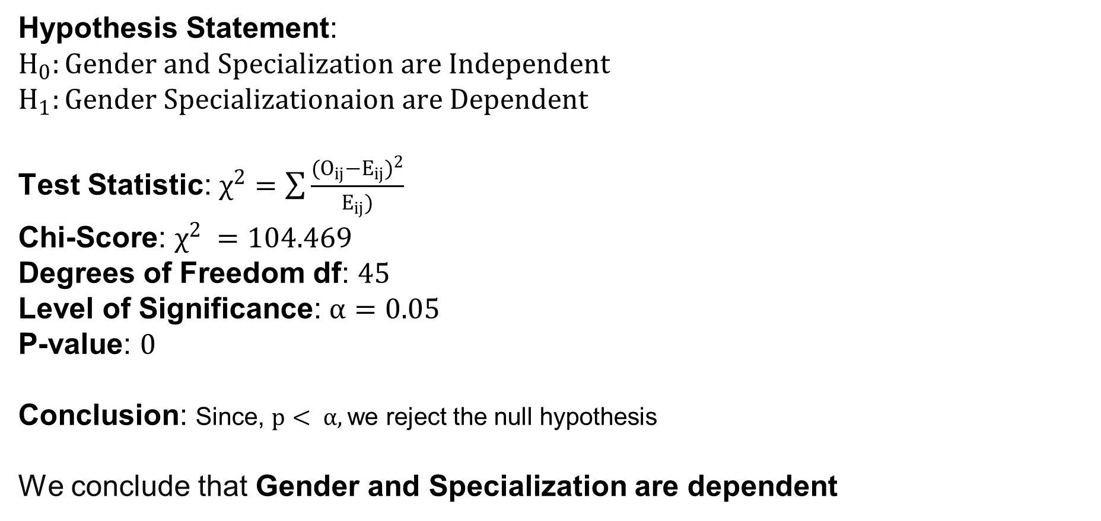
Hypothesis Statement:
$$H_{0}:Gender and Specialization are Independent$$
$$H_{1}:Gender Specializationaion are Dependent$$
Test Statistic: $χ^{2}=\sum{\frac{{(O_{ij}−E_{ij})}^{2}}{E_{ij})}}$
Chi-Score: $χ^{2} =104.469$
Degrees of Freedom df: $45$
Level of Significance: $α=0.05$
P-value: $0$
Conclusion: Since, $p< α,$we reject the null hypothesis
We conclude that Gender and Specialization are dependent

Slide 27
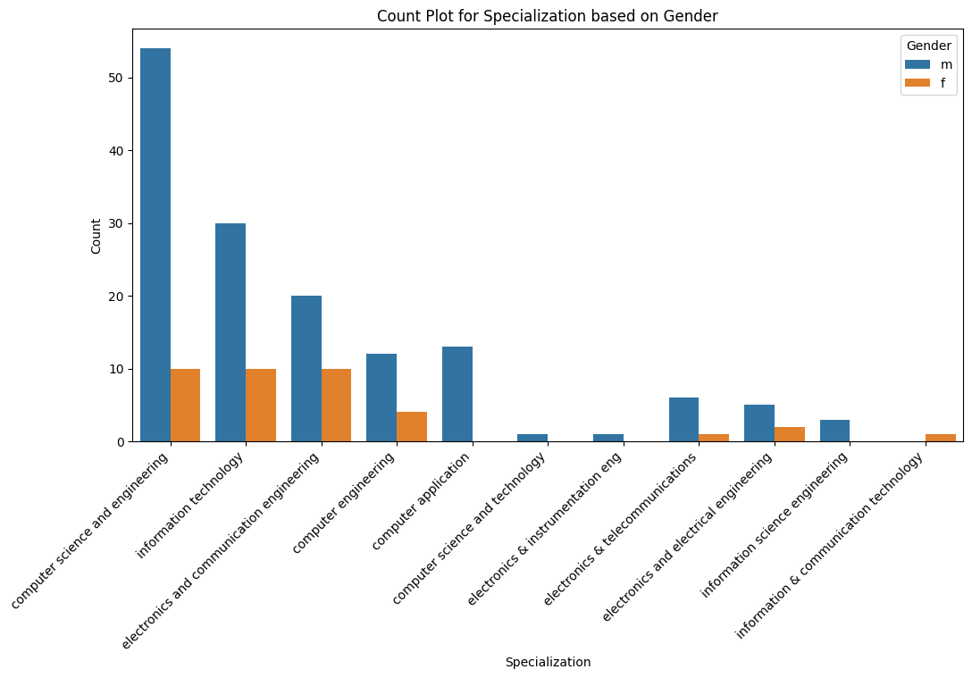
Count Plot for Specialization based on Gender

Slide 28
Conclusion
Demographic Overview:
Although females represent a smaller proportion (23.9%), their academic performance in tenth and twelfth grades is notably high.
Experience Distribution:
Two prominent peaks in experience distribution (0-5 years and 10-15 years) suggest distinct groups in the dataset.
Salary Analysis:
Log transformation is applied to Salary data for normalization, revealing a near-normal curve.
Correlation Analysis:
The correlation matrix indicates no strong negative or positive correlations, except for columns related to each other.
Job Cities Analysis:
Cities like Howrah, Muvattupuzha, Trichur, and others have the lowest average salaries.
Four out of the ten cities with the lowest average salaries are in Kerala.
Specialization Analysis:
Top three specializations based on the highest average salary: Electronics and Communication Engineering, Computer Science & Engineering, and Information Technology.
Gender and Specialization Relationship:
Chi-square test establishes a significant relationship between Gender and Specialization.
Research Hypothesis:
Contrary to the claim, only Programmer Analysts among fresh graduates earn up to 2.5 lakhs.
Experience and Salary Relationship:
Salary is not directly proportional to experience, as evident from the analysis.

Slide 29


Slide 30

THANK YOU

