Slide 1

Code Refactoring and Bug Fixing

Slide 2
About me
Name: Appaji Yaddla
Education: MSc in Mathematics from Andhra University
Current Pursuit:
Currently pursuing a Data Science course at Innomatics Research Labs.
Internship Achievement:
Selected among 1000 individuals out of 20,000 applicants for an internship course at Innomatics Research Labs.
Professional Role:
Software Engineer
Senior Content Developer
Key Skills:
Python, Data Analysis and Visualization, Machine Learning, Statistical Modeling, NLP, Deep Learning.
Contact Information:
Email: appajiyadla123@example.com
LinkedIn: www.linkedin.com/in/appajiyaddla
GitHub: https://github.com/Appaji-Yadla/Appaji-Yadla.git

Slide 3
Scenario:
A team of enthusiastic data scientists embarked on a mission to develop a Note Taking Application using Python, Flask, and HTML. However, their lack of experience in backend development has led to challenges in making the application fully functional. Recognizing your proficiency in backend development, you have been tasked with fixing the broken code and ensuring the application works seamlessly.
Task:
Refactor the existing codebase and ensure the proper functioning of the Note Taking Application. Document all identified bugs during the debugging process. Remember, the task is not about recreating the app from scratch. Your goal is to fix the already existing codebase and make the application work as intended.

Slide 4
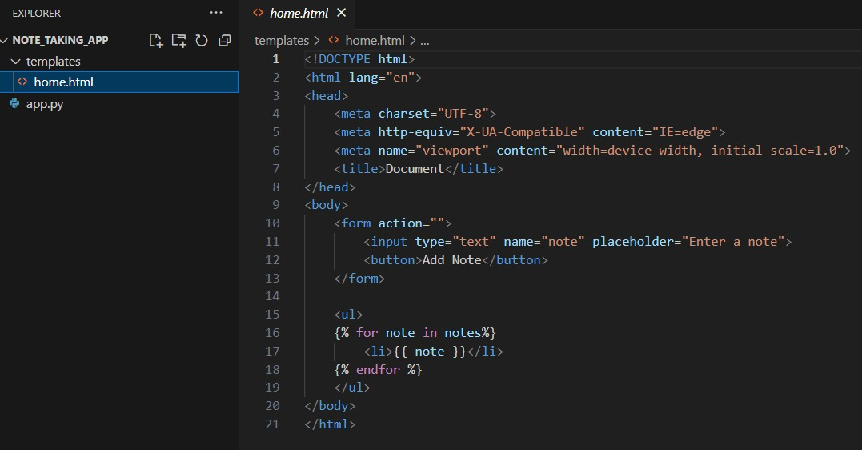
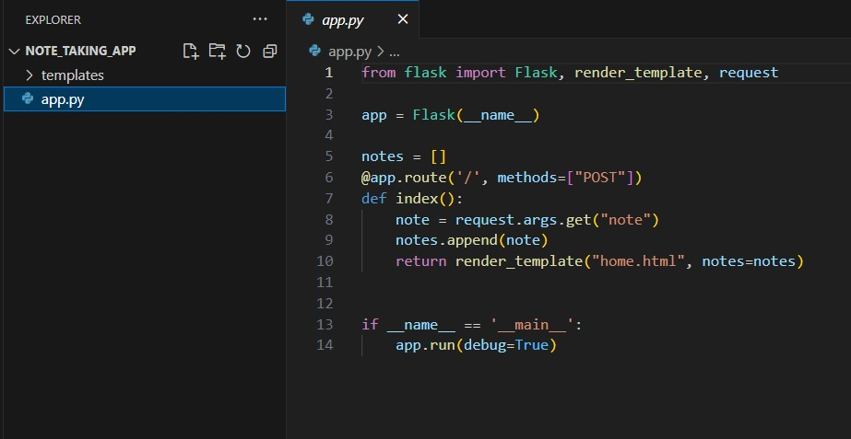
Note-Taking Application Overview
home.html: Capture a glimpse of our home.html interface, showcasing the text field and "Add Note" button. Witness how user input seamlessly transforms into a dynamic list of notes.
app.py: Accompanying the home.html, our app.py sets the foundation for the application's functionality. This script orchestrates the communication between the user interface and the backend, ensuring a dynamic and responsive interaction.

Slide 5
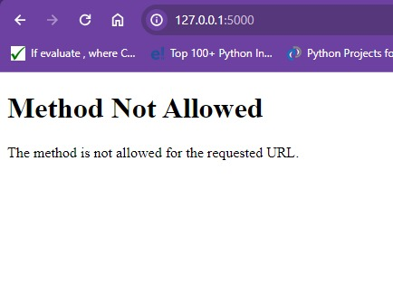
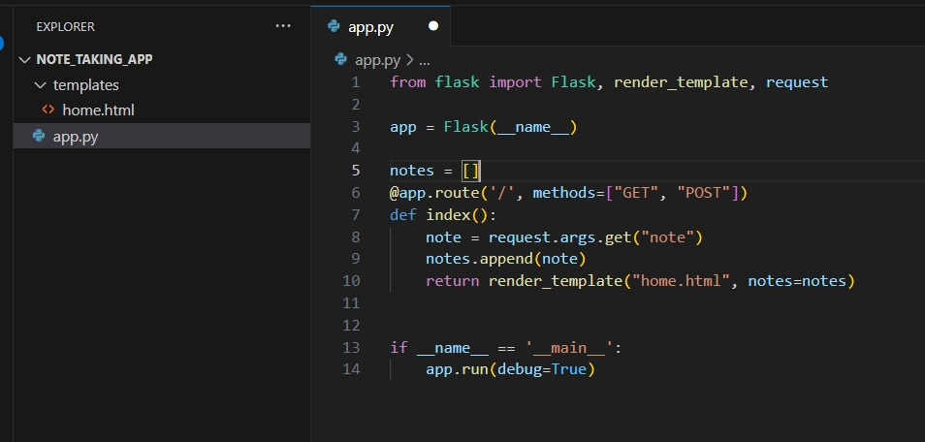
Fixing Bugs and Handling HTTP Methods
Bug1: The output after running the given code shows "Method Not Allowed."
Reason: The issue is with the @app.route('/') decorator and the specified HTTP methods. The route is defined to handle only POST requests, but the initial request when you access the root URL ("/") in the browser is typically a GET request.
Fix: To fix this issue, you can either allow both GET and POST methods or specifically handle GET requests by adding another decorator for the same route.

Slide 6
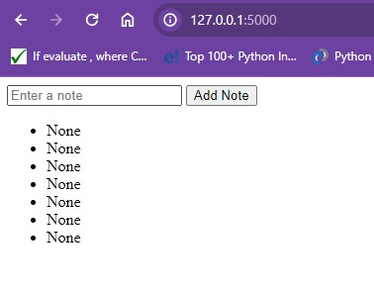
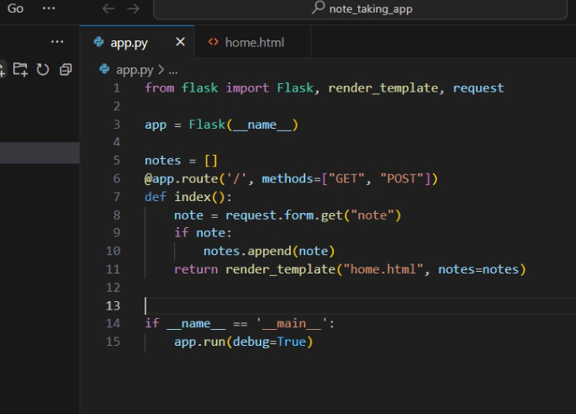
Fixing Note Retrieval Bug
Bug2: The application displays "None" as a note, and if the "Add Note" button is clicked, the count of "None" increases.
Reason: The bug occurs because request.arg.get("note") attempts to fetch the "note" parameter from the URL's query string (GET parameters), but the note is sent in the request body (POST parameters) from the HTML form. This results in retrieving None, causing the display of "None" as a note and an increasing count of "None."
Fix: Change it to request.form.get("note") to correctly retrieve the "note" parameter from the POST request body.

Slide 7
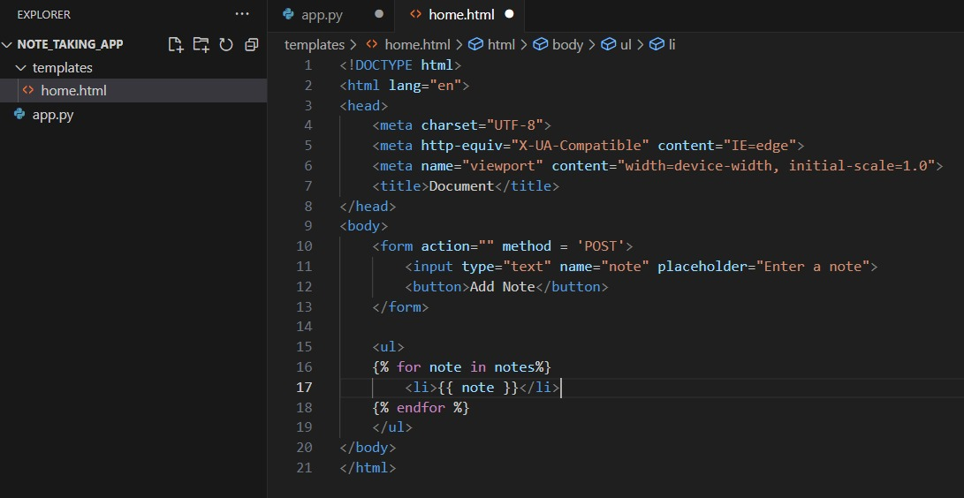
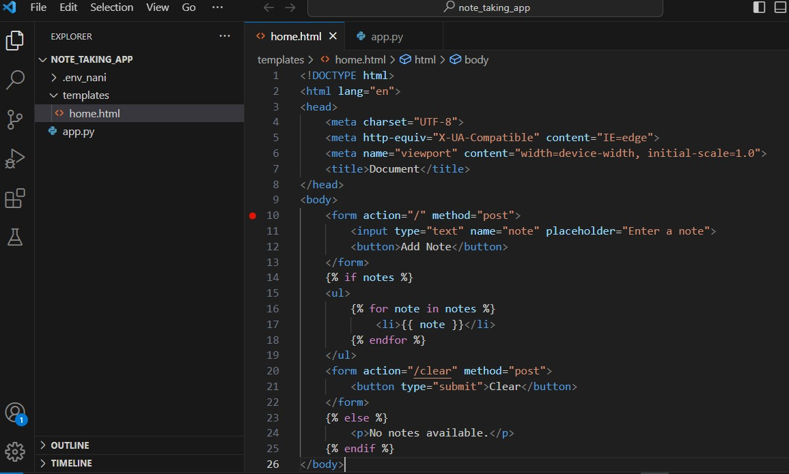
Enhancing User Experience: Handling Empty Notes List
Initial Code:
The initial HTML code presents a simple form for adding notes and displays a list of notes if available.
Conditional statements were added to check if the notes list is empty. If empty, a clear message is displayed, providing informative feedback to users.

Slide 8
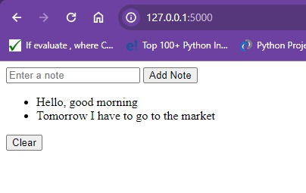
Enhancement - Adding a Clear Button:
The HTML code has been enhanced to include a "Clear" button, giving users the ability to clear the entire notes list.

Slide 9
Conclusion
Achievements:
Throughout this presentation, we've successfully addressed key issues and enhanced the functionality of our Note Taking Application.
Bug Fixes:
Identified and resolved bugs, ensuring a smoother and error-free user experience.
User Experience Enhancement:
Implemented features like handling empty notes and adding a "Clear" button to improve user engagement and satisfaction.
Code Refactoring:
Conducted code refactoring for improved readability, maintainability, and overall code quality.
Lessons Learned:
This experience has provided valuable insights into backend development, debugging, and Flask application structure.
Thank You!
We appreciate your attention and look forward to further refining and expanding our Note Taking Application.

Slide 10

THANK YOU

