Slide 1
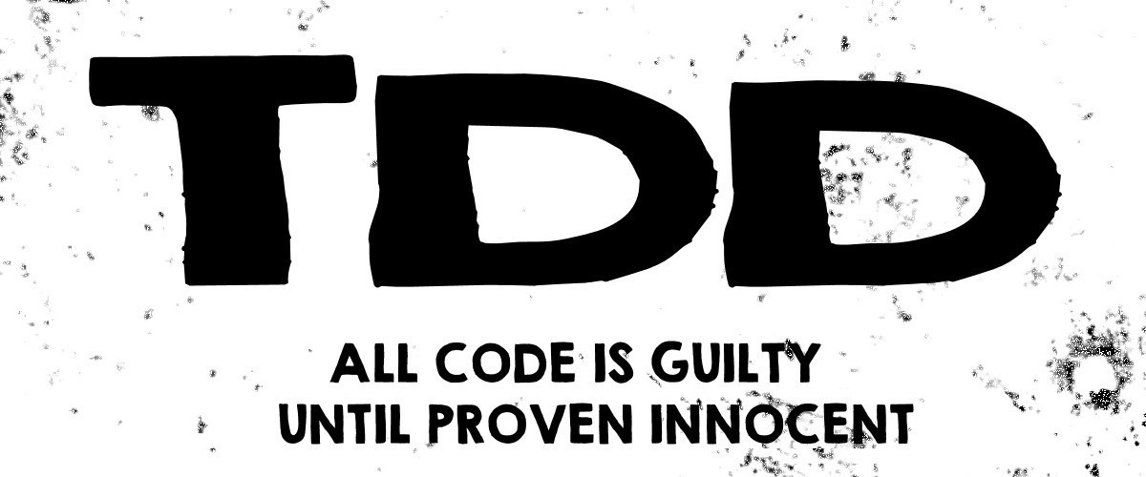

Slide 2
So what is it?
TDD means “Test Driven Development”.
Write new code only if an automated test has failed.

Slide 3
Problem - Test Last Approach
Test Last Approach - written tests are adapted to the code and not the other way around, thereby introducing a confirmation bias.
In the worst case, these tests are not even written since the code seems to work correctly, why waste time writing them?

Slide 4
Why use TDD?
Enables you to take small steps when writing software.
Avoids duplication of code.
The primary goal of TDD is to make the code clearer, simple and bug-free.
Easily catch regression bugs
Provides first level of documentation

Slide 5
How do we do TDD? - 3 phases
RED. First write a unit test in failure. The impossibility of compiling is a failure.
GREEN. Write as soon as possible the production code sufficient to pass this unit test even if it means allowing the “worst” solutions.
REFACTOR. This phase is often neglected but is essential because it eliminates possible code duplications but also makes it possible to make changes in architecture, factorization, presentation

Slide 6
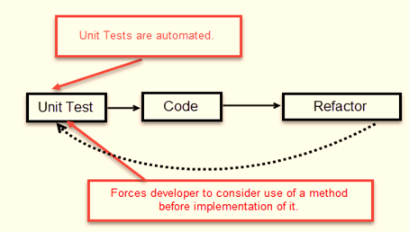
How do we do TDD?

Slide 7
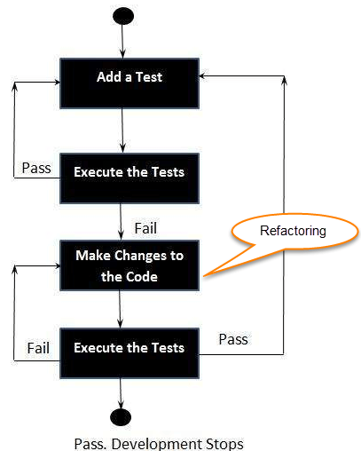

Slide 8
Maintain test suite - FIRST
Fast: a test must be fast to be executed often.
Independent: tests should not depend on each other.
Repeatable: a test must be reproducible in any environment.
Self-Validating: a test must have a binary result (Failure or Success) for a quick and easy conclusion.
Timely: a test must be written at the appropriate time, i.e. just before the production code it will validate.

Slide 9
Exercise
https://osherove.com/tdd-kata-1/

Slide 10
References
https://medium.freecodecamp.org/test-driven-development-what-it-is-and-what-it-is-not-41fa6bca02a2
https://www.guru99.com/test-driven-development.html

